Slide 1
Status of LHAASO Computing Platform
Qingbao Hu
huqb@ihep.ac.cn
On Behalf of IHEP-CC
08/18/2020

Slide 2
Outline
Overview of Data Processing Platform
Status of Computing Platform
Job & Resource Status
Storage
Network
Data transform system
Bookkeeping
Software publish
Summary & Next Plan
2

Slide 3
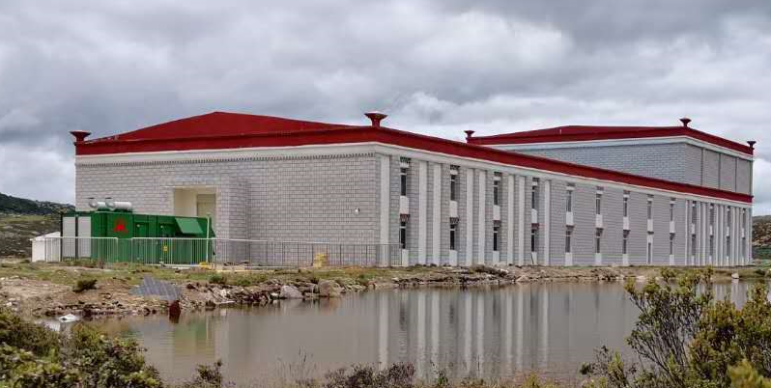
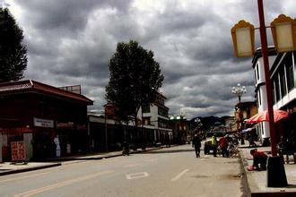
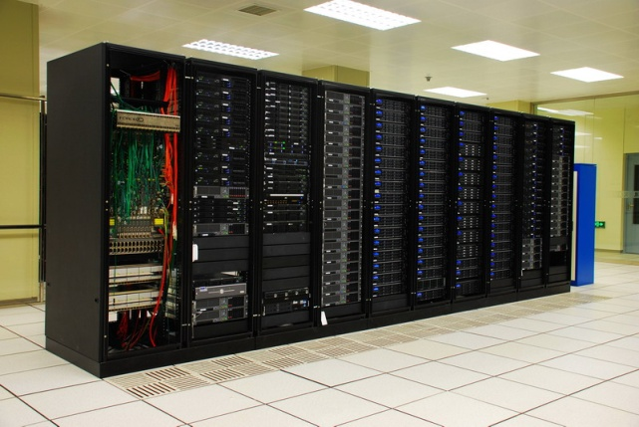
LHAASO Data Processing Platform
~600Mbps
Small on-site data center at Haizi Mountain observatory (~ 4500m)
~2000CPU cores and 1.64PB disk storage for calibration and rapid reconstruction
~1.4Gbps
Operation center at Daocheng city
Distributed
Computing sites
(grid/cloud)
Large Offline data center at CC-IHEP
~4000 CPU cores and 4PB disk storage, 20PB tape storage for simulation, reconstruction, analysis, data storage and archive
3

Slide 4
Outline
Overview of Data Processing Platform
Status of Computing Platform
Job & Resource Status
Storage
Network
Data transform system
Bookkeeping
Software publish
Summary & Next Plan
4

Slide 5
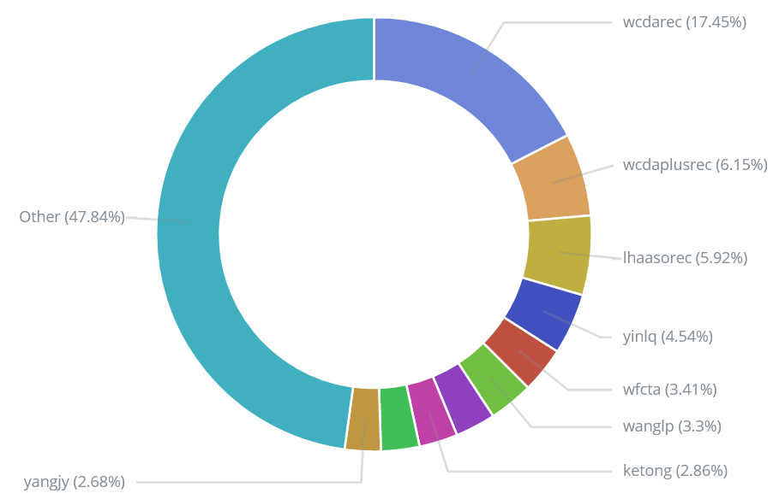
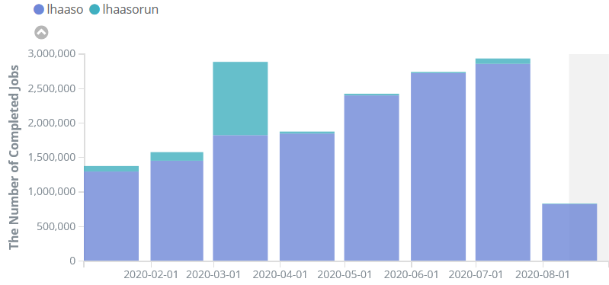
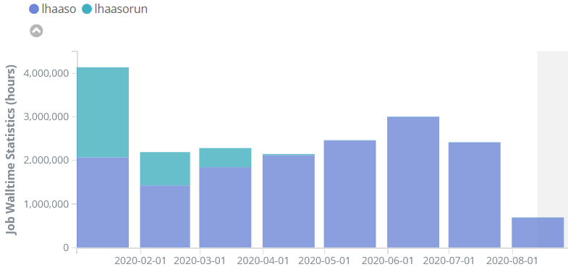
Job & Resource Status
Resource: (cpu cores)
On-site data center: 1748
IHEP data center: 4092(3036 + 1056(vm))
HTCondor Cluster
2020.1.1 – 2020.8.13
16,881,592 Jobs Completed
19,347,817 CPU Hours Consumed
Distribution of user’s cpu hours
5

Slide 6
OS Upgrade & New Job Walltime
OS Upgrade
The operating system on all the machines are upgraded to CentOS7
To use the old OS
On lxslc7.ihep.ac.cn , switch to SL6 (similar to SL5 or SL7), run:
/cvmfs/container.ihep.ac.cn/bin/hep_container shell SL6
/cvmfs/container.ihep.ac.cn/bin/hep_container shell SL6 -g lhaaso # the main group is not lhaaso
On worker node, submit jobs with parameter –os, for example:
hep_sub job.sh -os SL6
New job walltime definition
Test job (5 minutes), run: hep_sub job.sh –wt test
Short job (30 minutes), run: hep_sub job.sh –wt short
Normal job (10 hours), run: hep_sub job.sh
Mid job (100 hours), run: hep_sub job.sh –wt mid
Long Job (30 days), run: hep_sub job.sh –wt long
Note: test/short/mid/long jobs has number limitation of running jobs.
6

Slide 7
Storage Overview
Position | Mount Path | Total | Used | Free
On-site Data Center | /eos/daocheng | 1.63 PB | 1.14 PB | 0.49 PB
IHEP Data Center | /eos/lhaaso | 2 PB | 1.75 PB | 0.25 PB
 | /eos/user | 2.39 PB | 1.63 PB | 0.76 PB
 | /lhaasofs | 610 TB | 8.4 TB | 571 TB
 | /castor | 5.6 PB | 1.8 PB | 3.8 PB
Statistics until August 16
/lhaasofs has been online, managed by Lustre
Stores job scripts, parameter files…
7

Slide 8
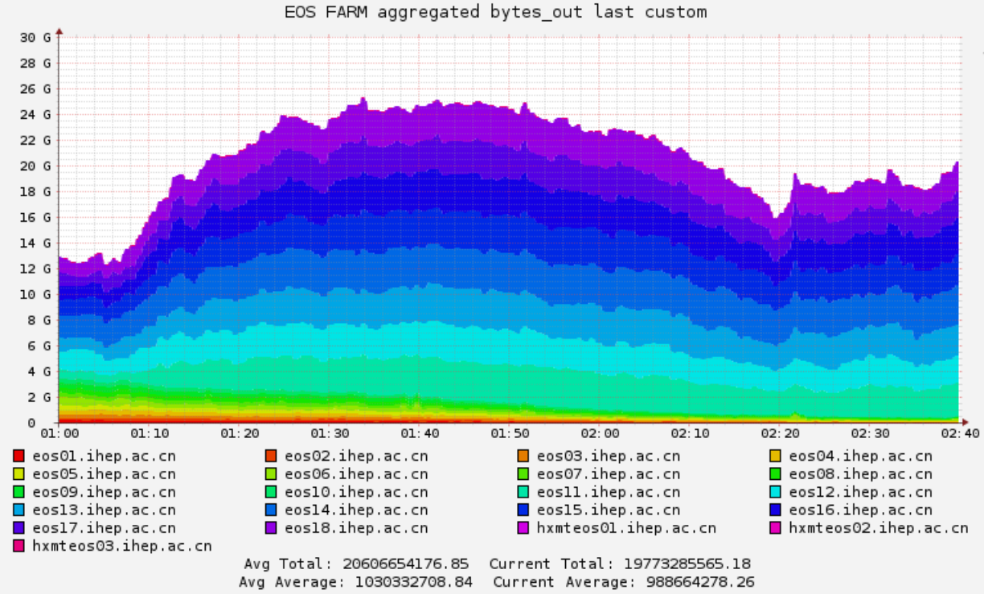
Disk Storage – EOS
EOS is the main filesystem for LHAASO.
Two instances:
EOS Daocheng
EOS Beijing
EOS Daocheng:
Capacity:
from 713 TB to 1.64 PB (2020/07)
Data grows fast: 1.03 PB used.
EOS BEIJING:
Upgraded from 4.4.23 to 4.7.7 (2020/08) .
Upgraded to QuarkDB: high availability, more stable, and boot fast.
Data storage space is close to saturation(only ~200TB left in total 2PB), the latest purchase plan(+4PB) will come next year.
The read bandwidth reached 25GB/s on August 11, it shows that the LHAASO job ran to the limit of the current EOS file system bandwidth.
8

Slide 9
EOS – Use Cases &Tips
Use EOS cli instead of fuse cmd to get high performance
Proper using cases:
Improper using cases:
Too many files (100K) in one directory : ls or eos ls becomes very slow.
Too many files opened but not closed: EOS may break down.
Fuse cmd | ls | mv | find | cp | rm
EOS cli | eos ls | eos mv | eos newfind | eos cp | eos rm
purpose | command
List files | eos ls /eos/lhaaso/raw/km2a/2020/0505
Find files | eos newfind –f --name "*KM2A*" /eos/lhaaso/raw/km2a/
Rename | eos file rename /old/path/to/file /new/path/to/file
Symlink | eos file symlink /target/path/to/file /link/path/to/file
Quota | eos quota
9

Slide 10
EOS – Xcache Service
XCache Overview
Caching accessed data to speedup next accessing
Based on XRootD protocol, and support various filesystem like EOS, Lustre
Deploy as clusters or standalone
XCache for LHAASO
Single node: lhaasocache.ihep.ac.cn
Target EOS: EOS daocheng
Usage: replace old url with new one.
Old url: root://lhmteos01.lhaaso.ihep.ac.cn//eos/path/to/file
New url: root://lhaasocache.ihep.ac.cn//eos/path/to/file
Cases:
List files: xrdfs root://lhaasocache.ihep.ac.cn/
Copy file: xrdcp root://lhaasocache.ihep.ac.cn//eos/path/to/file /local/path/to/file
Open file: root root://lhaasocache.ihep.ac.cn//eos/path/to/file
10

Slide 11
Tape Storage-Castor Status
Castor Service:
Castor/Stager: cnslhaaso.
Tpservers: 3 nodes, tplhaaso01-03.
Drives: 12 drives, all LTO7.
Tapes: 940 tapes, up to 5.6 PB, 400 tapes on order.
Data archived: 6TB or 1 tape per day.
Total space/Used: 5.6PB / 1.8PB
Plan for 2021:
Tpservers: 2 servers, up to 5 servers.
Drives: 8 drives, up to 20 drives.
Tapes: 1400 tapes, up to 2340 tapes or 14.04 PB.
EOSCTA
Next tape archive service combined with EOS
Developed by CERN, and under evaluation.
11

Slide 12
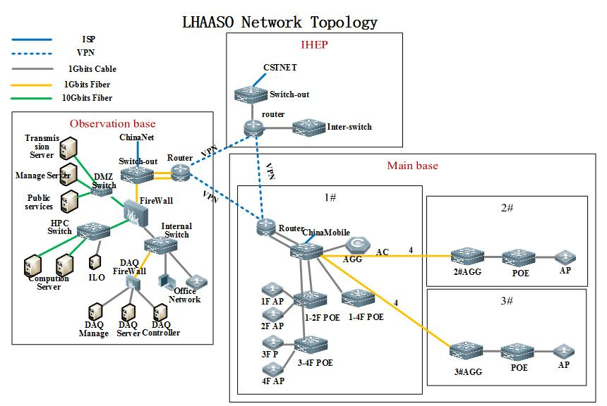
Network architecture
An important part of IHEP NETWORK
Remote branches network
Extend the internal network of IHEP
Network security
Regional logic isolation
Protected by network security system of IHEP
Increase on-site safety control 、detection and auditing
Internet and Domestic Network
CERNet and CSTNet : LHAASO←→IHEP ←→ EUR/USA/JAPAN…
Commercial Network Operators ：China Telecom 、China Mobile
Technology
High speed Ethernet：10G/160G
Flat architecture：2 layer
12

Slide 13
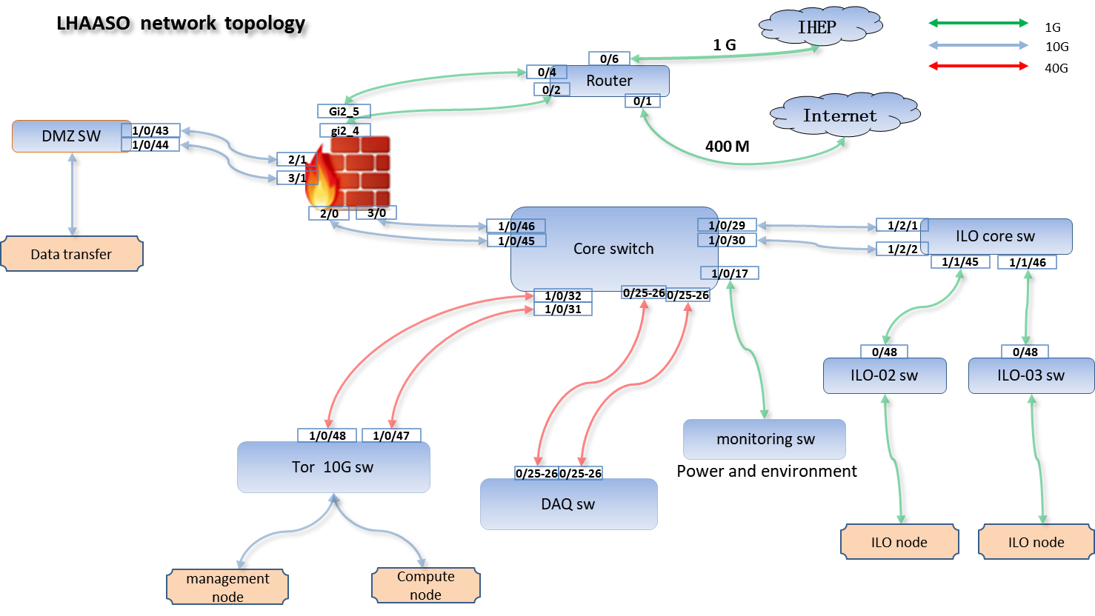
Network status
LHAASO Daocheng Base
Wifi (IHEP、eduroam)
Coverage ：Building 3、2、1 & Assembly hall
Network access control , radius service
Wired network Ready (static Binding policy )
LHAASO (haizi mountain)
Onsite network
New core switch 2X10Gbps Backbone -> 4X40Gbps Backbone
DNS server (as a IHEP sub-domain.) The domain rules：*.lhaaso.ihep.ac.cn
The DMZ area is independent ，uplink to Firewall (2X10G)
Wifi (IHEP、eduroam)
Coverage ：assembly hall, official gate, water purification station, power distribution room 1, ultra-pure water station and water purification cycle station. Will be ready this year.
13

Slide 14
Updates of Data Transfer system
Network Path：
dedicated network 1Gbps
VPN LINK 400Mbps
Upgrade data transfer system
add three modules: Log module, Inform module, Retransfer module
Interface with EOS XrootD
better adaptation to EOS and better bandwidth utilization
14

Slide 15
Data Transfer System status
Transfer Status
From February 6, 2018, the source data was transmitted from the LHAASO to the Data Center in IHEP, and is stable.
The total amount of source data currently transmitted is approximately 1.7PB
Data transfer status in IHEP eos until now:
15

Slide 16
Offline Data Management System
A job and file metadata management system
Support the management of the whole data lifecycle
Storing all kind of information about files and jobs in an organized way
Data can be linked to jobs, software and parameters/conditions
Data can be linked to production/raw data
Provide to final users an efficient way to get a collection of files for the analysis, making queries on the basis of the files and jobs metadata
16

Slide 17
Offline Data Management System
Prototype of the Offline Data Management System
Data Transfer management
DAQ -> IHEP EOS -> Tap
Raw data management
Raw data -> Decode data
Conditions management
Calibration data
Parameters
……
17

Slide 18
Software Publish & Access Service
AFS is replace by Cern-vmfs to support LHAASO experimental software publish service.
A global, read-only HTTP-based file system to distribute experiment software in a fast, scalable, reliable and low-maintenance way
HTTP transport, access and caching on demand, avoids most of the firewall issues on remote sites
New software release process was updated in July.
Flexible compilation environment
Software distribution is easier
Experimental software can be accessed at /cvmfs/lhaaso.ihep.ac.cn
Refer to http://afsapply.ihep.ac.cn/cchelp/zh/others/soft-service/
18

Slide 19
Outline
Overview of Data Processing Platform
Status of Computing Platform
Job & Resource Status
Storage
Network
Data transform system
Bookkeeping
Software publish
Summary & Next Plan
19

Slide 20
Summary & Next Plan
The computing platform has been running smoothly
According to the plan, some important service and system environment upgrades have been completed during summer maintenance
We are taking efforts to combine external computing resources to meet the requirements of users
Federation of external computing resources from collaboration members ,universities as well as commercial cloud computing resources (Ali Cloud) etc.
A distributed global pool is under developing. It will be ready for LHAASO production this year.
A visual real-time query interface for job resource information will be provided.
We welcome the collaboration members to consider contributing resources to the global pool.
20

Slide 21
Thank You! Questions ?
21

