Slide 1
LHAASO software and data based on frame-work
祝成光
前沿交叉科学青岛研究院，山东大学

Slide 2
Motivation
In collabration:
Personal analysis codes are different from each other. BUT, many parts are with the same functionality
MC production, data processing and validation are common work
Engineering code/data:
Improve code robustness, so that the physics result.
Efficient in data production/validation, analysis code composition.

Slide 3
LodeStar is starting point of LHAASO software
Software Frame-work
Lodestar is based on Sniper (general to any experiment), adding parts for LHAASO.
It's an “operation system” from the analyzer's point of view.
It is just scratch for LHAASO software.
Lodestar provide basic functionality for data analysis:
Data IO, memory management, and event loop
User only concentrate on processing of ”ONE” event.
LodeStar defines standards.
The standard of coding: package
Personal anaylysis code is made from package-level other than directly c++ level.

Slide 4
This report
Not aim to help develop frame-work, LodeStar
Not to compose code for analyzers
To coordinate the analysis code collabration-widely based on LodeStar.

Slide 5
Packages in official pool:
Sniper/ ： Core of frame-work
offline/: collected from all researchers
wanger packages
mazi
packages
zhangsan packages
Lishi
packages
Personal packages are developed by researchers
Official packages are frame-work plus collected from all researchers,

Slide 6
Structure of typical analysis based on frame-work
Tool1
Svc2
Algorithm 2
Algorithm 1
data model A
data model A
data model A
data model B
Memory
input service
output serive
disk
disk
data model A
data model A
data model B
event loop (sniper)

Slide 7
Transforming code to LodeStar-style is super SIMPLE
The code in event-loop is transformed to package: algorithm
which is the code to process data, read data (model) in memory, write out data (model) to memory.
The common functional code is transformed to pacakge: Tool/Service
which is code seperated from algorithm
which is used in more places.
Connect algorithms head-to-end, and plug in needed Tools/Services

Slide 8
open root file and connect variables in root file to local variables
InputSvc
define calibration instances and read in cali-files
Tools/Service packages
define instance of helper class
Tools/Service packages
get entry and event loop
task.run
process the variables
Algrithms
save histgram/tree to root file
OutputSvc

Slide 9
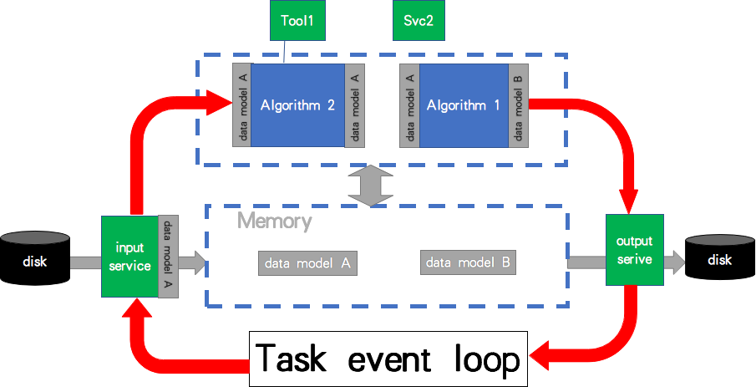
After transformation, re-make the analysis code
Algtask = Sniper.Task("Algtask")
algo2 = Algtask.createAlg("Algorithm2/myAlg2")
algo1 = Algtask.createAlg("Algorithm1/myAlg1")
tool1 = algo2.createTool(“Tool1/mytool”);
Svc2 = Algtask.createSvc("Svc2/mySvc2")
iSvc = Algtask.createSvc("InputSvc/InputSvc")
oSvc = Algtask.createSvc("OutputSvc/OutputSvc")
Algtask.run()
full example: http://svn.lhaaso.ihep.ac.cn/People/zhucg/trunk/myProject/run/myjob.py
to run: python myjob.py

Slide 10
efficiently switch code, such as different versions or code from other person.
Algorithm connected by data in memory other than file.
Just tell the system which data in memory you want to save.
Ntuple/Tree/Model
~100Gb
Raw Data
~pb
detector
database
Calibration
database
Service and Tools
input/decoding service
calibration
Reconstruction
output service
RawEvent
Memory
LHCaliEvent
LHRecEvent

Slide 11
Suggest:
Try the transformation of your code
Adopt the code in the release (not manditory)
Seperate your good/functional code to merge into official release as your contribution

Slide 12
Physics analysis
Loop the reconstructed event, do your statistics,producing Tree/Histograms
Produce final histograms from Tree or histograms
Draw Histograms in LHAASO-style
Raw Data processed centrally
tree/ntuple/RecEvent
statistics
hist producer
HistDrawing
tree/hist
hist
pdf/eps
tree/ntuple/RecEvent
statistics
hist producer
HistDrawing
tree/hist
hist
pdf/eps

Slide 13
LHAASO Data
Centrally storage and management
real data
data taking information：time，runnumber，detector etc
data stage：raw，cali， reco, version of software used in processing.
data quality map
MC：
simulation conditions:energy,version of software used
Data validation:
data validation (a series of standard analyses)

Slide 14
LHAASO software twiki for information sharing
LHAASO Twiki
http://twiki.ihep.ac.cn/twiki/view/LHAASO/WebHome
LHAASO software twiki:
http://twiki.ihep.ac.cn/twiki/view/LHAASO/LhaasoSoftware
official release
software structure and contributors
examples
SVN
LHAASO data twiki

Slide 15
黄性涛 2020自然基金杰青
软件工程和探测器工程一样,是高质量物理结果的保障
这次会议组委将软件部分放在第一天，说明合作组更加重视软件工程建设

Slide 16
Thanks

