Slide 1


Search for TeV electron neutrinos with LHAASO
Gou Quanbu^{1，2} , Li Zhuo³, Giuseppe Di Sciascio⁴, Hou Chao^{1，2}, Lv Hongkui^{1，2}, Huang Tianqi³，Hu Fan³ , Wang Yaping^{1，2}
1 Institute of High Energy Physics, Chinese Academy of Sciences
2 TIANFU Cosmic Ray Research Center, Chengdu, Sichuan, China
3 Department of Astronomy, School of Physics, Peking University
4 INFN - Sezione Roma Tor Vergata, I-00133 Roma, Italy

Slide 2
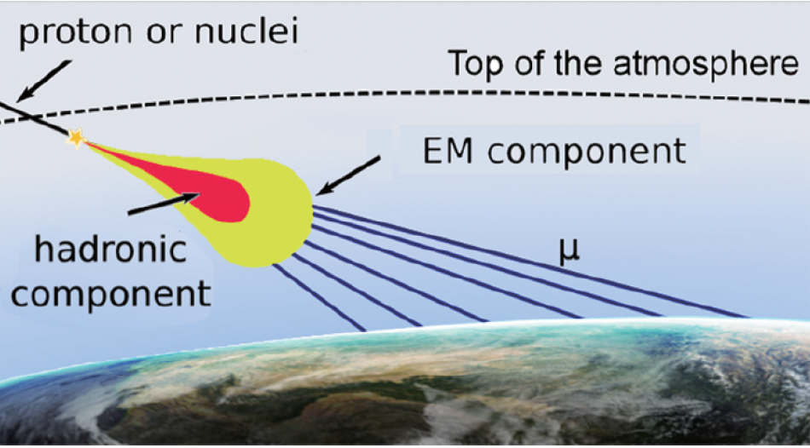
Horizontal Air showers (HAS)
Cosmic Rays can initiate a HAS in the atmosphere.
The hadronic and EM components are absorbed and only muons reach the Earth.
Gou Quanbu LHAASO Workshop - Chengdu Aug. 18-22, 2020

Slide 3
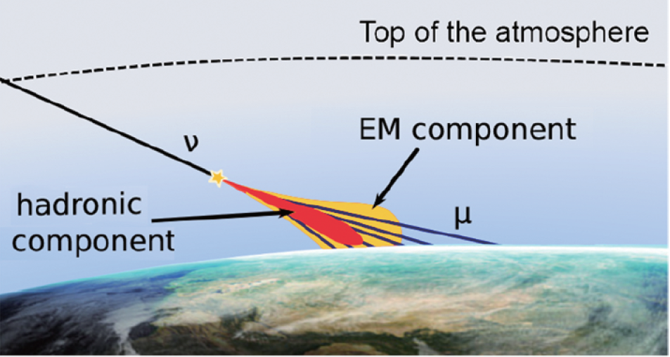
Neutrinos can initiate a HAS in the atmosphere.
In this kind of events both the EM and the muonic components reach the surface.
Gou Quanbu LHAASO Workshop - Chengdu Aug. 18-22, 2020

Slide 4
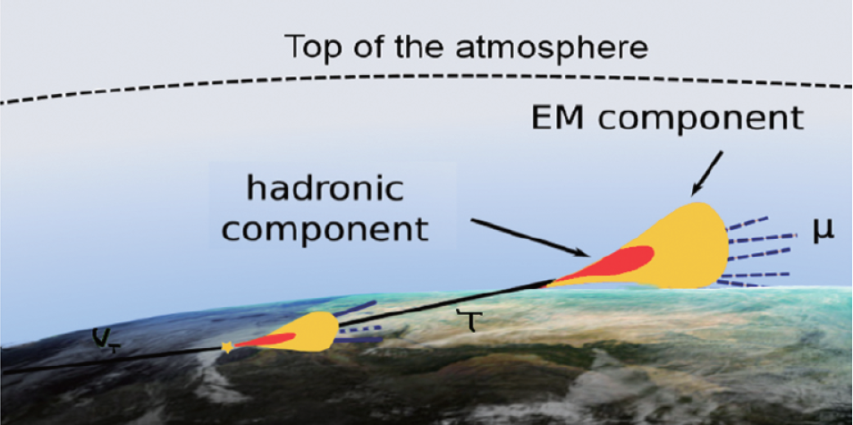
Tau neutrinos can initiate a quasi-HAS.
A ντ can interact in the Earth crust (Earth-skimming process) via CC-interactions and the resulting τ can escape the Earth and decay into the atmosphere initiating a quasi-HAS which, although having an up-going direction, produces particles that can be detected at ground.
Gou Quanbu LHAASO Workshop - Chengdu Aug. 18-22, 2020

Slide 5
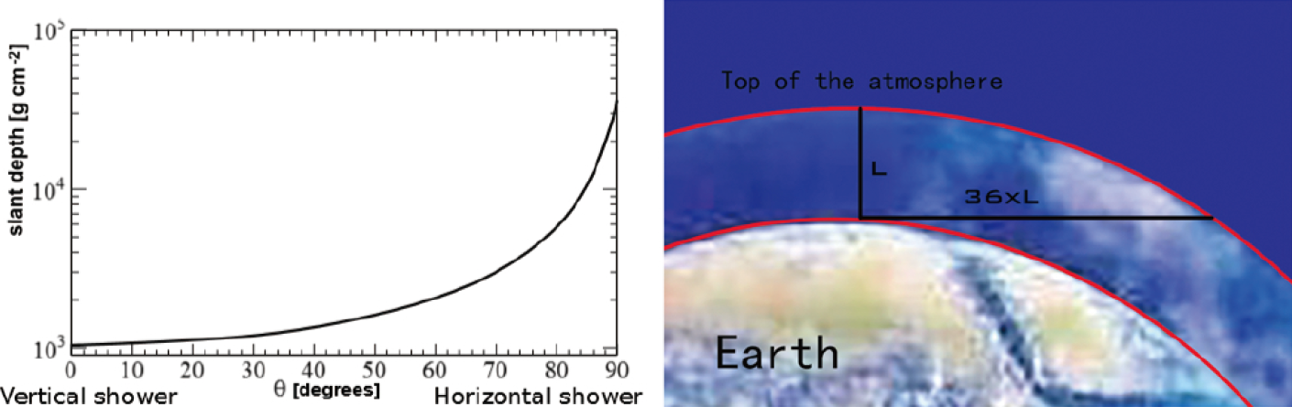
Left: Atmospheric depth as a function of the zenith angle. The amount of matter increases quickly after 60°.
Right: A horizontal shower goes through 36 times more mass than a vertical shower.
Gou Quanbu LHAASO Workshop - Chengdu Aug. 18-22, 2020

Slide 6
Horizontal Air showers
The observation of HAS provides a “well shielded laboratory” for the detection of penetrating particles: high energy muons, cosmic neutrinos, possible weakly interacting particles produced in the decays of cosmological super heavy particles, will leave a clear signature.
The showers with significant muon component could be further rejected by underground muon detector. This provides a method to search neutrinos from HAS.
Gou Quanbu LHAASO Workshop - Chengdu Aug. 18-22, 2020

Slide 7
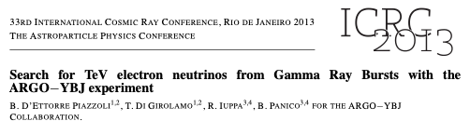
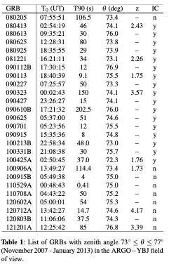
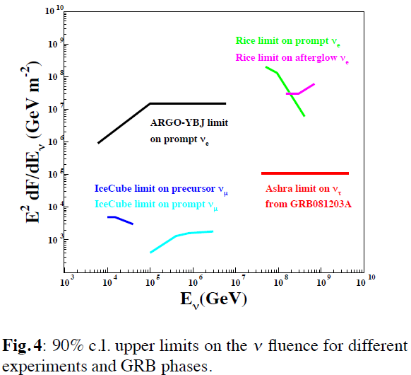
Follow-up ARGO-YBJ analysis
"We report here on a search for νe-induced HAS (73◦ ≤ θ ≤ 77◦) in temporal coincidence with the prompt phase of Gamma Ray Bursts."
Gou Quanbu LHAASO Workshop - Chengdu Aug. 18-22, 2020

Slide 8
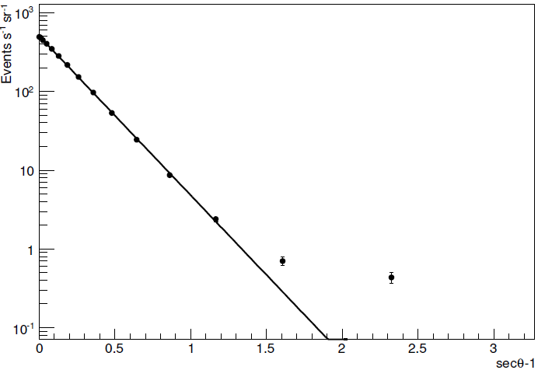
Observation of HAS with ARGO-YBJ
The zenith angle distribution of EAS measured with ARGO-YBJ. The best fit out to 60° is also shown.
Gou Quanbu LHAASO Workshop - Chengdu Aug. 18-22, 2020

Slide 9
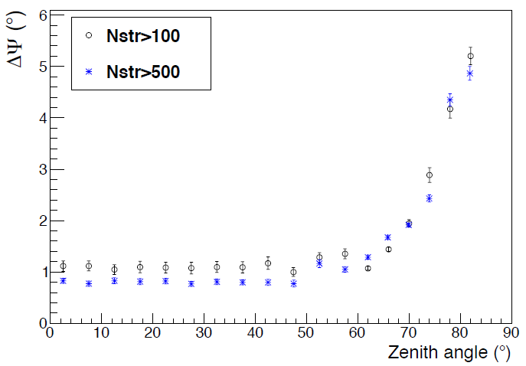
Angular resolution vs zenith angle
Angular resolution worsens with increasing zenith angle: 2.3° for 73° ≤ θ ≤ 77°
Gou Quanbu LHAASO Workshop - Chengdu Aug. 18-22, 2020

Slide 10
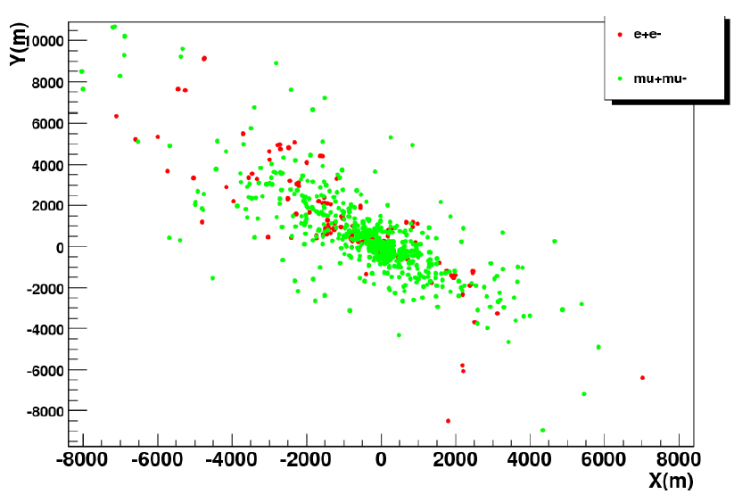
Simulated HAS
Monte Carlo simulation proton = 80° - 3367 g/cm²
Gou Quanbu LHAASO Workshop - Chengdu Aug. 18-22, 2020

Slide 11
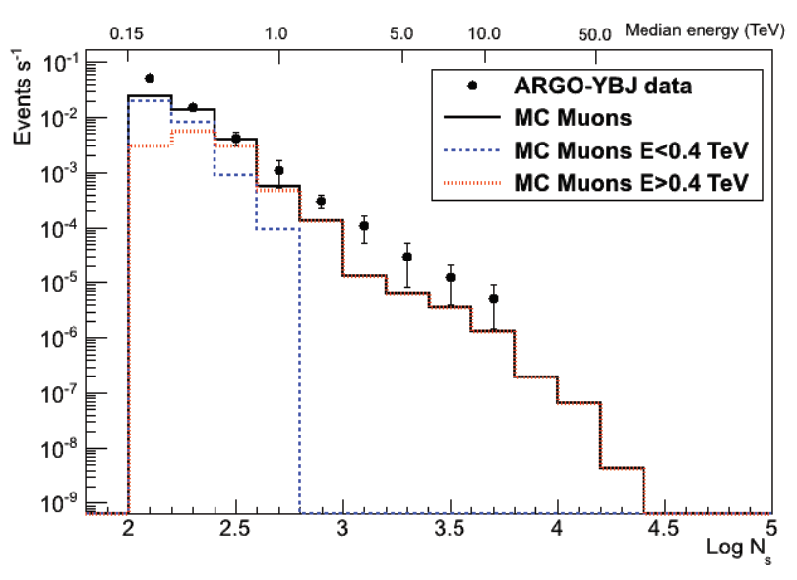
HAS size spectrum
Comparison (only shape) between HAS rate measured by ARGO-YBJ and MC expectations for 70◦ < θ <75◦. The upper scale shows the corresponding muon median energy.
We have simulated showers induced by muons with the energy spectrum measured by Allkofer and collaborators in 1979 at 75◦
Gou Quanbu LHAASO Workshop - Chengdu Aug. 18-22, 2020

Slide 12
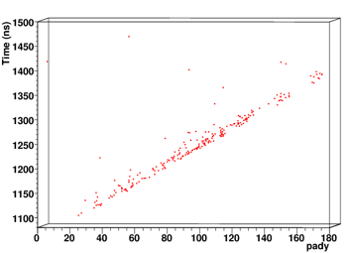
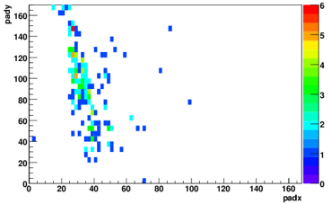
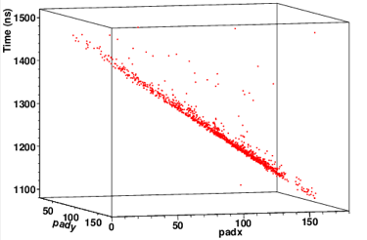
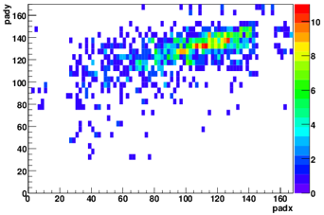
Horizontal Air Showers by ARGO-YBJ
Spatial distributions
Temporal profiles
θ = 80.50°
θ = 82.24°

Slide 13
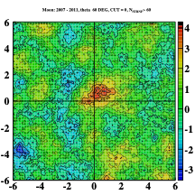
Moon Shadow > 60°
The significance map of the Moon region observed at a zenith angle θ > 60◦ . It contains all the events collected by ARGO-YBJ in 5-years data taking with bin N> 60 fired strips on the central carpet. The significance of the maximum deficit is about 5 s.d.
We stress that this is the first time that an air shower array detected the Moon shadow mainly due to muon-induced showers in horizontal events.
This result makes us confident about the angular resolution and the selection procedure of inclined showers.
Gou Quanbu LHAASO Workshop - Chengdu Aug. 18-22, 2020

Slide 14
Summary
The goal of this work is to establish and develop a method for searching TeV electronic neutrinos associated with astrophysical transients with LHAASO experiment, by looking at HAS induced by the charged current (CC) interaction of these neutrinos with the air nuclei.
This study can be crucial to constrain the physics of the related objects, and to identify the sources of the high-energy cosmic rays. In particular, this technique could represent a complementary methodology to search with large area arrays for electronic neutrinos associated to buried GRB jets which are predicted to generate a soft neutrino spectrum with a fluency at TeV energies.
Gou Quanbu LHAASO Workshop - Chengdu Aug. 18-22, 2020

Slide 15
The purpose of this talk
That is to attract young students to participate this interesting work.
Thanks for your attention!
Gou Quanbu LHAASO Workshop - Chengdu Aug. 18-22, 2020

Slide 16
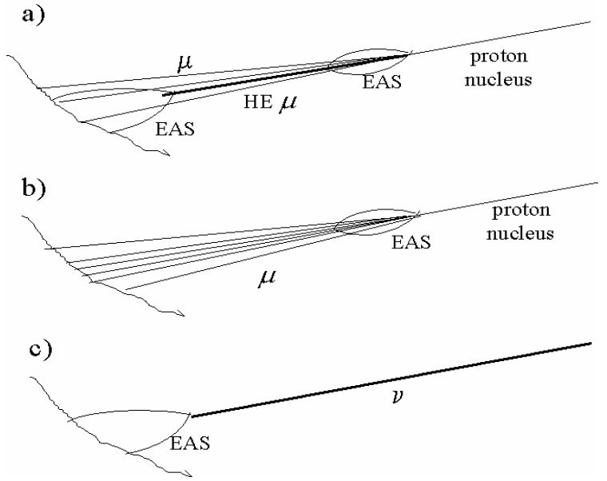
Different topologies of the µ/ν events
Possible sources of Horizontal Air Showers:
a) ”local” high energy muon interactions, b) muon dominated showers, residuals from an UHE c.r. interaction at very large distance, c) neutrino events.

Slide 17
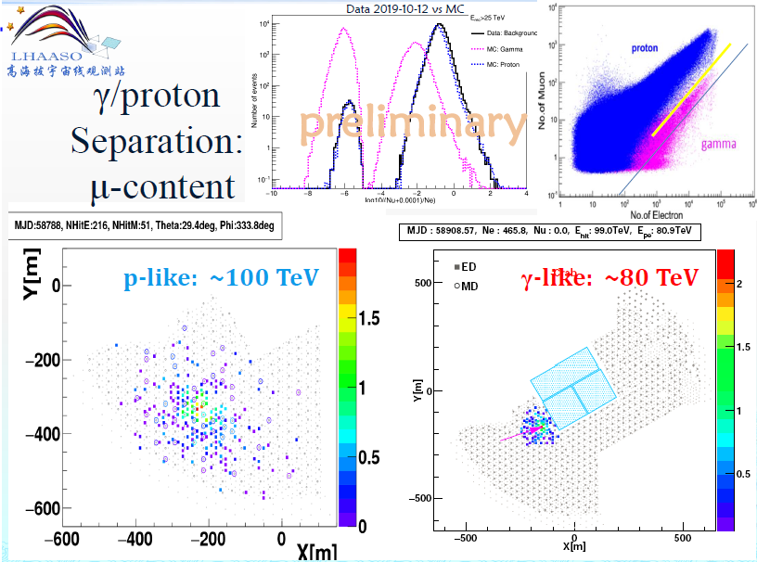

Slide 18
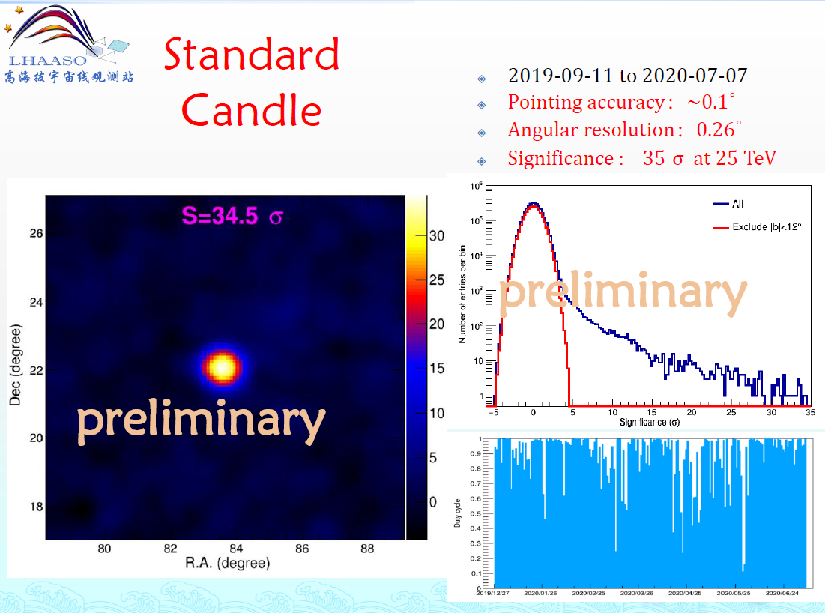

Slide 19
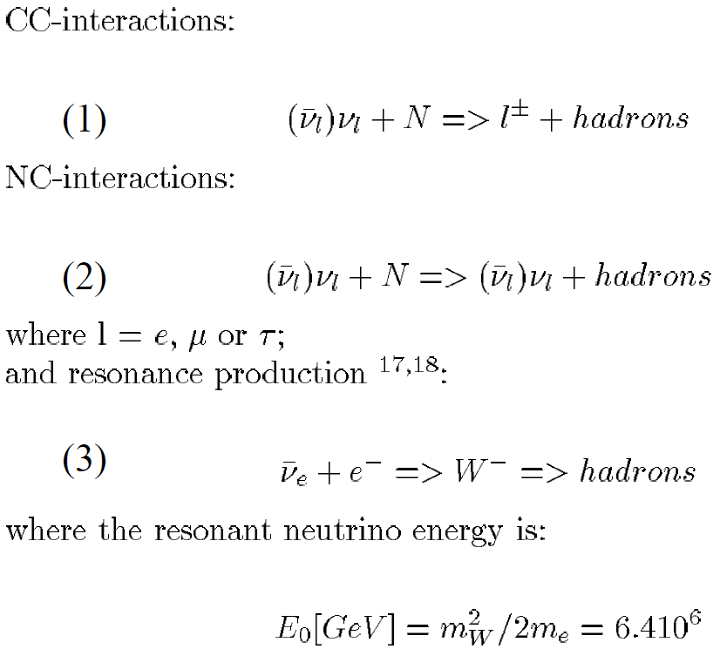
Neutrinos produce showers through:

Slide 22
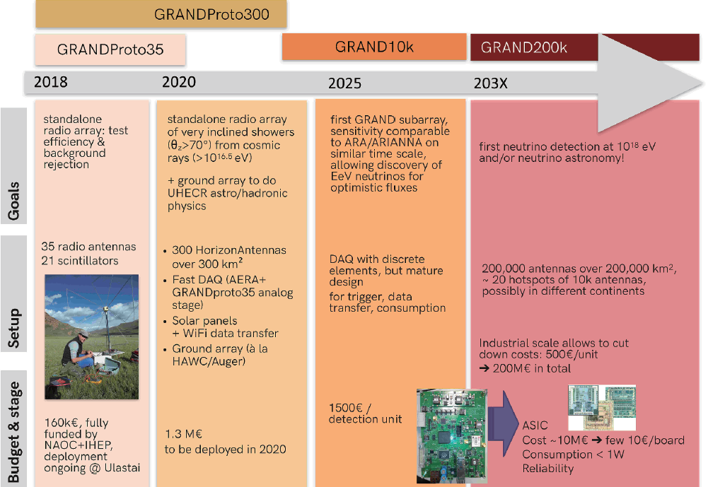
Timeline of the construction stages of GRAND

