Slide 1
Status of KM2A data and analysis
Chen Songzhan
IHEP
2020-08-18@Chengdu

Slide 2
Content
1. Introduction
2. Reconstruction of KM2A data
3. Observation on Crab and Moon shadow
4. Summary

Slide 3
1. Introduction

Slide 4
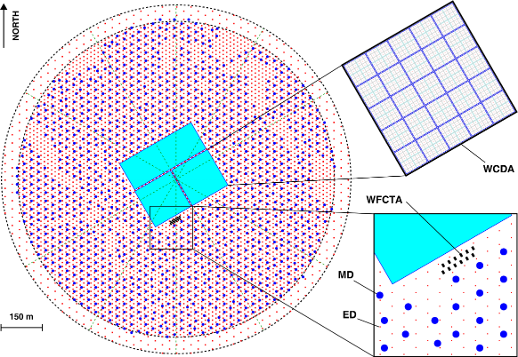
LHAASO detectors
5195 EDs
  1 m²
  Spacing 15 m
1171 MDs
  36 m²
  Spacing 30 m
3120 WCDs
  25 m²
12 WFCTs
KM2A
WCDA
WFCTA
1.3 km² @4410米

Slide 5
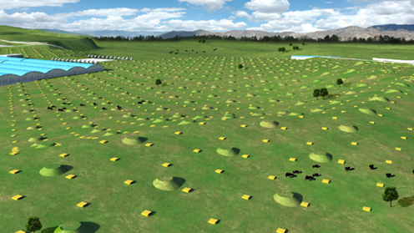
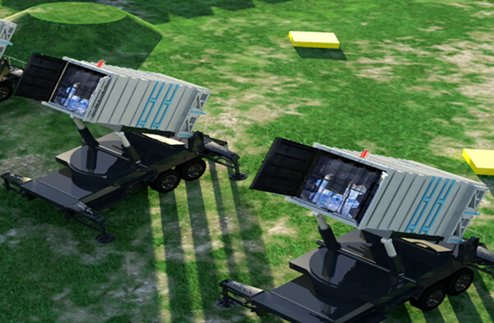
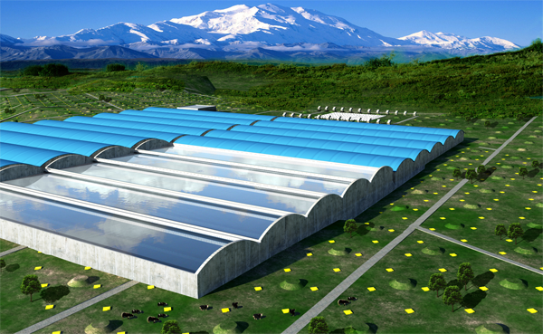
Main science goals of LHAASO
KM2A
100TeV gamma-ray
WFCTA(+WCDA+KM2A)
Individual nuclei spectra
WCDA
TeV gamma-ray

Slide 6
Status of LHAASO-KM2A
1. 33 EDs:
since 2018-02
2. Increasing stage:
since 2018-12
3. 1/4 KM2A 1200⁺EDs+250⁺MDs:
since 2019-09
4. 1/2 KM2A 2300⁺EDs+550⁺MDs:
since 2019-12-27
½ KM2A

Slide 7
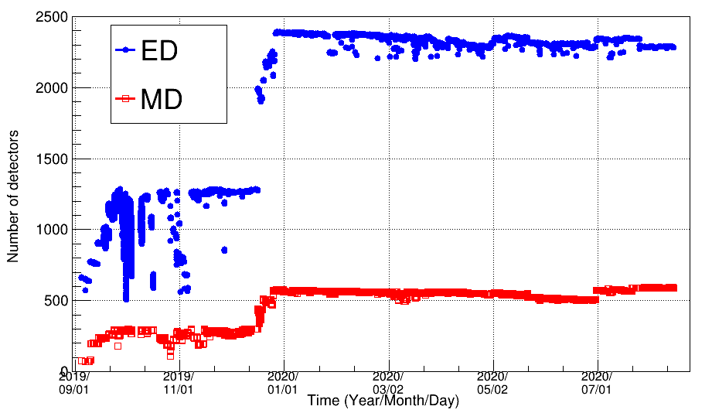
Number of detectors
1/4 KM2A: There are about 1.5 months steady data.
1/2 KM2A: The number of EDs is more than 2250 and number of MDs is more than 500.
The array is debuged and tuned.
1/4 array
1/2 array

Slide 8
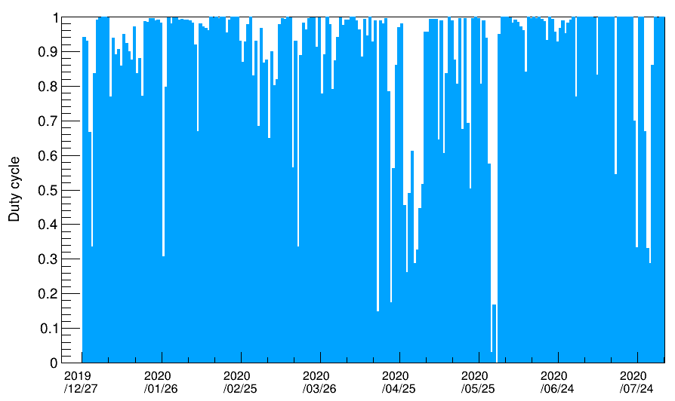
Duty cycle and events
The duty cycle is larger than 85%
About 8x10⁷ events per day, 1.6x10¹⁰ total events.

Slide 9
2. Reconstruction of KM2A data

Slide 10
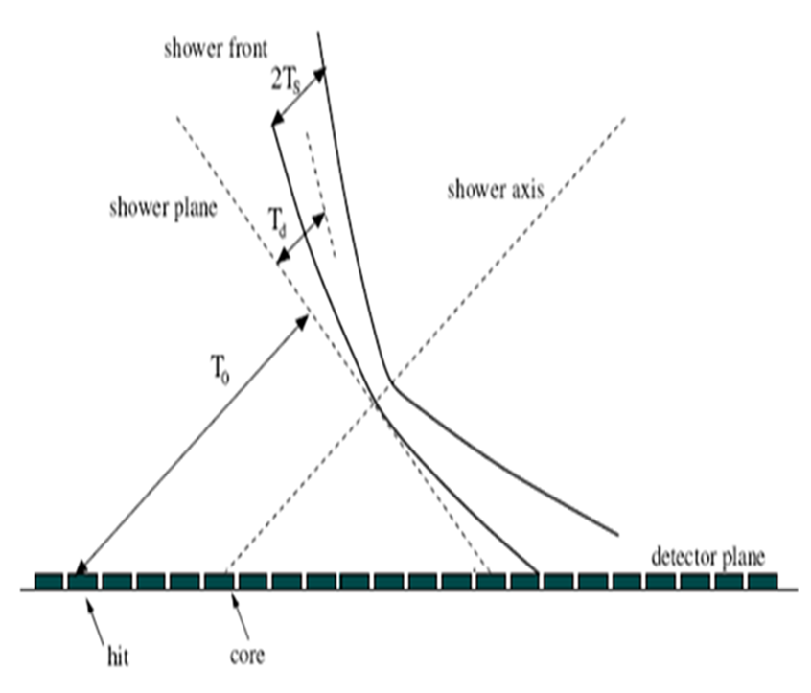
Time calibration
The telescope method is used to test the software calibraiton
The shower plane is used to calibrate detectors
Standard ED
ED
More details see Lv Hongkui's report.

Slide 11
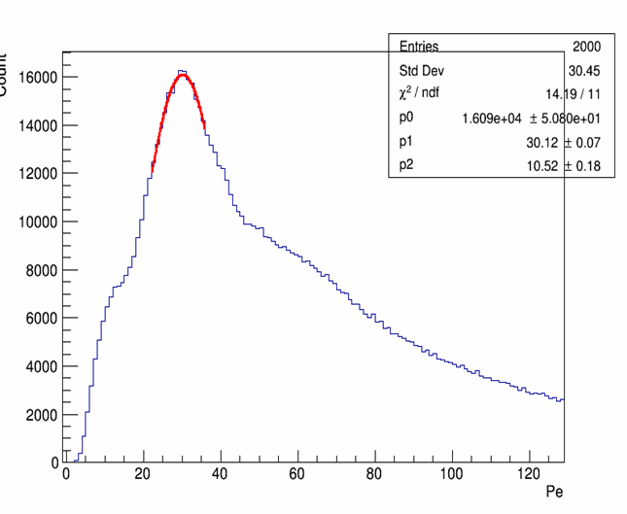
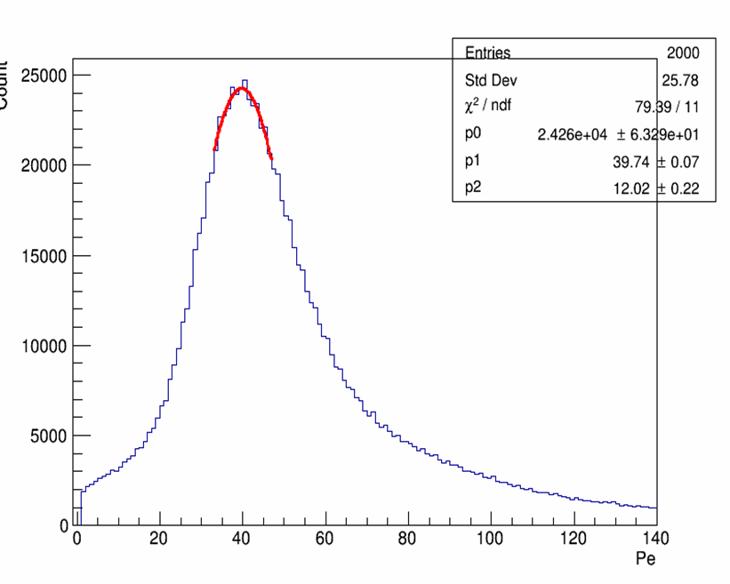
Charge calibration
The peak of single particle is used calibrate the ED and MD charge. Calibration updated day by day.
ED
MD
More details see Lv Hongkui's and Zuo Xiong's report.

Slide 12
Compared with MC
ED
MD
The number of particles is consist with MC
More details see Zhang Hengying's report.

Slide 13
Core reconstruction
Likelihood method to fit the modified NKG function.
More details see Li Cong's report.

Slide 14
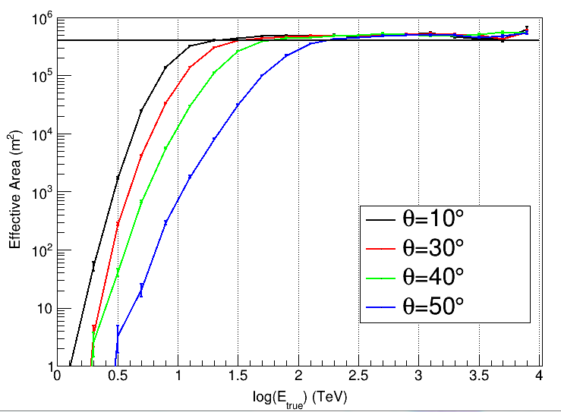
Core selection and effective area
Area: 4.e5 m^2
cos, rec and true are at same bin

Slide 15
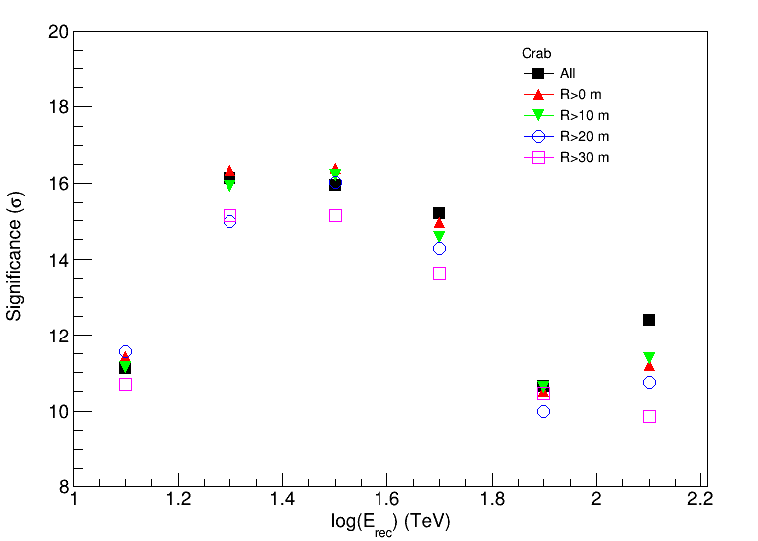
Test on Crab using different core selections
R is distance to the edge
R>0 is used now!

Slide 16
Energy reconstruction
The particle density at 50m from NKG fitting is used to reconstruct the energy.
More details see Li Cong's report.

Slide 17
Energy resolution
Energy resolution is zenith angle dependent

Slide 18
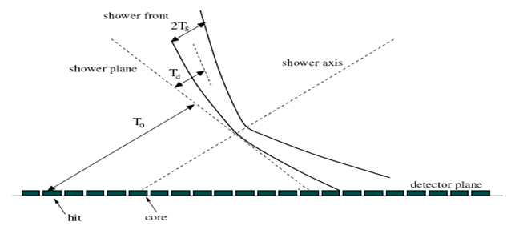
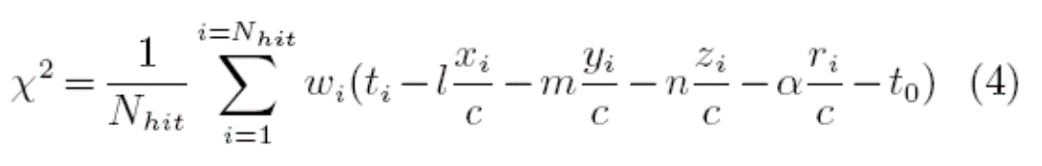
Direction reconstruction
Least square method is usually used to fit the shower plane.

Slide 19
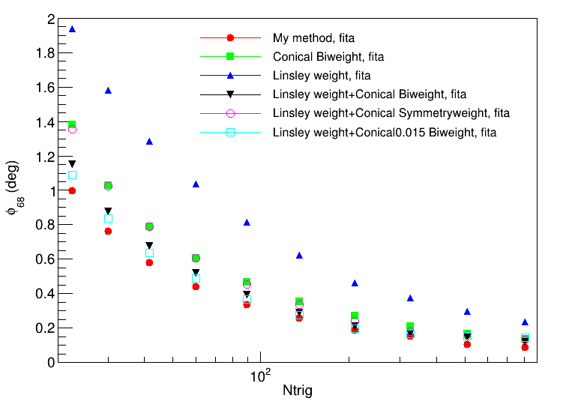
Angular resolution
Different methods are tested

Slide 20
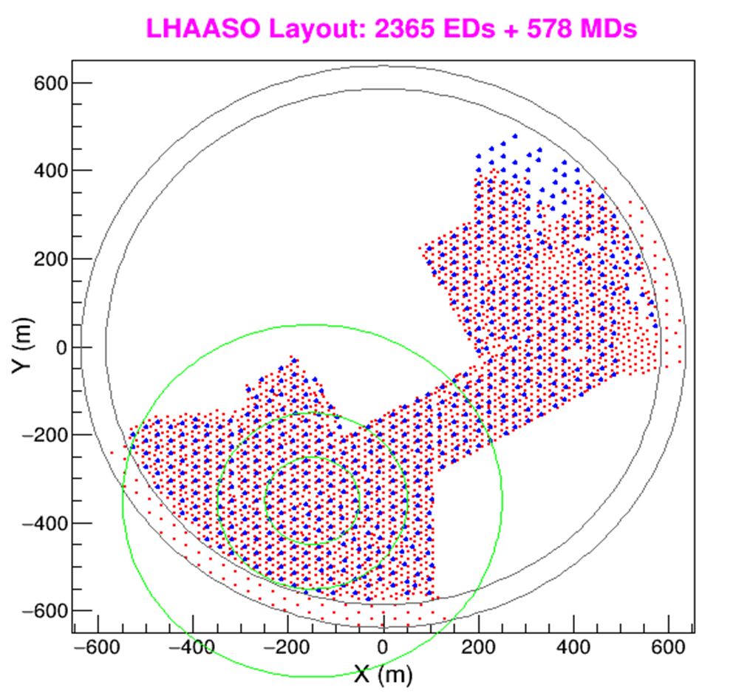
Time and space window
The optimization on window is to balance between signal and noise.
R=400m
ED noise rate:
1.5k Hz, 0.15 hit (per 100ns, 1000 EDs)
MD noise rate:
6kHz, 0.06 hit (per 100ns, 100 MDs)

Slide 21
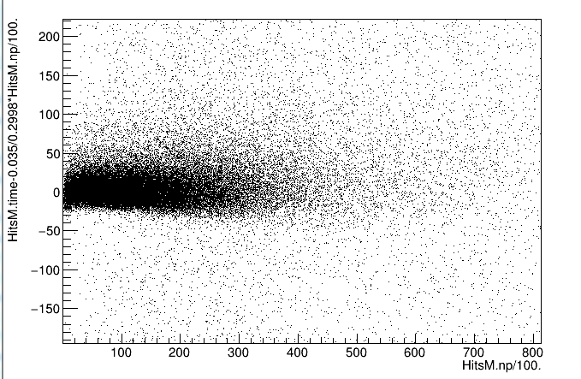
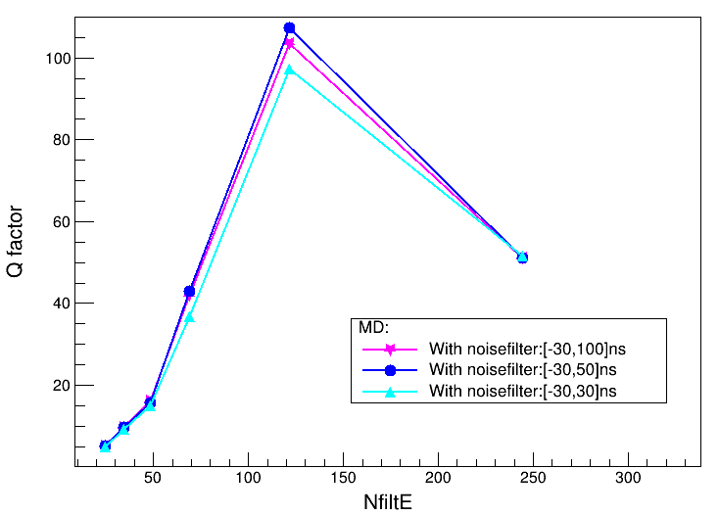
Muons of MD
dt (ns)
dt (ns)
The Q factor using [-30,50]ns is better than other two windows
Distance to core (m)

Slide 22
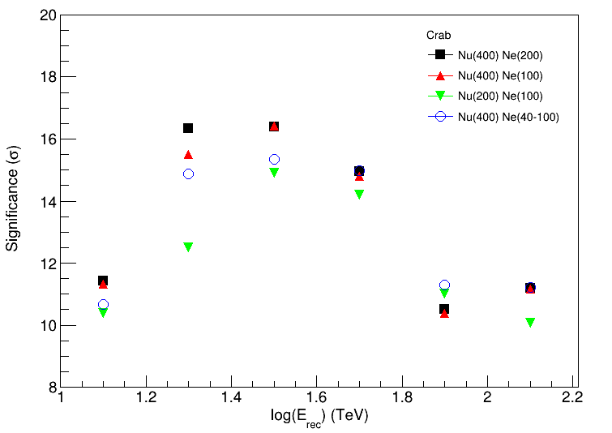
Test using Crab data
Space windows
Nu：15-200m， 15-400m
Ne：0-100m，0-200m，40-100m
The Nu 15-400m and Ne 0-200m is used for data analysis

Slide 23
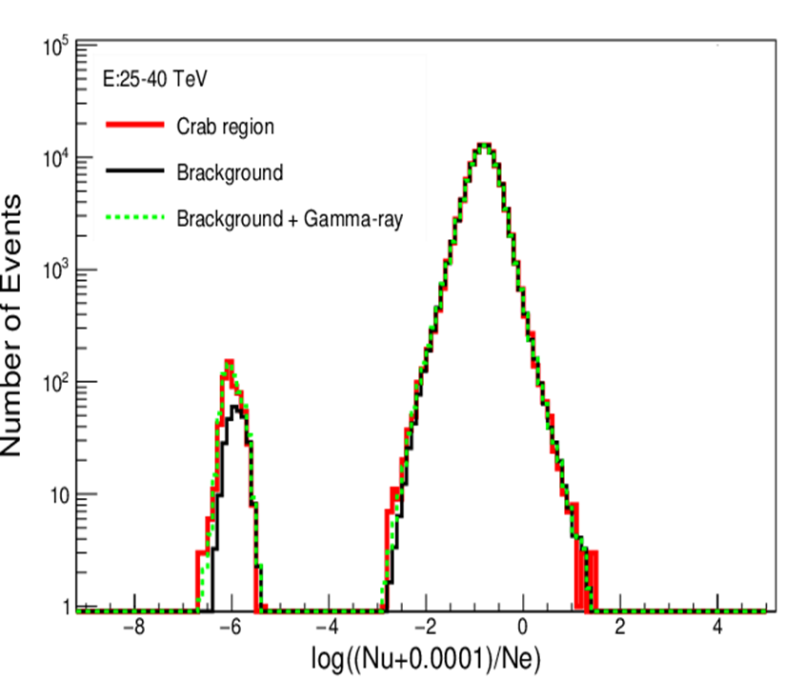
Gamma/background discrimination
Ratio is used to discriminate the gamma/background

Slide 24
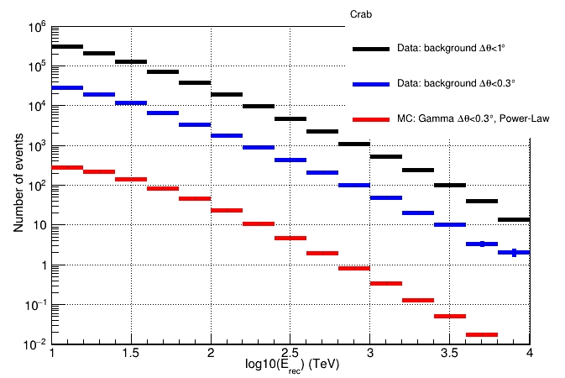
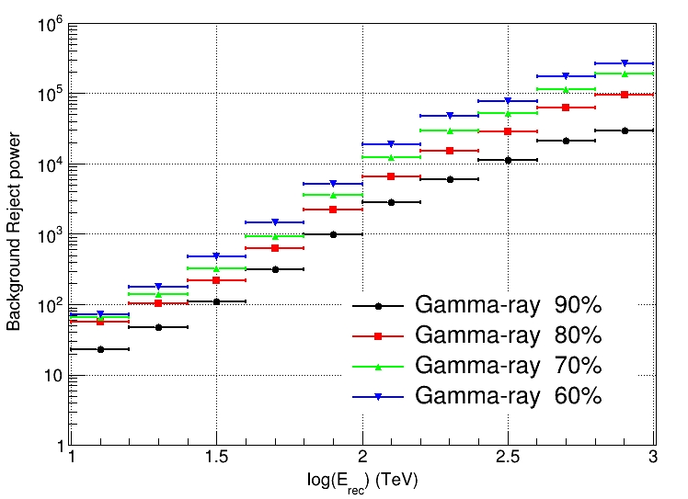
Optimization
For a specific source, we should balance the signal reservation and background reject power.
The Crab-like source is used to optimization the significance (Li-Ma).

Slide 25
Fraction after cut
Optimization using the background and angular window of Crab .

Slide 26
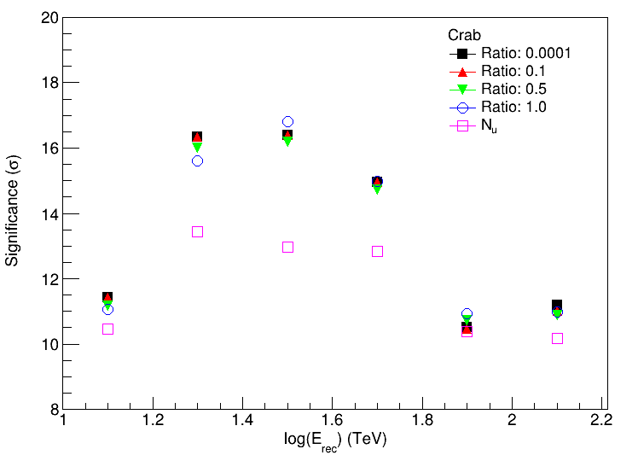
Test on Ratio using Crab data
Ratio：log10((Nu+r)/Ne)
r：0.0001，0.1，0.5，1.0
Or use Nu
Ratio is better than simple Nu.
0.0001 and 0.1 is about same.

Slide 27
The pipe line of KM2A data
TDC calibration
DAQ store data at LHAASO site
Transfer data to IHEP via internet
Auto decode the data to Root file
Auto data reconstruction
ADC calibration
Detector quality check
Data file quality check and selection
Auto Monitor and report
The delay of the data reconstruction is less than 3 days

Slide 28
Data quality: detector
Monitor each detector, and mask abnormal detector

Slide 29
Detector cut: noise rate
Detector cut: occupancy
More details see Wu Sha's report.

Slide 30
Event flile selection

Slide 31
Reconstruction data
Verison 0: Core centriod weight, Energy Ne
/eos/lhaaso/rec/km2a/half_array/20?? (old)
Version 1: Core NKG, Energy NKG
/eos/lhaaso/rec/km2a/half_array/20??_V1 (current)
Version 2: Core NKG, Energy NKG, Final configure.
/eos/lhaaso/rec/km2a/half_array/20??_V2 (future)

Slide 32
3. Observation on Crab and Moon shadow

Slide 33
Crab
10TeV-25TeV
25TeV-100TeV
>100TeV
Data: 2019-12-27 to 2020-05-28

Slide 34
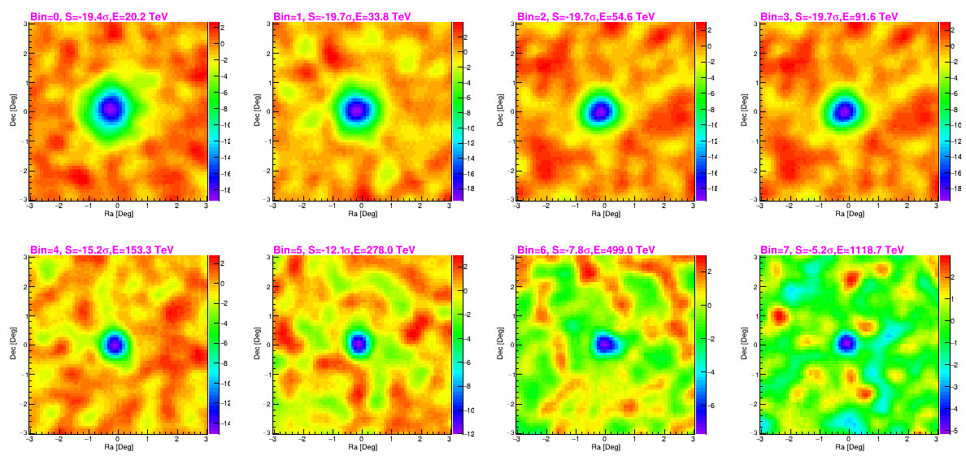
Moon Shadow
Data 2019-12-27 to 2020-07-03

Slide 35
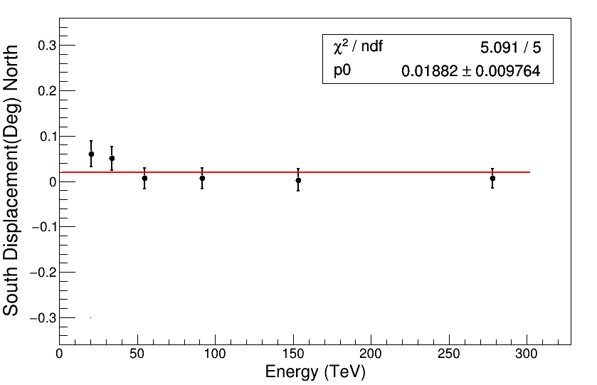
Pointing error
RA： - 0.024 ±0.016 degree
DEC： 0.035±0.014 degree
DEC： 0.019 ±0.010 degree
Crab
Moon Shadow

Slide 36
PSF of Crab (gamma-ray)
25TeV-40TeV
>100TeV
PSF vs E

Slide 37
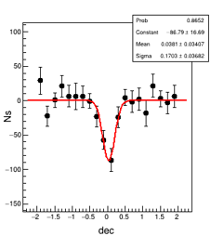
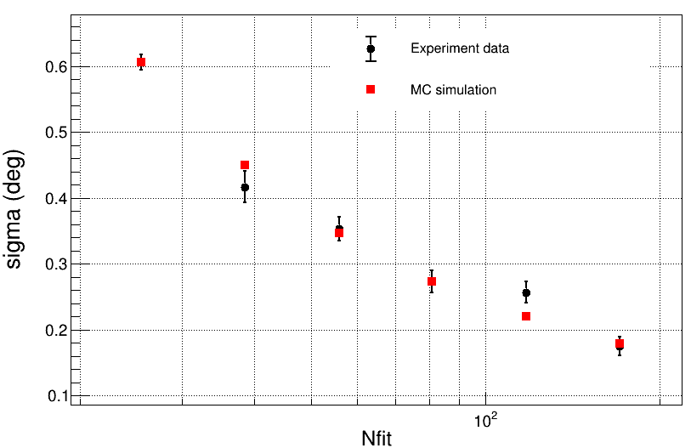
PSF of Moonshadow (cosmic ray)

Slide 38
The highest events from Crab
About 40 events above 100TeV
The highest energy is 880TeV
More details see Wang Lingyu's report.

Slide 39
SED fit method
from HEASoft manuals

Slide 40
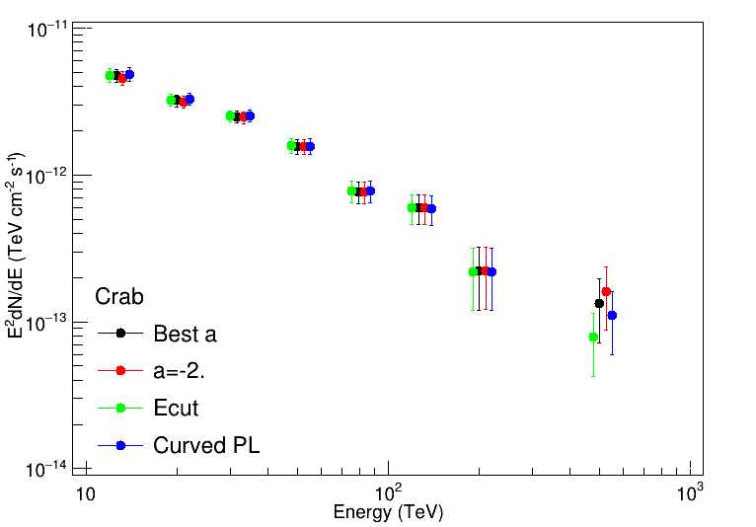
The SED is consistent using different models.
The SED using differenct spectral shape

Slide 41
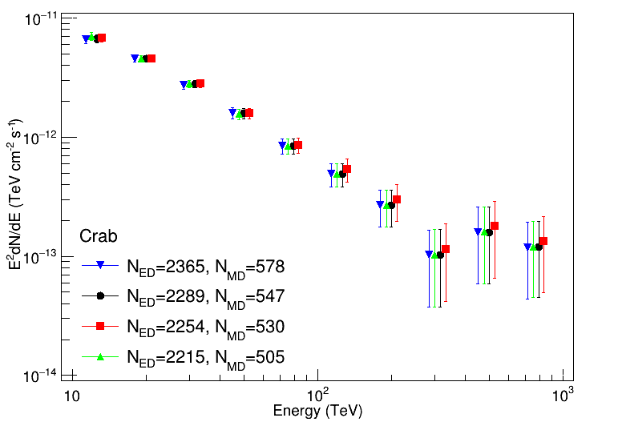
The SED using differenct detector configure in the MC
Flux variation within 2%，Spectral index within 0.02

Slide 42
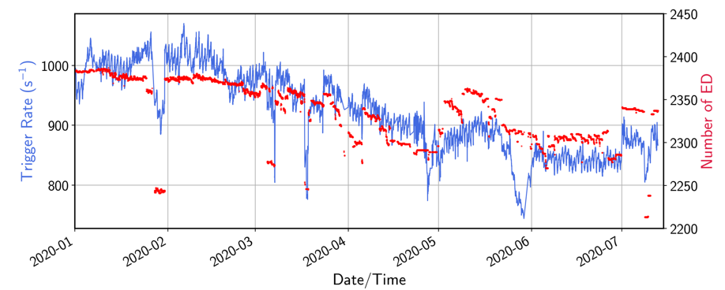
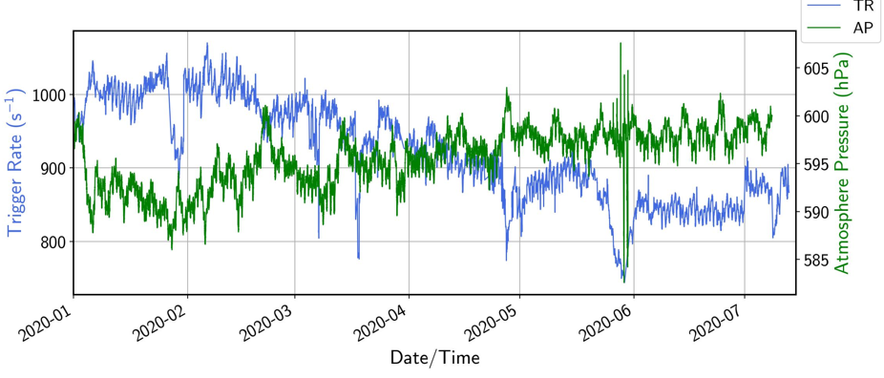
Systematic error: stability
Variation of enviroment(pressure) and detector numbers would cause the variation of event rate.
Influence on Crab SED: flux 7% and index 0.02.

Slide 43
Crab SED
KM2A crab is consistent with other experiments.

Slide 44
4. summary

Slide 45
Summary
1/2 KM2A started since 2019-12-27. 1.6x10¹⁰ events are collected.
According to Crab and Moonshadow, the pointing error is less than 0.1 degree, the PSF is general consistent with MC.
The measured Crab SED from 10-200TeV is consistent with other experiments, indicate the data is ready for gamma-ray astronomy.
Thanks for your attention！

