Slide 1
Study of WCDA reconstruction for events with core outside
报告人：郑应
单位：西南交通大学

Slide 2
outline
1.Introduction
2.methods
3.result
4.next

Slide 3
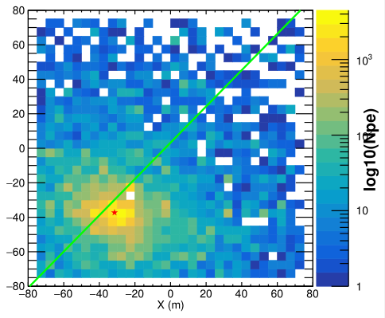
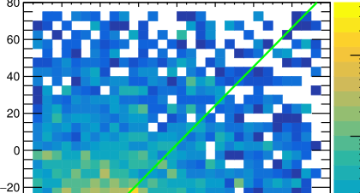
introduction
A small part of some shower fall within the WCDA,so that the reconstruction of core and direction untrue And not accurate using Center of gravity.
Data utilization is very low
if the core outside the poor ,It is difficult to find the core position accurately

Slide 4
rebuild direction
Taking into account the cone surface correction, the direction reconstruction will also depend on the core position, so the direction reproduction will also have a large deviation due to the core position deviation
ture direction
WCDA
ture core position
Reconstruction core position

Slide 5
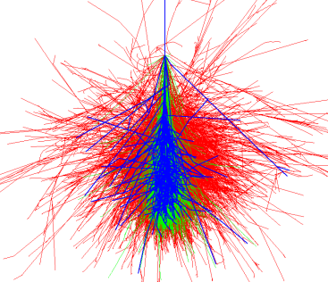
methods
Due to the cylindrical symmetry of the shower, the pe of WCDA must have cylindrical symmetry
Considering the direction of the shower, the energy on the WCDA array should be elliptical
Strictly above pe should follow the elliptical distribution, ignoring the influence of the zenith angle, it can be approximated that the distribution of pe is close to cylindrical symmetry

Slide 6
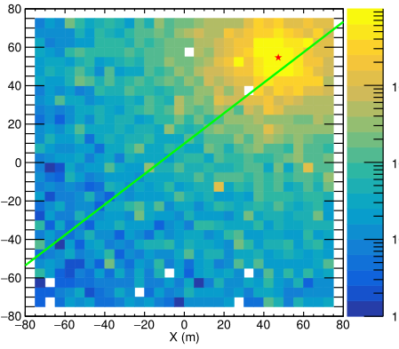
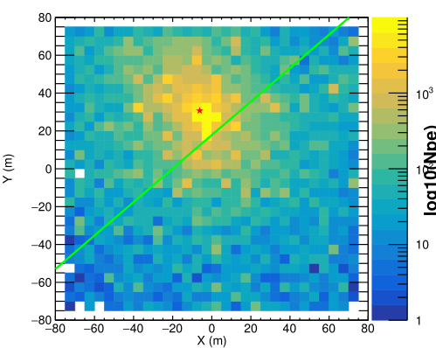
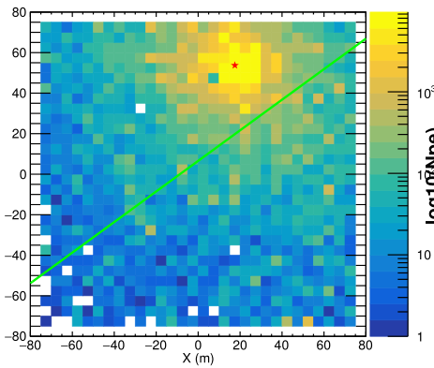
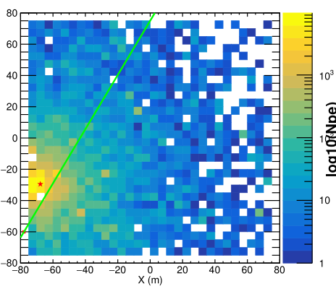
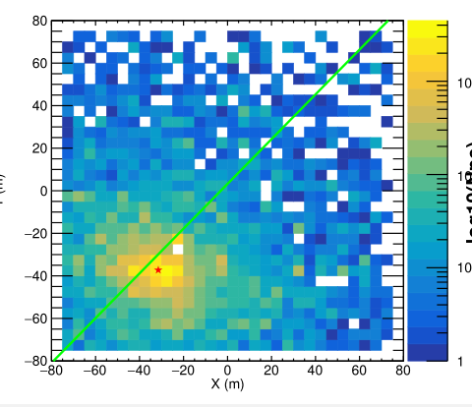
spherical symmetry of shower
500-1000TeV
300-500TeV
100-300TeV
50-100TeV
0-50TeV

Slide 7
∠γ
∠β

Slide 8
conclusion

Slide 9
Algorithm implementation
Group the pixels in WCDA according to the size of pe, for example, 0-100pe, 100-200pe……, and each group constitutes a band.
Fit each set of data with an elliptic equation, and find a core position according to the fitting result.
The core position obtained by reconstructing each pe range is processed by the center of gravity method to obtain the final core position
In fact, I plan to use a circle to fit first, and then use an ellipse to correct

Slide 10
result:low pe area
pe | number | x | y
0-100 | 236 | -6.5 | -145.7
100-200 | 123 | 796.3 | 1213.8
200-300 | 93 | 71.9 | 77.3
300-400 | 80 | 11.8 | 12.1
400-500 | 56 | 94.5 | 121.7
500-600 | 57 | 118.6 | 138.9
600-700 | 45 | 2723.8 | 17835.0
700-800 | 39 | 50.2 | 55.7
800-900 | 33 | 147.7 | 181.2
900-100 | 22 | 9.4 | 9.5

Slide 11
result:High pe area
pe | number | x | y
1000-2000 | 120 | 12.9 | 13.1
2000-3000 | 55 | 5.4 | 5.4
3000-4000 | 22 | 2.8 | 2.8
4000-5000 | 24 | 2.1 | 2.1
5000-10000 | 45 | 2.4 | 2.4
10000-20000 | 28 | 2.1 | 2.1
>20000 | 26 | 1.3 | 1.2

Slide 12
spont face fitting

Slide 14
Cone Correction of front face
Ri
夹角的正弦为α

Slide 15
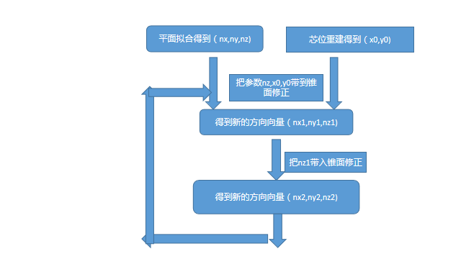
Cone correction iterative convergence

Slide 16
next program
Find out the pe value range suitable for core position reconstruction
Explore the weighting method to get the final core position
Optimize algorithms and improve accuracy through simulated data
An interesting inference

Slide 17
END
THANKS

