Slide 1
ENDA progress at YBJ
Maoyuan Liu
Tibet University
ENDA group
The First LHAASO Collaboration Meeting in 2020
Chengdu, China

Slide 2
outline
Targets at YBJ
Results at YBJ
Next steps

Slide 3
1. Targets at YBJ
Test specification of one cluster of ENDA
Test hybrid measurement of cosmic showers between ENDA and big array (YBJHA: ED+MD)

Slide 4
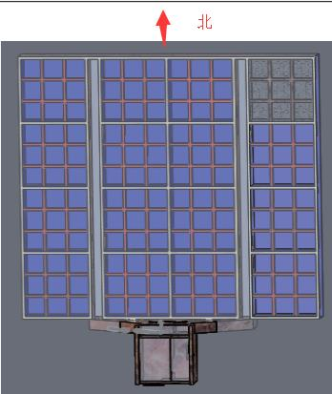
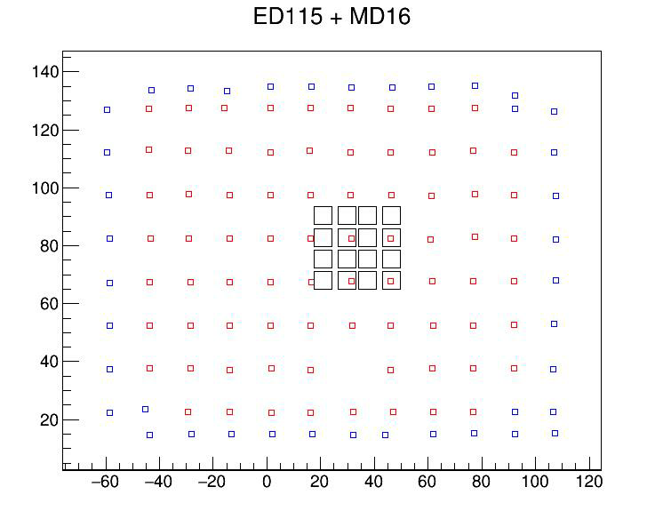
2. Results at YBJ
Dec. 2018 – July, 2019
ENDA-16 was on MD
ED
MD
YBJHA
EN-detector
13
14
15
16
ED
y(m)
9
10
11
12
MD
15m
ENDA
5
6
7
8
1
2
3
4
15m
x(m)

Slide 5
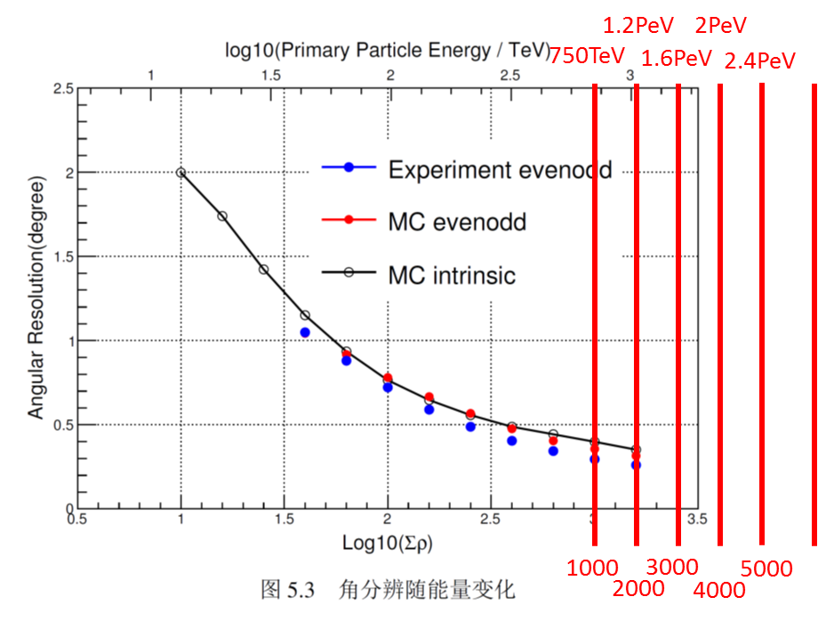
electrons - energy
Linear fitting y=a+bx
b=0.97±0.02
a=1099±43
Σρ_{e} ^{YBJHA} (m⁻²)
events
Σρ_{e}^{ENDA}(m⁻²)

Slide 6
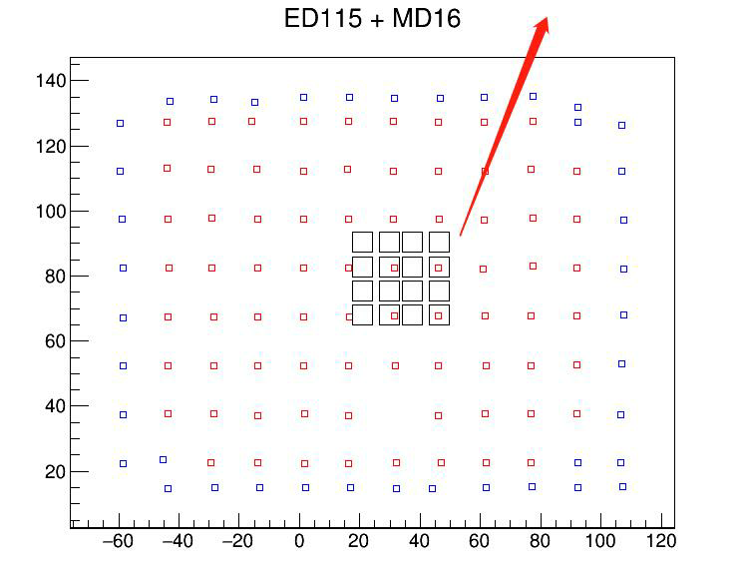
North
August 2019 – May, 2020
ENDA-16 was 50m away from MD
MD
y(m)
ED
ENDA
15m
15m
Water control room
x(m)

Slide 7
neutron distribution comparison
Period number | periods | status | Selected days | histogram line color
1 | 20190803-20190828 | Away from MD, detector distance 3m | 25 | red
2 | 20190911-20191006 | Away from MD, detector distance 5m | 25 | black
3 | 20191007-20191031 | Away from MD, detector distance 5m | 25 | Bright green
4 | 20191124-20191218 | Away from MD, detector distance 5m | 25 | yellow
5 | 20191219-20200112 | Away from MD, detector distance 5m | 25 | pink
6 | 20200113-20200206 | Away from MD, detector distance 5m | 25 | aqua
7 | 20200306-20200330 | Away from MD, detector distance 5m | 25 | green
8 | 20200401-20200504 | Away from MD, detector distance 5m | 25 | blue

Slide 8
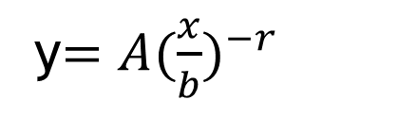
events
b：neutrons relative change
y$=A({\frac{x}{b})}^{−r}$
dry season
raining season
neutrons
Period number
Neutrons in rain season are 10% less than ones in dry season because more water in soil under the cluster.

Slide 9
Two typical events
Event #1
Event #2
Total electrons difference 1.4%，
But,
Total neutrons difference 55%
electrons
neutrons

Slide 10
hybrid measurement
Event #1
Event #2
ρ(m⁻²)
ρ(m⁻²)
(size)
(size)
(age)
e from ENDA
(age)
e from ENDA
e from YBJHA
e from YBJHA
neutrons from ENDA
neutrons from ENDA
muons from YBJHA (saturated)
muons from YBJHA (saturated)
r (m)
r (m)
#1 probably belongs to p-EAS, while #2 probably belongs to heavy-EAS with wider core and lower E0/nucleon and thus lower number of neutrons

Slide 11
NKG fitting
events
Data 11/09/2019-30/03/2020
Using direction from YBJHA
Using core from ENDA (weighted center method)
Core inside ENDA
age
events
events
13
14
15
16
9
10
11
12
5
6
7
8
1
2
3
4
Chi2/NDF
11
Lg(size)

Slide 12
size vs age
size vs neutrons
size
size
age
neutrons
Both age and neutrons are not simply linear-correlated to size. It infers that both age and neutrons may be sensitive to component separation. It is studied with MC simulation.

Slide 13
3. Next steps
We are building 1m³ SandCube under detectors:
To protect media (hadron target) from rain;
To improve knowledge about media because we can know more precisely about ingredient of sand than one of soil.
Make M-C simulation with GEANT4
hybrid detection between ENDA and YBJHA

Slide 14
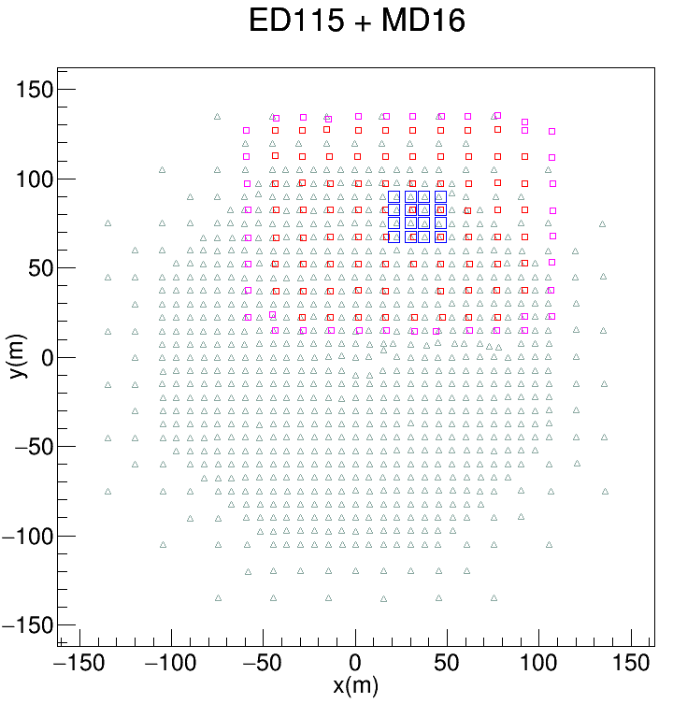
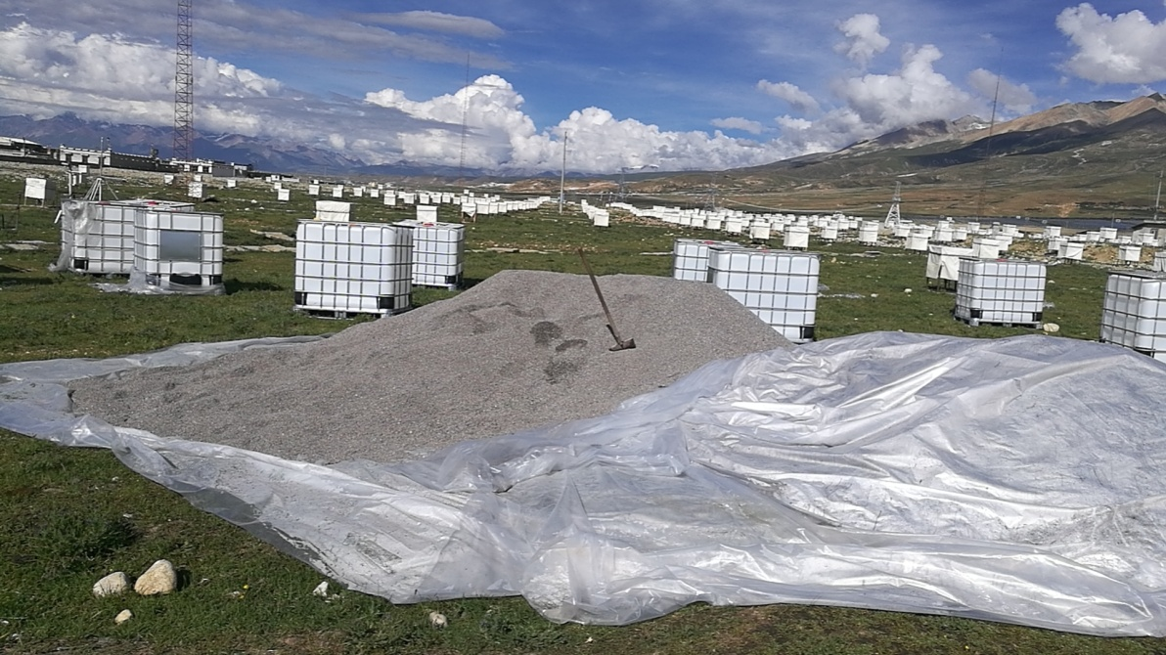
Asgamma+YBJ-HA
SandCube
ENDA
Because rain season has come, it is difficult to dry sand so that deployment is slow.
Easy for deployment
Further to MD so that MD is not saturated

Slide 15
Thank you！

