Slide 1
Search for SUSY
in CEPC
Huajie Cheng
Informal discussion
2020.04.30

Slide 2
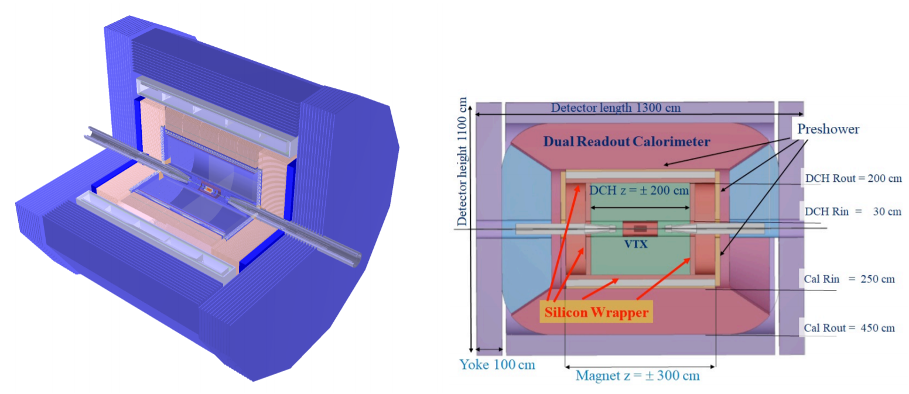
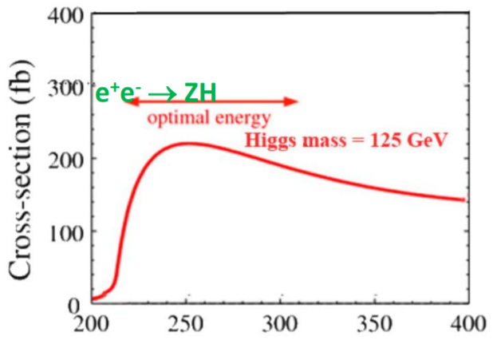
Introduction
A few words about CEPC (Circular Electron Positron Collider)
ECM=240 GeV as Higgs factory, 100 km, with 2 IPs (CDR I, II)
ILD-like detector: Vertex+Tracking, TPC, ECal, HCal, muon/yoke system
Full simulation performed using Mokka
Reconstruction using Marlin, Arbor algorithm (arXiv:1806.04879)
Very high accuracy and efficiency!
Also good chance to explore new physics!
Detector concepts
2

Slide 3
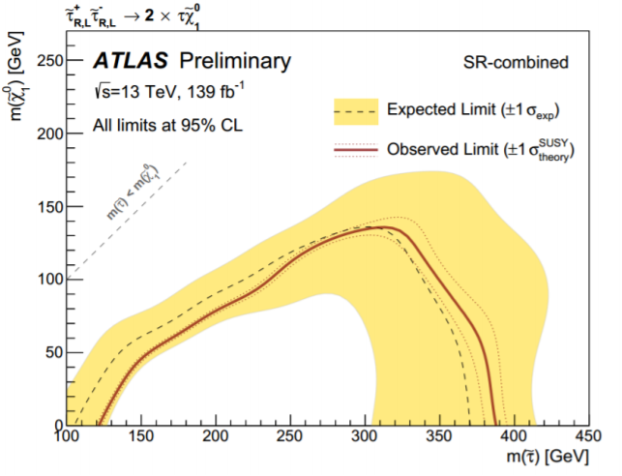
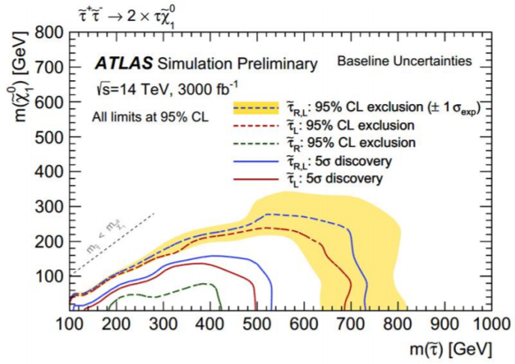
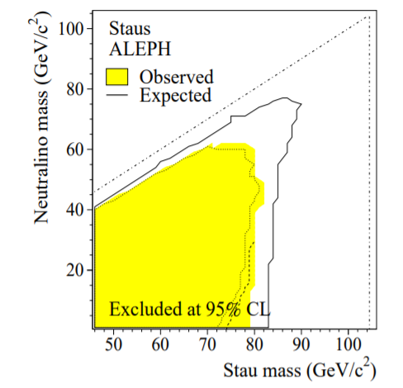
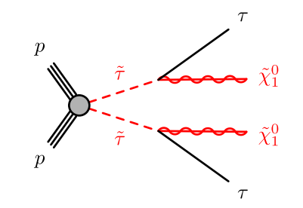
Motivation
Direct stau search at the LHC
Very attractive model, especially in the low mass and compressed spectrum
→ lead to a dark-matter relic density consistent with current cosmological observations
High beam energy allows to perform the search in very high mass parameter space
Huge amount of backgrounds, and low acceptance for (soft) tau + significant constrains from trigger → poor sensitivity especially in compressed region, even in LH-LHC
Possibilities at the CEPC
Very clean collision environment → less backgrounds!
High reconstruction efficiency/accuracy, no trigger requirement (excellent sensitivity in compressed region from LEP result)
Low energy, but feasible for low mass stau (m_{stau} < 120 GeV)
3

Slide 4
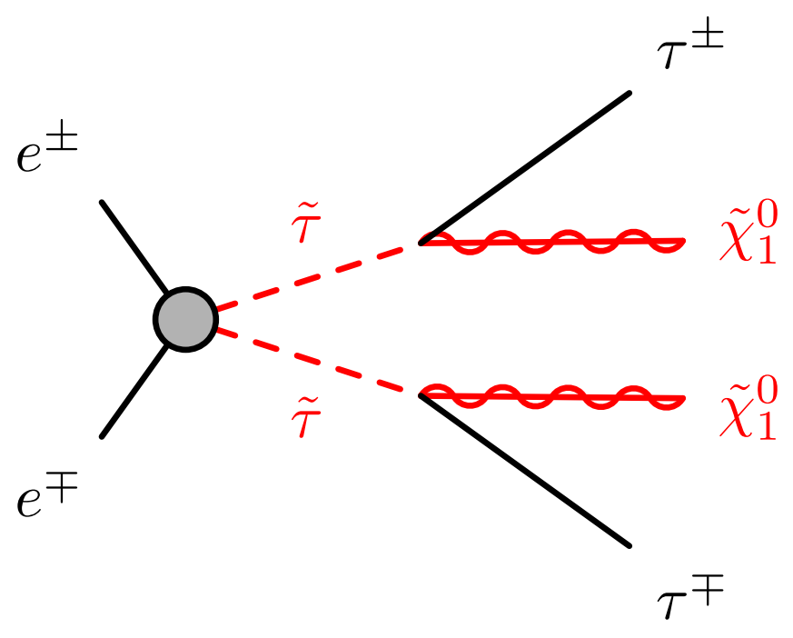
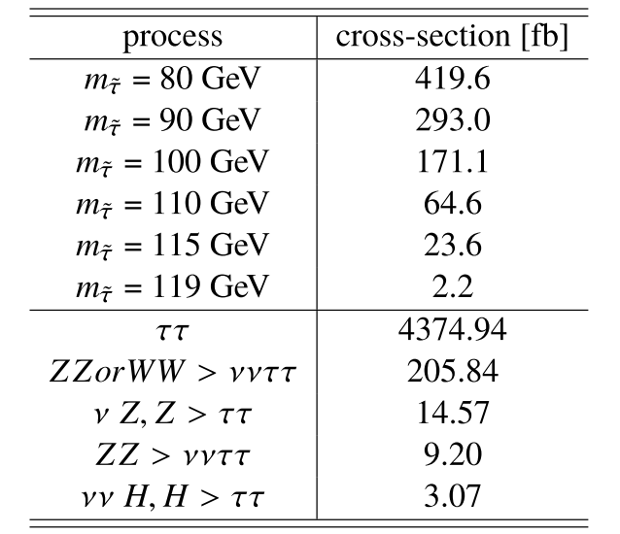
Analysis Strategy
Quick sensitivity study
Signal samples produced using MadGraph+Pythia8, currently only for stau mass 80, 90, 100, 110, 115, 119 GeV with LSP mass 1, 10, 20, … , (m_{stau}-10), (m_{stau}- 5), (m_{stau}- 2) GeV
Only the dominant backgrounds (same event topology) considered
Very simple analysis, aiming to derive the magnitude of sensitivity based on some common selections → can be further optimized in the future
Normalized to 5050 fb⁻¹
Use truth information
Kinematics (energy, mass):
all visible particles
Angular (dR, dPhi):
leading tracks with OS as tau1 and tau2
4

Slide 5
Validation of the angular between tracks vs truth taus
Compare the angular at different truth levels
Between two truth tau leptons
Between two leading tracks originating from tau leptons
Between two leading tracks with opposite sign → least truth info
Many OS tracks generated from the same parent → very close to each other
Observed in both signal and backgrounds
In general, promising to use the angular of the OS leading tracks
5

Slide 6
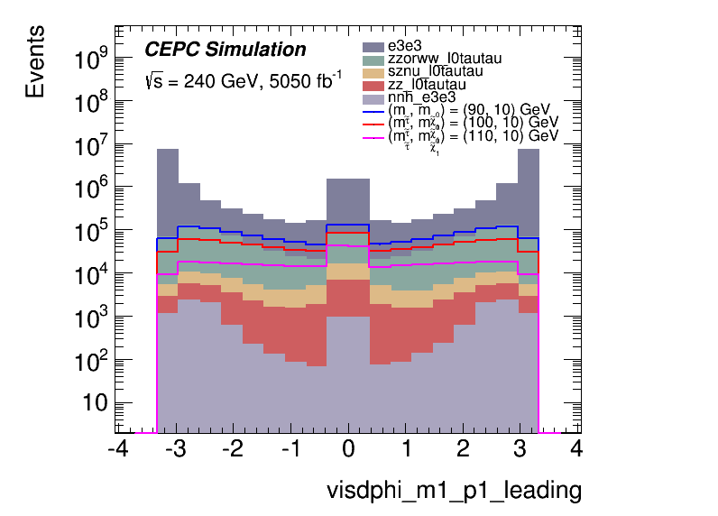
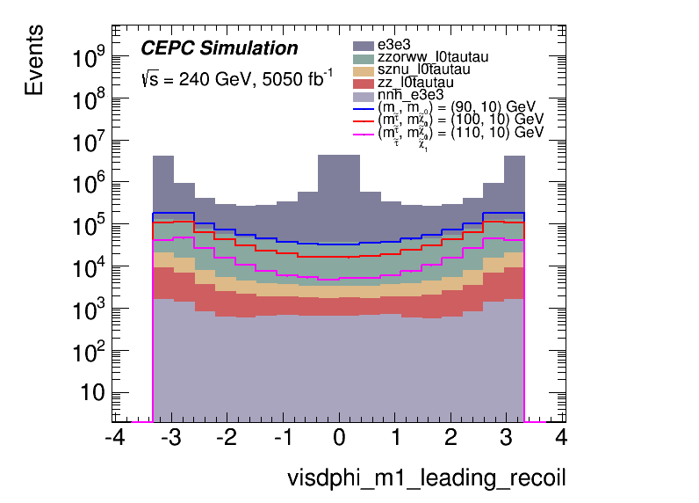
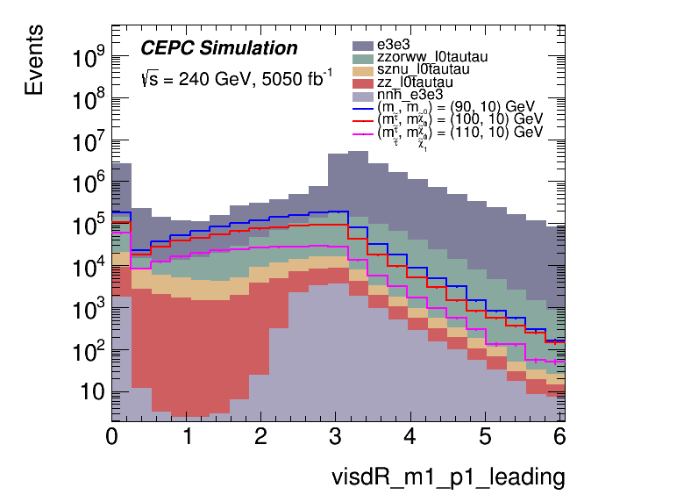
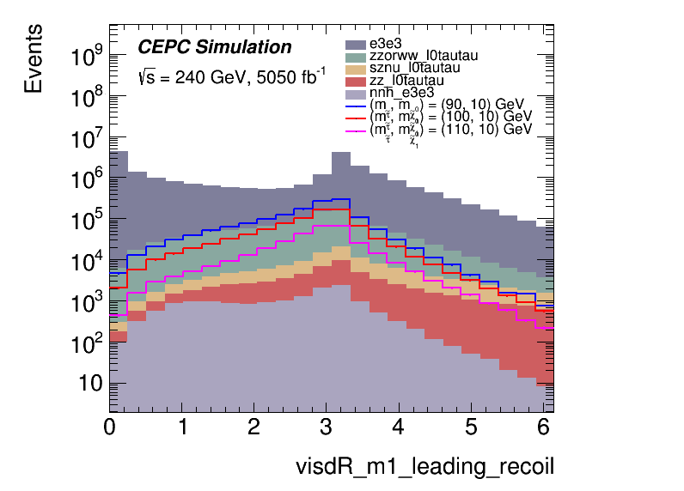
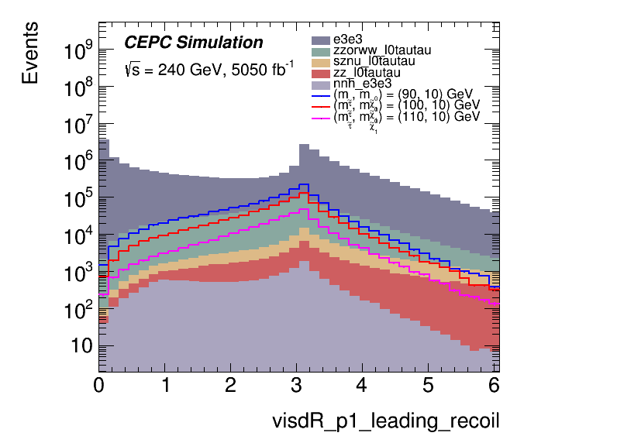
Kinematics distributions before any selections
$|Δφ\left(τ,recoil\right)|$ is a good choice!
$$Δφ(τ1,τ2)$$
$$Δφ(τ1,recoil)$$
$$Δφ(τ2,recoil)$$
$$ΔR(τ1,τ2)$$
$$ΔR(τ1,recoil)$$
$$ΔR(τ2,recoil)$$
6

Slide 7
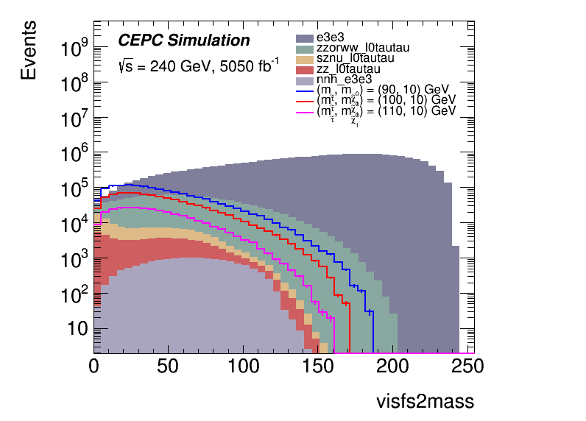
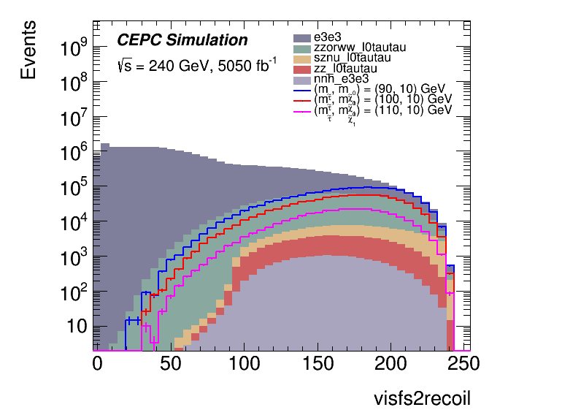
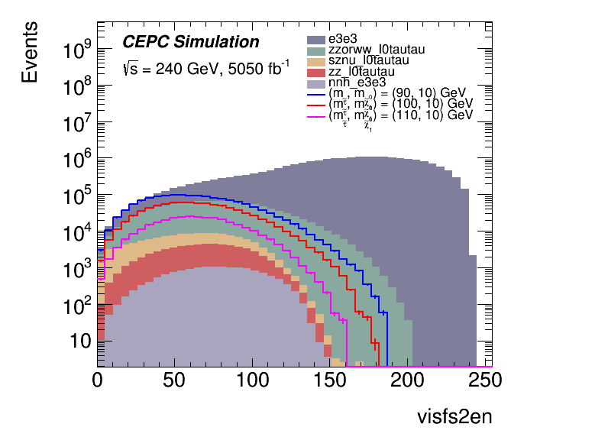
Kinematics distributions before any selections
Optimize using $\frac{S}{\sqrt{S+B+dB^{2}}}$ as the sensitivity (stat only)
|dPhi(tau, recoil)|, dR(tau, recoil), mtautau, mtautau_recoil
Similar distributions from different stau mass with similar dM, so we use signal with same stau mass and different dM for optimization
$$m_{ττ}$$
$$m_{ττ}^{recoil}$$
Total energy
7

Slide 8
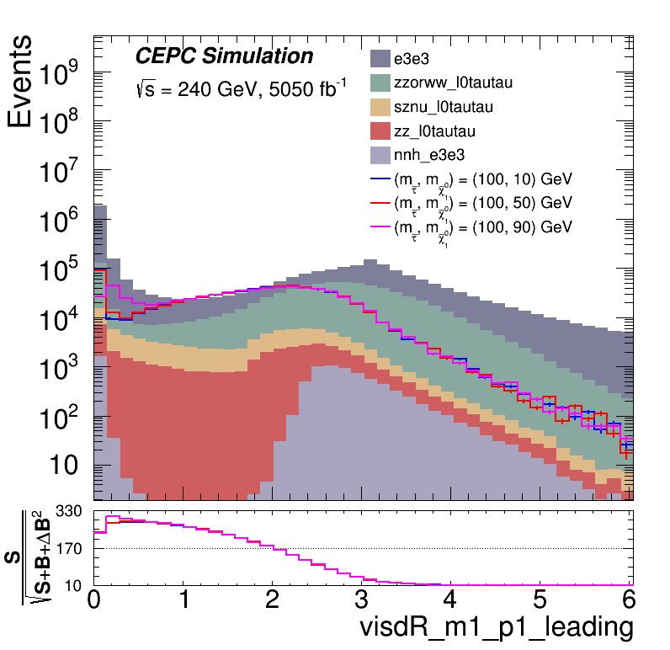
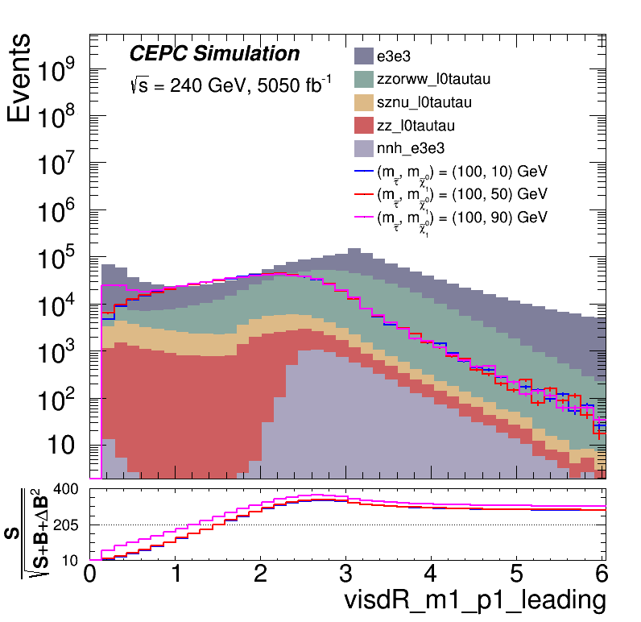
N-1 scan for the variables
Use $\frac{S}{\sqrt{S+B+dB^{2}}}$ as the sensitivity for reference (stat only)
$\left|Δφ\left(τ,recoil\right)\right|$ > 1 applied
0.2 < $\left|ΔR\left(τ, τ\right)\right|$ < 2.8 can improve the senstivitity
8

Slide 9
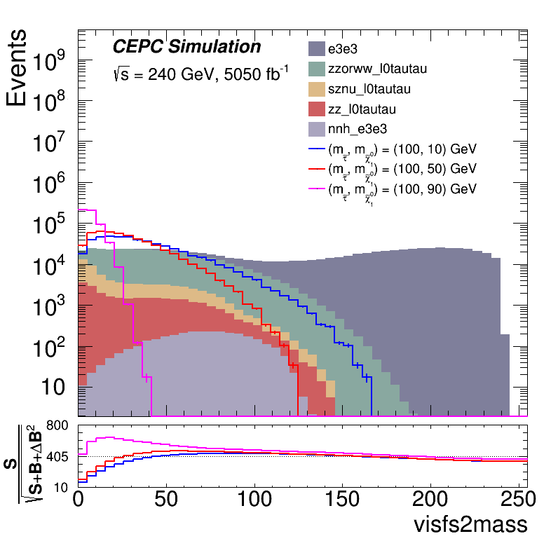
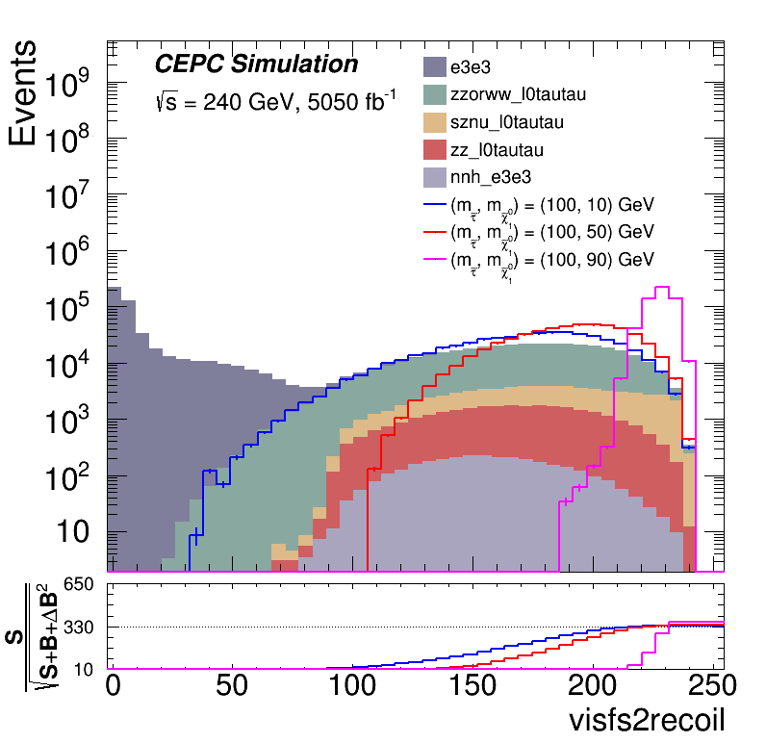
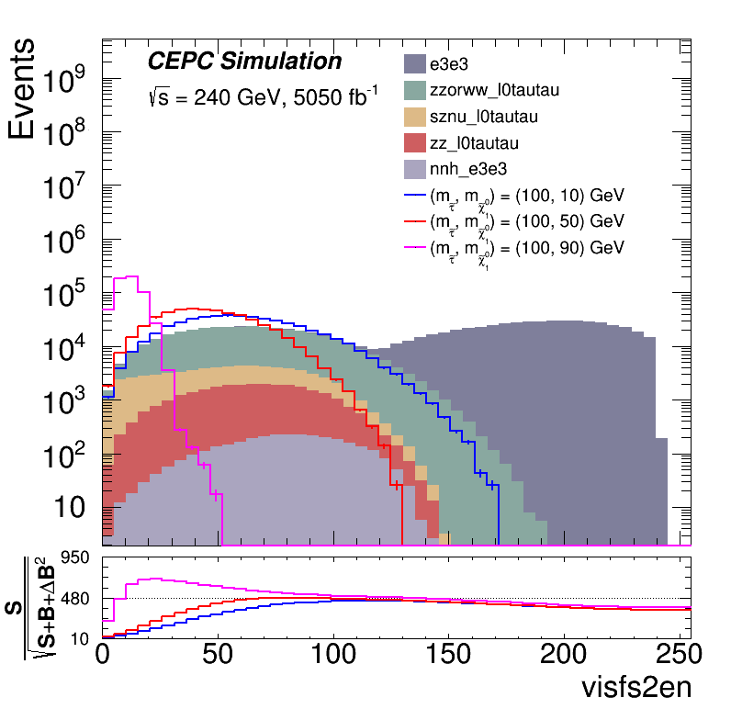
N-1 scan for the variables
Use $\frac{S}{\sqrt{S+B+dB^{2}}}$ as the sensitivity for reference (stat only)
$\left|Δφ\left(τ,recoil\right)\right|$ > 1 applied
0.2 < $\left|ΔR\left(τ, τ\right)\right|$ < 2.8 applied
The kinematics gives similar information, therefore only pick one:
$$m_{ττ}$$
$$m_{ττ}^{recoil}$$
Total energy
9

Slide 10
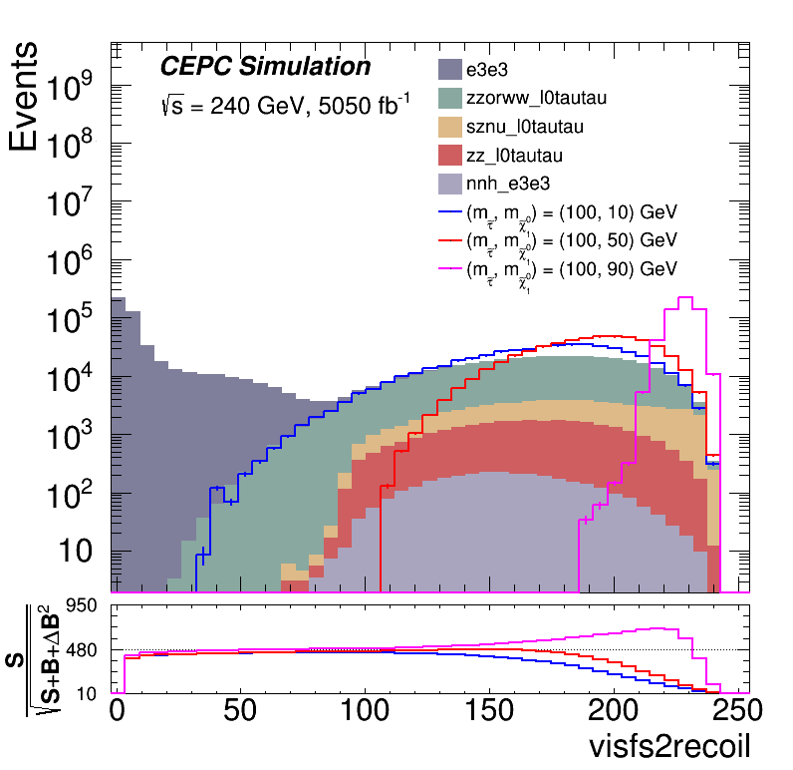
N-1 scan for the variables
Use $\frac{S}{\sqrt{S+B+dB^{2}}}$ as the sensitivity for reference (stat only)
$\left|Δφ\left(τ,recoil\right)\right|$ > 1 applied
0.2 < $\left|ΔR\left(τ, τ\right)\right|$ < 2.8 applied
The kinematics gives similar information, therefore only pick one
$$m_{ττ}$$
$$m_{ττ}^{recoil}$$
Total energy
10

Slide 11
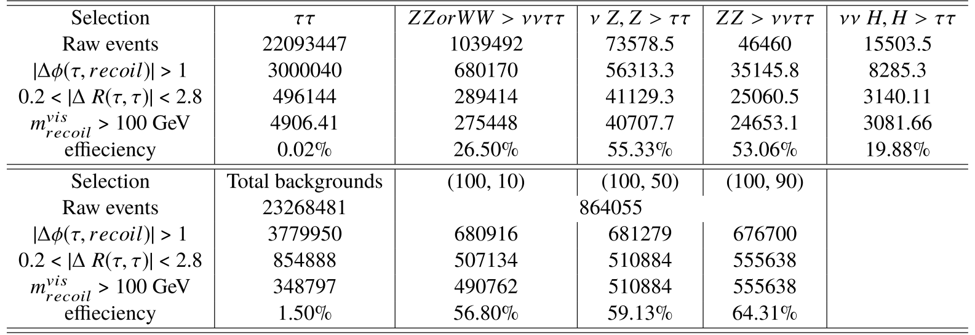
Cutflow
Raw events calculated by xSec * lumi (5050 fb⁻¹)
Dominant background is ww as expected (79%)
11

Slide 12
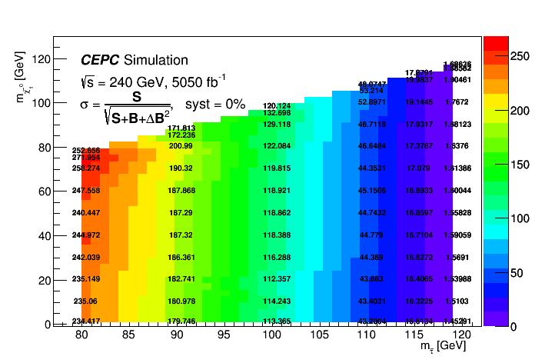
Sensitivity map (direct stau)
The map use $\frac{S}{\sqrt{S+B+dB^{2}}}$ as the sensitivity (stat + 0% syst)
12

Slide 13
Sensitivity map (direct stau)
The map use $\frac{S}{\sqrt{S+B+dB^{2}}}$ as the sensitivity (stat + 5% syst)
13

Slide 14
Sensitivity map (direct stau)
The map use $\frac{S}{\sqrt{S+B+dB^{2}}}$ as the sensitivity (stat + 10% syst)
14

Slide 15
Discussions
Highlight of this work:
A: first SUSY in CEPC
B: High eff in CEPC
C: Solid limits
D: Current detector is promising
Very important: choose one reference for the significance and replace the current one
Move to full simulation (w/ recon)
Q: probably should consider other backgrounds, like qq

Slide 16
Part II C1C1 decay via WW
16

Slide 17
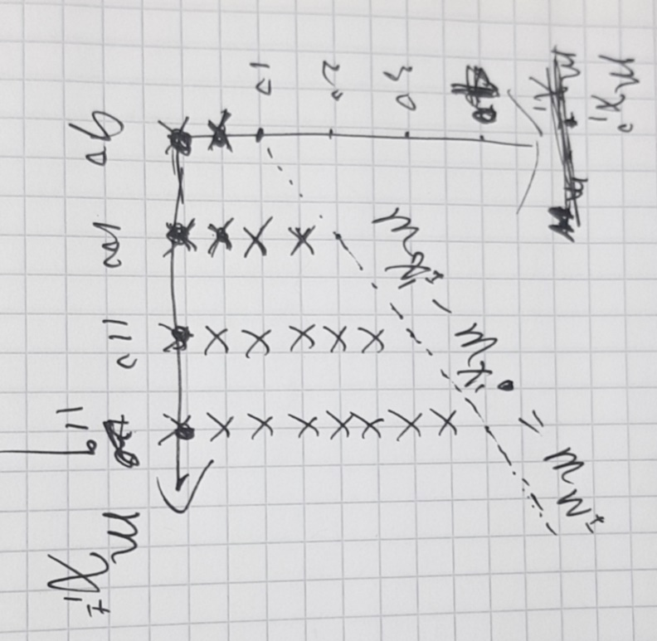
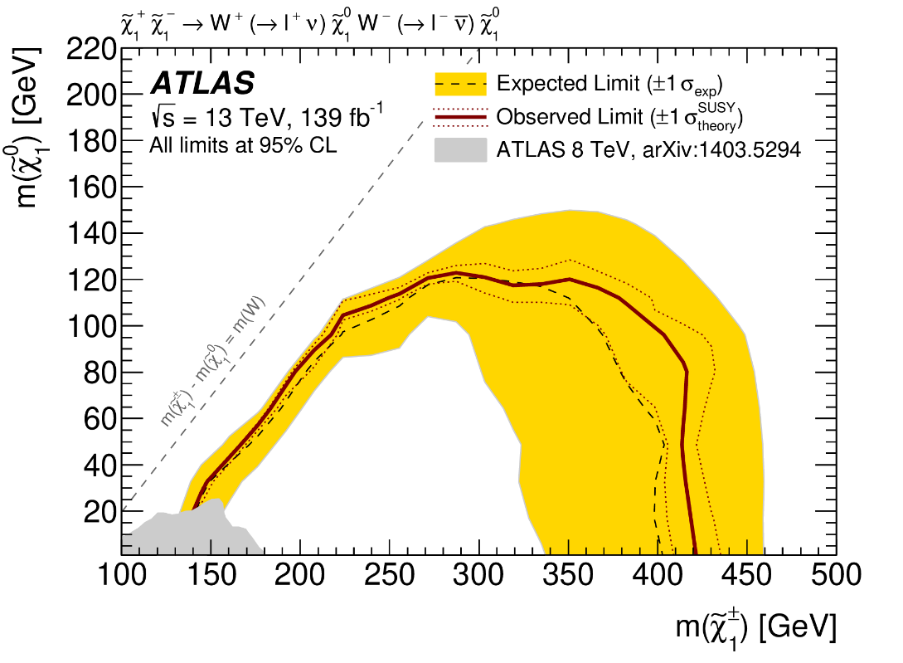
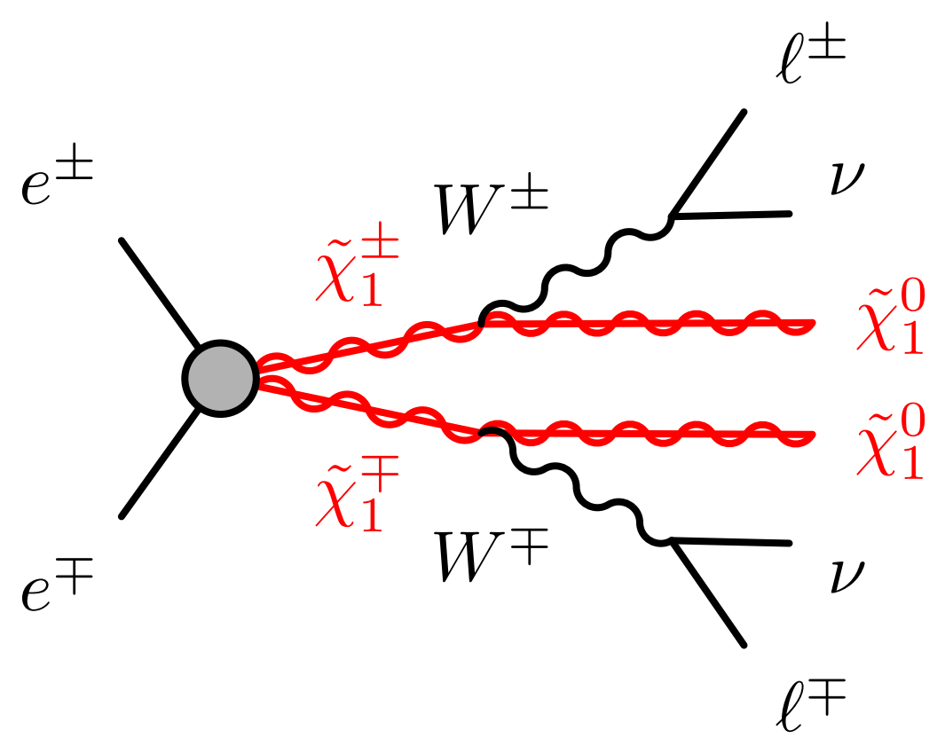
Analysis Strategy (C1C1)
C1C1 decay via WW
Signal samples produced using MadGraph+Pythia8
W forced leptonically decay
Generated 20 signal points, each with 500 k events
CEPC
17

Slide 18
Process | xSec [fb] | FiltEff | N Raw | effective Lumi [fb⁻¹] | N selected | Acceptance
(90, 1) | 4049 | 0.1024 | 500 k | 1205.9 | 76462 | 15.3%
(90, 5) |  |  |  |  | 79426 | 15.9%
(100, 1) | 3551 | 0.1024 | 500 k | 1375.1 | 79487 | 15.9%
(100, 5) |  |  |  |  | 78571 | 15.7%
(100, 10) |  |  |  |  | 81067 | 16.2%
(100, 15) |  |  |  |  | 78526 | 15.7%
(110, 1) | 2789 | 0.1024 | 500 k | 1750.7 | 72055 | 14.4%
(110, 5) |  |  |  |  | 72166 | 14.4%
(110, 10) |  |  |  |  | 75783 | 15.2%
(110, 15) |  |  |  |  | 77332 | 15.5%
(110, 20) |  |  |  |  | 79865 | 16.0%
(110, 25) |  |  |  |  | 79455 | 15.9%
(119, 1) | 927.7 | 0.1024 | 500 k | 5263.4 | 72730 | 14.5%
(119, 5) |  |  |  |  | 72666 | 14.5%
(119, 10) |  |  |  |  | 75399 | 15.1%
(119, 15) |  |  |  |  | 74328 | 14.9%
(119, 20) |  |  |  |  | 79075 | 15.8%
(119, 25) |  |  |  |  | 71898 | 14.4%
(119, 30) |  |  |  |  | 71601 | 14.3%
(119, 35) |  |  |  |  | 78271 | 15.7%
18

Slide 19
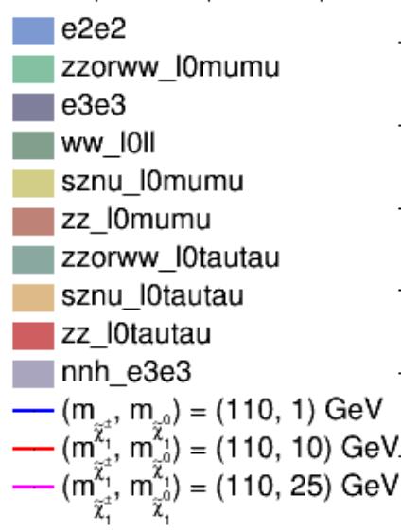
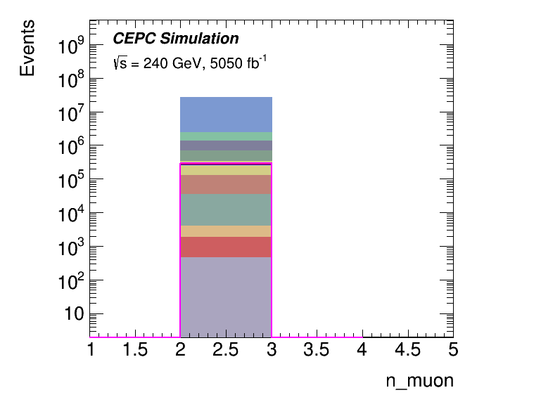
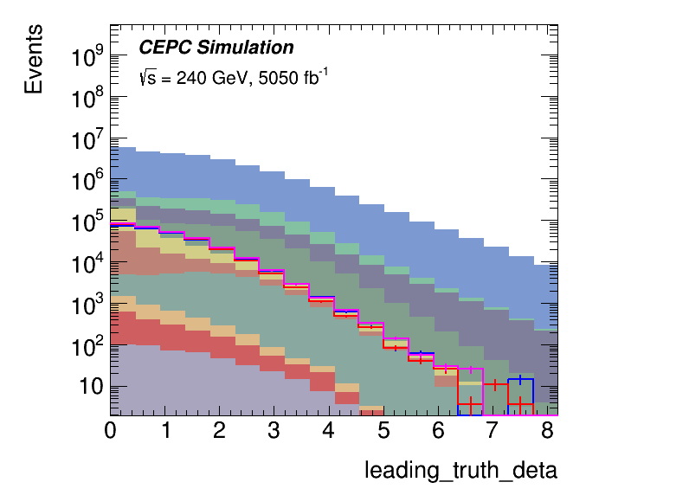
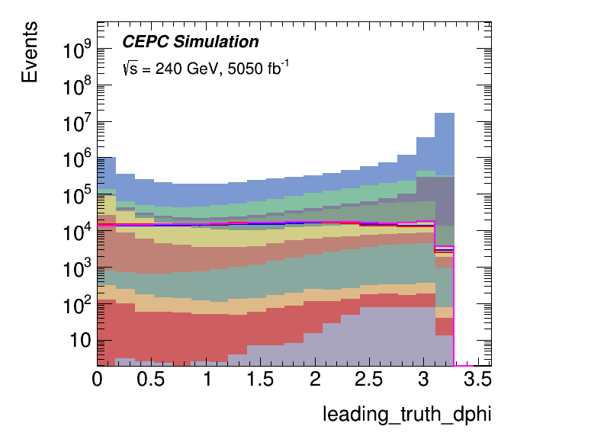
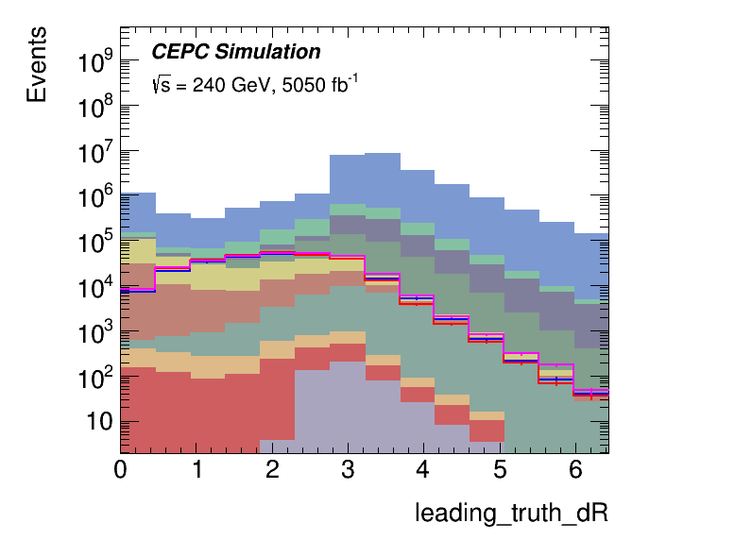
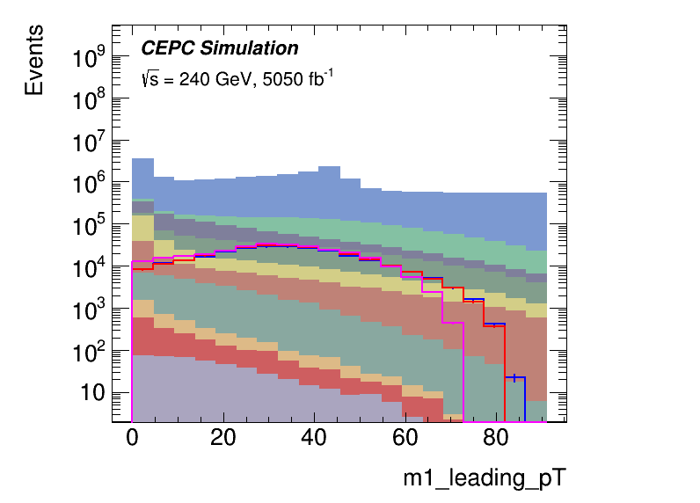
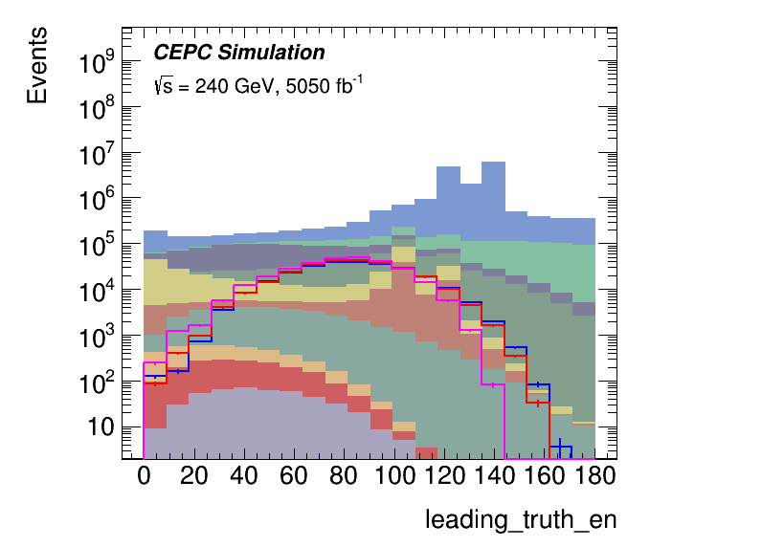
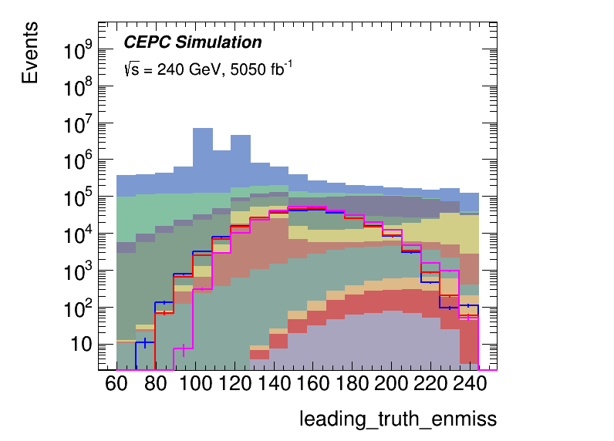
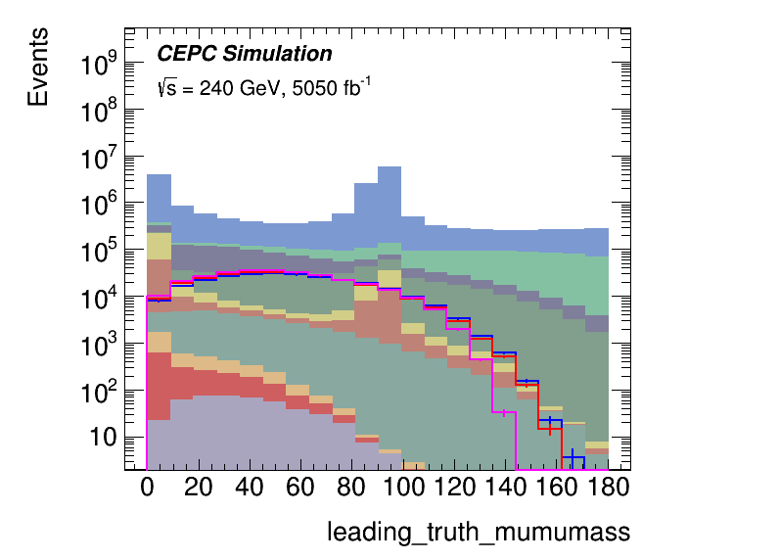
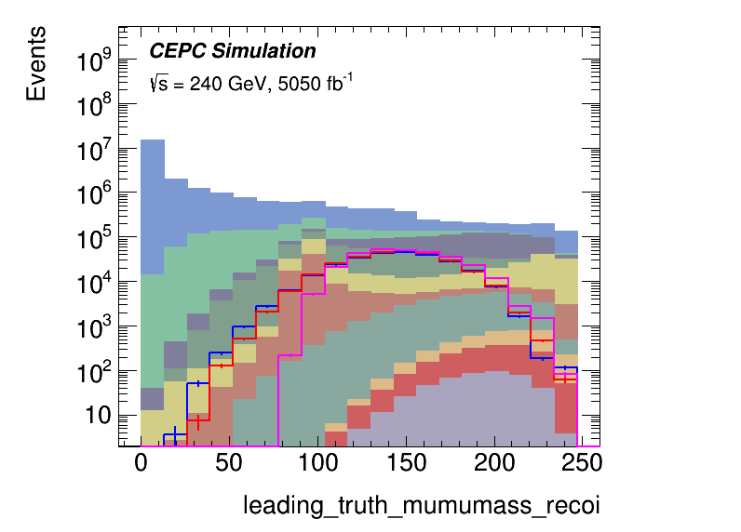
Distributions
Requiring for == 2 OS muons
Optimize using $\frac{S}{\sqrt{S+B+dB^{2}}}$ as the sensitivity
$$n_{μ}$$
$$Δη(μ,μ)$$
$$Δφ(μ,μ)$$
$$ΔR(μ,μ)$$
$$p_{T}^{μ^{−}}$$
Total energy
Missing energy
$$m_{μμ}$$
$$m_{μμ}^{recoil}$$
$$p_{T}^{μ^{+}}$$
19

Slide 20
Cutflow (C1C1)
Only consider the mu mu FS for signal processes
Process | N Raw | = 2 OS mu | Z-veto (81,101) | dR<3 && dR>0.5 | m^{recoil} > 100 | en > 40 | pT > 10 | efficiency
(90, 5) | 316166.7 | 331075 | 284838 | 214387 | 162484 | 152074 | 135750 +- 368.443 | 42.94%
(100, 5) | 277280.3 | 286984 | 247509 | 200322 | 177248 | 168166 | 155294 +- 394.073 | 56.01%
(110, 5) | 217779.4 | 206863 | 180617 | 150591 | 140726 | 135329 | 125594 +- 354.392 | 57.67%
(119, 5) | 72439.57 | 69209.4 | 62175.6 | 50940.4 | 49202.8 | 47026.8 | 43242.7 +- 207.949 | 59.69%
MC Total | 51734574 | 2.75344e+07 | 1.91865e+07 | 2.61429e+06 | 866366 | 610888 | 403156 +- 634.946 | 0.78%
e2e2 | 25086279 | 2.50945e+07 | 1.70146e+07 | 1.82883e+06 | 383584 | 260287 | 131919 +- 363.206 | 0.53%
e3e3 | 22093447 | 665129 | 625739 | 88948.3 | 88313.2 | 43161.9 | 24636.4 +- 156.96 | 0.11%
nnh_e3e3 | 15503.5 | 461.388 | 448.675 | 236.12 | 235.655 | 137.052 | 119.688 +- 10.9402 | 0.77%
sznu_l0mumu | 218816.5 | 218814 | 189241 | 99342.2 | 79786 | 26168.5 | 8726.16 +- 93.4139 | 3.99%
sznu_l0tautau | 73578.5 | 2187.66 | 2184.7 | 1543.14 | 1543.14 | 541.545 | 357.079 +- 18.8965 | 0.49%
ww_l0ll | 1984448 | 343781 | 290630 | 134679 | 112985 | 101132 | 80035.6 +- 282.906 | 4.03%
zz_l0mumu | 91758.5 | 91755.8 | 70025.3 | 34445.1 | 16258.4 | 10946.9 | 4259.44 +- 65.2644 | 4.64%
zz_l0tautau | 46460 | 1439.62 | 1436.99 | 992.735 | 992.209 | 440.572 | 282.661 +- 16.8125 | 0.61%
zzorww_l0mumu | 1084791 | 1.08479e+06 | 963011 | 411203 | 168689 | 160395 | 146624 +- 382.915 | 13.52%
zzorww_l0tautau | 1039492 | 31553.2 | 29182.7 | 14073.6 | 13978.6 | 7677.42 | 6196.86 +- 78.7202 | 0.60%
20

Slide 21
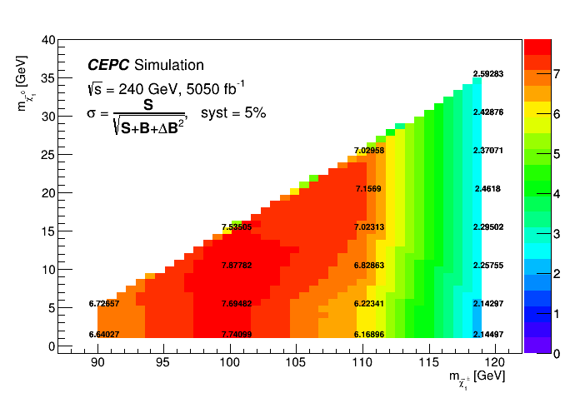
Sensitivity map (C1C1)
The map use $\frac{S}{\sqrt{S+B+dB^{2}}}$ as the sensitivity (stat + 5% or 10% syst)
21

Slide 22
Summary
A simple sensitivity check for direct stau and C1C1 productions in CEPC has been performed
With dominant backgrounds considered and quick cut-based optimization, very promising sensitivity reached
22

Slide 24
24

Slide 25
Analysis Strategy
25

Slide 26
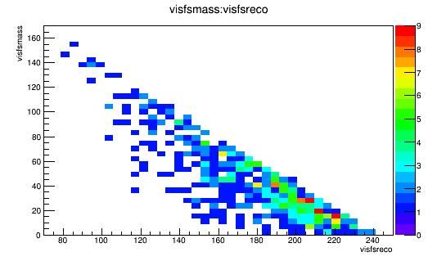
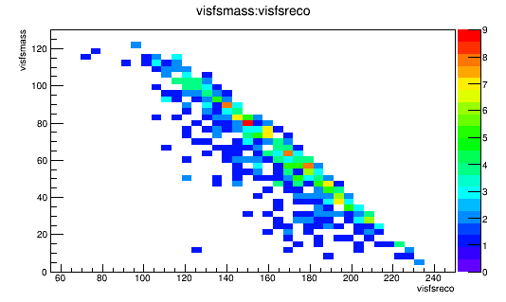
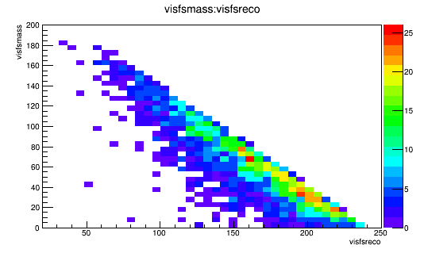
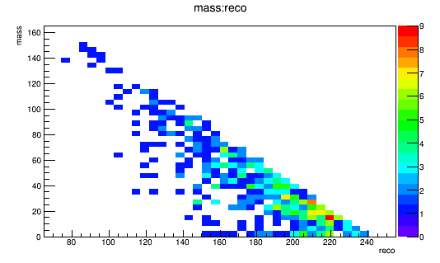
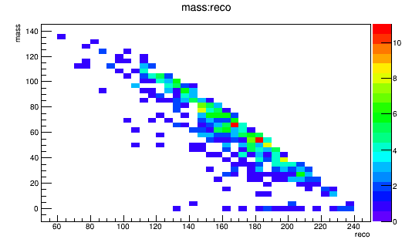
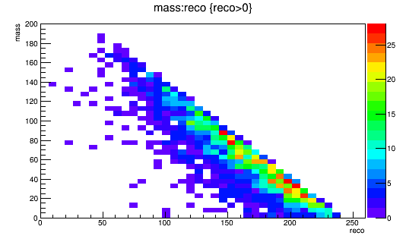
Truth vs Recon
The invariant mass/recoil mass (and other) distributions look similar between truth (top) and recon (bottom)
all stable and visible particles are included in truth
Signal (80, 30)
vvH->tautau
zzorww_l0tautau
26

