Slide 1
CEPC Z-pole polarization
Zhe Duan
On behalf of CEPC Polarization Working Group
2020. 08. 21

Slide 2
Outline
Motivation and wish list
Key questions and where we are
Project progress and next steps
Summary

Slide 3
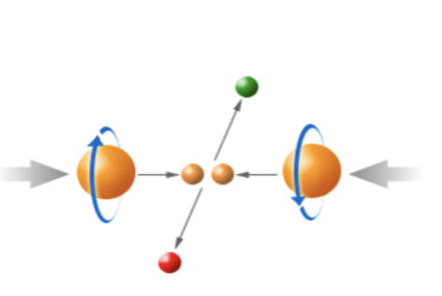
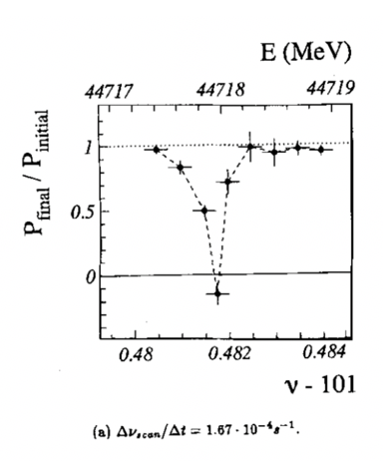
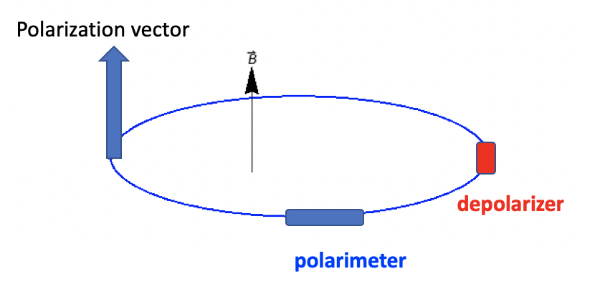
Motivation of CEPC Z-pole polarized beam program
Vertically polarized beams in the arc
  Beam energy calibration via the resonant depolarization technique
  Essential for precision measurements of Z and W properties
  At least 5% ~ 10% vertical polarization, for both e+ and e- beams
Longitudinally polarized beams at IPs
  Beneficial to colliding beam physics programs at Z, W and Higgs
  Figure of merit: Luminosity * f( P_{e+}, P_{e-} )
  ~50% or more longitudinal polarization is desired, for one beam, or both beams
L. Arnaudon, et al., Z. Phys. C 66, 45-62 (1995).
Final deliverable: a detailed design report of polarized beam operation @ Z-pole

Slide 4
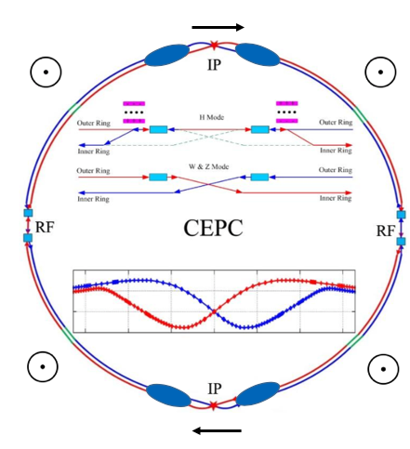
Wish list and key questions
Wish list
A small fraction of non-colliding bunches with at least 5% vertical polarization in the arc, depolarize one-by-one to carry out resonant depolarization
All colliding bunches have > 50% time-averaged longitudinal polarization at IPs
Luminosity not significantly affected
Beam lifetime is sufficient long so that top-up injection is feasible
Spin rotators
Key questions
How to polarize the beams?
How to adjust the polarization direction?
How to reach a high luminosity, a high polarization and a reasonable beam lifetime?
depolarizer
polarimeter

Slide 5
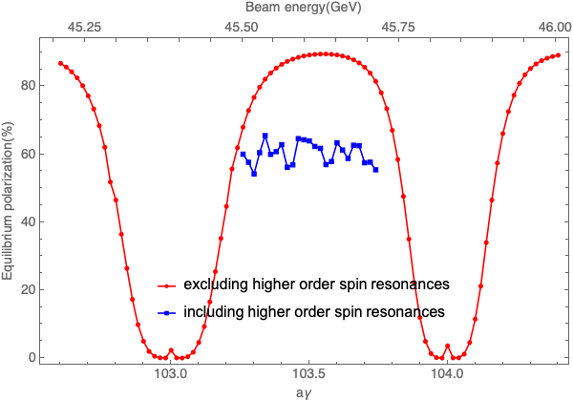
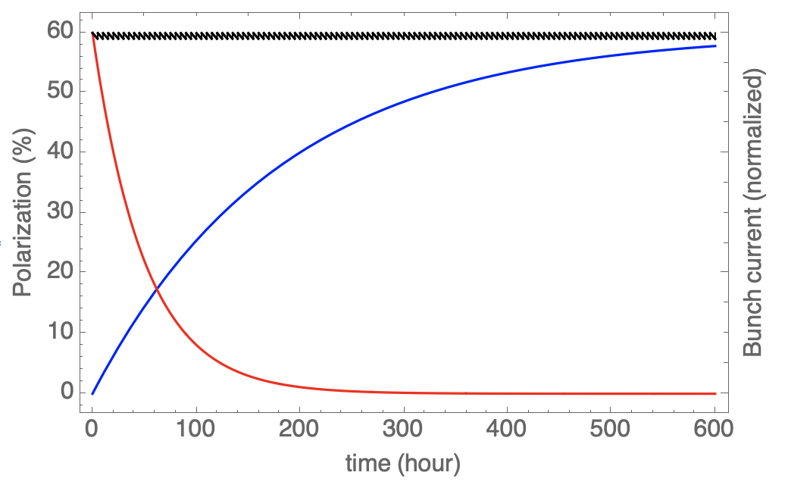
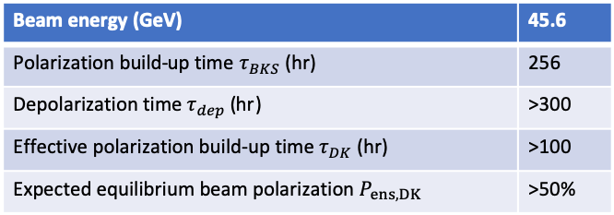
How to polarize the e+/e- beam?
Self-polarization
Beam energy (GeV) | 45.6
Polarization build-up time $τ_{BKS}$ (hr) | 256
Depolarization time $τ_{dep}$ (hr) | >300
Effective polarization build-up time $τ_{DK}$ (hr) | >100
Expected equilibrium beam polarization $P_{ens,DK}$ | >50%
Too long to accumulate sufficient polarization
Simulated polarization for a typical imperfect lattice seed
Evolution of beam polarization at 45.6 GeV (aγ = 103.5)
for this specified seed
Colliding, topuped bunch current
polarization
Non-colliding, decaying bunch current

Slide 6
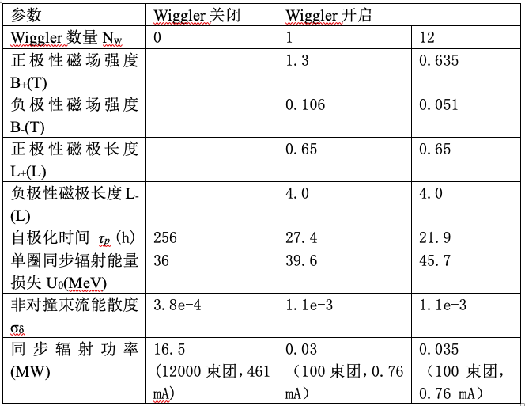
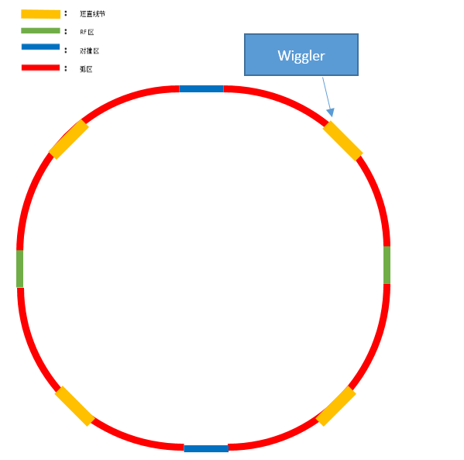
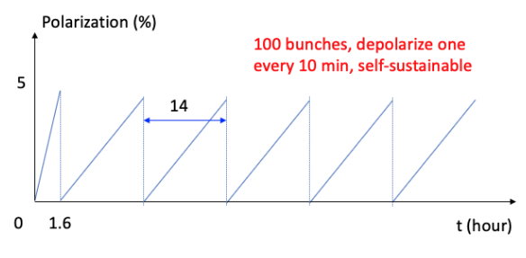
How to polarize the e+/e- beam?
Self-polarization: for resonant depolarization
Employ asymmetric wigglers to boost the polarization build-up, down to ~ 20 hr
These wigglers cost more power, increase energy spread
Therefore, they are turned-on initially only to set up polarization for ~100 non-colliding bunches, minimal influence on colliding bunches and luminosity

Slide 7


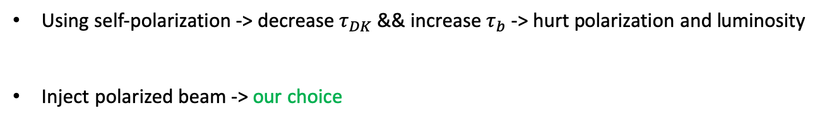
How to polarize the e+/e- beam?
Self-polarization vs injected beam polarization: for colliding beam experiments
Top-up injection -> competition of polarization & decay/inject
$$P_{avg}=P_{ens,DK}\frac{1}{{1+τ}_{DK}/τ_{b}}+P_{0}\frac{1}{{1+τ}_{b}/τ_{DK}}$$
$τ_{DK}$ > 100 hr >> $τ_{b}$= 2~3 hr
Using self-polarization -> decrease $τ_{DK}$ && increase $τ_{b}$ -> hurt polarization and luminosity
Inject polarized beam -> our choice

Slide 8
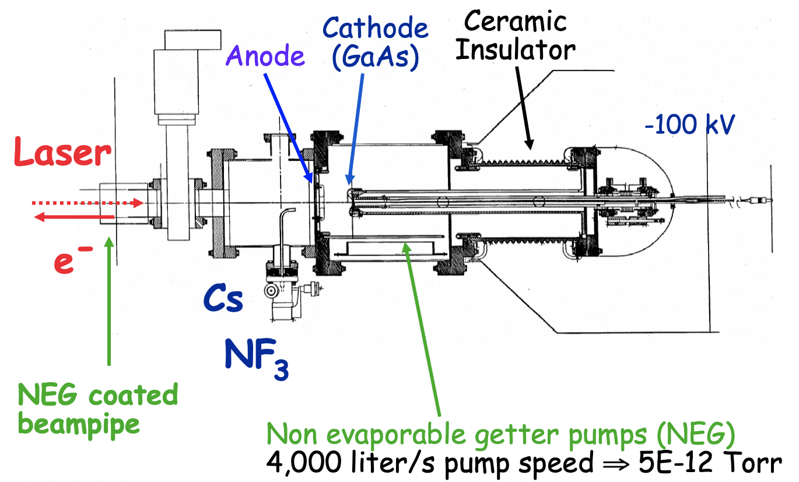
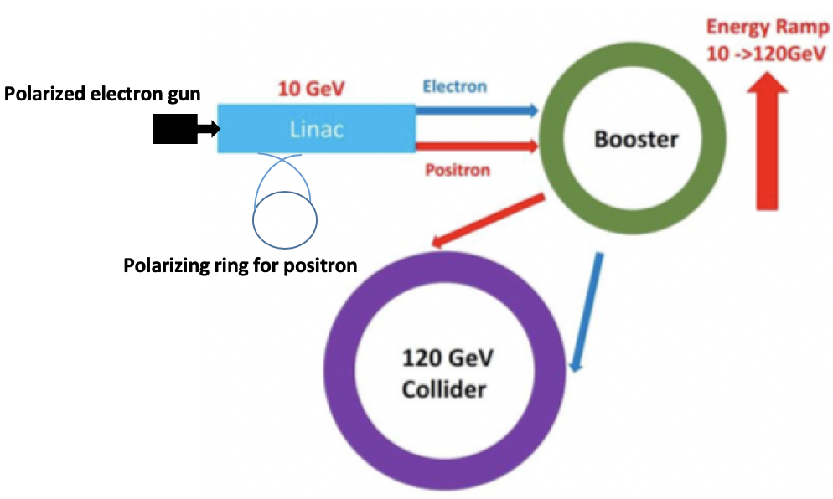
How to polarize the e+/e- beam?
Injected beam polarization, source?
Polarized e- source capable to provide ~90% polarization is quite matured
Polarized e+ sources suffer from low e+/e- conversion rate
We proposed to replace the e+ damping ring w/ a e+ polarizing ring to address this challenge
Courtesy of J. Grames, Jlab

Slide 9
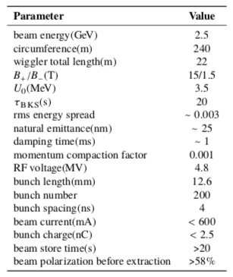
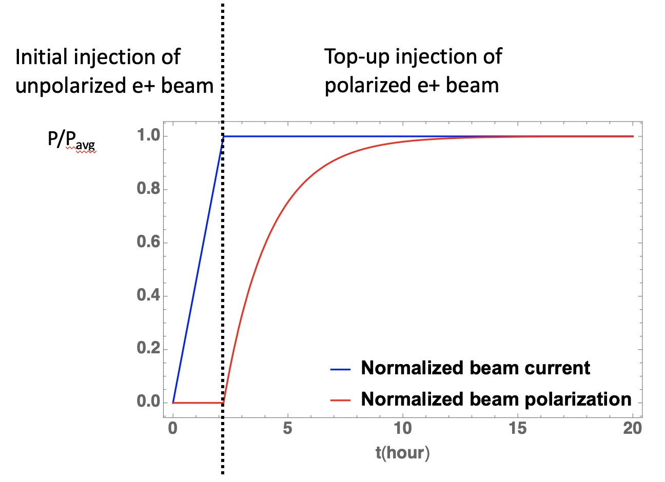
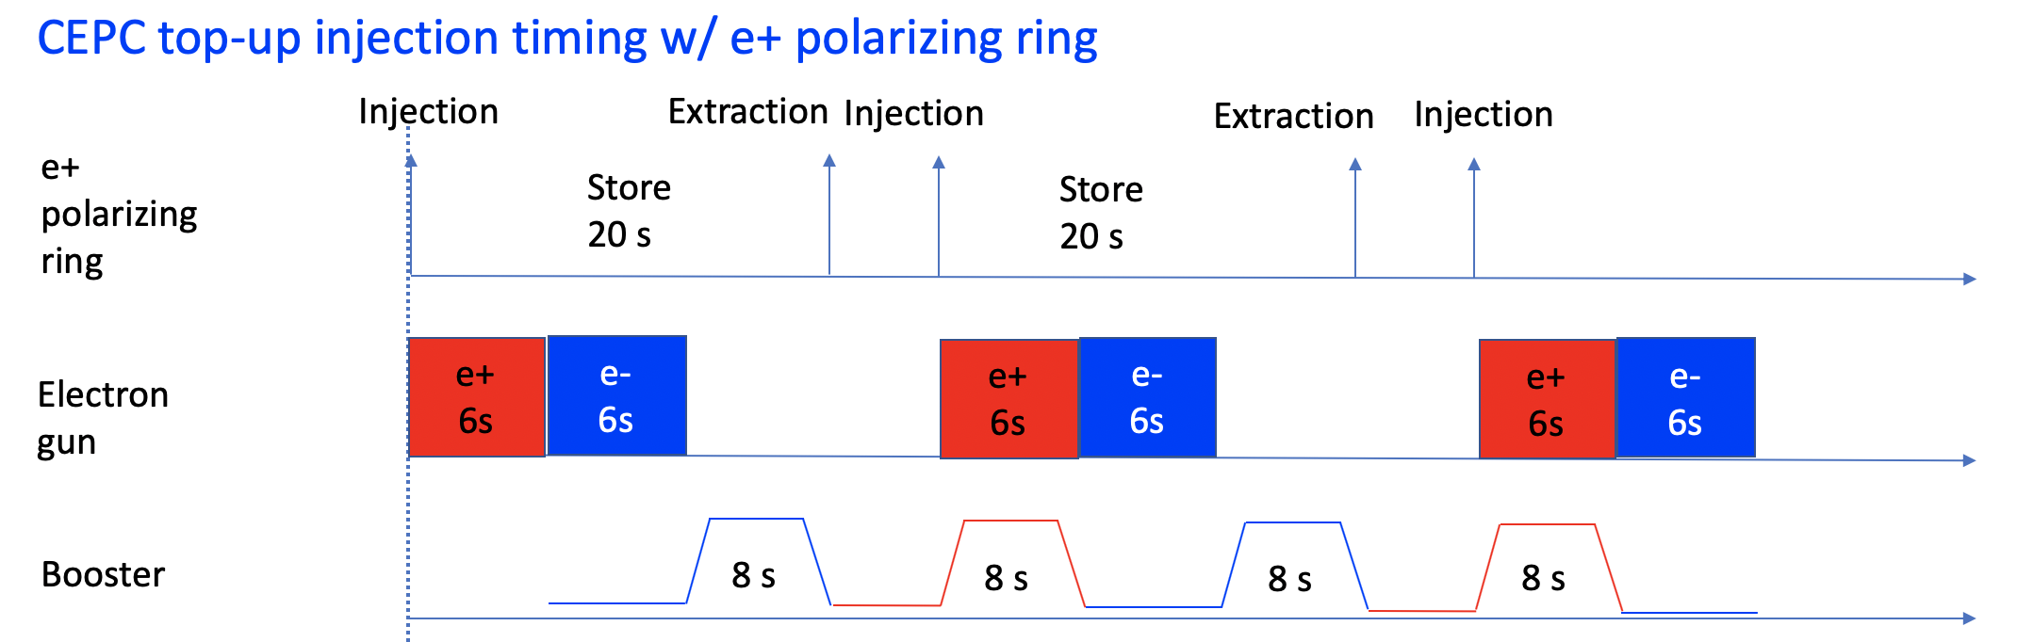
How to polarize the e+/e- beam?
Employ superconducting asymmetric wigglers to boost the polarization build-up down to ~ 20 seconds.
Consistent w/ top-up injection timing
Under way: lattice design & collective effects

Slide 10
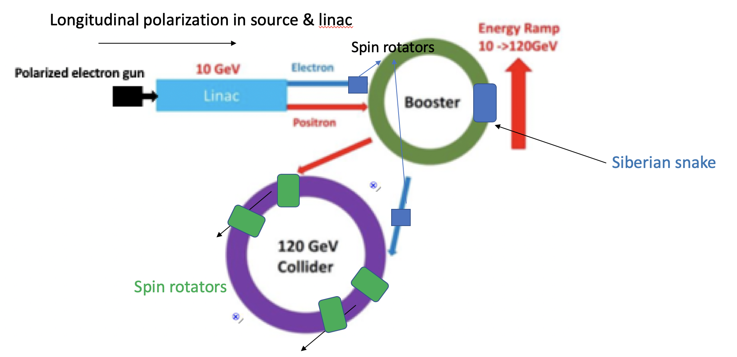
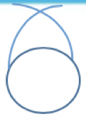
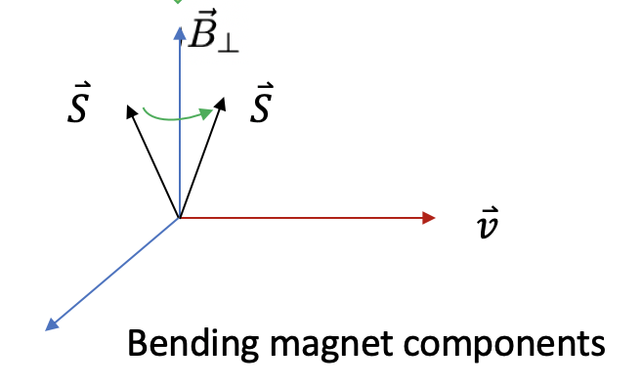
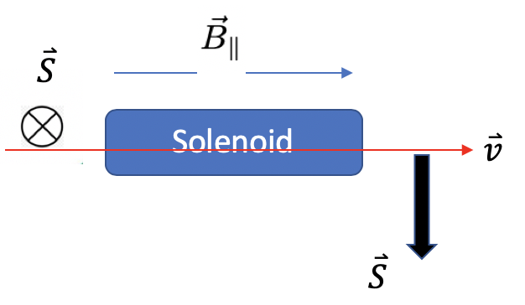
How to adjust the polarization direction?
e+ polarizing ring

Slide 11
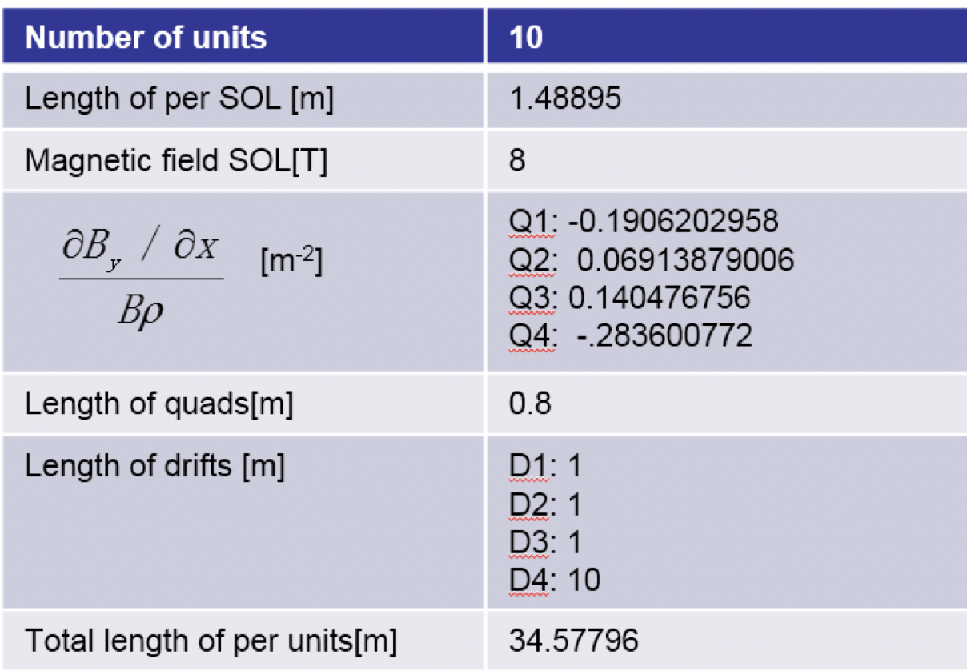
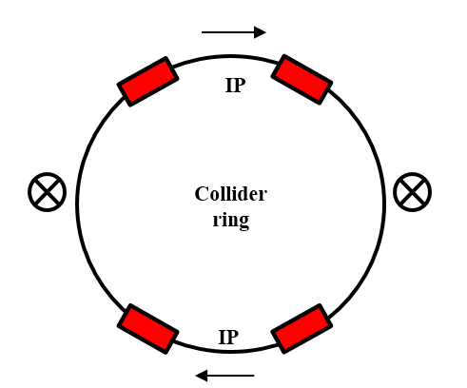
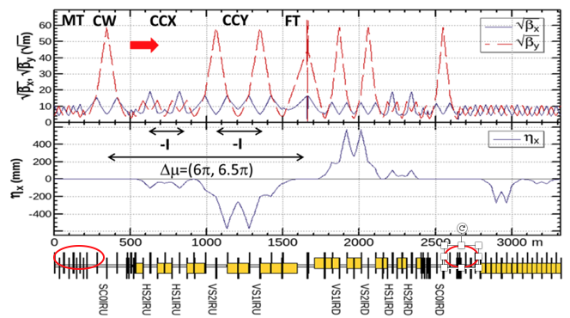
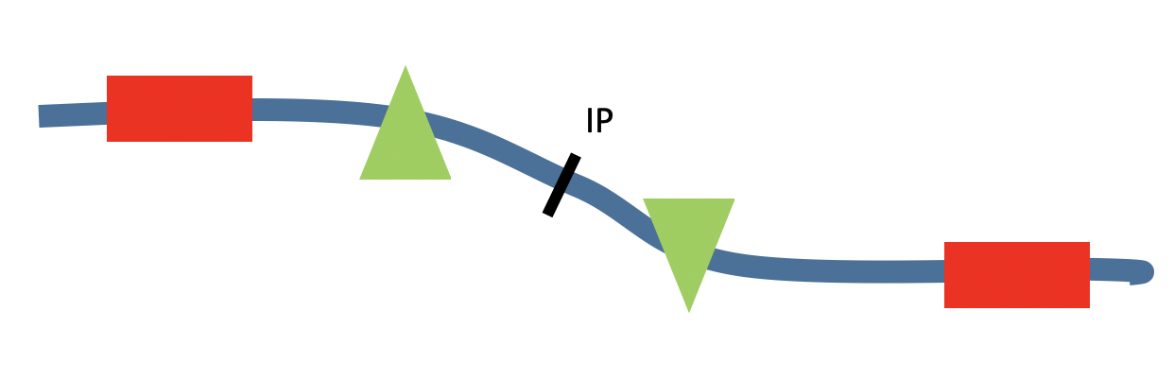
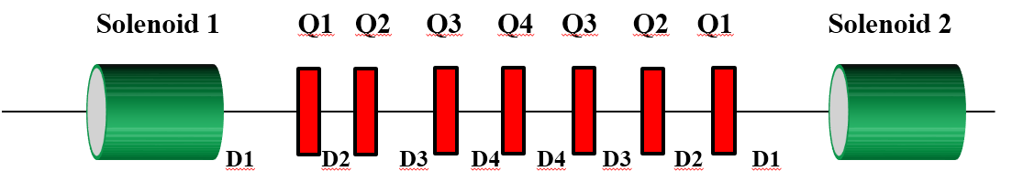
How to adjust the polarization direction?
Spin rotators in the collider rings (by Xia W. H.)
  Solenoids (90 degree) + bending magnets (90 degree)
  First attempt to implement into the lattice, focus on the influence on polarization
  Major challenge:
    Very long solenoid sections
    Change of ring layout
    Detrimental effect on polarization

Slide 12
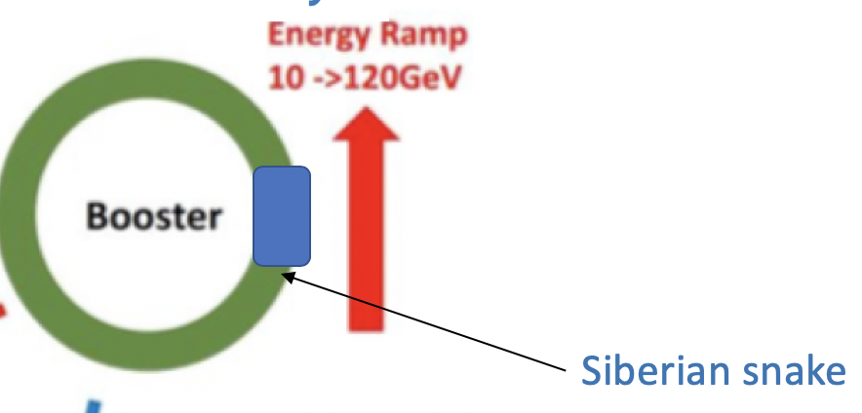
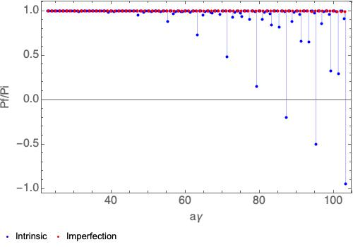
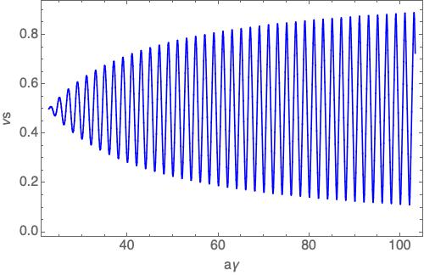
How to realize a high polarization?
Polarization maintenance in Booster Ring
  Siberian snake(s) are necessary to maintain the beam polarization in Booster
  Challenges:
    Very long snake section to be implement into lattice
    Spin resonance comparable to RHIC, detailed simulations are necessary
  Next:
    Detailed analytical and simulation studies of Siberian snakes, realistic tracking of accelerator
Remaining beam polarization after crossing a spin resonance
Closed orbit spin tune for a no-ramping solenoid snake with decreasing s over the beam energy
No beam polarization is expected after acceleration to 45.5GeV w/o snakes

Slide 13
How to realize a high luminosity, polarization and a reasonable lifetime?
Luminosity inversely correlated with lifetime, limited by allowed SR power
Very short lifetime & top-up injection imposes stringent requirement on the injector
Mitigation of depolarization in the collider rings
  Spin rotators introduce depolarization
  Plan:
    will study spin matching conditions to mitigate it
    Iterative lattice optimization for luminosity and polarization
Yet open question to address
  Beam-beam on polarization

Slide 14
Project goal and progress
Final deliverable:
a detailed design report of polarized beam operation @ Z-pole
Final indicators:
研究设计极化束对撞，束流极化度大于 50%，束流寿命大于 60 分钟
Study and design polarized colliding beams, beam polarization > 50%, beam lifetime > 60 min
Mid-term indicators:
明确极化插入件的基本参数选择和精确能量测量的工作模式；模拟研究束流极化度大于50%的实现条件。
1. The parameter selection of polarization insertion devices and the working mode of the precise energy measurement are defined.
2. The realization conditions of beam polarization > 50% are simulated.

Slide 15
Status of assessment indicator 1
“parameter selection of polarization insertion devices and the working mode of the precise energy measurement.” Done
Determined the polarization wiggler parameters
Implemented into the CEPC ring lattice
Worked out how to do resonant depolarization measurements to continuously monitor the beam energies.
Operation scheme (following FCC-ee)
100 non-colliding dedicated bunches
Turn on wigglers only to polarize these bunches
Afterwards, colliding bunches injected and physics starts
Self-substainable process

Slide 16
Status of assessment indicator 2
”The realization conditions of beam polarization > 50% are simulated.” Done
Updated the equilibrium polarization simulation program based on PTC
Realistic imperfect lattice seeds after dedicated correction generated by Y. Wei and B. Wang, in SAD lattice version (Y. Wei, talk on CEPC Workshop 2019)
Programed translation tool from SAD to BMAD/PTC (by W. Xia)
Launch Fortran90 scripts calling PTC to simulate equilibrium beam polarization
In preparation of a journal paper on these simulation studies.
One typical seed

Slide 17
Next steps
Spin rotator & collider ring lattice optimization
  Expect to be delivered in Late-2021
Siberian snakes & booster polarization maintenance simulations
  Expect to be delivered in mid-2022

Slide 18
Existing problems and solutions
Existing problems
  Due to the Covid-19 pandemic, international travels have been delayed till indefinite future. This impedes collaborative studies of CEPC beam polarization with experts from BINP of Russian.
Solution
  Video collaboration

Slide 19
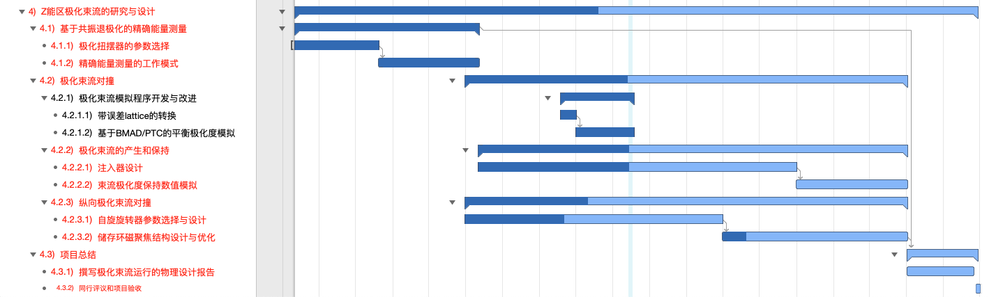
Summary
Mid-term assessment indicators have been reached
  Operation scheme of polarized beam for energy calibration
  Simulation of beam polarization for realistic imperfect lattices
Some progresses beyond mid-term have been made
  Proposal of e+ polarizing ring
  Maintenance of polarization in Booster
  Spin rotator in the Collider ring

Slide 20
Backup

Slide 21
Mid-term tasks and indicators in the task book
年度 Year | 任务 task | 考核指标 Assessment indicator | 成果形式 outcome
2018.5 – 2019. 4 | 研究极化扭摆器的参数选择及精确能量测量的工作模式 The parameter selection of polarization wigglers and the working mode of accurate energy measurement are studied. | 完成束流能量精确测量的工作模式研究与设计 completes the research and design of the work mode of beam energy accurate measurement. | 课题年度技术进展报告 Annual report
2019.5 – 2020. 4 | 开发完善储存环平衡极化度模拟程序，及误差效应对平衡极化度的影响。 The simulation program for the equilibrium beam polarization of storage ring is developed, and the effect of error effect on the equilibrium polarization is also studied. | 完成储存环平衡极化度模拟程序的开发，结合储存环误差校正的结果评估束流平衡极化度及对束流能量测量精度的影响，达到中期考核指标。 the development of the simulation program for the equilibrium beam polarization of the storage ring is completed, and the effect of the beam balance polarization and the measurement accuracy of beam energy is evaluated by the result of the correction of the storage ring error. Reaching the mid-term assessment index. | 课题中期技术进展报告 Mid-term report
Mid-term indicators:
明确极化插入件的基本参数选择和精确能量测量的工作模式；模拟研究束流极化度大于50%的实现条件。
1. The parameter selection of polarization insertion devices and the working mode of the precise energy measurement are defined.
2. The realization conditions of beam polarization > 50% are simulated.

Slide 22
After Mid-term tasks in the task book
年度 Year | 任务 task | 考核指标 Assessment indicator | 成果形式 outcome
2020.5 – 2021. 4 | 研究比较自旋旋转器的各种设计方案及储存环磁聚焦结构的调整。 Study and compare the various design schemes of spin rotators and study the adjustment of the storage ring lattice. | 完成自旋旋转器参数选择及储存环磁聚焦结构设计优化 Complete parameter selection of spin rotators, optimization of the storage ring lattice. | 课题年度技术进展报告 Annual report
2021.4 – 2022. 4 | 研究极化束流运行对注入器设计的要求及设计方案。 Study the requirement and design scheme of the injector for polarized beam operation. | 完成兼容极化束流运行的注入器设计。 Complete the design of injector for compatible polarized beam operation. | 课题年度技术进展报告 Annual report
2022.4 – 2023.4 | 完善储存环磁聚焦结构设计， 撰写极化束流运行的物 理设计报告,开展同行评 议。 Improve the storage ring lattice design, draft the physical design report of polarized beam operations, and carry out the peer review. | 完善储存环磁聚焦结构设 计，撰写极化运行的物理设计报 告。束流极化度大于 50%，束流 寿命大于 60 分 钟。 Improve the storage ring lattice design, draft the physical design report of polarized beam operations. Beam polarization exceeds 50%, beam lifetime exceeds 60 min. | 课程最终科技报告，论文，新方法（束流极化物理设计） Final report Papers, new method ( beam polarization design)
Final indicators:
研究设计极化束对撞，束流极化度大于 50%，束流寿命大于 60 分钟
Study and design polarized colliding beams, beam polarization > 50%, beam lifetime > 60 min

