Slide 1
Progress of Prototype Dipole Magnet for CEPC Booster
Wen Kang
Midterm Report
Beijing, Aug. 21, 2020

Slide 2
Contents
Specifications and midterm target
R & D of the subscale dipole magnet with iron cores
R & D of the subscale dipole magnet without iron cores
Design of the full-scale prototype dipole magnet
Next stage working plan
Summary

Slide 3
Specifications and midterm target
Main Specifications of CEPCB dipole magnets
Quantity | 16320 | Magnetic Length (mm) | 4700
Minimum field (Gs) | 28 | Good field region (mm) | 55
Maximum field (Gs) | 338 | Field uniformity | 0.1%
Gap (mm) | 63 | Field reproducibility | 0.05%
Midterm target
Quantity | 1 | Magnetic Length (mm) | 1000
Minimum field (Gs) | 60 | Good field region (mm) | 55
Maximum field (Gs) | 338 | Field uniformity | 0.1%
Gap (mm) | 63 | Field reproducibility | 0.05%
Two kinds of the subscale prototype magnet with and without iron cores have been designed and developed. The field specifications of both magnets reach the midterm target.

Slide 4
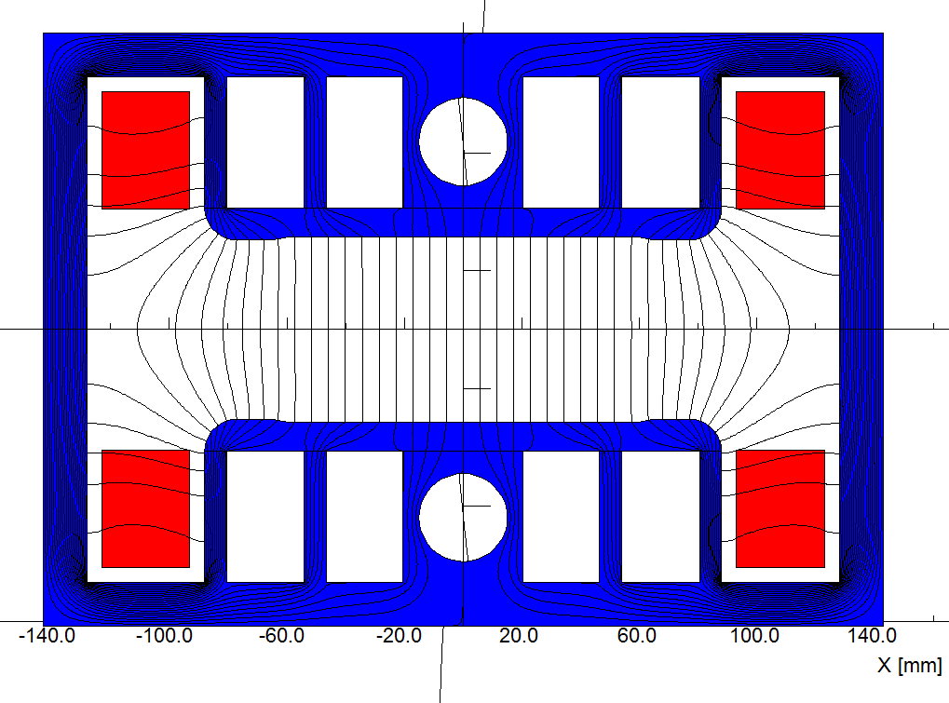
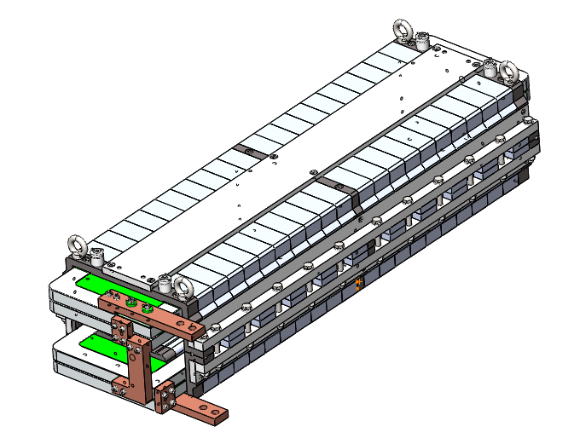
R & D of the dipole magnet with iron cores
1) Design of the dipole magnet with iron cores
To increase field in the cores and decrease weight of the cores, the technology of core dilution is adopted.
To reduce the influence of the remnant field on the low field precision, the grain-oriented silicon steel laminations are used to stack the magnet cores due to their low coercive and remnant field.

Slide 5
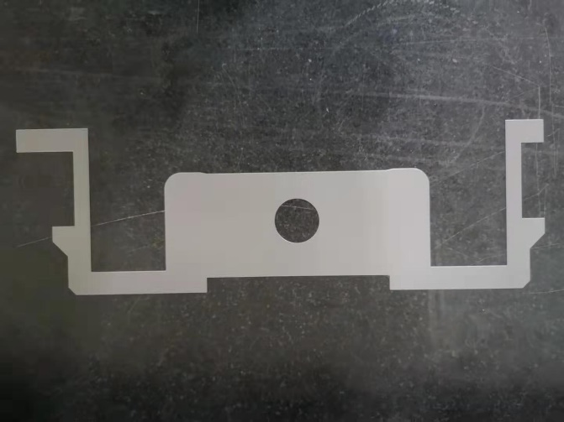
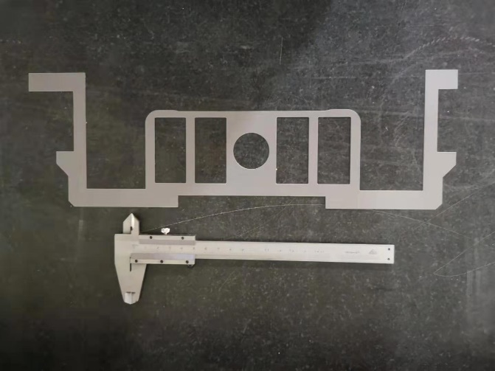
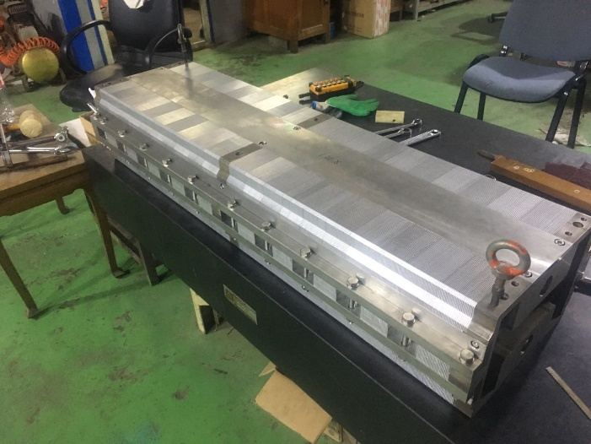
R & D of the dipole magnet with iron cores
2) Fabrication of the subscale prototype dipole magnet with iron cores
The magnet has the upper and lower cores, which are stacked by the grain-oriented silicon steel and aluminum laminations with the thickness ratio of 1:1.
To investigate the influence of the holes in the pole areas, two kinds of laminations with and without holes are produced. So each half of the cores is stacked by the laminations with the holes and half without holes.

Slide 6
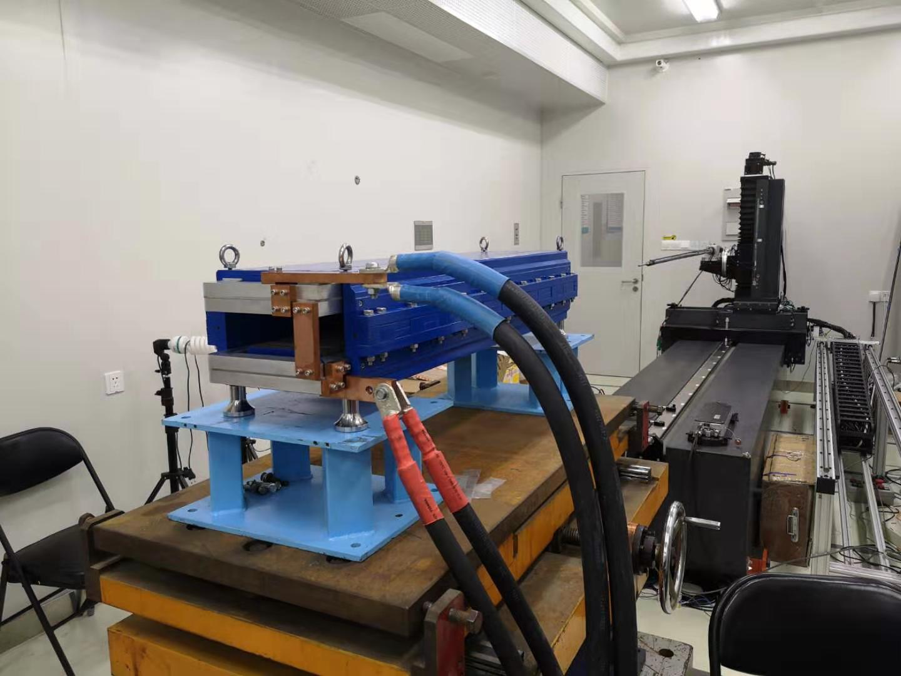
R & D of the dipole magnet with iron cores
3) Test of the subscale prototype dipole magnet with iron cores
The dipole magnet with iron core was tested in the lab.

Slide 7
R & D of the dipole magnet with iron cores
The measurement results show,
The field uniformity in GFR is about 0.3% at low field level of 28Gs and 0.1% at high field level, which can not meet the requirements.
The magnet is excited for 4 times from 28Gs to 338Gs then back to 28Gs, the field reproducibility at all level is better than the required value of 5E-4.
The field uniformity at 60Gs is about 3E-4, which is better than the midterm target.

Slide 8
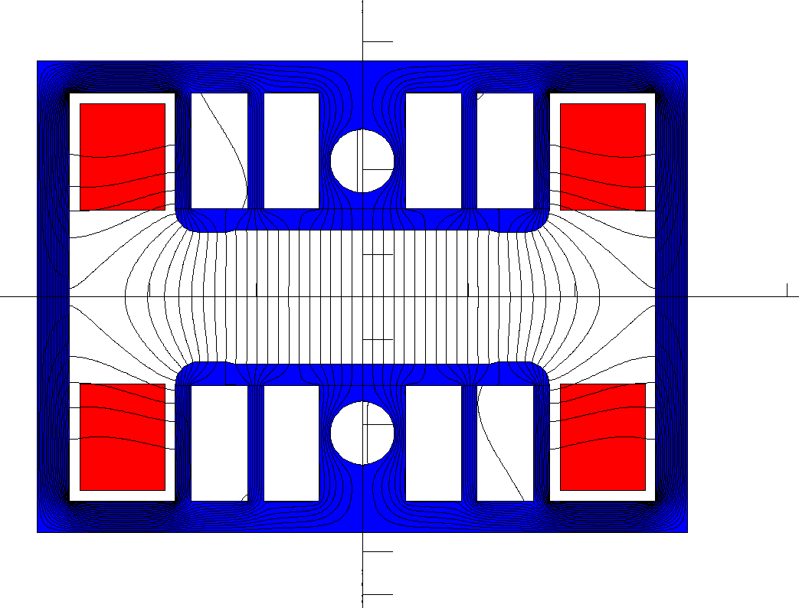
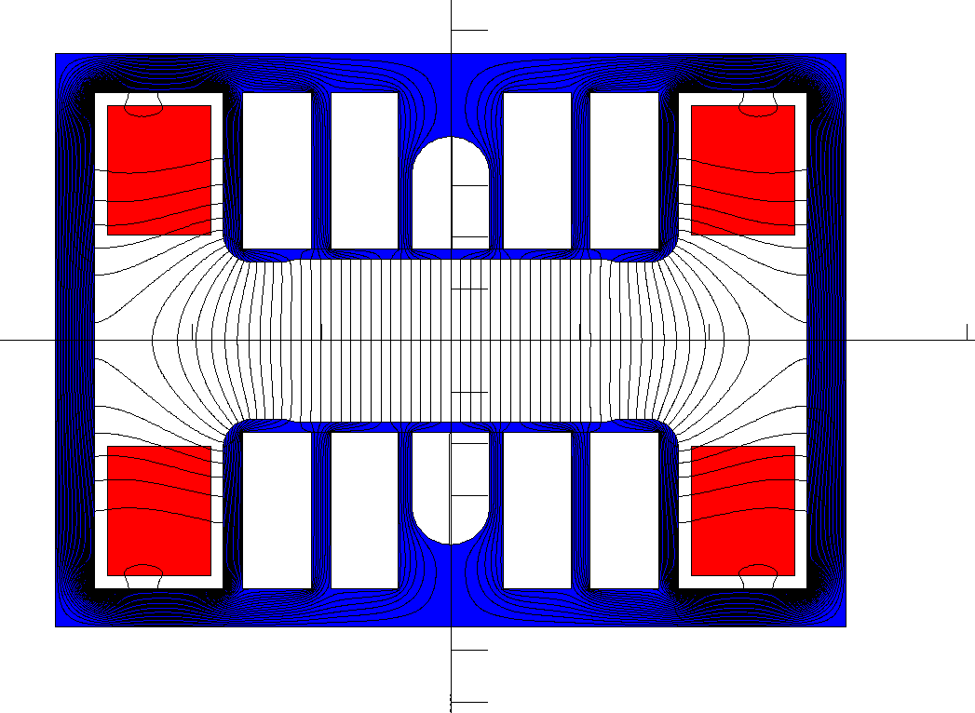
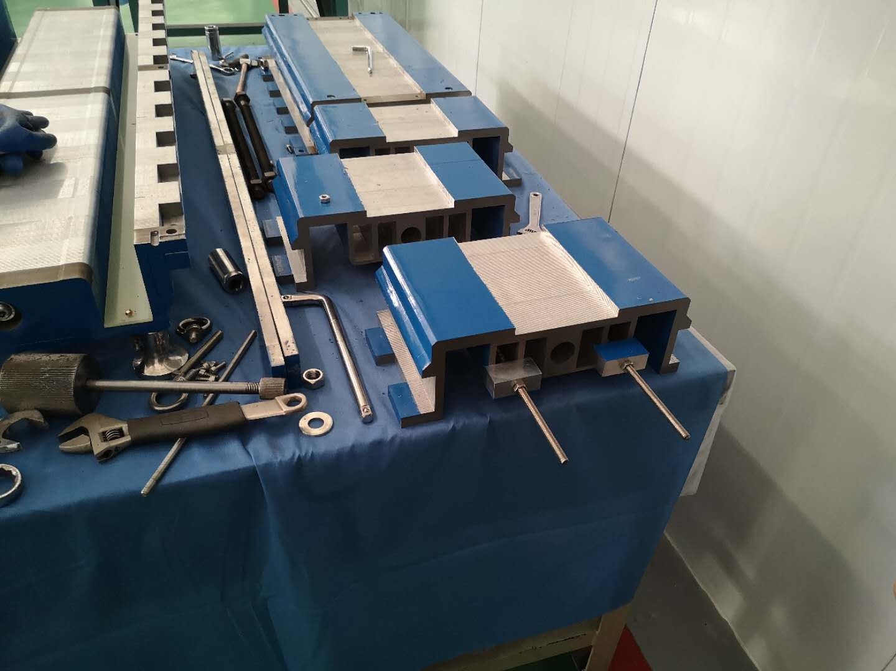
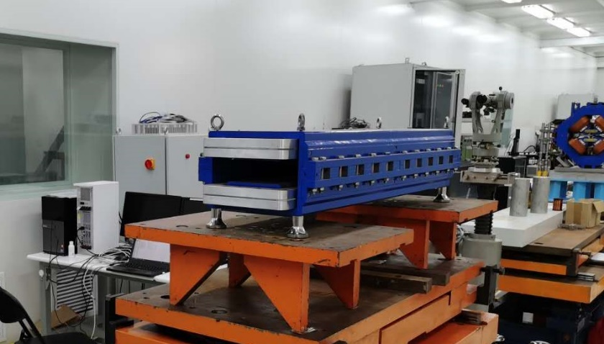
R & D of the dipole magnet with iron cores
In order to reduce the influence of the remnant field on the field quality, the subscale prototype dipole magnet was de-assembled and the holes of its laminations were reproduced. It was expected that the remnant field in the pole areas could be made uniform.

Slide 9
R & D of the dipole magnet with iron cores
The field measurement results show that the obvious modification of the magnet does not cause an obvious improvement on the low field quality.
The uniformity of low field of 28 Gs becomes a little better, from 0.35% to 0.25%. However, the uniformity of high field level becomes a little worse, from 0.1% to 0.15%

Slide 10
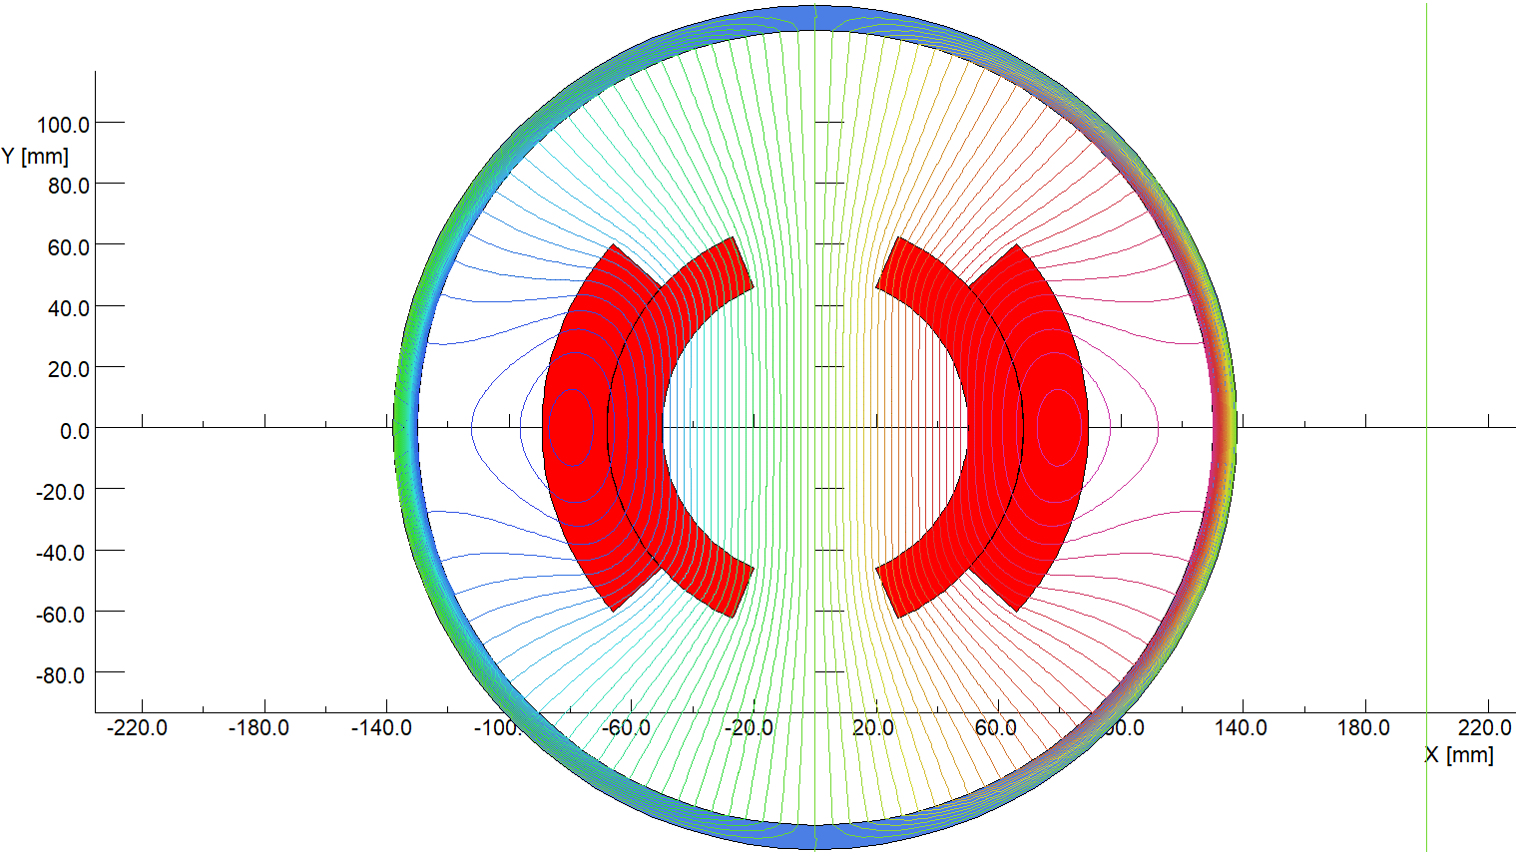
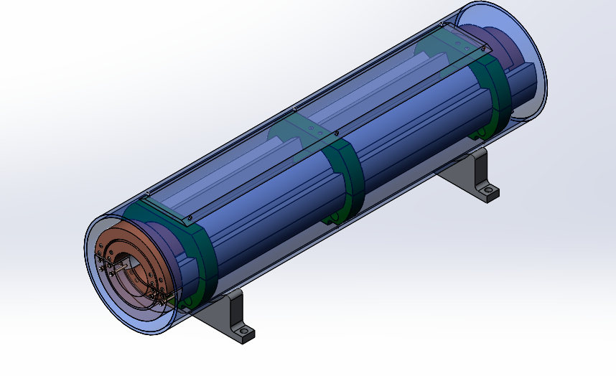
R & D of the dipole magnet without iron cores
1) Design of CT dipole magnet without iron core
The design of dipole magnet with Cosθ (CT) coil is a conventional measure for high field superconducting magnets, it is the first time for design of the high precision low field magnet.
To reduce the production cost, the structure of the CT coils is designed as simple as possible. The magnet have two coils, each coil has two layers and three, which are formed by aluminum bars with the same cross section areas.
In the structure, the upper and lower coils of the magnet are formed by six aluminum arc bars with the same cross section areas, so each coil has three turns, two turns in the inner and one turn in the outer.

Slide 11
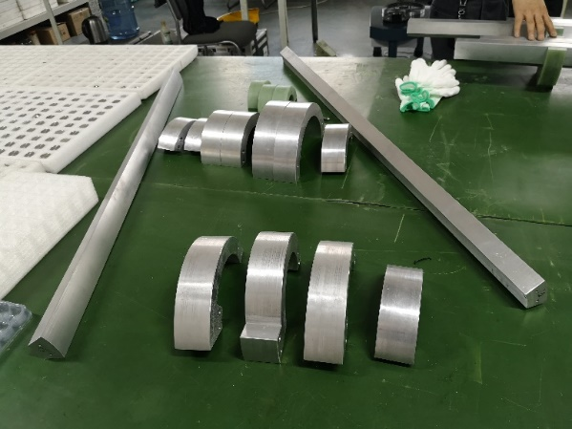
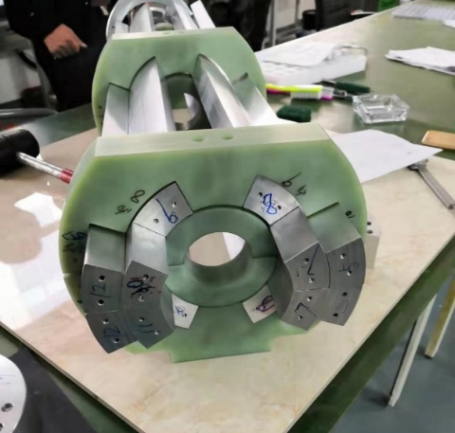
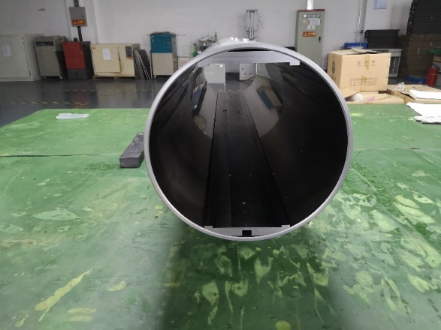
R & D of the dipole magnet without iron cores
2) Fabrication of the subscale CT dipole magnet without iron core
The inner and outer conductors of the CT coils are directly fabricated from two aluminum tubes with the right diameters.
The shielding cylinder was made from a long iron tube with inner diameter of 300mm.

Slide 12
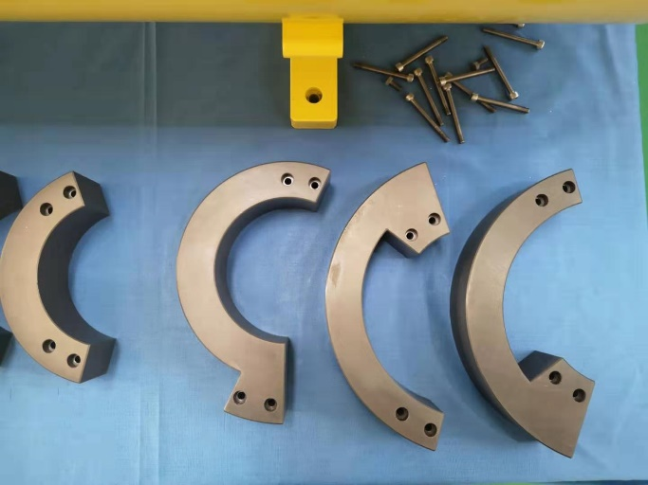
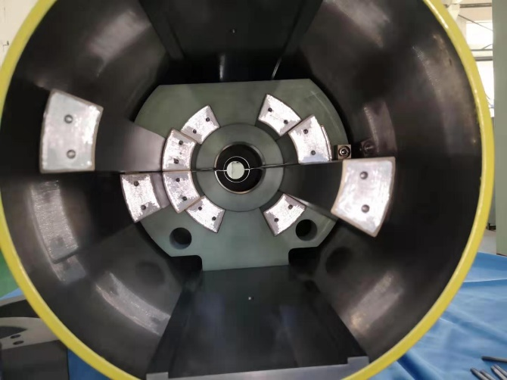
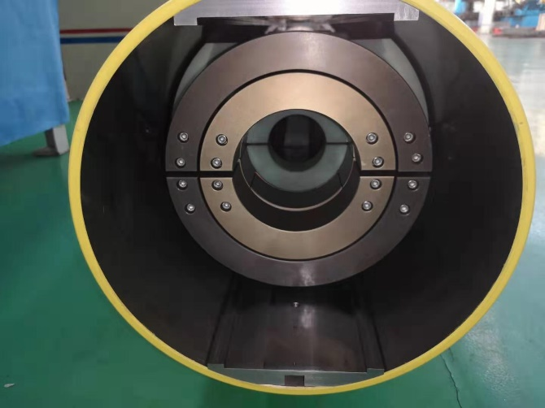
R & D of the dipole magnet without iron cores
All the surfaces of the aluminum conductors were anodized for the insulation from turn to turn, the thickness of the anodized film is about 50 microns.
The inner and outer conductors of the coils were connected by the by-pass circular conductors, the anodized film of the connected touch surfaces was gotten rid of before the conductors were connected.
The final assembling errors of the CT coil dipole magnet were checked to be less than 50 microns.

Slide 13
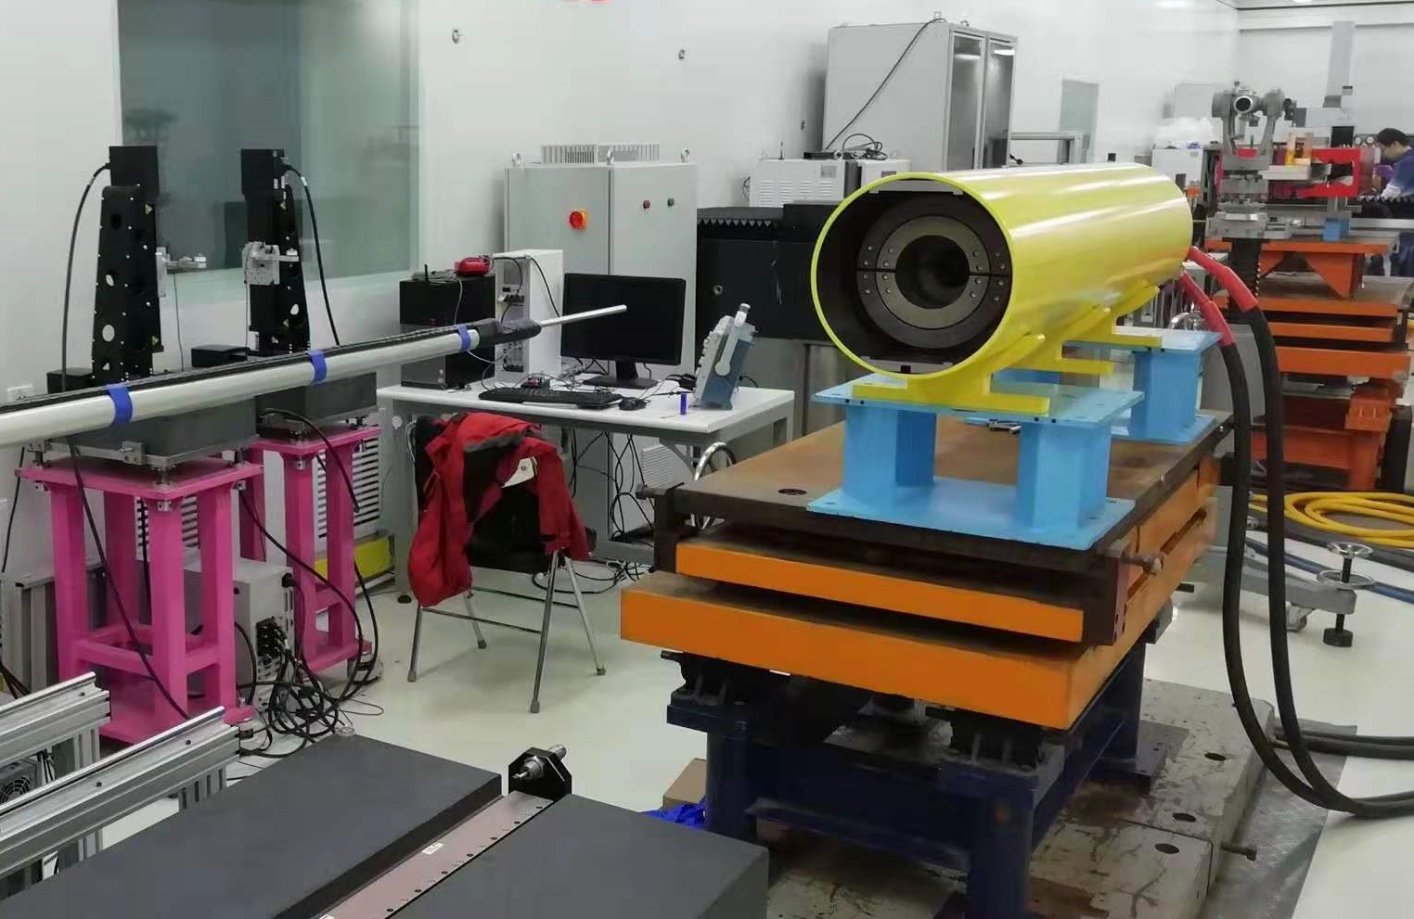
R & D of the dipole magnet without iron cores
3) Test of the CT coil dipole magnet without iron core
The CT coil dipole magnet was tested in the lab.

Slide 14
R & D of the dipole magnet without iron cores
The measurement results show,
The field precision at all level, especially at low field level of 28Gs, is better than the required value of 0.1%, which reaches the midterm target.
The magnet is excited for 3 times from 28Gs to 338Gs then back to 28Gs, the field reproducibility at all level is better than the required value of 5E-4.

Slide 15
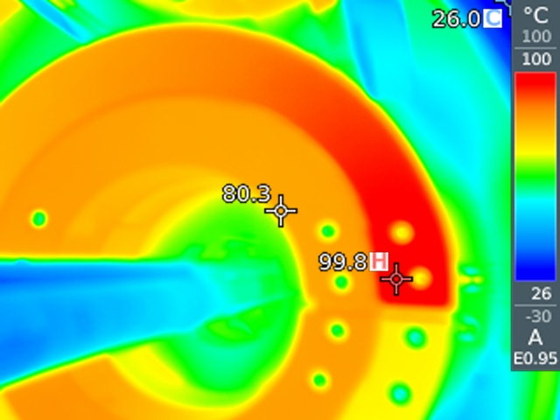
R & D of the dipole magnet without iron cores
A serious problem is that the temperature of the coils increases to 80ºC-100ºC when the field increases to high level.
The reason is that the aluminum alloy not the pure aluminum was selected as the material of the conductors because of its good mechanical properties when the magnet was produced.
The resistivity of the aluminum alloy is 1.6 times larger than the pure aluminum, so the power loss of the coils increases by 1.6 times.
In addition, the touch resistance of the contacted surfaces of the conductors is larger than the expected one.

Slide 16
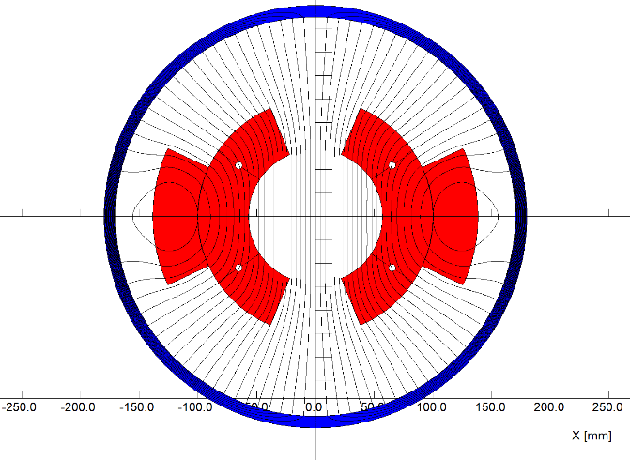
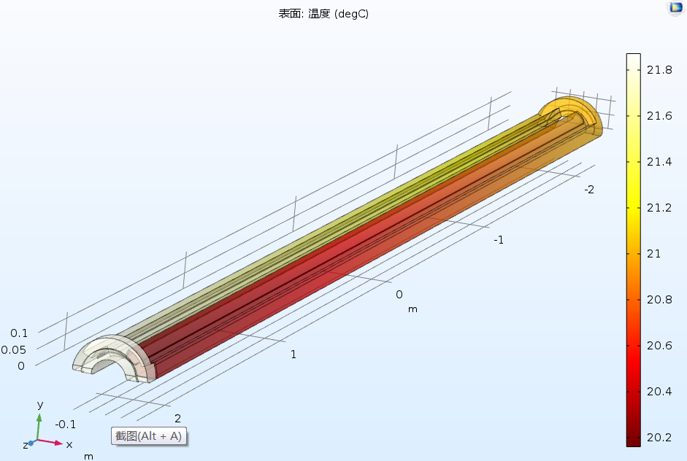
Design of the full-scale prototype CT coil dipole magnet
On the base of good results from the subscale CT dipole magnet, the mechanical design of a full scale prototype CT dipole magnet was finished on the cooperation with Hefei Keye company. The production of the magnet will be begun in the coming month.
The total length of the magnet including the shielding tube is 5.1m.
The coil conductors will be made from pure aluminum, the cooling tubes will be inserted between the inner conductors to decrease temperature rise.
The touch resistance of the contacted surfaces of the conductors will be reduced by coated silver films.

Slide 17
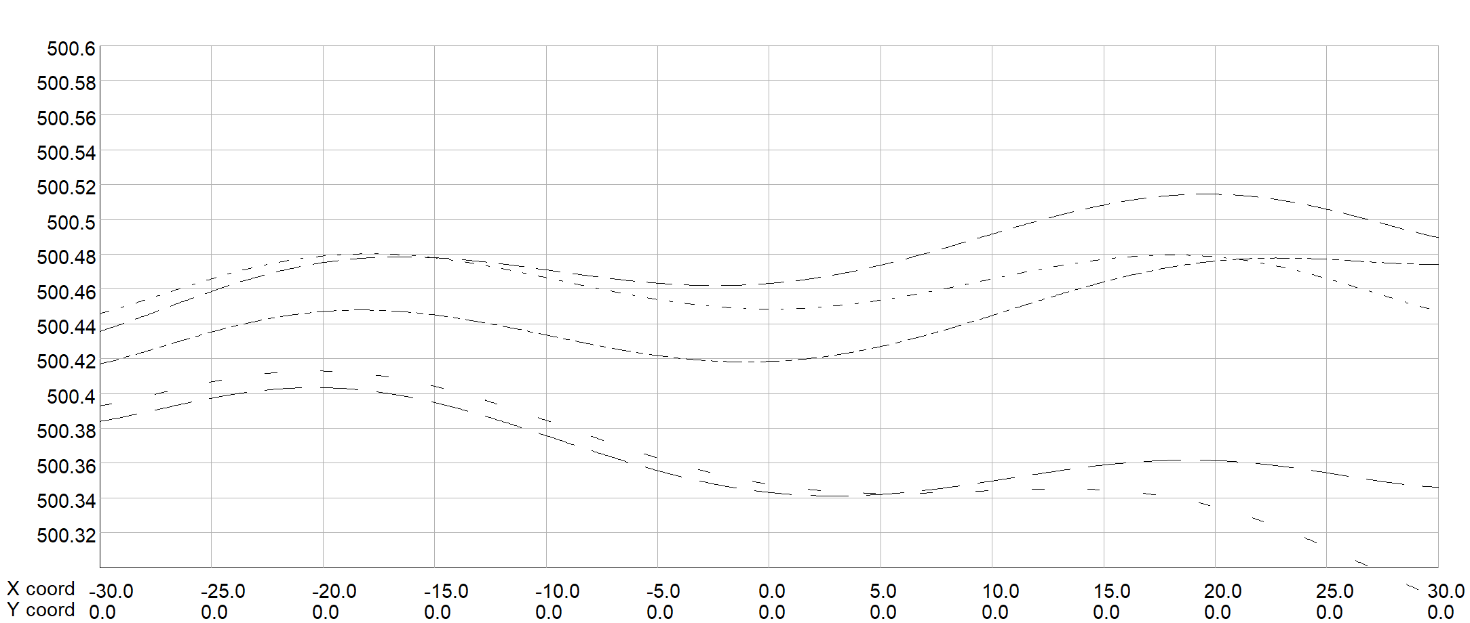
Design of the full-scale prototype CT coil dipole magnet
The magnet is composed of the upper and lower coils, each coil is formed by three conductors. The size and position tolerance of the conductors are the key factors for the precision of the field.
The field simulation shows,
The tolerance of size dimension for all conductors should be less than 0.05mm.
The position tolerance of the conductors should be less than 0.1mm in 4.7m longitudinal direction.

Slide 18
Design of the full-scale prototype CT coil dipole magnet
Each conductor is 4.7m long, it is designed to be directly fabricated from a long aluminum bar, which will need large machining and surface anodizing facility. In order to reduce the production cost, it is considered to be divided into 3 parts for convenient fabrication and then assembled together.

Slide 19
Design of the full-scale prototype CT coil dipole magnet
To control the size and position precision of the conductors, the supporters every 415mm in longitudinal direction are fabricated and assembled in the shielding tube.

Slide 20
Design of the full-scale prototype CT coil dipole magnet
After the coil conductors are produced, the whole assembly of the magnet will be done in the shielding tube, which can be opened into upper and lower parts. The position of the shielding tube that support the supporters of the CT coils will be carefully and precisely machined.

Slide 21
Design of the full-scale prototype CT coil dipole magnet
序号 | BST-63B设计参数 |  | 序号 | BST-63B设计参数 |  | 序号 | BST-63B设计参数
1 | 磁铁数量 | 1 | 18 | 电流[A]@10GeV | 96 | 35 | 最大直流电压[V]@120GeV | 1.1
2 | 磁铁气隙[mm] | 63 | 19 | 平均电流[A] | 733 | 36 | 感抗压降[mV] | 79.7
3 | 磁场 [Gs]@180GeV | 500 | 20 | 导线尺寸 [mm*mm] | I-A675R57-O-A248R13846 | 37 | 线圈R1[mm] | 57
4 | 磁场 [Gs]@120GeV | 338 | 21 | 导电截面[mm^2] | 1973.2 | 38 | 线圈R2[mm] | 100
5 | 磁场 [Gs]@10GeV | 29 | 22 | 最大电流密度[A/mm^2]@120 | 0.59 | 39 | 线圈R3[mm] | 138.46
6 | 磁有效长度 [mm] | 4700 | 23 | 最大电流密度[A/mm^2]@180 | 0.9 | 40 | 线圈角度A1[°] | 33.75
7 | 好场区宽度 [mm] | 55 | 24 | 平均电流密度[A/mm^2] | 0.37 | 41 | 线圈角度A2[°] | 67.5
8 | 积分磁场均匀性 | 0.001 | 25 | 平均匝长[m] | 11.00 | 42 | 线圈角度A3[°] | 24.8
9 | 磁场上升时间[s] | 4 | 26 | 单极导线长度[m] | 33 | 43 | 线圈端部过桥长度[mm] | 300
10 | 磁场平顶时间[s] | 1 | 27 | 线圈导线总长[m] | 66 | 44 | 线圈长度[mm] | 4700
11 | 磁场下降时间[s] | 4 | 28 | 直流电阻[mOhm] | 0.94658 | 45 | 屏蔽筒内径[mm] | 340
12 | 单极安匝数[At]@180GeV | 5160 | 29 | 最大功耗[W]@180GeV | 2800 | 46 | 屏蔽筒外径[mm] | 360
13 | 单极安匝数[At]@120GeV | 3477 | 30 | 最大功耗[W]@120GeV | 1272 | 47 | 屏蔽筒重量[kg] | 976
14 | 单极安匝数[At]@10GeV | 288 | 31 | 平均功耗[W]@10-180GeV | 1120 | 48 | 线圈重量[kg] | 385
15 | 单极线圈匝数 | 3 | 32 | 平均功耗[W]@10-120GeV | 510 | 49 | 磁铁总重[kg] | 1400
16 | 电流[A]@180GeV | 1720 | 33 | 电感[mH] | 0.300 | 50 | 所有磁铁最大功耗[MW] ]@120GeV | 20.7
17 | 电流[A]@120GeV | 1159 | 34 | 最大直流电压[V]@180GeV | 1.8 | 51 | 所有磁铁最大功耗[MW] | 8.3

Slide 22
Next stage working plan
In the April of next year, complete the fabrication of the full scale CT coil prototype dipole magnet.
In the same time, design and set up the field measurement system for the full scale magnet.
In Aug. of next year, complete the test of the full scale prototype dipole magnet.

Slide 23
Summary
Two kinds of subscale prototype dipole magnets with and without iron cores were fabricated and tested.
Although the field precision of the dipole magnet with iron cores has reached the midterm target at 60Gs, it is difficult to meet the precision requirement at low level of 28 Gs due to the unavoidable influence of the remnant field.
The CT coil dipole magnet without iron cores has high precision and good reproducibility field both at low and high field level, which is satisfied with the final requirements.
The full-scale CT dipole magnet has been designed on the basis of the good test results of the subscale prototype magnet and will be fabricated in the April of next year.

Slide 24
Thank you for your attention！

