Slide 1
R & D progress of CEPC vacuum system
Ma Yongsheng, Dong Haiyi, Huang Tao, Wang Pengcheng, Liu Jiaming
8/15/2020

Slide 2
Contents
Introduction
R&D of RF shielding bellows
R&D of vacuum chambers
NEG coating inside of vacuum chambers
Summary

Slide 3
Targets of the midterm from Most2
成果名称 | 成果 类型 | 考核指标² |  |  |  | 考核方式（方法）及评价手段⁴
 |  | 指标 名称 | 立项时已有指标值/状态 | 中期指标值/状态³ | 完成时指标值/状态
研制弯转真空盒、RF屏蔽波纹管和真空盒内表面镀吸气剂膜 | □新理论 □新原理 □新产品 □新技术 ■新方法 ■关键部件 □数据库 □软件 □应用解决方案 □实验装置/系统 ■工程工艺 □标准 □专利 ■论文 □其他 | 真空盒极限真空 | 5×10⁻¹⁰Torr | 设计指标：3×10⁻¹⁰Torr | 2×10⁻¹⁰Torr | 同行专家评审
 |  | 真空盒总漏率 | 5×10⁻¹⁰ Torr.L/s | 设计指标：3×10⁻¹⁰ Torr.L/s | 2×10⁻¹⁰ Torr.L/s | 同行专家评审
 |  | RF屏蔽波纹管接触力 | 125±50g | 设计指标：125±30g | 125±25g | 同行专家评审

Slide 4
Present status and problems
Targets of the midterm and present status
Project | Targets of the midterm | Present status | Remarks
The Leak rate of the vacuum chambers | 3×10⁻¹⁰Torr.L/s | 3×10⁻¹⁰Torr⋅L/s | Achieved
The ultimate pressure of the vacuum chambers | 3×10⁻¹⁰ Torr | Less than 3×10⁻¹⁰ Torr | Will be achieved in October
The contact pressure of spring fingers for RF shielding bellows | 125±30g | 125±25g | Achieved
problems
There are no obvious problems found.

Slide 5
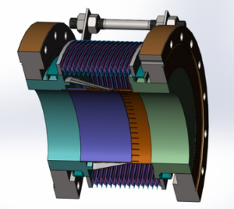
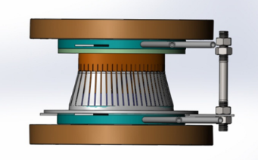
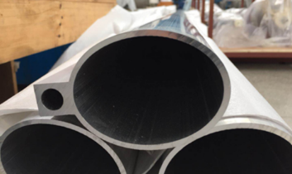
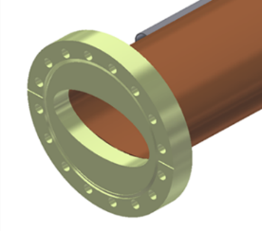
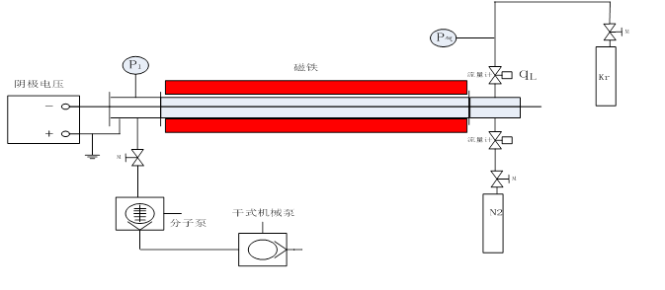
Introduction
Vacuum bellow modules are needed to compensate the mechanical misalignments of the vacuum chambers during installation and to absorb their thermal expansion during the bake-out. In order to reduce the beam impedance during operation with beams these modules are equipped with RF bridges to carry the image current.[1]
Aluminum chamber for electron ring, copper chamber for positron ring. Some technical challenges such as extrusion, machining and welding have been solved.
NEG coating coated inside of copper vacuum chamber is employed to suppress SEY. Setups have been built for a long vacuum chamber, and coating methods and parameters are being studied. The structure, composition, SEY and pumping speed of NEG film samples are measured.
[1]IPAC2015-WEPHA005

Slide 6
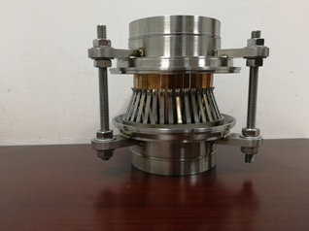
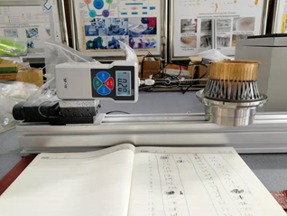
Progress of R&D of RF shielding bellows
Bellows module
Spring fingers module
Total length: 140 mm
Inner and exterior diameter of bellows: 125mm/140mm
Expansion/contraction: 5mm/12mm
Offset: 2 mm
Bending: 50 mrad
Above technical specifications have been reached.
Contact fingers module
Notes:
Along the 27 Km of LHC beam pipe, various types of vacuum bellow modules are needed to compensate the mechanical misalignments of the vacuum chambers during installation and to absorb their thermal expansion during the bake-out. In order to reduce the beam impedance during operation with beams these modules are equipped with RF bridges to carry the image current. They are usually made out of a copper tube insert at one side and Cu-Be RF fingers at the other end of the module. A spring is used to keep the contact between the RF fingers and the tube insert. The geometry and the choice of this spring become critical to ensure a good electrical contact.【1】
The electrical contact between the RF fingers and the tube insert depends on the geometry of both parts as well as on a spring, which assures the force to keep the contact [2] [3].
[1]IPAC2015-WEPHA005
[2] E. Metral et al., “Lessons learnt and mitigation measures for the CERN LHC equipment with RF fingers”, TUPWA042, IPAC’13, Shanghai, China.
[3] R. Veness et al., “Design aspects of the RF contacts for the
LHC beam PAC’01, Chicago, USA.

Slide 7
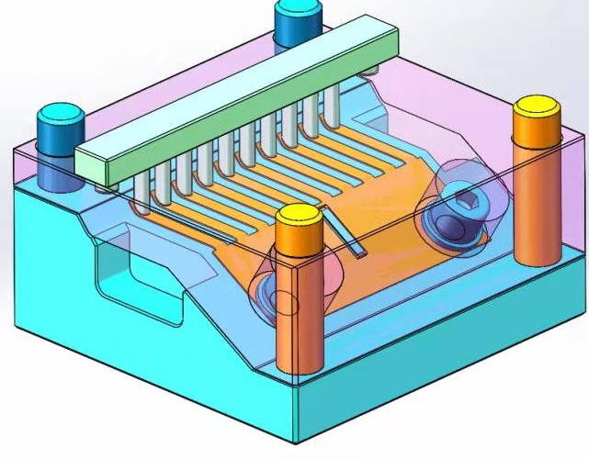
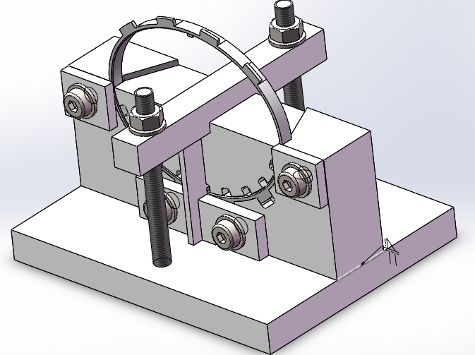
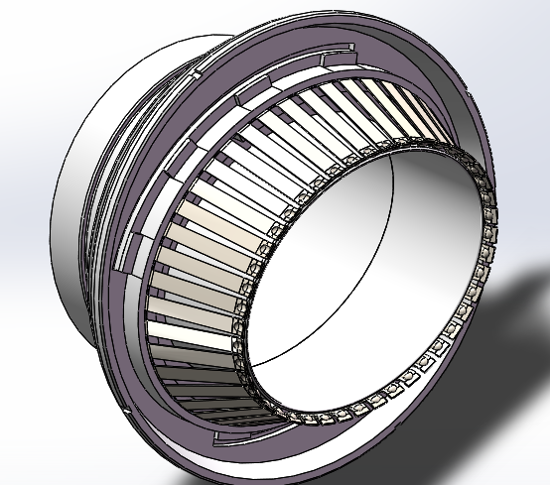
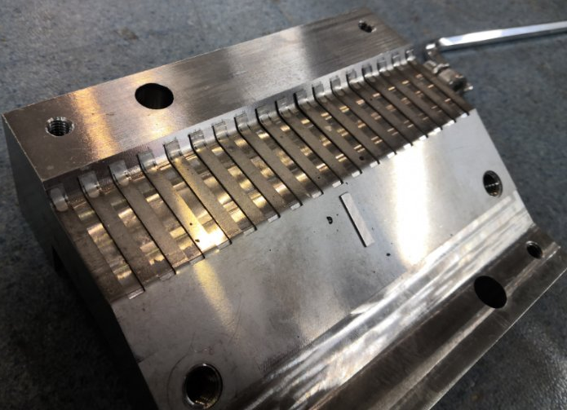
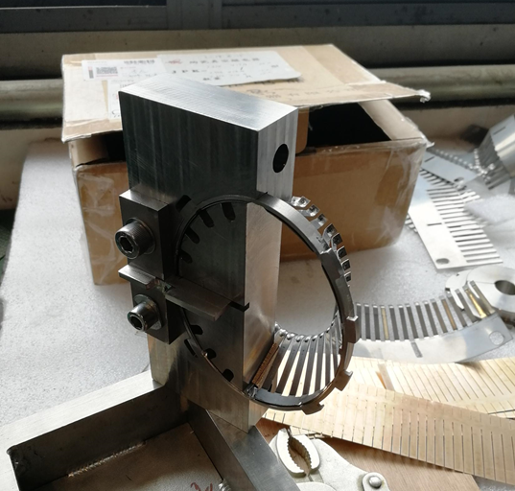
optimization of spring fingers
Contact force between the spring fingers and the contact fingers is a key parameter. The beforehand angle of contact fingers are being adjusted to achieve it.
Mould of contact fingers adjustment
Mould of compression ring
Assembled of contact and spring fingers
Notes:
1、弹簧指成型工艺
2、焊接工艺
根据近几次实验，确定了组合焊接工装以及弹簧指组件与端板的焊接方式，如图所示。
现阶段接触力测试结果：83-120g

Slide 8
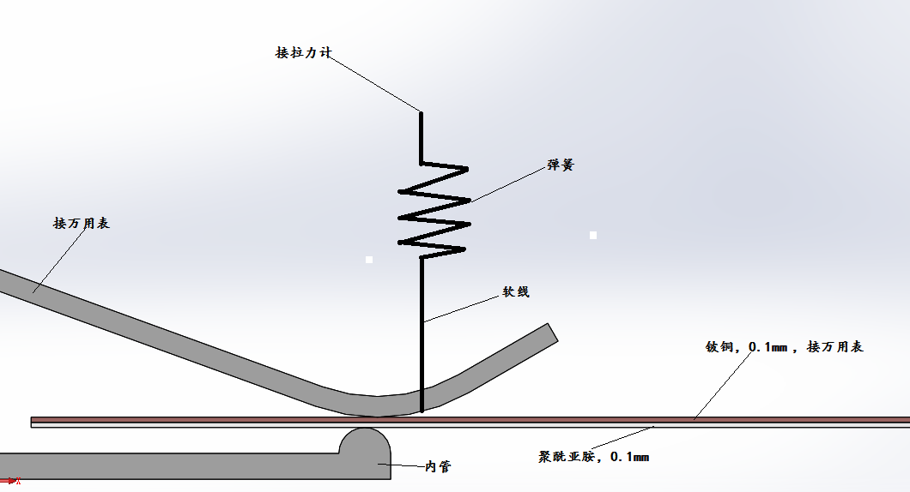
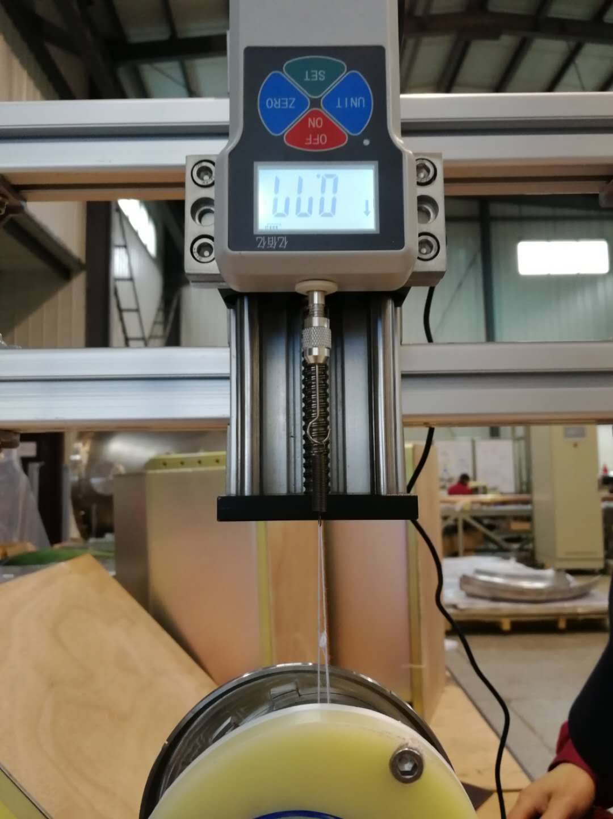
Test bench of the contact force of a spring fingers
Test bench developed and optimized to get more accuracy and uniform of contact force.
Notes:
2、测试方案实验总结
测试结果重复性很好,同一弹簧指反复测试结果100%一致
测得接触力结果偏高约5g
目前测试装置安装不便,且使用几次后结果有一定影响，待进一步改进
RF波纹管伸缩摩擦测试：通过制作相应工装，测试多次摩擦后，弹簧指与接触指以及内管之间的磨损程度，5000~10000次 ，后测量接触力和磨损程度

Slide 9
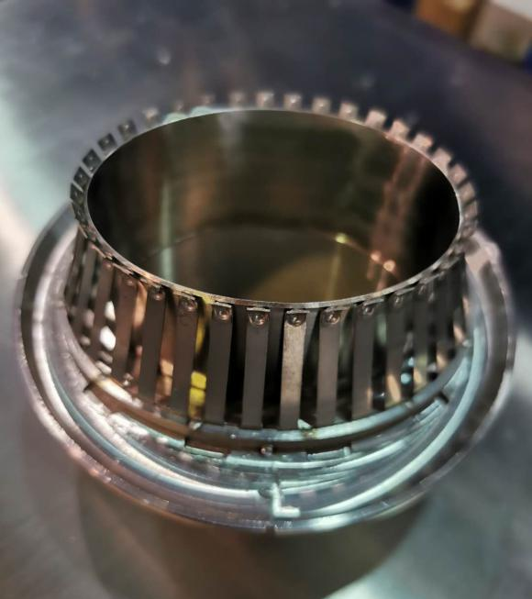
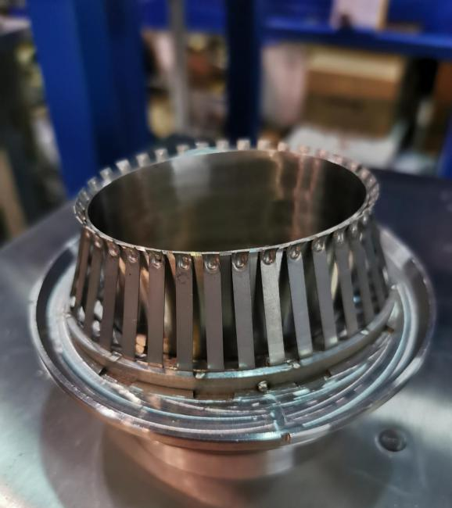
optimization of spring fingers
Contact force is determined by pre-bending angle of the contact fingers. Different pre-bending angles of 25°,26°,27°,31° have been tested which shows that 27°is best.
27°is chosen and which forces between the spring fingers and the contact fingers is uniformly from different fingers and is about 125±5g, which meets 125±30g.
Before weld
After weld
Notes:
1、弹簧指成型工艺
2、焊接工艺
根据近几次实验，确定了组合焊接工装以及弹簧指组件与端板的焊接方式，如图所示。
现阶段接触力测试结果：83-120g

Slide 10
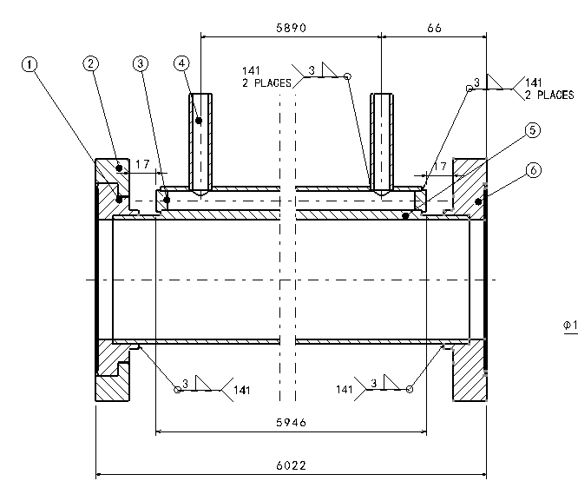
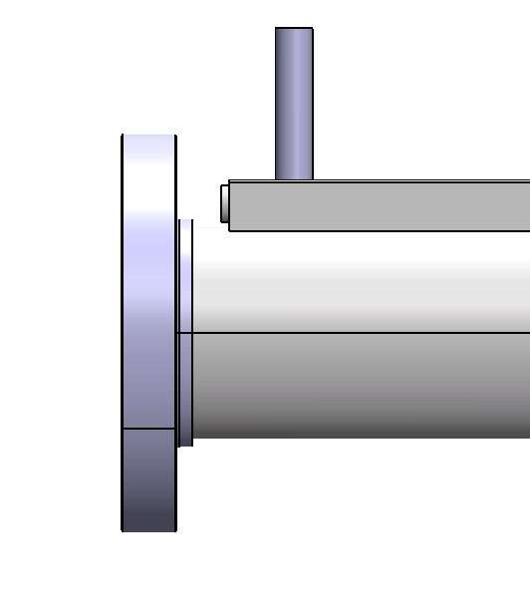
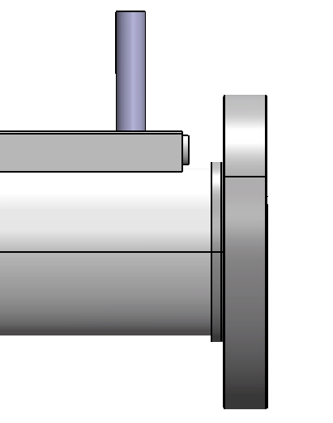
Progress of R&D of Al vacuum chamber
Structure of Al vacuum chamber
CF100 rotatable flange
CF100 no-rotatable flange
Al-6061 is chosen as the material of Al vacuum tube, and flanges are fabricated from explosion bonding S.S.-Al transition plate. Flanges and tube are welded by manual AC TIG. The fittings for water cooling channels are also Al-6061 and are welded by TIG.
Notes:
argon arc welding （TIG）

Slide 11
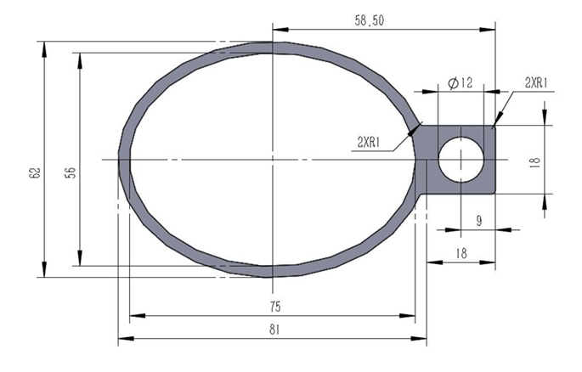
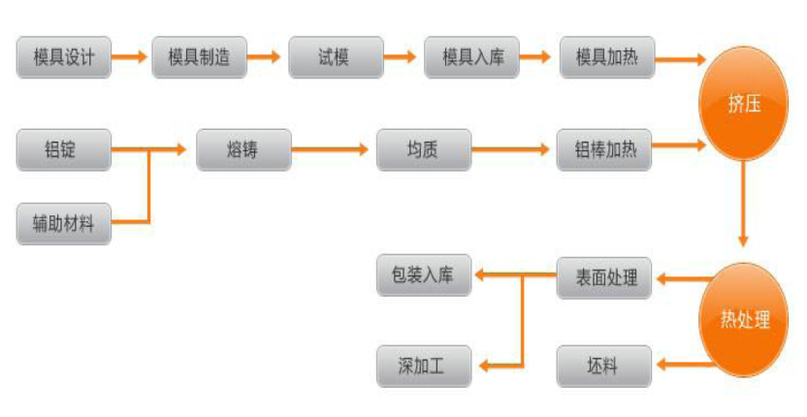
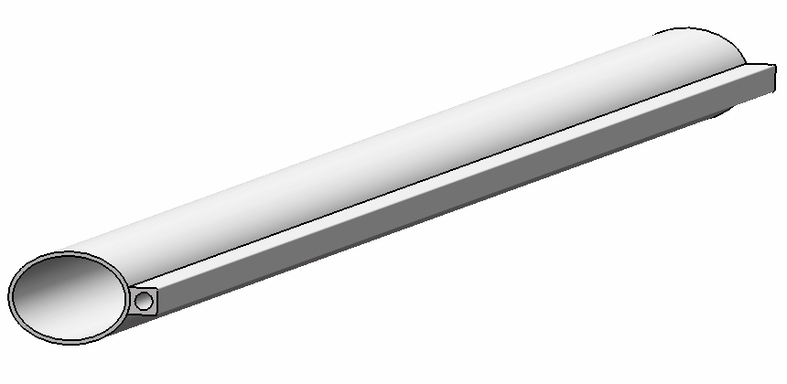
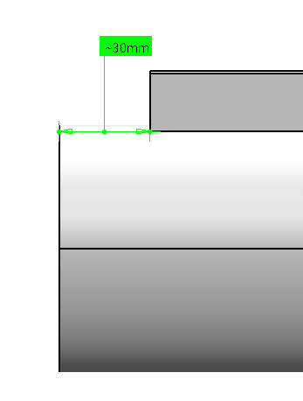
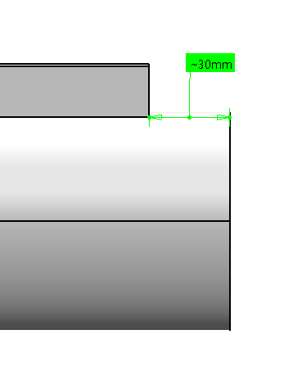
Fabrication process of Al vacuum tube
Aluminum vacuum tube is thermally extruded. Extrusion follows these steps as follows:
Aluminum vacuum chamber
(elliptic 75×56, thickness 3, length 6000)
The connection ports of cooling water channels are machined by numerical control machine tool.

Slide 12
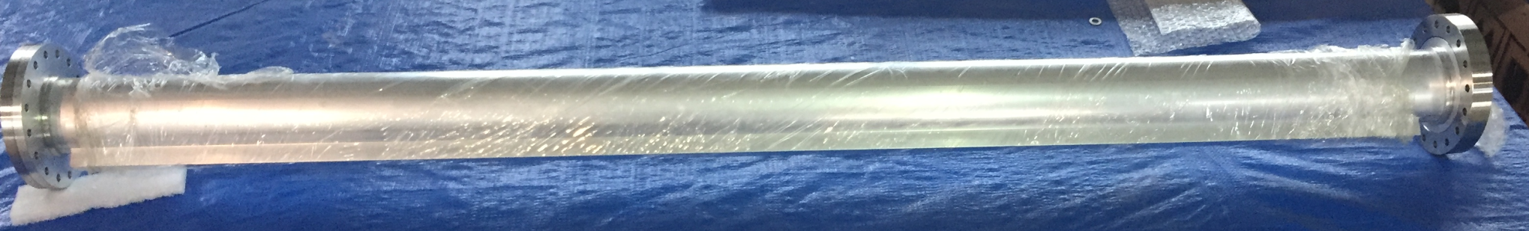
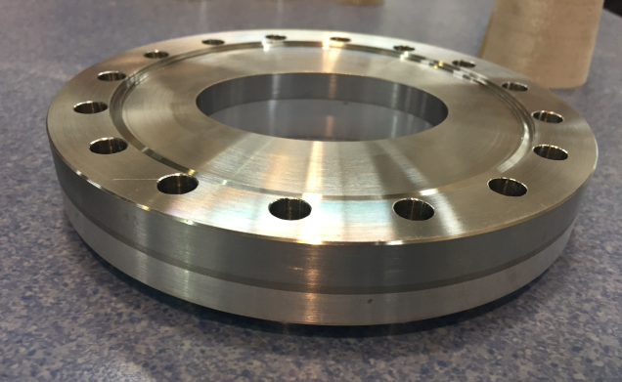
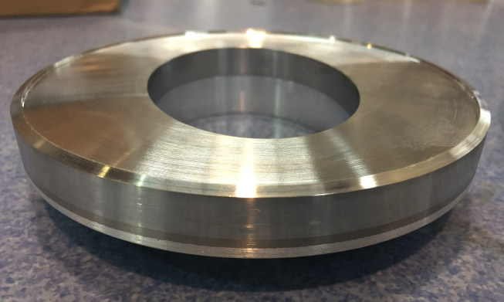
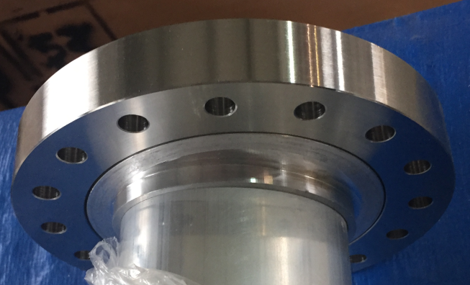
Conflate flanges of S.S.-Al transition material
S.S.-Al transition plate are fabricated through explosion bonding in a domestic company.
Ultrasonic flaw detection is used before the flange will be machined.
Leak detection is carried out after the flanges has been machined.

Slide 13
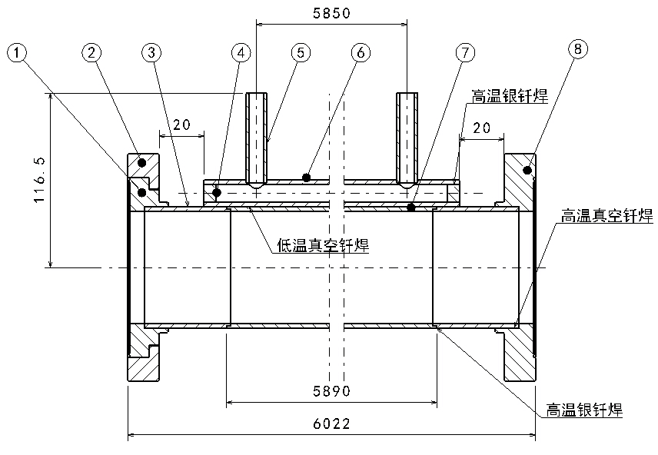
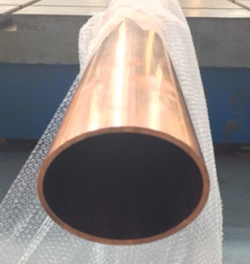
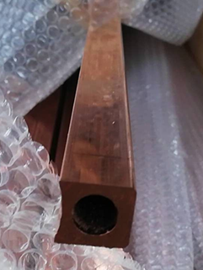
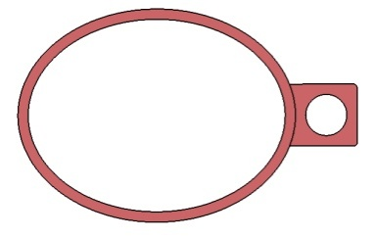
Progress R&D of Cu vacuum chamber
Cu beam pipe and water cooling channel are extruded respectively, and brazed together.
Stainless steel material is used for flanges, and there is a rotatable flange at an end of vacuum chamber.
The flanges and beam pipe are welded by high temperature brazing solder, and low temperature brazing solder are used between the beam pipe and water cooling channel as a 6 m long high temperature vacuum furnace is difficult to be found.
Vacuum chamber
Beam pipe +
Cooling channel
Notes:
过渡段铜管与正式段铜管采用火焰焊，氩弧焊也可以；基于强度考虑真空盒壁厚3mm；冷却水管采用低温钎焊防止高温引起退火，降低铜的强度；低温钎焊的温度是320℃（400℃ 焊料 也可以满足要求，暂时未采用）

Slide 14
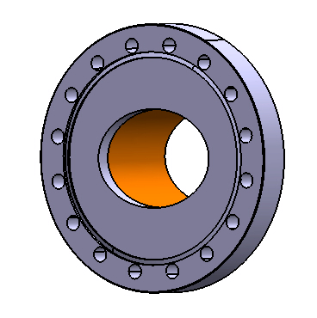
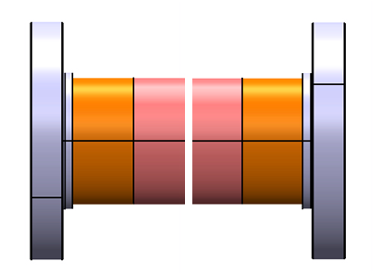
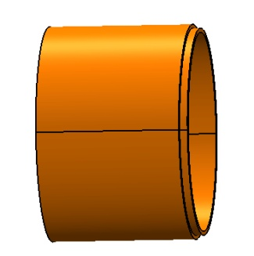
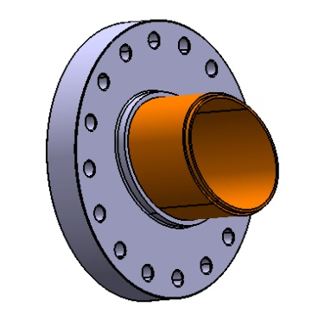
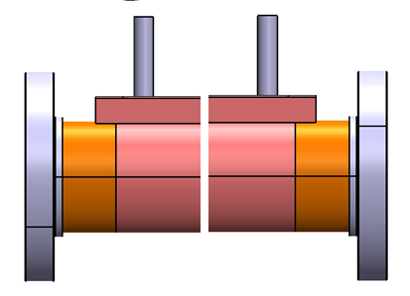
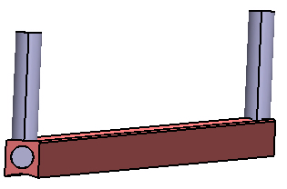
Technique process of Cu vacuum chamber
Leak detection
Transition tube machining
Brazing
Knife edge machining of flange
Silver brazing or EBW
Leak detection
Leak tests for hydraulic pressure and vacuum
Cleaning, leak detection, baking and pumping down
Welding between beam pipe and cooling channel with a low temperature brazing solder
Welding of fittings for cooling channel
Notes:
火焰焊 flame welding

Slide 15
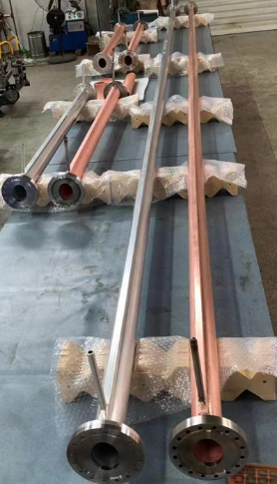
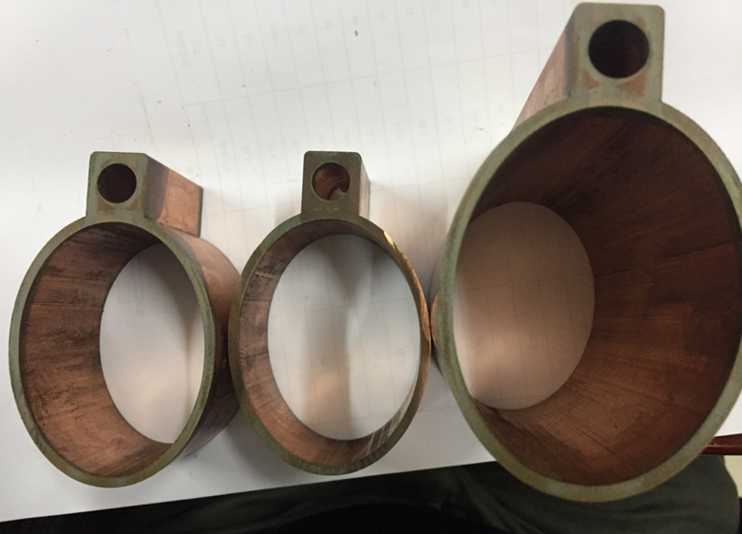
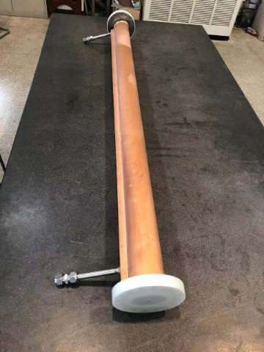
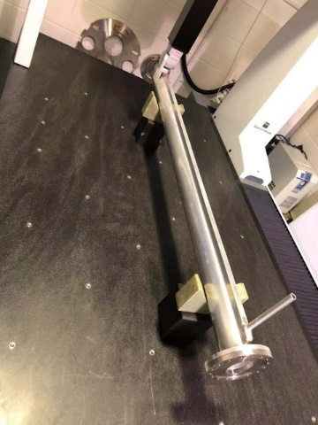
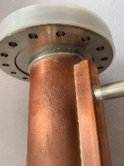
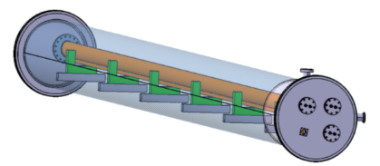
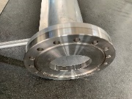
Cu and Al vacuum chamber prototypes
A 6 m long simple vacuum furnace is fabricated, which is used to weld the water cooling channels of Cu chambers through low temperature brazing solder.
The welding seams are checked by wire-electrode cutting. The welding joints are smooth and have good contacting.
The prototypes of copper & aluminum vacuum chambers with a length of 6 m have been fabricated and tested, which meet the engineering requirements.

Slide 16
Cu and Al vacuum chamber prototypes
A 6 m long simple vacuum furnace is fabricated, which is used to weld the water cooling channels of Cu chambers through low temperature brazing solder.
The welding seams are checked by wire-electrode cutting. The welding joints are smooth and have good contacting.
The prototypes of copper & aluminum vacuum chambers with a length of 6 m have been fabricated and tested, which meet the engineering requirements.
Project | Targets of the midterm | Present status | Remarks
The Leak rate of the vacuum chambers | 3×10⁻¹⁰Torr.L/s | 3×10⁻¹⁰Torr⋅L/s | Achieved
The ultimate pressure of the vacuum chambers | 3×10⁻¹⁰ Torr | Less than 3×10⁻¹⁰ Torr | Will be achieved in October

Slide 17
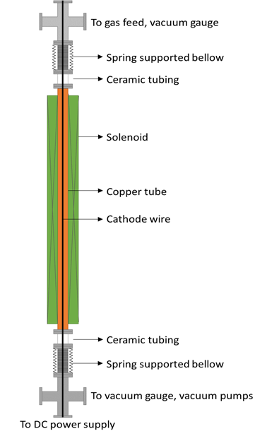
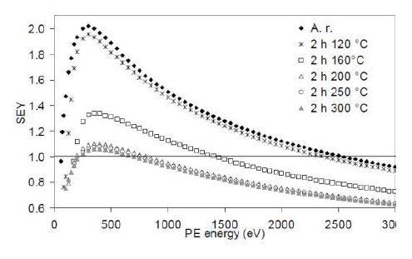
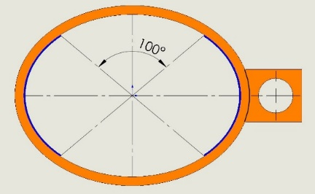
NEG coating of the inside chamber
NEG coating suppresses electron multipacting (SEY < 1.2) and beam-induced pressure rises, as well as provides extra linear pumping.
The NEG coating is a titanium, zirconium, vanadium alloy, deposited on the inner surface of the chamber through sputtering.
In order to decrease the resistive wall impedance, the top and bottom of the vacuum chambers will be uncoated NEG films, while the other part of inner surface will be coated with NEG films in thickness of 1 μm , which may supply enough pumping speeds and absorbed gas capacities, and acceptable impedance budgets.
1 μm TiZrV
B. Henrist, N. Hilleret, App. Surf. Sci.172(2001)95

Slide 18
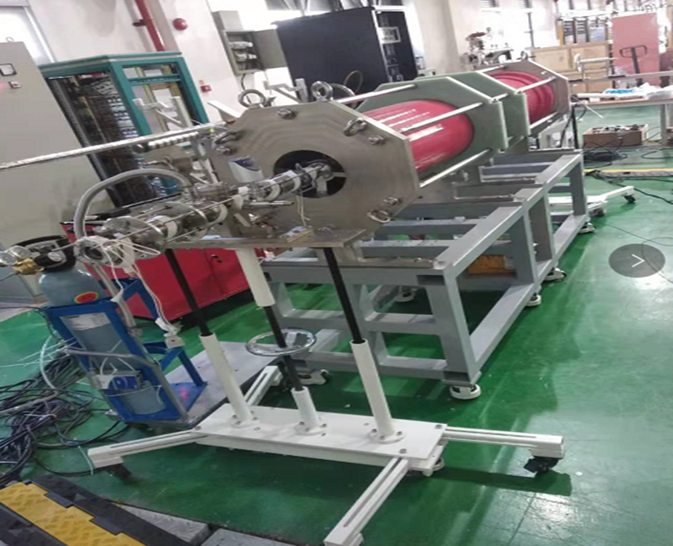
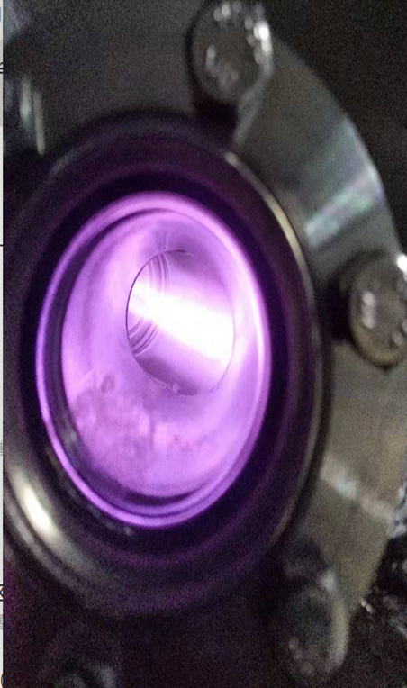


NEG coating setup
The DC magnetron sputtering setup of NEG coating have been built up and some experiments have been done on DN40 vacuum pipe.
Thickness of film: ∼1.1 μm; Proportion: Ti：Zr：V=0.28 : 0.3 : 0.42 ( after Ar⁺ surface etching of 10 nm) ; Columnar film for high pumping speed.
All related parameters (plasma gas pressure, substrate temperature, plasma current, and magnetic field value) are recorded and suitably adjusted to ensure the stability of the deposition process.
NEG coating setup

Slide 19



NEG coating setup
A horizontal coating equipment is easy to be installed, and 6m long vacuum chambers can be coated by moving the solenoid.
1.5m long vacuum pipe have been coated to explore the coating parameter at geometrical shape of 56×75.
6m long vacuum pipe will be coated after those parameters are optimized.
Before coating
Two target at inside of pipe
After coating

Slide 20


Pumping speed measurements for NEG films
A high pure hydrogen（99.999%）is introduced by the injection valve, the gas passes through the coated pipe and is absorbed by the NEG film. The P2/P1 ratio is measured by the pressure gauges, which is related to the average sticking probability and pumping speed of the pipe walls.

Slide 21


Results of pumping speed for NEG film
Pumping speed of DN40@750mm long pipe after coating have been tested and the maximum value is reached about 0.4 L/s·cm² which is closed to the engineering acceptance criteria.
The ultimate vacuum test facility have been designed and is being manufactured.

Slide 22
Summary
The prototypes of copper & aluminum vacuum chambers with a length of 6 m have been fabricated and tested, which meet the engineering requirements. Surface treatment of copper will be taken into account.
The key components experiments such as spring fingers and contact fingers have been carried out. Contact force is uniformly from different fingers and meets the target of 125±25g.
1.5m long vacuum pipe have been coated to explore the coating parameter at geometrical shape of 56×75. 6m long vacuum chambers will be coated by moving the solenoid by a horizontal coating equipment .

Slide 23
Thank you！

