Slide 1
Key material research
of CEPC beam pipe
Wei Shaohong
2020.08.29

Slide 2
Outline
1. Si detector support material
2. Beryllium pipe
3. Future work

Slide 3
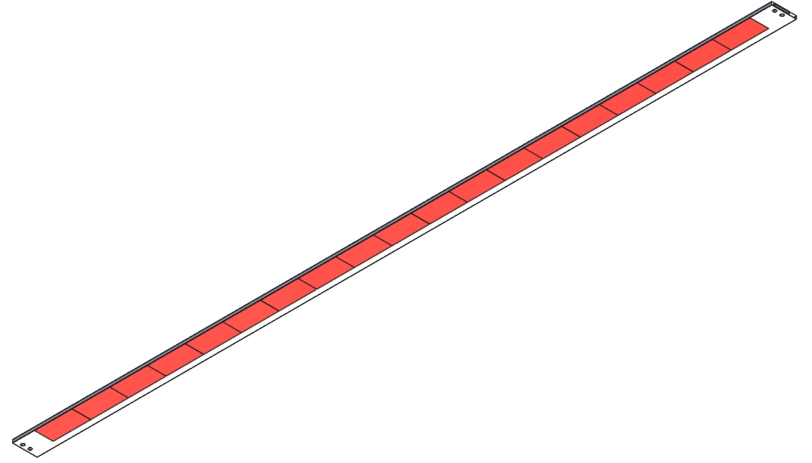
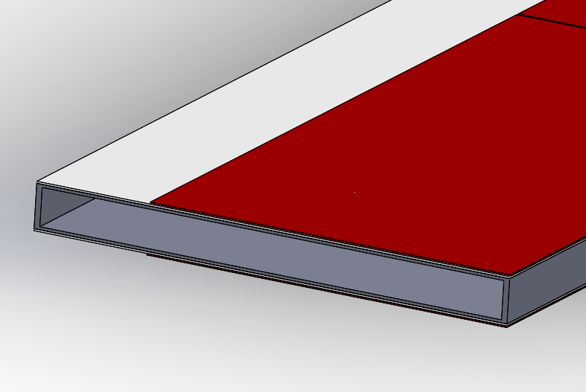
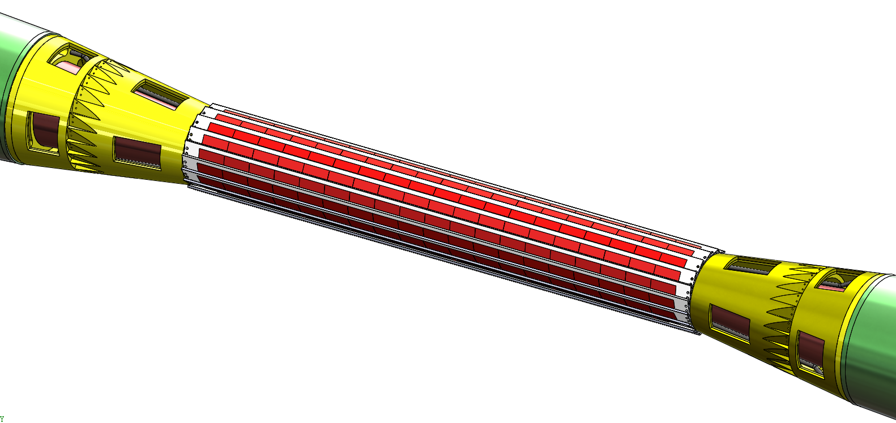
1. Si detector support material
1.1 Introduction
Function ：Support silicon detector
Location ：Outside of beryllium tube
Shape ：Sheet, rectangular section
Support material
Flexible circuit board
Si
Three sizes
layer one: 267mm long
layer second: 518mm long
layer third:738mm long

Slide 4
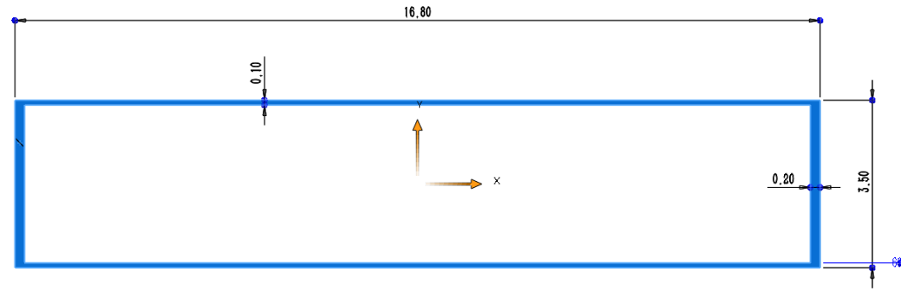
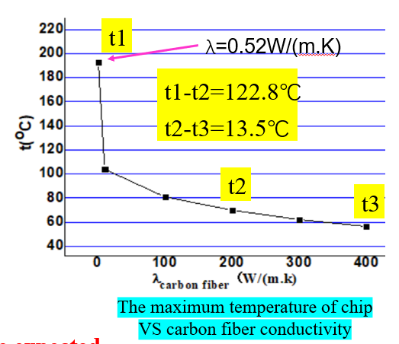
1. Si detector support material
1.2 Requirements
Light：Low density
----Less absorption，Improve detection efficiency
Structure of support
Thickness=0.1mm
Deformation value of support under different elastic modulus
High strength：High E
E | Deformation
100GPa | 0.077mm
200GPa | 0.042mm
300GPa | 0.029mm
----Small deformation and vibration，
Improve detection accuracy
E>200GPa
High thermal conductivity: High λ
---The calculation results shows that the heat of the chip can not be removed only by air cooling.
λ>200W/(m k)

Slide 5
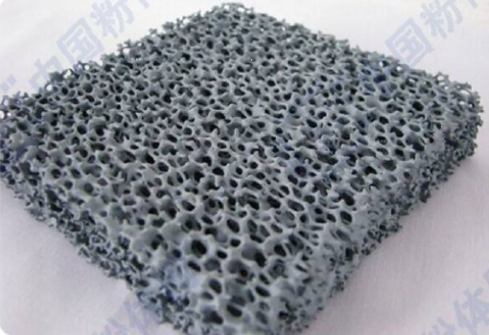
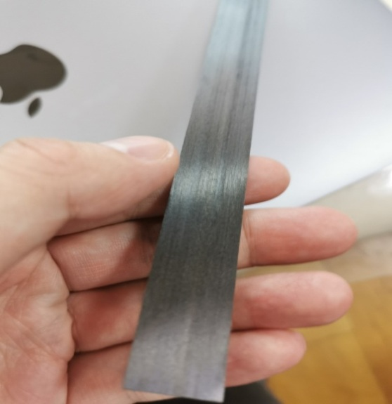
1. Si detector support material
1.3 Material selection
Porous SiC ceramics
Carbon fiber composites
Parameter | SiC | Carbon fiber
Element | C/Si | C/H/O
Density(g/cm³) | 3.1 | 2.0
Elastic modulus(E/GPa) | 400 | 200-900
Thermal conductivity(w/mk⁻¹) | 120 | 2--600
Carbon fiber composite as the preferred material

Slide 6
1. Si detector support material
1.3 Material selection
Classification of carbon fibers |  | Tensile strength MPa | Elasticity modulus GPa | Thermal conductivity W/(m k)
PAN base （polypropylene nitrile） | High T | 4000---11000 | 200-300 | <20
 | High E | 2000-4000 | 600 | <20
Pitch based |  | 2000--5000 | 600-900 | >600
Available
The properties of composites depend on the properties of carbon fiber materials ,generally about one-third to one-half of that of carbon fiber;
The properties of pitch based carbon fiber composites can meet the requirements;

Slide 7
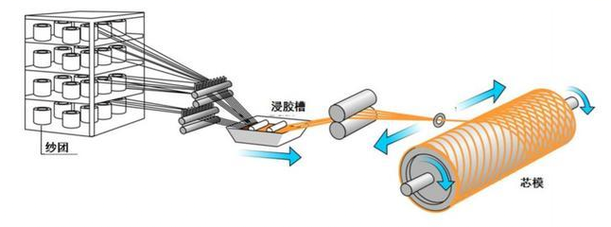
1. Si detector support material
1.4 Difficulties in preparation of carbon fiber composites
Winding process
Dipping
Minimum diameter of carbon fiber tow >0.1mm
Development difficulty
The diameter of carbon fiber tow is larger than the thickness of support

Slide 8
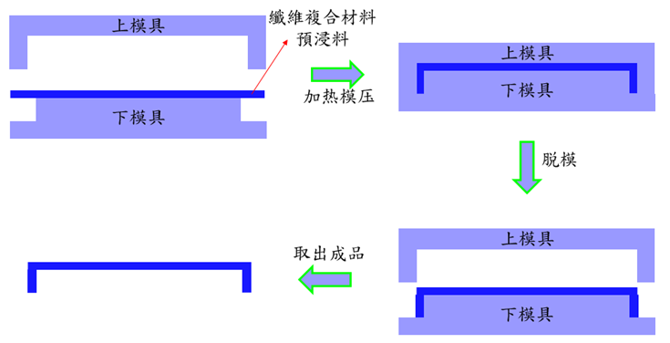
1. Si detector support material
1.4 Difficulties in preparation of carbon fiber composites
Structure of support
Schematic diagram of carbon fiber composite molding
Development difficulty
Demoulding process of square tube carbon fiber composites with large aspect ratio

Slide 9
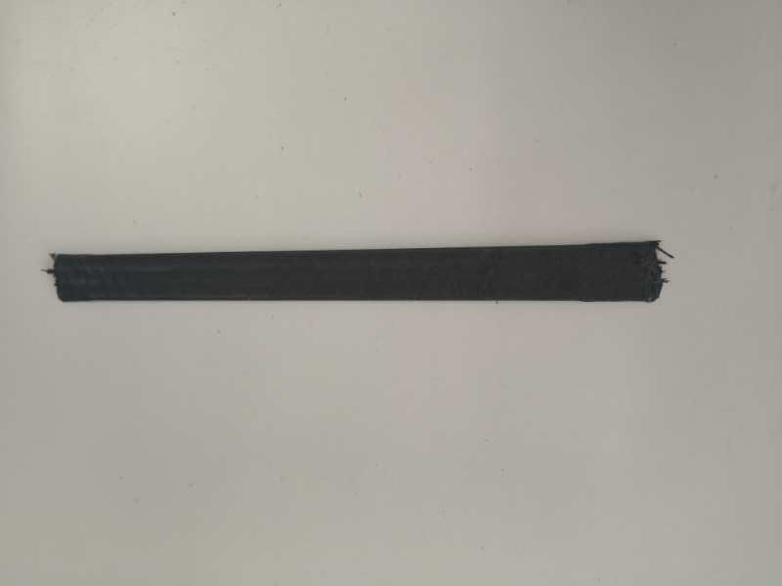
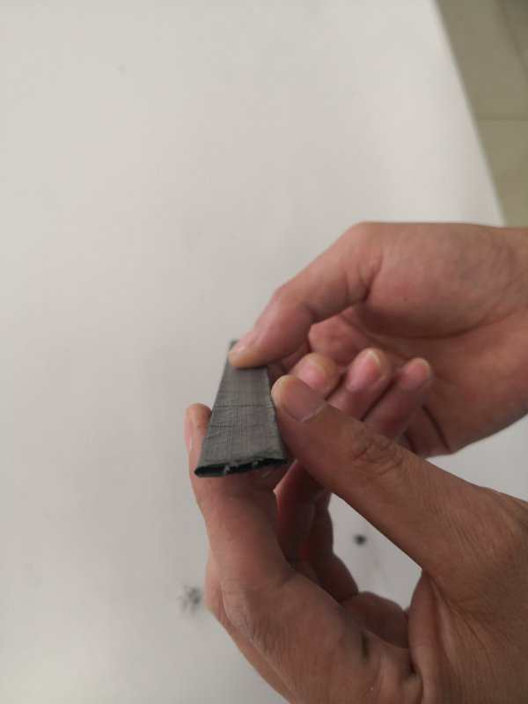
1. Si detector support material
Beijing Institute of Aeronautical Materials, AECC (621)
Aerospace Research Institute of Materials& Processing Technology, CACS (703)
Ningbo Institute of materials, CAS
None of the three institutes has experience in developing pitch based composite;
No carbon-fiber composite has ever been made so thin in China;
Thickness 0.15mm
Thickness 0.1mm
Sample prepared by 703
Sample prepared by Ningbo
Defects: deckle edge

Slide 10
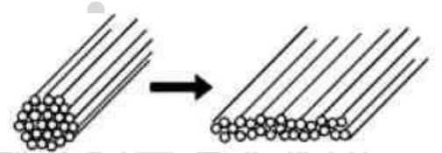
1. Si detector support material
1.5 Research scheme
Develop a support used carbon-fiber composite
Solutions: Flatten the carbon fiber tow, reduce the thickness
Flattening
Key point:
Spreading technology of pitch based fiber tow
difficulty: Thickness accuracy control
Weaving technology of ultrathin carbon fiber
Demoulding technology of square tube fiber composite
Expected performances
Thickness：0.1mm two layer
Density：1.9g/cm³
Elastic modulus：>250GPa
Thermal conductivity ：>240W/(m k)
Test
Tensile strength, bending strength, elastic modulus, thermal conductivity, density

Slide 11
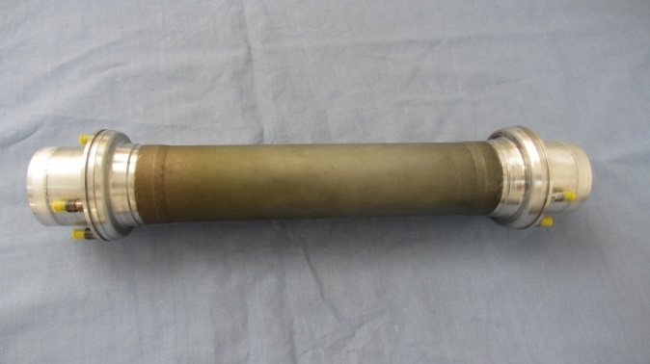
2. Beryllium pipes
1.1 Introduction
The structure size of beryllium tube is the basis of beam pipe design
inner and outer Be tubes
Al
CEPC beam pipe model
BEPC beam pipe picture
CEPC
Inner Be：Ф--20mm
T --0.5mm
L--240mm
Outer Be：Ф--22mm
T --0.35mm
L--230mm
BEPC
Inner Be：Ф--63mm
T --0.8mm
L--320mm
Outer Be：Ф--66.2mm
T --0.6mm
L--226mm
Diameter---- smaller
Wall ----thinner
The manufacture and welding of beryllium pipe are difficult

Slide 12
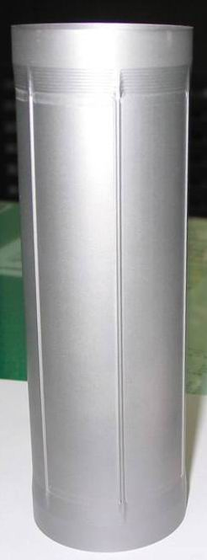
2. Beryllium pipes
2.1 Manufacture difficulty
highly toxic ----Very few company are allowed to machine Be
Too thin, too long
Brittle materials (RT)
Powder metallurgy
Beryllium rods are generally made of powder metallurgy
High surface quality requirements
Requirement：
Vacuum<8×10^{－8} Pa
Surface roughness<0.8μm
Plating gold in inner Be
Higher requirement: Purity, defects, heat treatment process
BEPC inner Be pipe
Ф66.2mm, 0.6mm，226mm

Slide 13
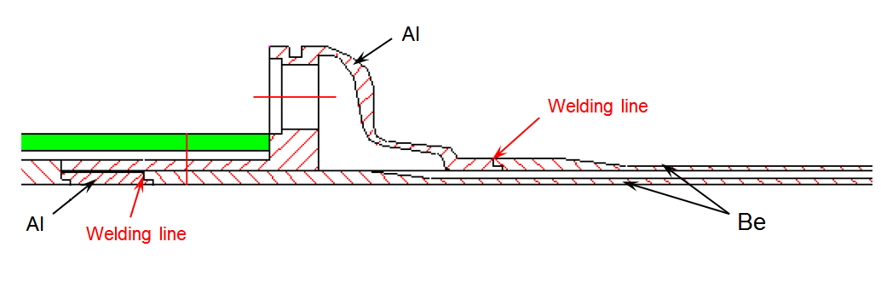
2. Beryllium pipes
2.2 Difficulty in Be-Al welding
Welding cracks
melting points Be--1289℃
Al ---660 ℃
oxidation
Welding stress
Low ductility
Severe anisotropy
Small welding depth
High welding deformation requirements
BEPC Be-Al welding
CEPC Be-Al welding

Slide 14
2. Beryllium pipes
Beryllium Processing Company
Northwest Institute of Rare Metal Materials (905)------BEPC Be pipe machine company
Shaanxi Haibao Special Metal Materials Co. LTD
Be-Al Welding Company
Sichuan Institute of Materials and Technology (903)---- BEPC Be-Al pipe welding company
Shanghai Shushuo Electronic Technology Co., LTD
All the company indicated that the processing and welding of the beryllium pipe was extremely difficult and need pre-research

Slide 15
2. Beryllium pipes
2.3 Research scheme
Development a thin - walled slender beryllium pipe
Inside diameter--20mm
Thickness --0.35mm
Long--120mm
To explore the processing technology and verify the possibility of manufacturing ultra-thin and ultra-fine beryllium pipe
Test
Dimensional accuracy
Surface roughness,
Concentricity,
Vacuum
Key technology
Processing technology
Impact of raw materials on process
Development of machining tools
Study on surface treatment technology
Expected research results
Master the processing technology of thin-walled beryllium pipe

Slide 16
2. Beryllium pipes
2.3 Research scheme
0.35 Be sheet—0.35 Al sheet welding
0.35mm Be-Al pipe welding
Welding parameter research
Beryllium pipe welding process
Test
Tensile strength,
Shear strength,
welding deformation,
interface morphology;
Vacuum
Leakage rate
Key technology
Welding parameters
Study on welding interface quality
Welding deformation control
Expected research results
Determined the final structure size of the beryllium pipe.
Master the welding process of thin-walled beryllium pipe

Slide 17
3. Future work
Deepen research on relevant materials.
Study on radiation damage of Beryllium
Actively apply for financial support and carry out pre-research of materials with relevant institute.

Slide 18
Thanks for your attention

