Slide 1
Design of HTS detector magnet
Ning Feipeng
2020-8-28

Slide 2
Outline
CEPC detector magnet HTS solenoid
HTS introduction
HTS magnet development
Radiation thickness calculation
Opportunities and challenges

Slide 3
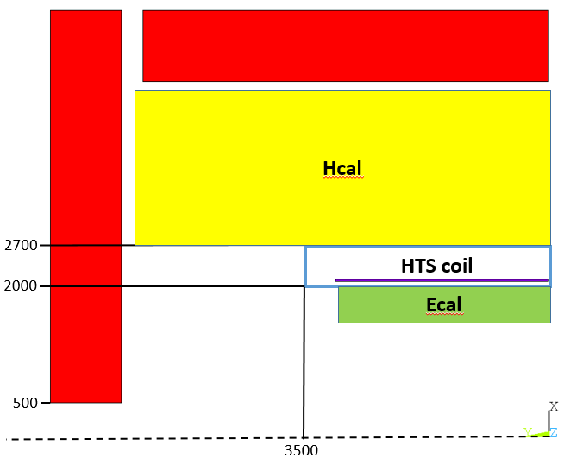
CEPC detector magnet HTS solenoid
The coil locates between Ecal
and Hcal.
The magnet parameters:
YOKE
Parameters | Value
Inner radius | 2 m
Outer radius | 2.7 m
Length | 7 m
Central magnetic field | 3 T
YOKE

Slide 4
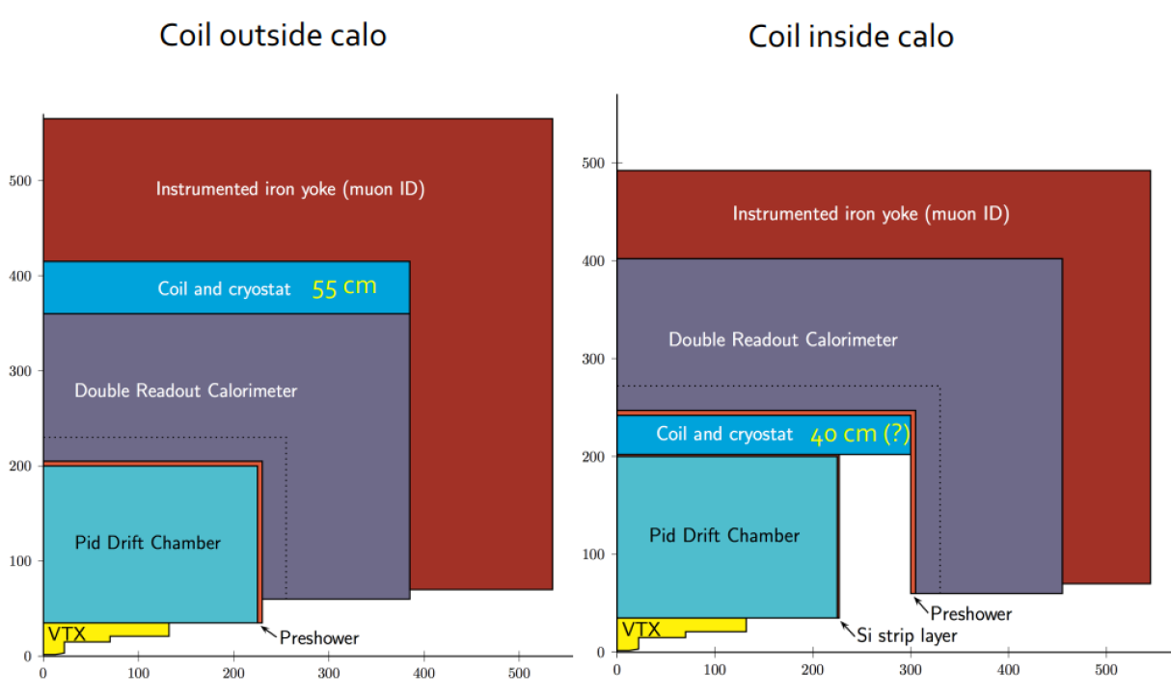
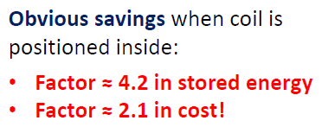
CEPC detector magnet HTS solenoid
IDEA LTS detector
  LTS solenoid inside
  Magnetic field is only required in the tracker + muon chambers, but most stored energy (some 80%) is wasted in the calorimeter space.
Solenoid outside or inside calorimeter?
Herman ten Kate

Slide 5
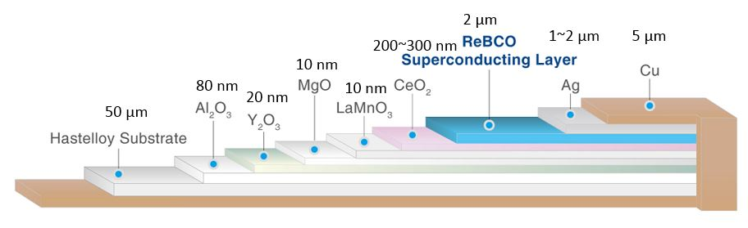
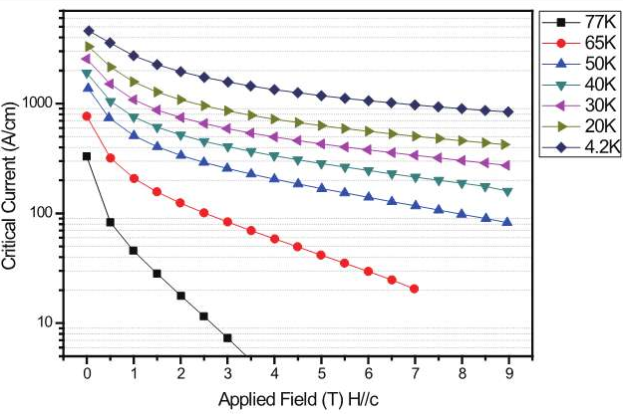
HTS introduction
A thin tape:
Critical temperature | About 80 K
Width | 2 mm ~ 12 mm
Thickness | 55 μm ~ 350 μm
10 mm width tape critical current (A):
 | 0 T | 1 T | 2 T | 3 T | 4 T
77 K | 422
30 K | 3016 | 1390 | 982 | 792 | 675
20 K | 4008 | 1982 | 1394 | 1124 | 961
4.2 K | 5755 | 3547 | 2534 | 2033 | 1733

Slide 6
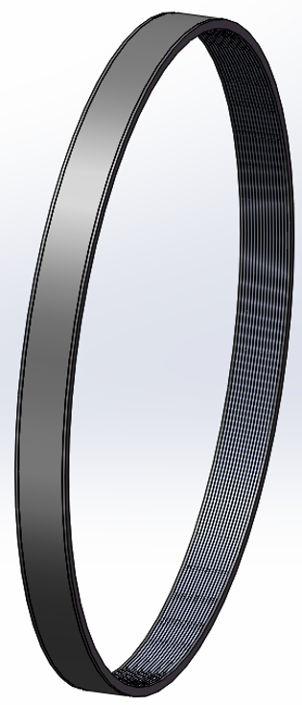
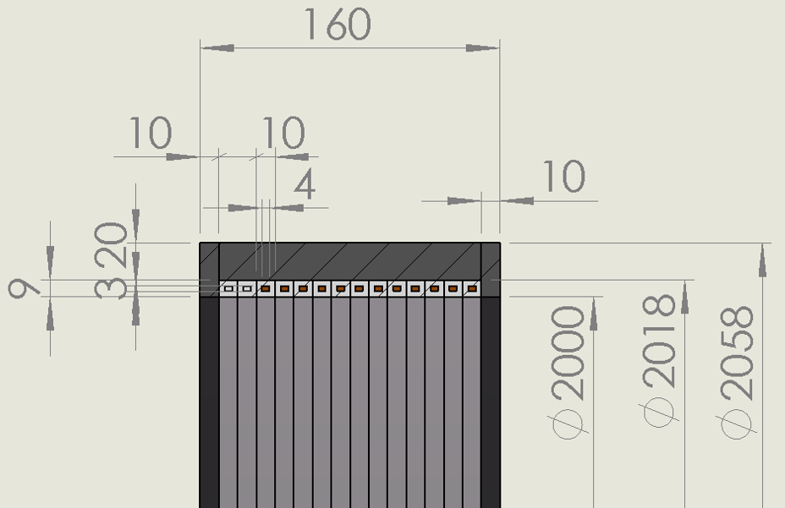
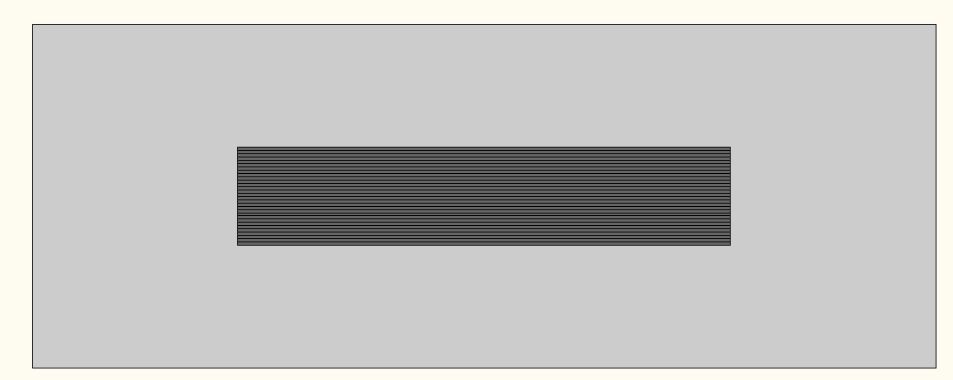
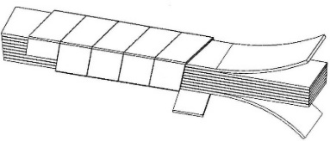
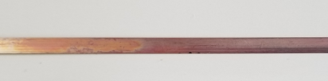
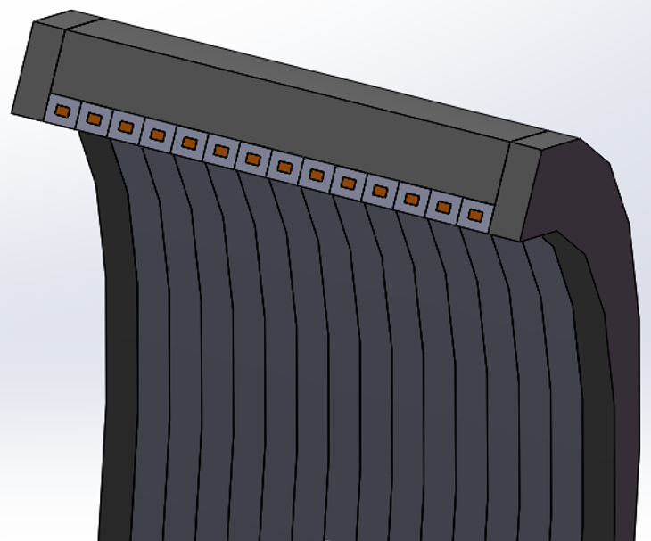
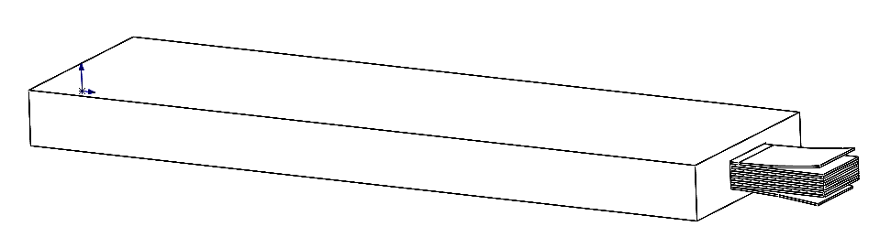
HTS magnet development
The prototype HTS coil is under development, 5 years plan(2019-2024):
  Al stabilized HTS stack cable (3 years).
  Prototype coil development (2 years).
3 years
2 years

Slide 7
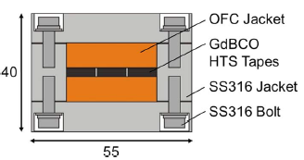
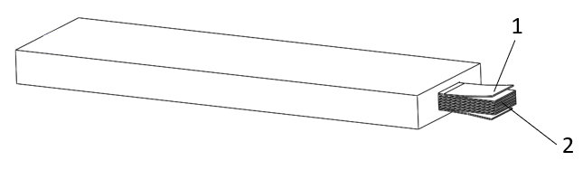
HTS cable development
TSTC(Twisted Stacked Tape Cable) by MIT
SSC(Simply—stacked HTS Conductors) by NIFS
ASTC(Al stabilized ReBCO Stacked Tape Cable) by IHEP
RACC(Roebel Assembled Coated Conductor) by KIT
CORC(Conductor On Round Core) by ACT

Slide 8
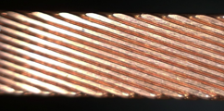
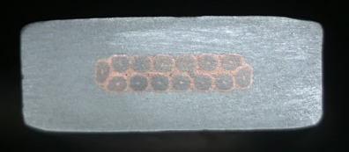
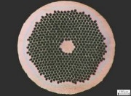
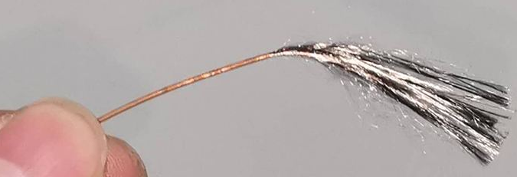
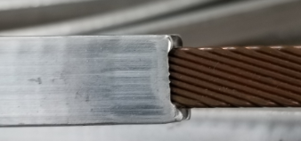

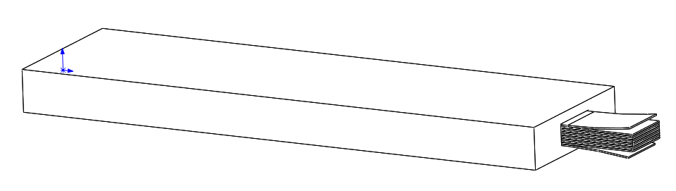
HTS cable development
LTS and HTS Cable development
Rutherford Cable
Al Stabilized Rutherford Cable
NbTi wire
LTS
Al stabilized ReBCO Stacked Tape Cable
ReBCO tape
ReBCO Stack Cable
HTS
It is developing

Slide 9

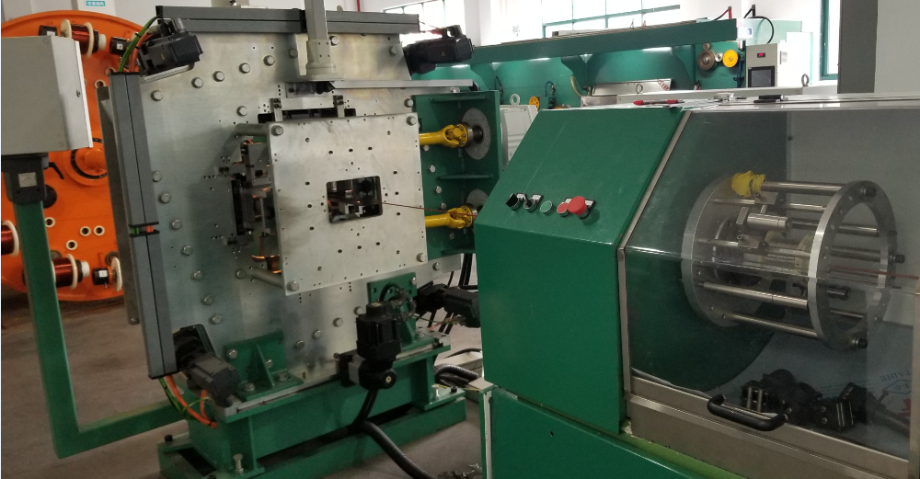
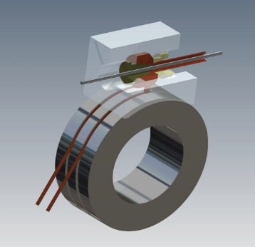
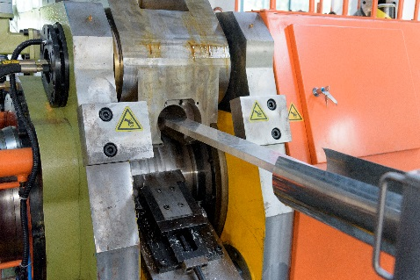
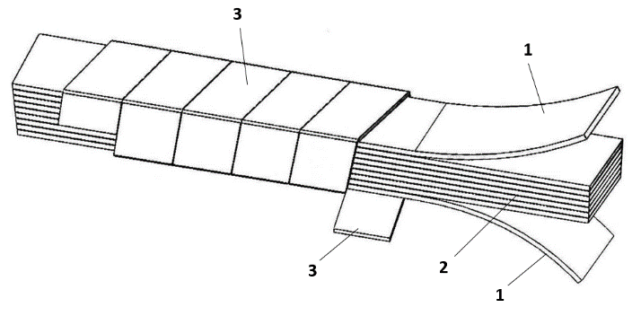
HTS cable development
ASTC(Al stabilized HTS Stacked Tape Conductor)
ReBCO tape
1, HTS stack cable
2, Add Al stabilization to HTS stack cable
Al stabilized ReBCO Stacked Tape Cable

Slide 10
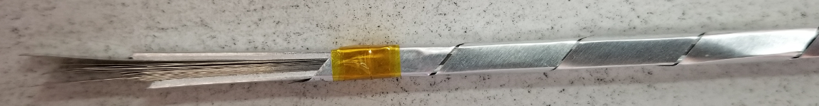
HTS cable development
Prototype cable:
Tape Width: 4 mm, thickness: 80 μm; tape layer: 20
Expected operating current: 6000 A
ReBCO Stack Cable
Compact stack structure:
Al film thickness and width
Winding stress
Other materials

Slide 11
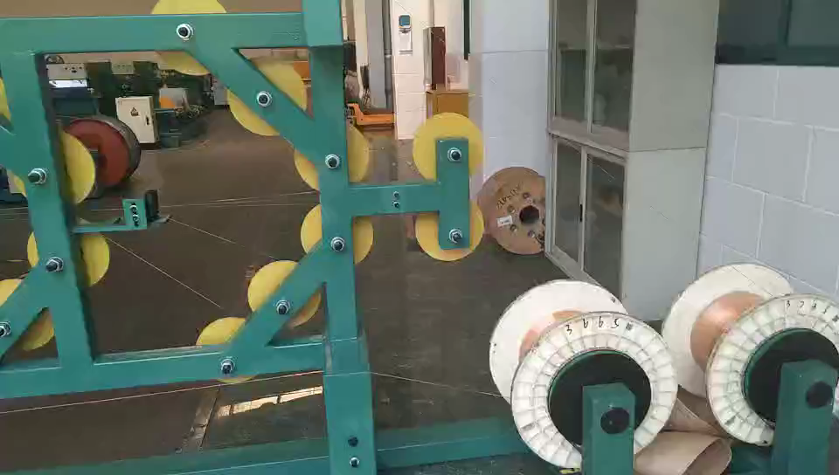
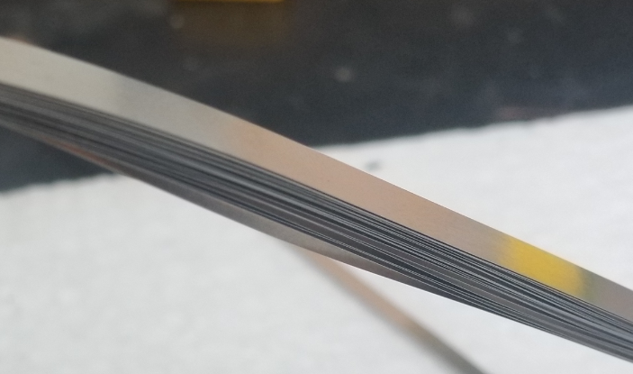
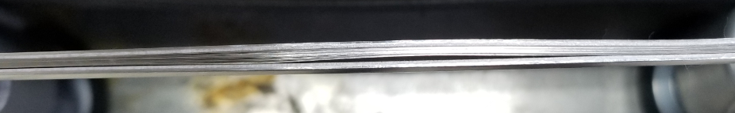
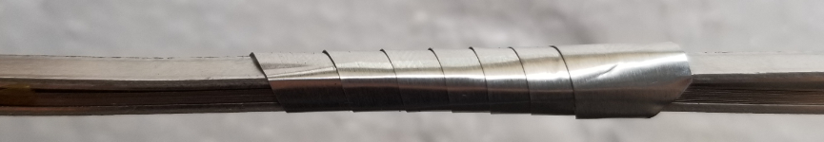
HTS prototype cable development
20 layers 60μm SS304
1mm Al
0.1 mm thickness& 10 mm width Al film

Slide 12
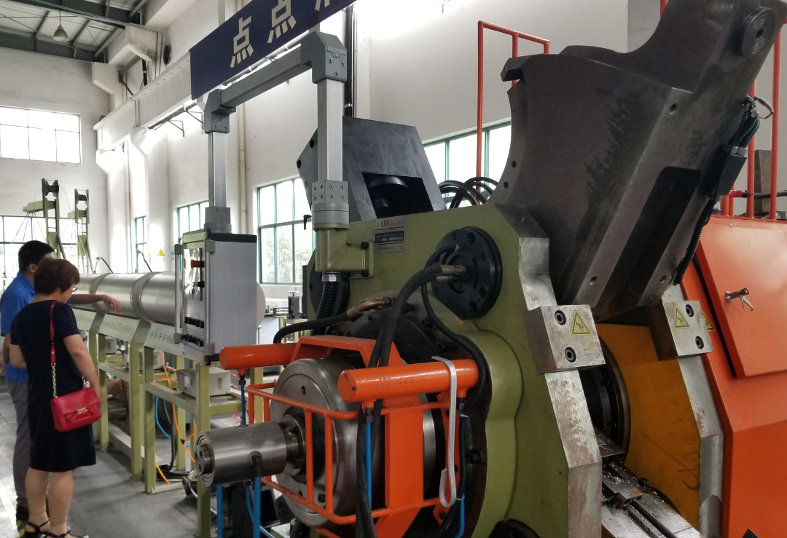
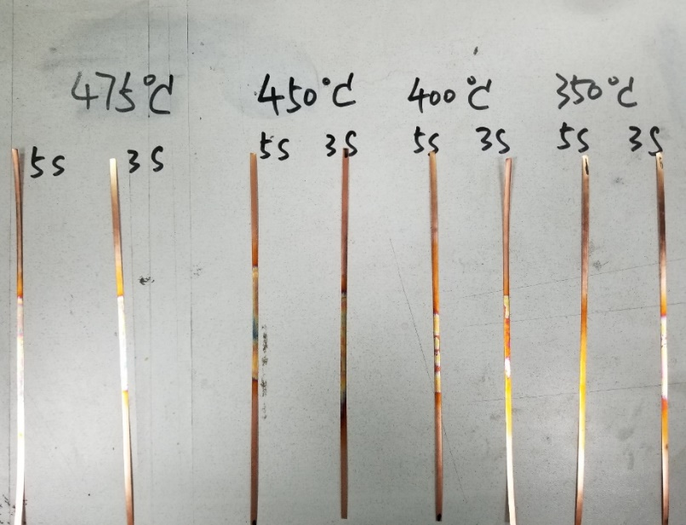
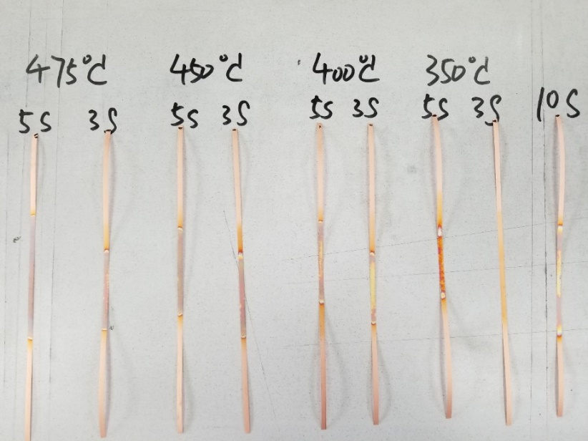
HTS cable prototype development
Add Aluminum stabilizer
Problems:
High temperature (420~450℃)
Big drawing force
High extrusion stress
Samri
SSC

Slide 13
HTS prototype coil development
Research:
  Large HTS coil winding;
  Winding process, No-insulation or insulation? Epoxy impregnating or not?
  Quench detection and protection;
  Current distribution in the cable;
  Cooling methods research;
  HTS cable joint;
  Current leads

Slide 14
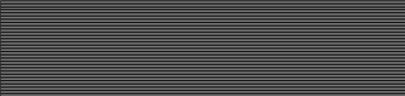
Radiation thickness calculation
Coil parameters:
Coil inner radius | 2.2 m
Coil length | 6 m
Cable layers | 2
Tape layer of each cable | 35
Tape width/thickness | 10 mm/80 μm
Operating current | 29700 A
Operating temperature | 5 K
20
10
5
15

Slide 15
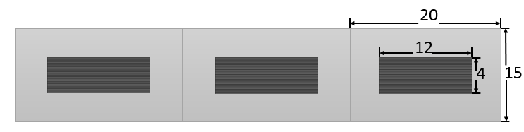
Radiation thickness calculation
35 layers HTS tapes of each cable.
Material | Thickness | Radiation thickness |  | Nuclear Interaction length
 | X, mm | X₀, mm | X/X₀ | λ0, mm | λ=X/λ0
Cu | 0.7 | 14.36 | 0.0244 | 153.2 | 0.0023
Fe | 1.75 | 17.57 | 0.0996 | 167.7 | 0.0104
Ag | 0.07 | 8.543 | 0.0082 | 154 | 0.0005
YBa2Cu3O7 | 0.07 | 12.49 | 0.0056 | 296.5 | 0.0002
MgO | 0.00000035 | 78.28 | 0.0000 | 274 | 0.0000
Al2O3 | 0.0000028 | 70.38 | 0.0000 | 247.9 | 0.0000
CeO2 | 0.0000105 | 16.54 | 0.0000 | 230 | 0.0000
Al stablizer | 10 | 88.97 | 0.1686 | 397 | 0.0378
MLI, Fiber glass | 0 | 286 | 0.0000 | 415 | 0.0000
Glassepoxy | 2 | 286 | 0.0070 | 428.9 | 0.0047
Total, X_{tot} |  |  | 0.2815 |  | 0.0455
Radiation thickness of HTS cable
(don’t include cryostat):
 | X0 | λ
Single cable | 0.2815 | 0.0455
Double layers cable | 0.563 | 0.091

Slide 16
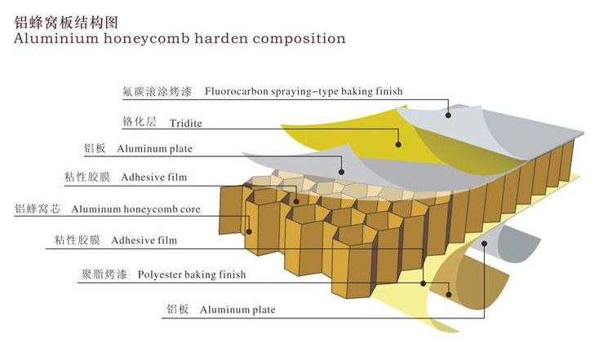
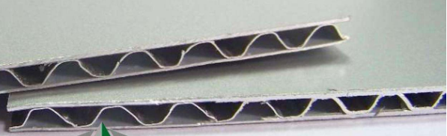
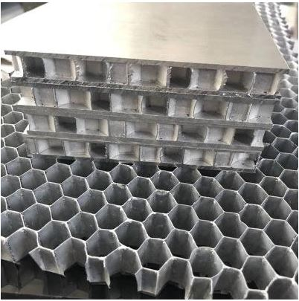
Radiation thickness calculation
The cryostat:
  Consider using the Cryostat (25 mm Al): X0= 0.28, λ= 0.07 Big chanllege
Total | X0 | λ
Cryostat 25 mm Al | 0.28 | 0.07
Cryostat 50 mm Al | 0.56 | 0.14
HTS cable | 0.563 | 0.091
Total (25 mm Al) | 0.843 | 0.161
Total (50 mm Al) | 1.123 | 0.231
Aluminum honeycomb plate
Need to develop new material in cryostat:

Slide 17
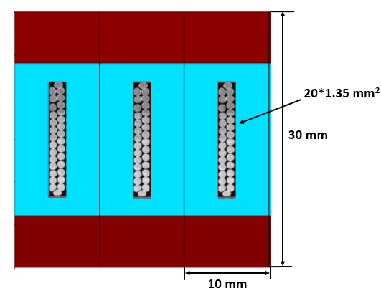
Radiation thickness calculation
LTS and HTS cable Comparison(double layers):
 | X0 | λ
LTS | 1.18 | 0.18
HTS | 0.563 | 0.091
Consider using the Cryostat (25 mm Al): X0= 0.28, λ= 0.07
Include cryostat
 | X0 | λ
LTS | 1.46 | 0.25
HTS | 0.843 | 0.161

Slide 18
Opportunities and challenges
New HTS cable development, variable applications in the future.
Large HTS magnet. Explore more HTS application
New cryostat development, aluminum honeycomb plate applied on cryostat.

