Slide 1

CEPC MDI
Sha Bai
for CEPC MDI group
Workshop on Detector & Accelerator Mechanics,
DongGuan, August 28-29, 2020.
2020-08-28

Slide 2
Outline
MDI layout and IR design
Key IR design issues
Beam physics requirement
IR heat load from SR and beam loss
Summary

Slide 3
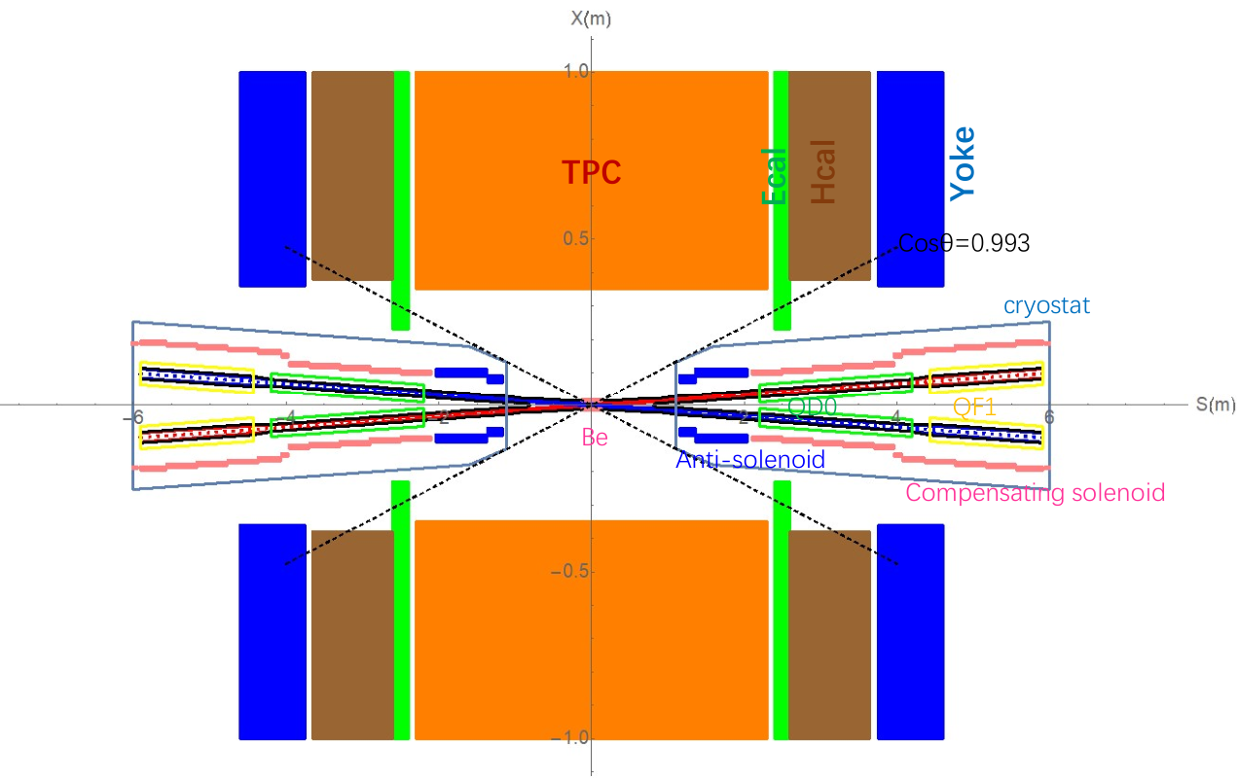
MDI layout and IR design
The Machine Detector Interface (MDI) of CEPC double ring scheme is about ±7m long from the IP.
The CEPC detector superconducting solenoid with 3T magnetic field and the length of 7.6m.
The accelerator components inside the detector without shielding are within a conical space with an opening angle of cosθ=0.993.
The e+e- beams collide at the IP with a horizontal angle of 33mrad and the final focusing length is 2.2m.

Slide 4
MDI related issues
IR superconducting magnet design
Cryostat
Anti-solenoid and solenoid design
IP BPM
Collimator
HOM absorber
Luminosity calorimeter
IR vacuum chamber
Remote vacuum connection
Shielding
Cooling
Vacuum pump
Supporting system
Flange
Bellows
Alignment
Coating
Luminosity monitoring
……………………………………………………………etc on

Slide 5
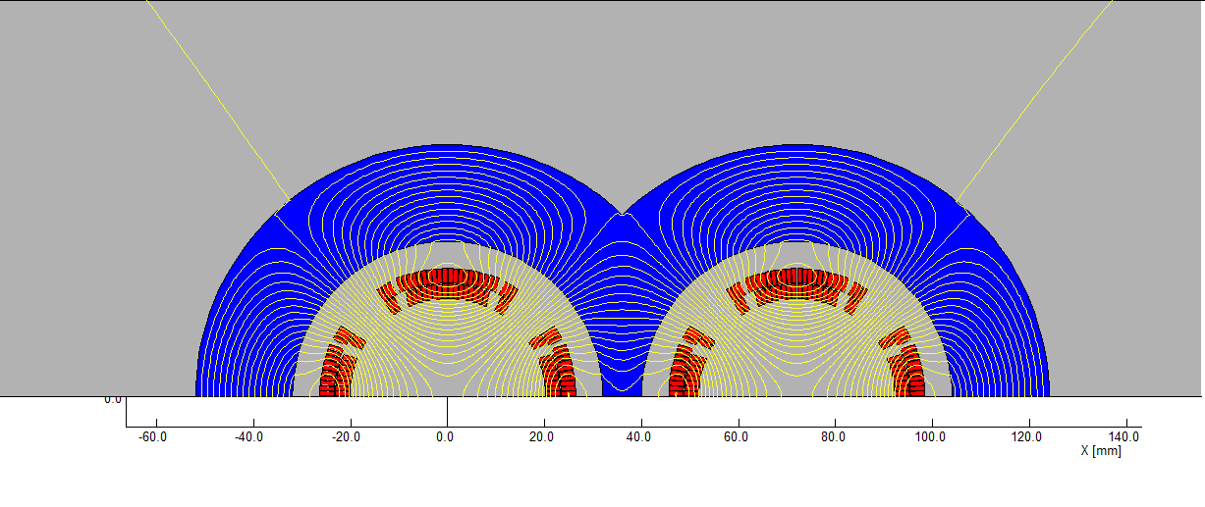
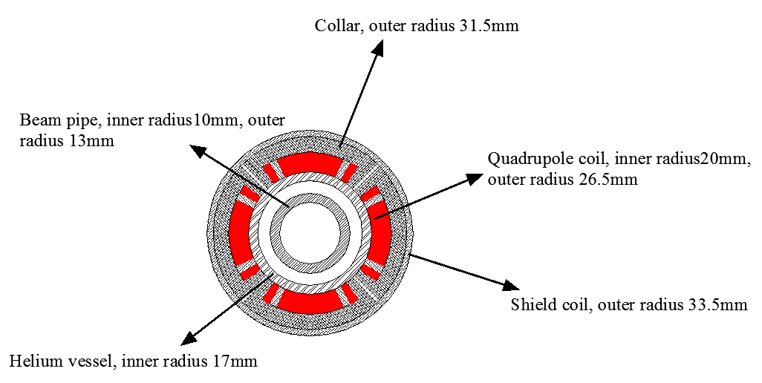
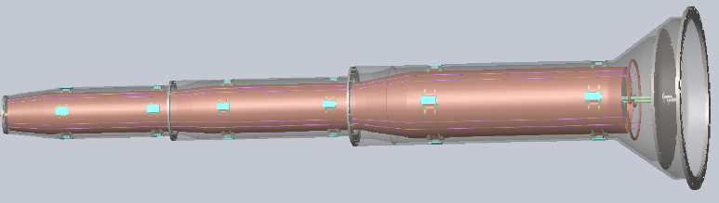
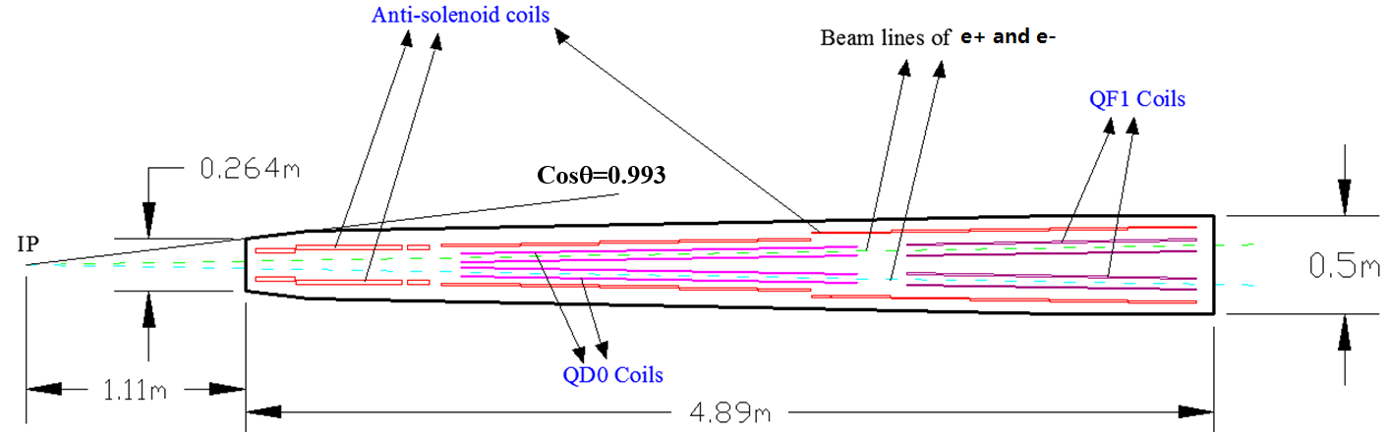
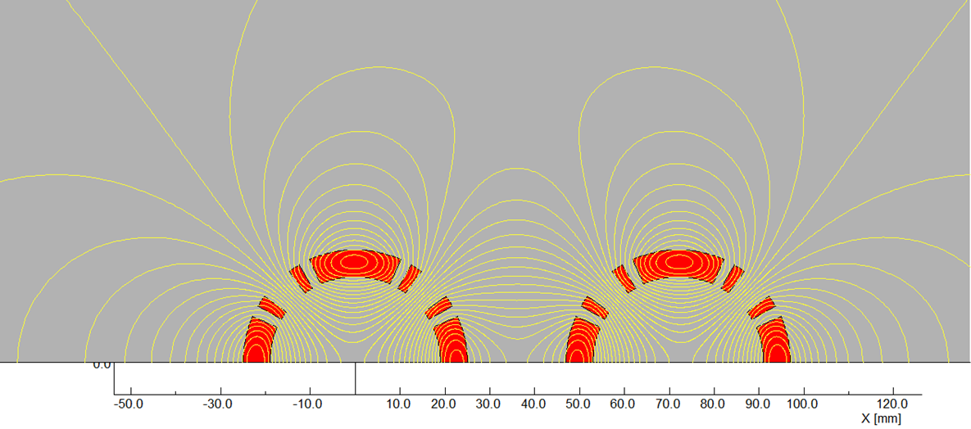
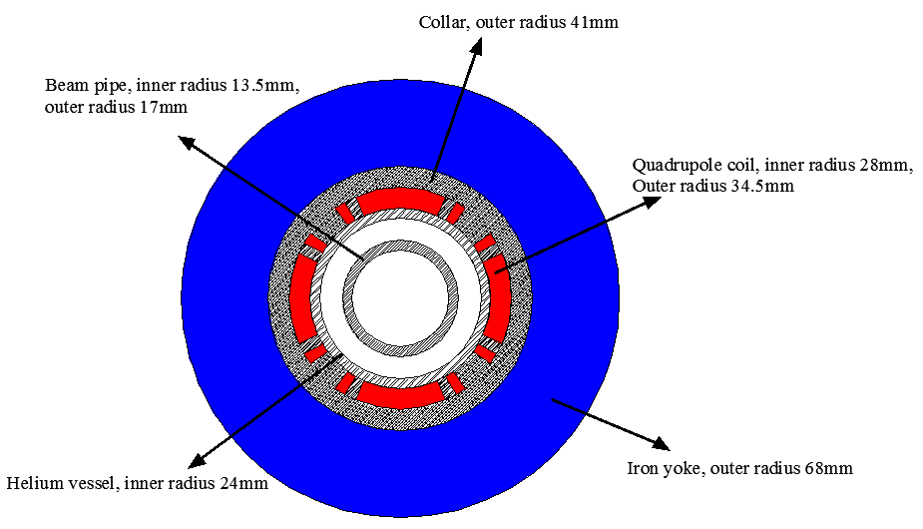
Key IR design challenges
✓ L*=2.2m, θc=33mrad, βx*=0.36m, βy*=1.5mm, Detector solenoid=3.0T
  Strength requirements of anti-solenoids (B_{z}~7.2T)
  Enough space for the SC quadrupole coils in two-in-one type (Peak field 3.8T & 136T/m) with room temperature vacuum chamber. magnetic field cross talk effect between two apertures is negligible using iron yoke.
The length of cryostat is 4.9m

Slide 6
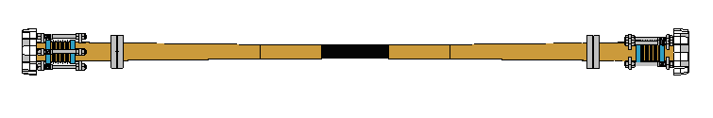
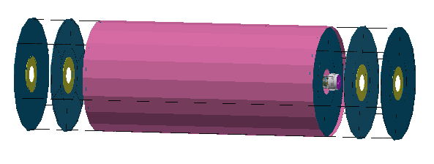
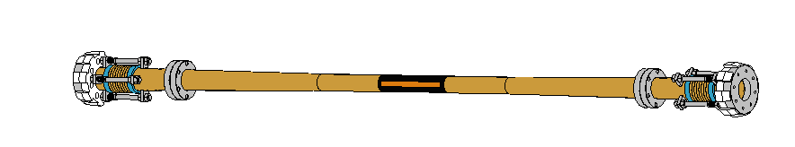
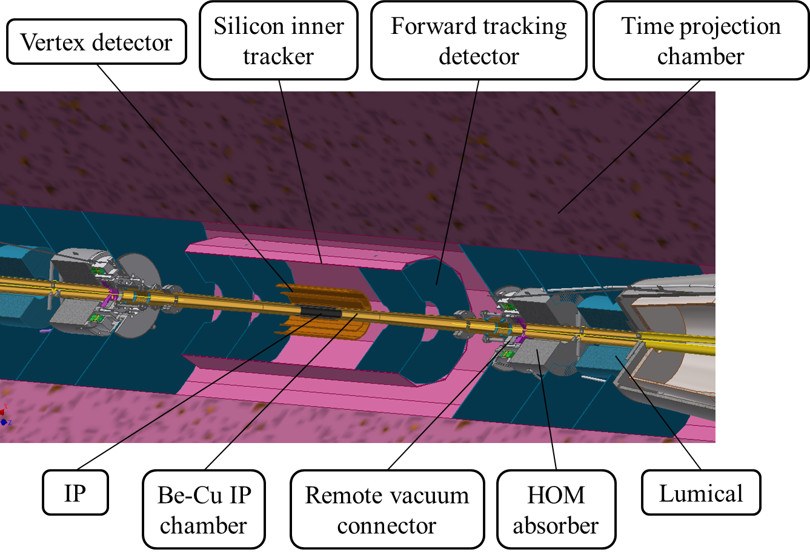
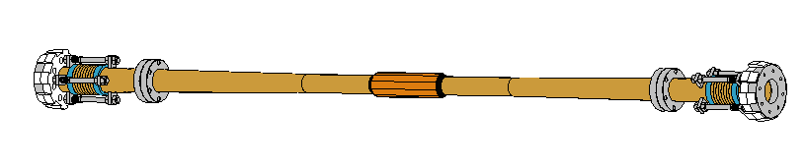
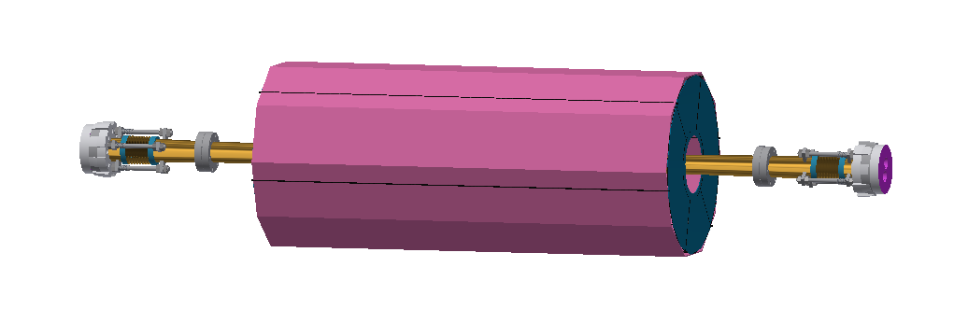
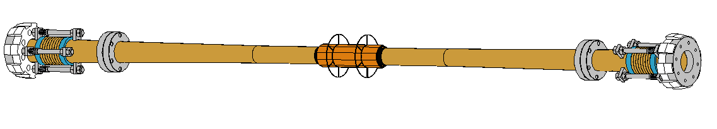
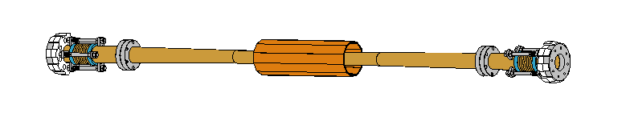
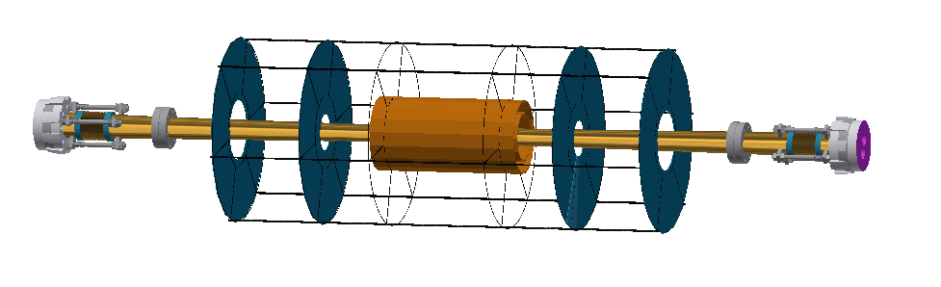
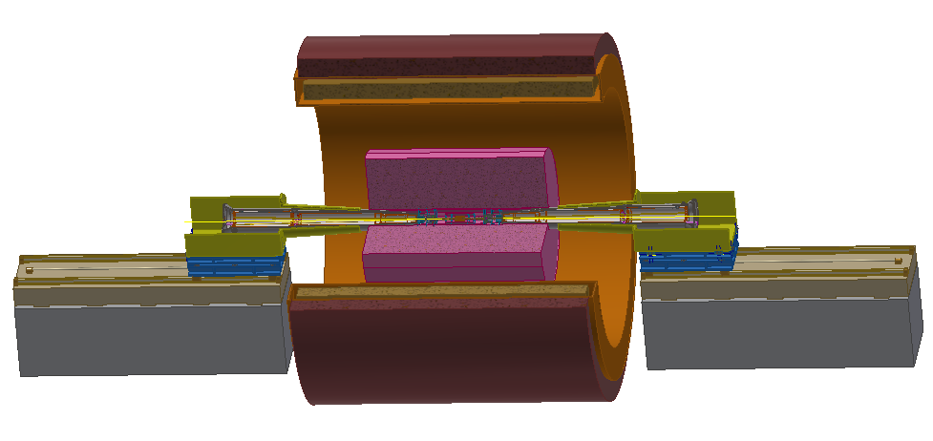
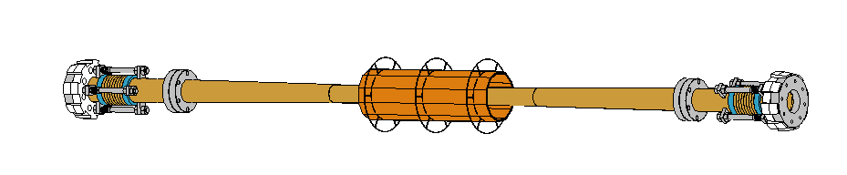
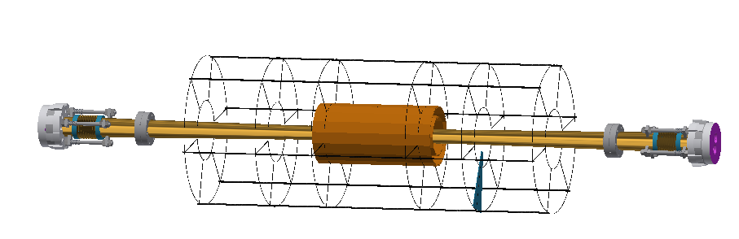
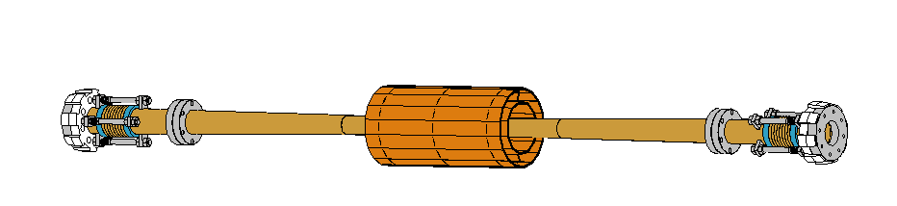
Key IR design challenges
IP assembly
  Support and connection (Preliminary)
  Alignment (No idea)
Connect the flanges using RVC

Slide 7
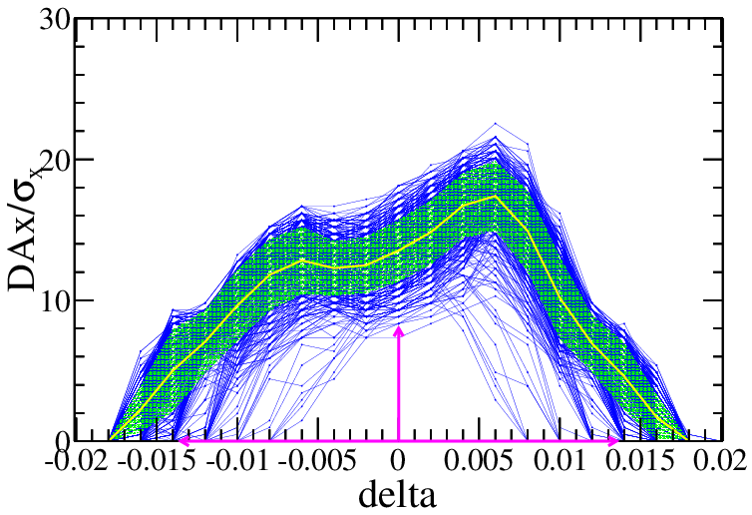
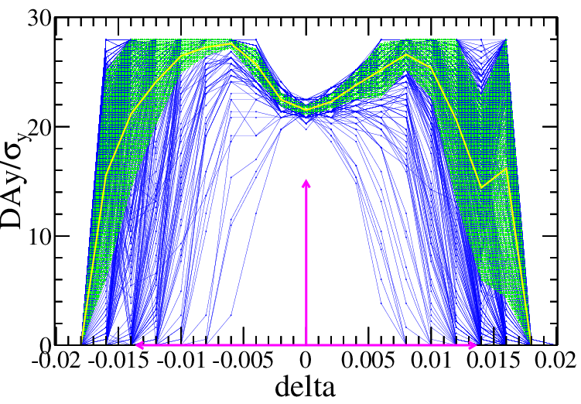
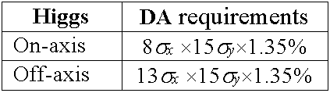
Key beam physics challenges
Dynamic aperture optimization with errors @ Higgs
Crab waist=100%
SAD code for tracking
145 turns tracked
100 samples
IR sextupoles + 32 arc sextupoles
(Max. free various=254)
Damping at each element
RF ON
Radiation fluctuation ON
Sawtooth on with tapering
$$10σ_{x}×20σ_{y} \& 0.014$$
> 90% of 1000 seeds
Component | Δx (mm) | Δy (mm) | Δz (mm) | Δθ_{x} (mrad) | Δθ_{y} (mrad) | Δθ_{z} (mrad) | Field error
Dipole | 0.10 | 0.10 | 0.10 | 0.1 | 0.1 | 0.1 | 0.01%
Arc Quadrupole | 0.10 | 0.10 | 0.10 | 0.1 | 0.1 | 0.1 | 0.02%
FF Quadrupole | 0.03 | 0.03 | 0.03 | 0.03 | 0.03 | 0.03
Sextupole | 0.10 | 0.10 | 0.10 | 0.1 | 0.1 | 0.1
Dipole | Quadrupole | Sextupole
B₂/B₀≤4×10⁻⁴ B₃/B₀≤0.8×10⁻⁴ B₄/B₀≤0.2×10⁻⁴ B_{n}(n>4)/B₀≤0.8×10⁻⁴ | B₂/B₁≤4×10⁻⁴ B₃/B₁≤4×10⁻⁴ B₄/B₁≤2×10⁻⁴ B_{n}(n>4)/B₁≤1×10⁻⁴ | B₃/B₂≤20×10⁻⁴ B₄/B₂≤3×10⁻⁴ B₅/B₂≤20×10⁻⁴ B_{n}(n>5)/B₂≤10×10⁻⁴
RMS
R=12mm
RMS close orbit distortions are smaller than 40 µm in both horizontal and vertical plane. Beta beatings < 1.5% , Coupling < 0.2%

Slide 8
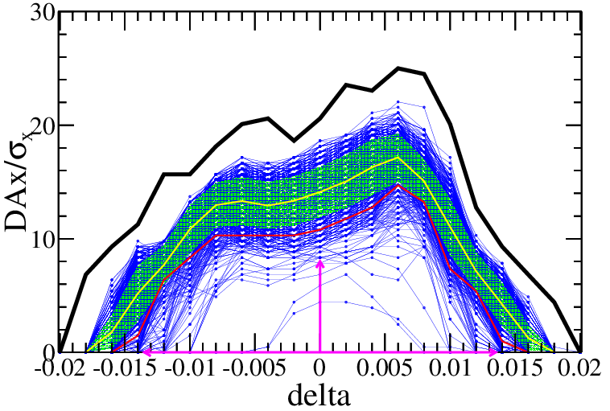
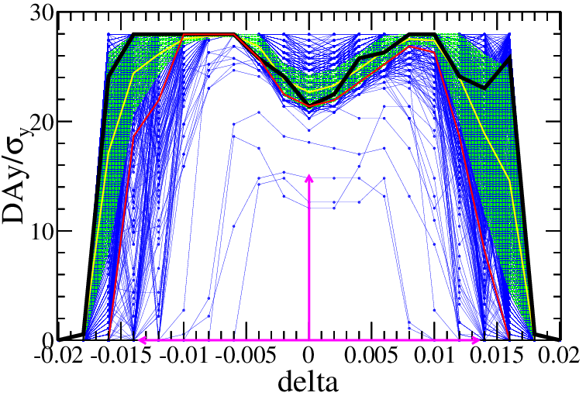
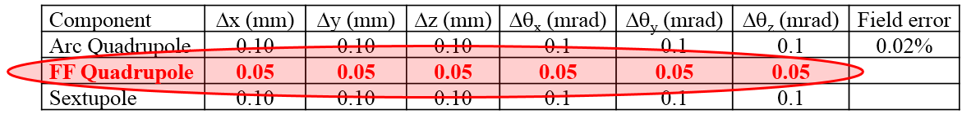
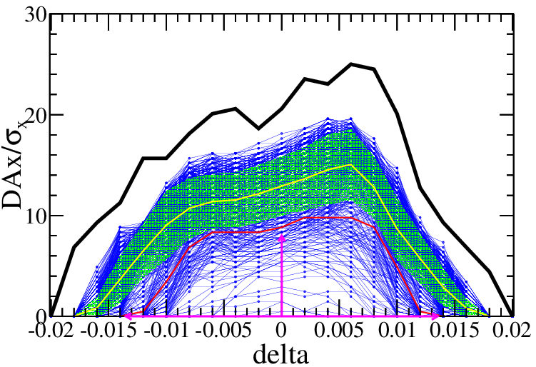
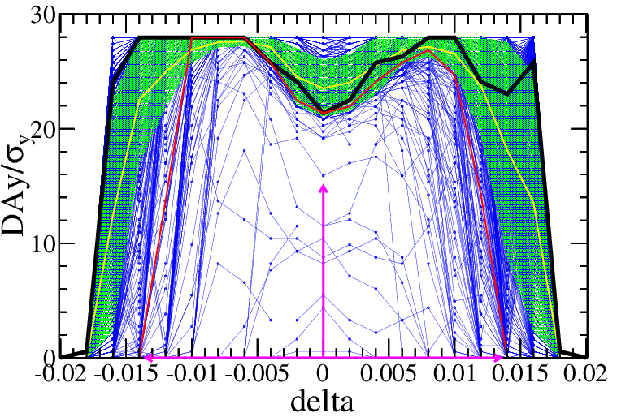
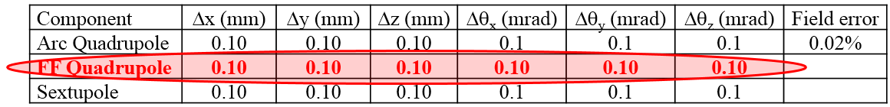


Physics requirements of IR alignment
Dynamic aperture optimization with errors @ Higgs
$$10σ_{x}×21σ_{y} \& 0.014$$
~89.1% of 1000 seeds
~72.4% of 1000 seeds
9$σ_{x}×20σ_{y} \& 0.014$
The optics correction is very challenging for the relaxed tolerance of the imperfections.
More finer correction of orbit and optics
More harsh alignment restrictions
Physics requirements of alignment can be ~100um

Slide 9
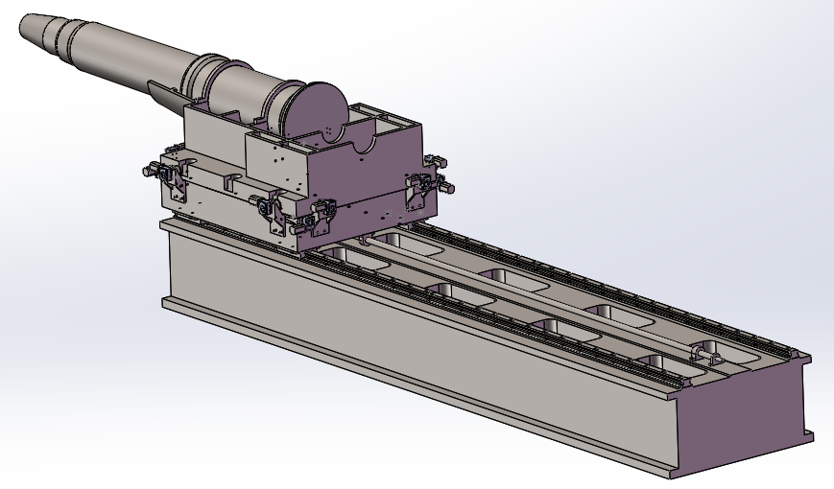
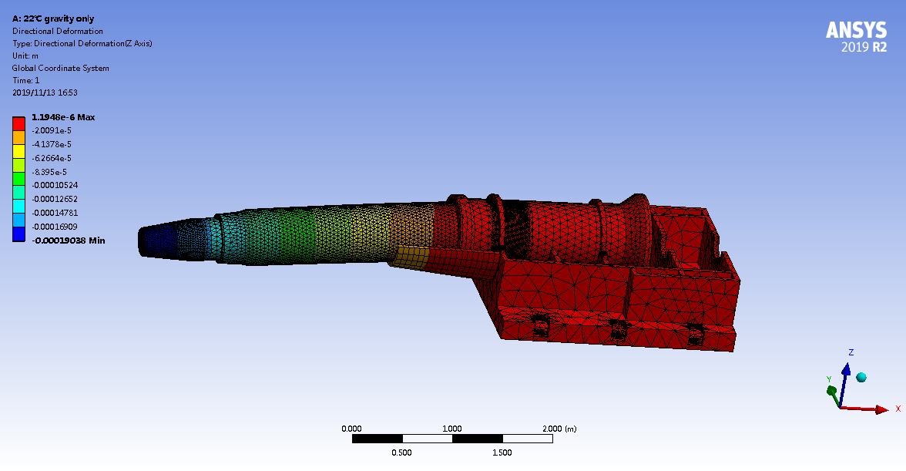
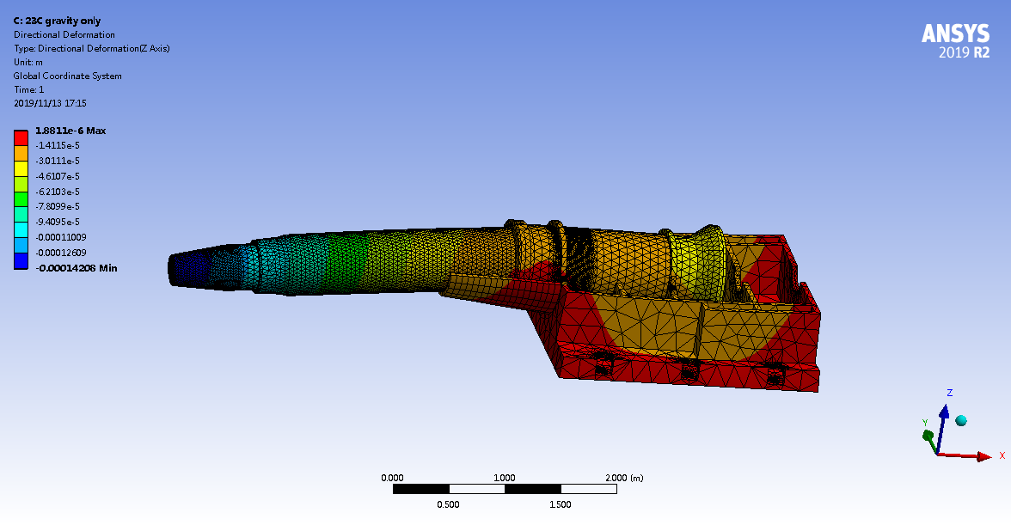
Key IR design challenges
In fact
Under gravity, deformation=190μm
1°C variation, deformation=48μm
Under magnetic field force the deformation> 0.5mm
  We still have no effective online measurement and alignment.
  Short FF system → larger betaY* → Decreasing the luminosity

Slide 10
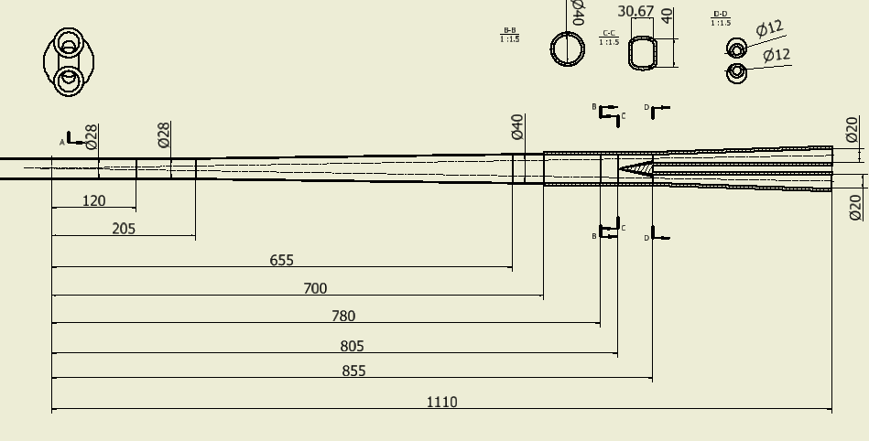
IR beam pipe design
开叉点805，有斜坡，叉管起始点855，锥形，接口700

Slide 11
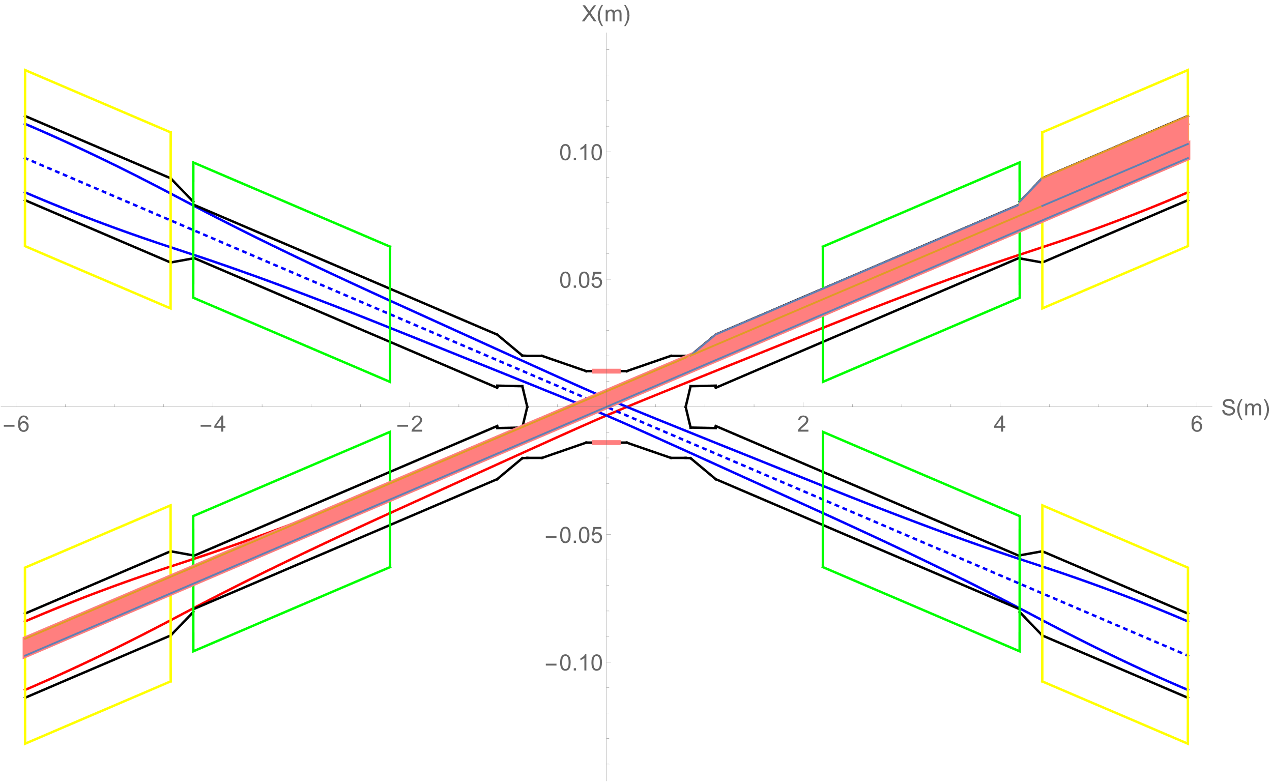
SR from last bending magnet upstream of IP
Normal condition
When in normal condition, the detector pipe (IP~0.855m) has no SR heat load.
0.855~1.11m beam pipe SR power ~36.35W，APD~ 39.6W/cm².
1.11m~2.2m SR power~1.49W, APD~0.38W/cm².
QD0~2.89W, APD~0.39W/cm². QD0~QF1~ 47.9W, APD~57.6W/cm².
QF1~3.42W, APD~0.64W/cm².
-0.854~-0.855m beam pipe SR power ~106.6W，APD~ 29608.3W/cm².
QF1
QD0

Slide 12
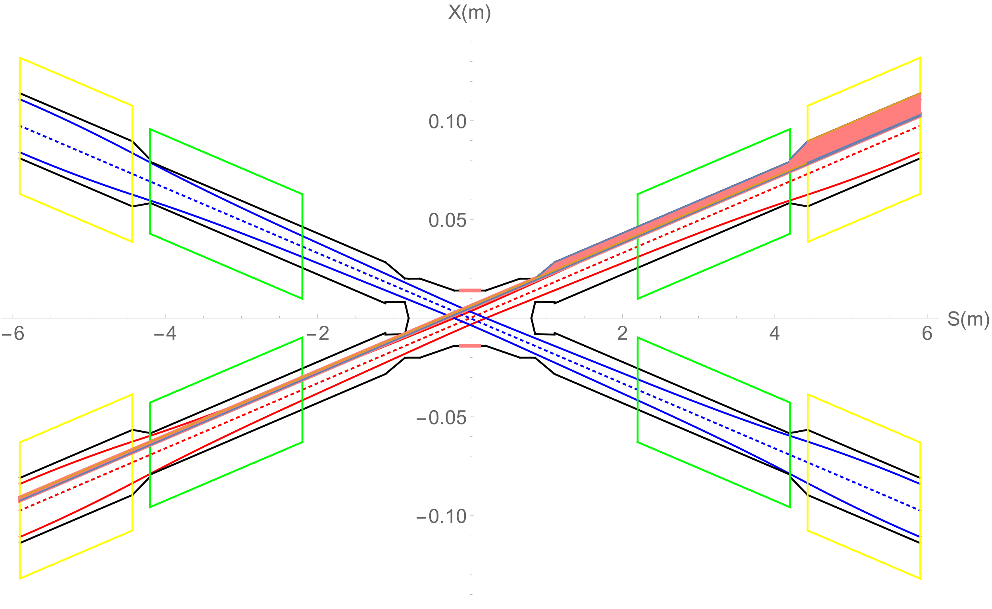
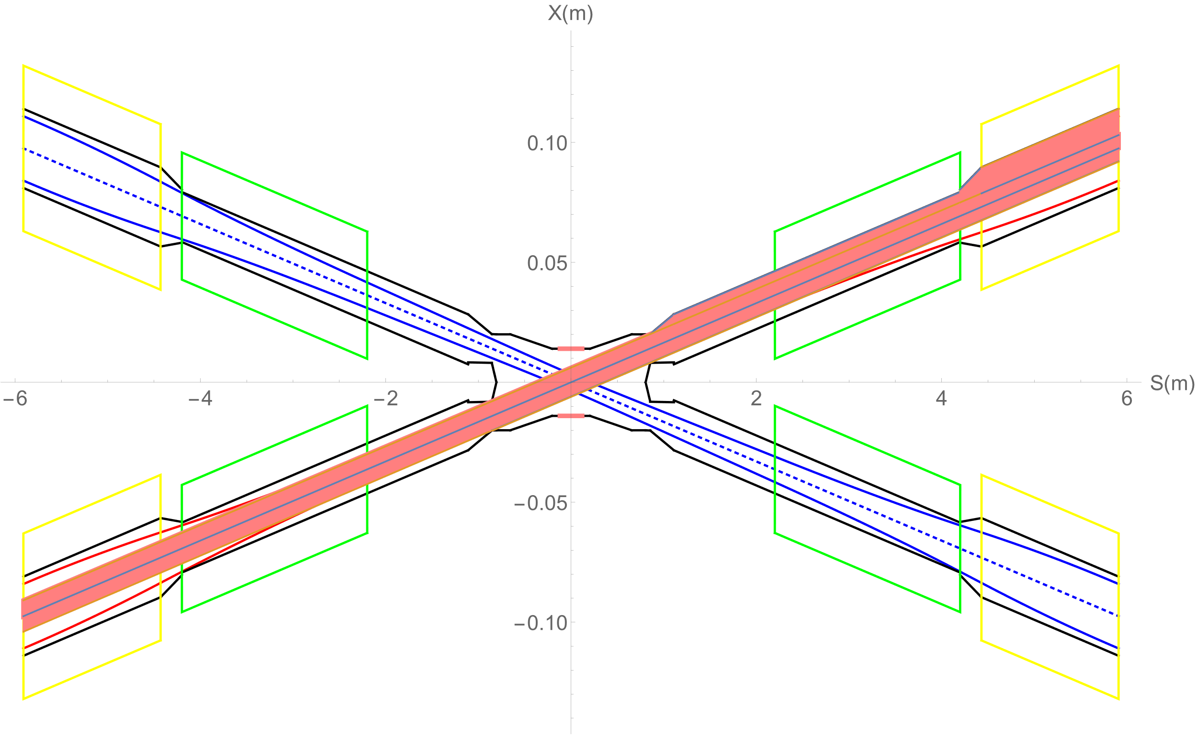
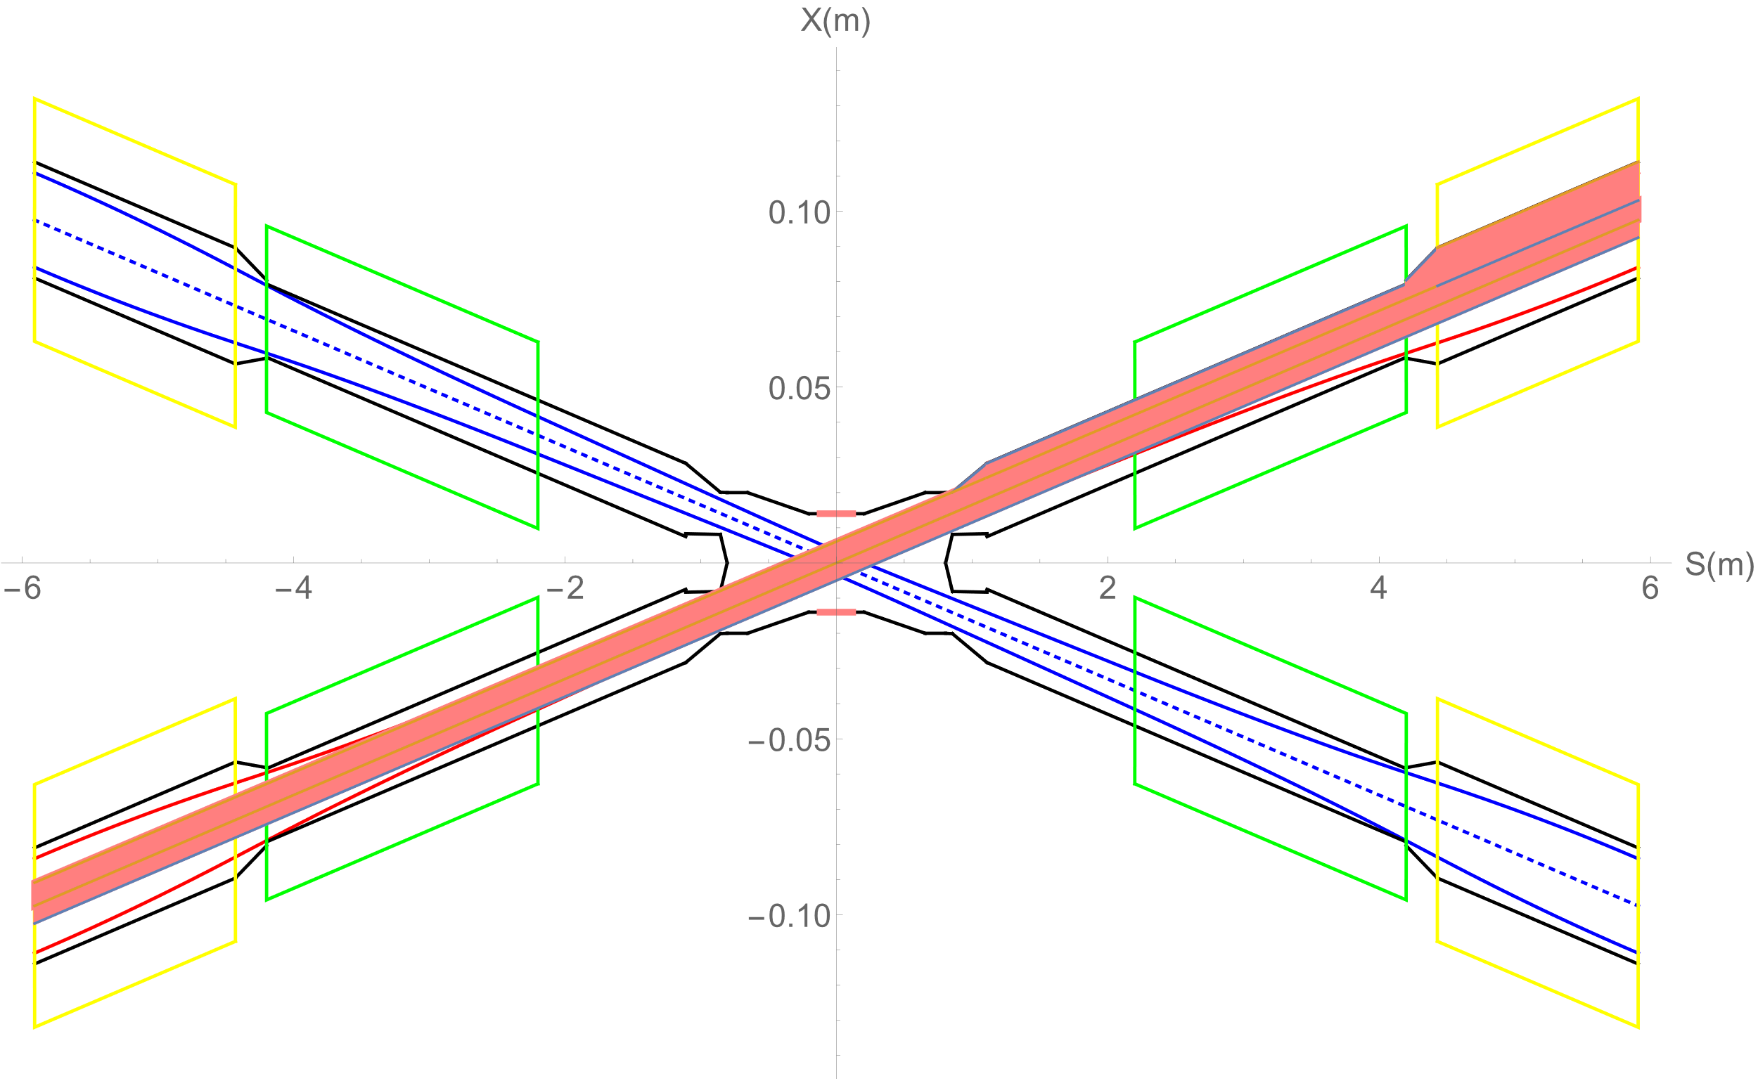
SR from last bending magnet upstream of IP
Extreme condition
For (a) When in normal condition, the detector pipe (IP~0.855m) has no SR heat load.
For (b) When the beam moves from 0 to +2mrad, in the range of (+0.089mrad~+0.091mrad) SR will enter into the acc Cu beam pipe. IP~839mm, no SR heat load. -839~-855mm beam pipe, SR power ~1.37W, APD~ 23.8W/cm².-854~855mm beam pipe, SR power~106.6W, APD~29608.3W/cm².
For (c) and (d), since shortest distance at 0.855m to beam axis, the upstream SR will be prevented, no SR thermal load from IP to 0.855m. The thermal load of other vacuum chamber no change (same as normal conditions), parameters of dipole no change, but SR fan will move up and down.
For (e) When the beam position offset +5mm with angle offset, in the range of (+0.162mrad~+0.166mrad)SR will enter into the acc Cu beam pipe.IP~832mm, no SR heat load. -832~-855mm beam pipe, SR power ~2.41W, APD~ 29.1W/cm².-854.8~855mm beam pipe, SR power~105.5W,APD~146486W/cm².
For (f) When the beam position offset -5mm with angle offset, in the range of (+0.0165mrad~+0.0161mrad)SR will enter into the acc Cu beam pipe.IP~847mm, no SR heat load. -847~-855mm beam pipe, SR power ~0.21W, APD~ 7.12W/cm².-853~855mm beam pipe, SRpower~107.7W, APD~14958.3W/cm².
(a) Beam angle offset 0~-2mrad
(c) Beam position offset 0~+5mm
(e) Beam position 0~+5mm+angle offset
(b) Beam angle offset 0~+2mrad
(d) Beam position offset 0~-5mm
(f) Beam position 0~-5mm+angle offset
SR Gaussian distribution with narrow band~ 0.36mm in width

Slide 13
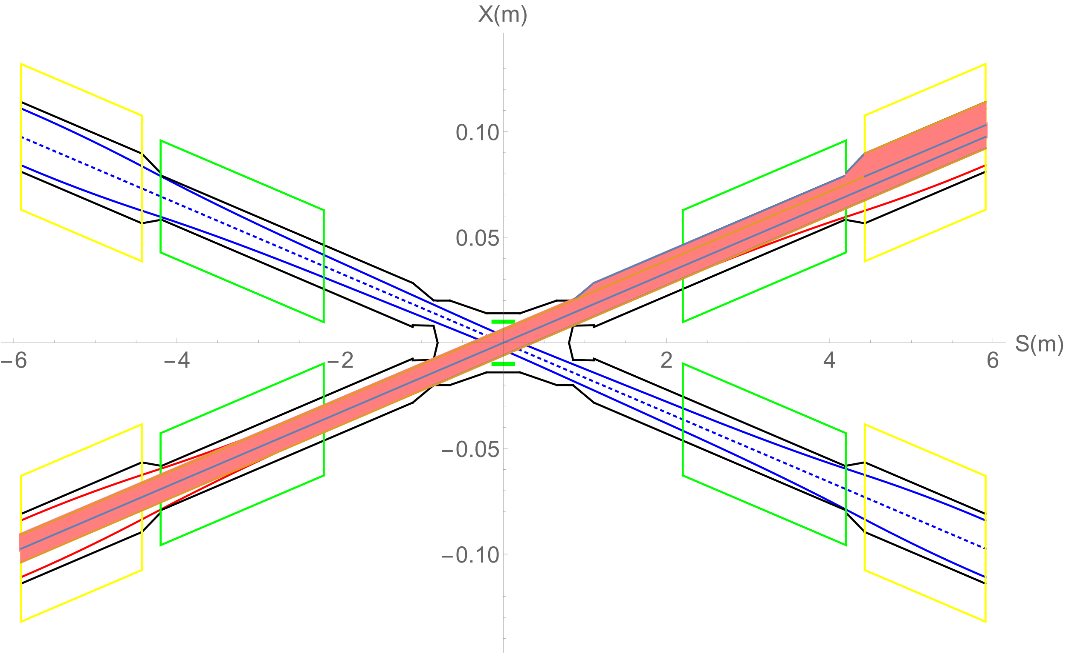
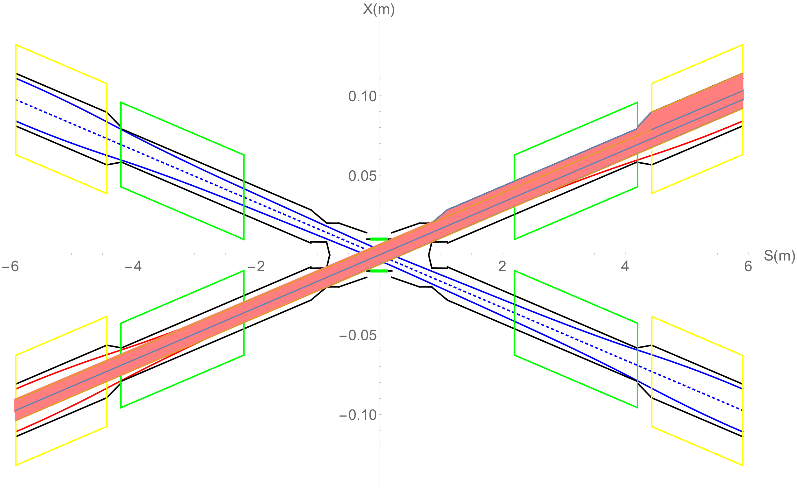
Be pipe inner diameter~20mm is OK or not?
Green lines shows the Be pipe with diameter~20mm.
There should be no SR photons directly hitting Be pipe, otherwise Be pipe will be melted.
SR photons will not hit Be pipe (-120mm~+120mm).
SR photons will not hit -205mm~+205mm beam pipe (Be+Al) with diameter 20mm.

Slide 14
Concerning of extreme conditions
Extreme condition, eg, if a magnet power is lost, a large distortion will appear immediately for the whole ring orbit. The beam will be lost when exceeded.
In extreme cases ~ at least 10 times per day. The beam will be stopped within 0.5ms when abnormal. It is not afraid of this 0.5ms for other material beam pipe except beryllium pipe.
The background of the detector should not be considered under abnormal conditions.
It is not necessary to care about whether the beam orbit deviation will affect detector operation, since the high background part will be removed when data analysis is carried out.

Slide 15
Beam loss due to Radiative Bhabha scattering
Without collimators
With collimator
With collimators
Heat load power on the Be pipe (IP~0.125m) ~9mW. （0.125m~0.7m) ~0.034W.
Heat load power on beam pipe(0.7m~2.2m) ~0.21W.
Heat load power on beam pipe(QD0) ~1.92W.
Heat load power on beam pipe(QD0~QF1) ~0.023W.
Heat load power on beam pipe(QF1) ~0.18W.

Slide 16
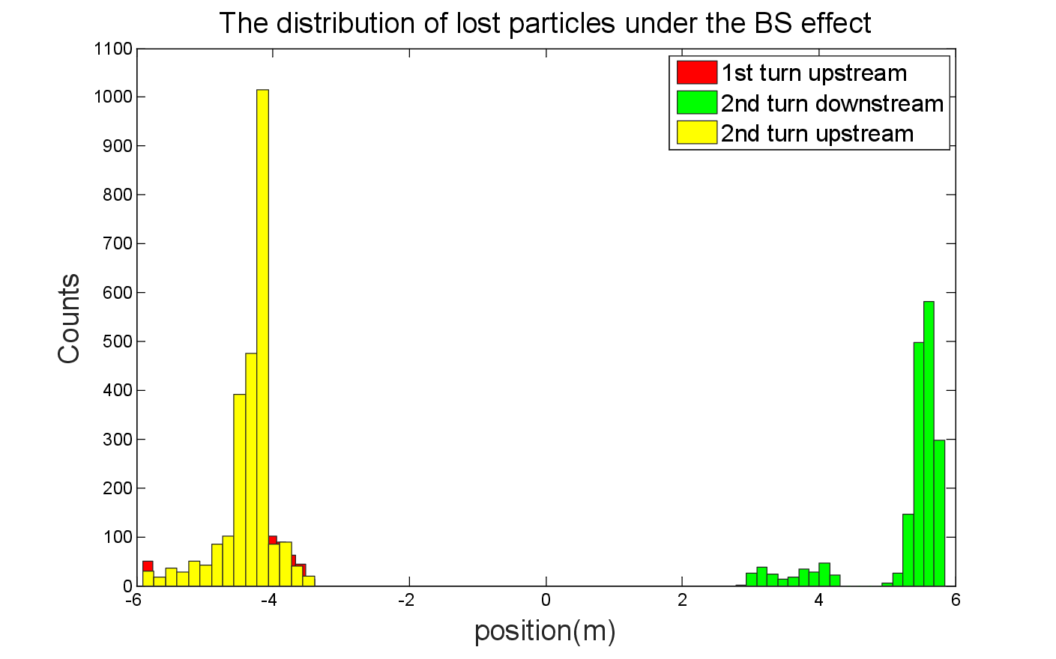
Beam loss due to Beamstrahlung
With collimator
Without collimator
There is no beam loss due to Beamstrahlung with the collimators, thus no heat load on beam pipe in MDI.

Slide 17
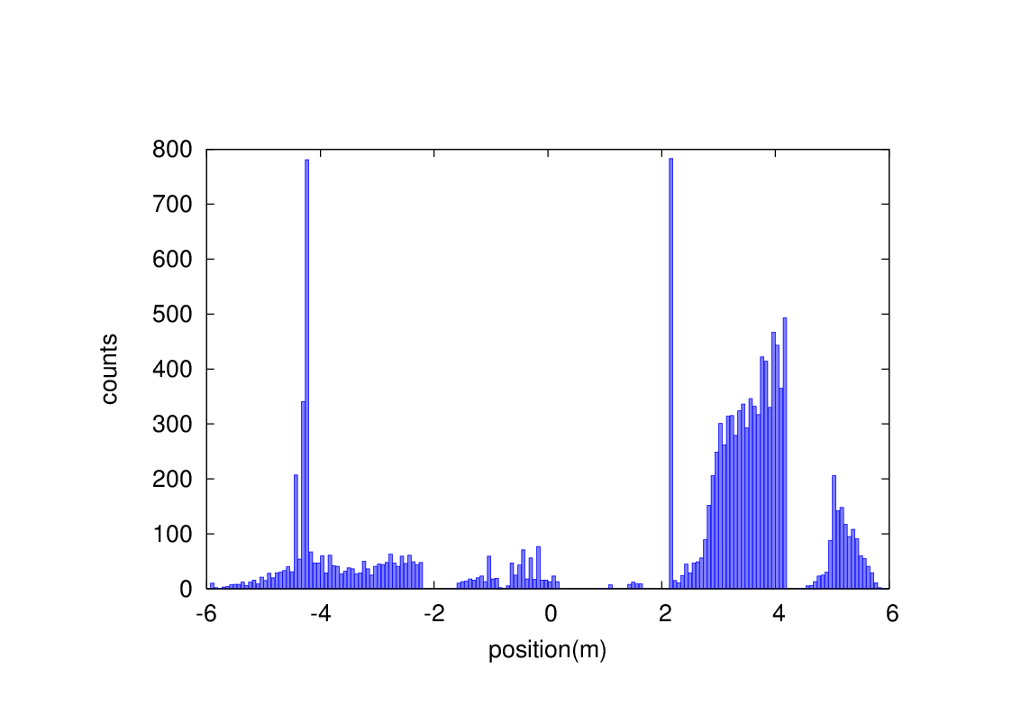
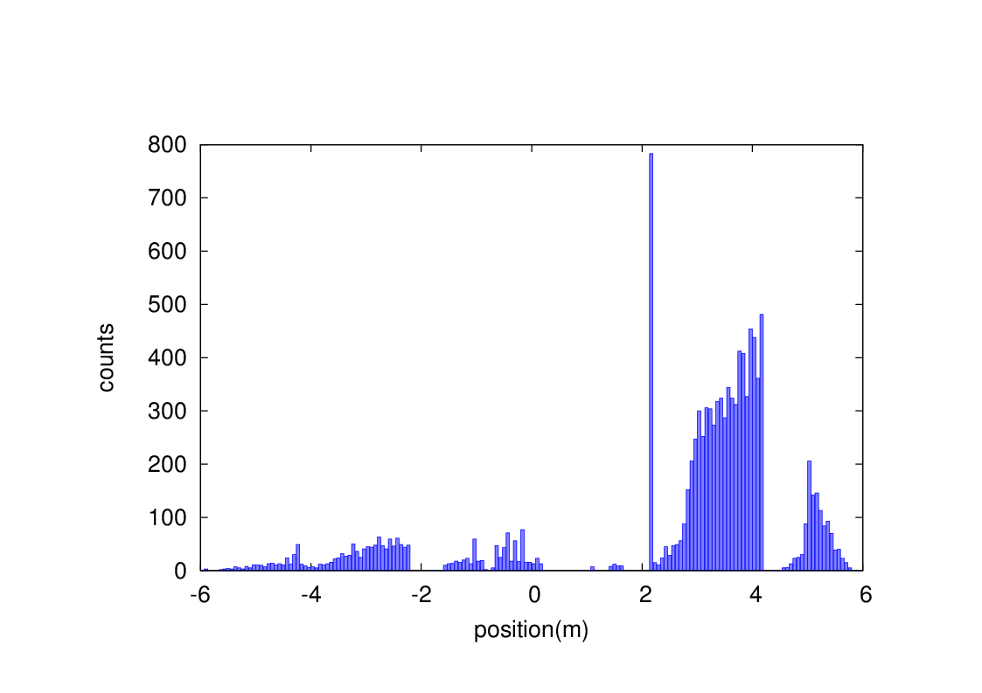
Beam-Gas bremsstrahlung
Without collimators
Heat load due to BG loss on the detector pipe (IP~0.7m) ~7.5uW.
Heat load power on beam pipe(0.7m~2.2m) ~3.3mW
Heat load power on beam pipe(QD0) ~0.011W
Heat load power on beam pipe(QD0~QF1) ~0W
Heat load power on beam pipe(QF1) ~1.2mW
With collimators

Slide 18
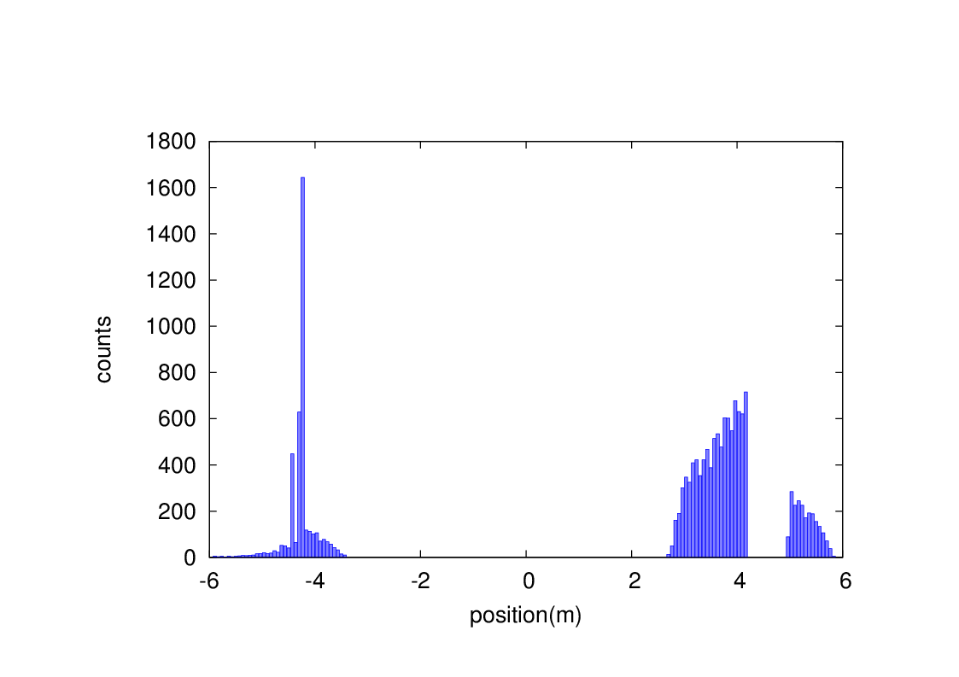
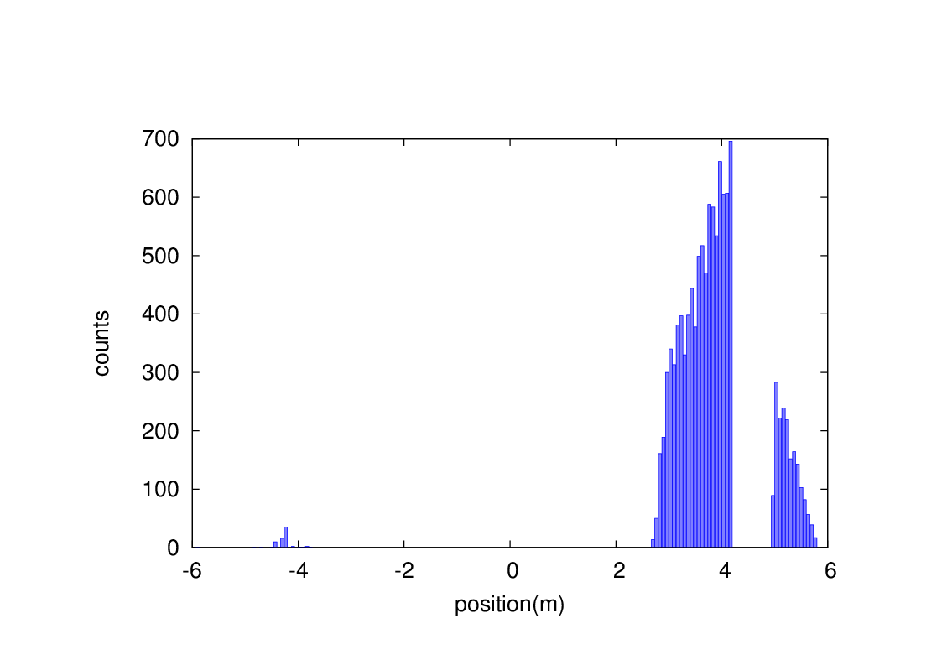
Beam-Thermal photon scattering
Without collimator
Heat load due to BTH loss on the detector pipe (IP~0.7m) ~0W.
Heat load power on beam pipe(0.7m~2.2m) ~0W
Heat load power on beam pipe(QD0) ~7.5mW
Heat load power on beam pipe(QD0~QF1) ~0W
Heat load power on beam pipe(QF1) ~1.1mW
With collimator

Slide 19
Concerning of IR beam pipe
Temperature on IR beam pipe due to heat load
Cooling structure
Temperature on IR beam pipe due to heat load with cooling structure
Heat load transmitted to the inner wall of cryostat through heat resistance layer, temperature of Helium vessel, can be absorbed and accepted or not ? CDR can be accepted, what about high luminosity Z ?
To protect SC magnet~ radiation dose, mainly from beam loss background, Solutions: tungsten IR beam pipe; shielding of SC magnet coils.
  It is unlikely to use pure tungsten, which is too brittle.
  WNiFe and WNiCu are two kinds of alloys that can be made. WNiCu is non-magnetic, but it is difficult to make this alloy too long. It must be welded in sections, with each section no more than 1m.
  For the 6m long IR beam pipe, there will be many welds.
  Tungsten alloy is made by powder pressing. It has certain machining performance and welding performance (brazing). The vacuum performance is unknown.

Slide 20
Summary
CEPC which aims at researching Higgs boson is a double ring scheme optimized at the beam energy of 120GeV. MDI deals with many topics concerning both detector and accelerator.
IR design is the most important for the whole machine, still searching for ideas and solutions for the key problems.
The key beam physics issues are DA and the alignment errors related to the MDI physics requirement.
SR has no heat load on detector beam pipe and beam loss heat load can be ignored.

Slide 21
Thanks

