Slide 1
Supporting and Installation Scheme
Haijing Wang
Workshop on Detector & Accelerator Mechanics
2020/8/28

Slide 2
Outline
Overview
Supporting and Installation Scheme in the IR
  Integration scheme
  Vacuum layout and vacuum connection mechanism
  Support system
  Alignment scheme
Supporting and Installation Scheme in the accelerator
  Magnet supports
  Transportation and installation
  Alignment scheme
Lists to be done

Slide 3
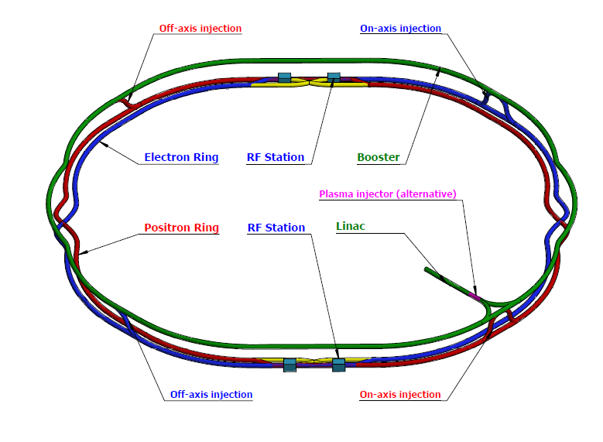
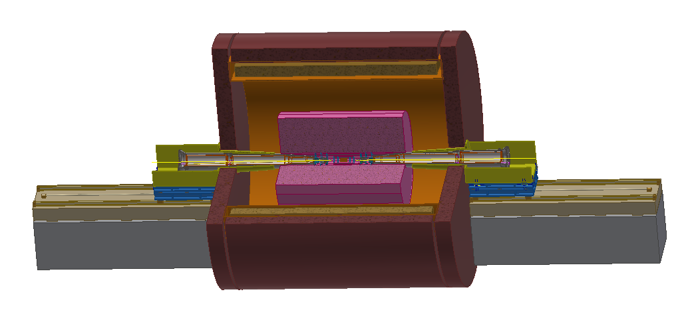
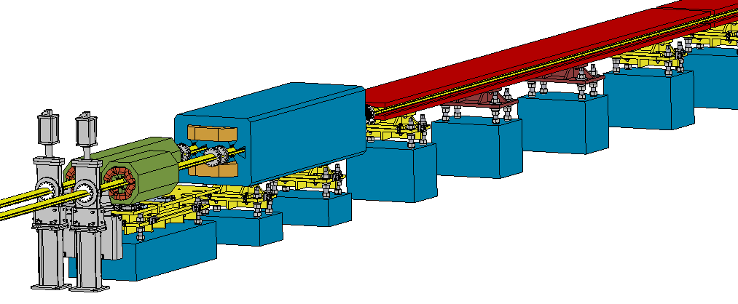
Overview
2 IRs
Supports & installation in IR
  Space limitation.
  High alignment requirements.
  High stability.
  Ultrahigh vacuum leak rate.
Supports & installation in accelerator
  Large quantity and low cost.
  High efficiency with simple structure.
  Space limitation.
100 km accelerator

Slide 4
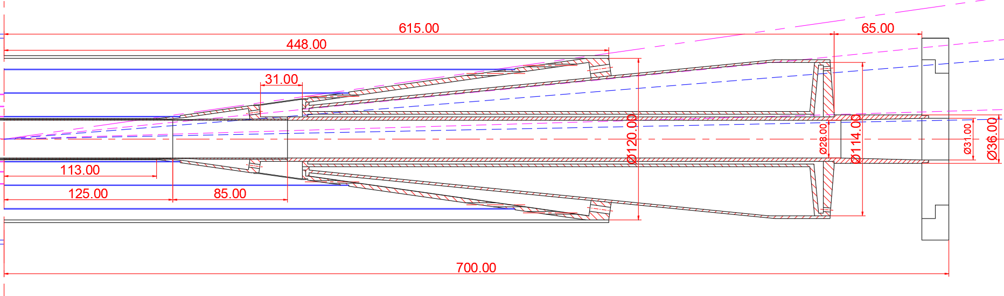
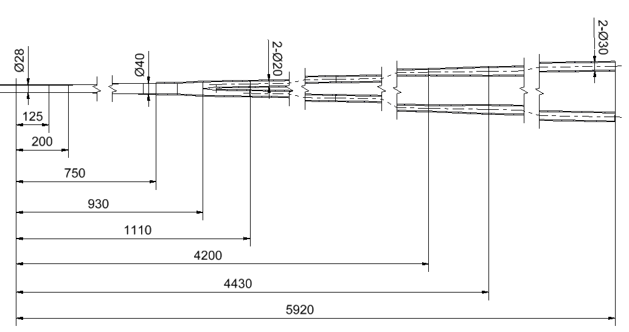
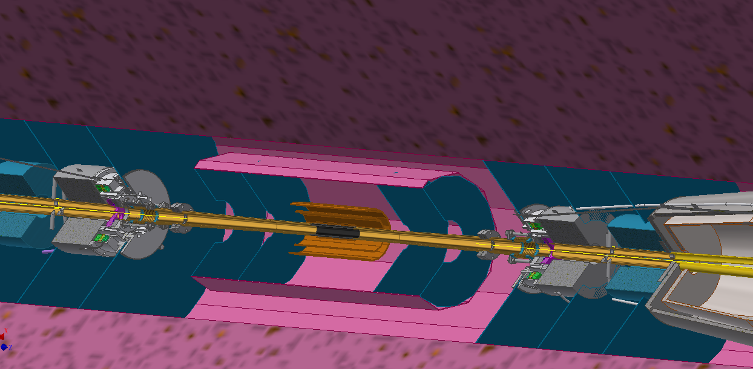
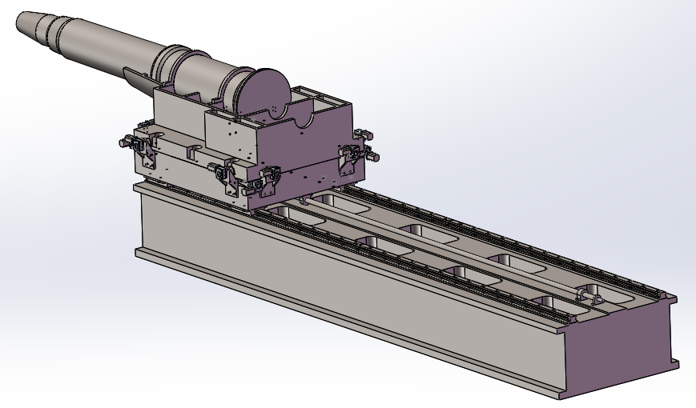
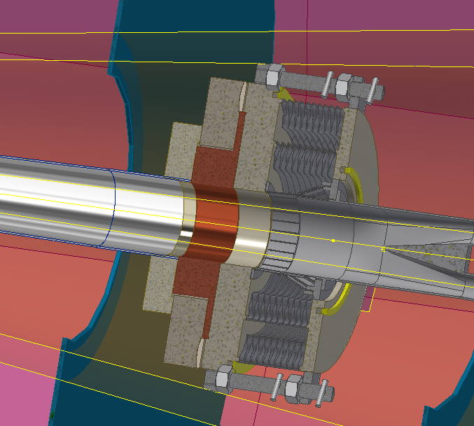
Supporting and installation scheme in the IR
IP chamber by Q. Ji
First vacuum pump @±6.5m
Connection interface of detector and accelerator
SC magnets, cryostat and their support

Slide 5
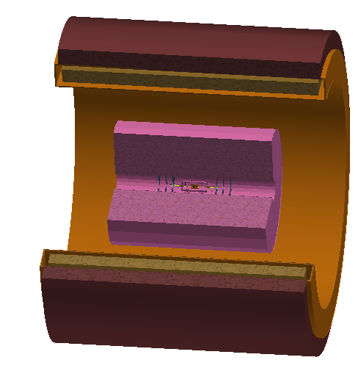
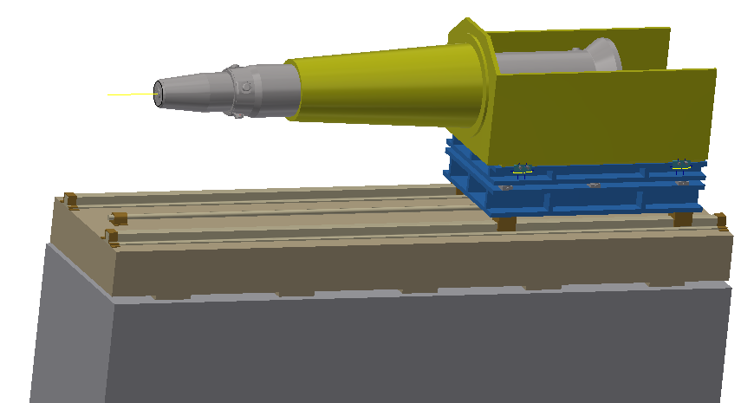
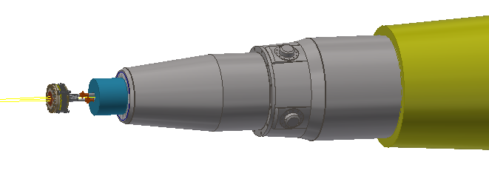
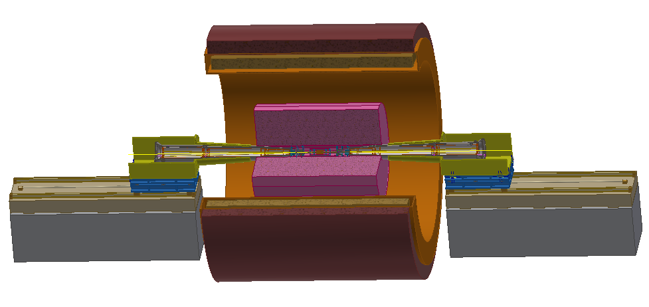
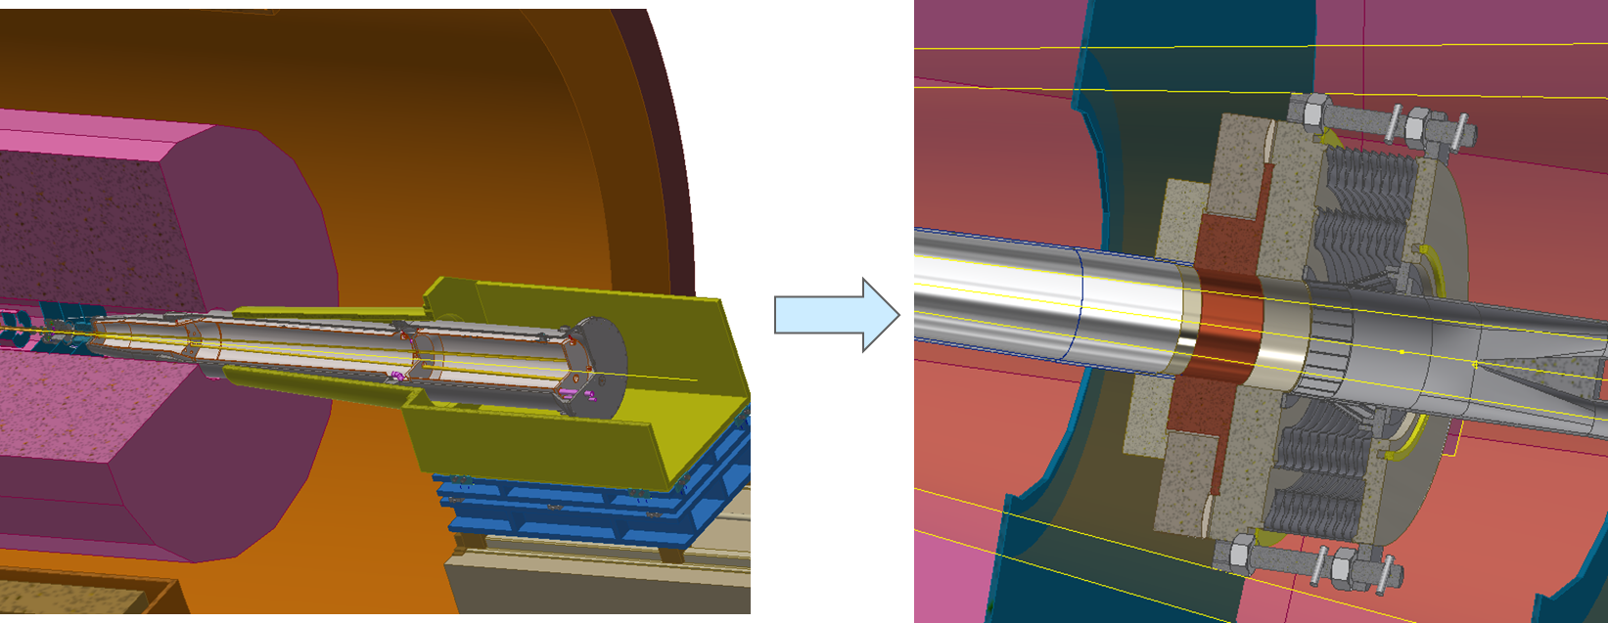
Integration scheme
Installation scenario of accelerator devices
  Assume the IP chamber and the detectors, the yoke have been installed.
  The remoted vacuum connection methods will be used.
  The main body of Lumical is in front of cryostat.
Pre-alignment of SC magnets and installation of accelerator components
The similar procedure at the other side
The connection and alignment of one side

Slide 6
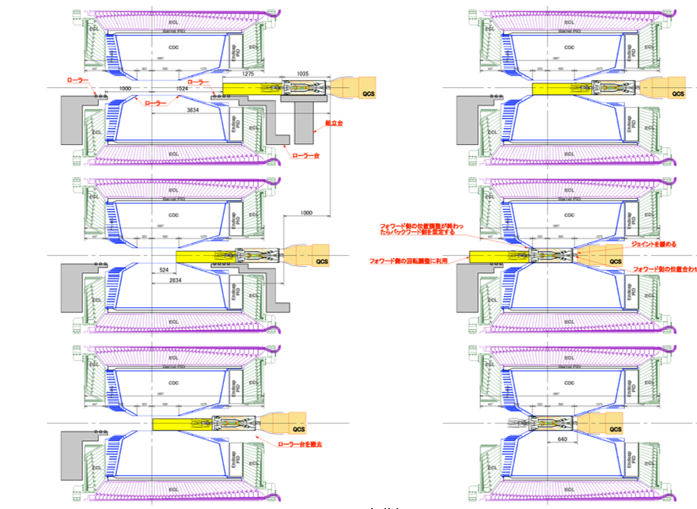
Integration scheme
An alternative scenario
  The baseline of SuperKEKB before the validation of RVC.
  This scenario is connecting one end of IP chamber with cryostat outside the detector .
  But unlike the asymmetry of SuperKEKB MDI, this scenario can't cut out the remote vacuum connection at the other end of IP chamber.
Not advisable
From K. Kanazawa of KEKB, the 18th KEKB Accelerator Review Committee, 2013

Slide 7
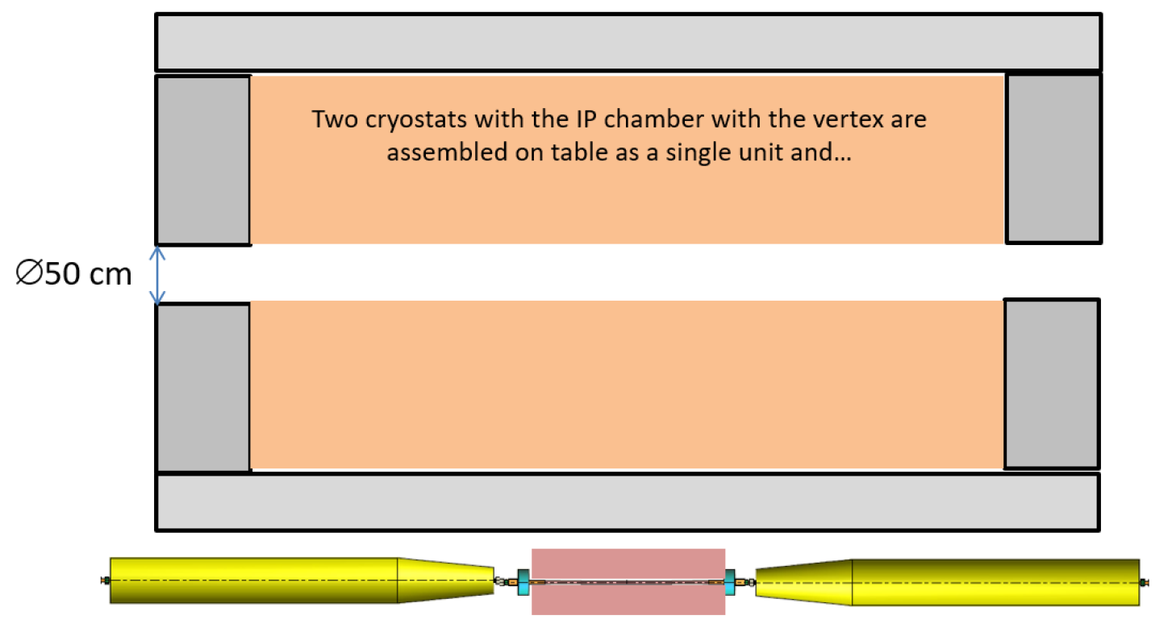
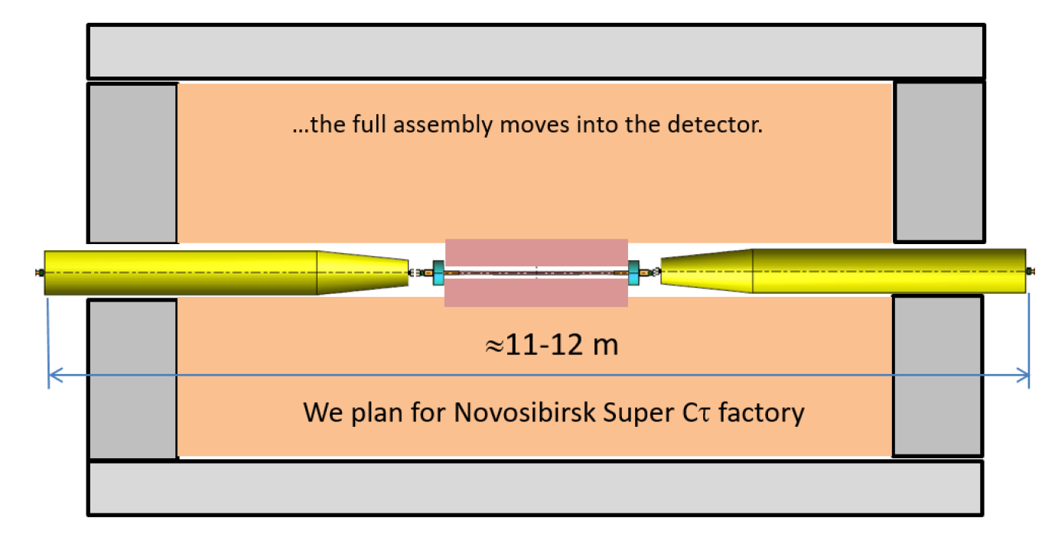
Integration scheme
Another alternative scenario
  The method like DAFNE. Being considered by FCC and BINP.
This scenario is connecting both ends of IP chamber outside the detector like
DAFNE.
The two cryostats can be well pre-aligned but it is impossible to move the whole assembly into the detector without changing the size of detector hole.
Not advisable
A. Bogomyagkov, et al., Mechanical design of the FCC-ee interaction region, FCC week (24 –28 June 2019) Brussel
A.Bogomyagkov, MDI issues of BINP Super TauCharmfactory, Report on IAS 2020.(Hongkong, 2020).

Slide 8
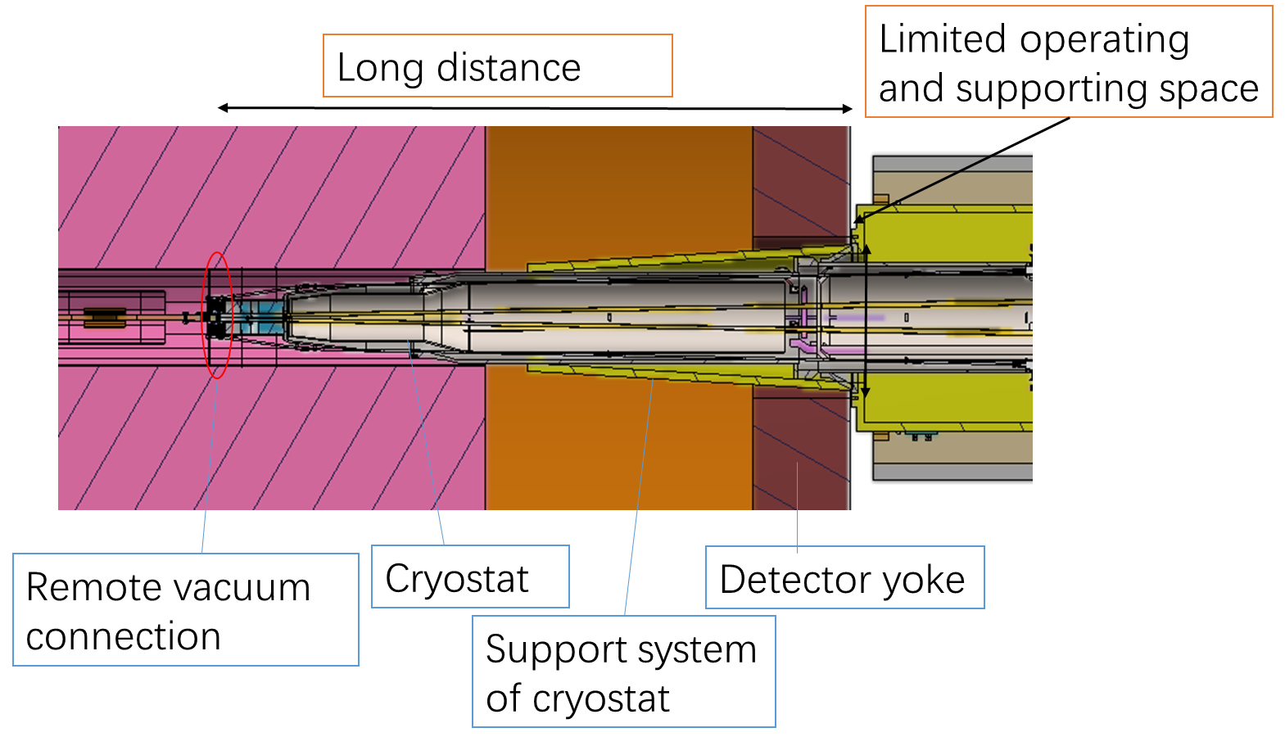
Integration scheme
Highly correlated with cantilever length
Key issues:
  Design of vacuum chambers.
  Vacuum connection. Leak rate requirement: ≤2.7e-11Pa.m3/s
  Support system. Stability, accuracy, easy-operating.
  Alignment scheme. Requirement: ≤50 μm.

Slide 9
Integration scheme
 | Distance from yoke boundary to connection location (m) | Alignment requirements of SC/ deformation of cryostat (μm)
BEPCII | ~2.3 (has manual operation space) | Tested deformation: 960
SuperKEKB | ~3.5 (the longer side) [1] | Analyzed deformation: 900 [2]
FCC-ee | ~4.37 [3] | Alignment error: ≤50 [4]
CEPC | ~3.8-6.1 * | Alignment error: ≤50
[1] Hiromi linuma, SuperKEKB status. Report, Nov, 2013。
[2] Hiroshi Yamaoka, et al, The mechanical and vibration studies of the final focus magnet-cryostat for SuperKEKB. Proceedings of IPAC 2014, Dresden, Germany.
[3] M. Koratzinos, Overview of MDI at FCC-ee, Report on IAS 2020.(Hongkong, 2020).
[4] Future Circular Collider Study. Volume 2: The Lepton Collider (FCC-ee). Conceptual Design Report. V0.20, 8 Nov, 2018
*: The distance needs to be discussed further.

Slide 10
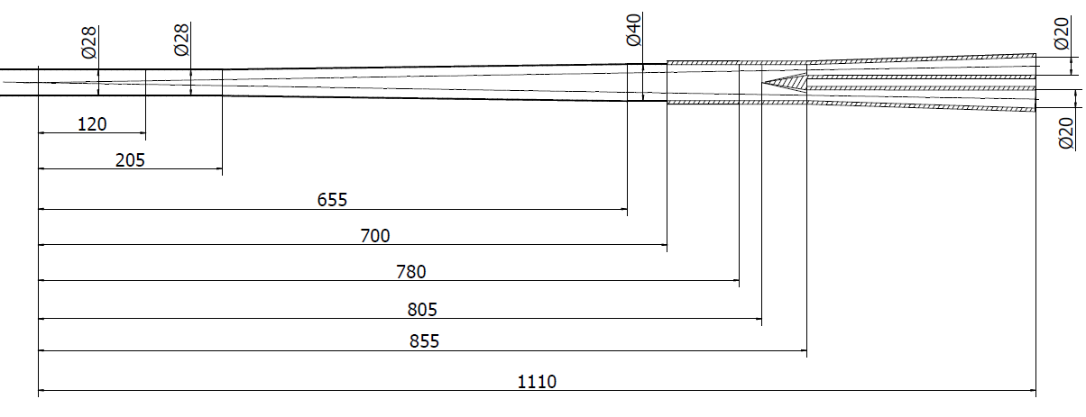
Vacuum layout and vacuum connection mechanism
Vacuum connection
Y-shape
chamber
Cryostat chamber
IP chamber
Paraffin cooled
Water cooled
Water cooled
Be
Al
Cu
IP
IP BPM
Lumical
End of cryostat chamber: about 6.5 meters form IP.

Slide 11
Vacuum layout and vacuum connection mechanism
Key points of vacuum layout design
15 different design versions.
One workable in theory at last.
First priority
Minimize HOM power
Avoid SR power in both IP chamber and connection region
Move Y-shape tip forward.
As smooth as possible.
Conflict
Space limitation
Contribute
Y-shape chamber with taper.
Move the taper end forward.
IP chamber
Connection mechanism
IP BPM
Lumical
Background
Working temperature
Detecting angle

Slide 12
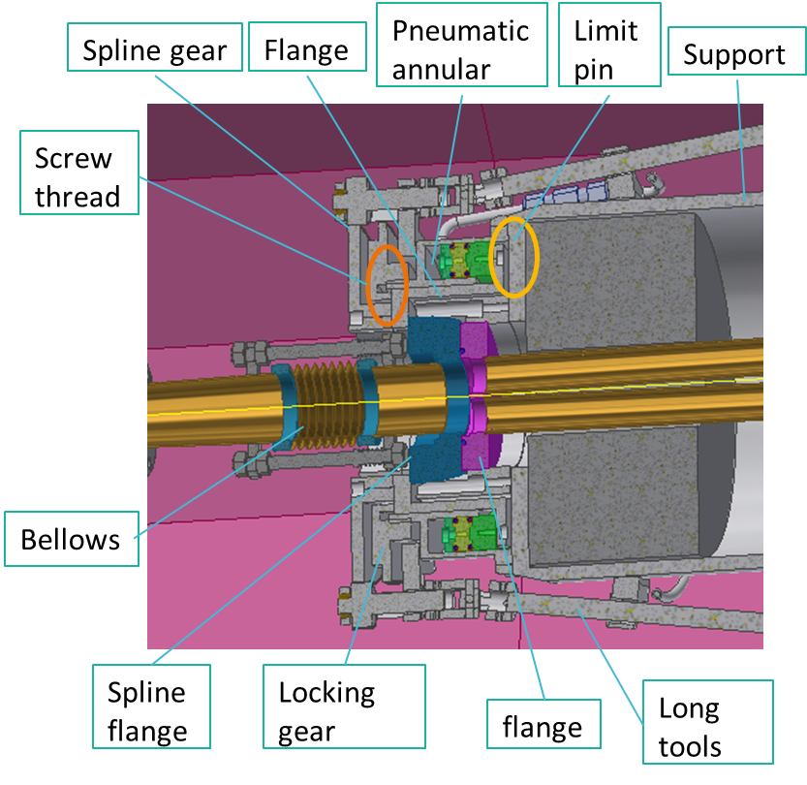
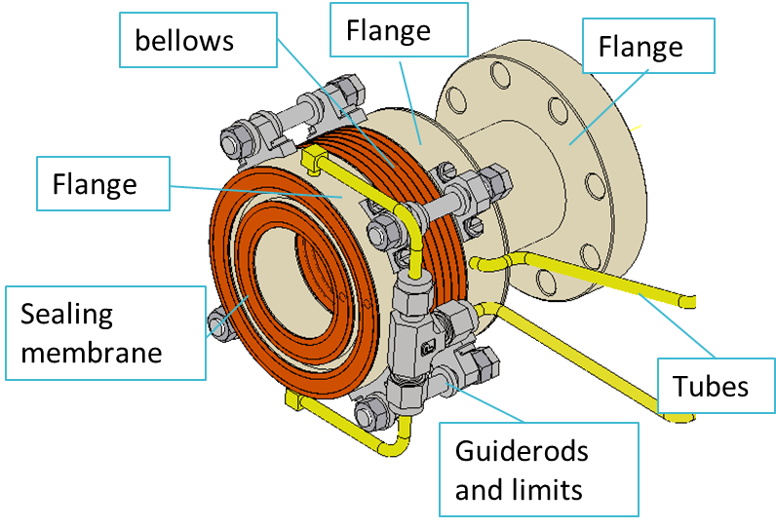
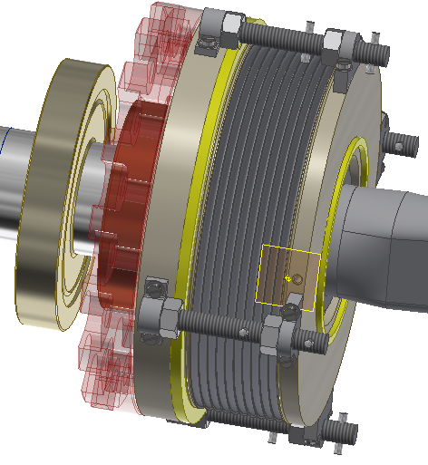
Vacuum layout and vacuum connection mechanism
Inflatable seal
RVC
Improved inflatable seal
Three MDI installation scenarios→ Remote vacuum connection is inevitable.
Remote vacuum connection design is relatively independent on other devices.
Two layers of edge sealing

Slide 13
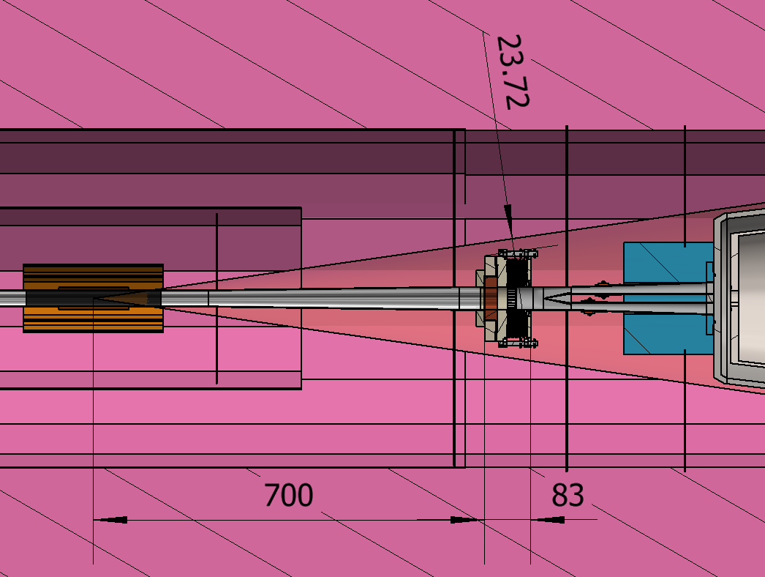
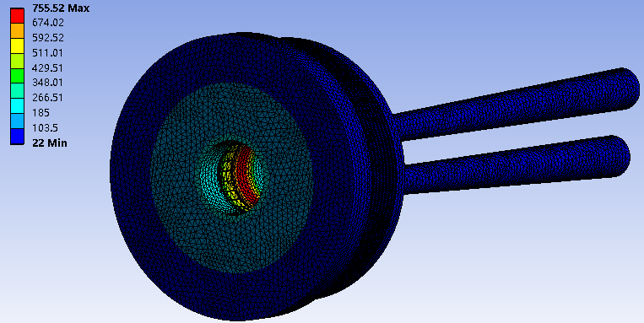
Vacuum layout and vacuum connection mechanism
Space limitation
  Two inflatable seal designs are within the detecting angle.
  Decrease bellow length by adding supports in front of cryostat.
Leak rate performance
  RVC has successful experience.
Smooth inner profile
  RF fingers
Working temperature
RF finger
 | CDR H | CDR Z | CDR High Luminosity Z
Power density (W/cm²) | 0.135 | 1.36 | 4.4
Highest temperature (℃) | 44.5 | 248.8 | 755

Slide 14
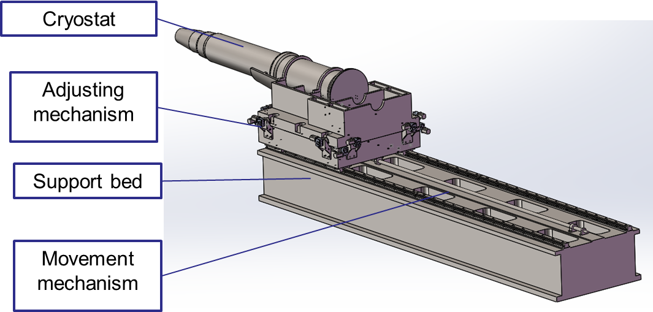
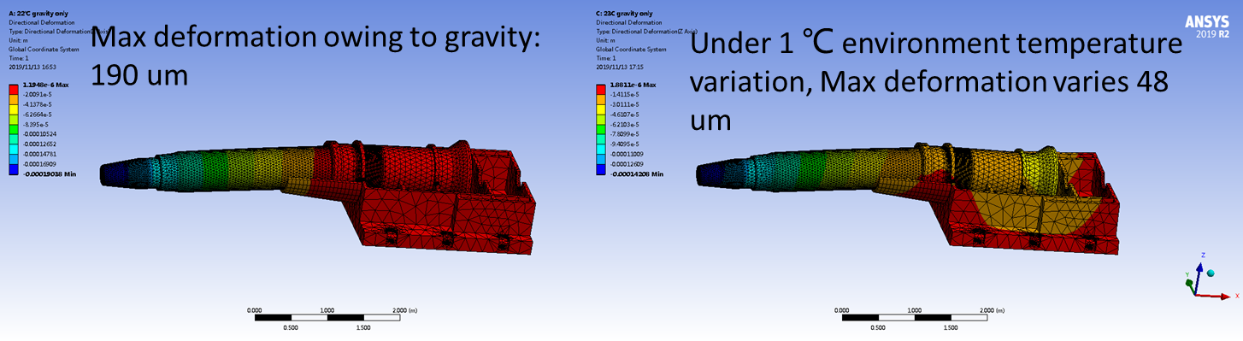
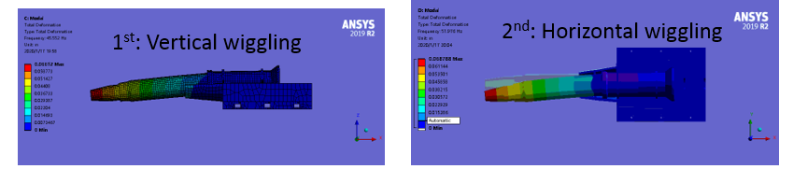
Support system
Key points
  Stability (static and modal)
  Accuracy
  Space limitation
  Easy-operating
Deformation analyses
Modal analyses

Slide 15
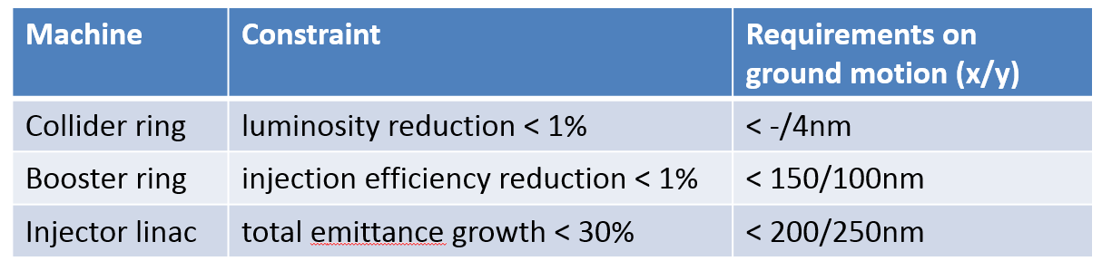
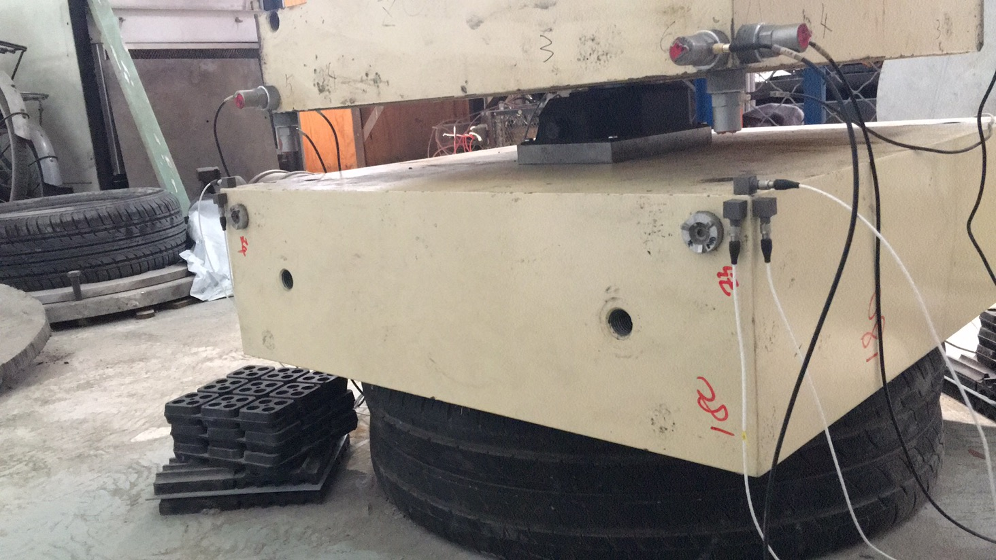
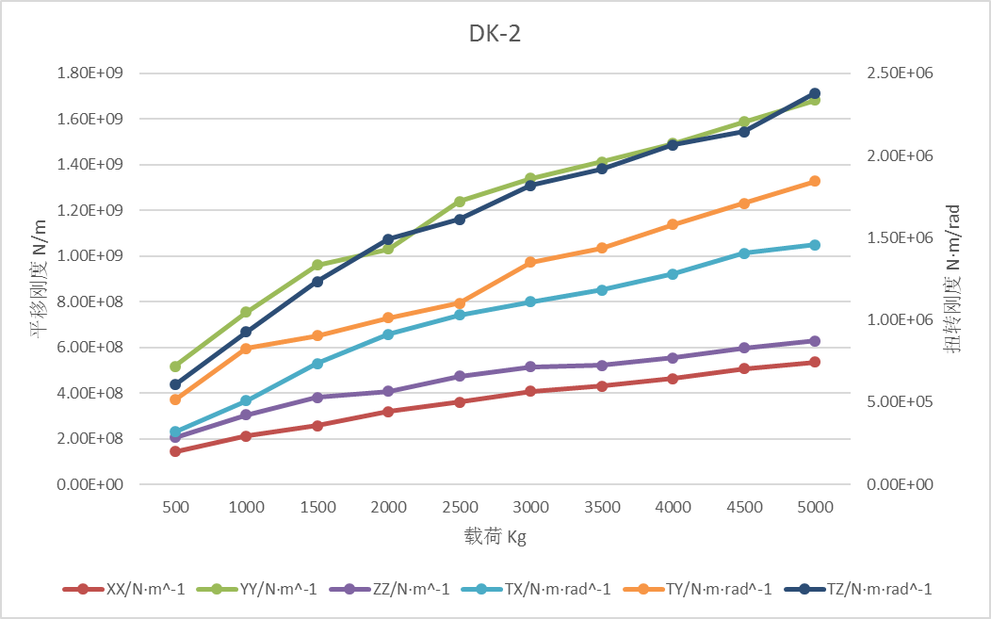
Support system
From Y. Wang
High stability
Confliction
High stiffness for stability Flexibility for high accuracy.
Studies on support stiffness is on-going.
Motor driven wedges jacks for high stiffness and accuracy.
Auxiliary support, high damping material/structure are also in consideration

Slide 16
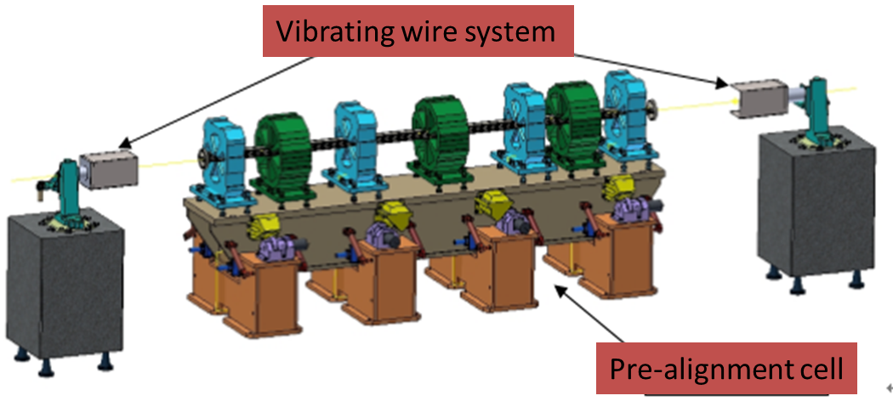
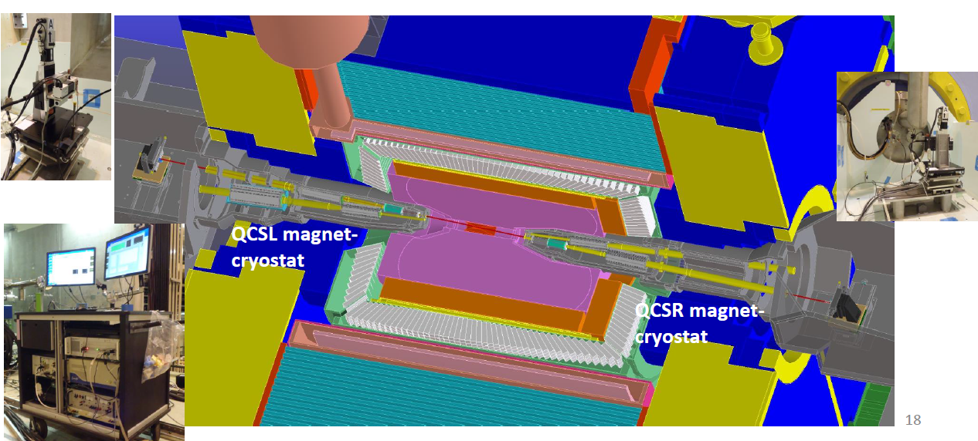
Alignment scheme
Alignment scheme
Alignment scenario:
  Pre-align the SC magnets using vibrating wire system to “certain location” to compensate the effect of loads.
  Align the SC magnets on two cryostats using optical system.
  Measure misalignment using SSW and adjust cryostats or corrector magnets meet the alignment requirements.
  Details are under study.
From X. Wang
VWS is a candidate pre-alignment method, accuracy of magnet centers: ≤10 μm
SSW measurement of SuperKEKB
Max. center misalignment is 0.69 mm
“Every alignment errors are able to corrected by the corrector magnets.
N. Ohuchi, IPAC2018

Slide 17
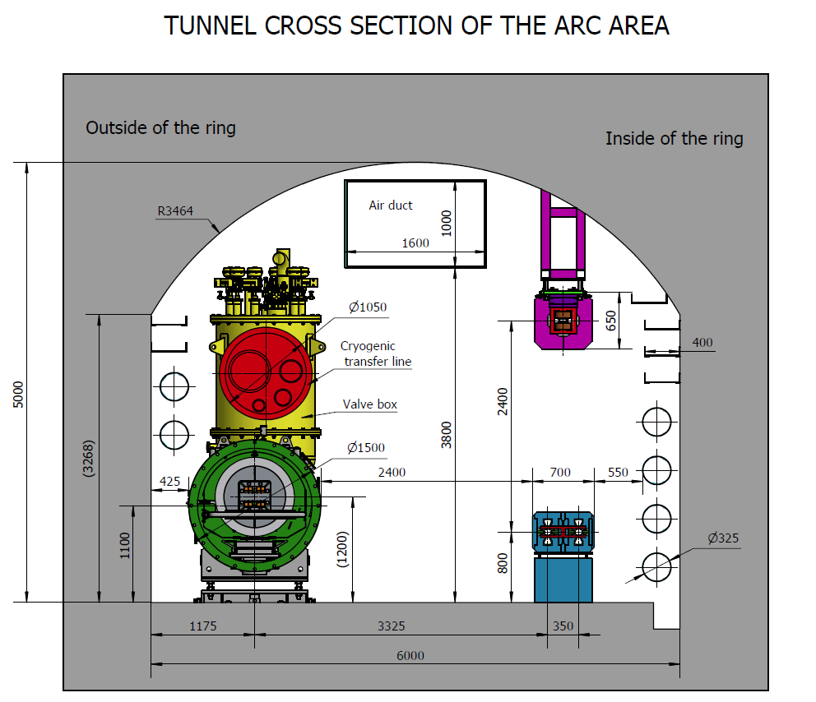
Magnet supports in the accelerator
Over 80% of the length is covered by magnets of about 138 types, each magnet needs to be supported.
Accelerating tubes, vacuum tubes, instruments…, all need supports.
Aims
  Simple & flexible structure: plates or standard elements
  Small deformation & good stability: multi-point support, optimization
  Low cost: concrete or steel frames, adjusted manually
Adjustment Ranges of magnets
X | ≥±20 mm | Δθx | ≥±10 mrad
Y | ≥±30 mm | Δθy | ≥±10 mrad
Z | ≥±20 mm | Δθz | ≥±10 mrad
Booster
Collider

Slide 18
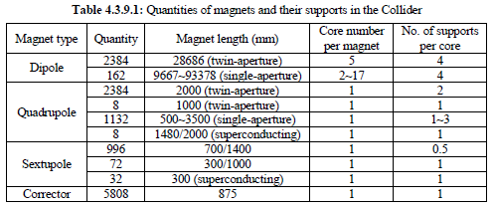
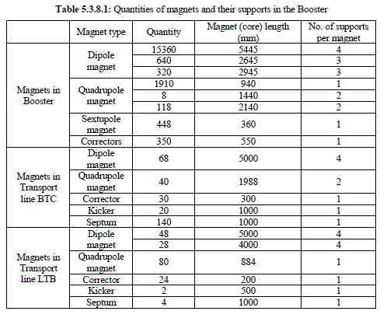
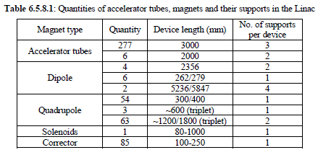
Magnet supports in the accelerator
Plenty of supports to be designed.
We has began the cooperation on design with members of CIPC

Slide 19
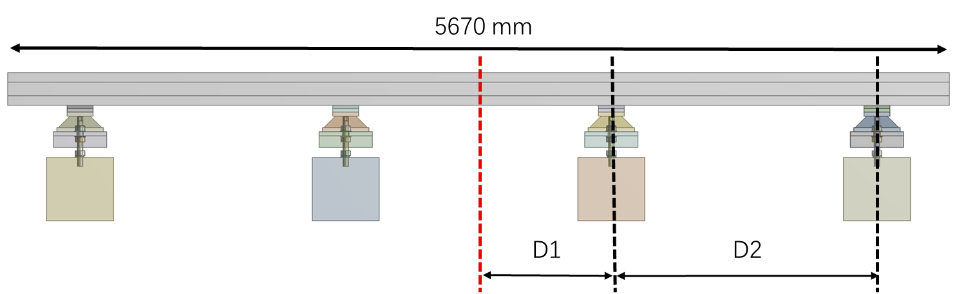
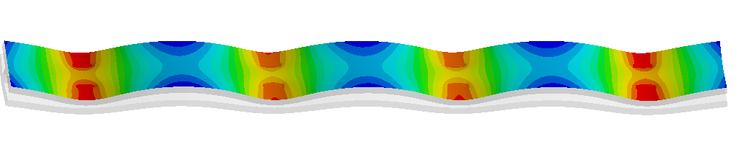
Magnet supports in the accelerator
Dipole in Collider and its support：
4 support points
Quadrupole in Collider and its support：
2 support points
Sextupoles in Collider and their support：
2 support points
Optimization for dipole supports
Common girders for quadrupoles and sextupoles are also in consideration
Pre-aligned units can save workload in tunnel and reduce the relative misalignment
Long and thin, hard to design in stiffness
Magnet group people will check if the deformation is workable.

Slide 20
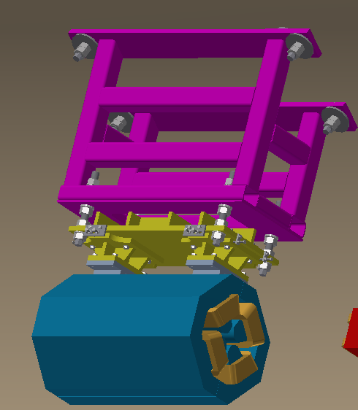
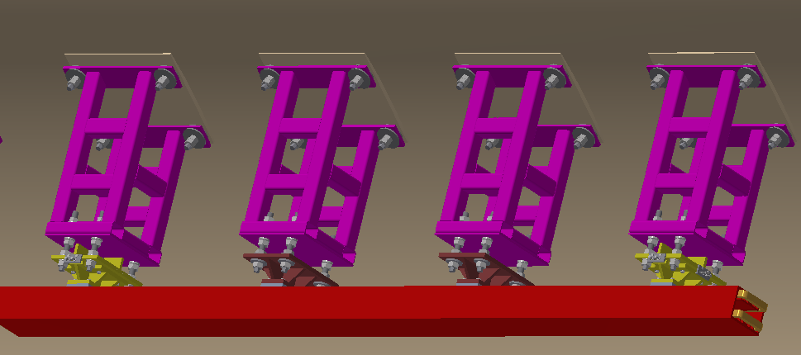
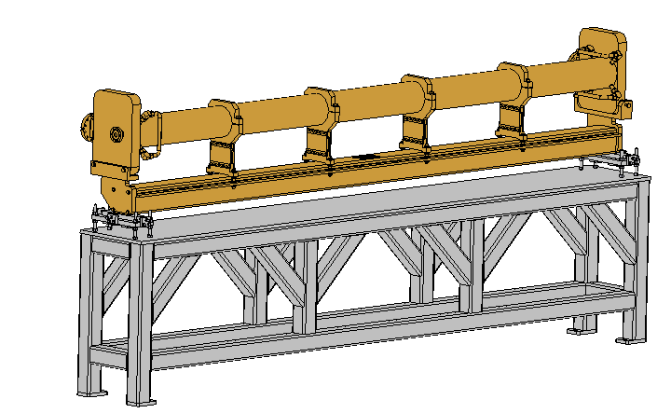
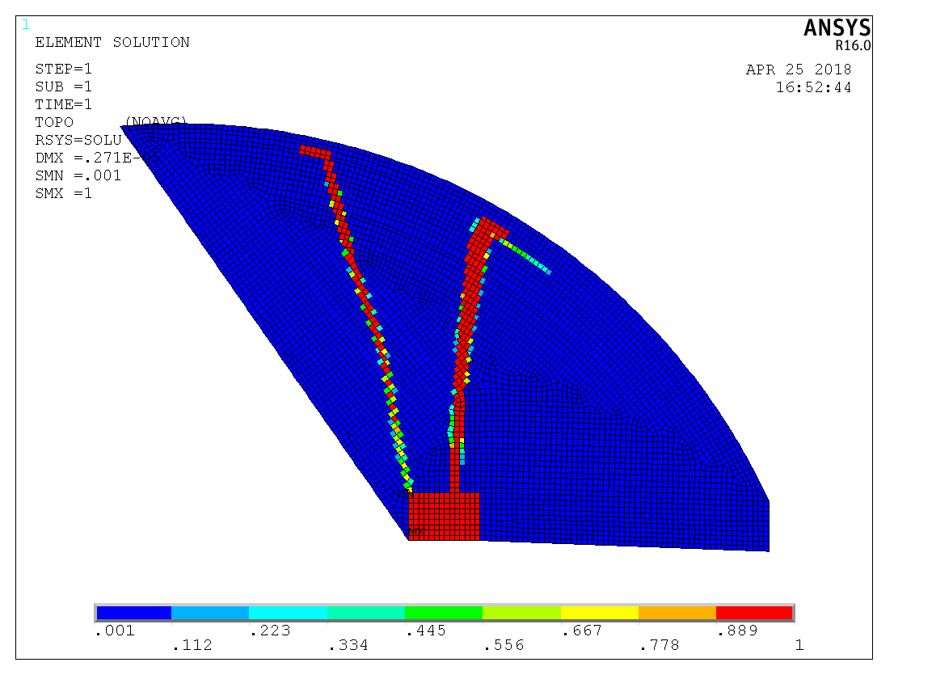
Magnet supports in the accelerator
Typical supports in Booster and Linac
Quadrupole in Booster and its support：
2 support points
Dipole in Booster and its support：
4 support points
  Topology optimization is used: best static stability
Accelerating tube in Linac and its support:
2 support points，3000 mm

Slide 21
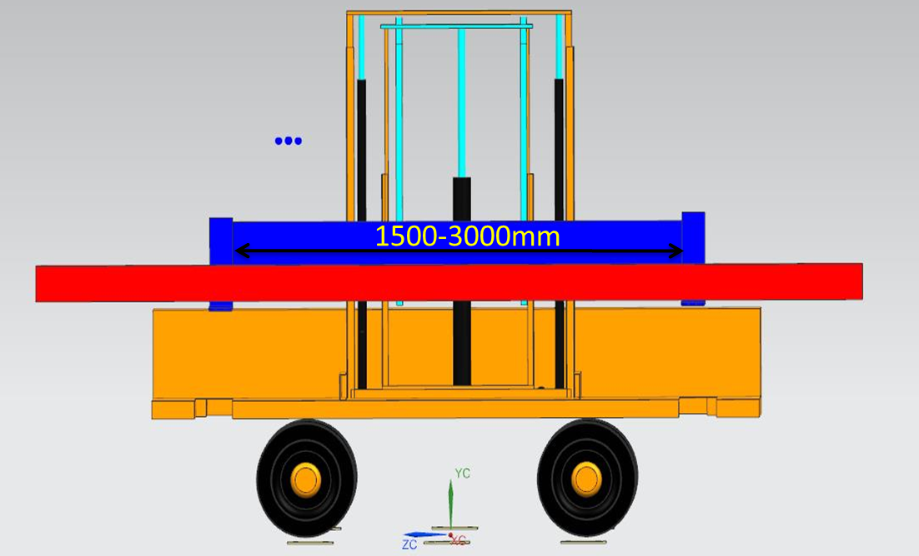
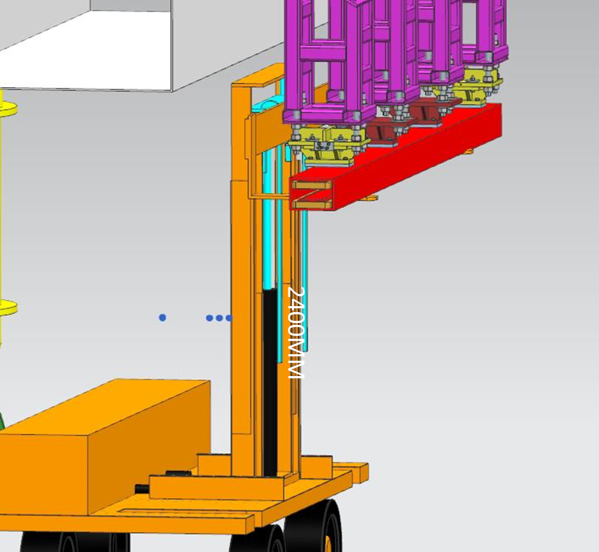
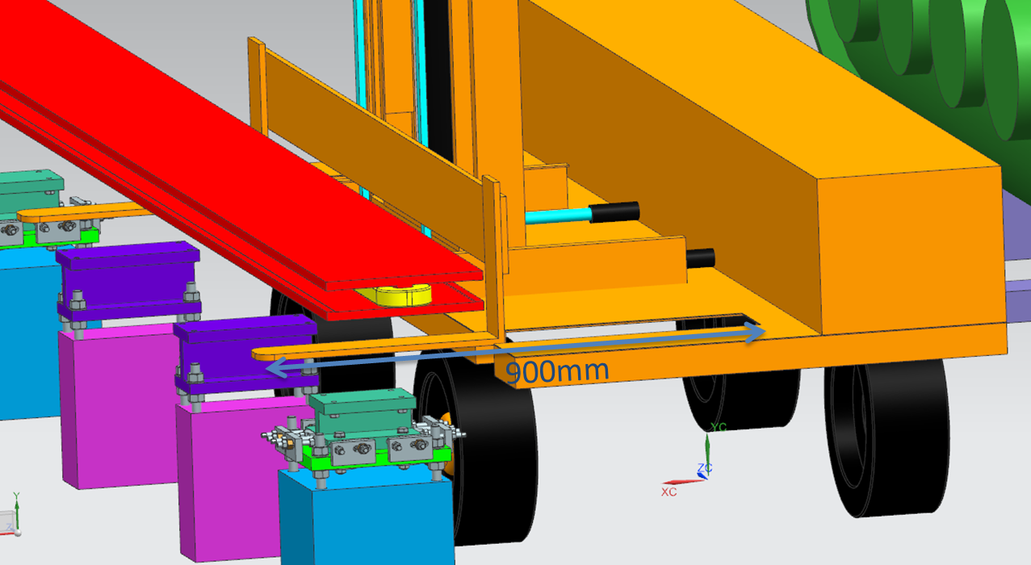
Transportation and installation
Flexible load support for “long” devices and “short” devices
Transportation and coarse location of magnets in Booster
Transportation and coarse location of magnets in Collider
  * Cooperate with Beijing North Vehicle Group Corporation.

Slide 22
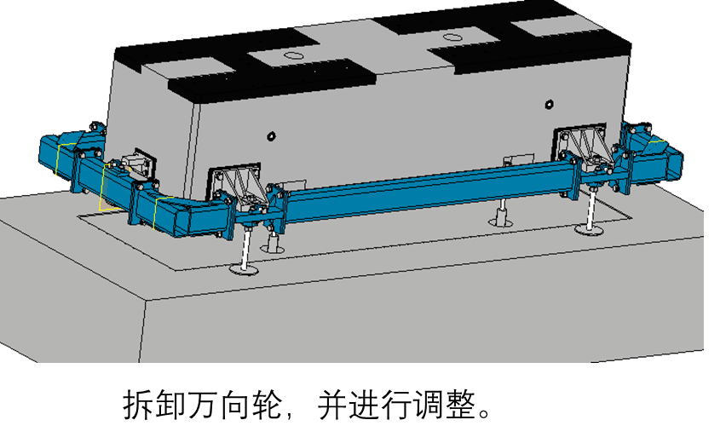
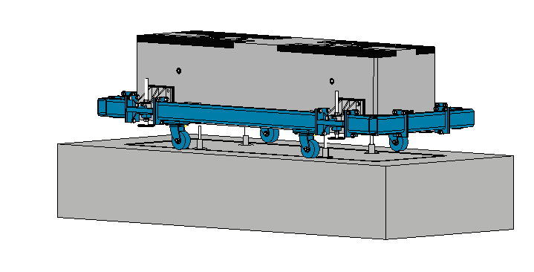
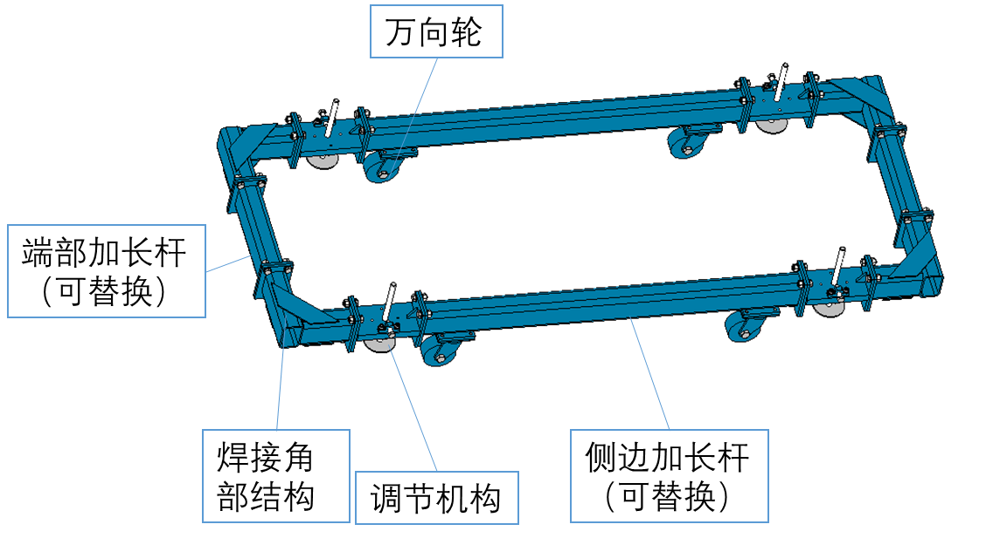
Transportation and installation
Plinth installation and grouting
  Pre-machined plinth.
  Specialized tooling to improve efficiency.

Slide 23
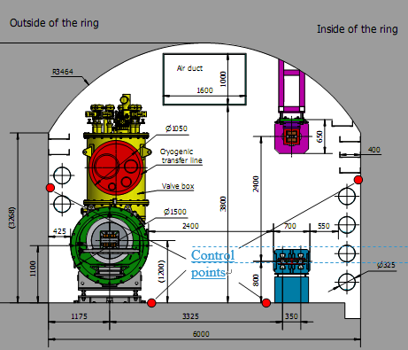
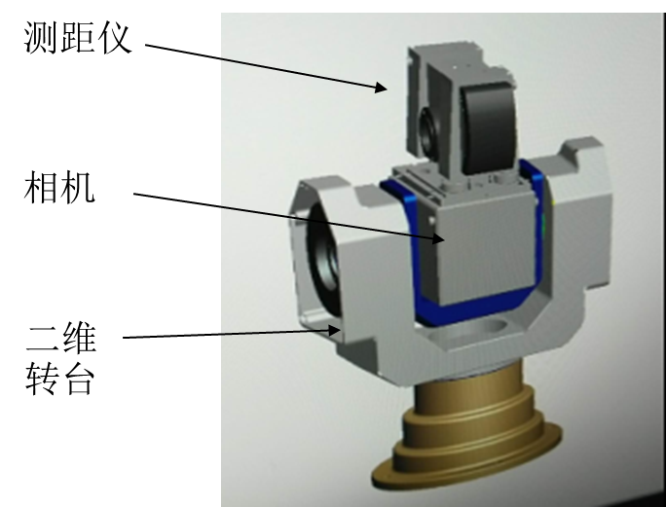
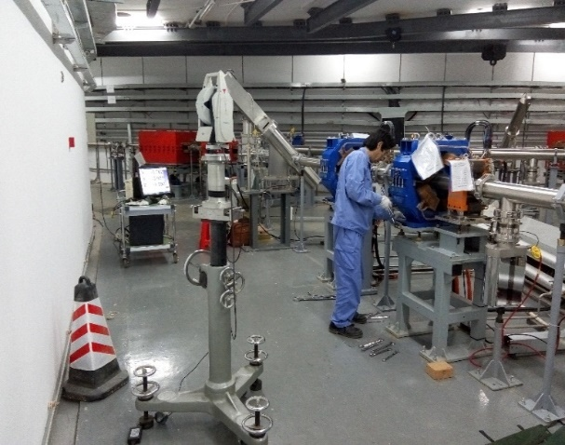


Alignment scheme
Difficulties:
  Improve efficiency for 100 km workloads.
  High accuracy for large dimensions.
Alignment scheme
  Construction and measurement of control network
  Pre-alignment, installation and alignment in the tunnel
  Smooth alignment
From X. Wang
视觉测量仪

Slide 24
Lists to be done
Mechanics in IR
  Optimization of vacuum layout
  Further thermal analyses for vacuum chambers
  More detailed integration scheme
  Validation of remote vacuum mechanism
  Pursuing workable solution for the supporting system of SC magnets and alignment methods.
Mechanics in the accelerator
  Detail design of magnet supports
  Common girders for quadruples and sextupoles. Support scheme comparison and optimization

Slide 25
Thanks

Slide 26
Back up

Slide 27

Back up
Accelerator foundation is fixed. It is good at:
  Beam stability.
  Integration of detector before push-in.
Detector foundation is fixed. It is good at:
  Detector stability
We are looking for the balanced approach (very long distance with only beam pipes near MDI)
Before and after BESIII push-in
Before Beast(II) push-in
Detector push-pull arrangement

Slide 28



Back up
RVC Design
Spline flange
Flange
Pneumatic annular
Limit pin
Spline gear
Support
Screw thread
Spline gear
Bellows
Dimensions:
Transversal: Max. ϕ264mm
Longitudinal: ~223mm
Spline flange
Locking gear
Long tools
flange
  * Cooperate with Shenyang Huiyu vacuum technics co., Ltd.

Slide 29


Back up
Inflatable seal design
  Experience from CSNS: leak rate ~10-7 Pa.m3/s level, four levels higher then CEPC requirement.
Flange
bellows
Flange
Flange
Sealing membrane
Tubes
Guiderods and limits
Dimensions:
Transversal: Max. ϕ112mm
Longitudinal: ~120mm

Slide 30
Back up
Inflatable seal design
Improved methods
  Precision machining of sealing membrane and flange.
  Different materials of sealing membrane and flange.
  Using edge sealing instead of membrane sealing.
  …
Two layers of edge sealing

Slide 31


Key mechanics issues in the IR
Leak rate estimation
  RVC has successful experience from SuperKEKB.
  Inflatable seal design.
    Improve surface roughness.
    Single-layer → double layer, leak rate can be improved from 1e-6 Pa.m3/s to 8.5e-10 Pa.m3/s from CSNS experience.
    Replace membrane sealing by edge sealing
From J-PARC

Slide 32


Back up
 | RVC | Inflatable seal | Long tools
Sealing methods | Pneumatic clamping with auxiliary locking | Pneumatic clamping | Screws clamping using long tools
Advantages | Successful experience from SuperKEKB | Successful experience from CSNS; Small and simple; Bellows at accelerator side | Simple and small
Disadvantages | Big and complex; Bellows at IP chamber side | Difficult for leak rate requirement | Difficult in operation
Before moved
The bellows of all methods have RF fingers.
Physics requirements: all accelerator devices are within acos0.99.
RVC design exceeds the boundary.
New consideration is that main body of Lumical move to IP assembly, thus the space is better.
After moved

Slide 33


Back up
Test schemes
Support
“Fake” cryostat
IP assembly interface（fixed）
Support at accelerator part (can be adjusted to simulate the deformation and misalignment of cryostat)
Remote vacuum connection（eg. Inflatable seal）

Slide 34


Back up
Support system of SC magnets
  The alignment accuracy of SC magnets: ≤30 μm, at least ≤50 μm.
  Movement mechanism: high precision track & rack.
  Adjusting mechanism: motor driven wedges jacks for vertical direction, motor driven screw jacks
Cryostat
Adjusting mechanism
Support bed
Movement mechanism
  * Cooperate with Beijing Institute of Space Mechatronics

Slide 35


Back up
Max deformation owing to gravity: 190 um
Under 1 ℃ environment temperature variation, Max deformation varies 48 um
~3.6m
The current design of cryostat is 5 meters long with18 mm thick stainless walls. The weight of the cryostat is about 2 tons.
Only the cryostat itself is considered in the calculation above.
If the yoke length gets larger, the deformation will be even larger, which is proportional to the 4th power of length.
If the weight of components inside the cryostat and the magnetic field forces are considered, the deformation will be much larger.

