Slide 1
Heat transfer analysis of CEPC beampipe
Youlian Lu
2020.8.29

Slide 2
Contents
Introduction of the beampipe
Heat transfer analysis of beampipe
Heat transfer analysis of vertex detector
Summary

Slide 3
1.Introduction of the beam pipe
Ver：BP20200829
Structure
The extending Al pipe
The central Be pipe
Vertex detector
LumiCal
Coolant: water
Coolant: paraffin
Heat flux: 50~200mW/cm²
Coolant: Air
The detector has not given the design requirements.
Heat flux
Only High-order mode heat
Total heat load in high Luminosity Z：3476.6W
Objective
To obtain the best cooling parameters and working temperature.
Provide basis for structure design.
——Form Liu Yudong

Slide 4
2. Heat transfer analysis of beampipe
2.1 Two kinds of heat exchange structures
Integrated cooling structure
Paraffin inlet
Paraffin inlet
Sub-sectional cooling structure
Paraffin inlet
water inlet
paraffin inlet
water outlet

Slide 5
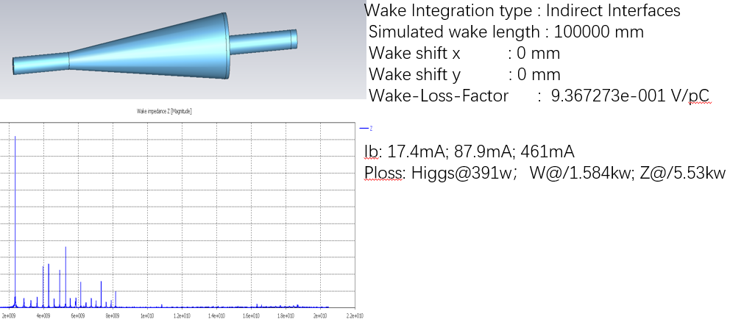
2. Heat transfer analysis for beampipe
2.2 Integrated paraffin cooling of Be and extending pipes(2019.10)
Calculation model and condition
Structure
u=0.5zm/s
Tin=23℃
Cu
Be
Cu
Al
Coolant: paraffin
Four inlet, four outlet
Viscous model: Laminar
Al
Cu
Temperature distribution
Heat flux
1.Synchronous photothermal load :151.6W,
Width is 0.36 mm
2.High-order mode heat: Higgs@782W, Z@11060W
uniform distribution
 | Δp | Δt | Maximum temperature
 |  |  | Be | Al | Cu | SS304
Synchronous photothermal load +Higgs | kPa | ℃ | ℃ | ℃ | ℃ | ℃
 | 66 | 3.7 | 41.8 | 72.9 | 100.3 | 96.1
Synchronous photothermal load +Z |  | 38.9 | 76.3 | 211.4 | 322.2 | 305.3
——From Bai Sa
Δp：Pressure drop
Δt: Temperature difference between inlet and outlet of cooling medium
——From Liu Yudong
High order heat is too large.
Cannot meet the engineering requirement.

Slide 6
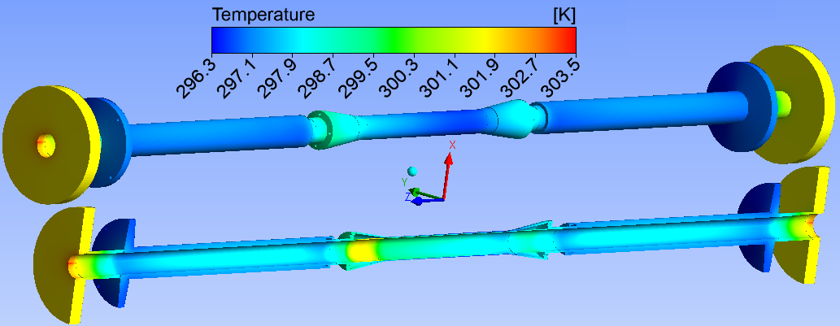
2. Heat transfer analysis for beampipe
2.3 Sub-sectional cooling for Be and extending pipes
Calculation model and condition
Be
Cu
SS304L
(1) 2019.12
Cu
Al
Al
SS304L
Structure
Vacuum wall diameter：Φ28 Φ28 Φ31
Coolant：paraffin
Two inlet, two outlet
t_{in}=23℃
Flow rate: 0.85L/min
Total heat:
Coolant：water
Two inlet, two outlet
t_{in}=23℃
Flow rate: 1.7L/min
Total Heat:
Coolant：water
Two inlet, two outlet
t_{in}= 23℃
Flow rate: 1.7L/min
Total heat:
Viscous model: Laminar
Temperature distribution
Heat flux
Thermal load on the wall of the beam pipe:
1.Synchronous radiant heat: 25.24W
0 ~259mm: 0W
259 ~620mm: 24.5W, Width is 0.36 mm
620 ~ 700mm: 0.74W, Width is 0.36 mm
2.High-order mode heat :168 W
Max.t of transition section of SS316L: 31.3℃
Oil: Δp=3.8kPa, Δt=2.2℃ H₂O: Δp=6.6kPa,Δt=0.7℃
The total heat flux is very low.
Meeting the engineering requirement.
——From Bai Sa and Liu Yudong

Slide 7
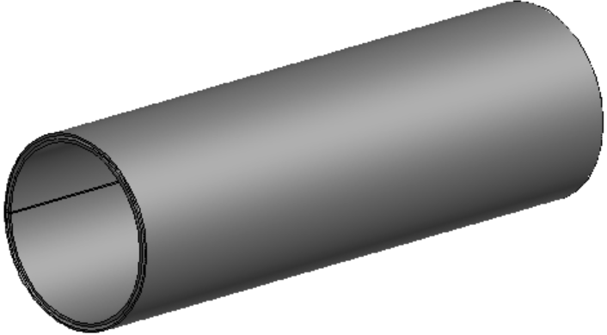
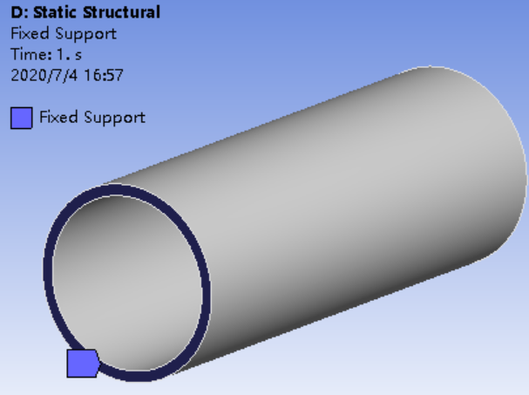
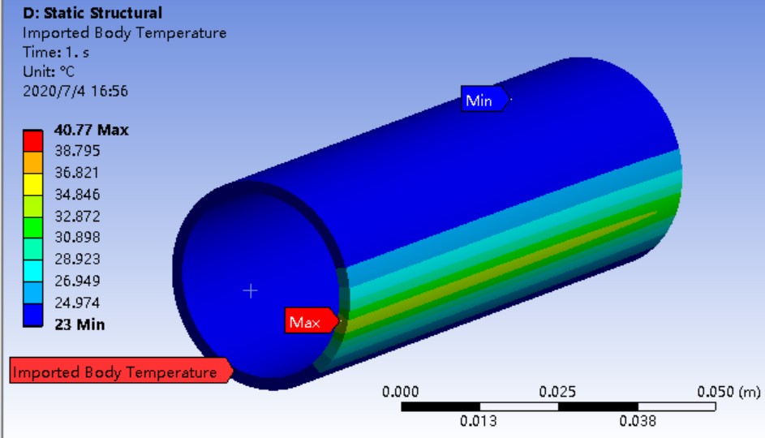
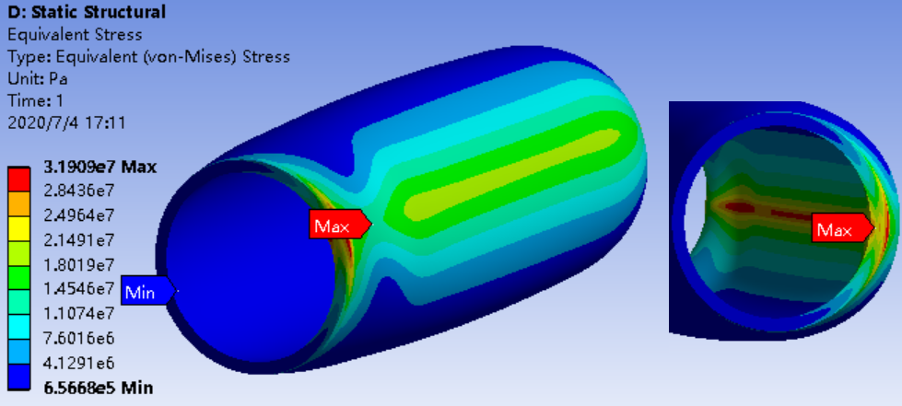
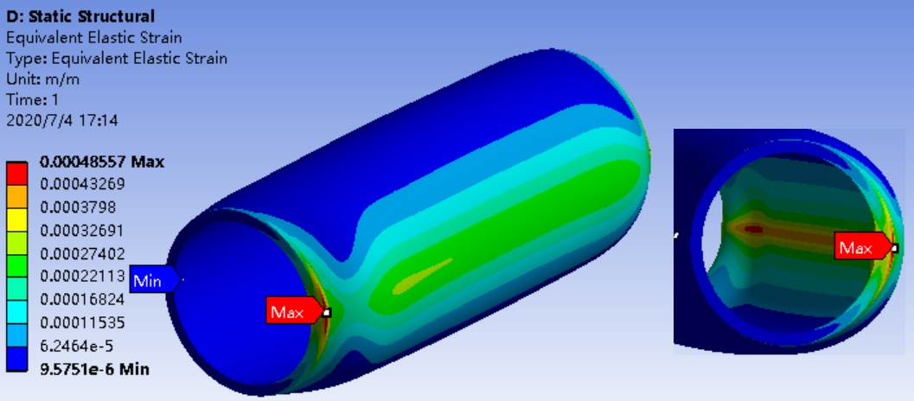
2. Heat transfer analysis for beampipe
2.3 Sub-sectional cooling for Be and extending pipes
(3) 500W/cm² synchronous radiant heat on 95mm Al pipe(2020.5)
Thermal stress analysis
Calculation condition:
length: 95mm
Inner wall diameter of inner pipe: Φ30mm
Inner pipe thickness: 2mm
Outer pipe thickness: 2mm
Gap: 2mm
Inlet temperature:23℃
Synchronous radiant heat: 500W/cm²
Synchronous radiant heat Width is 0.36 mm
Heating time: 0.5s
transient calculation
Fix the ends
Temperature distribution of Al pipe
Calculation model
Maximum stress of Al：31.9MPa
Maximum strain of Al pipe：0.49mm
Heat flux
Heat transfer results
Al pipe/water:0.5m/s
Maximum temperature | Water Δt
℃ | ℃
40.8 | 0.14
The strain of Al pipe is too large.
Synchronous radiant heat is unexpected.

Slide 8
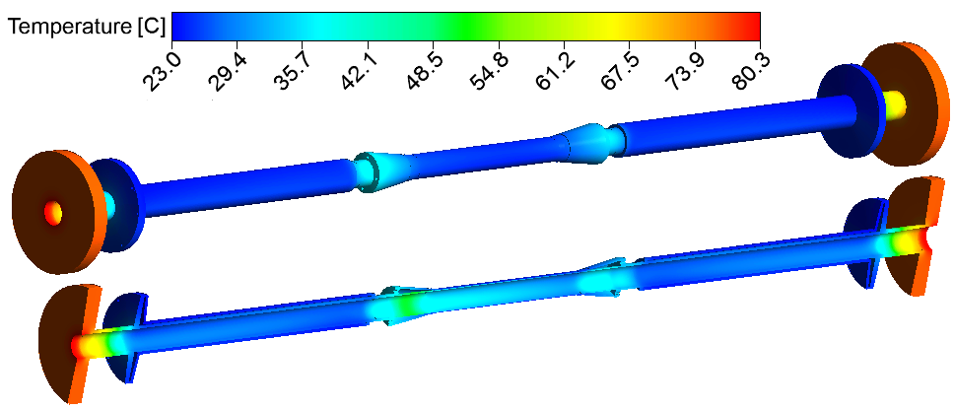
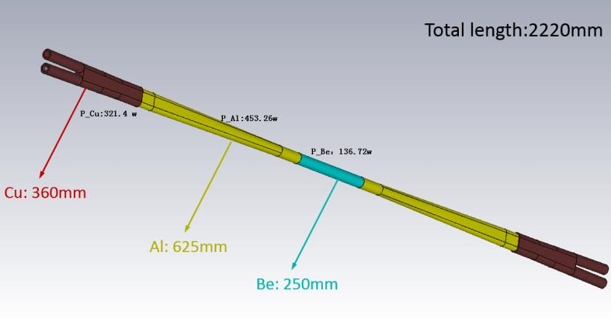
2. Heat transfer analysis for beampipe
2.3 Sub-sectional cooling for Be and extending pipes
Calculation model and condition
(2) ver.2020.5
Structure
Vacuum wall diameter：Φ28 Φ40
Coolant: paraffin
Four inlet, four outlet
t_{in}= 23℃
Inlet velocity: 2.2L/min
Coolant: water,
Two inlet, two outlet
t_{in}= 23℃
Inlet velocity: 3.4L/min
Coolant: water
Two inlet, two outlet
t_{in}= 23℃
Flow: 3.4L/min
Viscous model: Laminar
Temperature distribution
Heat flux
High order mode heat : 1043.2 W
Max.t of detector installation position: 27.8℃
Max.t of outer Be: 25.5℃
——From Liu Yudong
Max.t of transition section of SS316L: 80.3℃
Al:453.26W
Be:136.72W
The heat flux has increased a lot.
No cooling in the ends leads to high temperature.
Al:453.26W

Slide 9
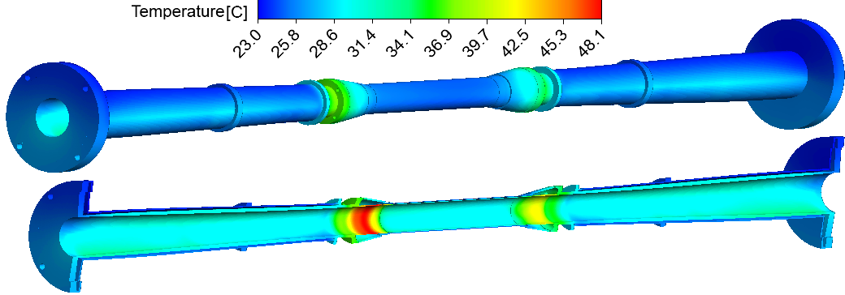
2. Heat transfer analysis for beampipe
2.3 Sub-sectional cooling for Be and extending pipes
Calculation model and condition
(4) Ver.2020. 7
Al
Be
Al
Structure
Coolant: water,
Inlet temperature: 23℃
Inlet velocity: 3.4L/min
Coolant: paraffin,
Inlet temperature: 23℃
Inlet velocity: 2.2L/min
Coolant: water,
Inlet temperature: 23℃
Inlet velocity: 3.4L/min
Viscous model: Laminar
Temperature distribution in Z model
Heat flux
Only high order mode heat
Z model: 1031.5 W
High Luminosity Z: 3476.6W
Max.t of detector installation position: 27.2℃
Max.t of outer Be: 25.7℃
Max.t of transition section of inner Al: 48.1℃
paraffin: Δp=19.5kPa, Δt=5.6℃
water: Δp=19.4kPa, Δt= 3.3℃
——From Liu Yu Dong
Structure can be cooled in Z model.

Slide 10
2. Heat transfer analysis for beampipe
2.3 Sub-sectional cooling for Be and extending pipes
(4) Ver.2020. 7
Temperature distribution in High Luminosity Z
Max.t of detector installation position: 33℃
Max.t of outer Be: 28.9℃
Max.t of transition section of inner Al: 81.2℃
paraffin: Δp=19.5kPa, Δt=14℃
water: Δp=19.4kPa, Δt= 6.3℃
Meets the requirements of engineering application.
But the temperature of detector installation position is higher than our expectation.

Slide 11
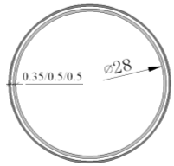
2. Heat transfer analysis of beampipe
2.4 Optimization of key parameters
Critical pressure results
(1) Critical pressure
 | thickness | R1 | R2 | Pcr
 | mm | mm | mm | Mpa
Be | 0.5 | 14 | 14.5 | 3.3
 | 0.35 | 15 | 15.35 | 0.94
Al | 0.5 | 14 | 14.5 | 0.82
 | 0.35 | 15 | 15.35 | 0.23
Be
Al
Al
0.35mm Al can bear only 0.23MPa.
Making a step of Be to enlarge the interface thickness, which will increase the critical pressure of Al.
Pressure loss design : Δp≤20KPa
(BEPCII: Δp=8KPa )
Be Pipe: Simple three-tier structure
Critical pressure calculation formula：
where：E——modulus of elasticity
t ——thickness
μ——Poisson's ratio
R——(R1+R2)/2
 | E | μ
Be | 303Gpa | 0.1
Al | 68.2GPa | 0.32

Slide 12
2 Heat transfer analysis of beampipe
2.4 Optimization of key parameters
(2) Velocity for Be pipe
(3) Gap thickness for Be pipe
Calculation model
Calculation model
Inlet: u=0.5~0.8m/s
Inlet: u=0.8m/s
Pressure drop under different gaps
Pressure loss change as Velocity
gap | u | dp
mm | m/s | kPa
0.5 | 0.8 | 17
0.4 | 0.8 | 29.6
0.3 | 0.8 | 46.7
gap | u | Δp
mm | m/s | kPa
0.5 | 0.5 | 10.5
 | 0.8 | 17
 | 0.95 | 20.1
According to pressure drop and heat transfer: u=0.8m/s
Gap thickness: 0.5mm

Slide 13
2.Heat transfer analysis of beampipe
2.5 Exploration of coolant for Be pipe
Heat transfer calculation results
power | gap | velocity | dp | Maximum temperature |  | dt
 |  |  |  | Inner Be | Outer Be
W | mm | m/s | KPa | ℃ | ℃ | ℃
87.9 | 0.2 | 0.3 | 21.3 | 27.5 | 26.8 | 4
 |  | 0.5 | 35.4 | 25.9 | 25.2 | 2.4
 | 0.25 | 0.4 | 18.2 | 26 | 25.2 | 2.4
 |  | 0.5 | 22.7 | 25.6 | 24.7 | 1.9
 | 0.3 | 0.5 | 15.8 | 25.4 | 24.3 | 1.6
412.6 | 0.3 | 0.5 | 15.8 | 34 | 29.1 | 7.4
 |  | 0.75 | 23.8 | 31.5 | 26.7 | 5
 |  | 1 | 35.1 | 30.5 | 25.4 | 3.7
(a) Water cooling
Water isn’t adopted in cooling Be pipe, because:
Water corrodes Be.
Water density is higher than paraffin.
Be reflector in CSNS is used water cooling.
Reduce the gap thickness.
Calculation model
Mass contrast
inlet: t=23℃; 0.3~0.5m/s
 | Density | thickness | Thickness *density | Mass ratio
 | Kg/m³ | mm
paraffin | 810 | 0.5 | 405 | 1
water | 1000 | 0.3 | 300.0 | 0.74
 |  | 0.25 | 250.0 | 0.62
 |  | 0.2 | 200.0 | 0.49
Z model: Better heat transfer effect！Less mater mass!
High Luminosity Z: difficult

Slide 14
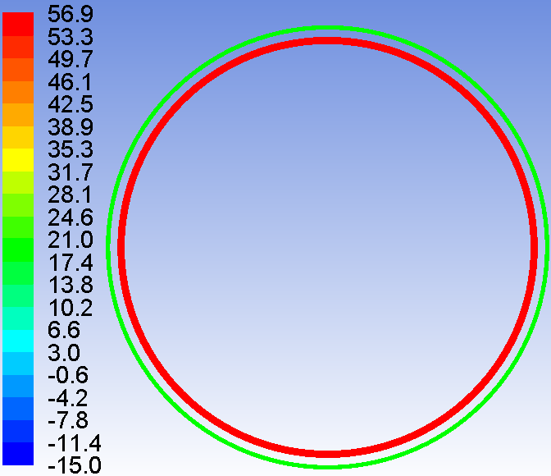
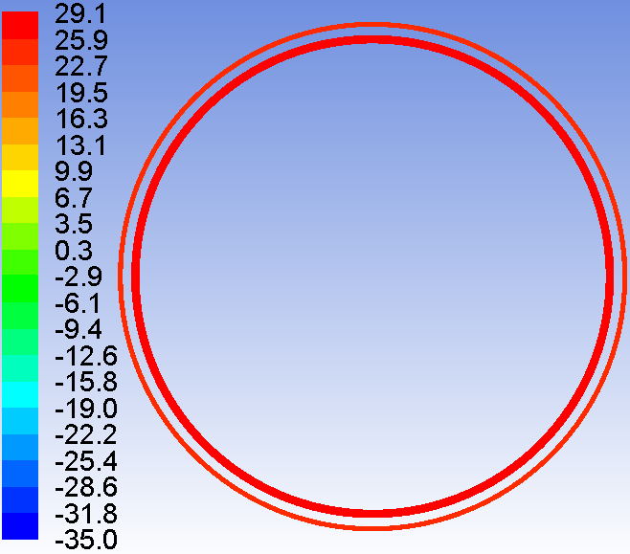
2 Heat transfer analysis of beampipe
2.5 Exploration of coolant for Be pipe
Results
Power |  | pressure (gage pressure) | velocity | tin | Δp | Maximum temperature |  | Δt
 |  |  |  |  |  | Inner Be | Outer Be
W |  | MPa |  | ℃ | KPa | ℃ | ℃ | ℃
87.9 | N₂ | 0 | 10 | -50 | 2 | 110.2 | 69.6 | 135
 |  | 0.1 | 15 | -15* | 4 | 56.9 | 19.9 | 46.6
 | He | 0 | 10 | -50 | 3.5 | 128.6 | 124.5 | 176.3
 |  | 0.1 | 15 | -35** | 4.2 | 29.5 | 23.4 | 60.6
412.6 | N₂ | 0.1 | 15 | -50 | 4 | 233.2 | 96 | 191.6
(b) Cryogenic gas cooling
Calculation model
Inlet, u=10~15m/s
Formula of convective heat transfer coefficient in circular tube:
It is suitable for forced convection heat transfer without phase transition.
N₂(*)
He(**)
Z model: Cryogenic gas cooling is feasible. But it is difficult to realize in engineering.
High Luminosity Z: Difficult
Temperature distribution of outlet section

Slide 15
3. Heat transfer analysis for vertex detector
3.1 Detector position and heat transfer requirement
Air inlet
Air outlet
Vertex detector
4-Φ12
4-Φ12
Heat transfer condition:
Heat flux: 50mW/cm²~200mW/cm²
Coolant： Air
Working temperature：40℃ or 60℃？

Slide 16
3. Heat transfer analysis for vertex detector
3.2 Detector heat source
High heat flux: 50mW/cm²~200mW/cm²
Total heat
 | Carbon fiber quantity | Chip quantity on a single carbon fiber | Total number of chips | Single chip |  |  | Total area | Total heat
 |  |  |  | length | width | area
 |  |  |  |  |  |  |  | 50mW/cm² | 100mW/cm² | 200mW/cm²
 |  |  |  | mm | mm | cm2 | cm2 | W | W | W
First | 9 | 19 | 171 | 25.6 | 12.8 | 3.277 | 560.3 | 28.0 | 56.0 | 112.1
Second | 18 | 20 | 360 | 25.6 | 12.8 | 3.277 | 1179.7 | 59.0 | 118.0 | 235.9
Third | 24 | 20 | 480 | 25.6 | 12.8 | 3.277 | 1572.9 | 78.6 | 157.3 | 314.6
Total | 51 | 59 | 1011 | 25.6 | 12.8 | 3.277 | 3312.8 | 165.6 | 331.3 | 662.6
For air cooling, 1W thermal power classically needs 3000mm² cooling area.
（For conventional air cooling, air velocity is generally above 5m/s in radiator air cooling.）
(散热器常规风冷的风速一般在5m/s以上)
1W/3000mm²=3.33e-4W/mm²=3.33e-2W/cm²=33.3mW/cm²
The heat flux is higher than conventional air cooling.

Slide 17
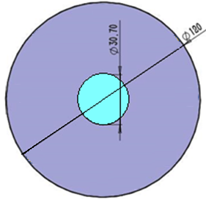
3. Heat transfer analysis for vertex detector
3.3 Air velocity in the vertex cavity
Duct inlet
Beam pipe
Velocity in the detector cavity
Time | Pipe inlet area |  |  |  |  | Vertex cavity cross section
 | ID | Velocity | Number | flow | Sectional area | OD | ID | Sectional area | Effective area | Area ratio | Actual average velocity
 | mm | m/s |  | m³/h | mm² | mm | mm | mm² | mm² |  | m/s
2020.5 | 6 | 15 | 8 | 12.2 | 226.1 | 120 | 30.7 | 1.06E+04 | 1.03E+04 | 45 | 0.3
2020.7 | 12 | 15 | 4 | 24.4 | 452.2 | 118 | 30.7 | 1.02E+04 | 9.91E+03 | 22 | 0.7
Φ12
Sectional area contrast
Air velocity is inversely proportional to area
For the air velocity that can be provided under the beam tube structure is only 0.7m/s.
Due to the tight space, the air velocity required for cooling cannot be provided.

Slide 18
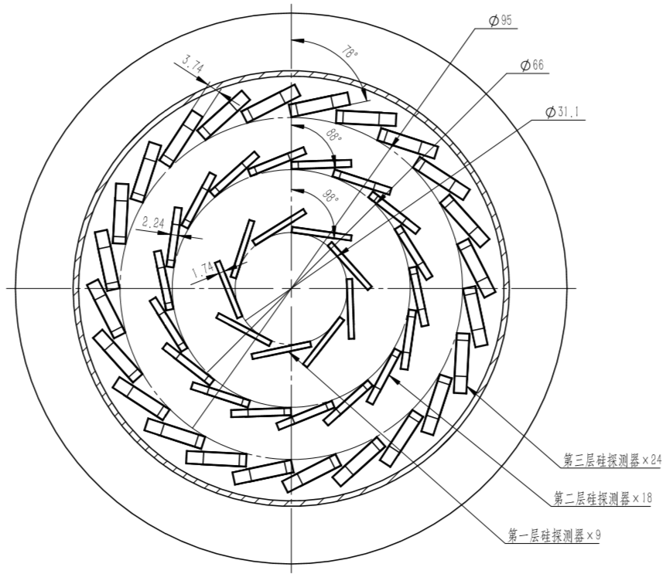
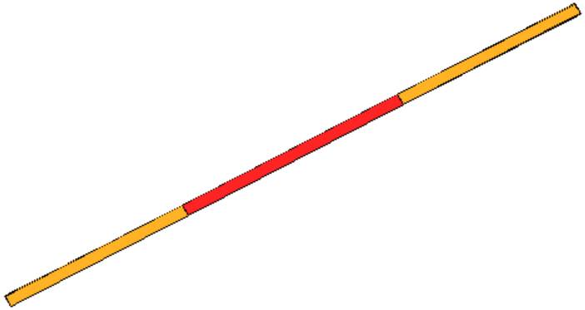
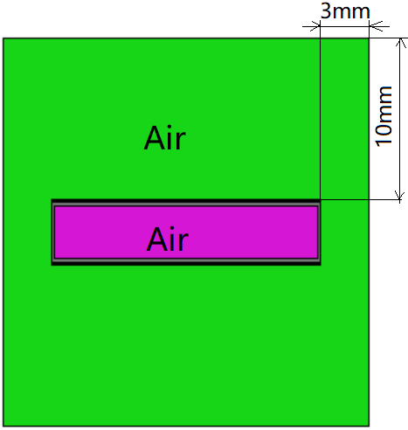
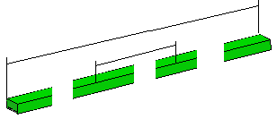
3. Heat transfer analysis for vertex detector
3.4 Air cooling analysis of single silicon strip in the third layer(2020.5)
(1) Calculation model
Exothermic layer(Si)：
25.7mm*12.8mm*0.05mm*10plates
A
Flexible circuit board(Kapton):
698mm*16.8mm*0.07mm
Carbon fiber：698mm*16.8*0.2mm
Silicon strip distribution
Silicon strip
A profile
structure
Material property
carbon fiber length：698mm
material | density | Specific heat | conductivity
 | kg/m³ | J/(kg.k) | W/(m.K)
Si | 2419 | 713 | 149
kapton | 1417 | 1260 | 0.2
carbon fiber | 1810 | 710 | 0.52
Chip length(10 plates)：257mm
Air flow direction
t_{in}=20℃，0.3~0.5m/s
Because of symmetry, using half to simulate.
Calculation model with air

Slide 19
3. Heat transfer analysis for vertex detector
3.4 Air cooling analysis of single silicon strip in the third layer(2020.5)
(2)Results
Temperature distribution
Heat flux | Δt |  | Maximum temperature
mW/cm² | 0.3m/s | 0.5m/s | 0.3m/s | 0.5m/s
 | ℃ | ℃ | ℃ | ℃
200 | 76.5 | 48.2 | 537.9 | 489.5
100 | 38.2 | 24.1 | 276.7 | 251.8
50 | 19.1 | 12.1 | 146.6 | 134.5
Only air cooling can’t take away the heat.
The outlet temperature of air is high.
Cooling the ends of carbon fiber

Slide 20
3. Heat transfer analysis for vertex detector
3.5 Air cooling + ends cooling for single silicon strip in the third layer(2020.5)
carbon fiber length：698mm
t=20℃
Results
Chip length(10 plates)：257mm
Heat flux | Maximum temperature
 | Only air cooling | Air cooling + Ends cooling
mW/cm2 | ℃ | ℃
200 | 537.9 | 525.6
100 | 276.7 | 271.2
50 | 146.6 | 144.8
0.3m/s
t=20℃
Air flow direction
Calculation model
The temperature can be decreased by end cooling, but it is limited by the thermal conductivity and cross-sectional area of the material.
Increasing carbon fiber conductivity

Slide 21
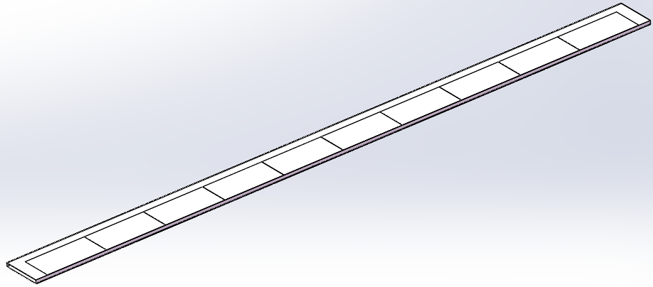
3. Heat transfer analysis for vertex detector
3.6 Air cooling + ends cooling for single silicon strip in the first layer(2020.7)
Choose the shortest silicon strip to analysis. The shortest, the easiest for ending cooling.
(1) Calculation model
Many influencing parameters in calculation
Silicon strip distribution
outside:
10plates
Natural convection
Simply calculation: Adding natural convection on the surface instead of air cooling.
t=20℃, h=?
Inner side:
9plates
No Natural convection
(because no air cooling here)
Range of natural convection heat transfer coefficient: h=1~10W/(m².K).
Determine the parameter of h: h=f(u)
Single silicon strip
h?, t=20℃
t=20℃
Determine the velocity around the first layer
carbon fiber length：267mm
t=20℃

Slide 22
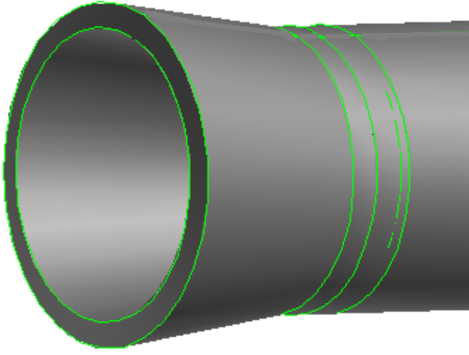
3. Heat transfer analysis for vertex detector
3.6 Air cooling + ends cooling for single silicon strip in the first layer(2020.7)
(2) Determine the velocity of the first layer(2D)
Calculation model(2D)
Inlet:1.5m/s
outlet
Determination of inlet velocity
4-Φ12，u=15m/s
3D: u=1.5m/s
2D: u=1.5m/s
Velocity distribution
Average velocity:
1.0m/s
0.7m/s
0.5m/s
The average velocity next to the first layer is 0.5m/s.

Slide 23
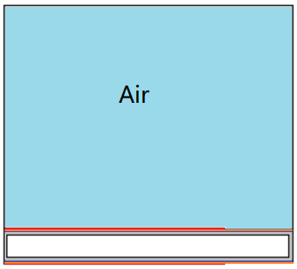
3. Heat transfer analysis for vertex detector
3.6 Air cooling + ends cooling for single silicon strip in the first layer(2020.7)
(3) Determine natural convection heat transfer coefficient
Calculation model
Air average velocity: 0.5m/s
outlet
inlet
t_{in}=20℃
u=2.17m/s
Silicon strip in the first layer
Section profile
Calculation condition
Carbon fiber thickness:0.25mm
Carbon fiber length: 267mm
Heat source: 50mW/cm²
Air cooling VS Natural convection
Carbon fiber conductivity | Air cooling | Natural convection
 | Average velocity: 0.5m/s | t=20℃
 |  | h=5 | h=10
W/(m.K) | ℃ | ℃ | ℃
0.52 | 115.3 | 185.2 | 117
200 | 53.7 | 74.2 | 54
Natural convection heat transfer coefficient: h=10W/(m².K)

Slide 24
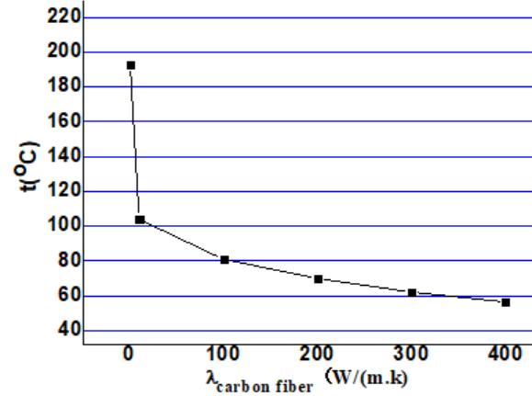
3. Heat transfer analysis for vertex detector
3.6 Air cooling + ends cooling for single silicon strip in the first layer(2020.7)
(4) Influence of carbon fiber thermal conductivity on heat transfer
Calculation model
t=20℃
t1
λ=0.52W/(m.K)
Outer face: h=10W/(m².K), t=20℃
t1-t2=122.8℃
t2-t3=13.5℃
Inner face: no convection
t=20℃
Calculation condition
Carbon fiber thickness: 0.1mm
Carbon fiber length: 267mm
Heat source: 50mW/cm²
t2
t3
Increasing conductivity of carbon fiber can greatly reduce the chip temperature.
The maximum temperature of chip
VS carbon fiber conductivity
But the temperature has not fallen to what we expected.
Increasing the thickness of carbon fiber

Slide 25
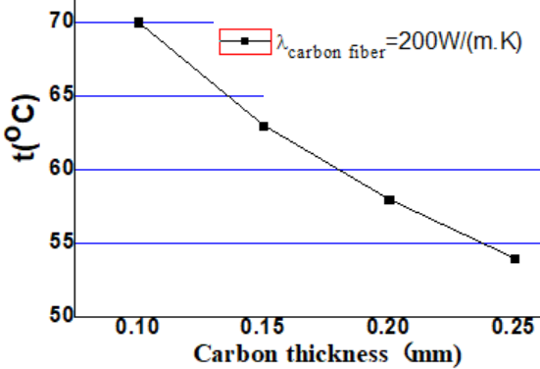
3. Heat transfer analysis for vertex detector
3.6 Air cooling + ends cooling for single silicon strip in the first layer(2020.7)
(5) Influence of carbon fiber thickness on heat transfer
Calculation condition
Carbon fiber length: 267mm
Carbon fiber conductivity: 200W/(m.K)
The ends temperature: 20 ℃
Heat source: 50mW/cm²
Unilateral natural convection: h=10W/(m².k),t=20℃
The detector maximum temperature can be reduced to less than 55℃ when carbon fiber thickness is 0.25mm and it’s conductivity is 200W/(m.k).
Detector preferred temperature: ≤40℃
The maximum temperature of chip
VS carbon fiber thickness
Adding high conductivity coating

Slide 26
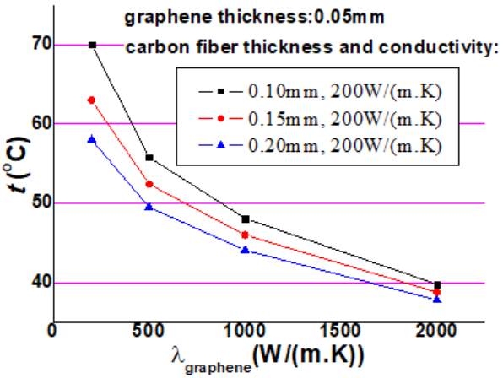
4.5.2 Influence of different factors on vertex detector heat transfer
3.6 Air cooling + ends cooling for single silicon strip in the first layer(2020.7)
(6) Influence of graphene conductivity on heat transfer
Adding high conductivity coating
graphene：0.05mm
Calculation condition
Carbon fiber length: 267mm
Carbon fiber conductivity: 200W/(m.K)
The ends temperature: 20 ℃
Heat source: 50mW/cm²
Unilateral natural convection: h=10W/(m².k),t=20℃
The maximum temperature of chip
VS graphene conductivity
Adding high conductivity coating it’s possible to reduce the detector temperature the range of 40~50℃.

Slide 27
5. Summery
(1) Beampipe
（a） Paraffin cooling for Be and water cooling for extending AL pipe
Be pipe: Paraffin cooling can satisfy the engineering requirement, but the temperature of detector installation position is a little higher than our expectation.
Extending Al pipe: cooling well!
（b） Coolant Exploration for Be
Water: Good cooling medium. Water eroding on the thin Be tube remains to be studied.
Cryogenic gas: Feasible in Z mode. But it is difficult to realize in engineering.
(2) Vertex detector
A series of cooling optimization has been done, but the purpose is still not achieved. Cooling is very difficult.

Slide 28
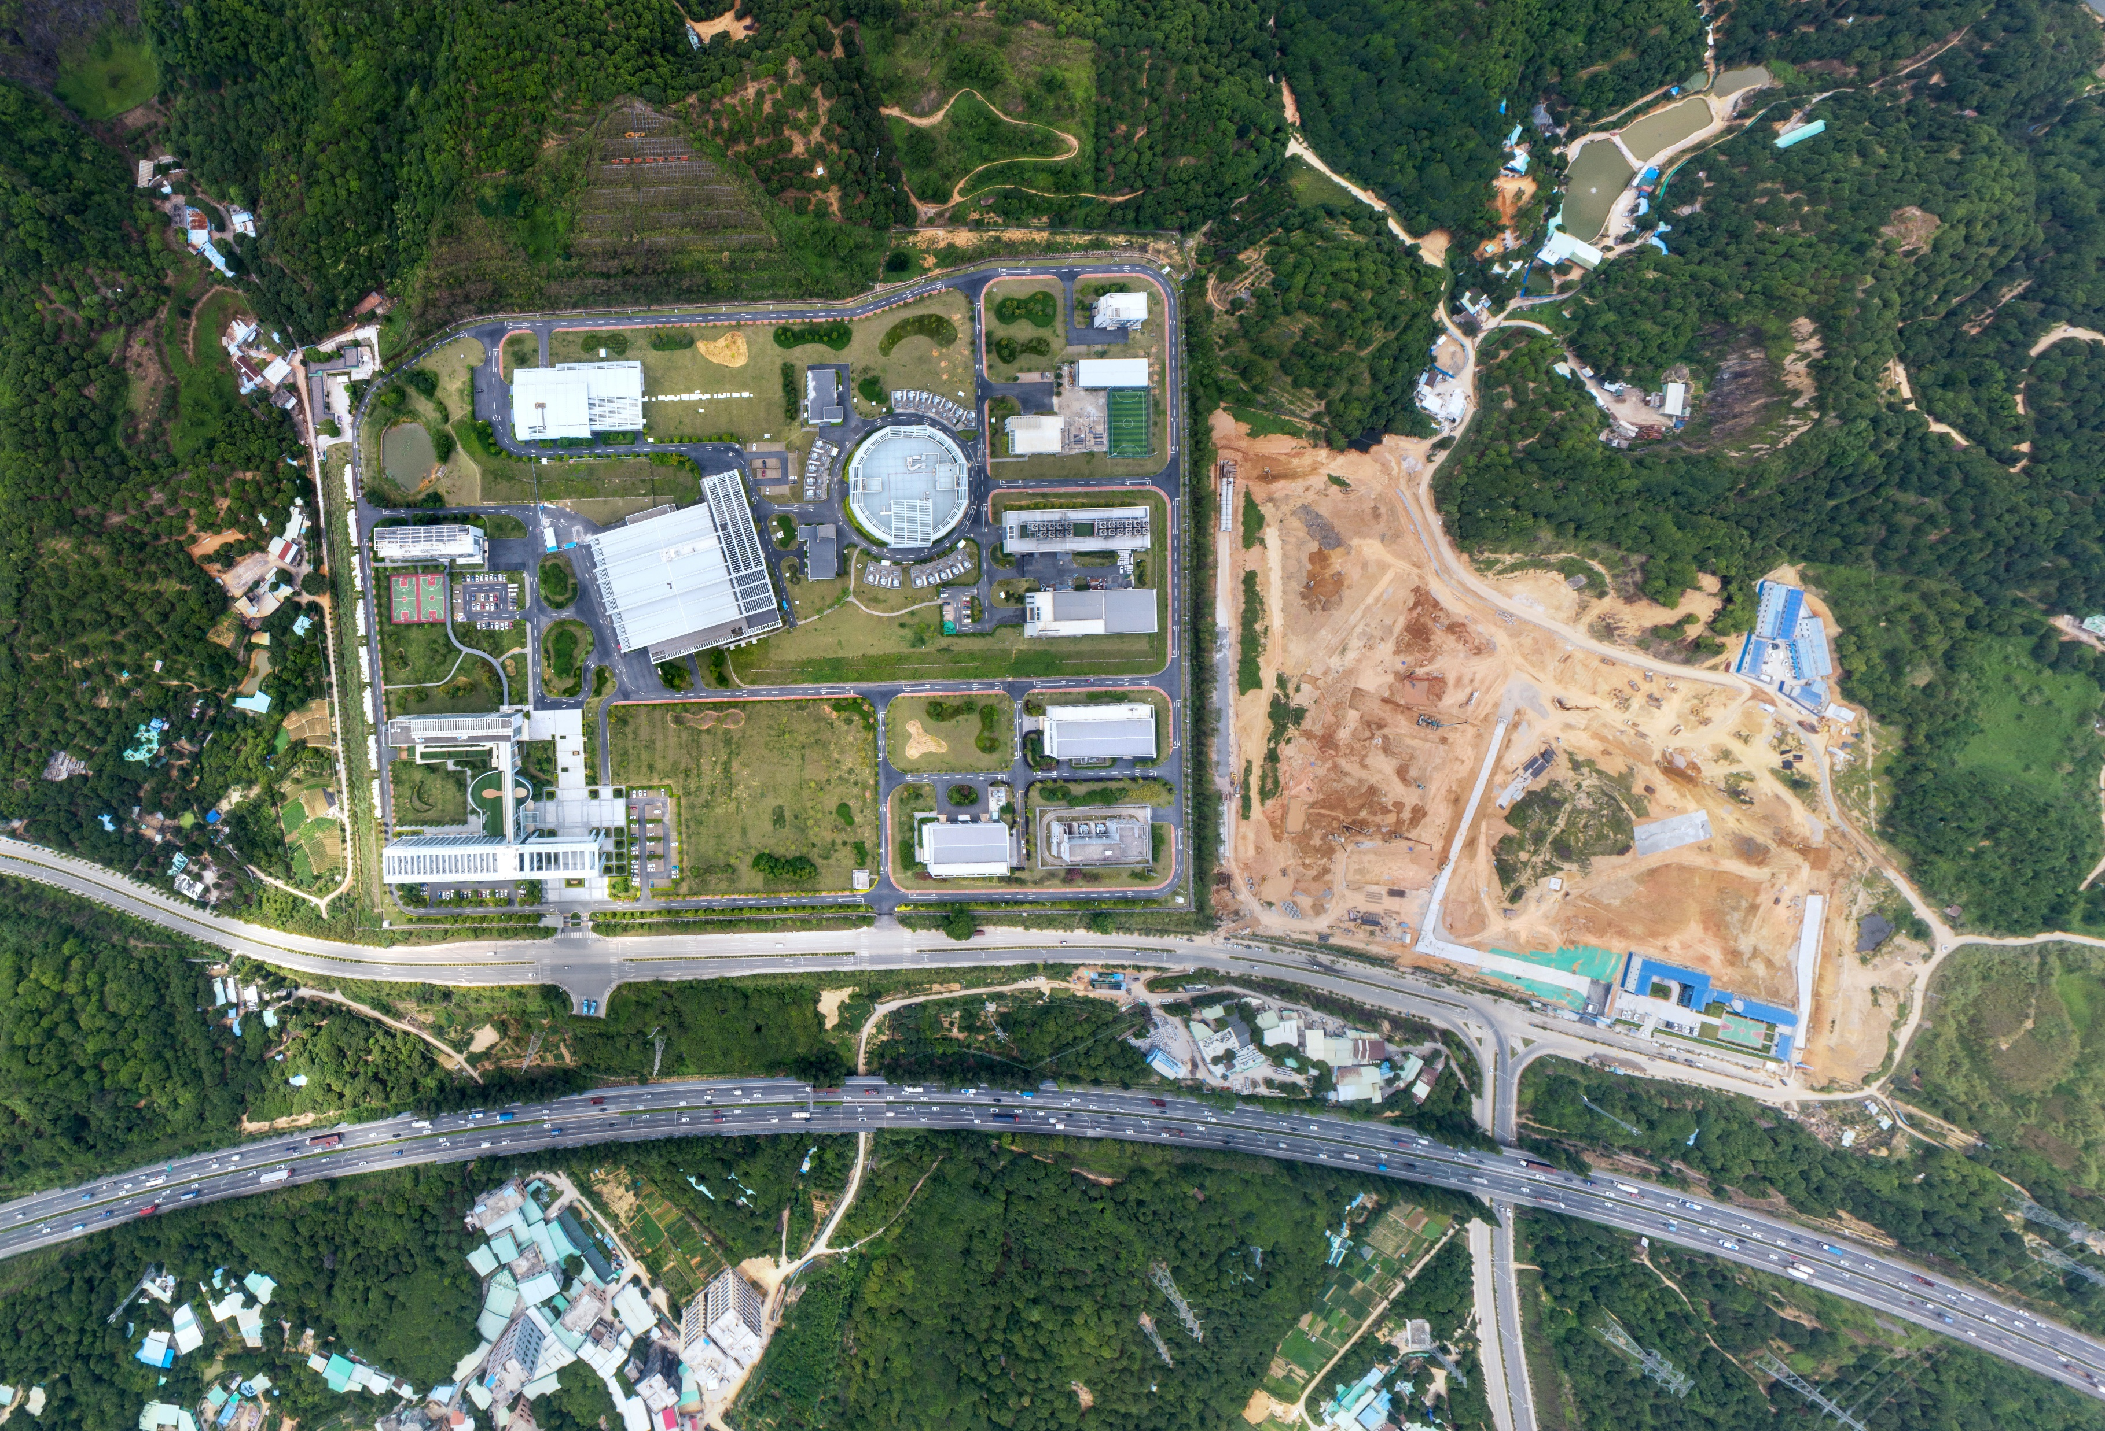
Thanks for your attention!

