Slide 1
Status of Pixel Vertex Detector
Zhijun Liang
(IHEP, Chinese Academy of Sciences)

Slide 2
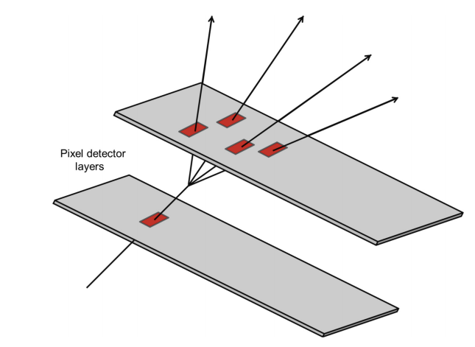
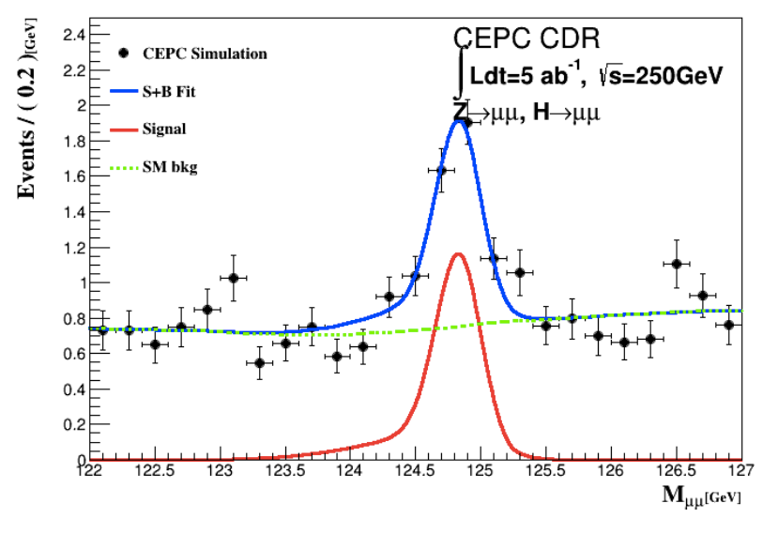
Vertex detector: Physics goal
Higgs precision measurement
H → bb precise vertex reconstruction
H → μμ (precise momentum measurement)
Main technology
High spatial resolution technology → pixel detector
Low-mass detector technology
Radiation resistance technology
Need tracking detector with
high spatial resolution, low material

Slide 3
CEPC vertex detector R & D
Three on-going R & D programs on vertex detector
Previous update in CEPC day (June 15th) https://indico.ihep.ac.cn/event/11875/
This talk focuses on MOST2 project
MOST2 aims to build full-size vertex detector prototype
Funding agency | Process | International collaborators | Objectives of the project | schedule
MOST1 | CMOS | Strasburg IPHC | Small pixel size design with in-pixel digitization and low power frontend | 2016.6-2021.5
MOST2 | CMOS | IFAE/Oxford/ Livepool … | full-size vertex detector prototyping ( Full-size sensor support structure, module …) | 2018.5-2023.4
NSFC | SOI | KEK/SOIPIX collaboration | Verification of SOI process with small pixel size and low noise design | 2016-

Slide 4
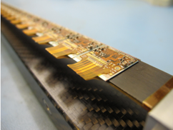
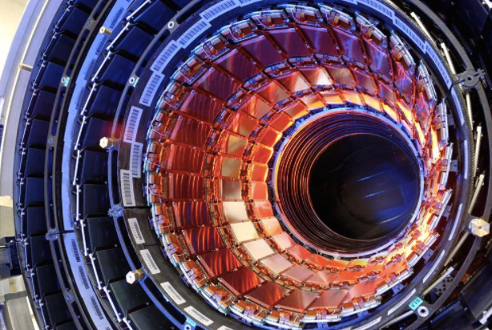
MOST2 vertex detector R & D: Research Goal
Typical module
Produce a world class vertex detector prototype
Spatial resolution 3~5 μm (pixel detector)
Radiation hard (>1 MRad)
Preliminary design of prototype
Three layer, module ~1 cm × 12 cm²
Typical tracker
Resolution
ATLAS/CMS upgrade
（~15 μm）
Alice upgrade
（5~10 μm）
World
leading
This project（3~5 μm）
Notes:
General description highlighting major points and assessment indicators

Slide 5
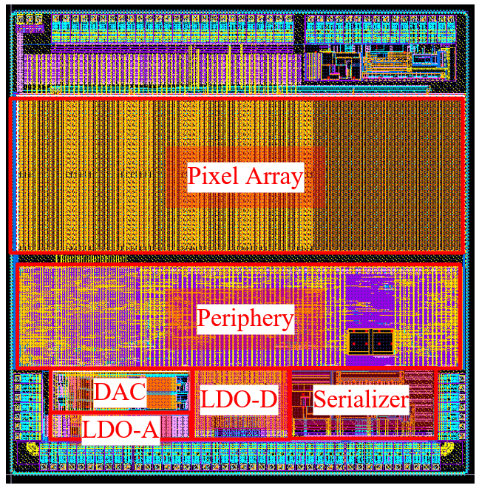
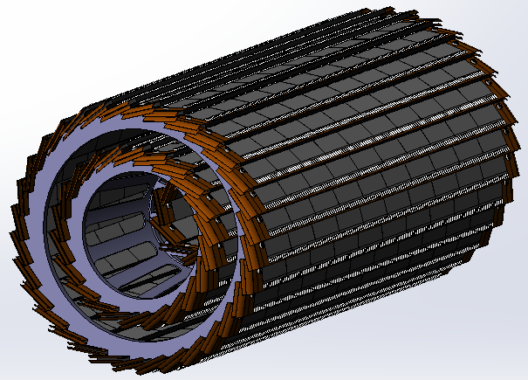
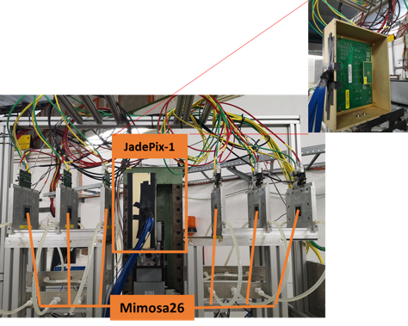
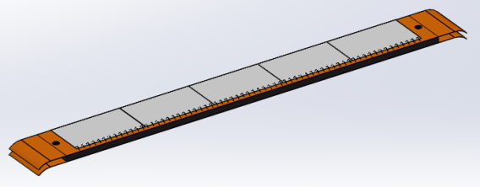
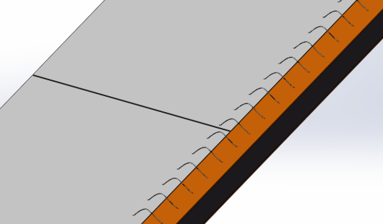
Overview of MOST2 vertex detector R & D
Can break down into sub-tasks:
CMOS imaging sensor chip R & D
Detector layout optimization, Ladder and vertex detector support structure R & D
Detector assembly
Data acquisition system R & D
CMOS imaging
sensor prototyping
Detector module (ladder)
Prototyping
Beam test to
verify its spatial resolution
Full size vertex detector Prototype
sensor
FPC
Ladder support
Notes:
Full size vertex detector

Slide 6
Research Team in MOST2 silicon project
4 institutes
课题2：IHEP - 中国科学院高能物理研究所
SDU - 山东大学
NJU - 南京大学
NWU - 西北工业大学
Institutes | Tasks
IHEP | Full CMOS chip modeling, Pixel Analog, PLL block Detector module (ladder) prototyping Data acquisition system R & D Vertex detector assembly and commissioning
CCNU/IFAE | CMOS sensor chip: Pixel Digital
NWPU | CMOS sensor chip: Periphery Logic, LDO
SDU | CMOS sensor chip: Bias generation, TCAD simulation Sensor test board design
NJU | Irradiation, test beam organization
Notes:
Total 51, average age is 39
Acc: 39=703/18
Silicon: 39=866/22
HCAL: 40=440/11
Total: 39

Slide 7
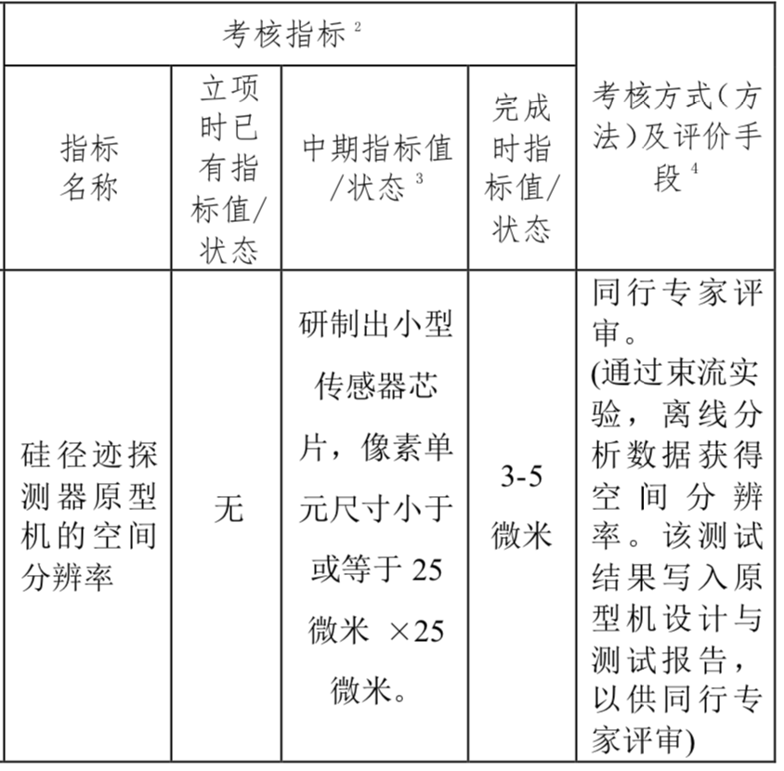
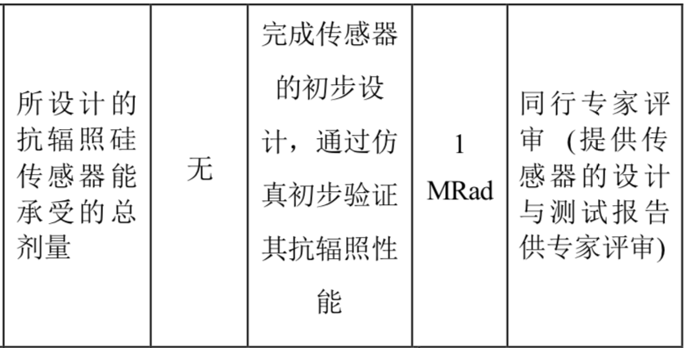
Achievement Presentation and Assessment Methods
Assessment index
Spatial resolution
- Mid-term: produce 25*25 μm pixel size chip
- Final : 3-5 μm resolution in Beam test
Silicon Detector
Radiation hardness
- mid-term: verified by TCAD simulation
- Final : Total ionization dose >1 Mrad

Slide 8
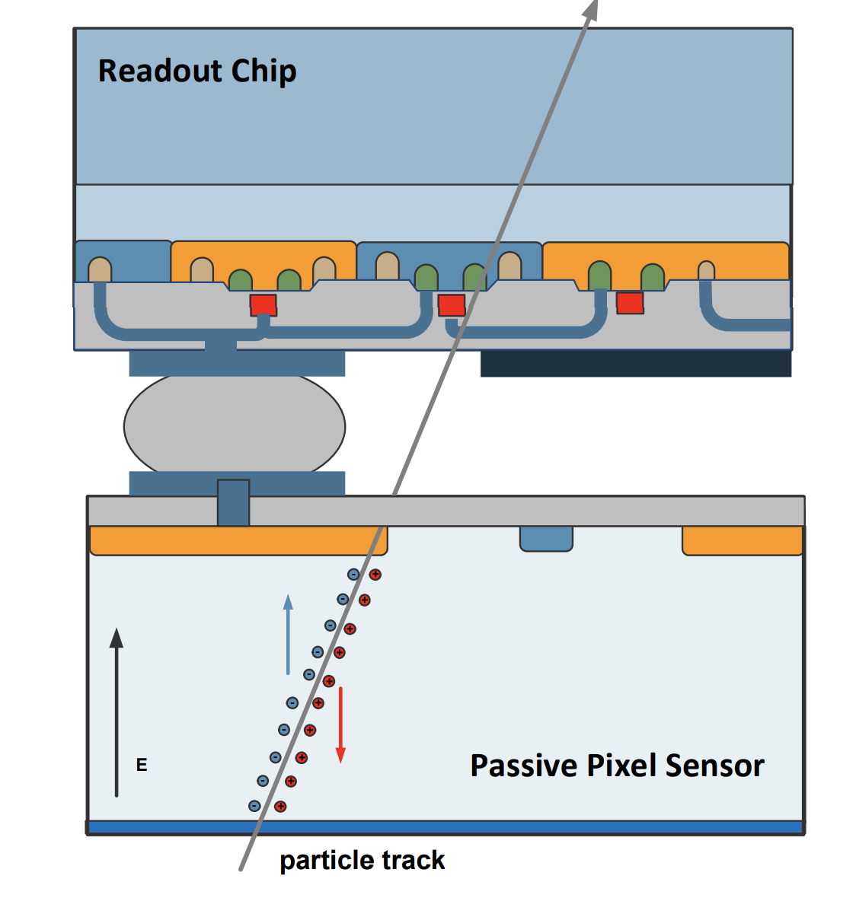
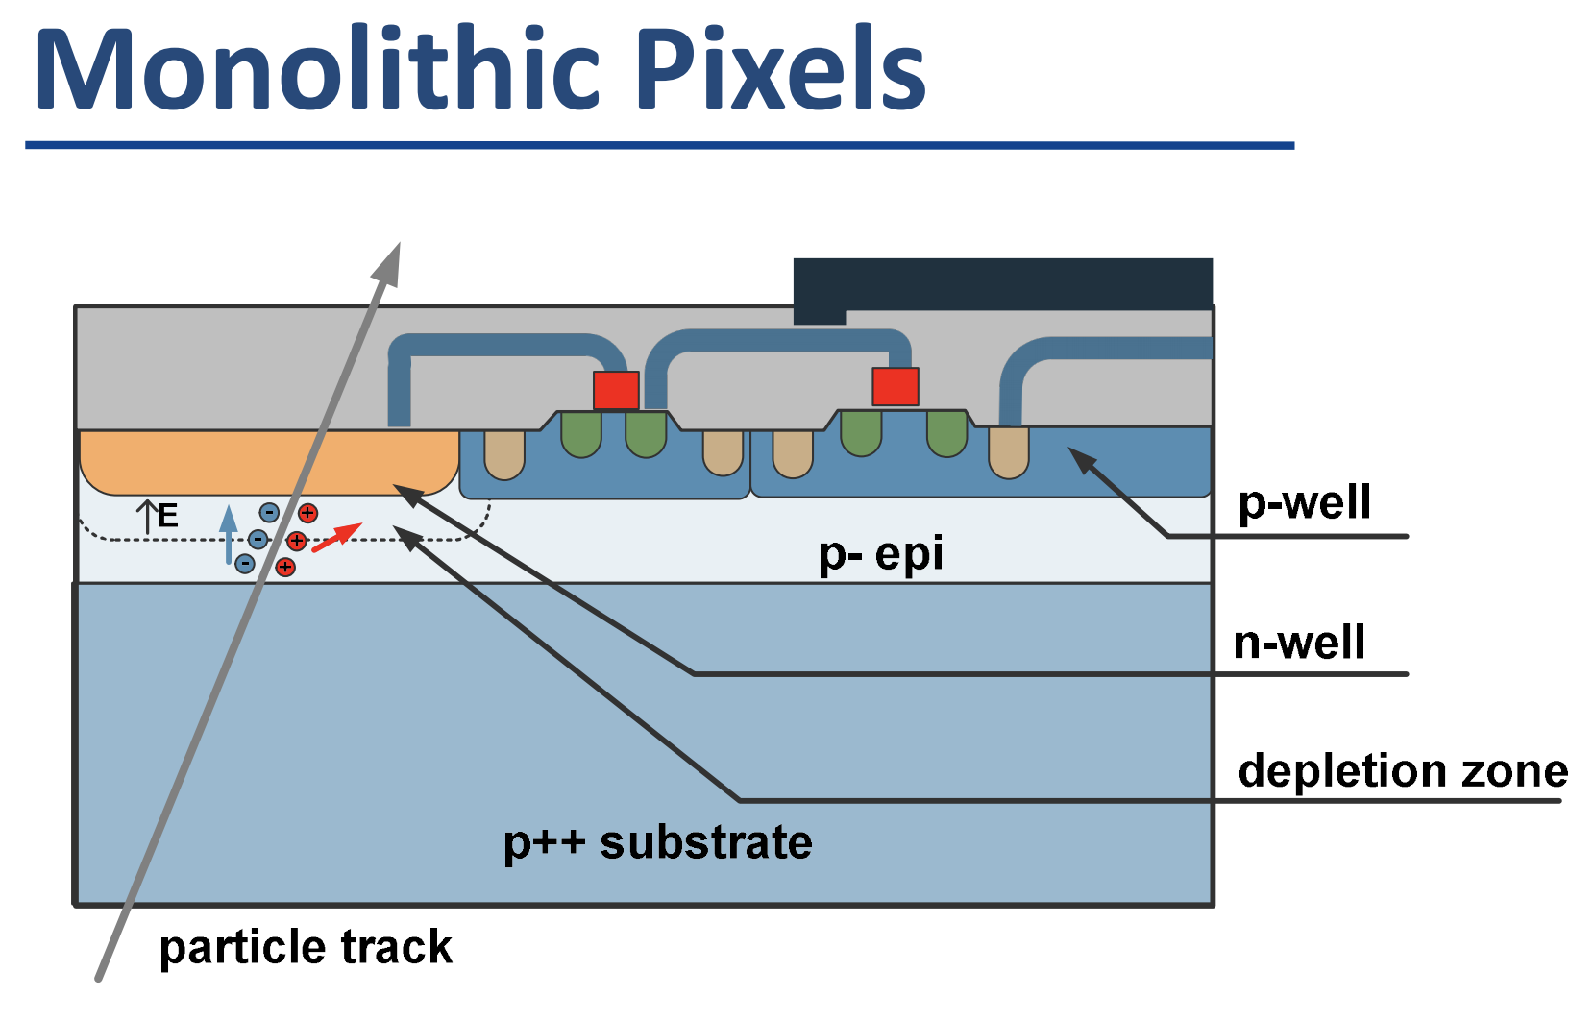
CMOS Monolithic pixel sensor
CMOS Monolithic pixel (CIS process) is ideal for CEPC application
low material budget (can be thin down to 50μm)
This project use TowerJazz CIS 180nm technology
Hybrid pixel technology developed by ATLAS and CMS
Thickness of sensor is about 200~300 μm
Need to bump bonding with readout ASIC (ASIC thickness is about 300μm)
Material budget about silicon sensor is about 10 times larger than CIS process
Hybrid pixel

Slide 9
CMOS Sensor chip R & D
The existing CMOS monolithic pixel sensors can’t fully satisfy the requirement
Major Challenges for the CMOS sensor
Small pixel size -> high resolution (3-5 μm)
High readout speed (<500ns deadtime @40MHz at Z pole) -> for CEPC Z pole high lumi
Radiation tolerance (per year): 1 MRad

Slide 10
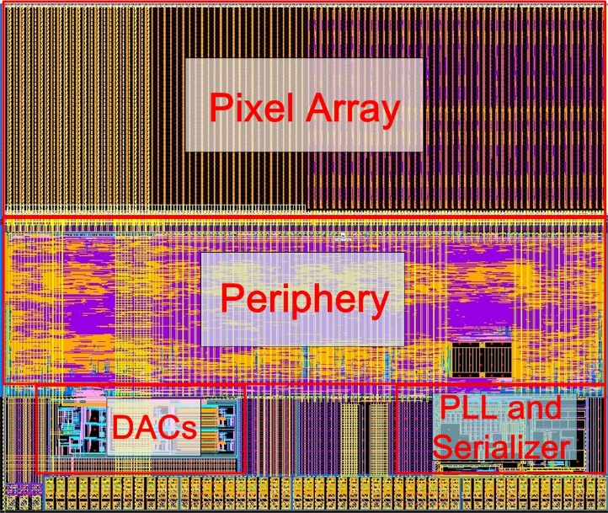
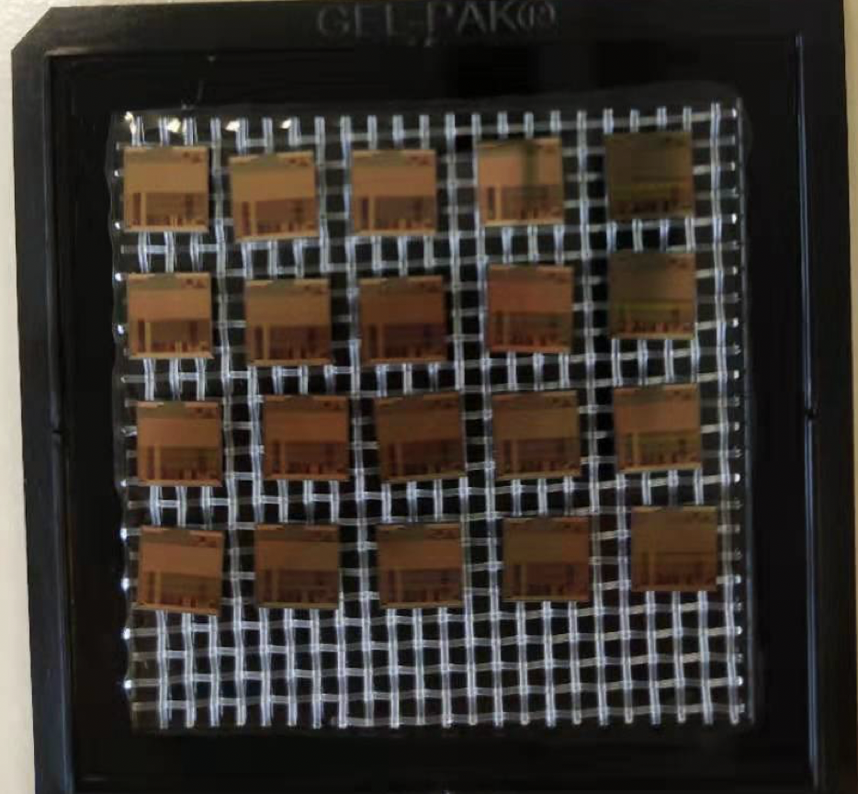
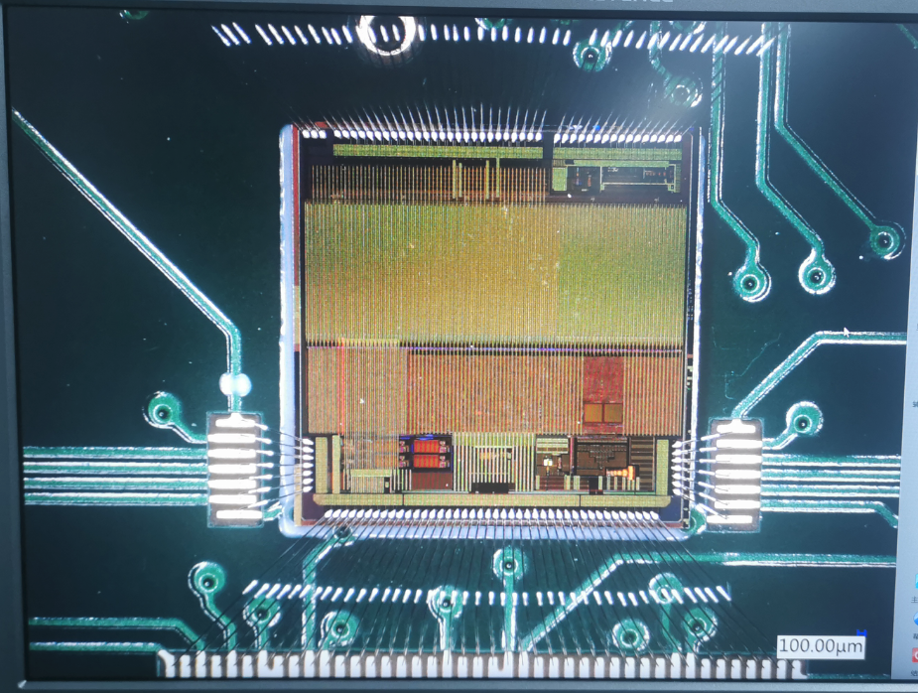
Sensor prototyping
Taichupix1
Chip size：5mm×5mm
Pixel size：25μm×25μm
Completed two round of sensor prototyping
1st Multi-wafer project chip (Taichupix1)
Submitted in June 2019, received in November 2019
Test functional blocks
pixel array ( in-pixel amplifier and digital logic )
Periphery block: digital readout architecture
Periphery block：PLL and Serializer
Periphery block： LDO and power supply
2nd Multi-wafer project chip(Taichupix2)
Submitted in Feb 2020, received in July 2020
Major bugs fixed in Taichupix1
Radiation hard design (enclosed gate) in pixel analog
Taichupix2
Chip size：5mm×5mm
Pixel size：25μm×25μm
Taichupix2 on test board

Slide 11
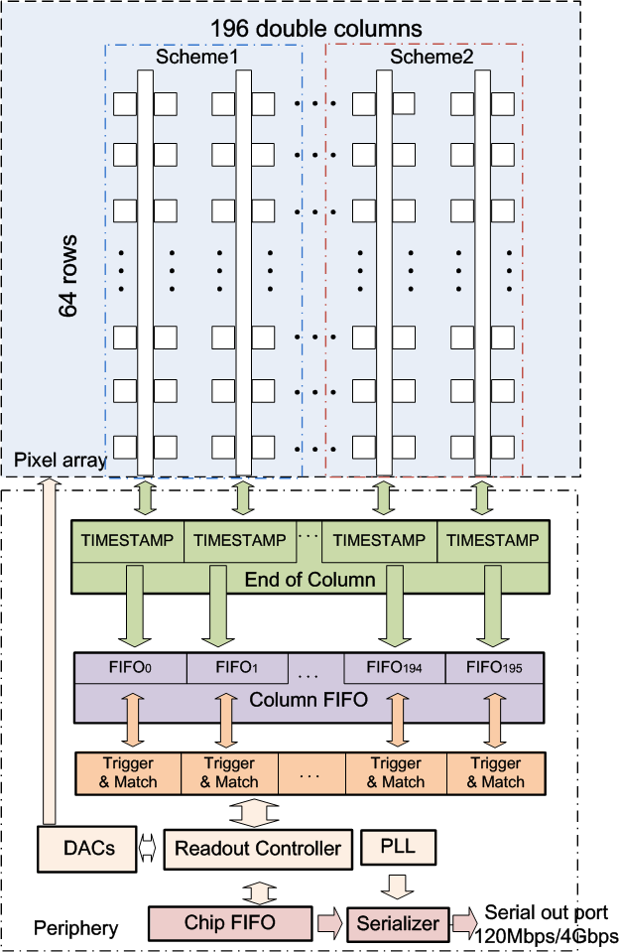
New proposed readout architecture in TaichuPix
New readout architecture
→ reduce power consumption and reduce pixel size
CEPC readout time requirement:
<500ns deadtime @40MHZ(Z pole)
Taichu-1 Column-drain readout
Priority based data driven readout; time stamp at EOC
Dead time: 2 CLK for each pixel (50ns @40MHz CLK)
Two digital pixel designs: FEI3-like and ALPIDE-like design
2-level FIFO architecture
L1: column level, to de-randomize injecting charge
L2: chip level, to match in/out data rate between core and interface
Trigger readout:
Coincidence by time stamp, matched event read out
df

Slide 12
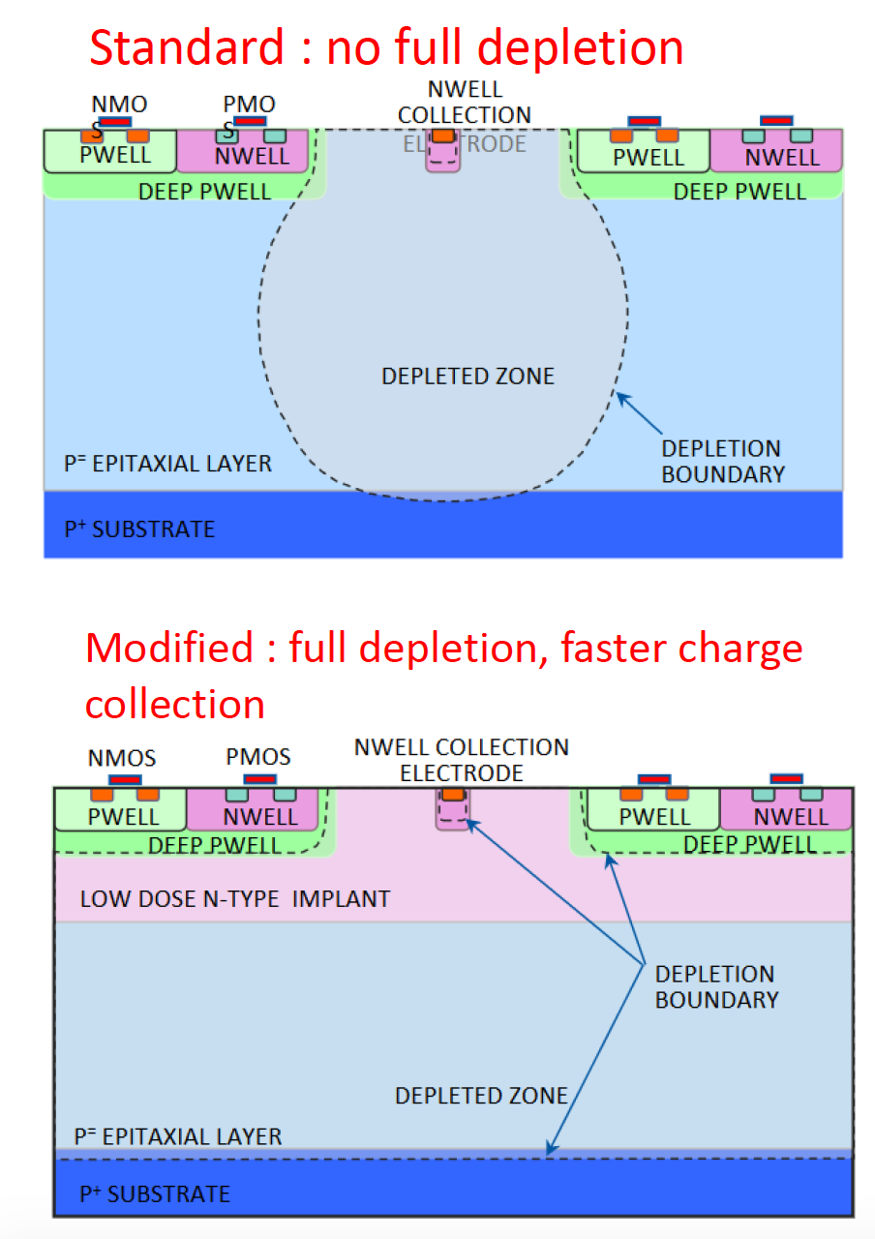
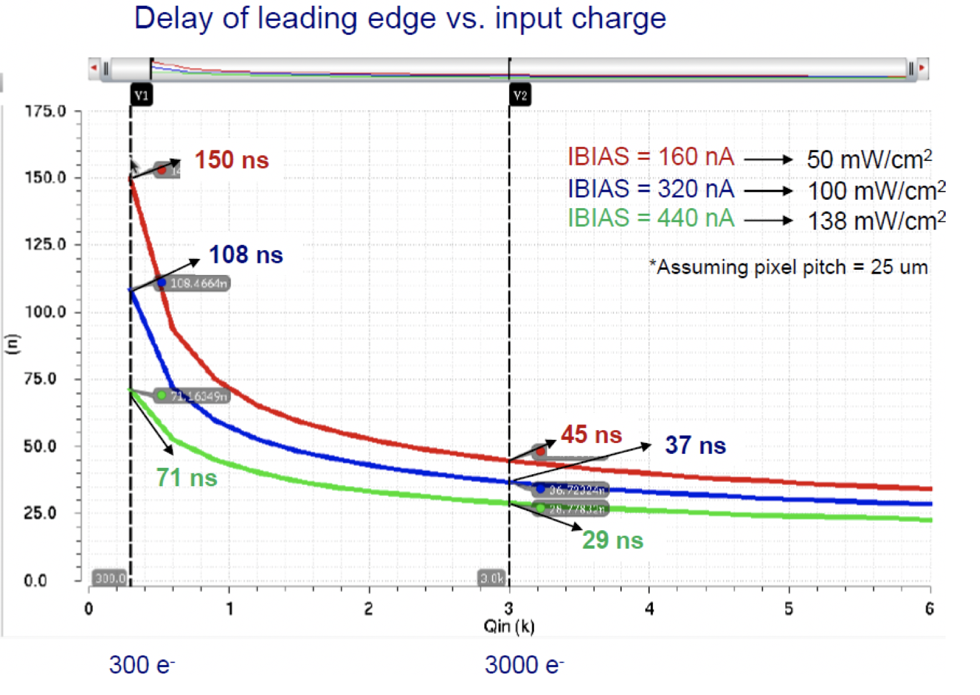
Pixel Analog design
CEPC time stamping precision requirement:
25-100ns, better to time stamping each collision at Z pole
Taichu-1 pixel analog design:
50ns~150ns (based one standard CMOS MAPS tech.)
Consider to use depleted CMOS MAPS

Slide 13
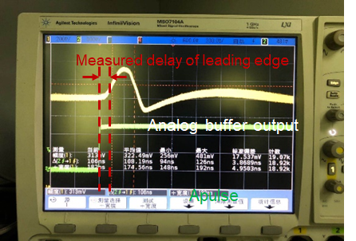
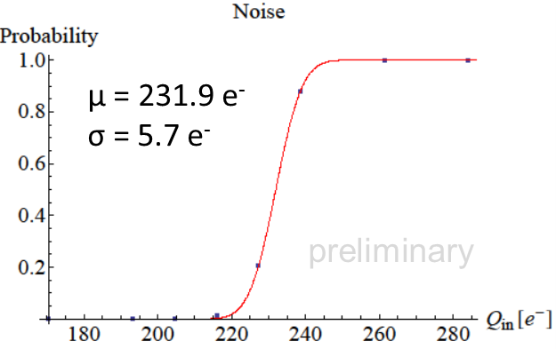
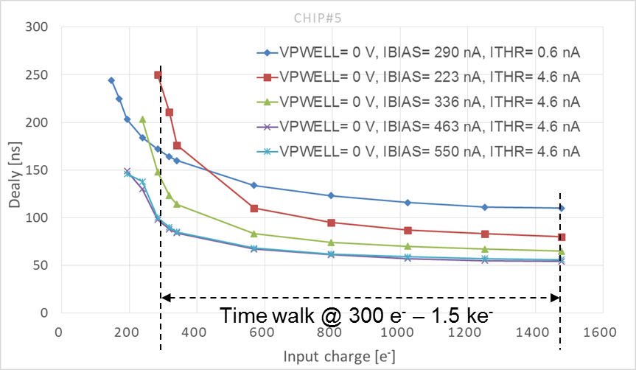
Pixel Analog Testing
Pixel analog was tested by the probed output
The tested performance was at the same level as in simulation, though the test condition is not perfect
Tested noise 5.7e-
Tested time walk 36ns(@300 e⁻–1.5 ke⁻)
Noise measurements
Tested time walk measurements

Slide 14
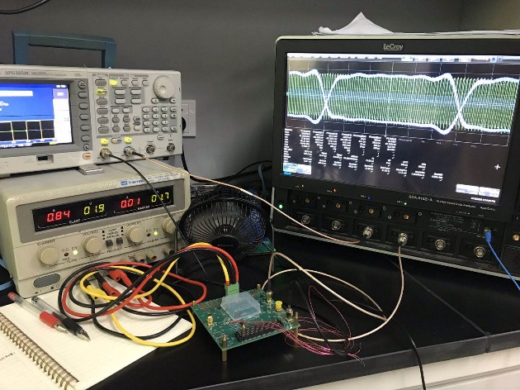
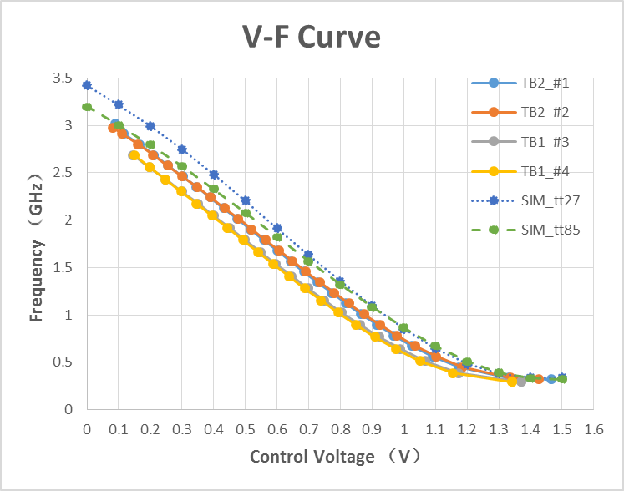
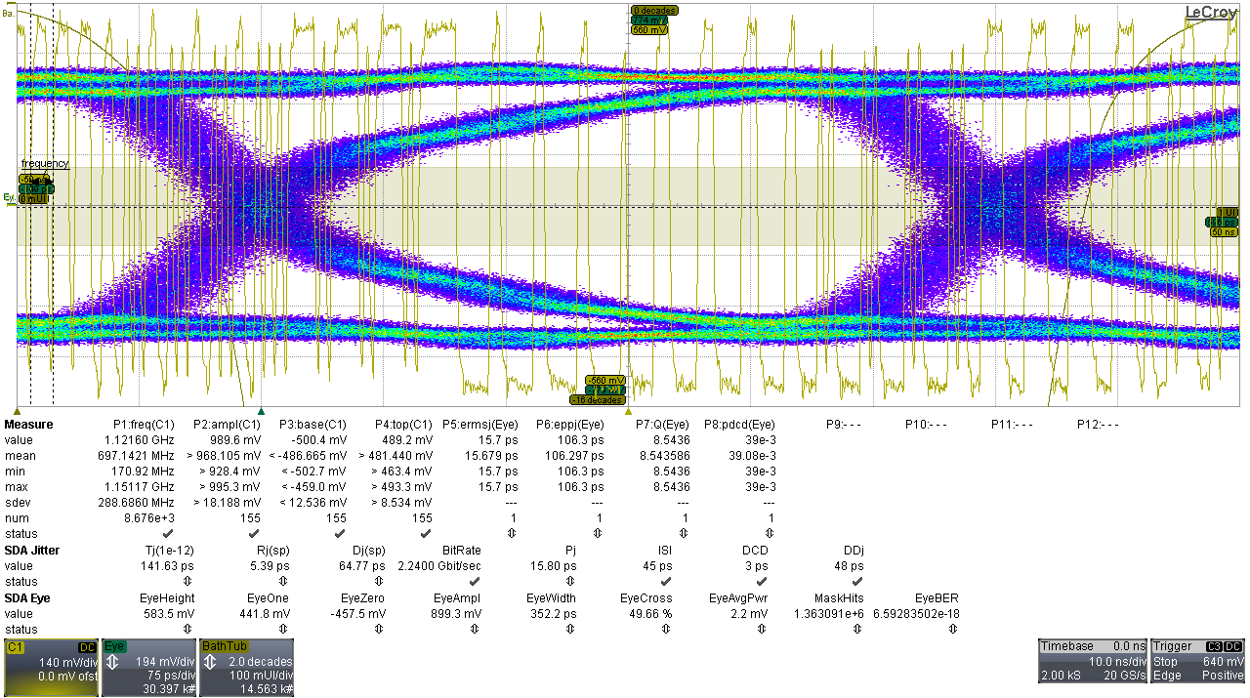
PLL and Serializer Testing
PLL and the serializer was thoroughly tested and proved
PLL’s tuning range 0.32~2.91GHz agrees with the simulation
Good and robust eye-diagram observed at 2.24GHz, with the total jitter < 150ps (@ error rate < e⁻¹²)
Serializer could run steadily @ 2.24GHz for trigger less mode
Eye-diagram

Slide 15
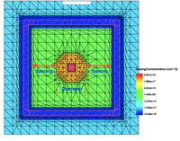
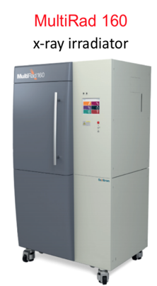
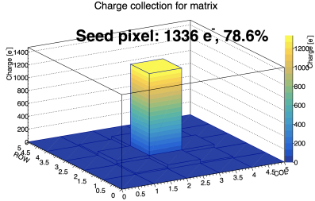
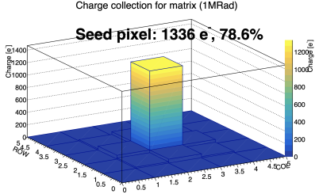
Radiation hardness
TCAD simulation model
df
Sensing diode was simulated by TCAD to study its TID behavior
The impact is negligible for the charge collection, and the leakage current after 1Mrad radiation
X ray irradiator in IHEP has been setup for irradiation tests
X ray irradiator
Collected charge
Before irradiation
Collected charge
After 1 Mad total ionization dose

Slide 16
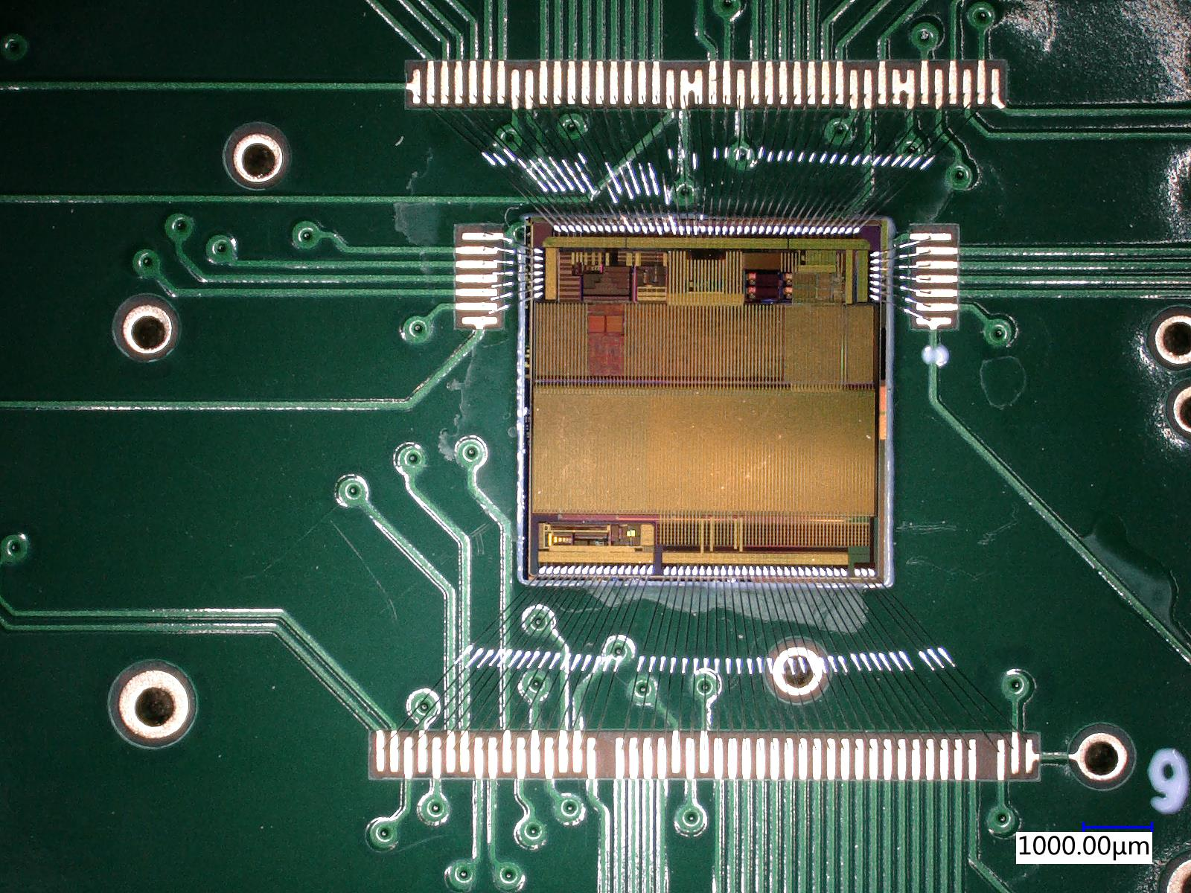
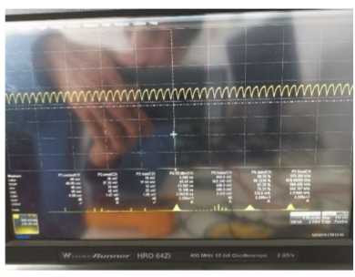
Status of TaichuPix2
received chips in July 23rd , 2020
New features
A 64*192 pixel array with the same dimension as Tcpx1
32 + 32 double column modified FE-I3 readout
32 double column modified ALPIDE readout
Newly integrated blocks: Two LDOs for power supplies
8b10b encoder added for Triggerless output
X-chip buses added for multiple chip interconnections
Functional verification status
IO rings works fine (problem solved)
Bandgap reference output proved (oscillation cancelled)
Periphery blocks tested
PLL lock function preliminarily proved
Pixel array digital communication with the periphery
Taichupix2 on test board
Oscillation issue reported in last update
Fixed in TaichuPix2

Slide 17
Summary of CMOS Sensor chip R & D
Major achievement in two round of prototyping
High Spatial resolution
Pixel size reduced to 24×25 μm → reach midterm Assessment index (实现中期指标）
Radiation hard
According to TCAD simulation, the impact is negligible for the charge collection, and leakage current after 1Mrad total ionization dose radiation→ reach midterm Assessment index (实现中期指标）
Next steps
3rd Multi-wafer project (to be submit early 2021)
Goal: All functional blocks work together
Maybe skipped if 2nd MPW chip is working
Full size sensor engineering run (in August 2021 )
Goal: full-size, full functionality

Slide 18
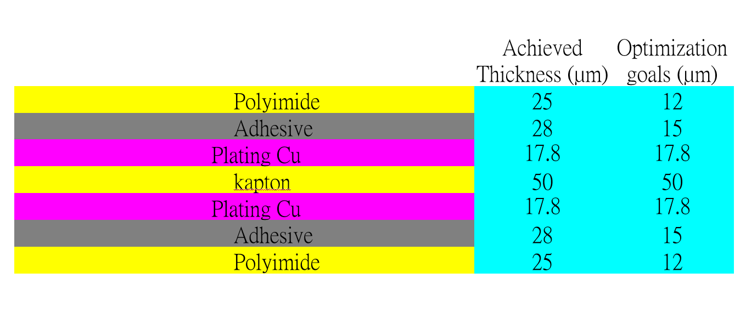
Detector module (ladder) R & D
Completed preliminary version of detector module (ladder) design
Detector module (ladder)= 10 sensors + support structure+ flexible PCB+ control board
Sensors will be glued and wire bonded to the flexible PCB
Flexible PCB will be supported by carbon fiber support structure
Signal, clock, control , power, ground will be handled by control board through flexible PCB
3D model of the ladder
Schematic of ladder electronics
Profile of flexible PCB
Flexible PCB prototype

Slide 19
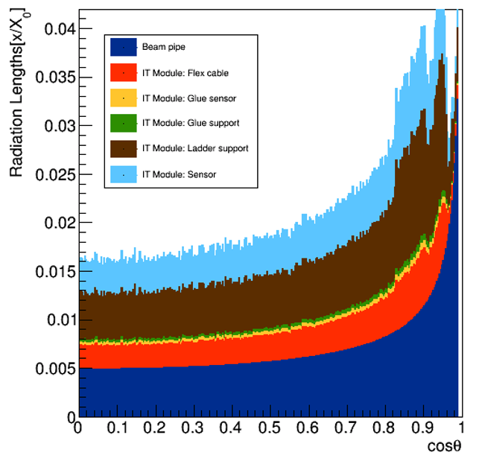
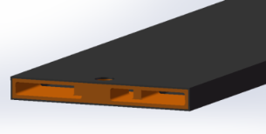
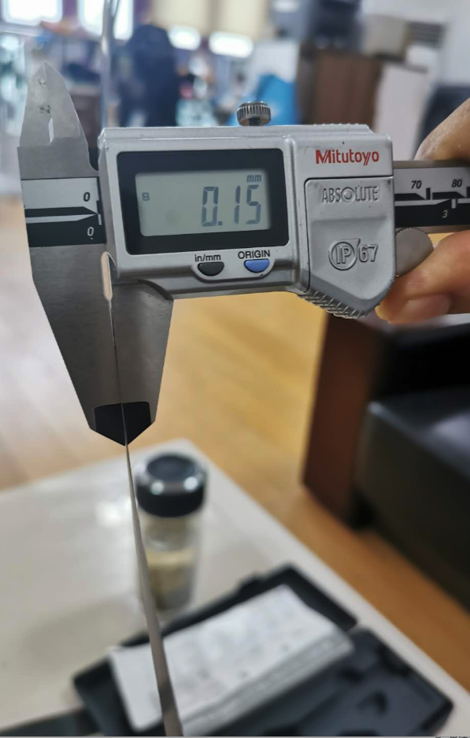
Support structure of the ladder
Support structure of the ladder: 3 layer of carbon fiber, 0.15mm thick
3 time thinner than conventional carbon fiber
A few times more rigid than conventional carbon fiber
for tracks with small cosθ, radiation length ~0.015 X0 (reduce multi-scattering )
Ladder support
structure 3D model
Conventional carbon fiber
0.15mm (1 layer)
Flexible PCB prototype
Finite elements analysis
Max def. under full load: 5.3 um

Slide 20
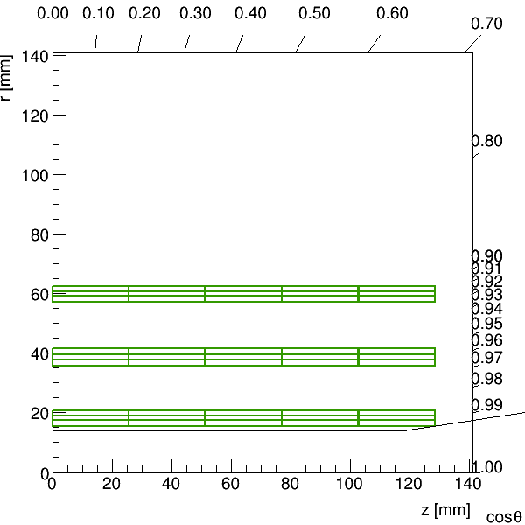
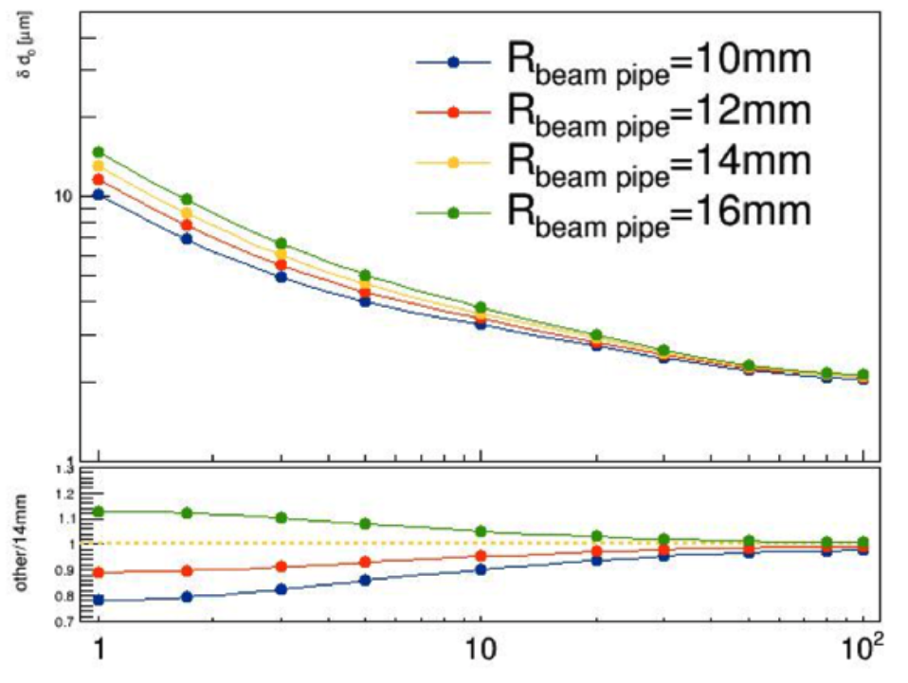
Vertex Detector Prototype R & D
Completed preliminary version of detector engineering design
3 double layer barrel design
10 modules in inner layer, 22 modules in 2nd layer, 32 modules in outer layer
Start thermal design (air cooling)
Physics simulation to optimize vertex detector layout design.
The length of inner layer pixel should be the same as other two layers
Inner pixel radium should be as close to beam pipe as possible
Impact parameter resolution
Vs beam pipe radius
Vertex detector layout
(R-Z view)
3D Model of vertex detector
Dead area in detector

Slide 21
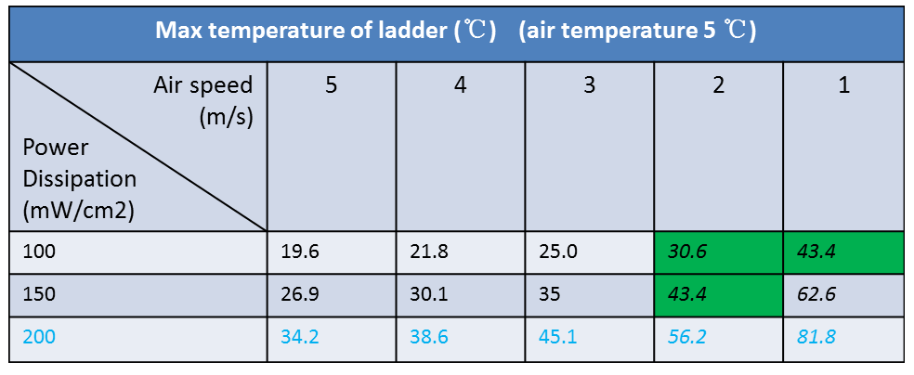
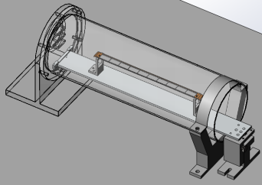
Cooling design
Air cooling is baseline design for CEPC vertex detector
Sensor Power dissipation:
Taichupix : ≤ 100 mW/cm². (trigger mode)
CEPC final goal : ≤ 50 mW/cm²
Cooling simulations of a single complete ladder with detailed FPC were done.
Need 2 m/s air flow to cool down the ladder to 30 ℃
Testbench setup has been designed for air cooling , vibration …
Test setup for ladder cooling
Use compressed air for cooling

Slide 22
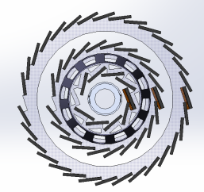
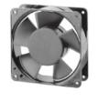
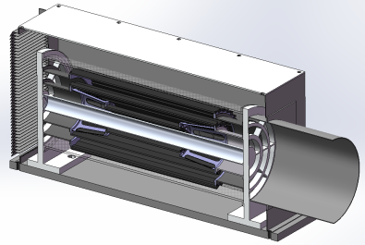
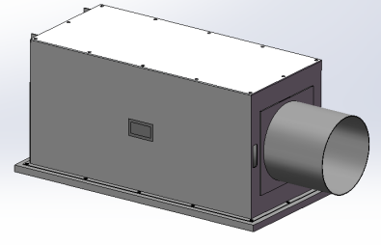
Plan for test beam
Expect to perform beam test in DESY(3 - 7GeV electron beams)
IHEP test beam facility as backup plan (a few hundreds MeV electrons )
Enclosure for detector with air cooling is developed for beam test
Beam is shooting at one sectors of vertex detectors
DESY test beam
Beam
Beam
outlet
Beam
inlet

Slide 23
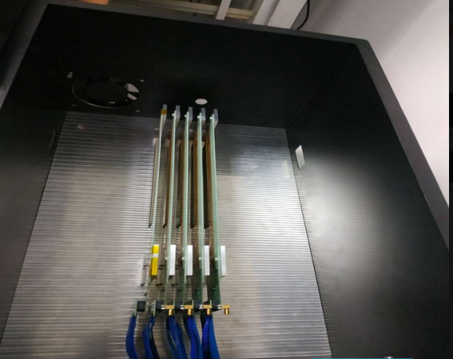
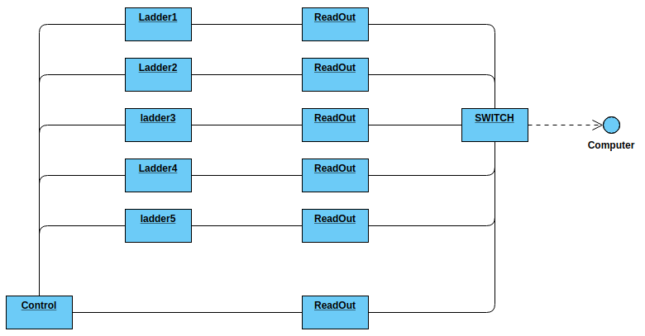
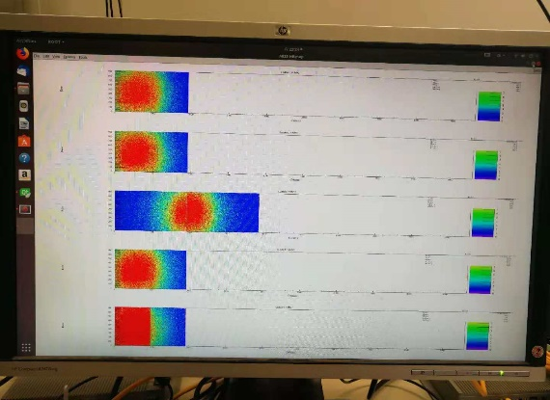
Data acquisition system
DAQ Tests with 5 MIMOSA chips
Preliminary design of data acquisition system(DAQ)
Ladders are reader by readout boards
All readout boards connected to computer through a switch
User interface developed
DAQ tested in five modules equipped with MIMOSA sensors
DAQ system data display
Tested with MIMOSA modules

Slide 24
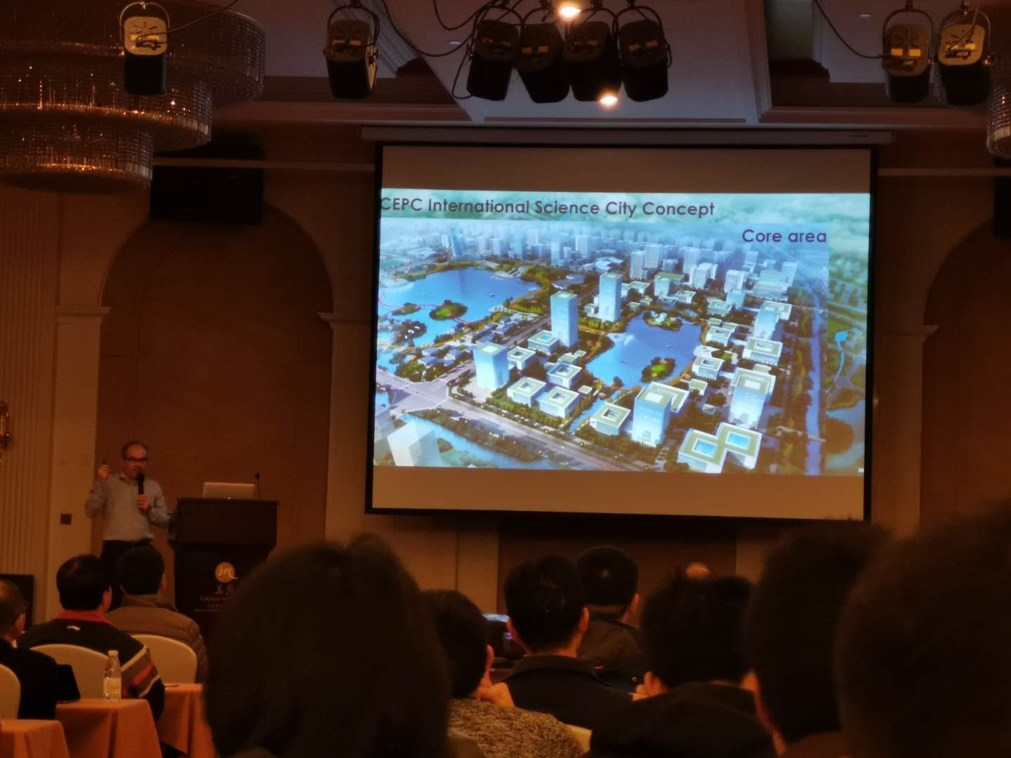
Publications and International talks
Publication:
JINST 14 (2019) C12012
IEEE ICECS (doi: 10.1109/ICECS46596.2019.8965105.)
International conference talks:
Joao Guimaraes Da Costa, CepC phys/detectors, Workshop on the Circular Electron-Positron Collider,EU Edition, April 15 - 17, 2019, Oxford, UK
T. Wu , A full functional Monolithic Active Pixel Sensor prototype for the CEPC vertex detector, in proceeding of International Conference on Electronics Circuits and Systems, Nov. 27-29, 2019, Genova, Italy.
Xiaomin Wei, High data-rate readout logic design for 1024*512 CMOS pixel array dedicated for CEPC experiment, International workshop on radiation imaging detectors, International workshop on radiation imaging detectors, July 2019, Crete, Greece
Ying Zhang, Overview of the chip design for the MOST2 CEPC vertex project, Workshop on the Circular Electron-Positron Collider,EU Edition, April 15 - 17, 2019, Oxford, UK
Wei Wei, Full size pixel chip for high-rate CEPC Vertex Detector，Workshop on the Circular Electron-Positron Collider,EU Edition, April 15 - 17, 2019, Oxford, UK

Slide 25
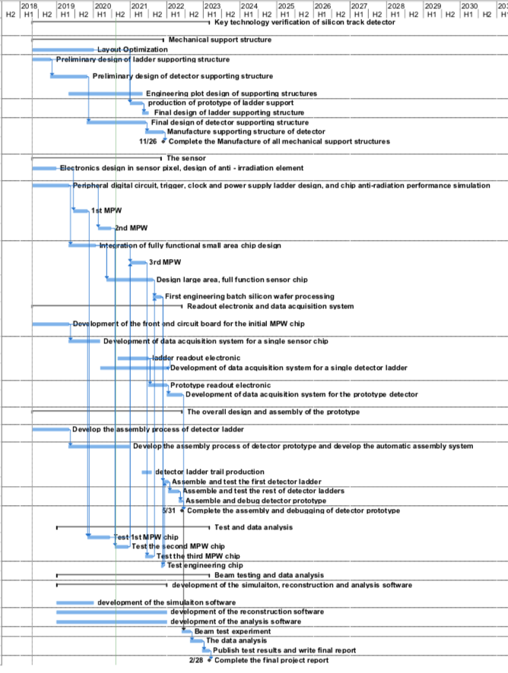
Future plan
3rd Year:
3rd CMOS sensor fabricated and tested
→ may be skipped if 2nd MPW chip is fully working
Final support structure engineering design completed
Fabricated support structure for ladders
4th Year:
Competed R & D large area sensor
Manufactured the support structure for whole detector
Assembling and installing the detector prototype
Completed DAQ system for whole detector
5th Year:
Completed detector assembly and commissioning
Test beam and data analysis
Finish assembling of prototype

Slide 26
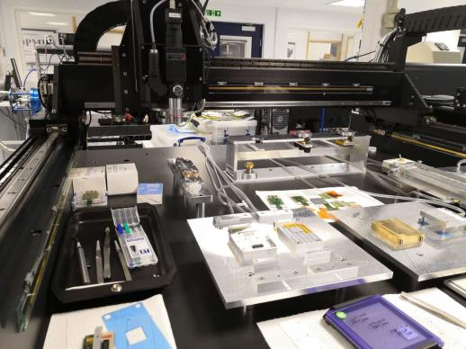
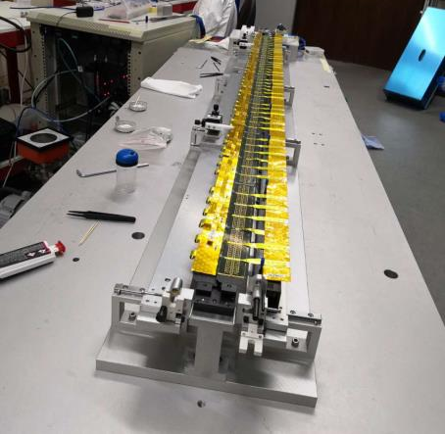
International collaboration
IFAE(Spain): very active in CMOS Sensor design and testing
Liverpool (UK): Tracker mechanical design,
Oxford(UK): CMOS sensor design validation, thermal design
RAL(UK): Pixel module design
Queen Mary(UK): module mechanical design (Zero mass concept)
Strasbourg (FR): CMOS sensor design, Tracker mechanical design
University of Massachusetts (US): Tracker mechanical design, thermal design
In 2019, we have one engineer visited Oxford and Liverpool for 4 weeks, learned a lots about silicon.
Lab visit in Oxford
Labs visit in Liverpool
Mu3e ladder, Atlas barrel strip stave prototype.
Module of Alice’s OB tracker,
Advance material Lab

Slide 27
Risk and Opportunity
Risk: Schedule for sensor chip is very tight
→ Opportunity to skip 3rd Multi-project runs, if 2nd MPW chip is fully working
May submit full-size sensor engineering run in early 2021 (7 months earlier than schedule)
Save 0.4M RMB in funding
Risk: 1st full-size sensor engineering runs doesn’t work completed
→If this happens, we need 2nd full-size sensor engineering runs
→ risk of not having enough fund for 2nd engineering runs (~2M RMB )

Slide 28
Mid-term review of MOST2 project
Midterm review meeting (Aug 20-21)

Slide 29
Mid-term review of MOST2 project
Comments from review:
This topic is a cutting-edge technology of high-energy particle detection,
Good progress of the project
Suggestion:
Check uniformity of the sensors
Should try to further reduce the power consumption
Should start testing radiation hardness of the sensor chip
Should pay more attention to mechanical support, air cooling , power consumption
→ related to spatial resolution of vertex detector prototype
This project may be short of funding at the end, suggest to give more support

Slide 30
Summary
Completed two round of CMOS sensor prototyping
New readout architecture to reduce pixel size to 25μm*24μm
→ Reach midterm Assessment index (实现中期指标）
According to TCAD simulation Radiation hardness >1Mrad total ionization dose radiation
→ Reach midterm Assessment index (实现中期指标）
Complete preliminary design for the followings
Detector module (ladder)
Vertex detector overall support structure
Data acquisition system
Strong international connection, large impact to the community if the project success.
Next major milestones
Competed full size full functionality sensors design (3rd year)
Manufactured support structure for vertex detector (4th year)
Finished detector assembly and commissioning and beam test (5th year)

Slide 31
backup

Slide 32
Mid-term review of MOST2 project

Slide 33
Budget status
Implementation rate（执行率） is about 60% for first two years
Cost profile is not linear, expect to spend more in 3rd and 4th year for detector fabrication
Testing fee(测试加工费）is mainly allocated for sensor chip engineering runs (to be done in 2021)
Device fee: will purchase gantry system for automatic assembly in next 1~2 months
序号 | 预算科目名称 | total | Budget until Midterm | Implementation until 2020/6/30 | Rate of expense/total budget | Rate of expense/midterm budget
2 | （一）direct fee | 1047.700 | 402.583 | 234.84 | 22.41% | 58.33%
3 | 1、device fee | 196.300 | 176.2 | 53.11 | 27.06% | 30.14%
4 | （1）purchase device | 196.300 | 176.2 | 53.11 | 27.06% | 30.14%
7 | 2、material fee | 235.66 | 112.49 | 52.01 | 22.07% | 46.24%
8 | 3、testing fee | 299.8 | 9.45 | 2.20 | 0.73% | 23.28%
9 | 4、power fee | 20.64 | 8.26 | 0.00 | 0.00% | 0.00%
10 | 5、travel/conference/international communication | 123.81 | 39.9 | 44.80 | 36.18% | 112.28%
11 | 6、publication | 8.5 | 3.4 | 1.90 | 22.35% | 55.88%
12 | 7、labor | 157 | 50.5 | 81.27 | 51.76% | 160.93%
13 | 8、consult | 6 | 2.4 | 1.56 | 26.00% | 65.00%

Slide 34
Internal organization
Task 2 meetings
Task 2 meetings
CMOS sensors chip design meeting (weekly )
Vertex detector overall design meeting (weekly)
Full-day internal review meeting (every 3 months)
Institutes worked closely
Project leader followed closely the progress

Slide 35
Backup:外围电路模块——高速数据接口

Slide 36
Power managements in TaichuPix chip

Slide 44
Goal for the second year
Achieve the target in task book for the 1st and 2nd years
Completed preliminary engineering designs of support structure for vertex detector prototype
Completed second sensor CMOS chip prototyping
Completed data acquisition system for sensor testing

Slide 45
Main specs of the full size chip for high rate vertex detector
Bunch spacing
CEPC Z+Higgs (240GeV): 680ns;
WW threshold scan (160GeV): 210ns;
CEPC Z pole runing (90GeV) Z: 25ns
High Hit density
2.5hits/bunch/cm² for Higgs/WW runs
0.2hits/bunch/cm² for Z pole running

