Slide 1
CEPC polarization design progress
中国科学院高能物理研究所
INSTITUTE OF HIGH ENERGY PHYSICS
Wenhao Xia
On Behalf of CEPC Polarization Working Group
Institute of High Energy Physics,
Chinese Academy of Sciences
Beijing,26,Aug,2020
1

Slide 2
Outline
Introduction to CEPC Z Polarization
Spin Rotator in the collider ring
Polarization simulation with Bmad/PTC
Summary
2

Slide 3
Introduction to Polarization
Polarized Beam?
Polarization degree:
N+: number of particles with spin parallel to the polarization direction.
N-: number of particles with spin anti-parallel.
Example: P= 1/3
3

Slide 4
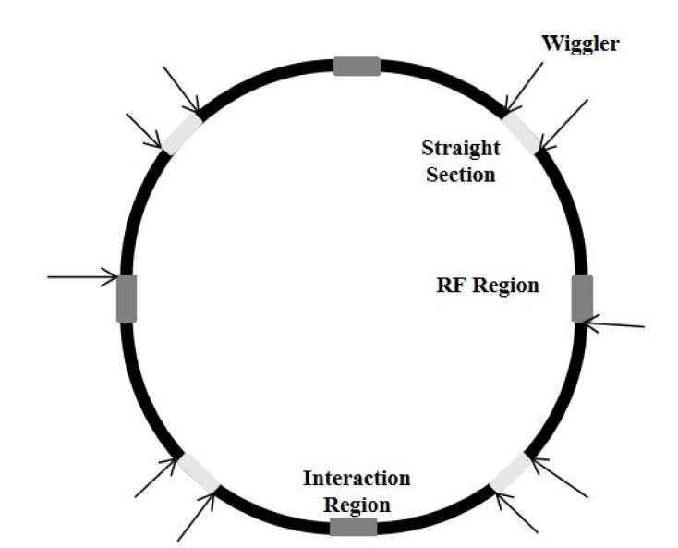
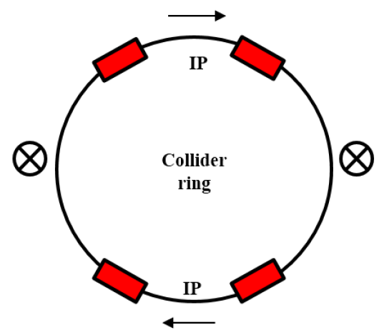
Motivation of CEPC Z Polarization
 | Vertical Polarization In the ARC | Longitudinal Polarization At IPs
Generation type | Self-polarization (Skolov-Ternov effect) | Polarized particle source
Particle | e+/e- | e- /e+
Purpose | Energy calibration (Accuracy 10^(-6)) | Collision
Goal | P≥5% | P≥50% at IP
Insertion Device | Asymmetric wiggler | Siberian Snake, Spin rotator
Benefits | A precise measurement of the beam energy with resonant depolarization technology. | Beneficial to colliding beam physics programs at Z ,W and Higgs
Vertical Pol
Longitudinal Pol
4

Slide 5
Introduction to CECP Z Polarization
CEPC Z-pole Beam Polarization
Longitudinal Polarization’s preparation:
To overcome spin resonance.
To design Siberian Snakes
To insert snakes into booster
…
Vertical polarization for energy calibration:
1) To design asymmetric wigglers
2) To insert asymmetric wigglers into collider ring.
3) To overcome depolarization in a real storage ring.
4)…
Longitudinal Polarization at IPs:
To design spin rotators
To insert rotators into collider ring
….
Spin simulation with Bmad/PTC
1) Spin tracking
2) Equilibrium polarization calc.
5

Slide 6
Spin Rotators in Collider
Spin Rotators rotate the spin from vertical to longitudinal at IPs then rotate it back to vertical .
Soleniod-based rotator with antisymmetric dipole arrangement at Z-pole
Solenoid section:
Bending magnet section: total horizontal bending angle about 0.015 [rad]
D. P. Barber et al.,Part. Accel. 17, 243 (1985).
6

Slide 7
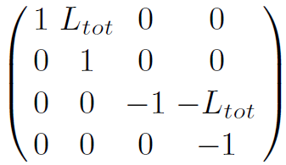
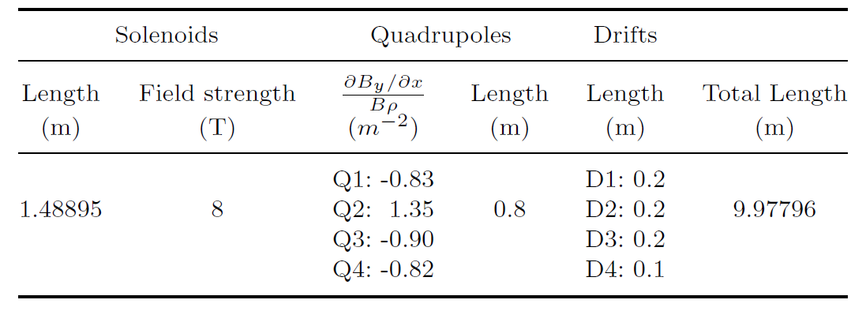
Spin Rotators in Collider
Solenoid section in spin rotator
x-y coupling suppressed with the compensation unit.
Each spin rotator contains 10 identical units.
4x4 transport matrix of the unit:
4. The unit equivalent to :
A drift with L_{tot} length & vertical phase advance 0.5 x 2π
Vladimir N. Litvinenko and Alexander A. Zholents,arXiv:1809.11138 [physics.acc-ph](2018).
7

Slide 8
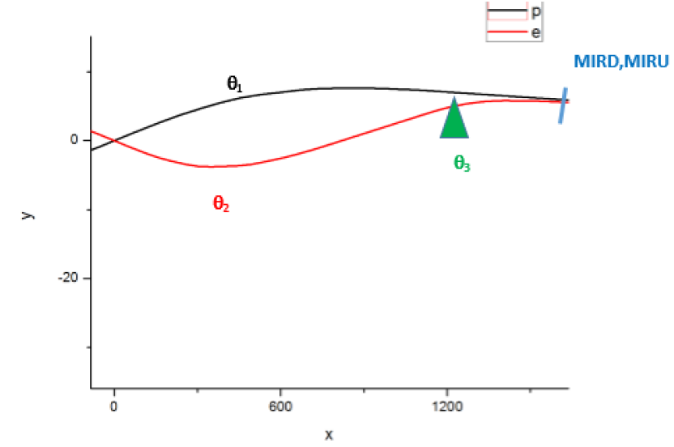
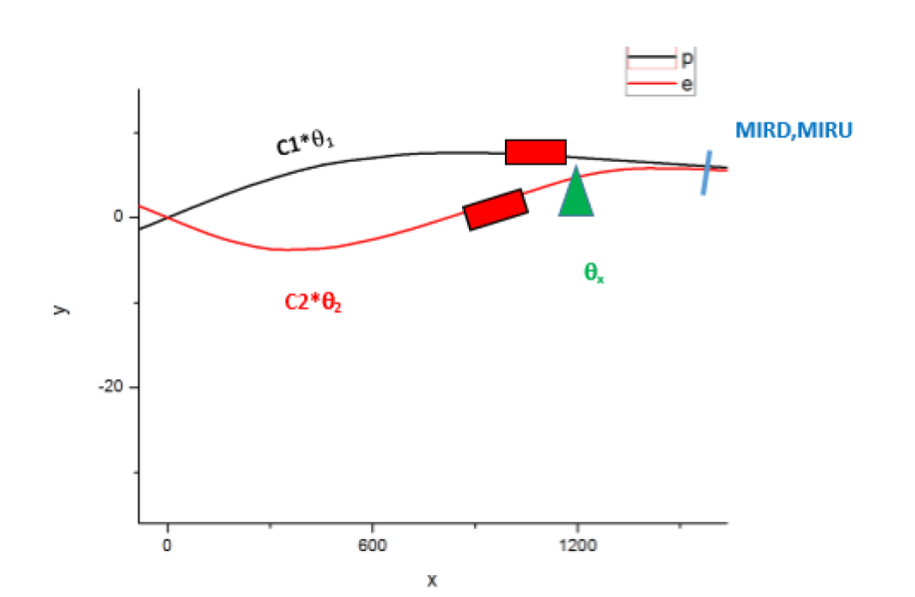
Spin Rotators in Collider
Bending magnet section:
Geometry around IPs is changed.
Keep D=0.35 m , the distance between e- and e+ rings at arc.
Before: θ₁=-0.01921[rad], θ₂=0.02935[rad], θ₂+θ₃=0.01379 [rad]
After: -c₁*θ₁=c₂*θ₂= 0.015[rad], θx= 0.0025[rad]
To make as little impact as possible on the original lattice,
the strength of each magnet is multiplied by the corresponding coefficient.
ARC
ARC
w/o spin rotator
w/ spin rotator
8

Slide 9
Spin Rotators in Collider
Polarization with Bmad simulation:
Vertical: in the most part of the collider ring
Longitudinal : at IPs
9

Slide 10
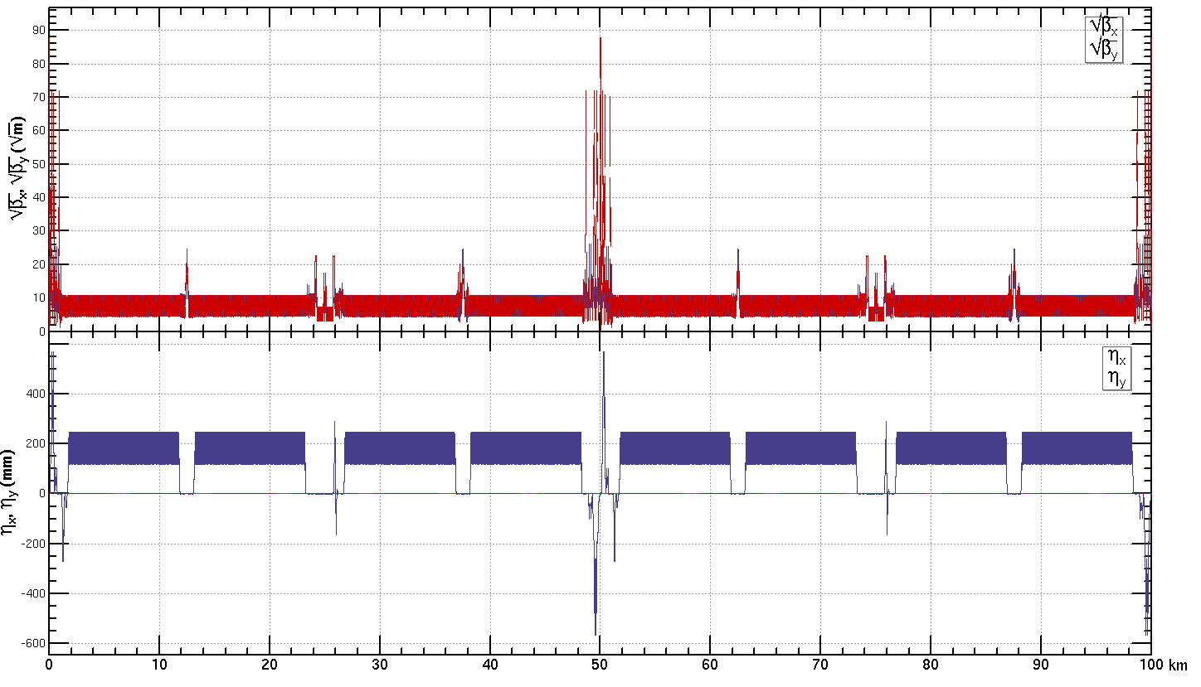
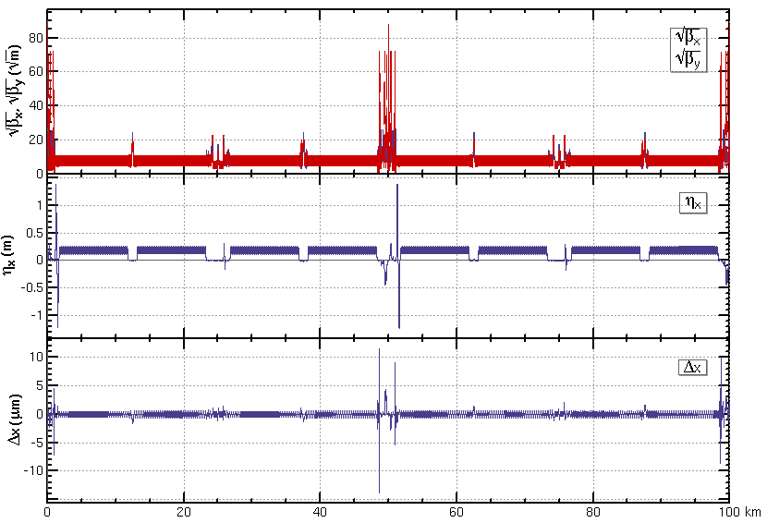
Spin Rotators in Collider
Influence on orbital motion:
Optics: Locally.
Global parameters:
w/o spin rotator
w/ spin rotator
Next, Optimization need to be done
10

Slide 11
Polarization simulation with Bmad/PTC
Motivation:
Most CEPC lattice files are in SAD version. Polarization simulation in SAD is
under development.
Bmad can do polarization simulation.
To some extent, Bmad have the similar lattice format to SAD.
Bmad is interfaced to PTC (“Polymorphic Tracking Code”) libraries.
A lot of work have been done by Demin Zhou, Etienne Forest, David Sagan … on conversion and comparison between SAD , BMAD, and PTC.
11

Slide 12
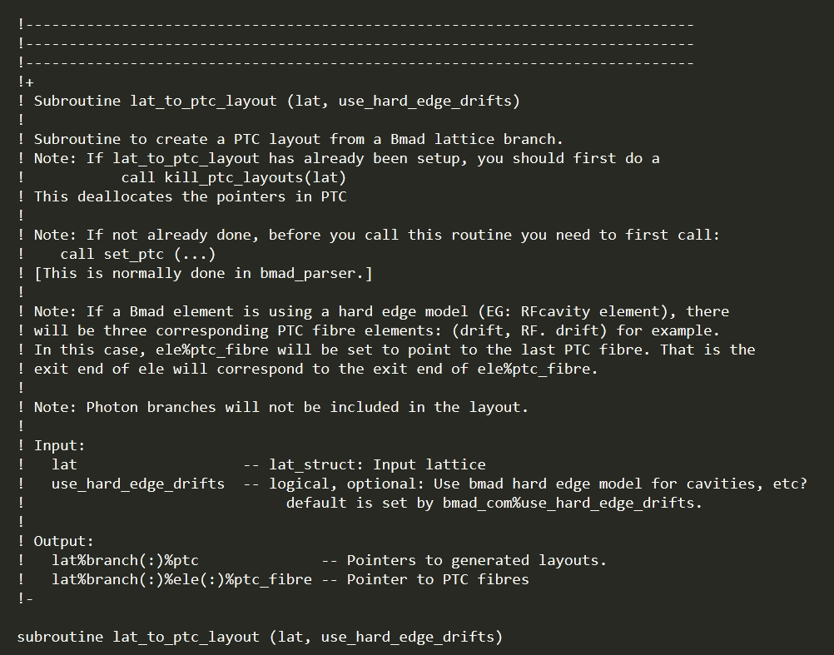
Introduction to Bmad
Something about Bmad:
A library for the simulation of charged-particle.
Developed at Cornell University since 1996.
Originally , Bmad used a subset of the MAD lattice syntax .
”Baby MAD”
Open Source, written in objected-oriented Fortran 2008.
Lattice files use a MAD(SAD) like syntax.
Highly readable.
David Sagan. The Bmad Reference Manual .http://classe.cornell.edu/bmad
12

Slide 13
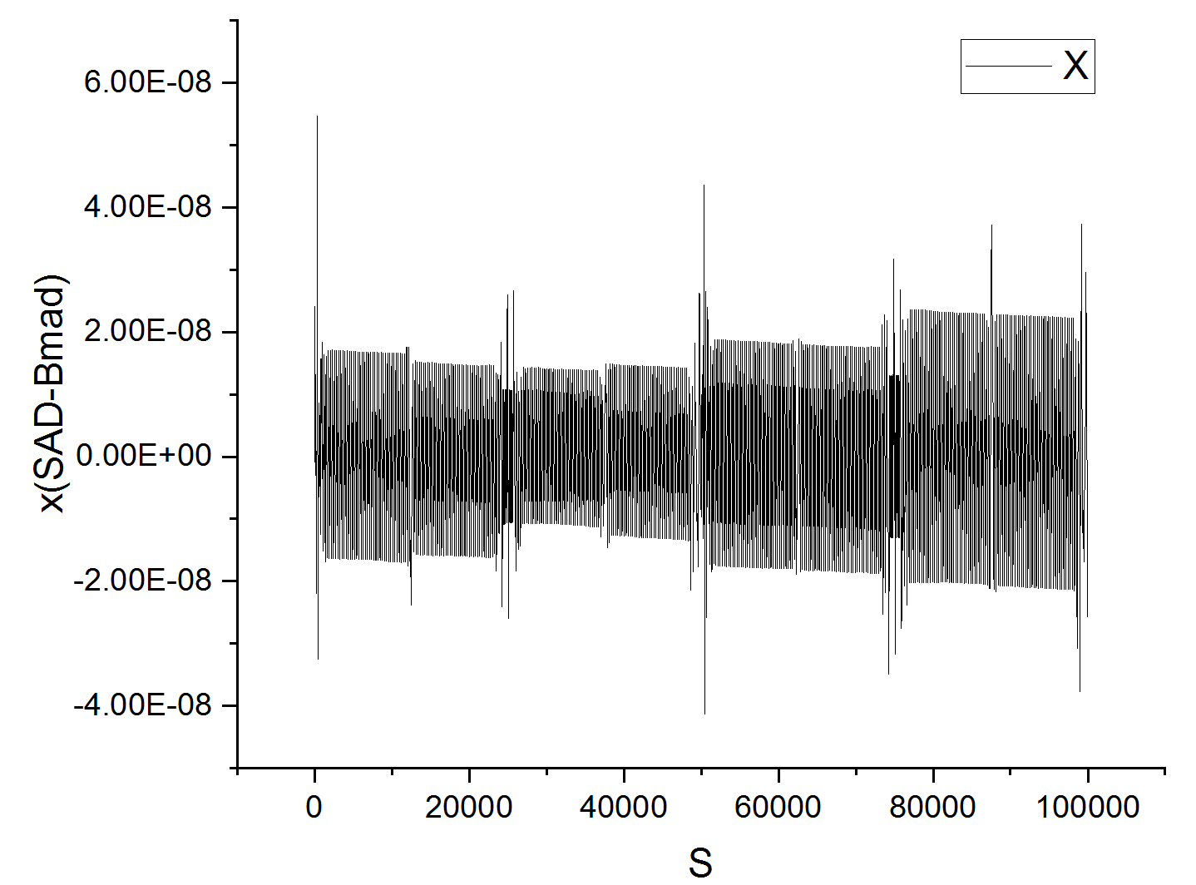
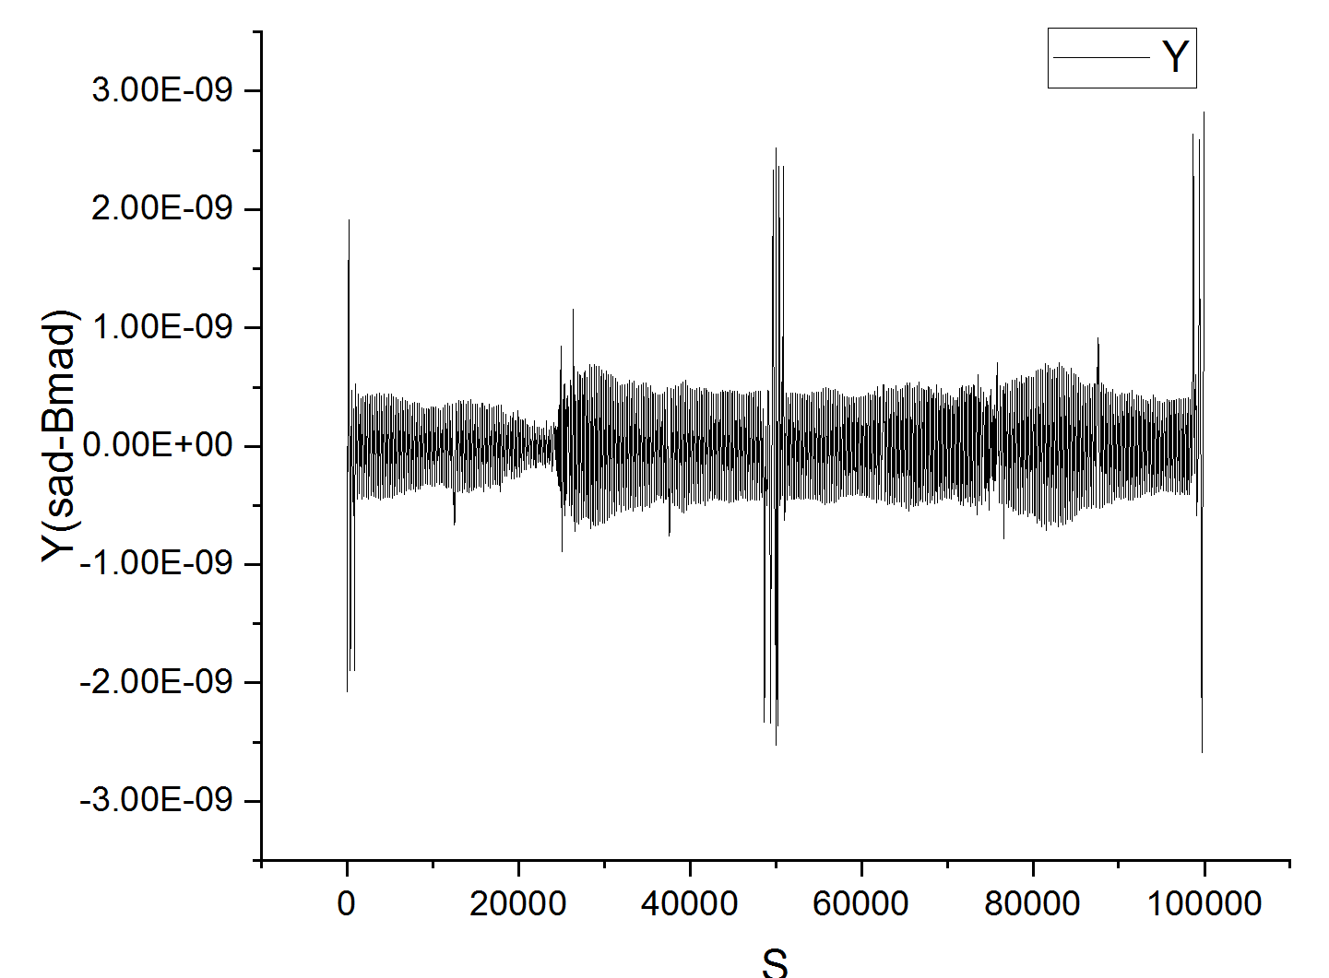
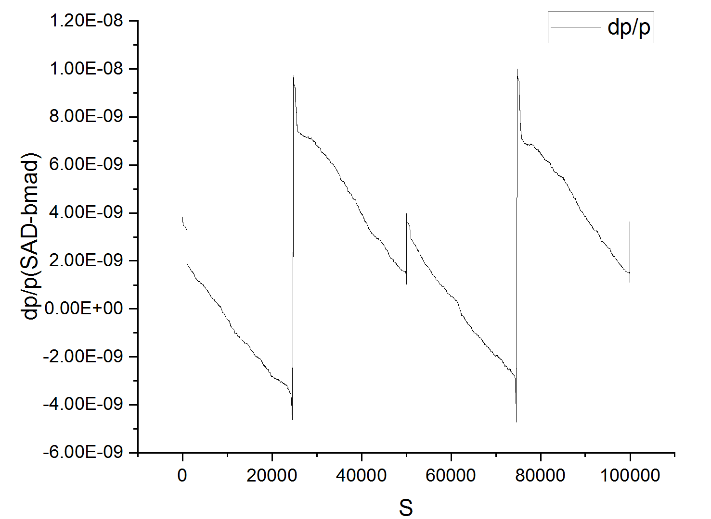
Translation from SAD to Bmad
Lattice file SAD to Bmad:
Based on “sad_to_bmad.py” in Bmad.
Good for bare lattice. Not for realistic imperfect lattice.
Update to “sad_to_bmad.py”
Rfcavity: phi0=ArcSin[EnergyLossU0/RfVoltageVc]/twopi
Zero-length bend magnet translated to Kicker
3. Set initial closed orbit：[x, px, y, py, z, dp/p ]
Imperfect lattice after correction provided by B. Wang
13

Slide 14
Translation from SAD to Bmad
Emittances and tunes
Slices of Quadrupoles : [num_steps]= 1->12
Bmad
SAD, Bmad/PTC results agree with each other.
14

Slide 15
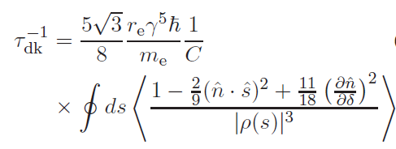
Polarization simulation with Bmad
Derbenov-Kondratenko-Mane formula:
Polarization build-up rate:
Balance between self-polarization and depolarization due to photon-induced longitudinal recoils.
Invariant spin field n and spin orbit coupling function ∂n/ ∂δ need to be calculated.
n: Invariant spin field;
g: 1/ρ bending radius;
: unit vector in the direction of motion;
: fractional energy deviation
Ya.S. Derbenev, A.M. Kondratenko, Sov. Phys. JETP. 37 (1973) 968
15

Slide 16
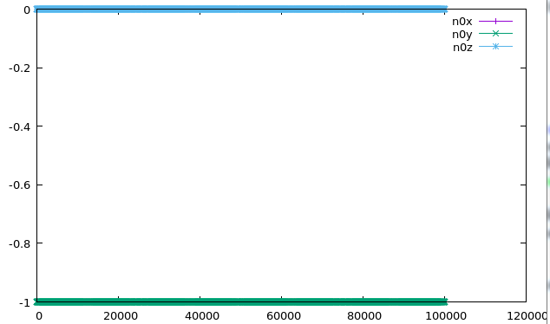
Spin simulation in Bmad
Invariant spin Field n0:
Designed polarization direction:
W/o spin rotator: vertical all over the ring
W/ spin rotator : vertical ->longitudinal(IP)->vertical
W/o Spin Rotators at 45.5GEV
Designed polarization in CEPC w/ Spin Rotators by Bmad simulation
At 45.5 GEV
16

Slide 17
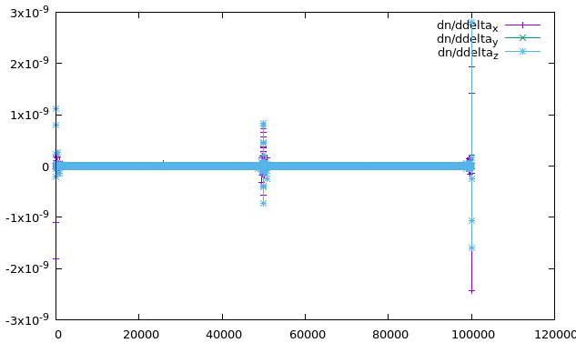
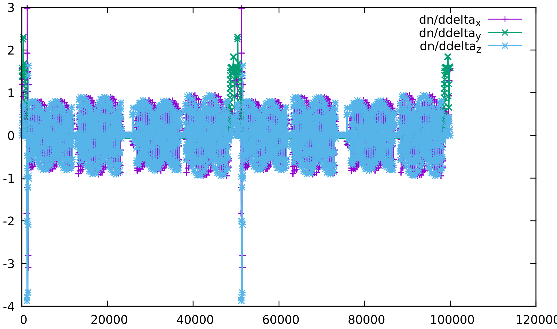
Spin simulation in Bmad
Spin orbit coupling function ∂n/ ∂δ :
It quantifies the depolarization.
W/o spin rotator : ∂n/ ∂δ ≈0
W/ spin rotator: ∂n/ ∂δ ->[-4, 3]
W/o Spin Rotators at 45.5GEV
Designed polarization in CEPC w/ Spin Rotators by Bmad simulation at 45.5GEV
17

Slide 18
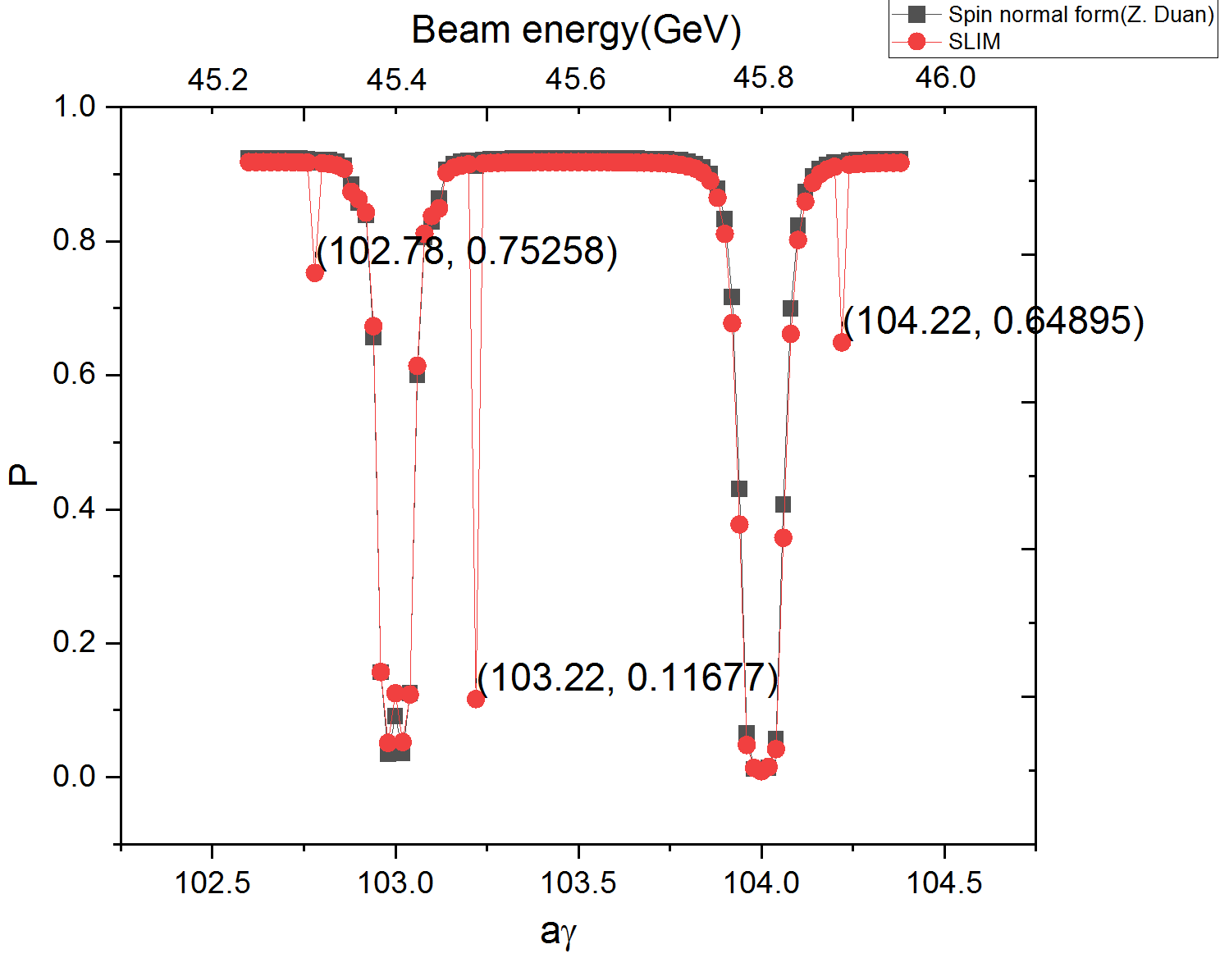
Polarization simulation with Bmad
Equilibrium polarization P:
3 Bad points or spin resonance???
Simulated polarization for a imperfect lattice provide by B. Wang.
Only first-order spin resonance is considered.
18

Slide 19
Summary
Done:
Spin rotators’ design and insertion in collider ring, preliminarily.
Simulation of beam polarization for realistic imperfect lattices with Bmad/PTC.
Next:
Evaluate P_eq w/ spin rotators& lattice optimization for orbit and spin motion.
One code is not enough (Most CEPC lattice optimization based on SAD).
Bmad is a good choice to test the simulation work of SAD.
Keep collaborative studies of CEPC beam polarization with experts from BINP of Russian .
19

