Slide 1
CEPC ttbar (180GeV) and high luminosity H, high luminosity Z lattices collective effects
Na Wang, Yudong Liu, Yuan Zhang
CEPC DAY, Aug. 26, 2020, IHEP

Slide 2
Main beam parameters
From WangDou
Parameter [unit] | ttbar | Higgs-High Lumi* | Z-High Lumi
Beam energy [GeV] | 180 | 120 | 45.5
L_{max}/IP (10³⁴cm⁻²s⁻¹) | 0.34 | 5.0 | 101.1
Emittance (H/V) [nm] | 2.4/0.0072 | 0.68/0.0014 | 0.52/0.0016
Beam current [mA] | 3.52 | 16.8 | 841.0
Bunch number | 28 | 214 | 10870
Bunch Population [10¹⁰] | 26.1 | 16.3 | 16.1
Momentum compaction [10⁻⁵] | 1.11 | 0.73 | 2.23
Natural bunch length σ_{z} (mm) | 2.59 | 2.25 | 2.93
Natural energy spread | 1.48×10⁻³ | 1.0×10⁻³ | 3.8×10⁻⁴
Betatron tune ν_{x}/ν_{y} | 355.10/355.22 | 445.10/445.22 | 266.10/267.22
Synchrotron tune | 0.104 | 0.052 | 0.0457
Radiation damping [ms] | 14/14/7 | 44/44/22 | 849.5/849.5/425.0
*The beam parameter design of High-Lumi Higgs is still under exploration.

Slide 3
Rough estimations
Requirements on broadband and narrowband impedances.
Parameter [unit] | ttbar | Higgs-High Lumi | Z-High Lumi
Beam current [mA] | 3.52 | 16.8 | 841.0
Bunch number | 28 | 214 | 10870
Bunch Population [10¹⁰] | 26.1 | 16.3 | 16.1
Threshold on broadband |Z_{L}/n|_{eff} [mΩ] | 16.4 | 5.3 | 0.9
Threshold on broadband k_{y} [kV/pC/m] | 87.6 | 58.6 | 11.9
Threshold on narrowband | 136.9 | 4.6 | 5.2×10⁻⁴
Threshold of narrowband Zy | 54.3 | 3.0 | 7.1×10⁻⁴
No apparent showstoppers for ttbar & Higgs.
Impedance budget | Z||/n, mΩ | ky, kV/pC/m
Total | 11.4 | 20.2

Slide 4
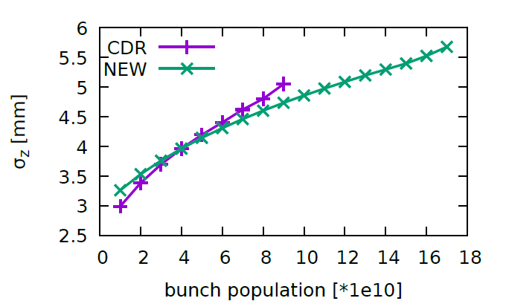
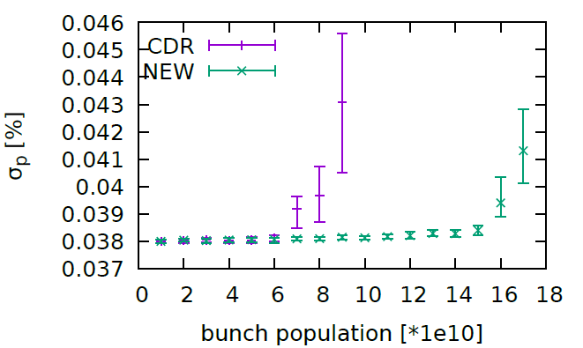
Single bunch Instability for Z (1)
Yuan Zhang
Microwave instability and bunch lengthening
Rarely induce beam losses, but may reduce the luminosity due to the deformed beam distribution and increasing of the beam energy spread.
W/ impedance, W/O beam-beam
σ_{l} with ZL [mm] (σ_{l}/σ_{l0}-1) | 5.5 (90%)
σ_{e}/σ_{e0}-1 | 4%
30MW
30MW

Slide 5
Single bunch Instability for Z (2)
Yuan Zhang
Microwave instability and bunch lengthening
W/ impedance, W/ beam-beam
With beam-beam, much larger bunch lengthening and beam energy spread induced by the beamstruhlung.
The scan of bunch lengthening with bunch charge will be further estimated.
 | W/ RW | W/ RW &BB
σ_{l} with ZL [mm] (σ_{l}/σ_{l0}-1) | 5.5 (90%) | 9.6 (230%)
σ_{e}/σ_{e0}-1 | 4% | 220%

Slide 6
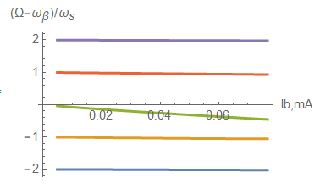
Single bunch Instability for Z (3)
Transverse mode coupling instability
Fast instability, normally with beam losses.
Considering bunch lengthening due to the impedance
30MW
No mode coupling observed below or at the design bunch intensity.
The instability will be further detuned when considering the bunch lengthening due to the beam-beam

Slide 7
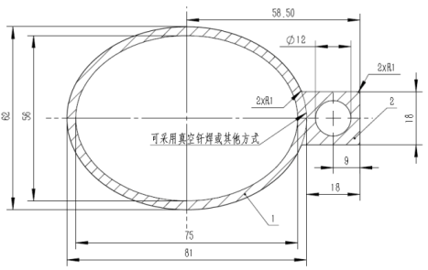
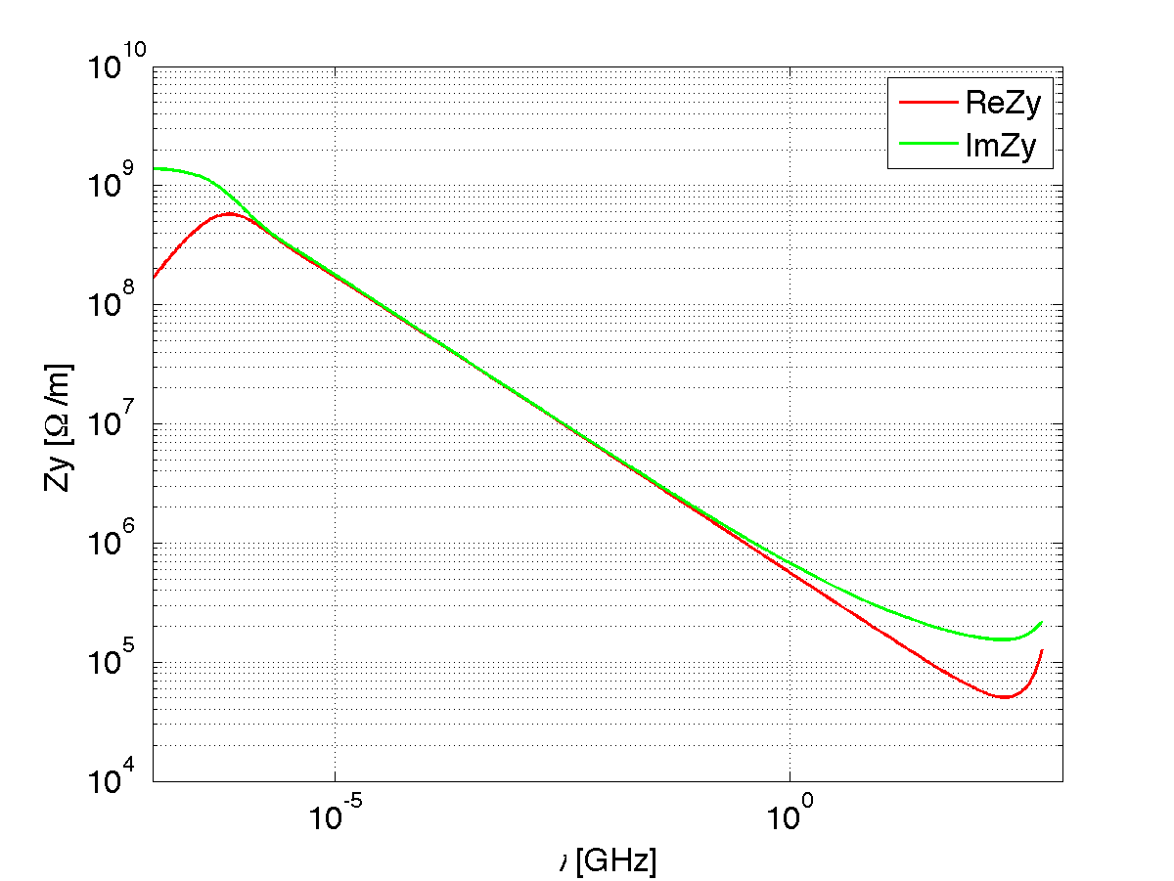
Coupled bunch instability for Z (1)
Transverse resistive wall instability
The coupled bunch instability can be driven by the resonance at zero frequency of the transverse resistive wall impedance.
Resistive wall impedance:
Copper (3mm) with NEG coating (0.2μm)
Elliptical cross section: 28mm (V)×37.5mm (H)
Multi-layer analytical theory of cylindrical pipe is used
Vacuum
Cu
NEG
σ_{cu}= 5.9E7 [S/m]
σ_{NEG}= 1.0E6 [S/m]
NEG
Cu
Vacuum

Slide 8
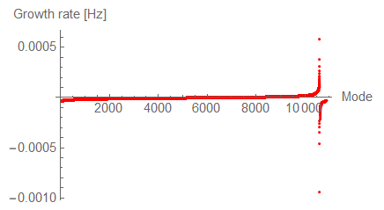
Coupled bunch instability for Z (2)
Transverse resistive wall instability
Growth time of the most dangerous mode vs. damping factors
=> Current feedback design can not damp this instability.
=> A more efficient damping of 2~3 turns is required.
 | Z-High Lumi
Instability growth time [ms] | 1.7 (~5 turns)
Radiation damping [ms] | 843
Bunch by bunch feedback [ms] | 1.7(~5 turns)

Slide 9
Coupled bunch instability for Z (3)
CBI due to RF HOMs
60 1-cell cavities will be used for High-Lumi Z.
Courtesy of H. J. Zheng and J. Y. Zhai
Monopole mode | f (MHz) | R/Q (Ω)
TM011 | 1165.574 | 32.6
TM020 | 1383.898 | 0.7
TM021 | 1717.475 | 9.9
TM012 | 1832.801 | 8.6
Dipole mode | f (MHz) | R/Q (Ω/m)
TE111 | 844.738 | 139.9
TM110 | 907.592 | 210.0
TE121 | 1475.553 | 62.9
TM120 | 1662.599 | 9.4
Cut off frequency: 1471MHz
Cut off frequency:1126 MHz
* k_{∥mode} = 2πf ·(R/Q) / 4 [V/pC]
** k_{⊥mode} = 2πf ·(R/Q) / 4 [V/(pC·m)]

Slide 10
Coupled bunch instability for Z (4)
CBI due to RF HOMs
The requirements on the loaded Q for a single cavity are given by considering synchrotron radiation damping or feedback damping (transverse damping time: 5 turns, longitudinal damping time: 44 turns).
Monopole mode | f (MHz) | R/Q (Ω) | Required Q (SR) | Required Q (FB)
TM011 | 1165.574 | 32.6 | 229 | 6.6E3
TM020 | 1383.898 | 0.7 | 9.0E3 | 2.6E5
TM021 | 1717.475 | 9.9 | 512 | 1.5E4
TM012 | 1832.801 | 8.6 | 552 | 1.6E4
Dipole mode | f (MHz) | R/Q (Ω/m)
TE111 | 844.738 | 139.9 | 85 | 4.3E4
TM110 | 907.592 | 210.0 | 57 | 2.9E4
TE121 | 1475.553 | 62.9 | 189 | 9.6E4
TM120 | 1662.599 | 9.4 | 1.3E3 | 6.4E5

Slide 11
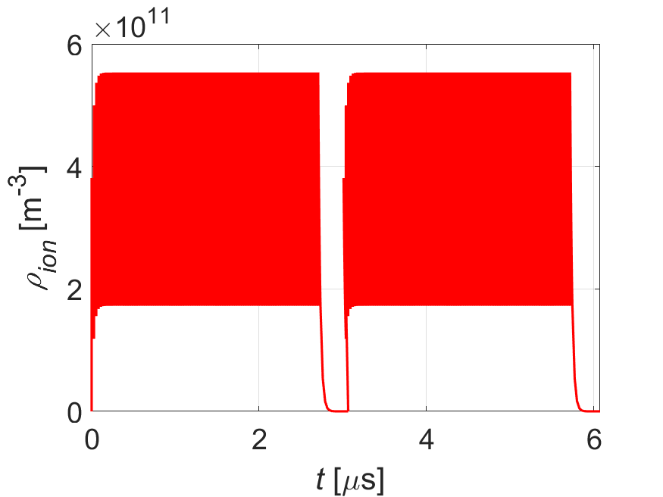
Two-stream Instabilities for Z (1)
Beam ion instability
Induce emittance blow-up and a positive tune shift along the bunch train.
Filling pattern: CDR {Ntrain=120, Bunch spacing=25ns, Gap=270ns}
High-Lumi {Ntrain=110, Bunch spacing=27.6ns, Gap=310ns}
Emittance growth due to the beam ion interaction are foreseen ⇒ Effectiveness of feedback on fighting ion instability need to be checked
Parameters | Z-30MW
L_{sep}ω_{ion}/c₀ | 0.7
ρ_{ion,ave}[m⁻³] | 3.1E11
τ_{e} [ms] | 0.1
τ_{H} [ms] | 5.2
Δν_{y} | 0.014
Build-up of the ions along the bunch train

Slide 12
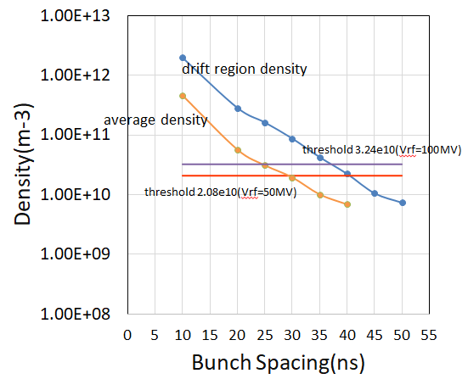
Two-stream Instabilities for Z (2)
YuDong Liu
Electron Cloud
With the CDR parameter, the average electron cloud density in dipole and drift region is around 3.2e10 m⁻³ with SEY=1.6 & bunch spacing=25ns
⇒Comparable with the threshold determined by the single bunch instability.
A lower SEY is expected with NEG coating
⇒ Some safety margin can be gained for CDR.

Slide 13
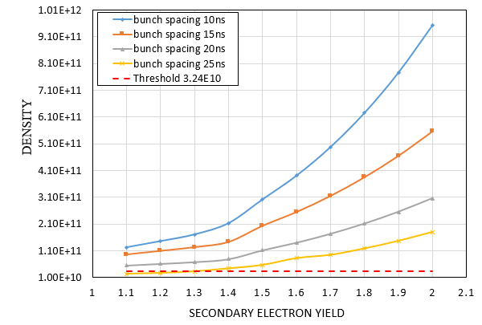
Two-stream Instabilities for Z (3)
YuDong Liu
Electron Cloud
Dependence of the electron density on SEY.
With the High Lumi. Z
Electron density
Increase by a factor of 2 from bunch intensity ⇒ Can be canceled by decrease SEY from 1.6 to 1.4
Instability threshold
$$ρ_{e,threhold}=\frac{2γν_{s}ω_{e}σ_{z}/c}{\sqrt{3}KQr_{e}C\overline{β}}$$
20%
⇒ Rough estimation shows ecloud will not be a bottleneck, detailed simulations are underway.
Notes:
高亮度Z，束团间隔约20ns，计算表明即使采用NEG镀膜可以将二次电子发射系数降低到1.1，电子云密度仍然在阈值以上，因此需要采取其他的措施来抑制电子云不稳定性，比如antechamber，螺线管和清洗电极等。

Slide 14
Summary
No apparent showstoppers for ttbar and High-Lumi Higgs.
Main conclusions for High-Lumi Z include:
Single bunch instability will not be an issues.
Transverse resistive wall instability needs more efficient feedback damping:
Damping time from 5 turns to 2~3 turns
Rough estimation shows ecloud will not be a bottleneck, detailed simulations are underway.
Emittance growth due to the beam ion effect are foreseen ⇒ Effectiveness of feedback on fighting ion instability need to be checked with simulations.
Requirements on the loaded Q of the RF HOMs are given ⇒ More efforts are needed for the RF designs.

