Slide 1
CEPC collider ring quadrupole R&D progress
Mei Yang
2020-08-26，CEPC DAY

Slide 2
Content
DAQ prototype design and measurement results
New simulations
  Orign
  No DT4 compensated sheet
  Filled with J23 sheet
  Pole move
  Simulations by keye
  Summary and next work
FCC DAQ prototype measurement results

Slide 3
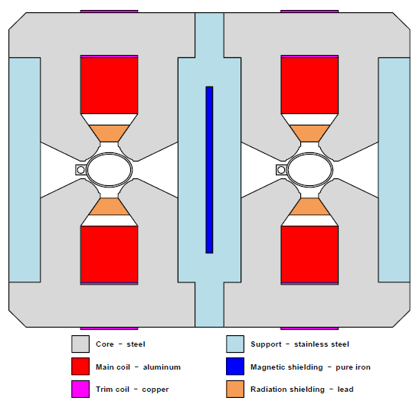
DAQ prototype measurement results
Parameters of DAQ
Short model (1m in length),laminated yoke
Trim coils :±1.5% adjustability, enameled copper wire
Main coils: hollow aluminum coils, water cooled, 64 turns/pole
Large size of wire and low current density
Stainless steel as a supporter and separate two yokes.
Gradient(T/m) | 8.42@120GeV
Max Gradient(T/m) | 12.63@180GeV
Aperture(mm) | 76
Effective length(m) | 1 or 2
GFR(mm) | 12.2
Adjustment capability | ±1.5%
Field quality | 5×10⁻⁴

Slide 4
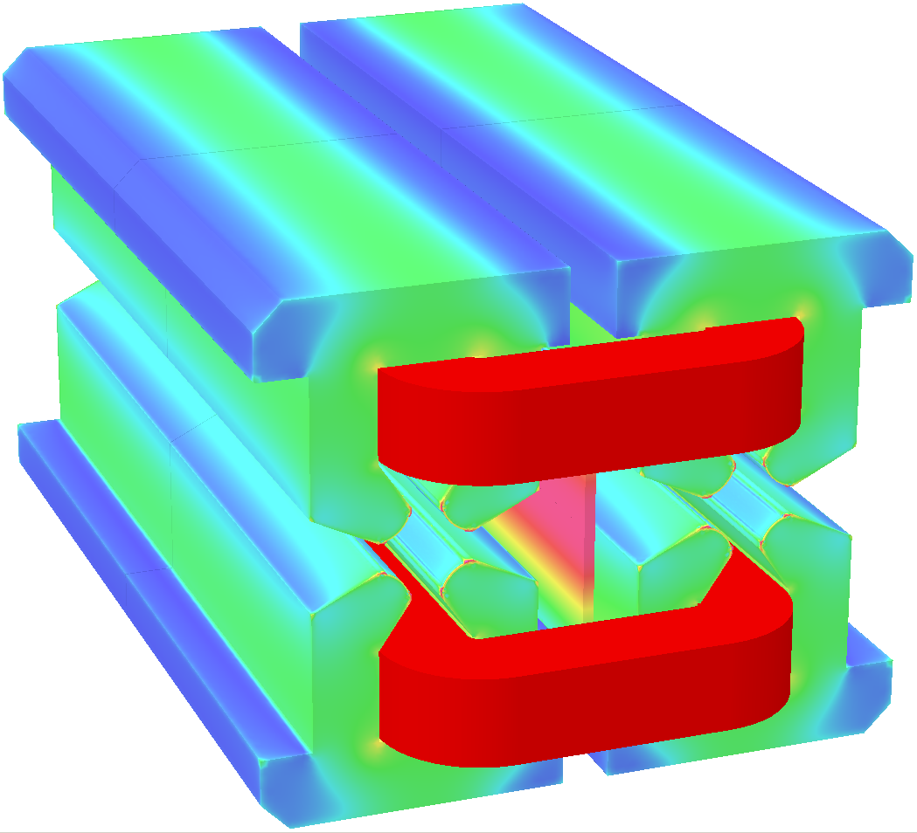
Physical design of DAQ prototype
Design parameters of DAQ prototype
Gradient [T/m] |  | 8.42
Aperture [mm] |  | 76
Main coil | Turns | 64×2
 | Material | Aluminum
 | Current [A] | 154
 | Current density [A/mm²] | 1.89
 | Power consumption [kW] | 3.3
Trim coil | Turns | 20×4
 | Material | Copper
 | Current [A] | 7.2
 | Current density [A/mm²] | 0.9
 | Power consumption [kW] | 0.04
Cooling water | Velocity [m/s] | 1.3
 | Flux [l/s] | 0.201
 | Temperature rise [°C] | 6.3

Slide 5
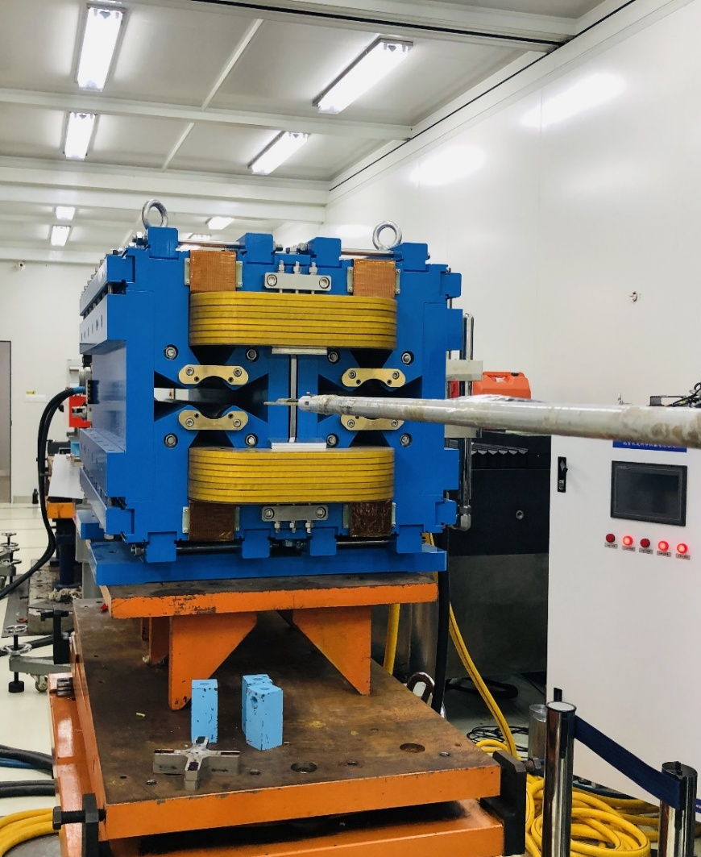
Primary measurement results
Hall Probe measurement with the DT4 sheet.
  Aperture A:Defocus G<0
  Aperture B:Focus G>0
  GL is obtained by the integral field at x=-12.2mm
  and 12.2mm.
A
B

Slide 6
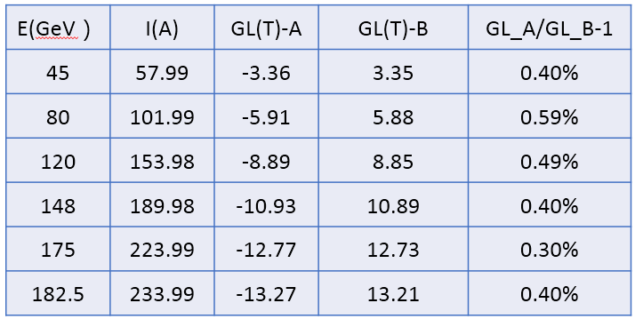
Primary measurement results-2
Difference between the two apertures
  Less than 0.6%.
Magnetic axis location
  The magnetic center in horizontal direction is shown below. The Xcen shift by 2mm in aperture A and by -1.7mm in aperture B when the energy rises from 45GeV to 182.5GeV. The magnetic center distance between the two apertures is less than 350mm and shifted by 3.7mm in the ramping process.
Aperture A
G<0
Aperture B
G>0
350mm

Slide 7
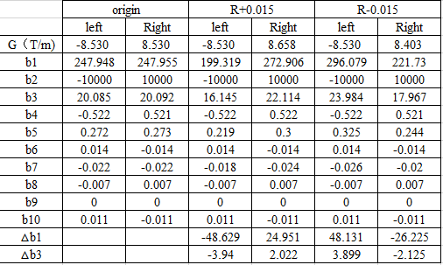
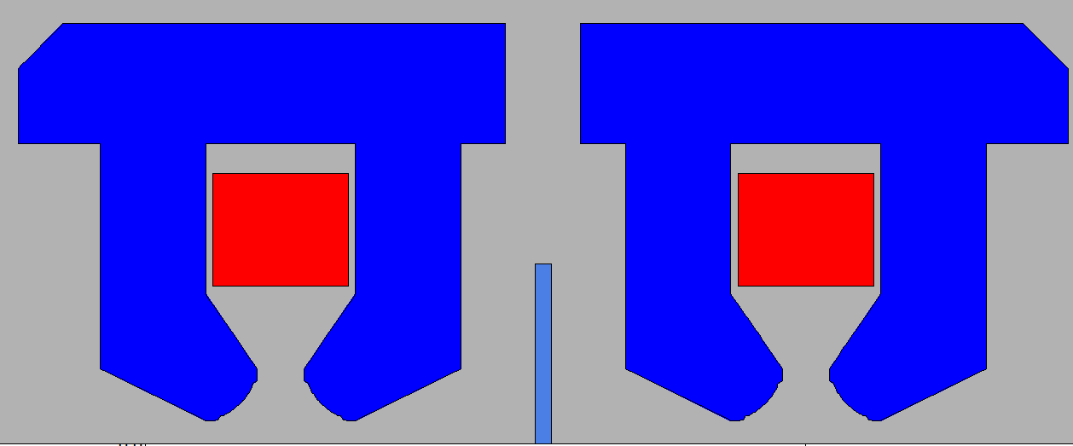
New simulations
Try to solve the magnet center displacement in the energy range.
Origin design
  For the component DT4 sheet is thin and easy to be saturated when the energy is ramping up. So the b1 and b3 component is changed a lot.
  Also when there is trim coil, the b1 and b3 component is changed a lot.
E(GeV) | 45.5 | 120 | 182.5
G(T/m) | 3.49 | 8.53 | 12.94
b1 | 423.143 | -7.976 | -602.69
b2 | -10000 | -10000 | -10000
b3 | 34.28 | -0.65 | -48.829
b4 | -0.479 | -0.521 | -0.532
b5 | 0.465 | -0.009 | -0.662
b6 | 0.013 | 0.014 | 0.015
b7 | -0.037 | 0.001 | 0.053
b8 | -0.008 | -0.007 | -0.008
b9 | -0.001 | 0 | 0.001
b10 | 0.011 | 0.011 | 0.011

Slide 8
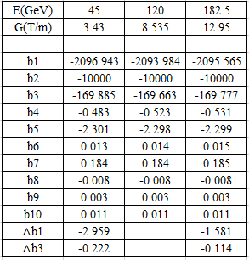
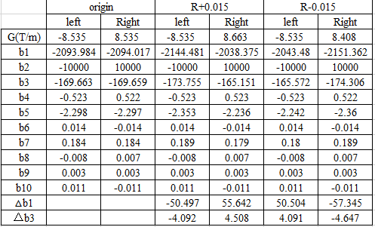
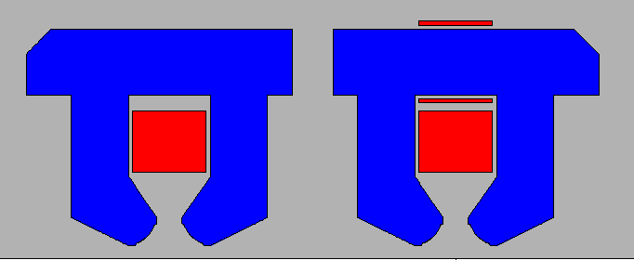
New simulations-2
No DT4 compensated sheet
  The two apertures are coupled.
  The b1 and b3 changed a little in the energy range.

Slide 9
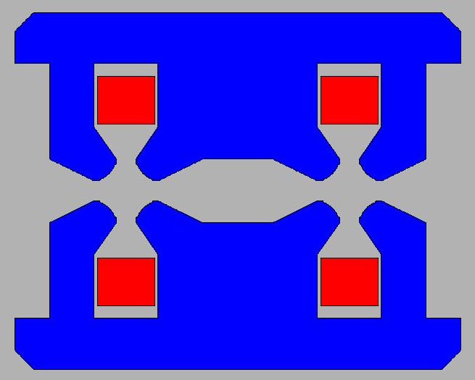
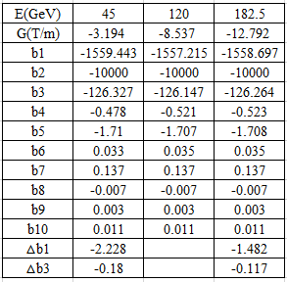
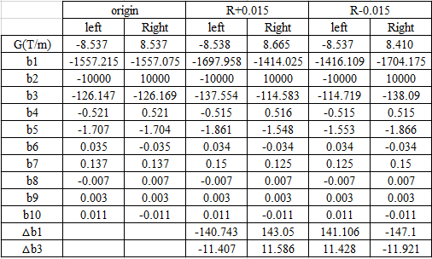
New simulations-3
Filled with J23 sheet

Slide 10
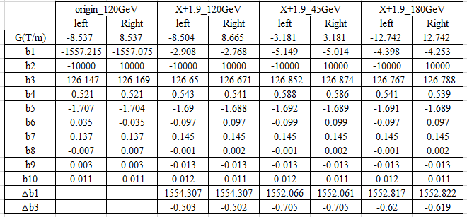
New simulations-3
Filled with J23 sheet
  Offset the cavity outside by 1.9 mm, the b1 component can down to zero.
  The b1 and b3 changes a litter in the energy range.

Slide 11
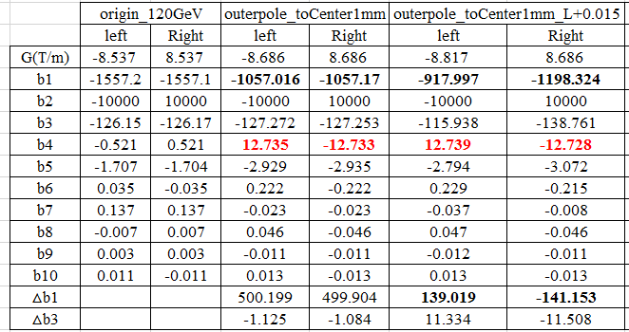

New simulations-4
Introducing asymmetries in the inward/outward pole tips
Filled with J23 sheet + pole move
  Outer poles move to center by 1mm.

Slide 12
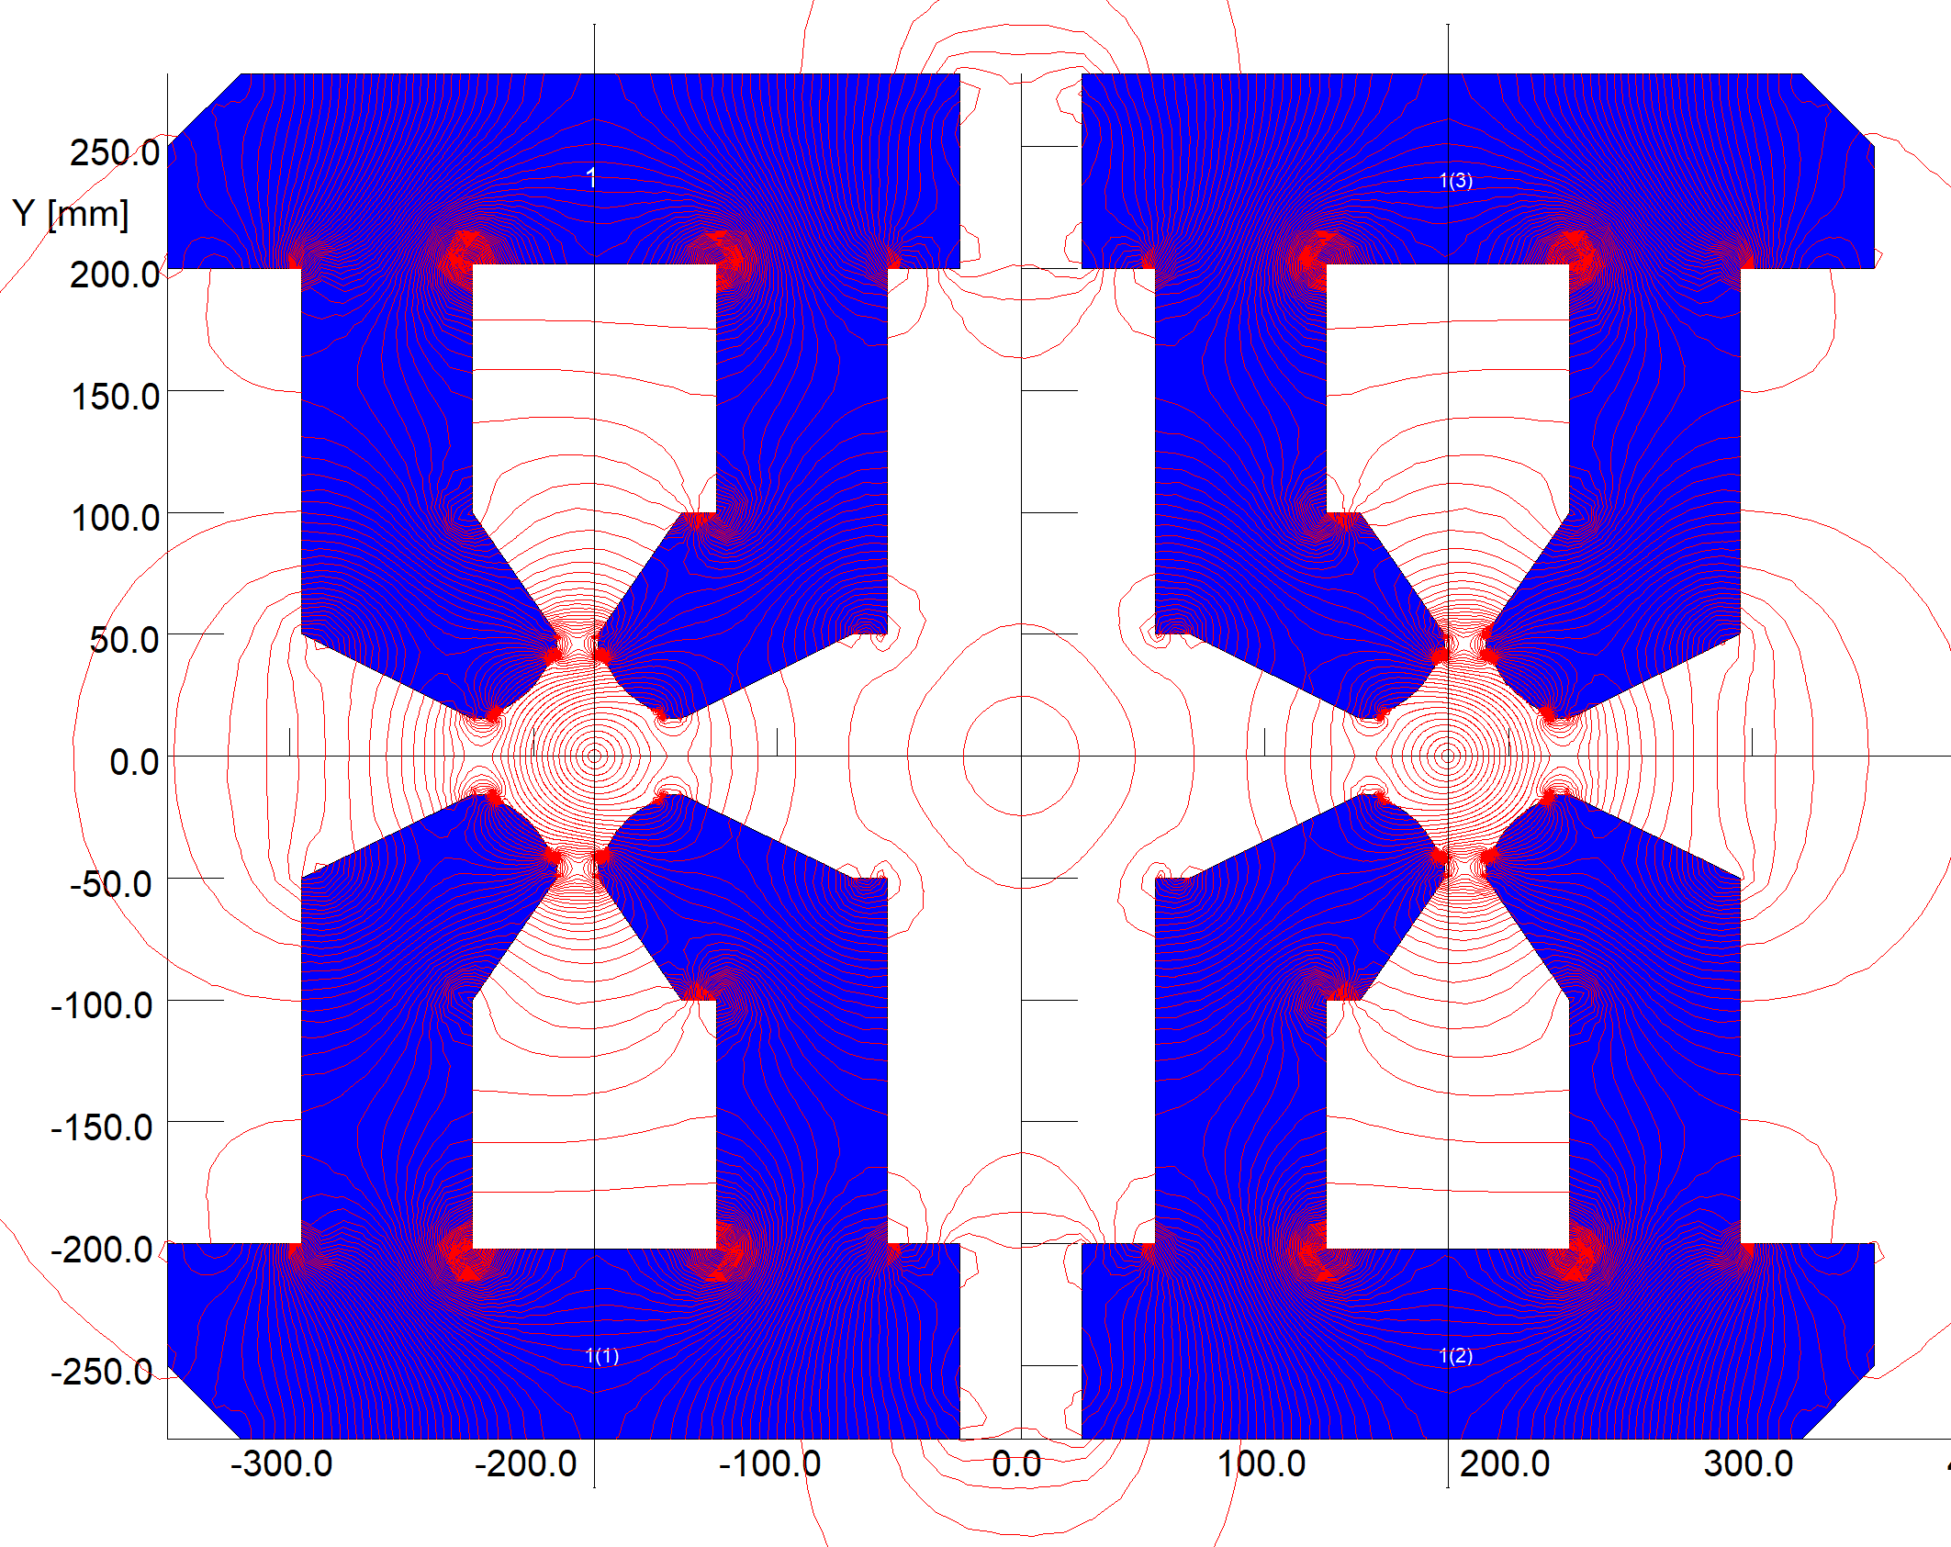

Simulations by keye
Try to compensate the magnetic center shift.
  1) Offset middle poles to the beam center by 14.3mm-----interferes with the cavity.
  2) Enlarge the whole iron by 2 mm, even worse

Slide 13
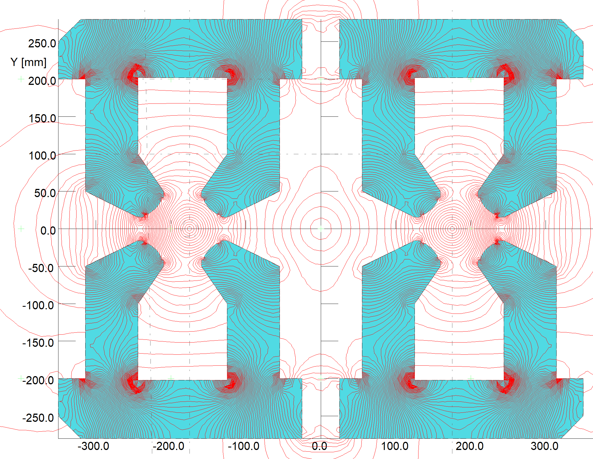
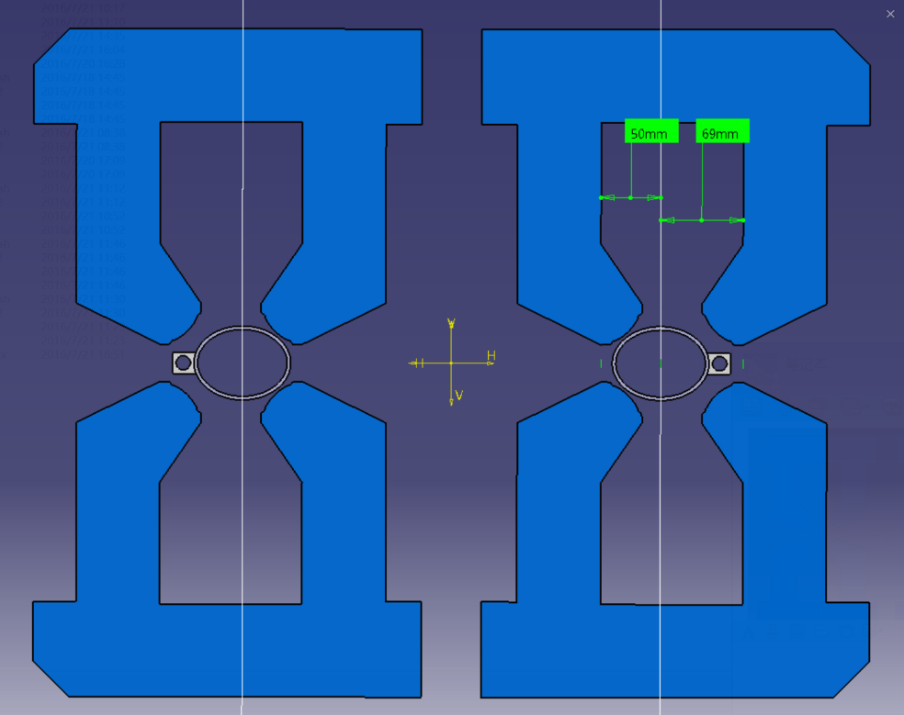
Simulations by keye-2
3) Offset the outer poles by 19mm in x axis.

Slide 14
Summary and next work
The dual aperture quadrupole can save about 50% power but has strong cross talk effect, causing large b1 and b3.
Without considering the correcting coil
  Offset the cavity to reduce the b1 component in the latter two cases(without DT4 sheet and filled with J23) whose harmonics kept unchanged at different energy.
  Further optimization will be done on b3 component.
Next work
  Further measurement on DAQ prototype.
  3D simulations and optimization.
  Try some other designs.

Slide 15
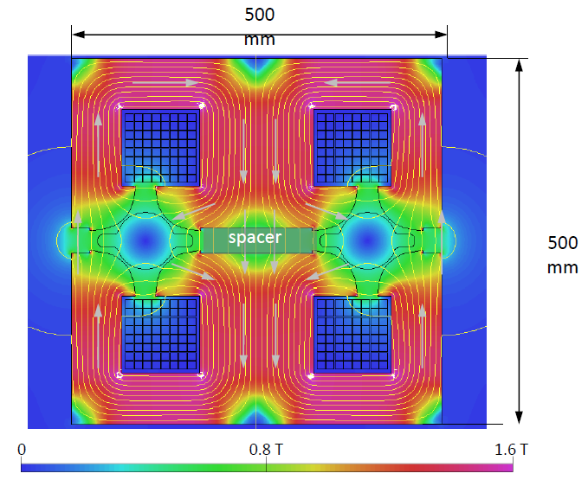
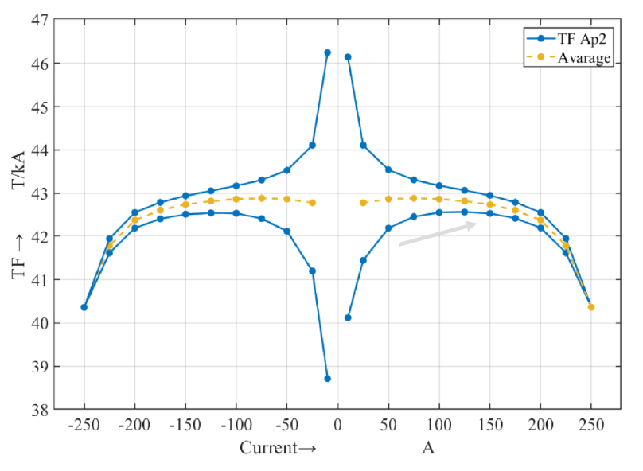
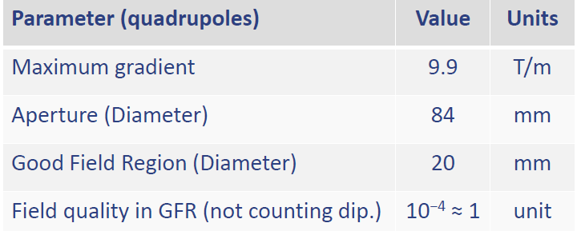
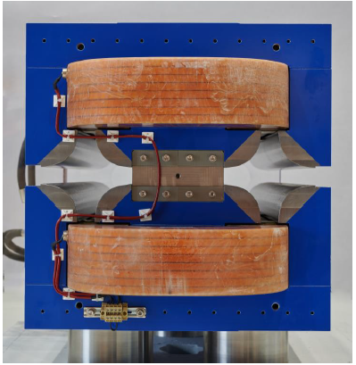
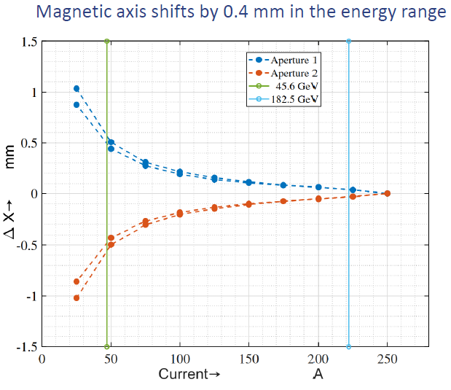
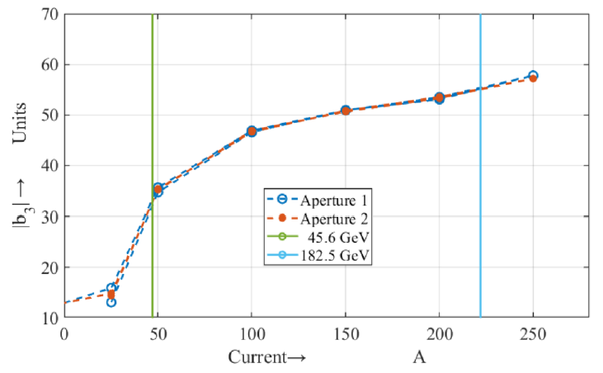
FCC DAQ prototype measurement results
C. Petrone, MT26-Wed-MO-Or10-01
Parameters of DAQ
ARMCO pure iron, solid yoke
The shift of the magnetic axis needs to be studied further
or considered in the beam optic.

Slide 16
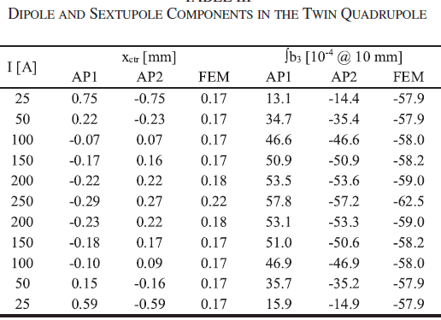
FCC DAQ prototype measurement results-2
b1 and b3 vary in the energy range
  the two apertures show a very consistent behavior, with however a stronger dependency on the excitation current with respect to the FE model.
  Looking at the signs for both the axis shift and the sextupole term, we suspect that the cause might be a more pronounced saturation in the central part of the yoke, where a strong dipole is generated.

