Slide 1
CEPC-SppC compatibility design progress
Yiwei Wang, Yukai Chen, Dou Wang,
Chenghui Yu, Jie Gao, Jingyu Tang
CEPC day, 26 Aug. 2020

Slide 2
Outline
Introduction
Geometry compatibility at the IP2 and IP4
Geometry compatibility at the IP1 and IP3
Reduction of the bending field for bypass
Summary

Slide 3
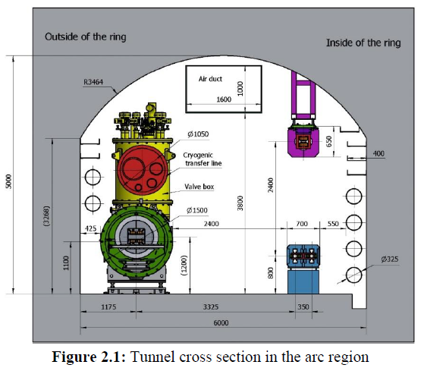
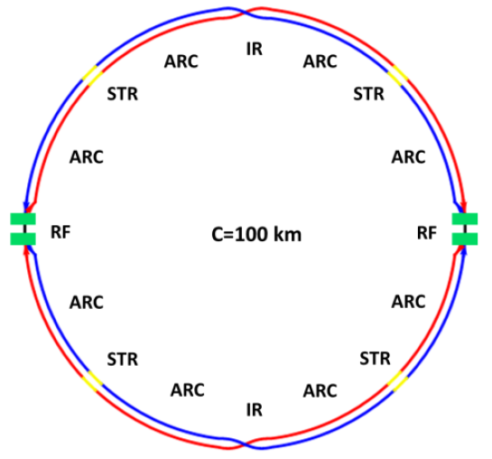
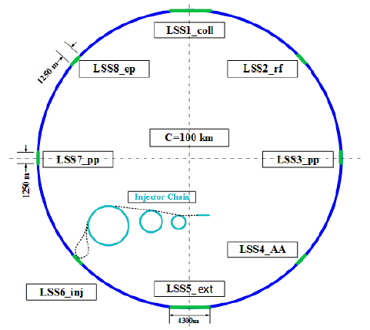
Introduction
Geometry compatibility of the CEPC and SPPC
The SPPC will share the tunnel of CEPC as much as possible.
The SPPC locates outside of CEPC due to the project phases
In the 8 arc regions and 4 short straight sections, two machines share the tunnel (distance of machine centers=3.5m)
In the 4 long straight sections, the SPPC will bypass the CEPC (distance of machine centers at IPs=23m as the big size of CEPC and SPPC detectors)
IP1 and IP3 for CEPC interaction and SPPC collimation, IP2 and IP4 for CEPC RF and SPPC interaction
Tunnel in the ARC
CEPC Layout
SPPC Layout
IP1
IP1
IP4
IP2
IP4
IP2
IP3
IP3

Slide 4
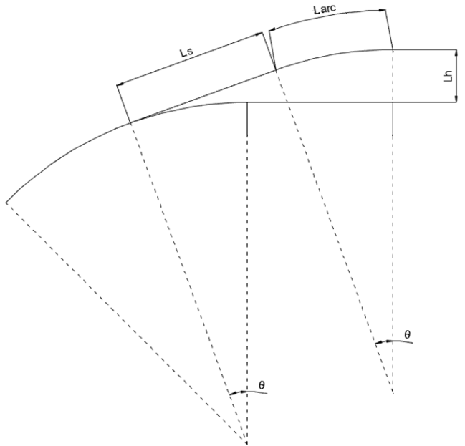
Geometry compatibility at IP2 and IP4
For IP2 and IP4, the SPPC interaction regions are much shorter than the CEPC RF regions. SPPC can bypass CEPC within a reasonable length using baseline bend (12T).
Bypass Scheme
add a short straight section at the end of ARC
Lw is the additional length for bypass which is 0.28km for distance of 23m
Total length of bypass at IP2 or IP4 is 4 km
Add a short straight section
Part of arc is moved to here
 | IP2 & IP4
SPPC | 1.25 km
CEPC | 3.42 m
Lw

Slide 5
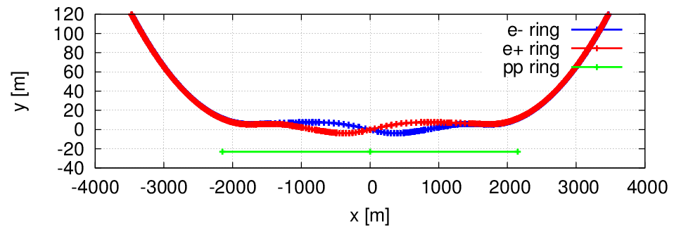
Geometry compatibility at IP1 and IP3
For IP1 and IP3, the SPPC collimation regions are longer than the CEPC interaction regions. SPPC can not bypass CEPC within a reasonable length using baseline bend (12T).
Possible bypass Schemes
bypass within a reasonable length using much stronger bend
bypass within a reasonable length using a bit stronger bend which need to shorten the length of SPPC collimation length thus a different design of SPPC collimation section
 | IP1 & IP3
SPPC | 4.3 km
CEPC | 3.32 m
3.32 km
4.3 km

Slide 6
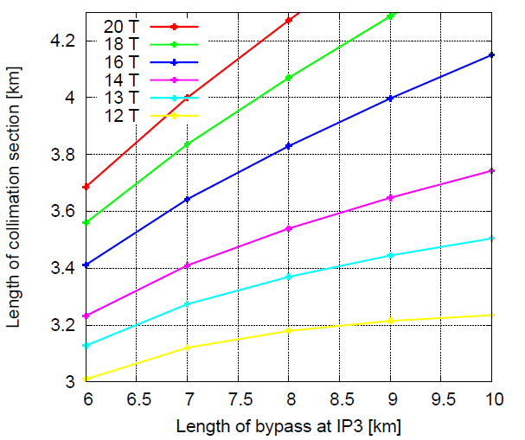
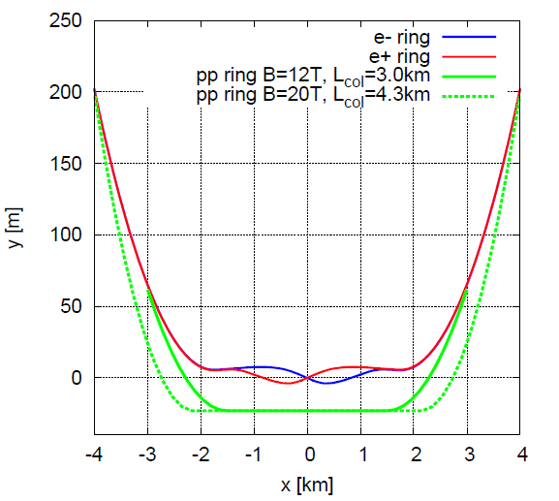
Geometry compatibility at IP1 and IP3
Possible bypass Schemes
bypass within a reasonable length using much stronger bend
Lcol = 4.3 km, 17 T ≤ B ≤ 20 T, 8km ≤ length of bypass ≤ 10 km
bypass within a reasonable length using a bit stronger bend which need to shorten the length of SPPC collimation length thus a different design of SPPC collimation section
3 km ≤ Lcol < 4.3 km, 12T ≤ B < 17 T, 6km ≤ length of bypass ≤ 10 km
solutions of two schemes
CEPC IR
SPPC collimation
Notes:
difficulties

Slide 7
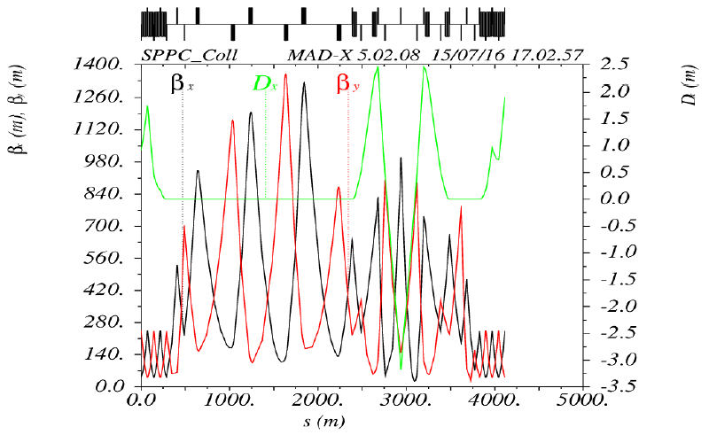
Reduction of the bending field for bypass
A shorter collimation section will help to reduce the bending field for the bypass.
The SPPC collimation can be reduced from 4.3km to around 4km by using SC quadrupoles instead of RT quadrupoles in the transverse collimation section. (Jingyu Tang)
The adjustment of bending angle in the CEPC IR will help as well.
Slightly change the bending angle of CEPC IR
w/o considering the nonlinear dynamics effects
Jianquan Yang et al.

Slide 8
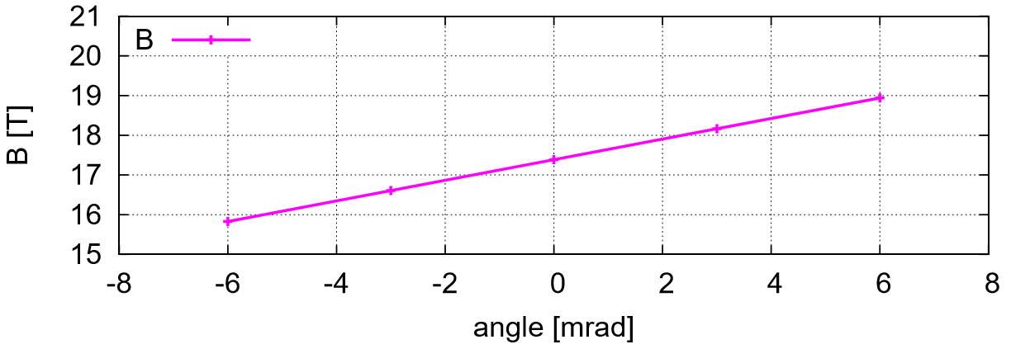
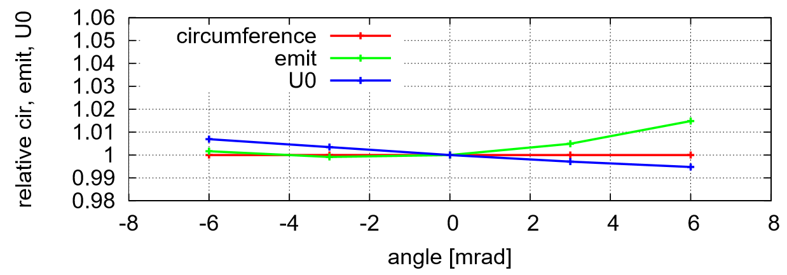
Reduction of the bending field for bypass
Keep length of bypass=8km
Reduce length of collimation section from 4.3km to 4km
More anti angle in the CEPC interaction region
Circumference almost kept to be 100.016km
Emittance and radiation power growth less than 1%
Nonlinear dynamics effects need to be checked
Lcol=4.3km -> 4.0km
more anti-angle

Slide 9
Geometry compatibility of CEPC collider, CEPC booster and SPPC
CEPC booster will locate upside of CEPC collider (d=2.4m) except the IP1 and IP3
CEPC booster will also bypass the CEPC detector at IP1 and IP3
The present design is to share the part of SPPC tunnel at IP1 and IP3.
However, SPPC collimation section is nasty and the power is as high as MW. Putting the booster into the same tunnel will be challenging (Angeles, Jingyu Tang)
Tunnel in the ARC
solutions of two schemes
CEPC IR
CEPC booster
SPPC collimation

Slide 10
Summary
The SPPC will share the tunnel of CEPC as much as possible.
In the 8 arc regions and 4 short straight sections, two machines share the tunnel.
In the 4 long straight sections, the SPPC will bypass the CEPC.
For IP2 and IP4, SPPC can bypass CEPC within 4km using baseline bend (12T).
For IP1 and IP3, the SPPC collimation regions are longer than the CEPC interaction regions.
Two bypass schemes with stronger bend (>12T)
Reduction of the bending field for bypass: shorter collimation section and adjustment of bending angle in the CEPC IR
Nonlinear dynamics effects need to be checked
The booster and SPPC share part of tunnel at IP1 and IP3 will be challenging as SPPC collimation section is nasty and the power is as high as MW.
Notes:
difficulties

Slide 12
Geometry compatibility at IP1 and IP3
Two kind of bends with slight different strength are used
assume filling factor of bend same with SPPC are region (79%)
Constraints
B1 ≤ 20 T, B2 ≤ 20 T
3km ≤ length of collimation ≤ 4.3 km
6km ≤ length of bypass ≤ 10 km
match (x, y, theta)
distance of machine centers=3.5m

