Slide 1
CEPC instrumentation system design progress
Yanfeng Sui
On behalf Beam Instrumentation Group
Aug. 26, 2020. IHEP.

Slide 2
Outline
Investigation on beam instrumentation requirements
CEPC linac beam instrumentation design
Summary

Slide 3
Beam instrumentation
People from AP group and BI group discussed the requirements in May 20 ,May 27 and Jul. 17, 2020.
Most of the requirements were confirmed and listed in the table below
 | Item | Method | Parameter | Amounts
Linac | Beam position | Stripline BPM | Resolution ：30um | 140
 | Beam current | ICT | 2.5%@1nC-10nC | 42
 | Beam profile | YAG/OTR | Resolution: 30um | 80
 | Beam emittance | Q+PR | 10% | 3
 | Beam energy & spread | AM+PR | 0.1% | 3
Damping ring | Average current | DCCT | Resolution :50uA@0.1mA-30mA | 1
 | Beam position | Button BPM | Resolution : 20um @ 5mA TBT | 40
 | Tune measurement | Frequency sweeping | Resolution:0.001 | 1

Slide 4
The beam instrumentation in CEPC booster
 | Item |  | Method | Parameter | Amounts
Booster | Beam position monitor | Turn by turn | Button electrode BPM | Measurement area (x × y)：±20mm×±10mm Resolution：<0.02mm Measurement time of COD：< 4 s | 1808
 |  | Bunch by bunch | Button electrode BPM | Measurement area (x × y)：±40mm×±20mm Resolution：0.1mm | 1808
 | Bunch current |  | BCM | Measurement range：10mA / per bunch Relatively precision：1/4095 | 2
 | Average current |  | DCCT | Dynamic measurement range：0.0~1.5A Resolution:50uA@0.6-8mA Linearity：0.1 % Zero drift: <0.05mA | 2
 | Beam size |  | Double slit interferometer x ray pin hole | Resolution:0.2 µm | 2
 | Bunch length |  | Streak camera Two photon intensity interferometer | Resolution:1 ps | 2
 | Tune measurement |  | Frequency sweeping method | Resolution:0.001 | 2
 |  |  | DDD | Resolution:0.001
 | Beam loss monitor |  | optical fiber | Space resolution:0.6m | 400
 | Feedback system |  | TFB | Damping time<=3ms | 2
 | Feedback system |  | LFB | Damping time<=35ms（50ms） | 2

Slide 5
The beam instrumentation in CEPC ring
 | Item |  | Method | Parameter | Amounts
Storage ring | Beam position monitor | Closed orbit | Button electrode BPM | Measurement area (x × y)：±20mm×±10mm Resolution：<0.6um Measurement time of COD：< 4 s | 2900
 |  | Bunch by bunch | Button electrode BPM | Measurement area (x × y)：±40mm×±20mm Resolution：0.1mm | 2900
 | Bunch current |  | BCM | Measurement range：10mA / per bunch Relatively precision：1/4095 | 2
 | Average current |  | DCCT | Dynamic measurement range：0.0~1.5A Linearity：0.1 % Zero drift: <0.05mA | 2
 | Beam size |  | Double slit interferometer x ray pin hole | Resolution:0.2 µm | 4
 | Bunch length |  | Streak camera Two photon intensity interferometer | Resolution:1ps@10ps | 2
 | Tune measurement |  | Frequency sweeping method | Resolution:0.001 | 2
 |  |  | DDD | Resolution:0.001
 | Beam loss monitor |  | PIN-diode | Dynamic range:120 dB Maximum counting rates≥10 MHz | 5800
 | Feedback system |  | TFB | Damping time<=47ms | 2
 |  |  | LFB | Damping time<=100ms（24ms） | 2

Slide 6
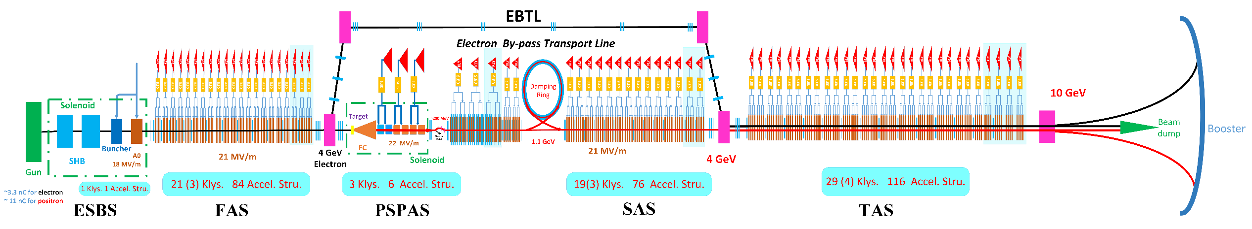
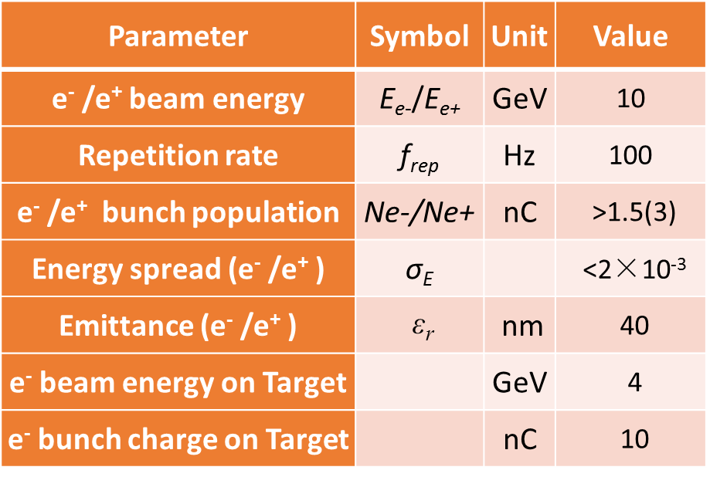
Linac baseline design （C. Meng）

Slide 7
CEPC linac beam instrumentation system
Beam current monitor
Beam position monitor
Beam profile monitor
Bunch length measurement
Beam energy & spread
Beam emittance
Tune measurement(DR)

Slide 8
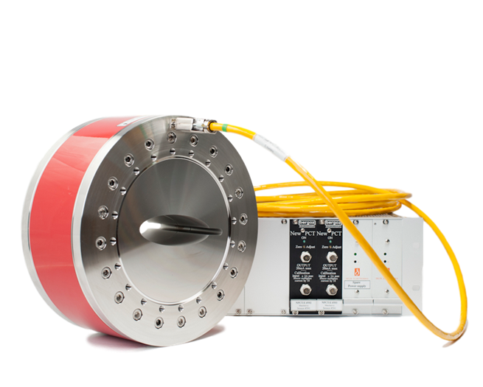
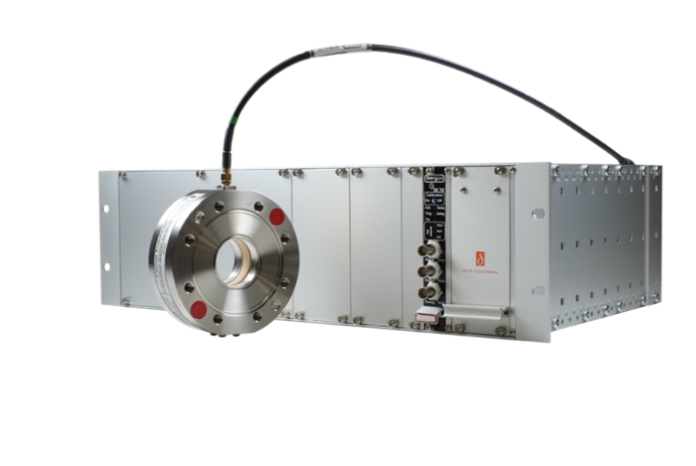
Beam current/charge monitor
Bergoz type integrating current transformer (ICT) connected to integrate and hold electronics is adopted to measure bunch charge during normal operation and the efficiency of linac.
There are 42 ICTs in Linac and located at the space between acceleration units.
1 DCCT is used for beam current measurement in the damping ring .
ICT & electronics
DCCT & electronics

Slide 9
Beam Position monitor
Total of 140 BPMs will be installed along the Linac. One BPM will be installed at the section of gun exit to pre-injector, the other BPMs will be installed at the space between acceleration structures.
Due to limited longitudinal space at the gun exit. The first BPM pick-up will adopt button type. The others are strip-line type.
There are 40 BPMs with button pick-ups in the damping ring. The electronics will provide turn-by-turn of the damping ring beam.

Slide 10
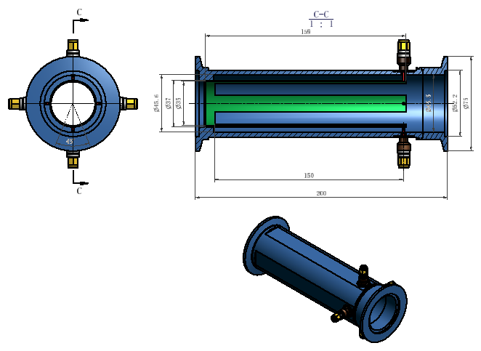
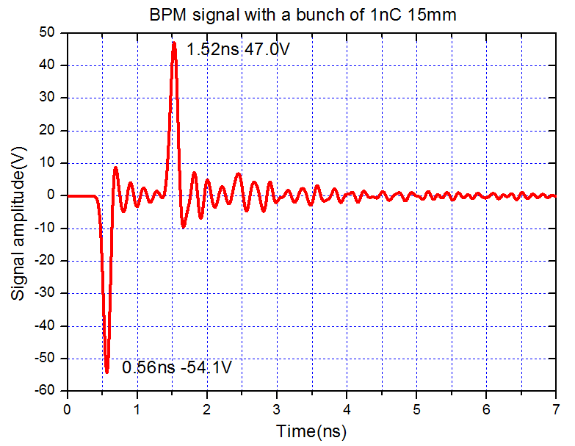
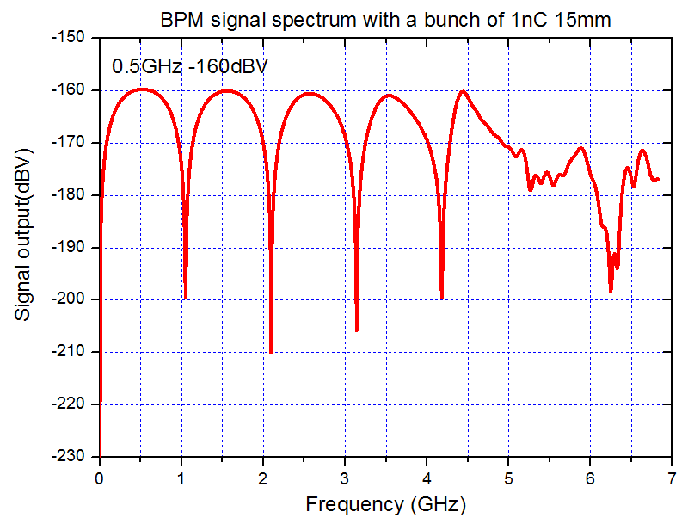
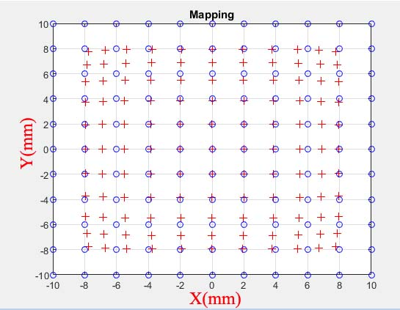
Beam position monitor
Total length | 200mm
Duct outer diameter | 52mm
Duct inner diameter | 45.6mm
Stripline length | 150mm
Stripline outer diameter | 37mm
Stripline thickness | 1.5mm
Stripline opening angle | 30 degrees

Slide 11
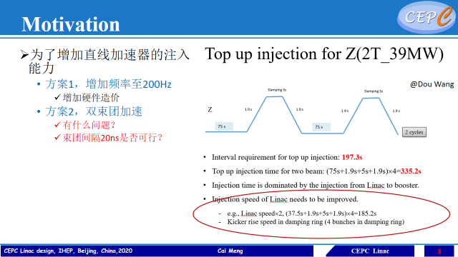
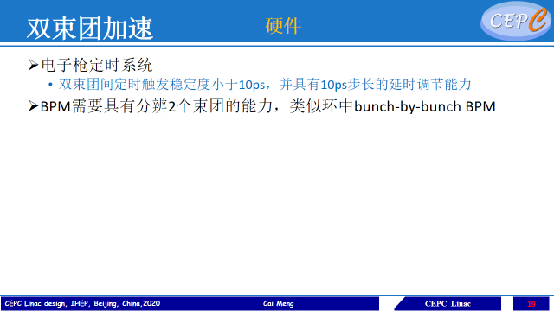
BPM electronics
The BPM electronics is home-made. The hardware is similar to HEPS BPM electronics and will improve the design according to RF frequency of CEPC Ring. The algorithm is adapted for single pass mode of linac accelerator.
Bunch by bunch BPM electronics will be used for each bunch position monitor in two-bunch acceleration mode.

Slide 12
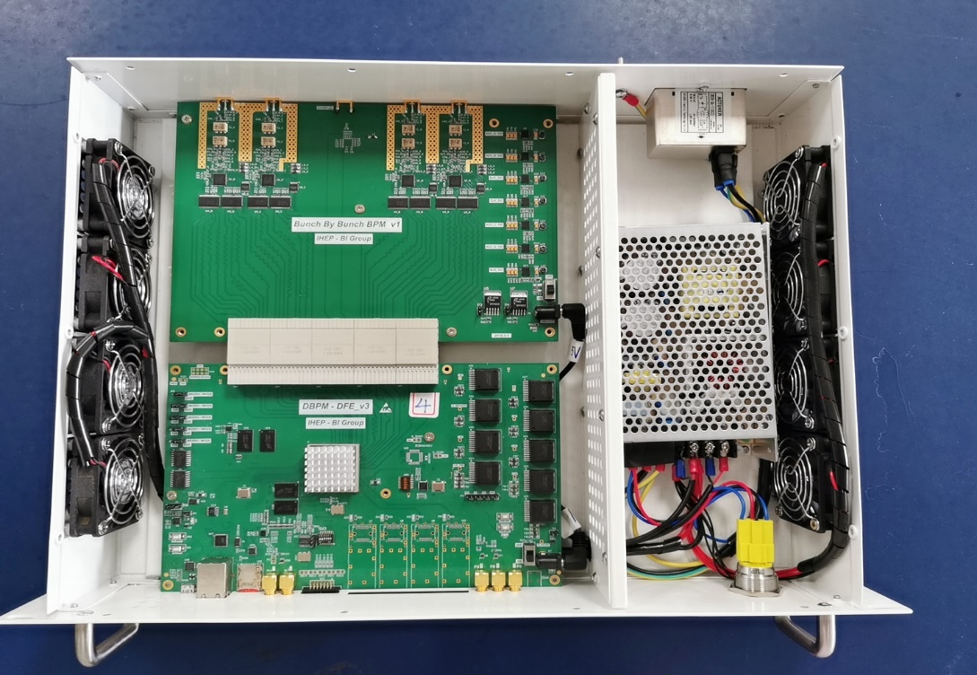
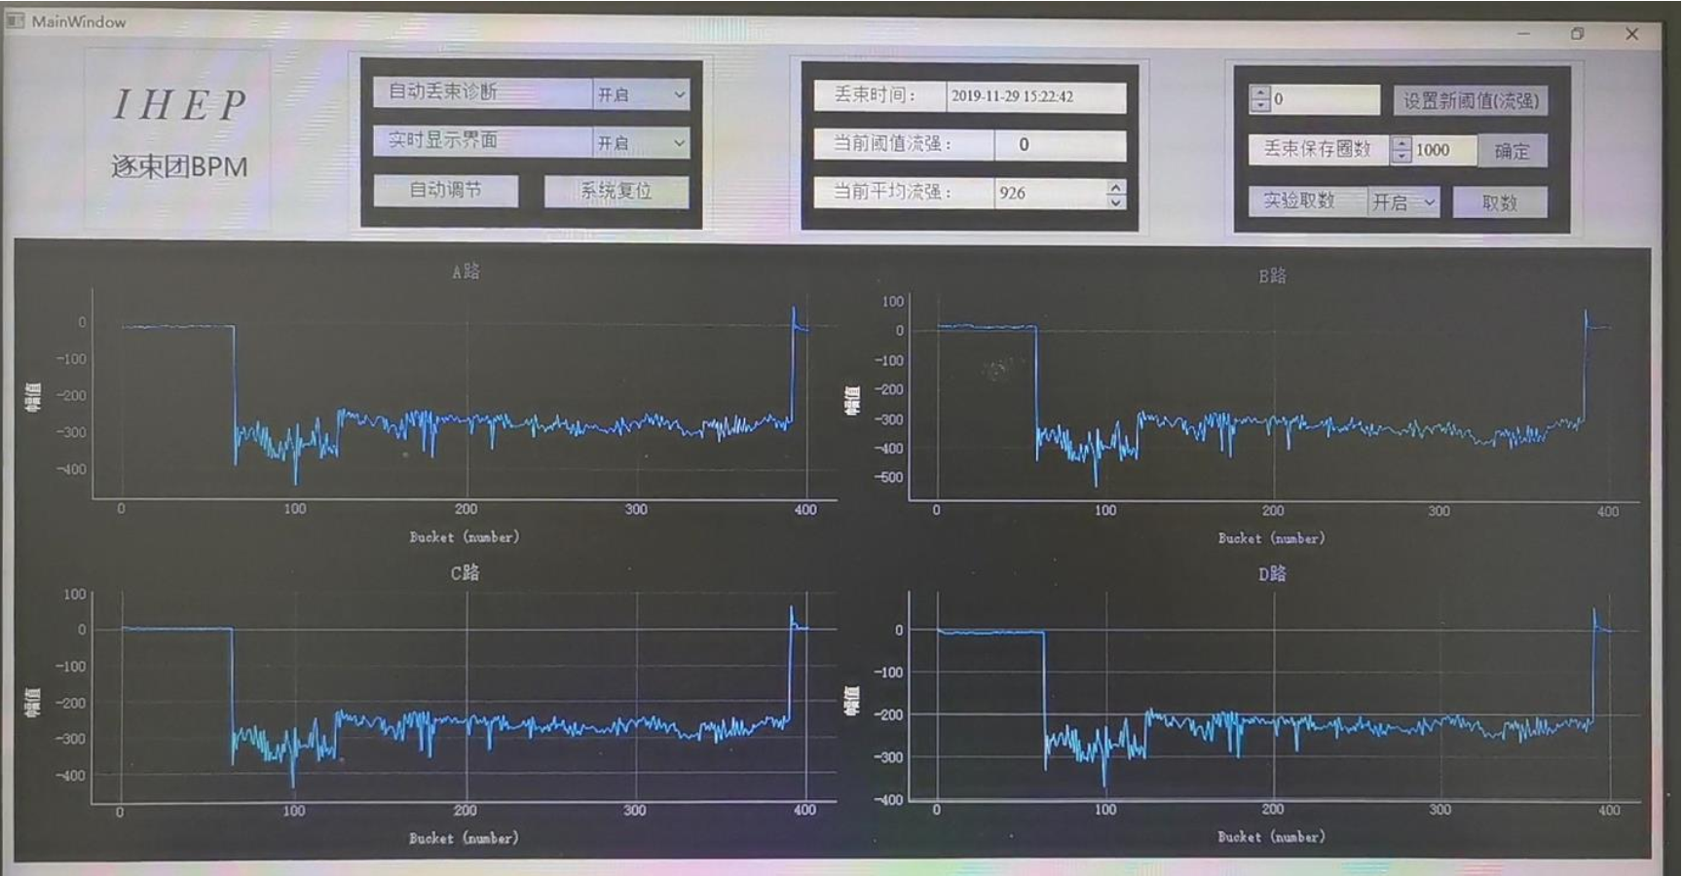
BPM electronics-bunch by bunch BPM

Slide 13
BPM electronics-bunch by bunch
Trigger
Buffer of bunch by bunch raw ADC data

Slide 14

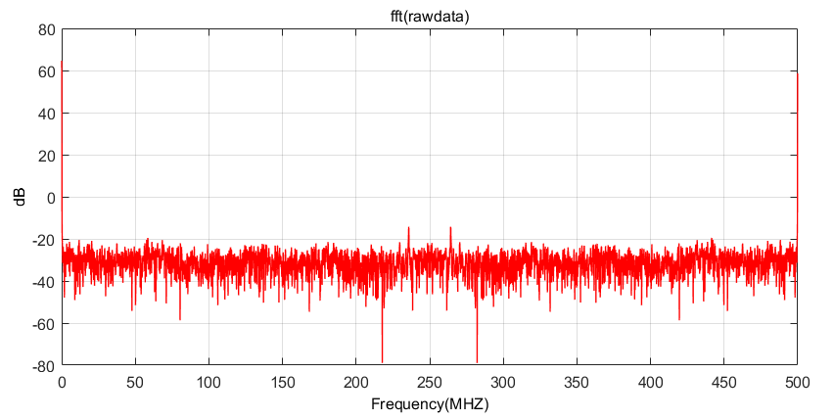
SNR Test
SNR : 68dB
Input signal: 500MHz ， 13dbm
Terminated inputs: @50ohm

Slide 15
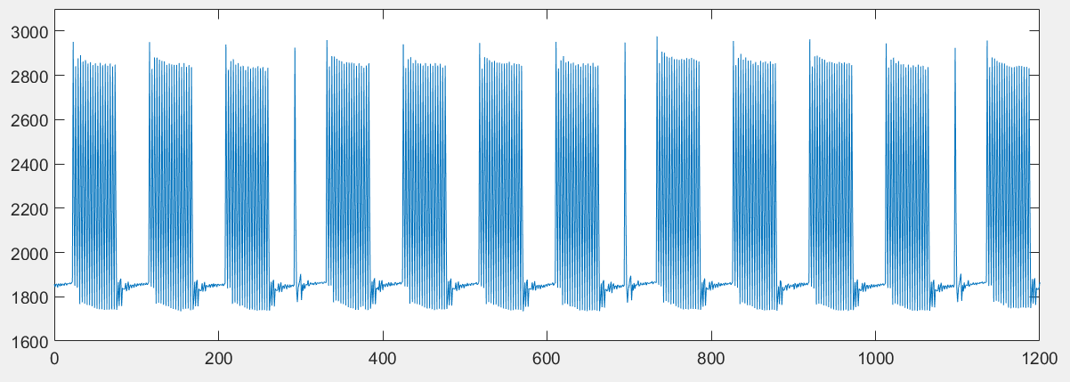
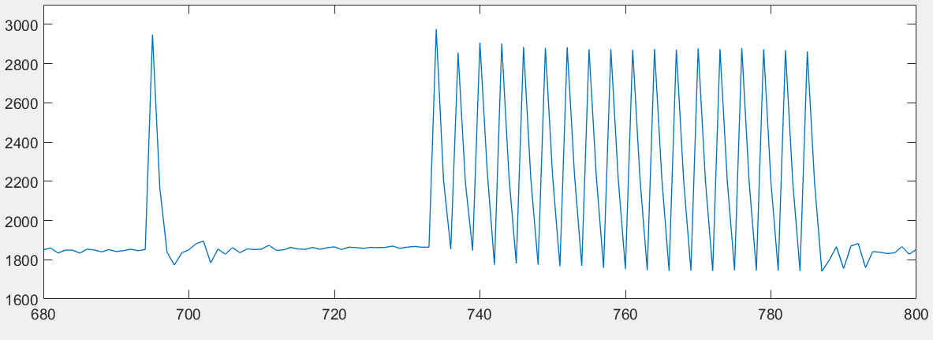
ADC data test with simulated beam signal
Input: simulation pattern of BEPCII , repetition period 6ns

Slide 16
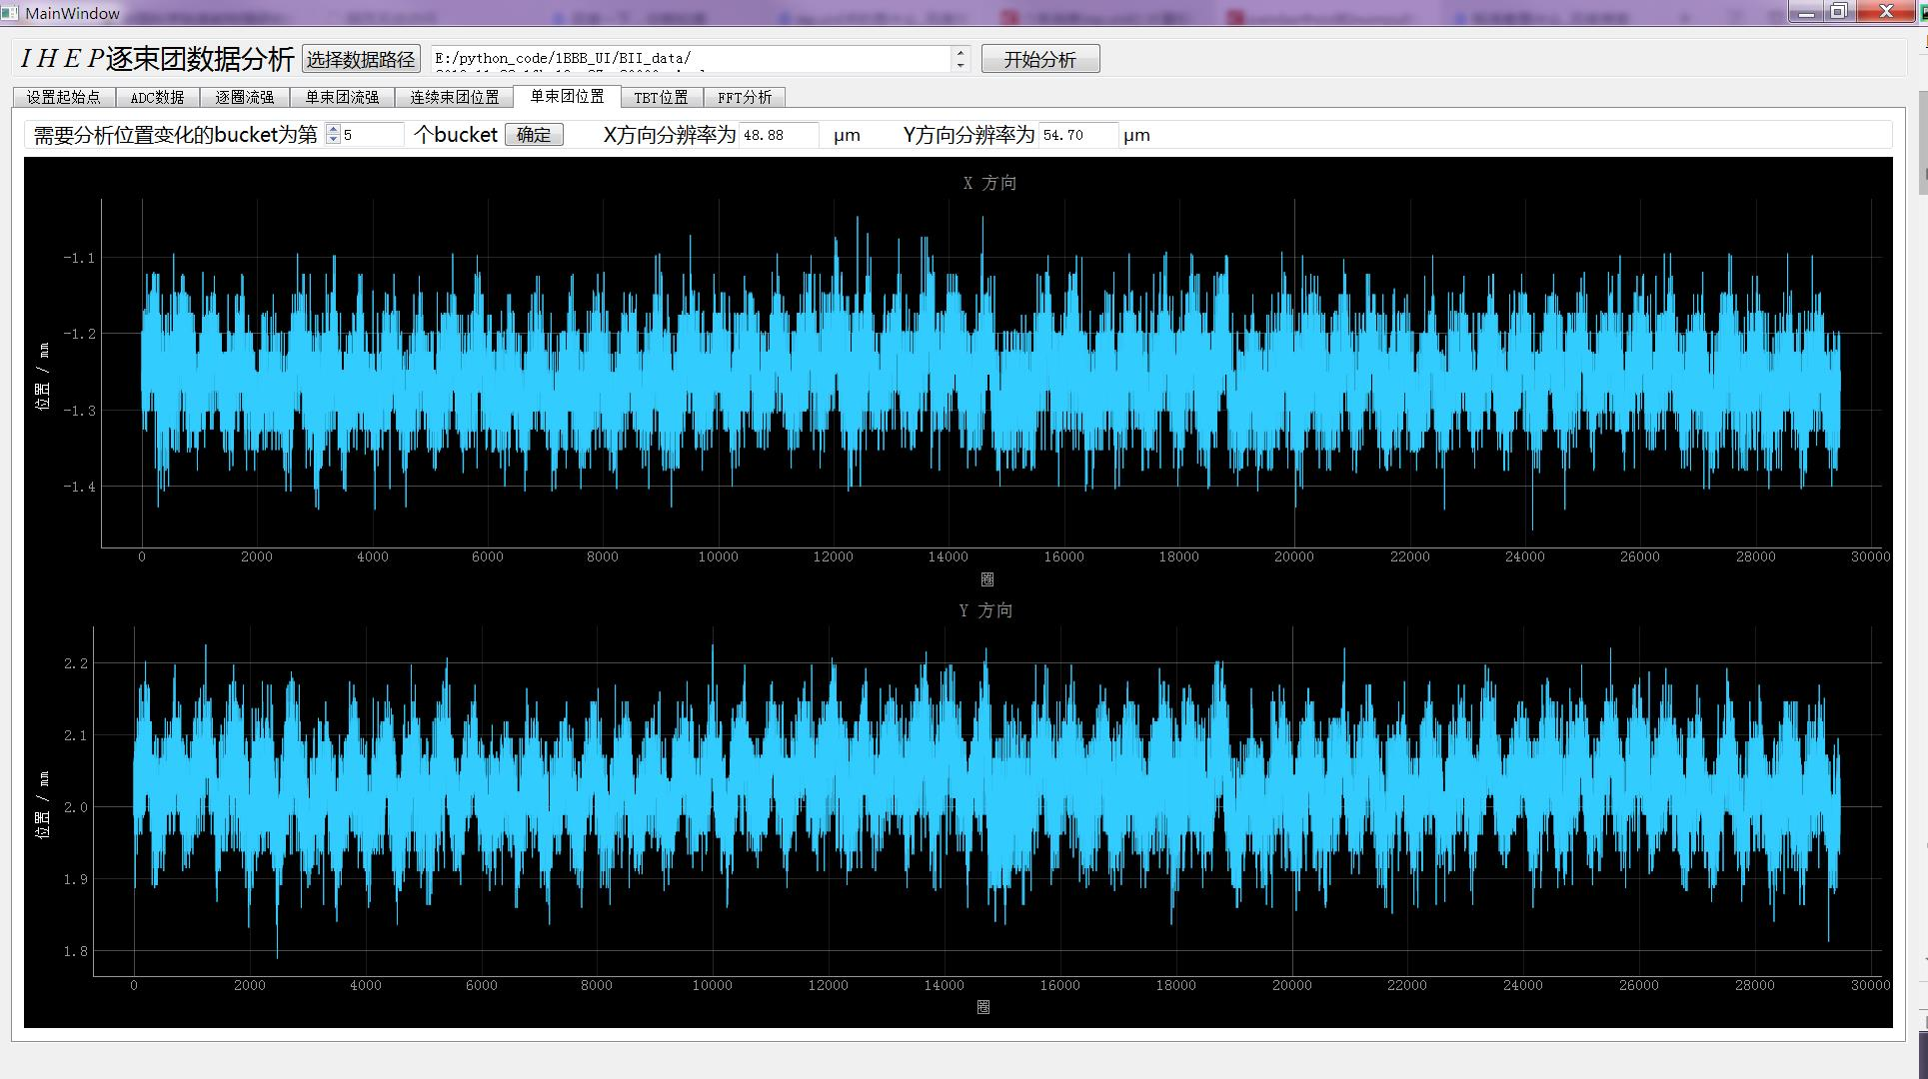
B&B BPM data offline analysis
The beam position of the same bunch 30000 turns, the resolution is 49um(H),55um(V)

Slide 17
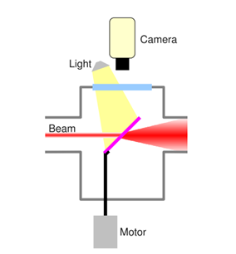
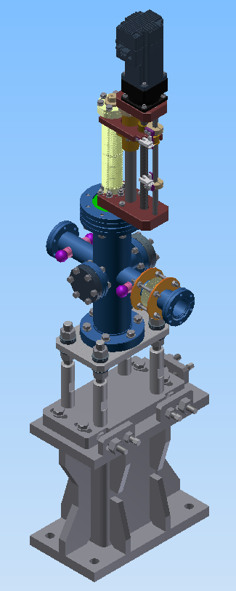
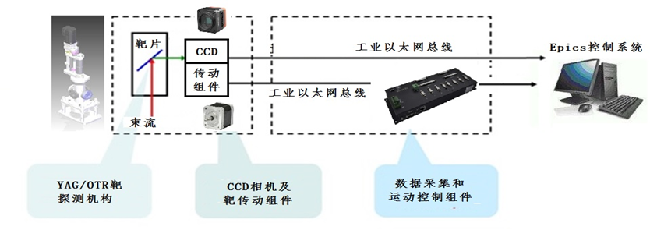
Beam profile monitor
The beam profile monitors (PR) are used to image the electron beam, to show spatial charge distribution and to check focusing in linac .
The PRs is located at relatively low electron energy section(<100MeV), YAG screen is used. The rest are equipped with YAG and OTR screens in high energy location.
The digital CCD camera with EPICS drive are used
The two beam profile monitors after analysis magnets are intended for beam energy measurement.
The profile monitors are also used in emittance measurement based on Q-scan

Slide 18
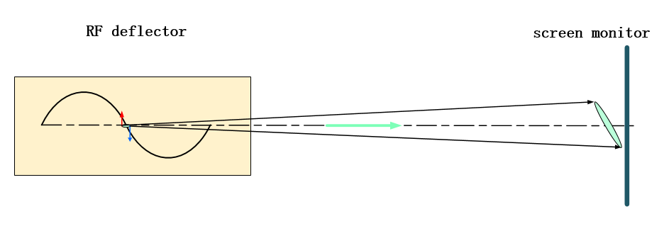
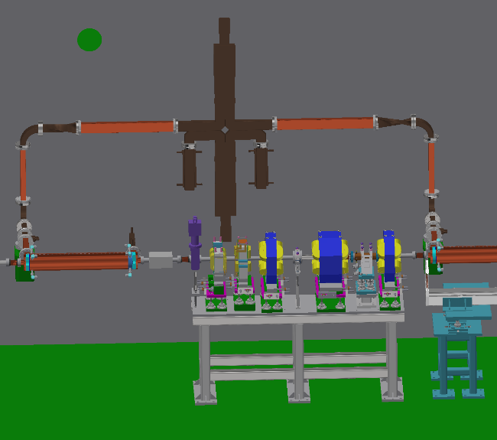
Bunch length measurement-Deflecting cavity
Deflecting cavity will be installed at the linac for bunch length measurement.
Bunch length resolution 0.2ps@ 1ps~5ps.
The power of the deflecting cavity is from the accelerating structure output.
Travelling wave deflecting cavity has been selected.
Acc structure output
Microwave switch
A & Ph
Directional coupler
Power source
Load
Gun
SLIT
Deflecting cavity
BPM
Profile

Slide 19
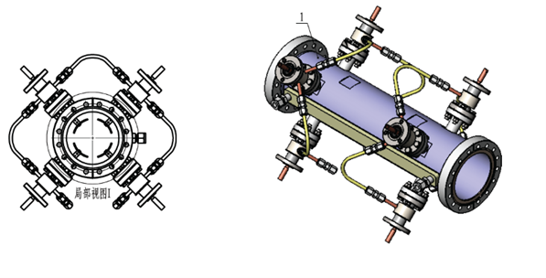
Tune monitor (DR)
Tune in damping ring is measured in two ways.
Frequency sweeping method used as daily monitor as the picture showing.
The FFT of the BPM TBT data is another way to monitor tune.
Beam
Kicker

Slide 20
Summary
The Investigation on beam instrumentation requirements was finished. Most of measurement requirements were discussed and confirmed by AP and BI group
Complete the linac beam instrumentation system design on the basis of reference to BEPCII and HEPS designs.

Slide 21
Thank you for your attention

