Slide 1
Progress of CEPC Control System ----Timing System
Presented by Gang Li
Aug. 26th, 2020

Slide 2
Outline
Timing System of CEPC
EVG/EVR V.S White Rabbit
Summary

Slide 3
Timing system of CEPC
Important subsystem of CEPC Control System
Trigger signal
Time&Frequency reference
Etc
定时系统：
产生一系列精确的时序信号，使加速器的特定设备在重复周期内按照一定的时序工作，确保束团注入到高频俘获区（bucket）内，使束流强度达到预设值。
向束流测量和谱仪亮度测量等设备发送触发信号和时钟参考信号，为数据获取，提供时间基准。

Slide 4
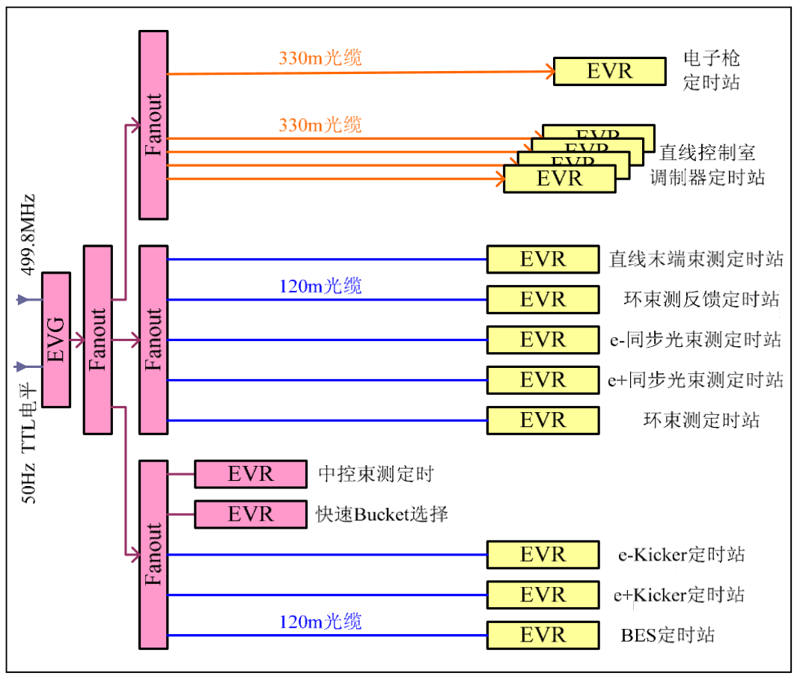
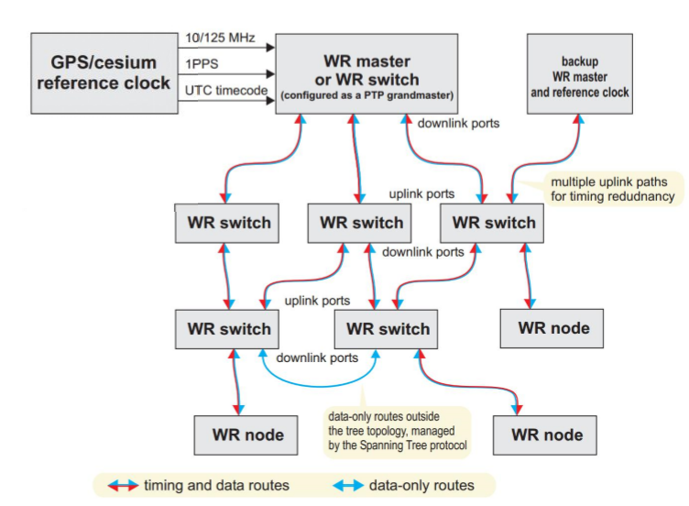
EVG/EVR VS White Rabbit
EVG/EVR Timing System
Trigger
RF reference
Precise timestamping
EVG/EVR：Broadcast
Site：APS、SLS，BEPCII，CSNS，SSRF，etc
Support
Commercial products
EVG/EVR of SSRF
Homemade I/O and delay board
White Rabbit Timing System
Precise timestamping
Trigger
RF reference
Master/Slave: Bi-directionality
Site：CERN、GSI、ESRF、Spring-8、 HIAF、CiADS、SHINE、LHAASO、CSNS、German Stock Exchange，etc
Support
OpenHareware+Commercial products
V.S

Slide 5
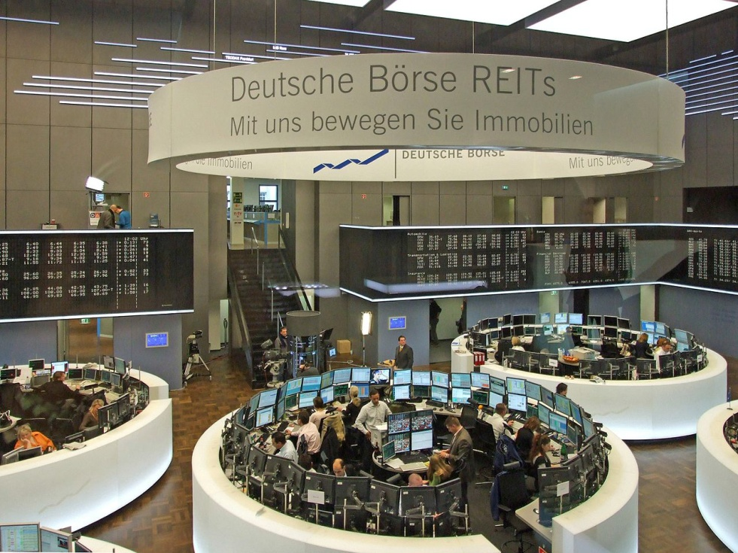
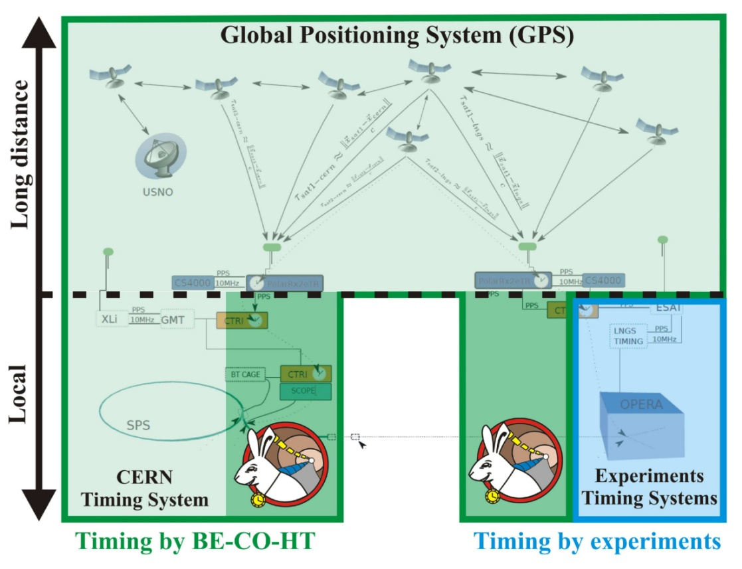
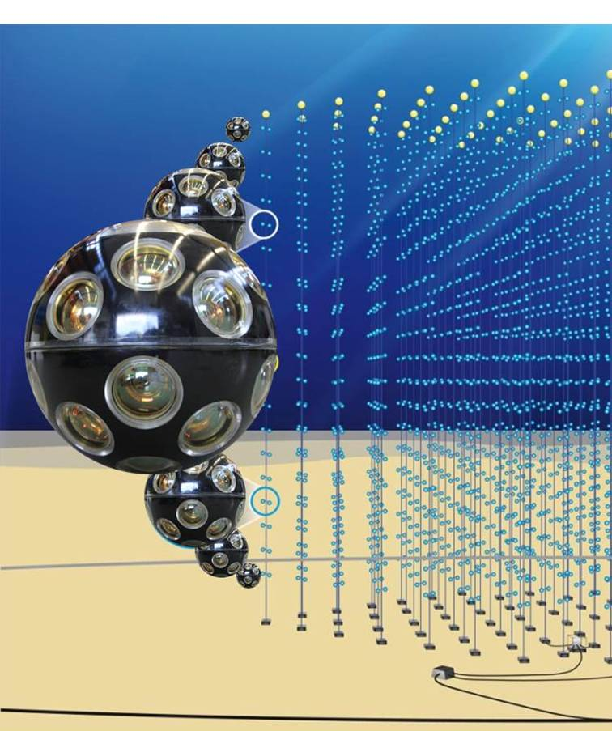
White Rabbit Timing System: Precise timestamping
The most widely used WR application
Time-of-flight measurement
Speed of neutrinos - CNGS
Types of particles - ProtoDUNE
Cosmic ray and neutrino detection
Large High Altitude Air Shower Observatory
Cubic Kilometre Neutrino Telescope
High Frequency Trade monitoring
German Stock Exchange
8

Slide 6
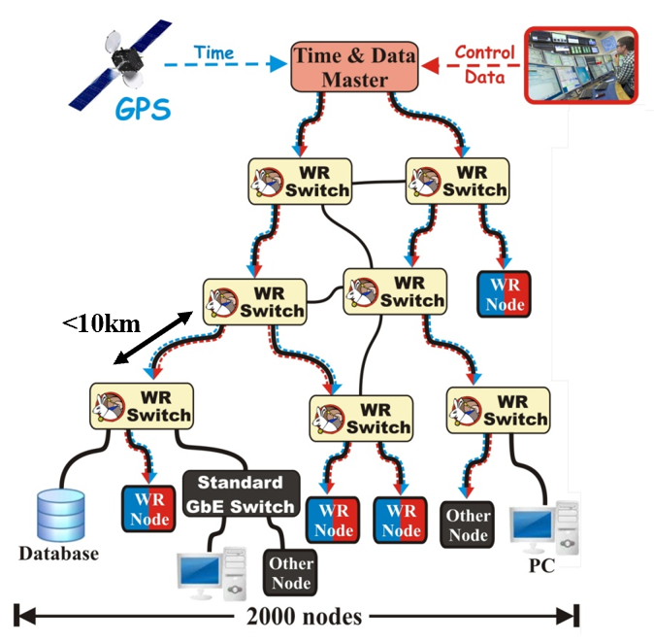
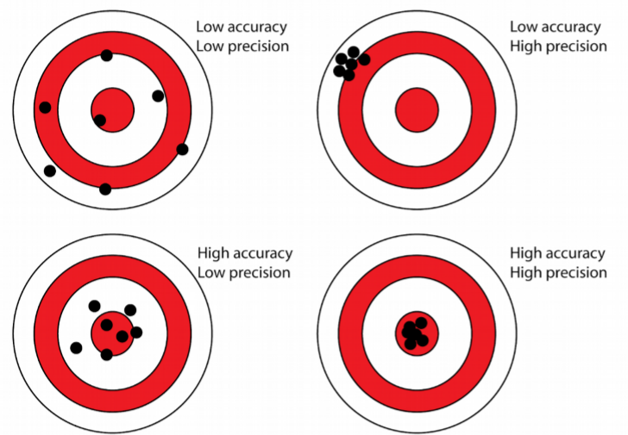
White Rabbit Timing System:Trigger
CERN and GSI initiative for control & timing
Based on well-established standards
Ethernet (IEEE 802.3)
Bridged Local Area Network (IEEE 802.1Q)
Precision Time Protocol (IEEE 1588)
Extends standards to provide
Sub-ns synchronisation (included in IEEE 1588)
Deterministic data transfer
Initial specs: links ≤10 km & ≤2000 nodes
Many applications worldwide
White Rabbit materials from ：
https://indico.cern.ch/event/913576/
https://www.ohwr.org/projects/white-rabbit/wiki/overview
https://www.ohwr.org/projects/white-rabbit/wiki/jun2018meeting

Slide 7
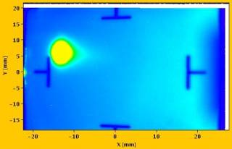
White Rabbit Timing System:Trigger
Bending
magnet
B (t)
Synchrotron operation
f (t) – RF in accelerating cavities
Beam Instrumentation diagnostics
B(t) – magnetic field in bending magnets
I(t) – current provided by power converters
I(t)
f_{rev} (t)
V
Beam Inst.
Diagnostics
Accelerating
RF cavity
Power
converter

Slide 8
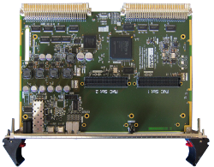
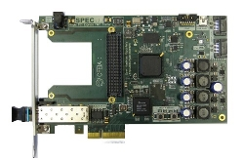
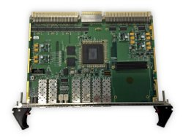
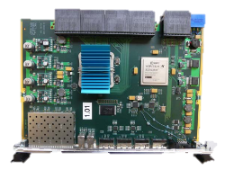
White Rabbit Timing System:Trigger
Bending
magnet
B (t)
Simple VME64x FMC Carrier (SVEC)
Simple PCIe FMC carrier (SPEC)
VME FMC Carrier HPC-DDR3 (VFC-HD)
VXS Switch
FPGA
I(t)
FPGA
WR Switch
FPGA
f_{rev} (t)
V
FPGA
Power
converter
Beam Inst.
Diagnostics
Accelerating
RF cavity

Slide 9
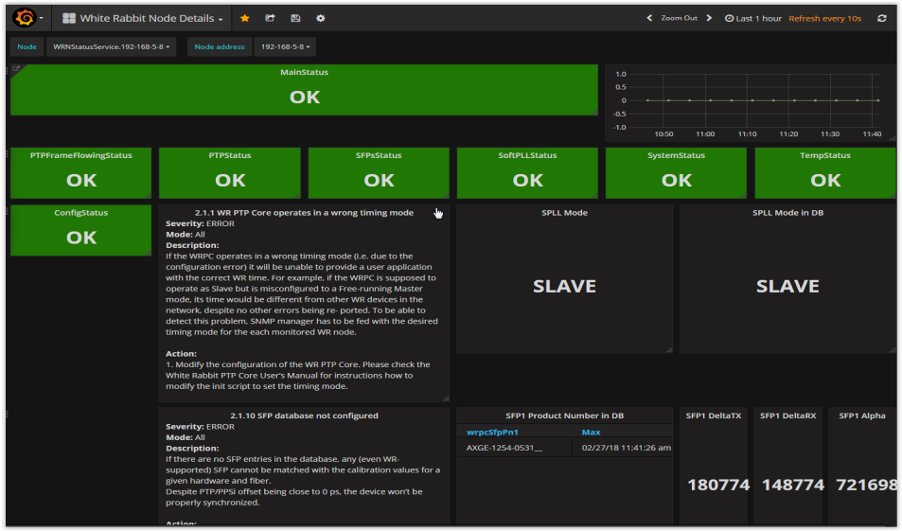
Support and monitoring
White Rabbit Timing System:Trigger
FPGA
User logic
B
I
Developed by BE-CO-HT, support eventually by TE-MSC-MM
BTrainFrameTxRx
CO-supported
Controls Open Source
MOnitoring System
WR Streamers
Monitoring
WR Switch and its ports state
WR Node state
Frames tx/rx/lost
Max/min/avg latency
WR PTP Core
Switch monitoring
over SNMP
WR Switch
Nodes monitoring
over SNMP
FPGA
WR PTP Core
WR NEtwork MOnitoring
and Configuration
WR Streamers
Developed by BE-CO-HT, support eventually by TE-MSC-MM
BTrainFrameTxRx
B
I
User logic
19

Slide 10
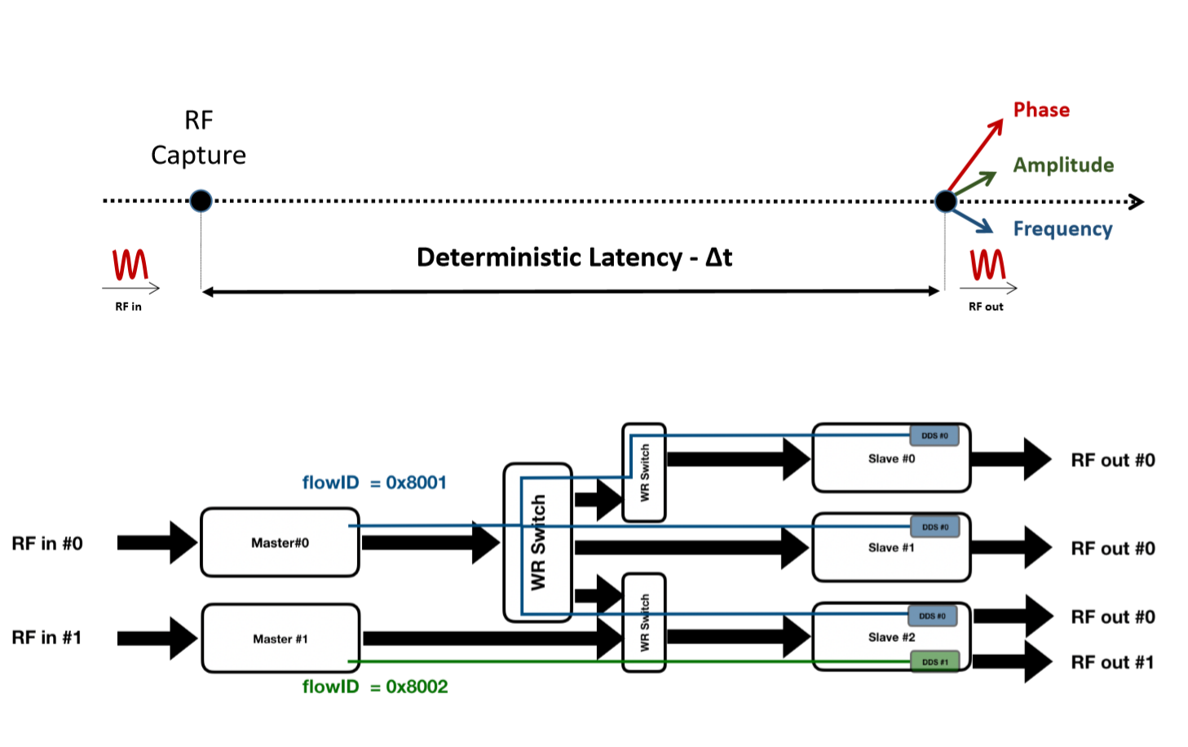
White Rabbit Timing System: RF transfer
11

Slide 11
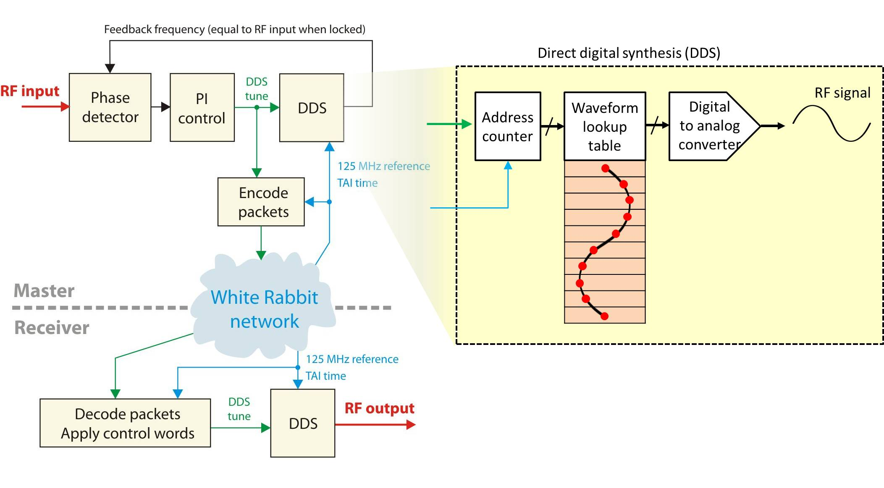
White Rabbit Timing System: RF transfer
A prototype tested in operation: <10 ps jitter, ESRF
A prototype: <100 fs jitter and <10 ps reproducibility over reboots, CERN
11

Slide 12
Summary
A lot of experience about EVG/EVR has been/will be accumulated through BEPCII, CSNS projects/HEPS projects
White Rabbit technology is accepted and adopted by more and more new projects or upgrading projects
Thanks a lot!
Notes:
h

