Slide 1
CEPC plasma injector RF gun system design progress
Zhang Jingru
On behalf of LINAC group

Slide 2
Outline
1
Introduction
2
State of the art
3
Preliminary beam dynamics study
4
Summary and outlook

Slide 3
Introduction
Plasma WakeField Accelerating, an alternative option to the conventional NC linac
5 guns, different charge
Gun | Gun1 | Gun2 | Gun3 | Gun4 | Gun5
Bunch Charge(nC) | 6.5 | 18 | 1.2 | 5 | 10
courtesy of D. Li, C. Meng

Slide 4
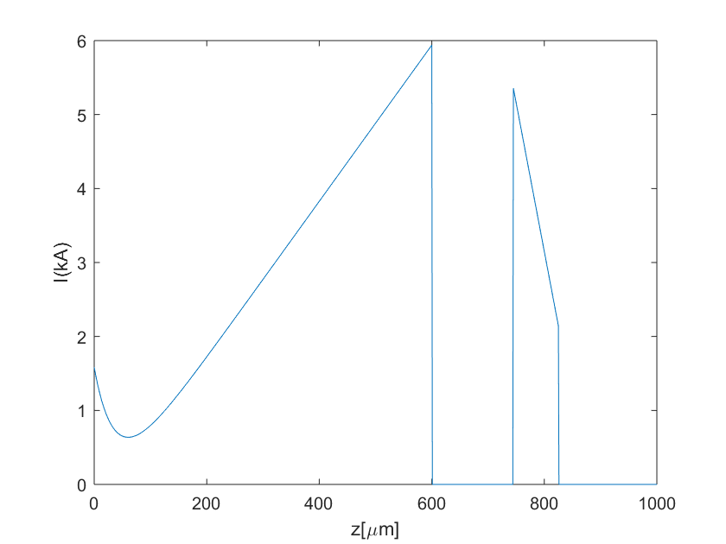
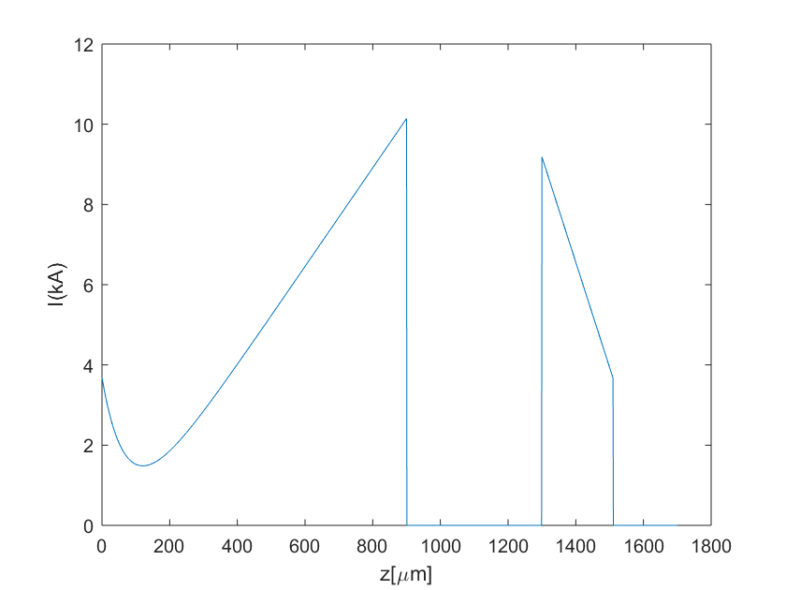
Photoinjector requirements of CEPC PWFA
Basic beam requirements of photoinjector
High bunch charge ( >18 nC )
Beam shaping in injector + bunch compression in main LINAC → triangle and trapezoidal beam for high TR in plasma cell
Transverse normalized rms emittence ~50 um.rad
e- beam before entering plasma cell
e- beam before entering plasma cell
drive beam， 6.5 nC
witness beam, 1.2 nC
drive beam,
18 nC
witness beam, 5 nC
Gun1+Gun3
Gun2+Gun4
courtesy of D. Li, C. Meng

Slide 5
State of the art
RF photoinjector is used to generate high brightness beams → low emittance, high current
Widely used in FEL, collider injector, UED/UEM, inverse Compton scattering source, etc.
 | KEK SuperKEKB [1] | CERN CTF3 [2] | ANL AWA [3] | DESY E-XFEL, PITZ [4] | SLAC LCLS-I [5]
Application | e- injector for collider | CLIC driving linac | Plasma wakefield accelerator | FEL source | FEL source
Freq. | 2856 MHz | 2998 MHz | 1300 MHz | 1300 MHz | 2856 MHz
Cavity type | Quasi traveling wave, 7 cell | 2.5 cell | 1.5 cell | 1.6 cell | 1.6 cell
Cathode | Ir5Ce | Cs2Te | Cs2Te / Mg | Cs2Te | Cu
Max. bunch charge(sigle bunch) | ~5.0 nC | 4 nC | 0.1 ~ 100 nC | Up to 4 nC | 1 nC
No. bunch / pulse | 2 | 1 | 1~32 | Up to 2700@1nC | 1
Rep-rate | 50 Hz | 50 Hz | 10 Hz | 10 Hz | 120 Hz
Norm. emittance | 40/20 um (Hor./Ver.) | 8 um@ 4nC | ~100 um @100 nC | ~ 0.7 um @1nC | 1.2 um @ 1nC
Beam energy at gun exit | 11.5 MeV | 5.5 MeV | 8.0 MeV | 6.0 MeV | 6.0 MeV
[1] N. Takuya, et al., eeFACT2016, TUT2H2
[2] M. Petrarca, et al., IPAC10, THPEC032
[3] W. Gai, IPAC 2016, FRXCB01; M.E. Conde, et al., IPAC2011, WEPZ014
[4] F. Stephan, et al., PRAB, 13 (2010), 020704; M. Krasilnikov, et al., PRAB, 15 (2012), 100701
[5] R. Akre, et al., PRAB 11.3 (2008), 030703.
AWA is a dedicated facility for the novel acceleration concept with the extremely high charge beams.
Notes:
Q: Why KEK use a complex side coupler gun?
A: For conventional 1.6 cell S band gun, the max. charge is ~ 1nC. With a charge of 5 nC, the aiming of KEK quasi-traveling wave side coupler gun is to control the beam size and emittance simultaneously.
Q: Why KEK use Ir5Ce?
A: Based on the concerning of cathode QE and lifetime for large charge.

Slide 6
RF photoinjector design considerations
Bunch charge ( >18 nC ), extremely large charge among the rf gun applications
ANL L band gun is a good candidate → 1.5 cell with normal coupler
Space charge effect, cathode gradient > 80 MV/m → to extract enough charge
Photo cathode, e.g. Cs2Te 100 nC; Mg 10 nC; Cu 21 nC → in combination with laser energy capability
Bunch shaping (triangle and trapezoidal) for high TR
Laser temporal shaping : 1. pulse stacking ^{[1]} ; 2. spectral masking
Emittance exchange program, still in R&D stage ^{[2]}
Longitudinal shaping preservation during beam propagation
Transverse normalized rms emittence
$ε_{n}=\sqrt{{ε_{th}}^{2}+{ε_{sc}}^{2}+{ε_{rf}}^{2}}$
Parameters in optimization:
Gun cavity(gradient, phase) ;
Laser (transverse & temporal distribution);
Solenoid (position, strength)
Linac (position, gradient, phase)
1
A large charge with precise bunch profile manipulation is of great challenge. Not only the beam generation but also beam diagnostics.
[1] G. Loisch et al., NIM A 909, pp. 107-110 (2018)
[2] Y. Sun et al., PRL 105, 234801 (2010).

Slide 7
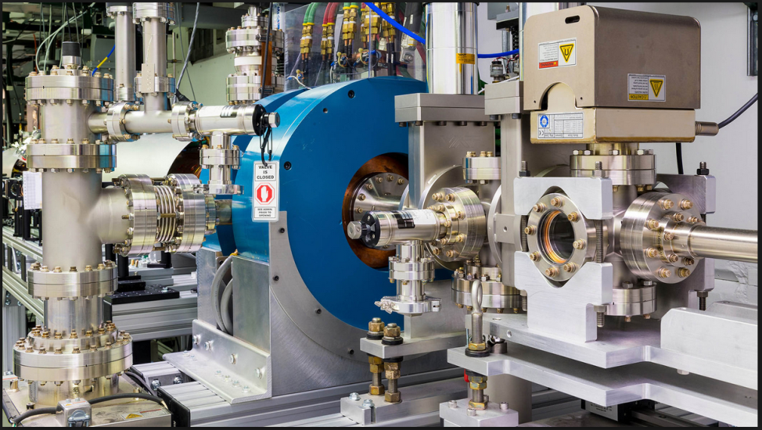
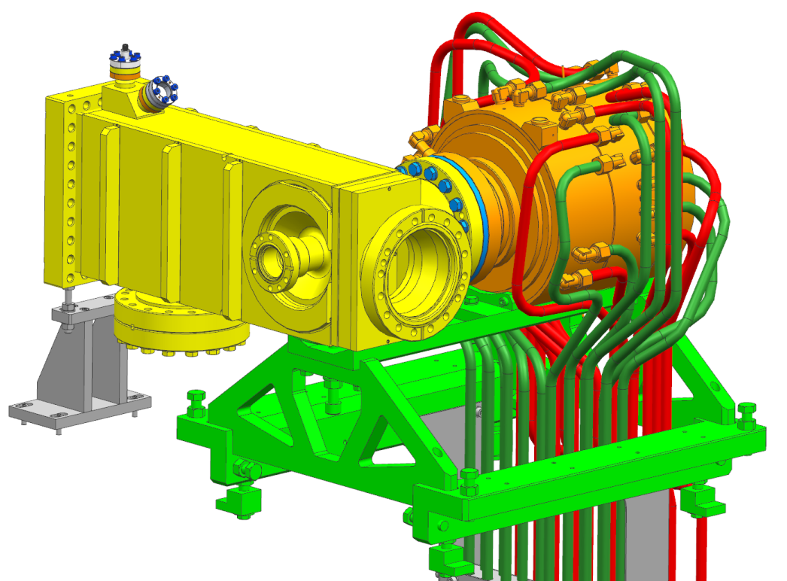
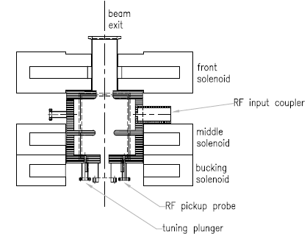
L band rf gun
DESY L band rf gun
ANL gun : 1.5 cell, waveguide coupling, gradient 80 MV/m
DESY gun: 1.5 cell, coaxial coupling, gradient 60 MV/m
ANL L band rf gun

Slide 8
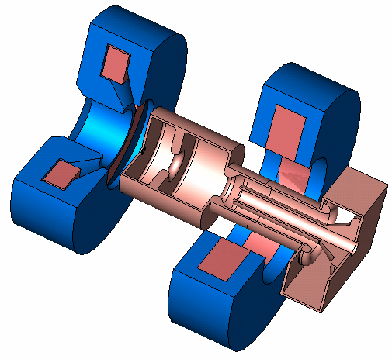
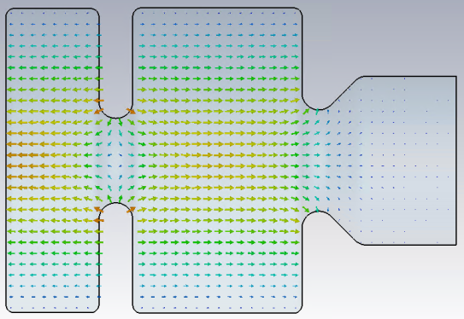
DESY L band rf gun
Bucking solenoid
RFgun:
L-band (1.3 GHz) Cu standing wave 1½-cell cavity
Main solenoid,
Bz_peak~0.2T
Gun properties
Freq. (Pi mode) | 1300 MHz
Unload Q | 23250
Coupling factor | 1
Input power | 6.5 MW
Rep-rate | 10
RF Pulse duration | 650 us
Gradient | 60 MV/m
Beam momentum | 6.7 MeV/c
Charge | Up to 4 nC
Cathode | Cs2Te
Photo cathode (Cs₂Te, QE ~20%) +
Load-lock system
Cathode laser
257nm
~20ps (FWHM)
Vacuum mirror
UHV
Coaxial RF coupler
Electron bunch
1nC, ~6.7MeV/c
E field

Slide 9
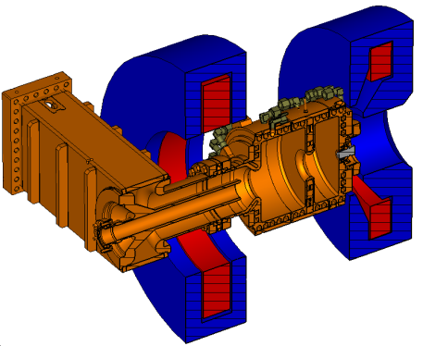
Preliminary bean dynamics study via ASTRA
DESY-PITZ ^{[1]} beam line layout is used for a quick start of beam dynamics simulations
L band 1300 MHz
1.6 cell Cu cavity
Cs2Te cathode with load-lock system
Cath E ~80 MV/m
Beam momentum ~ 8.2MeV/c
Input rf power ~10 MW
L band 1300 MHz
14 cell Cu cavity, side coupling
Gradient ~18 MV/m
Beam momentum gain ~ 25 MeV/c
Input rf power ~12 MW
[1]F. Stephan, et al., PRAB, 13 (2010)

Slide 10
Preliminary beam dynamics study via ASTRA (cont’d)
Four guns
triangle driving beam (6.5 nC)
trapezoidal witness beam (1.2 nC)
triangle driving beam (18.0 nC)
trapezoidal witness beam (5.0 nC)
Fixed parameters in ASTRA
Main component position, e.g. gun, solenoid, accelerator
Gun gradient 80 MV/m (max. value of gun operation in the world), MMMG phase
Linac gradient 18 MV/m, MMMG phase
Thermal emittance 0.85 um/mm (Cs2Te)
Variable parameters in ASTRA
Laser distribution (transverse and temporal modulation)
Solenoid strength
100 K macro particles were used to calculated space charge effect of high charge regime. The simulation is time consuming!

Slide 11
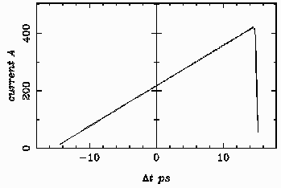
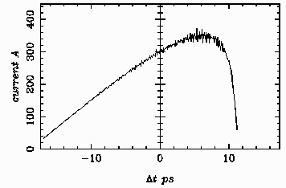
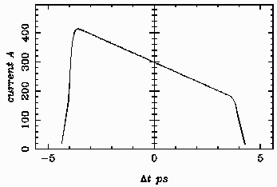
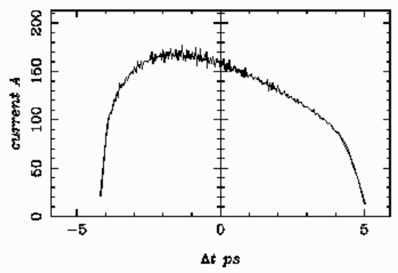
Preliminary beam dynamics study via ASTRA (cont’d)
Beam is longitudinally stretched due to space charge force, further compression in main LINAC is required.
Laser temporal distribution
Injector outlet beam shape
Charge 6.5 nC
Rms norm. emit=10.7 um
Beam transmission =100%
Gun1
Laser temporal distribution
Injector outlet beam shape
Charge 1.2 nC
Rms norm. emit=4.8 um
Beam transmission =100%
Gun3

Slide 12
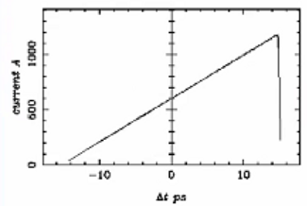
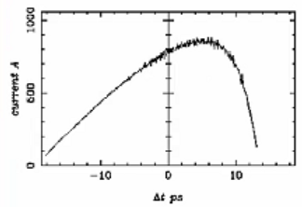
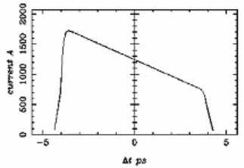
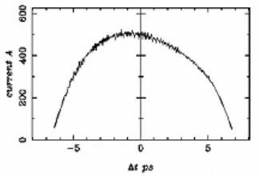
Preliminary beam dynamics study via ASTRA (cont’d)
Beam is longitudinally stretched due to space charge force, further compression in main LINAC is required.
Laser temporal distribution
Injector outlet beam shape
Charge 18 nC
Rms norm. emit=25.9 um
Beam transmission =100%
Gun2
Laser temporal distribution
Injector outlet beam shape
Charge 5.0 nC
Rms norm. emit=8.2 um
Beam transmission =100%
Gun4

Slide 13
Summary and outlook
Investigations on rf photoinjector applications were done. The L band rf gun is a potential candidate for CEPC PWFA due to its successful operation at ANL and DESY.
Basic design considerations are introduced. The preliminary beam dynamics simulations based on DESY-PITZ beam line were performed:
18 nC can be generated, 100 % transmission ratio
Normalized emittance is within specification
With laser shaping, the desired beam shape can be partially obtained. Significant distortion is observed.
For a better beam profile, a higher gun gradient is needed, but also a higher breakdown risk → need high power demonstration
Outlook:
Many critical technologies need experimental demonstration of capability of generating electron beams with high bunch charges
Experience of gun cavity fabrication / low power tuning / high power operation
Other related issue, e.g. cathode preparation, laser shaping capability and beam diagnostic system should also be concerned.
Thank you for your attention.

