Slide 1
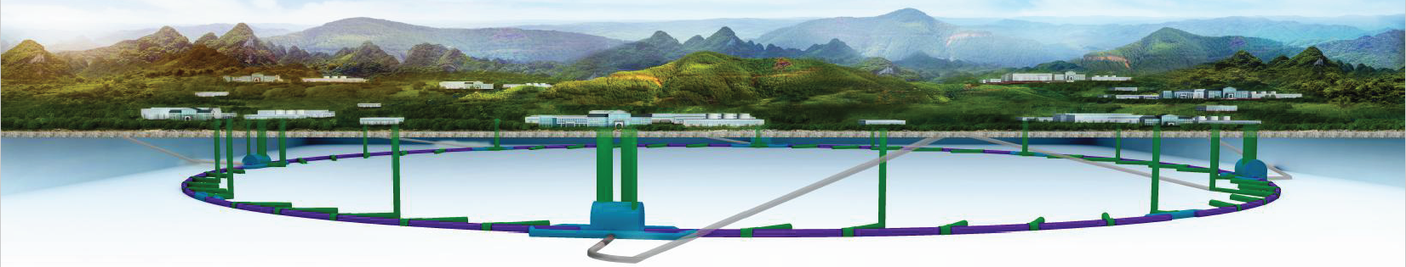
CEPC injection and extraction system hardware design progress
Jinhui Chen, Lihua Huo, Lei Wang, Yuwen Wu, Hua Shi
Injection group
2020-8-26

Slide 2
Outline
1
Overview of CEPC inj./ext. systems
2
Damping Ring injection & extraction kicker design
3
Booster low energy injection kicker design
4
Summary

Slide 3
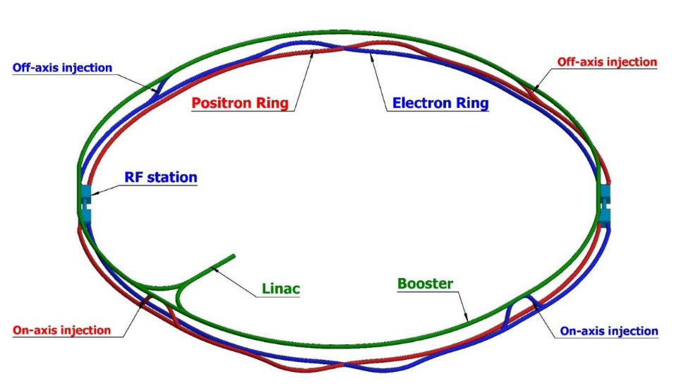
Overview of the CEPC injection and extraction systems
120GeV
120GeV
100km
Dump
Damping ring
Dump
e+
e-
10-120GeV

Slide 4
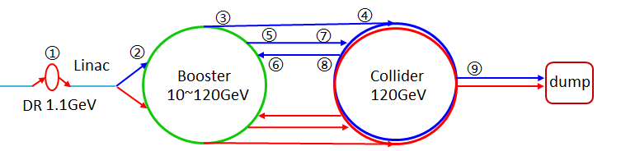
Main types of injection hardware
 | Sub-system | Kicker Type | Kicker waveform | Septa Type
1 | Damping ring inj./ext. | Slotted-pipe kicker | Half-sine/250ns | Horizontal LMS
2 | Booster LE inj. | Strip-line kicker | Half-sine/50ns | Horizontal LMS
3 | Booster ext. for CR off-axis inj. | Delay-line dipole kicker | Trapezoid /440-2420ns | Vertical LMS
4 | Collider off-axis inj. | Delay-line NLK kicker | Trapezoid /440-2420ns | Vertical LMS
5 | Booster ext. for CR on-axis inj. | Ferrite core dipole kicker | Half-sine/1360ns | Vertical LMS
6 | Booster HE inj. | NLK or Pulsed sextupole | Half-sine/0.333ms | Vertical LMS
7 | Collider swap out inj. | Ferrite core dipole kicker | Half-sine/1360ns | Vertical LMS
8 | Collider swap out ext. | Ferrite core dipole kicker | Half-sine/1360ns | Vertical LMS
9 | Collider beam dump | Delay-line dipole kicker | Trapezoid /440-2420ns | Vertical LMS
10 | RF region beam separating | Delay-line dipole kicker | CW square / 165us,50% | Horizontal Copper septa

Slide 5
Damping ring injection & extraction kicker design
Designed by Huo Lihua, Wang Lei

Slide 6
DR Kicker design parameters
parameter | DR-injection &extraction kicker | Unit
name | DRK | -
Quantity | 2 | -
Type | Slotted-pipe kicker | -
Deflect direction | Vertical | -
Beam Energy | 1.1 | GeV
Deflect angle | 1.5 | mrad
Magnetic effective length | 0.25 | m
Magnetic strength | 0.024 | T
Integral magnetic strength | 0.006 | T·m
Clearance region(H×V) | 44×44 | mm
Good field region(H×V) | x=±10，y=±10？ | mm
Field uniformity in good field region | ? | -
Repetition rate | 100 | Hz
Amplitude repeatability | ±0.5% | -
Pulse jitter | ≤5 | ns
Bottom width of half sine pulse | < 250 | ns

Slide 7
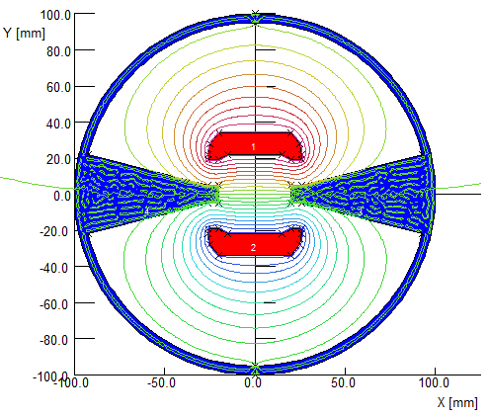
Magnet physics design
Slotted-pipe kicker
2D model by Opera
Umax=3200V
Imax=2326.5A
Inductance=194nH
250ns

Slide 8
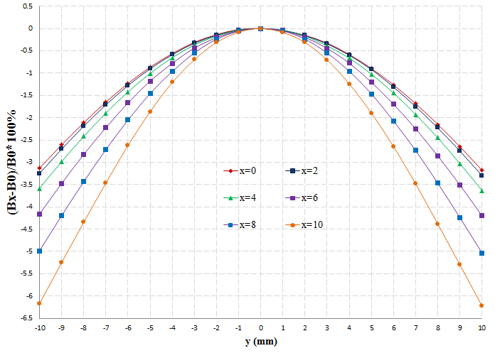
Field uniformity
x=0, y=(-10,10):Un.=±1.6%
x=0, y=(-5,5):Un.=±0.9%
x=2, y=(-10,10):Un.=±1.65%
x=4, y=(-10,10):Un.=±1.8%
x=6, y=(-10,10):Un.=±2.1 %
y=8, x=(-10,10):Un.=±2.5%
y=10, x=(-8.8,8.8):Un.=±2.5%

Slide 9
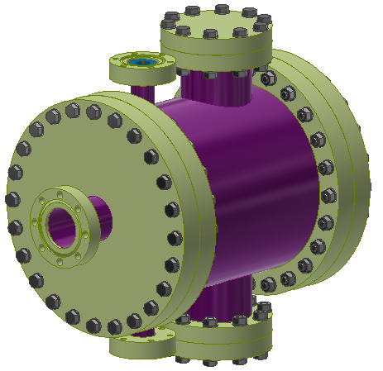
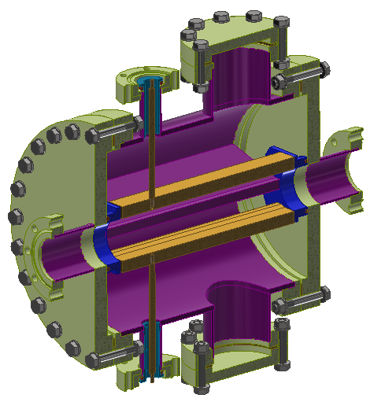
Preliminary engineering design
Auxiliary hole
HV feedthrough
Outer body (316L)
electrodes
To be improved :
the HV end structure
Ground end structure
Canceling Auxiliary hole？
HV feedthrough and connector
HV feedthrough
To vacuum pump

Slide 10
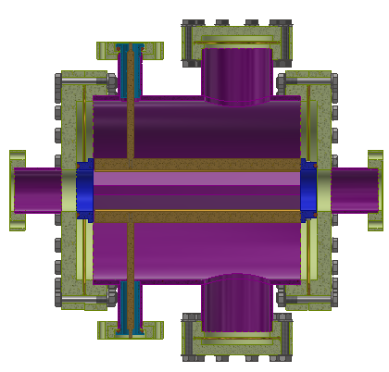
Mechanical Dimensions
44mm
Φ200mm
210mm
250mm

Slide 11
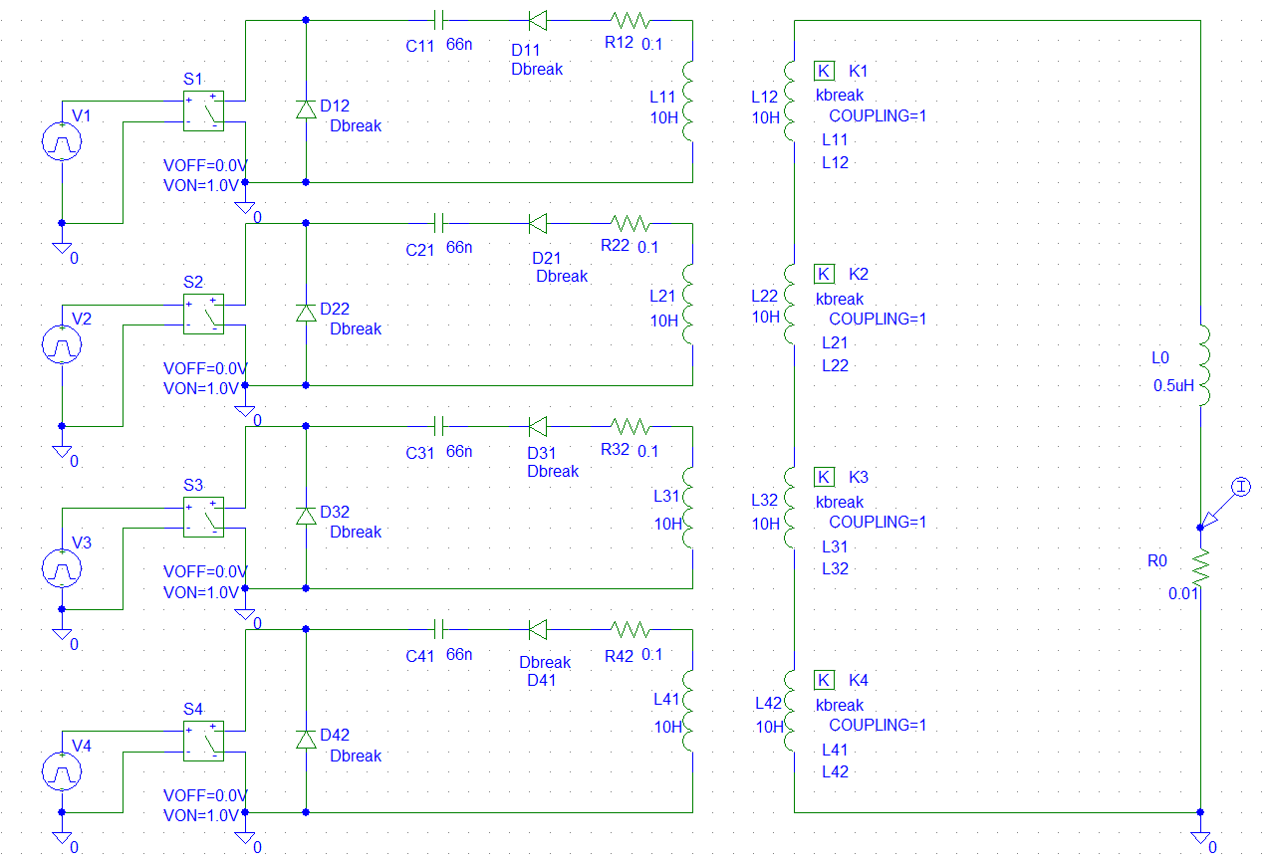
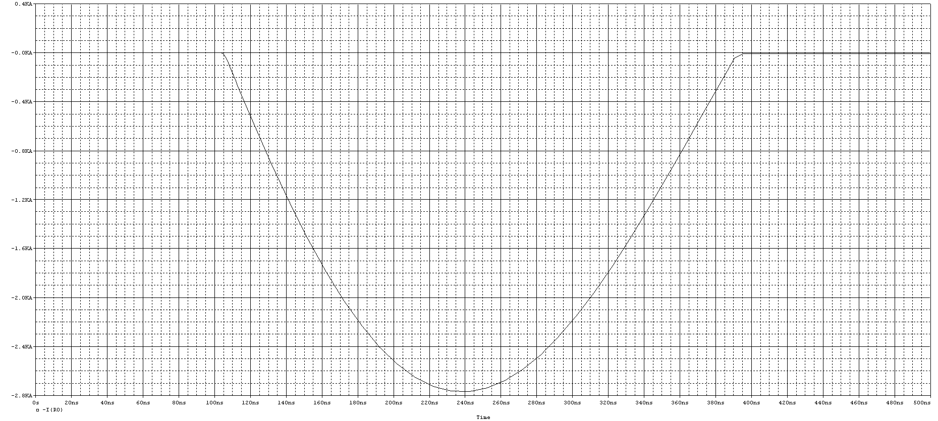
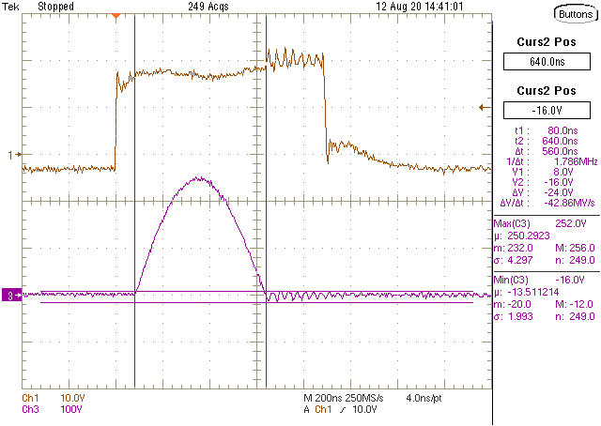
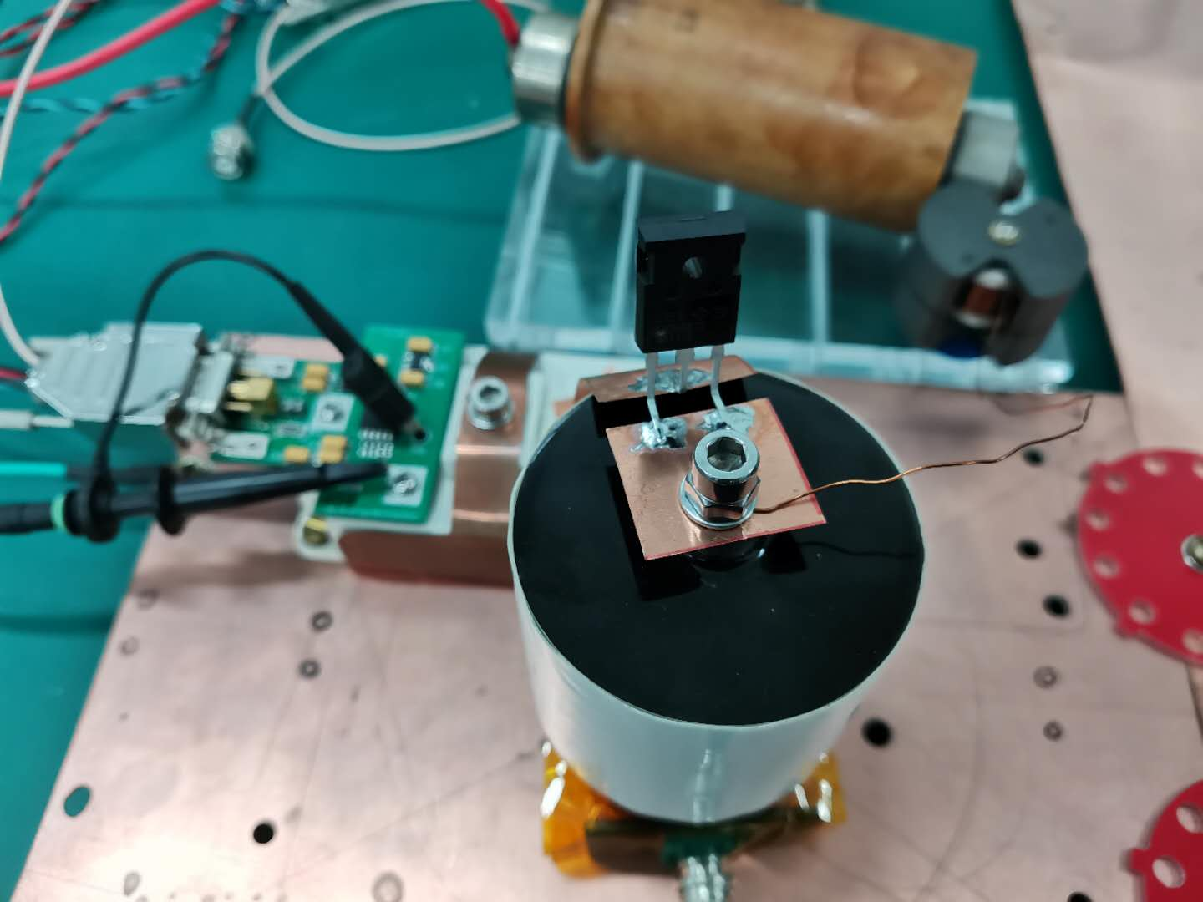
Kicker pulser
LC resonance discharge circuit (IGBT+SBD)
Imax=2326.5A(2500A)
L=194nH(250nH)
C=25nF
Tw=π√LC=248.4ns
Z=√L/C=3.16Ω
U=7357V(8000V)
IGBT quantity=10*4=40
IGBT
SIC 1200V SBD

Slide 12
Booster Low Energy Injection kicker design
Designed by Huo Lihua, Shi Hua, Wang Lei

Slide 13
DR Kicker design parameters
parameter | Booster Low Energy injection kicker | Unit
name | BSTLEIK | -
Quantity | 2 | -
Type | Strip-line kicker | -
Deflect direction | Vertical | -
Beam Energy | 10 | GeV
Deflect angle | 0.11 | mrad
Length of Strip-line kicker electrode | 1000 | mm
Gap between two electrodes | 55 | mm
Odd mode impedance | 50±1 | Ω
Even mode impedance | <65 | Ω
Clearance region(H×V) | 55×55? | mm
Good field region(H×V) | x=±1.1，y= (-0.85, 2.1)？ | mm
Integral field uniformity | ? | -
Amplitude of electrical pulse（into 50Ω） |  | kV
Repetition rate | 100 | Hz
Amplitude repeatability | <2% (RMS) | -
Pulse jitter | ≤1 | ns
Bottom width of electrical pulse（3%-3%） | < 50 | ns

Slide 14
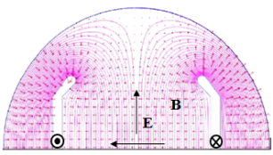
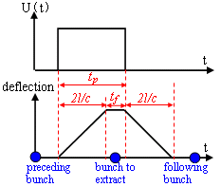
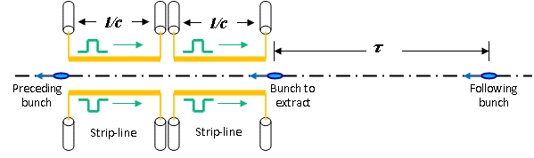
Strip-line kicker design for booster LE inj.
Kick strength
  Total kick angle: θ=0.11mrad
  E=10GeV, d=55mm, g=1 =>U*L>30.25kV∙m
  Total strip-line kicker electrode length L=1m =>U>30.25kV(or ±16kV)
50ns,100Hz
Here, θ is kick angle(rad)；E is beam energy(eV)；U is applied pulse voltage for both electrodes(V)；l is strip-line length；d is the distance between the electrodes，g is the geometry factor, determined by the shape of the electrode. w is the strip-line width.
Kick speed
  Min bunch spacing - τ=25ns
    Electrode length l<3.75m => l= 1m
    Electrical pulse Width 6.7ns< t_{p} <43.3ns =>Flat-top t_{top} >6.7ns, Rise/fall Time t_{r}/t_{f} <18.3ns

Slide 15
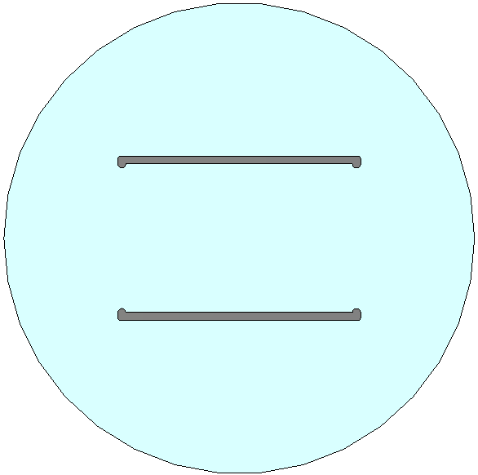
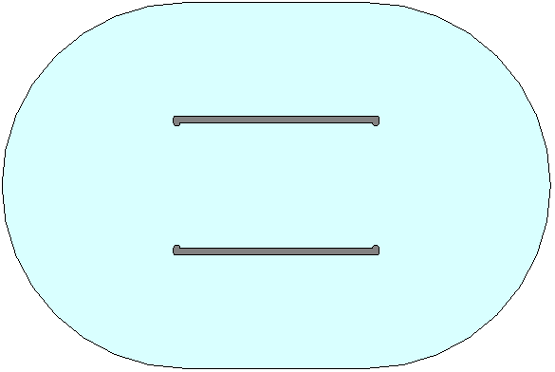
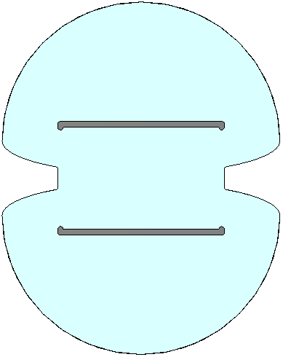
Geometry design
To achieve highest geometric factor(g=0.9884) the blade width should be w=90mm, when d=55mm.
Blade thickness=3mm? shape?
Odd mode impedance Zodd=50Ω
Even mode impedance Zeven=68 Ω
(Vane width=90mm)
55mm
90mm
Zeven=87Ω
Zeven=94Ω
Zeven=68Ω
Field uniformity:
    X(-8.8~+8.8mm)，0.4%
    Y(-16.2~+16.2mm)，~1.1%

Slide 16
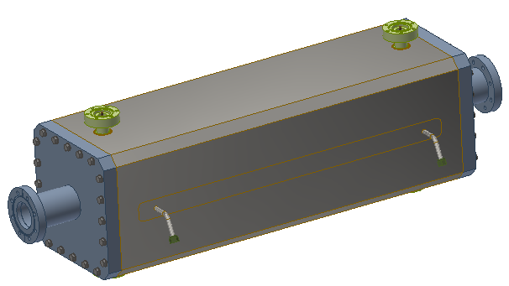
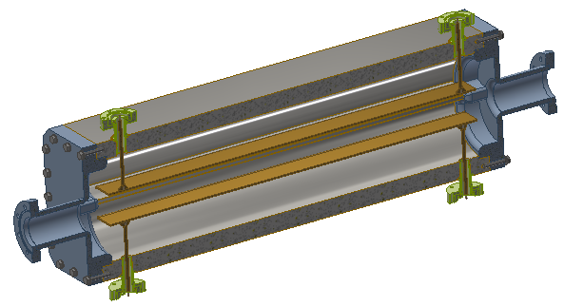
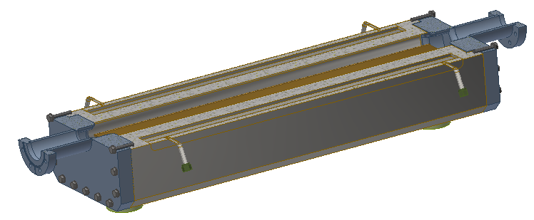
Preliminary engineering design
HV feedthrough
Outer body (316L)
HV feedthrough
electrodes
Cooling Water hole
To be improved :
the shape of electrodes
the ends of electrodes
Electrode supporting
HV feedthrough and connector
Cooling Water tubes

Slide 17
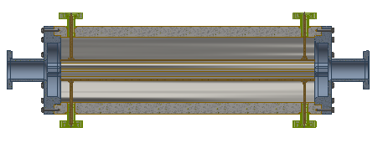
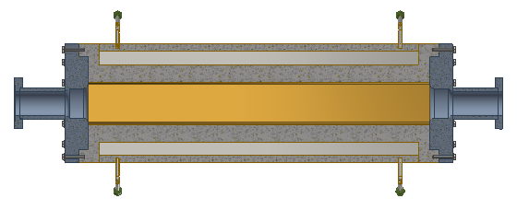
Mechanical Dimensions
260mm
55mm
1000mm
1100mm
260mm
1100mm

Slide 18
Summary
Slotted-pipe kicker is adopted for damping ring injection and extraction system. Preliminary magnet design was done , but there are still some details should be considered to improved.
The booster low energy injection system need a very fast kicker with 50ns bottom width. The strip-line kicker is best choice for it. Preliminary magnet design was done , but there are some details should be considered to improved too.

Slide 19
END
Thank you for attentions!!!

