Slide 1
G4练习3
刘倩
中国科学院大学物理科学学院

Slide 2
Copy一个几何体
DetectorConstruction.cc里：
new G4PVPlacement(0, //no rotation
G4ThreeVector(0, 0, 50*cm), //at (0,0,0)
logicEnv, //its logical volume
"Envelope", //its name
logicWorld, //its mother volume
false, //no boolean operation
1, //copy number
checkOverlaps); //overlaps checking
SteppingAction.cc里：
auto touchable = step->GetPreStepPoint()->GetTouchable();
auto copyNo = touchable->GetVolume()->GetCopyNo();
G4cout<<"Now you are hitting: "<<copyNo<<G4endl;

Slide 3
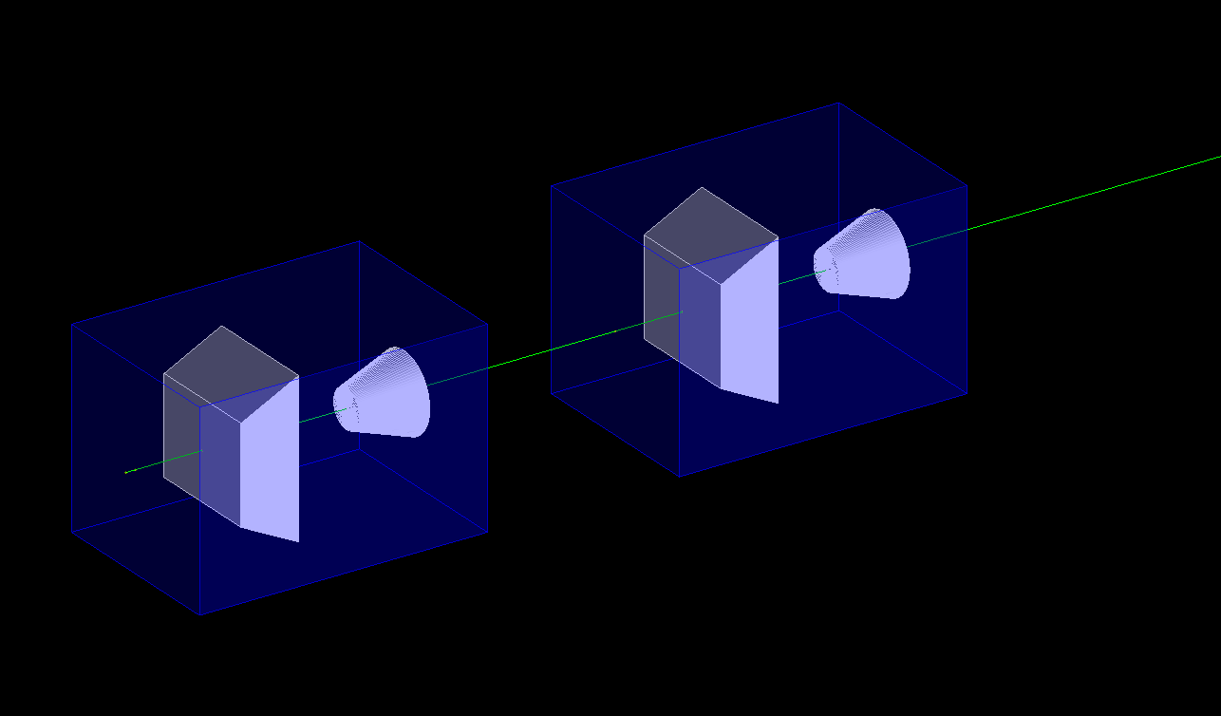
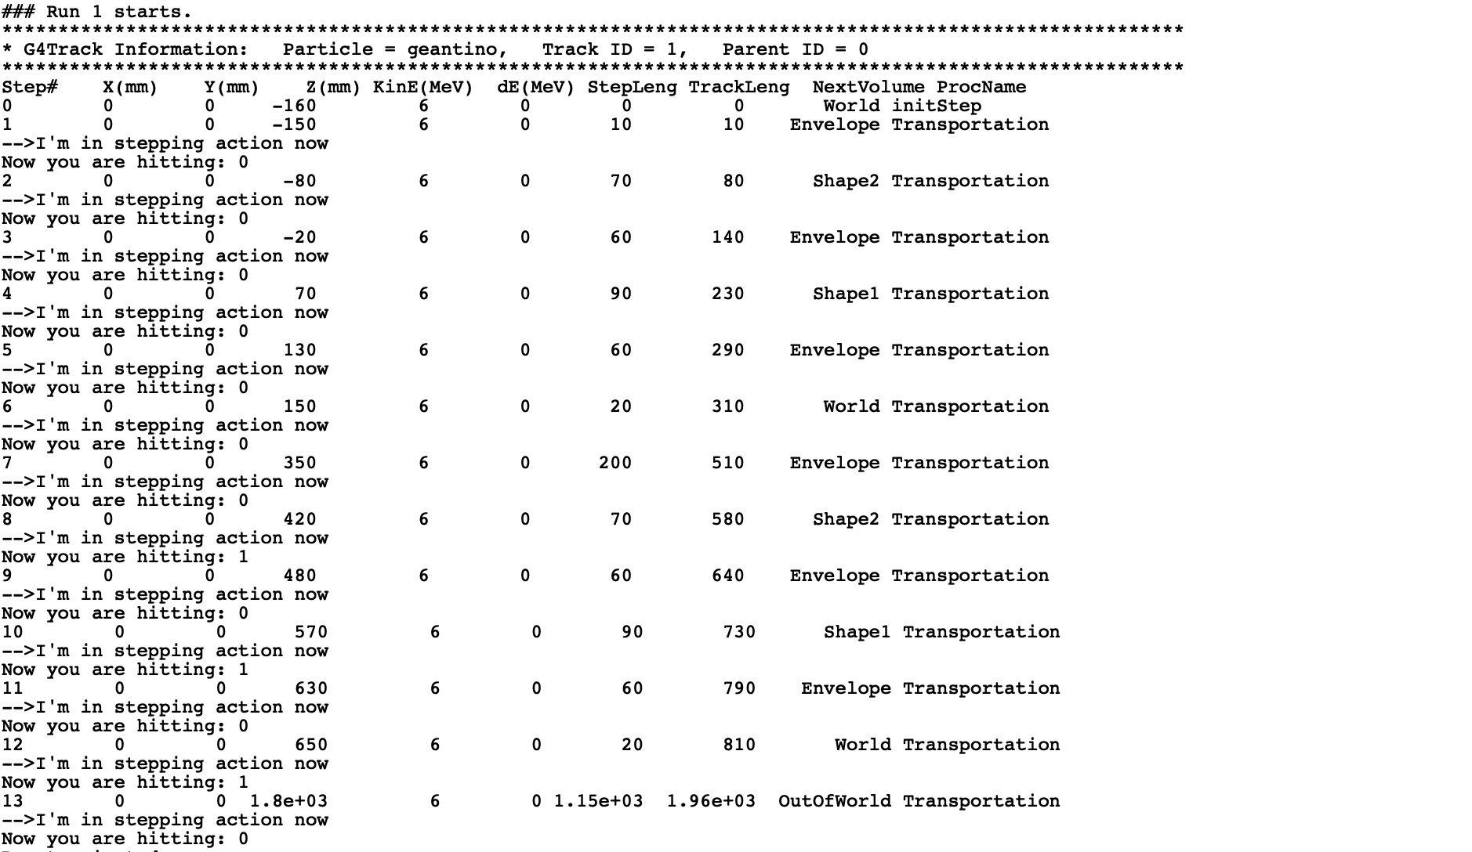
修改后的结果
*适当修改了一些几何体的位置和显示的设置

Slide 4
练习1:
高能物理常用大面积阵列排布来实现大面积的探测。例如羊八井宇宙线实验。

Slide 5
G4里的旋转
http://nucleus.usask.ca/Geant/Exercises/rotations.html
将copy的这一个备份旋转：
G4RotationMatrix* fieldRot = new G4RotationMatrix();
fieldRot->rotateX(90.*deg);
new G4PVPlacement(fieldRot, //no rotation
G4ThreeVector(0, 0, 50*cm), //at (0,0,0)
logicEnv, //its logical volume
"Envelope", //its name
logicWorld, //its mother volume
false, //no boolean operation
1, //copy number
checkOverlaps); //overlaps checking

Slide 6
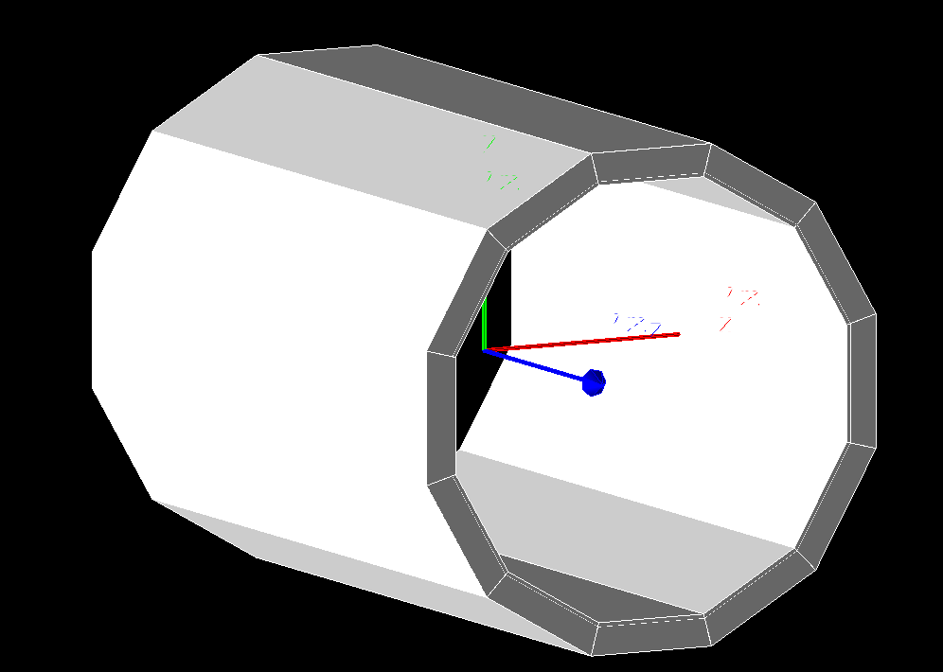
练习2:
将Envelop设置为梯形，然后摆成桶状的结构

Slide 7
G4里的粒子
B1PrimaryGeneratorAction :: B1PrimaryGeneratorAction初始化的定义 (0, 0, -160)
最低优先级
Run.mac / GUI的界面另外再指定gun粒子的信息
(0, 0, -80)
次高优先级
B1PrimaryGeneratorAction :: GeneratePrimaries 里
(0, 0, 0)
最高优先级
练习3: 在geant4的源代码里，找到geant4预定义的各种粒子及其name

