Slide 1
Progress/Status of CMS Upgrade
Zhen-An LIU(IHEP)*, Yong BAN(Peking U.), Huaqiao ZHANG(IHEP)
On behalf of the CMS Upgrade Team
The 6th China LHC Physics Workshop(CLHC2020)
Nov. 6-9 2020

Slide 2


Outline
Overview of CMS Upgrade
Progress
  GEM Detector
  HGCAL Detector
  RPC/iRPC Trigger/Backend electronics
Summary

Slide 3
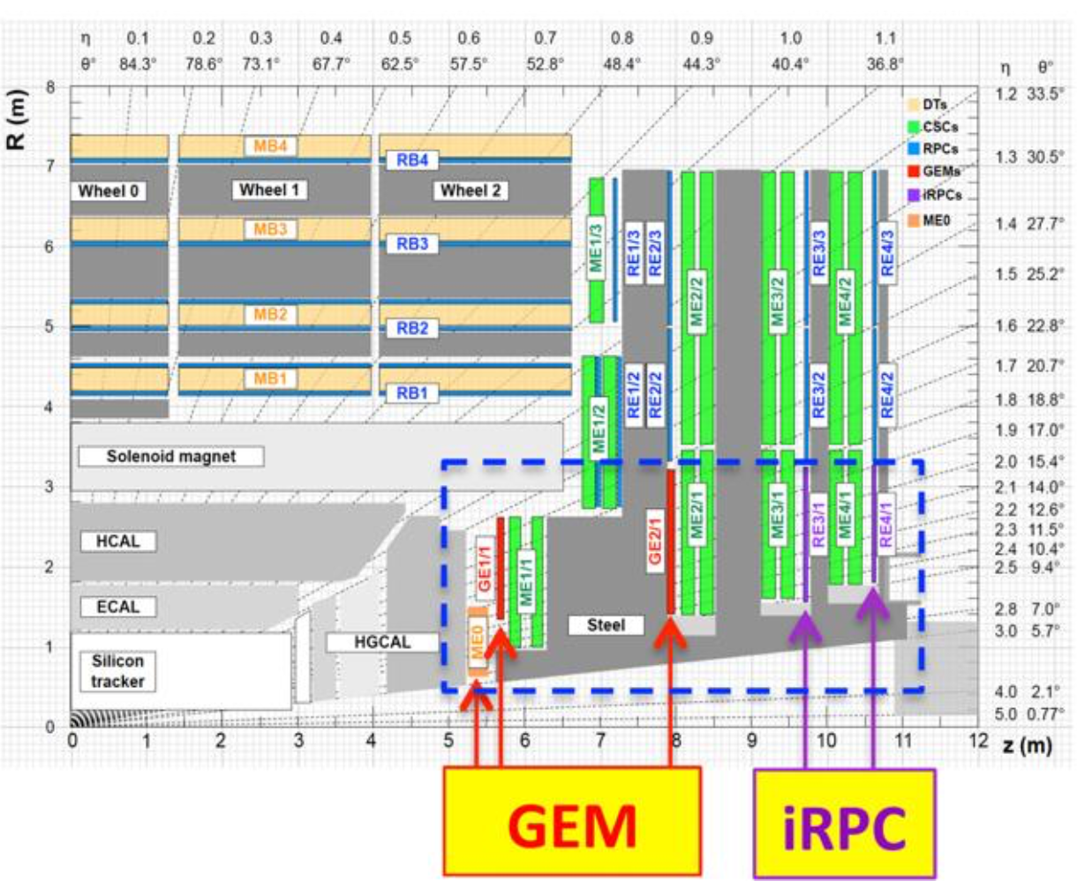
Overview: China Participation in CMS Phase II Upgrade
RPC
HGCal

Slide 4
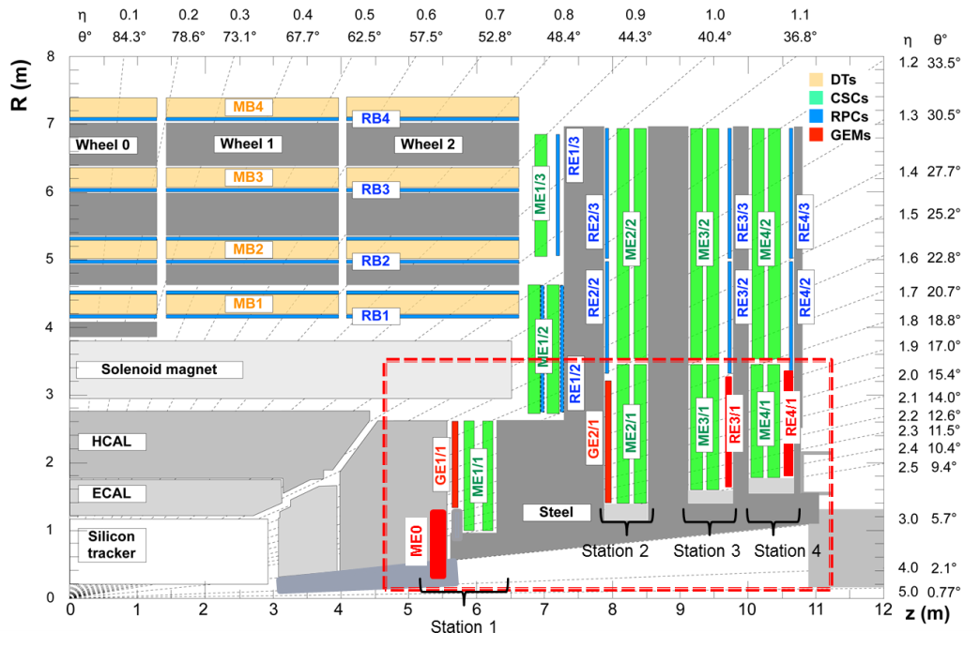
CMS Phase II Upgrade: GEM tasks
Y.BAN(Pek.U)
GE1/1 GEM：production of all GEM Electronics Boards (GEB) in China (completed!); assembly and commission
GE2/1 GEM： Design, R&D and production of all GEB in China ; production of ~1/8 GEM at PKU， assembly and commission
ME0 GEM：Design, R&D and production of all GEB in China ; production of ~1/5 GEM at PKU， assembly and commission
CMS-GEM China group：
Peking U., Tsinghua U., Sun Yetsen U., Beihang U.

Slide 5
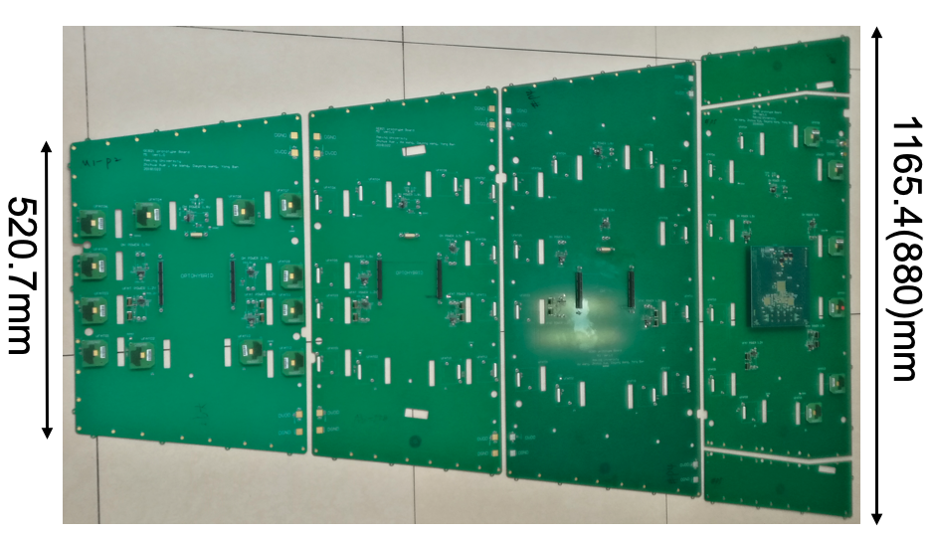
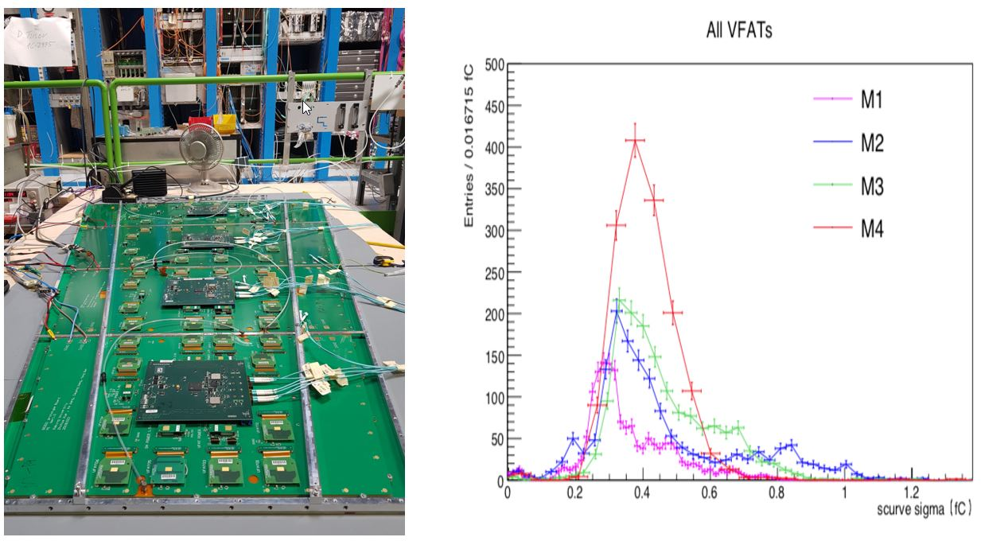
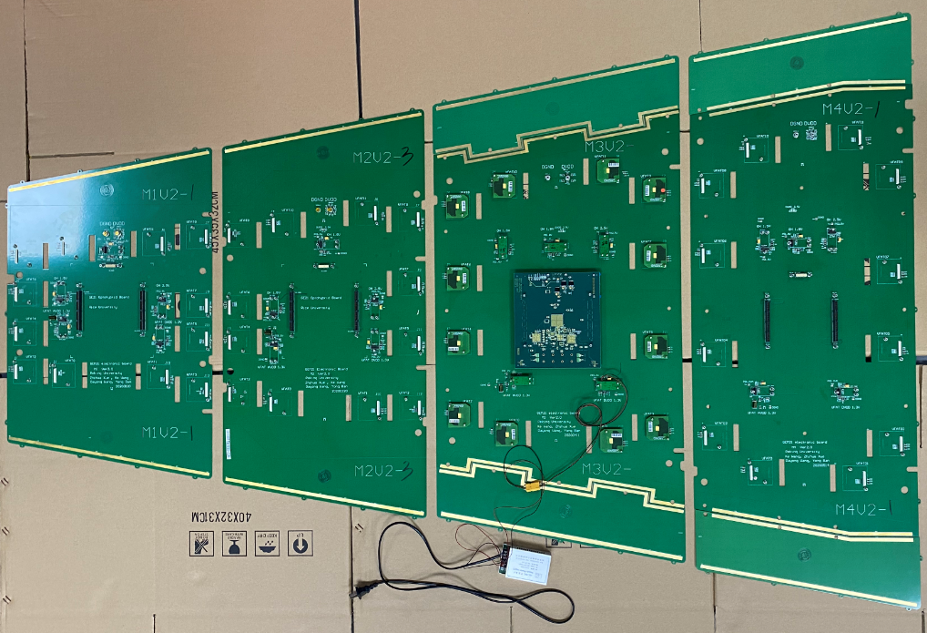
CMS Phase II Upgrade: GEM status: GE2/1 GEB
Y.BAN(Pek.U)
Successfully completed the design and prototyping of all 8 types GEB’s, tested and validated by GEM collaboration. Test results: noise <0.5 fC，Bit Error Rate <10⁻¹³.
Mass production is expected to start by the end of 2020.
1st version
Test setup and noise test results
2nd version
GE2/1 (M1-M4) prototypes
→ Li Zhe’s talk

Slide 6
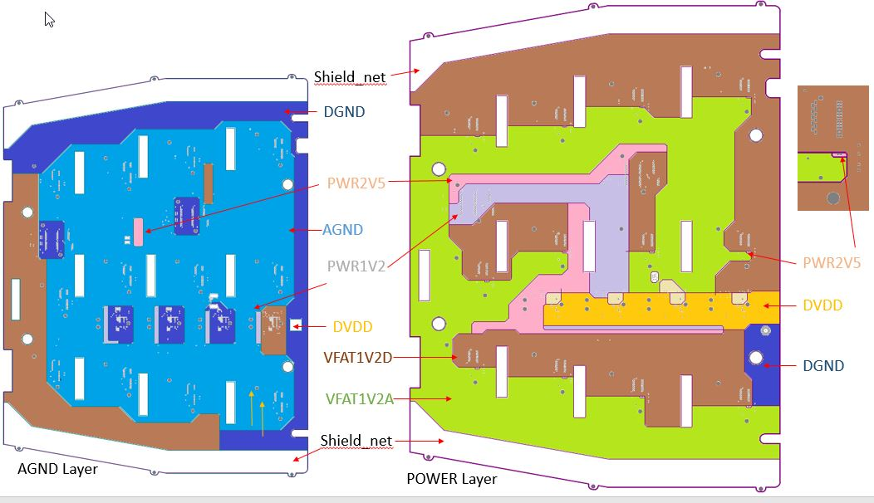
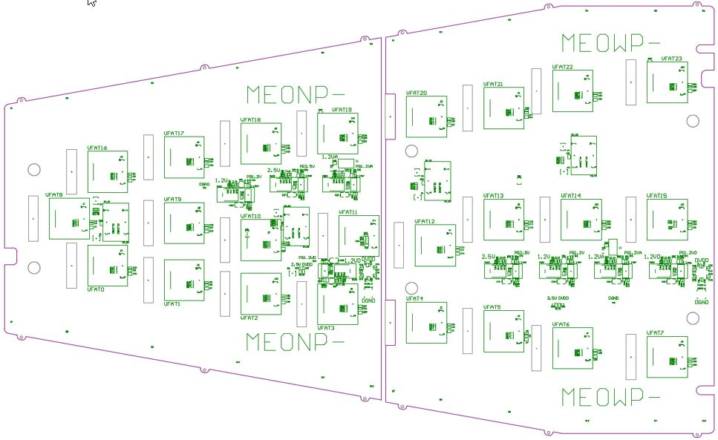
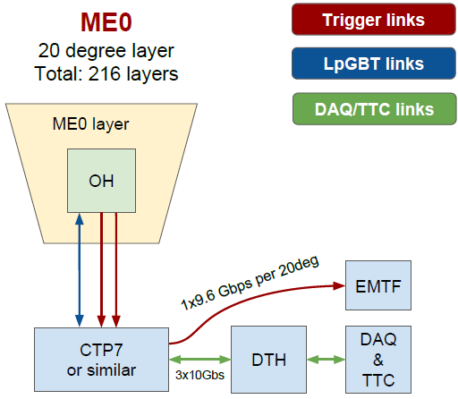
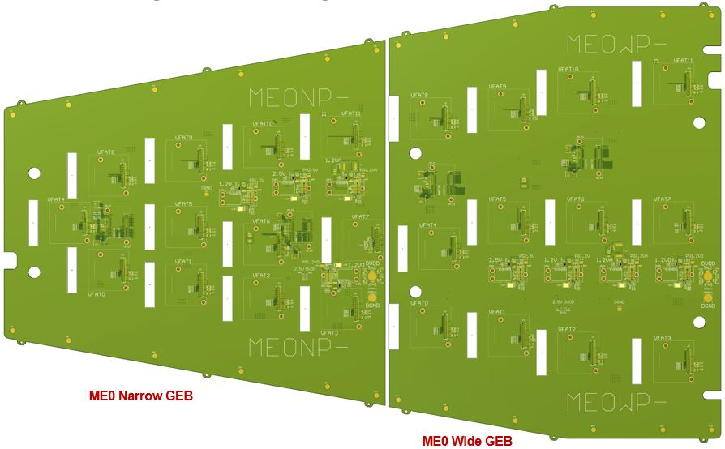
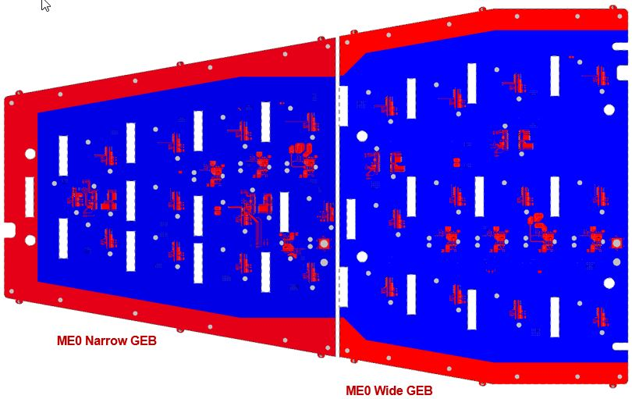
CMS Phase II Upgrade: GEM status: ME0 GEB
Y.BAN(Pek.U)
Completed the ME0 GEB design (1st version), reviewed and validated by GEM collaboration,
6 sets of prototypes are being produced in Shenzhen Sinofast Ltd. since ~ 25 Oct. 2020
Power distribution
ME0 GEM and its readout system
ME0 GEB design
Screen layer
→ Li Zhe’s talk

Slide 7
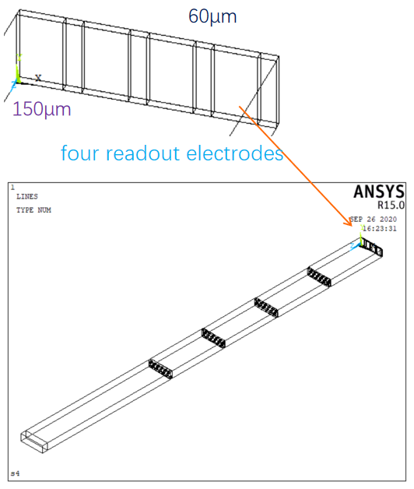
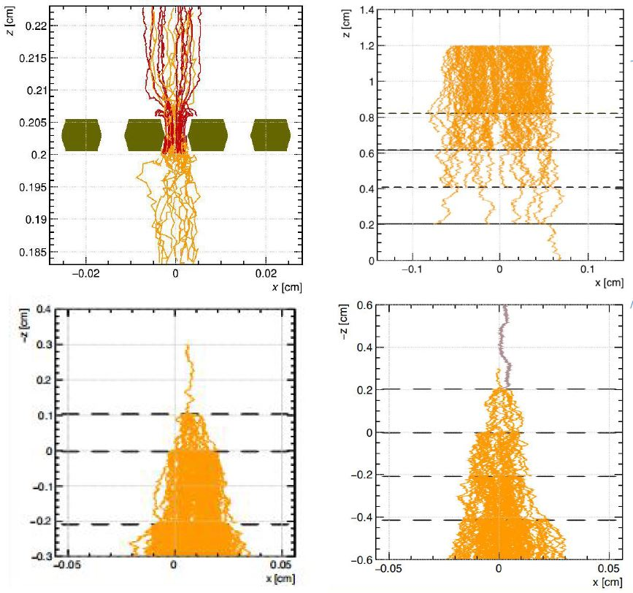
CMS Phase II Upgrade: GEM status: GEM simulation
Y.BAN(Pek.U)
Simulation study of the performances of quadruple GEM:
Comparison of triple and quadruple GEM performances
Effects of the aligned or mis-aligned holes on GEM foils
Primary generation, transparency, drift and energy resolution study
Time, spatial resolution and effective gain study…
electrons and ions drift lines
Quadruple GEM
4.8-2-2-2mm
Mis-aligned holes
transfer gap
Triple GEM
Quadruple GEM
induction gap
Aligned holes
Aligned holes
drift gap
quadruple GEM model
→ Wang Yue’s talk

Slide 8
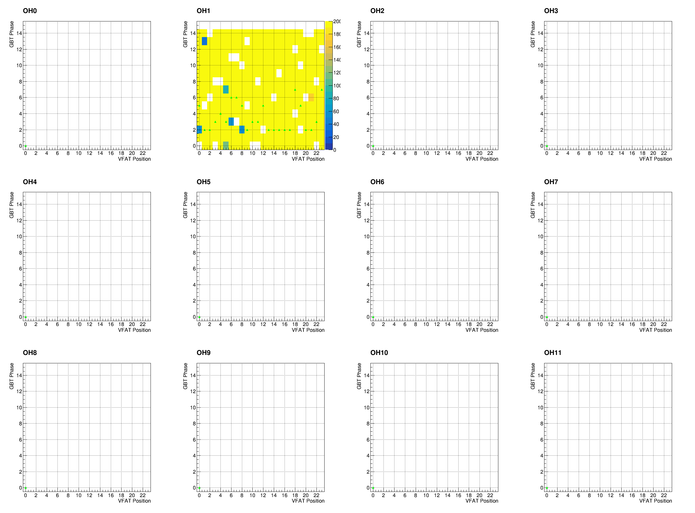
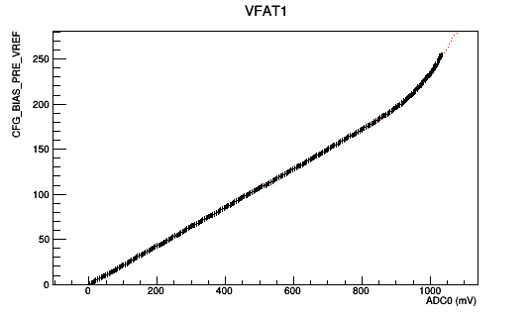
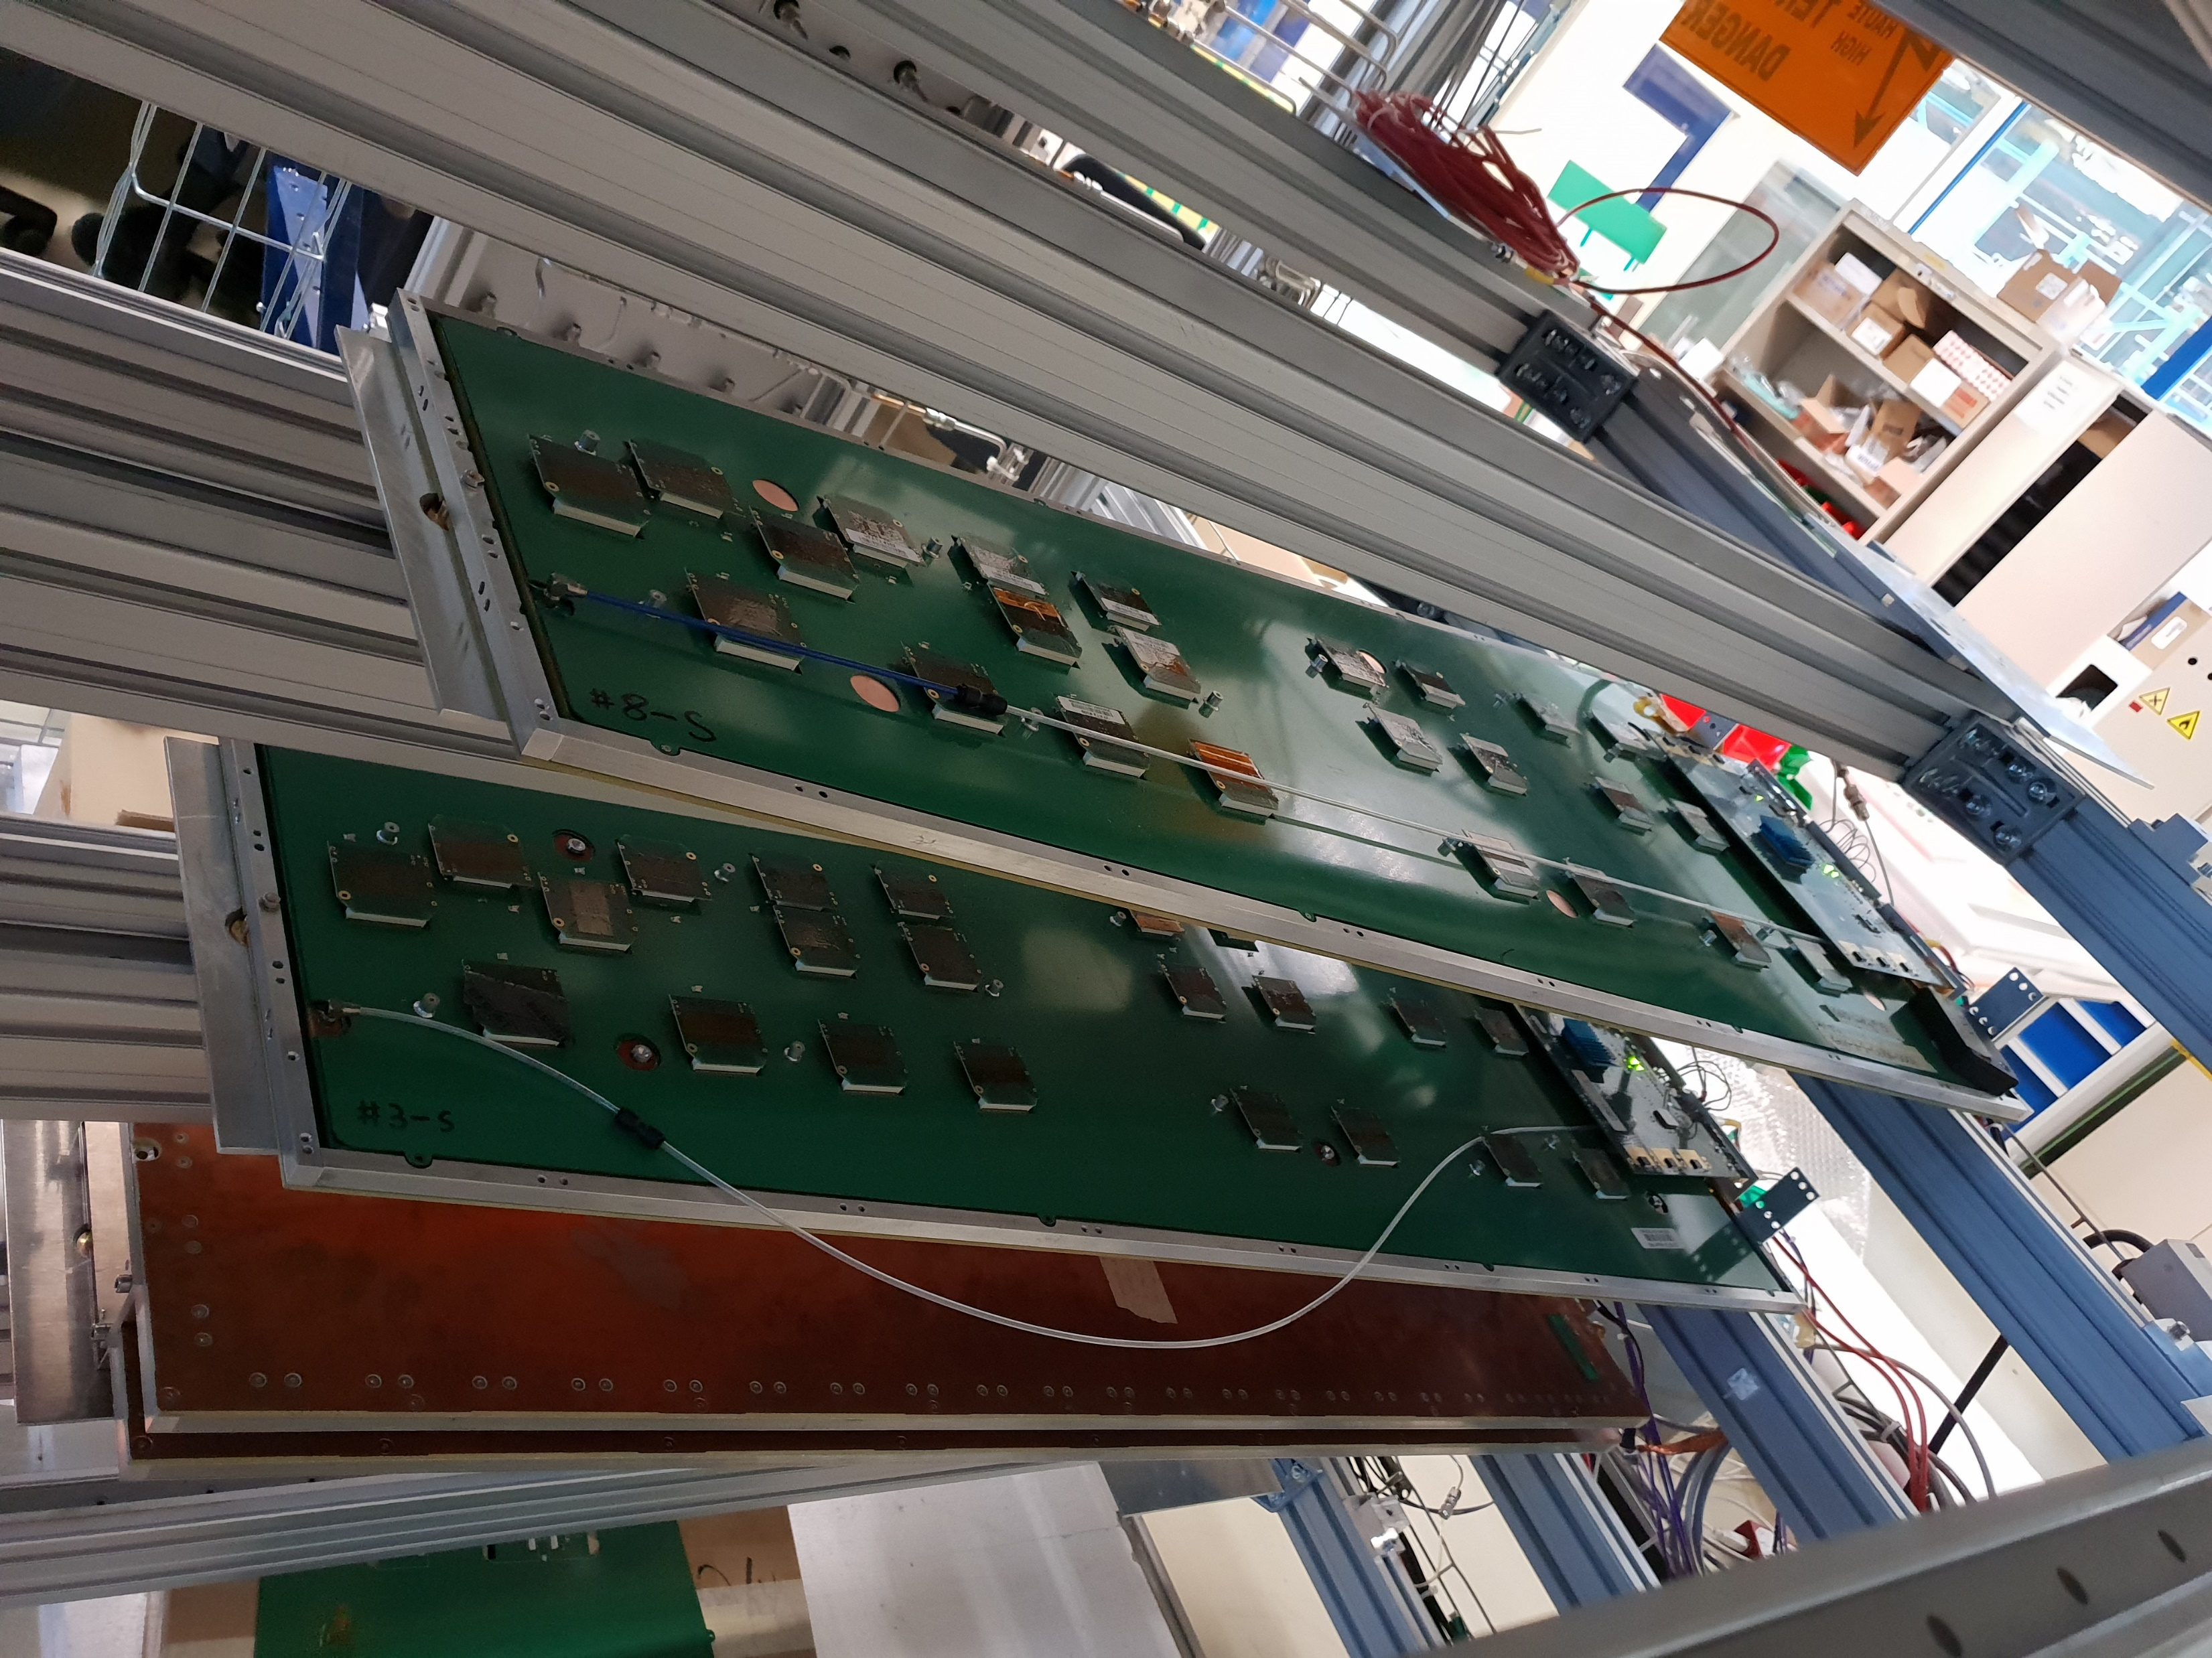
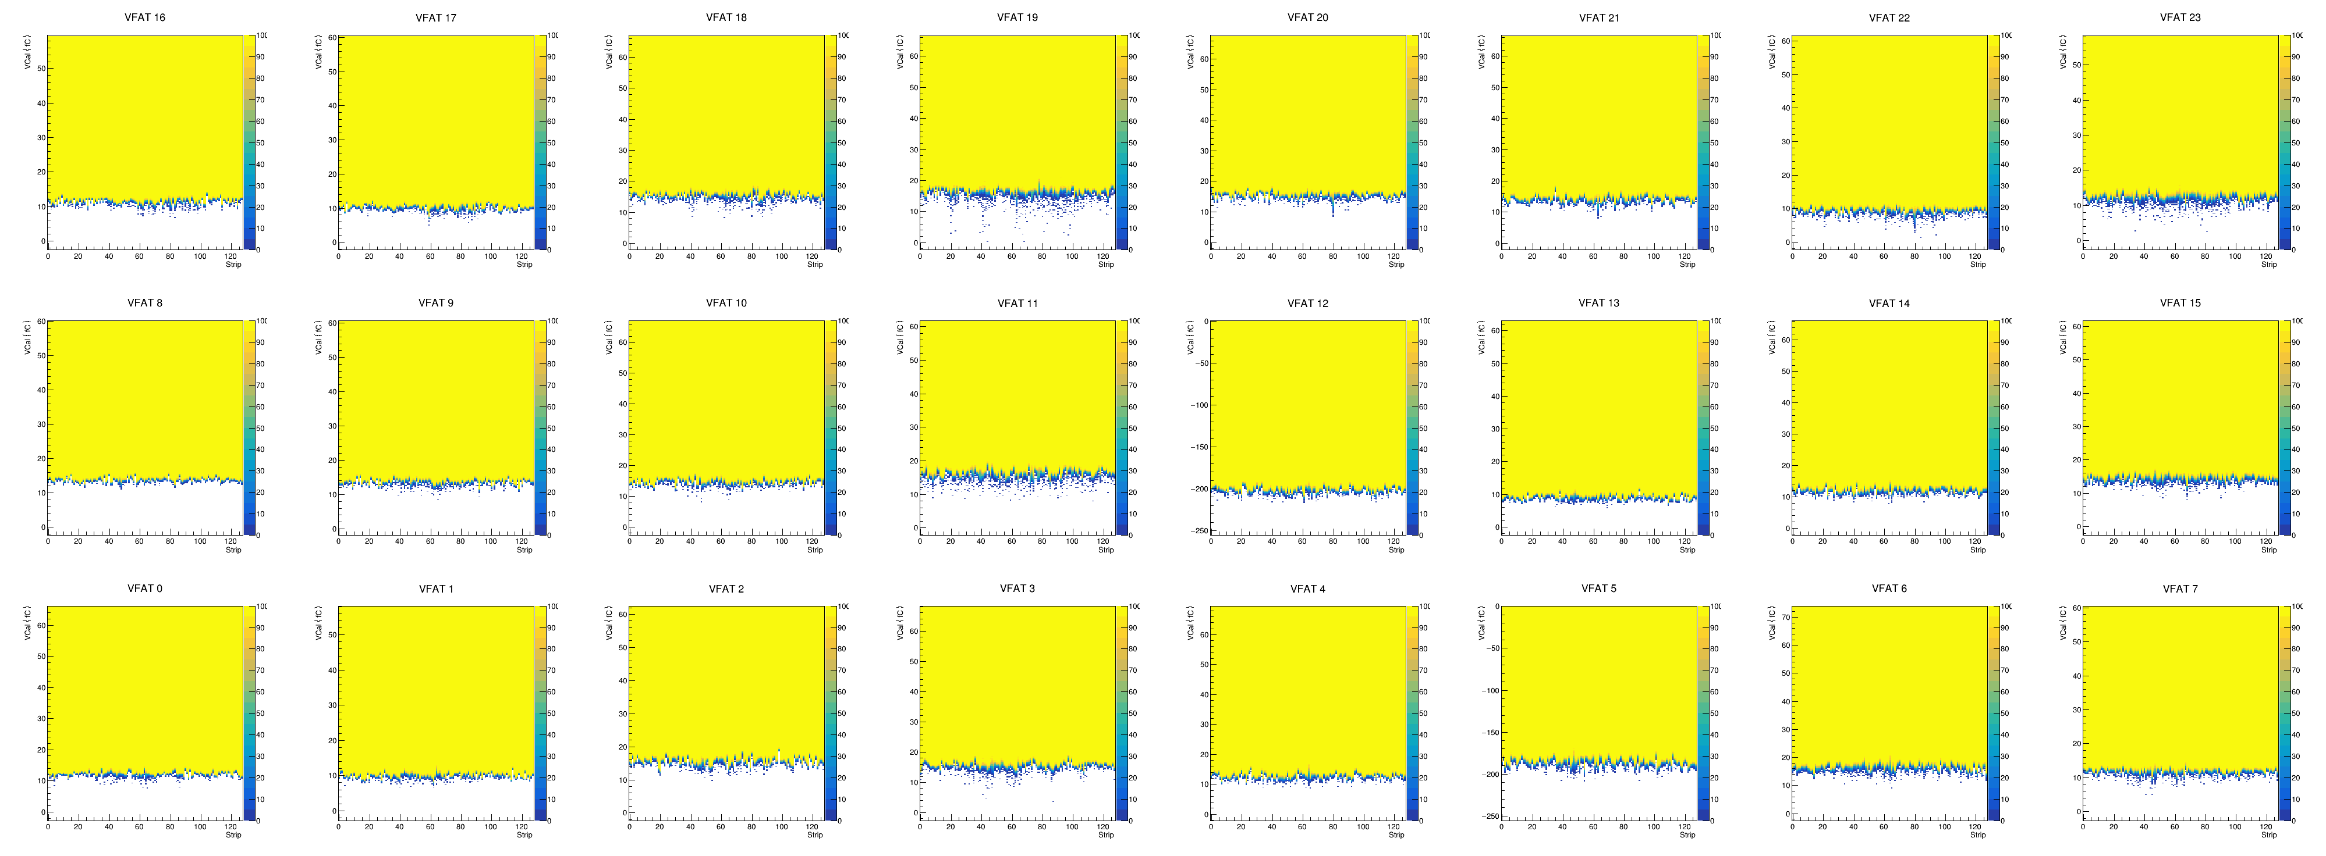
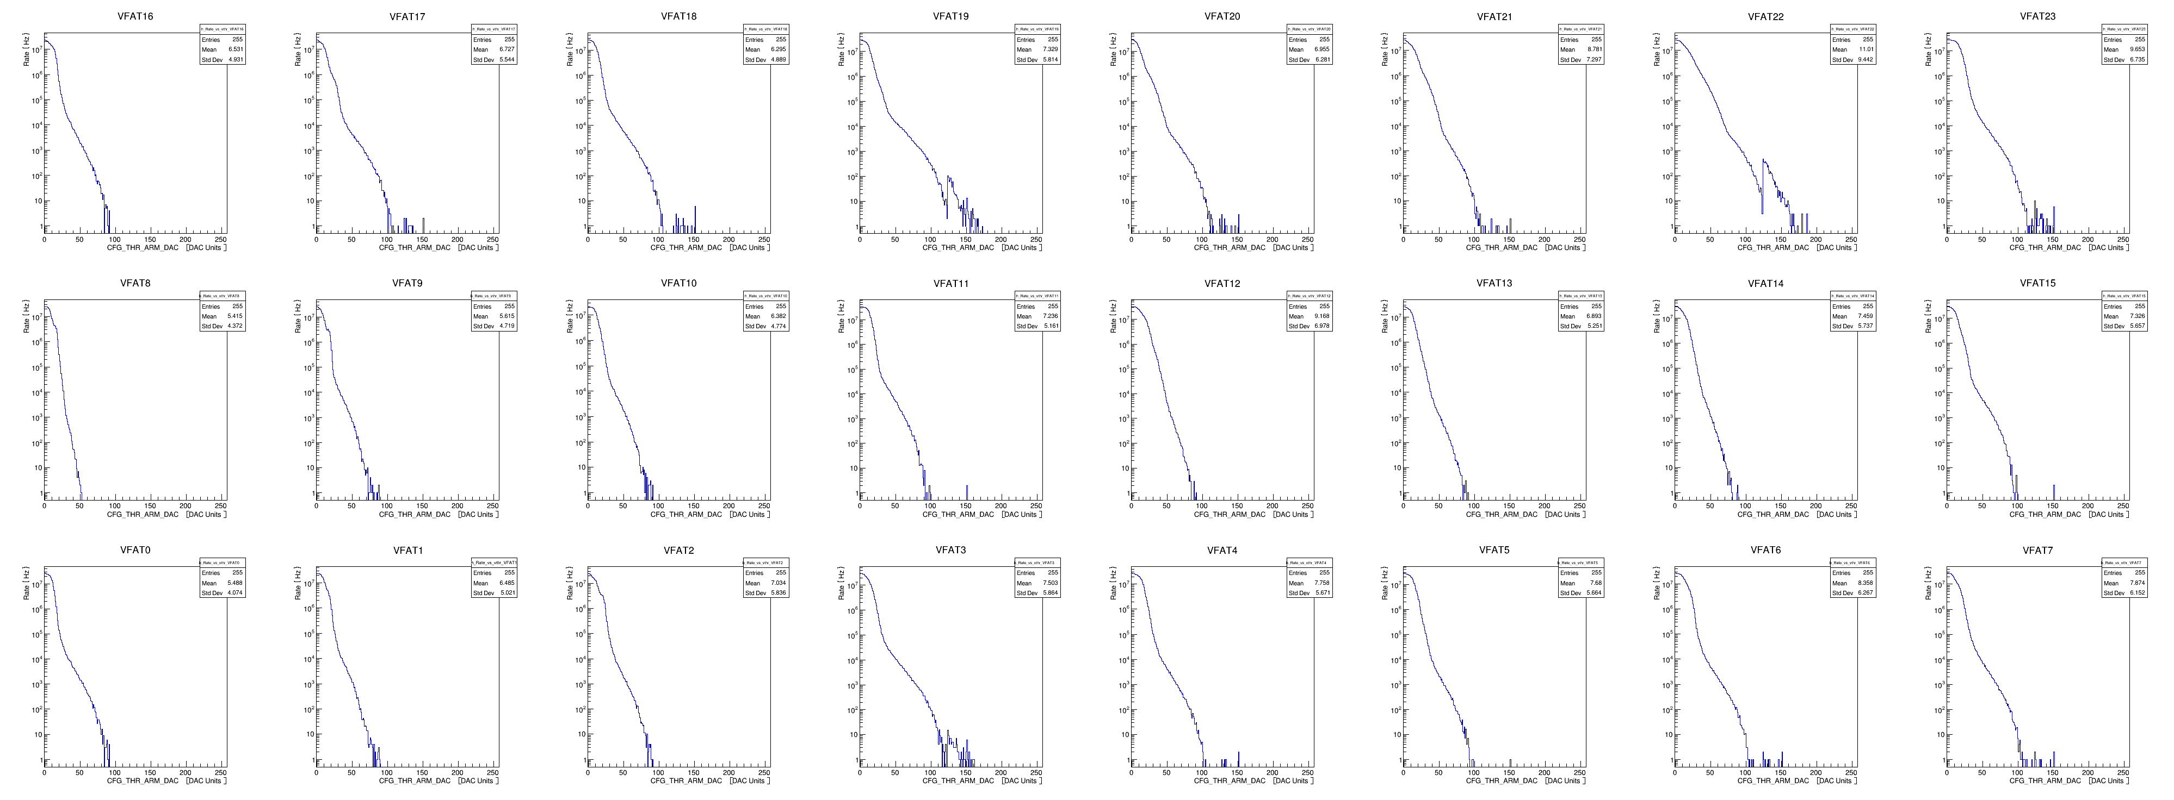
CMS Phase II Upgrade: GEM status: QC at CERN
Y.BAN(Pek.U)
GEM detectors were assembled into “super-module”s at CERN, tested with cosmic rays (QC8) before installed into CMS.
Contents of the test: GBT phase scans, DAC scans, S-curve scans, S-bit rate scans, Iterative trimming…
All GE1/1 GEM detectors were tested successfully and installed in CMS
GBT phase scans DAC scans
S-curve scans S-bit rate scans
QC8 test setup at CERN 904
→ A. Levin’s talk

Slide 9
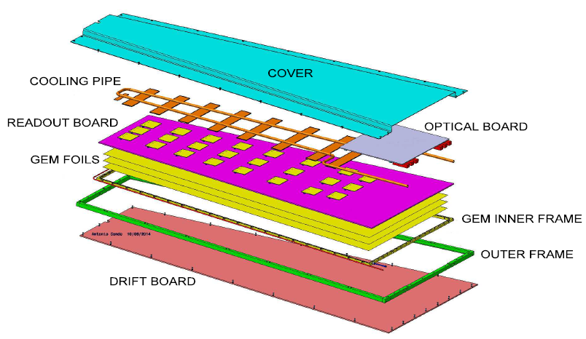
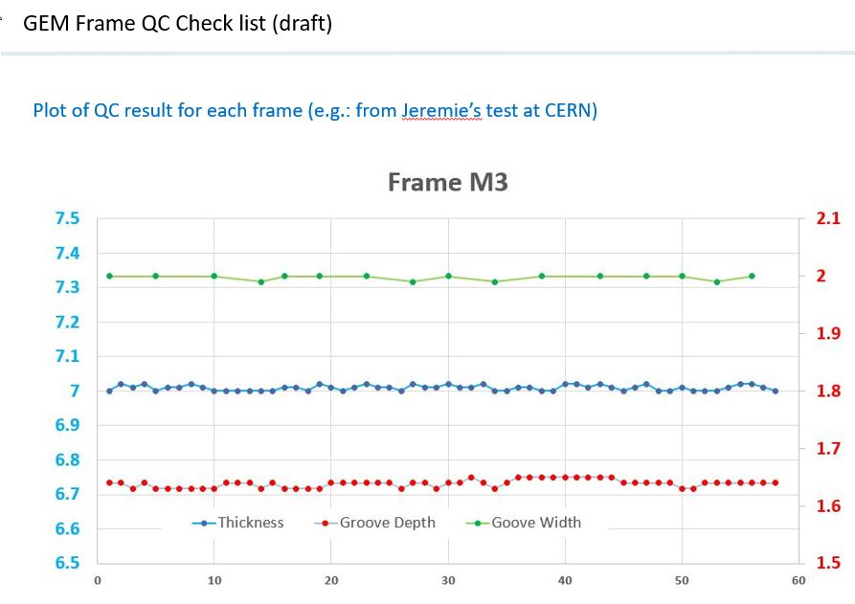
CMS Phase II Upgrade: GEM status: FR4 frame
Y.BAN(Pek.U)
Started R&D of GEM external frames (FR4) since 2019, prototypes of produced in China has passed CERN test in Feb. 2020.
The GEM Collaboration review approved mass production in China, expected to start by the end of 2020.
GEM external frames (FR4): extremely high requirements on mechanical tolerance
CERN test results of GEM external frames produced in China

Slide 10
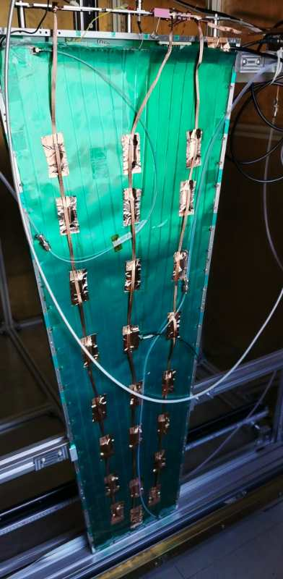
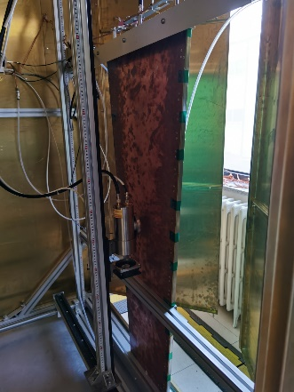
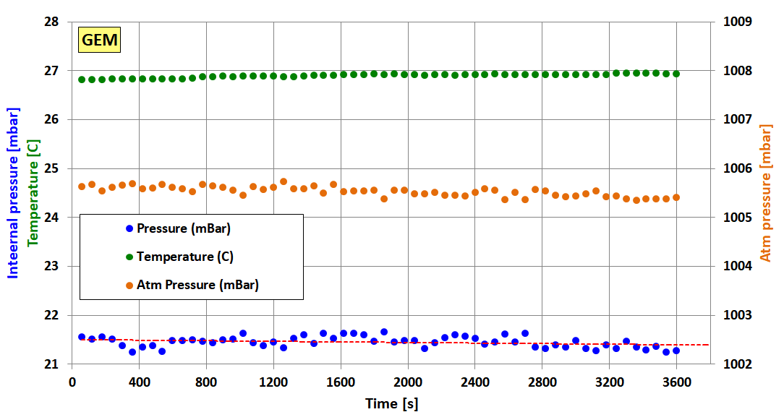
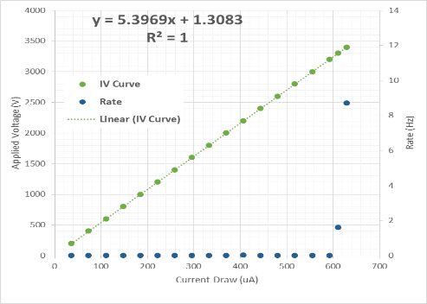
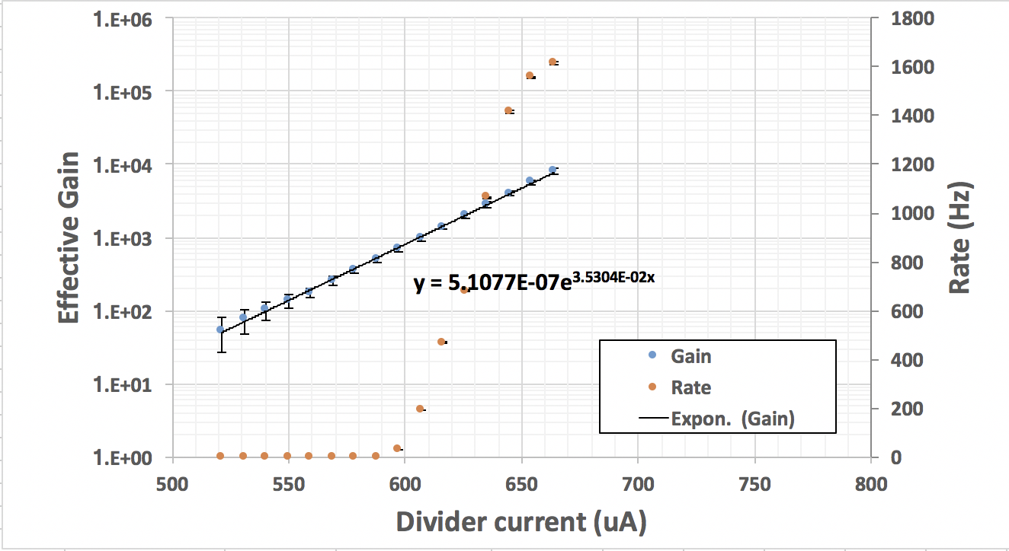
CMS Phase II Upgrade: GEM status: detector
Y.BAN(Pek.U)
Completed gas-tightness, HV performance and gain test etc. with full-size GE1/1 GEM, QC procedure setup done.
Full-size GE1/1 GEM detector
Test results of GEM gas-tightness, HV performance and gain
GEM X ray gain test at PKU
→ GEM Production site in PKU is ready

Slide 11
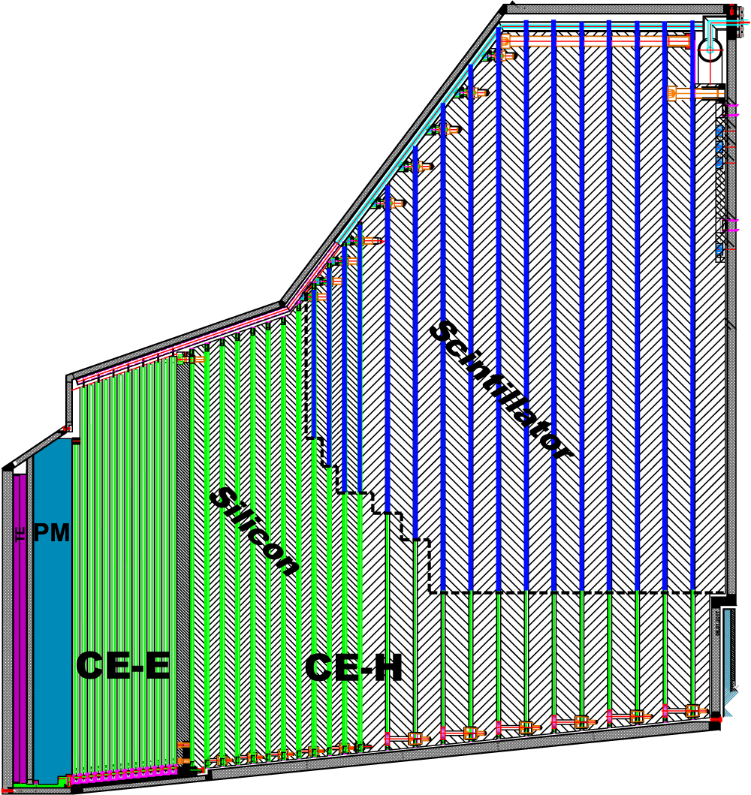
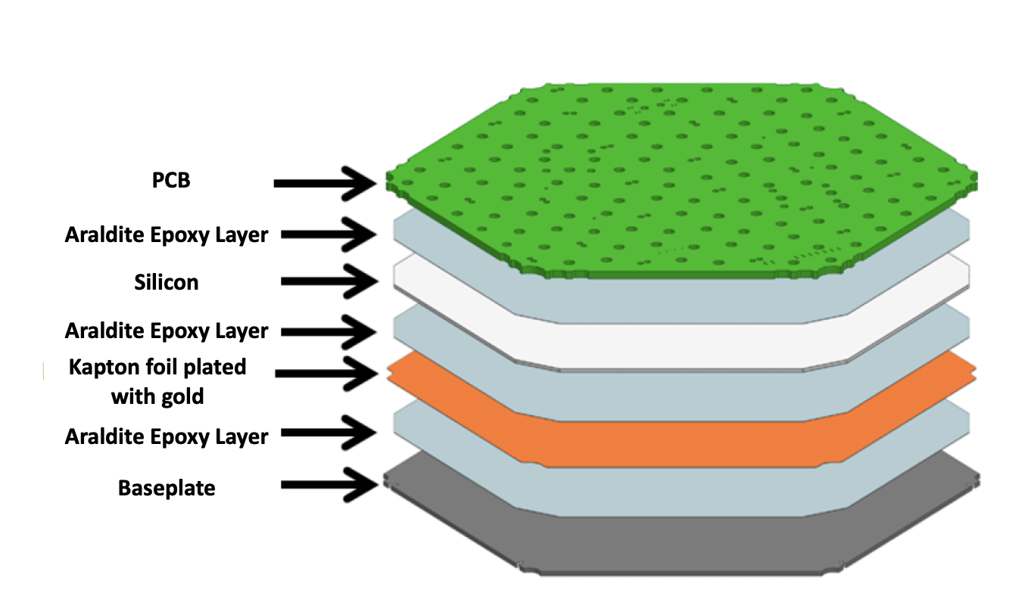
CMS PhaseII HGCal task
Huaqiao Zhang(IHEP)
CMS HGCal: first particle flow based 5dimentional calorimeter
3D position + energy + time
challenges：
2MGy does
140 pileup
220kW heat load
640m² silicon sensor
…
~31000 silicon module
Main task：
  A HGCal module assembly center(MAC) at IHEP, Beijing
  Module related prototyping, beam test, PCB design…
plan（need adjust according to COVID-19）
More details in Yong Liu, Feng Wang, Zhen Lin’s talk
Milestone | WBS | Title | Date
CE.MO.4 | 7.4.5 | All Si module assembly sites & procedures qualified (HL) | 01 Feb 21
CE.MO.7 | 7.6.2 | Silicon Module components orders placed (HL) | 2 DEC 21
CE.MO.9 | 7.6.4 | Silicon Modules production 5% complete (HL) | 26 OCT 22
CE.MO.10 | 7.6.6 | Silicon Modules production 50% complete (HL) | 21 OCT 23
CE.MO.11 | 7.6.8 | Silicon Module production 100% complete (HL) | 22 JUL 24

Slide 12
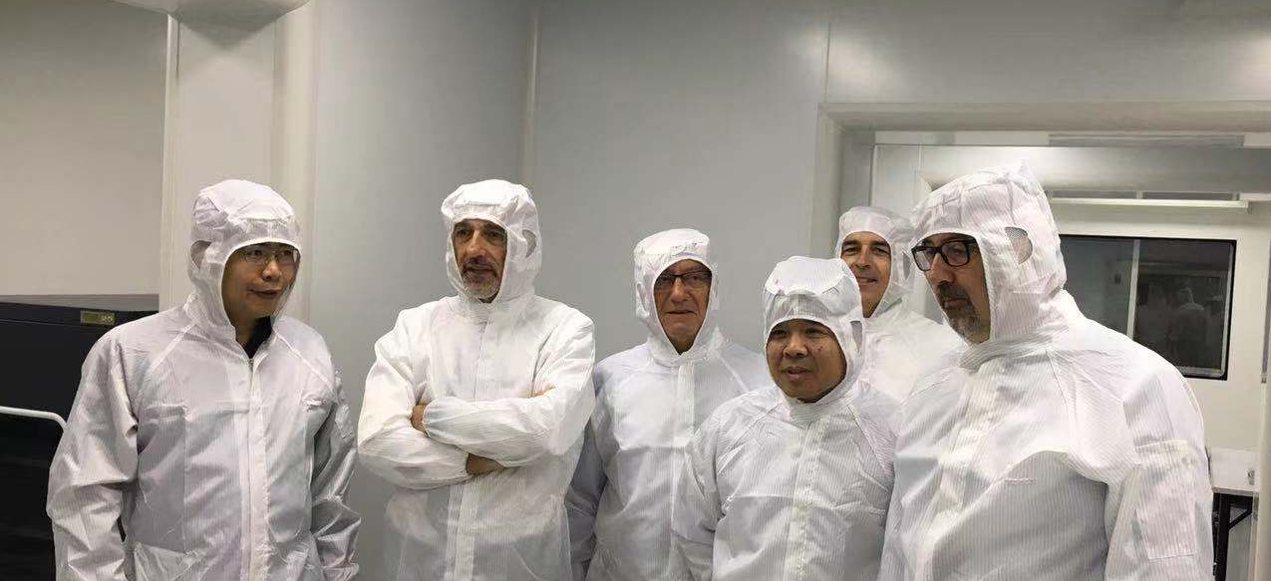
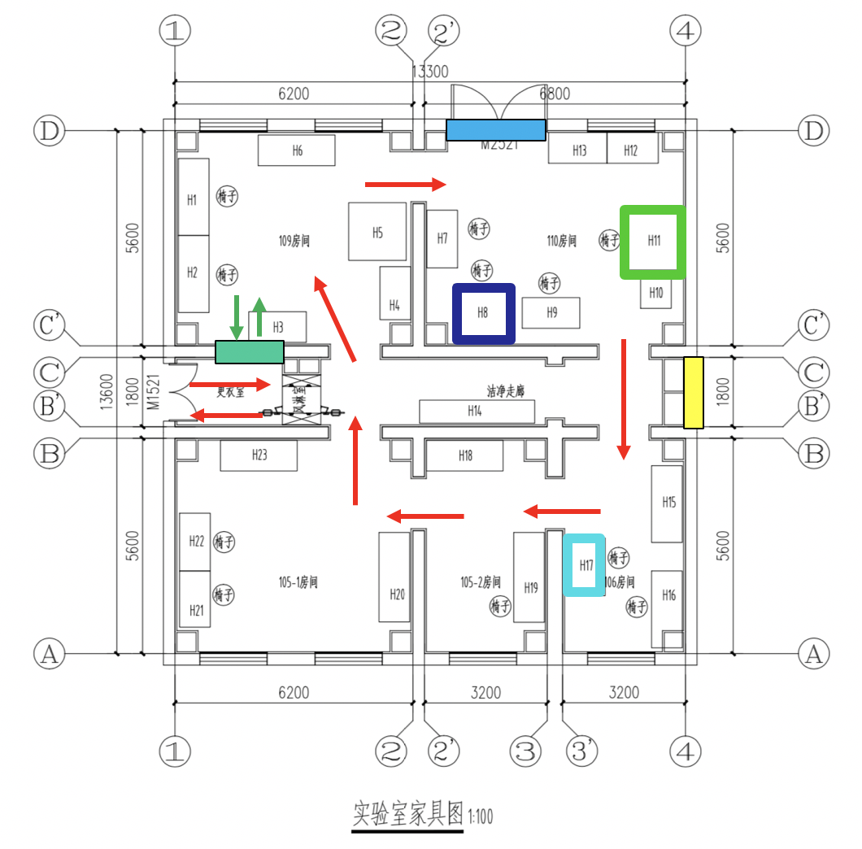
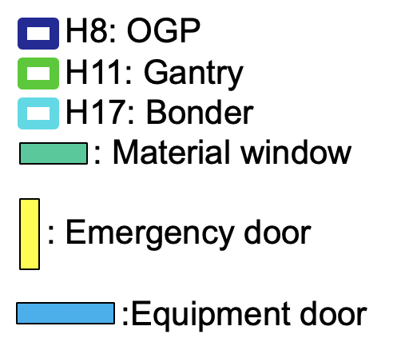
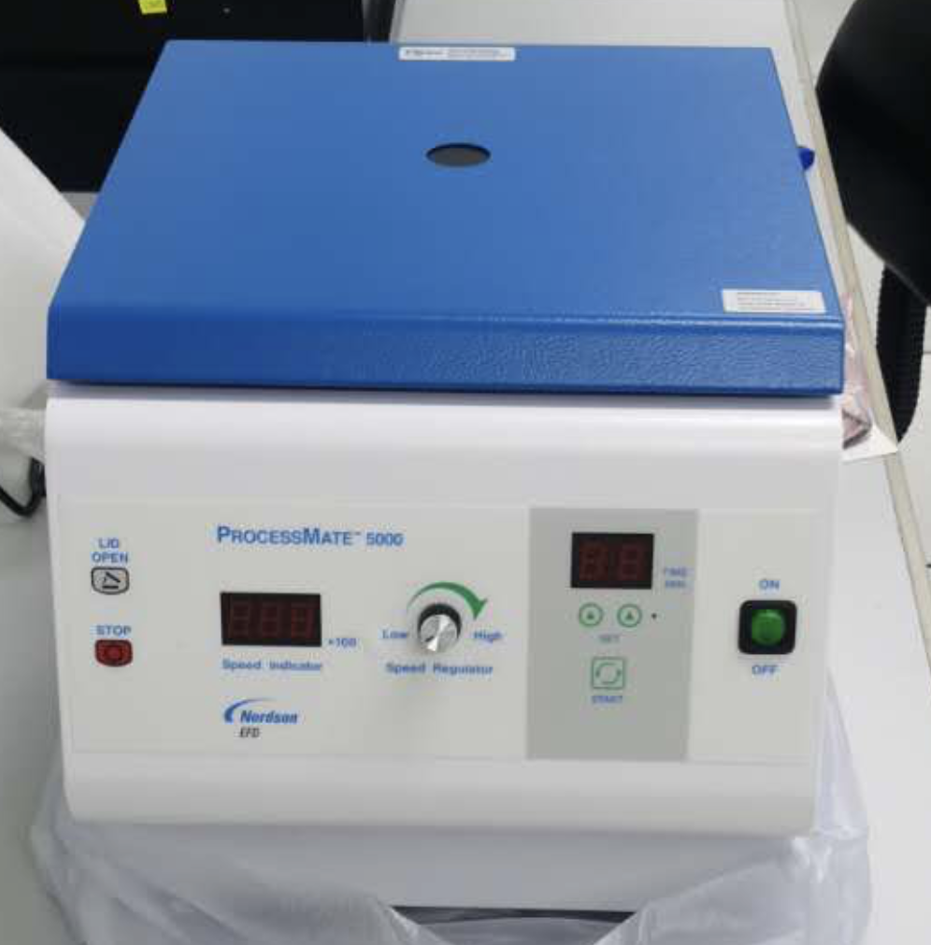
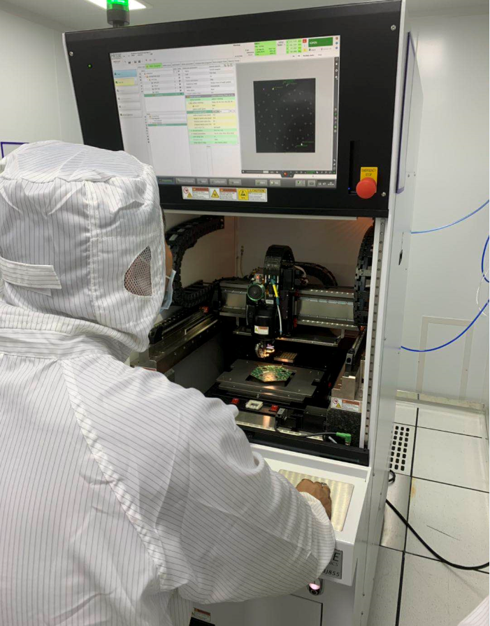
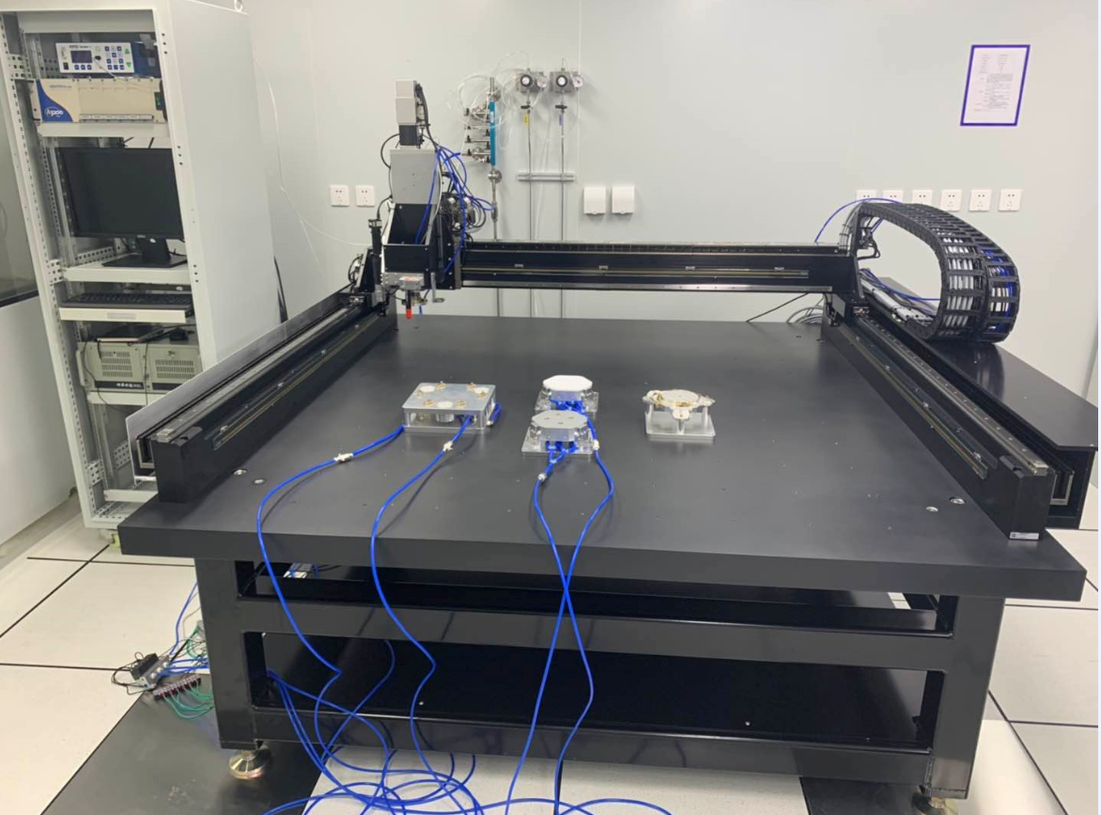
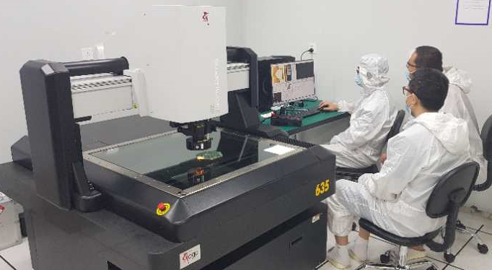
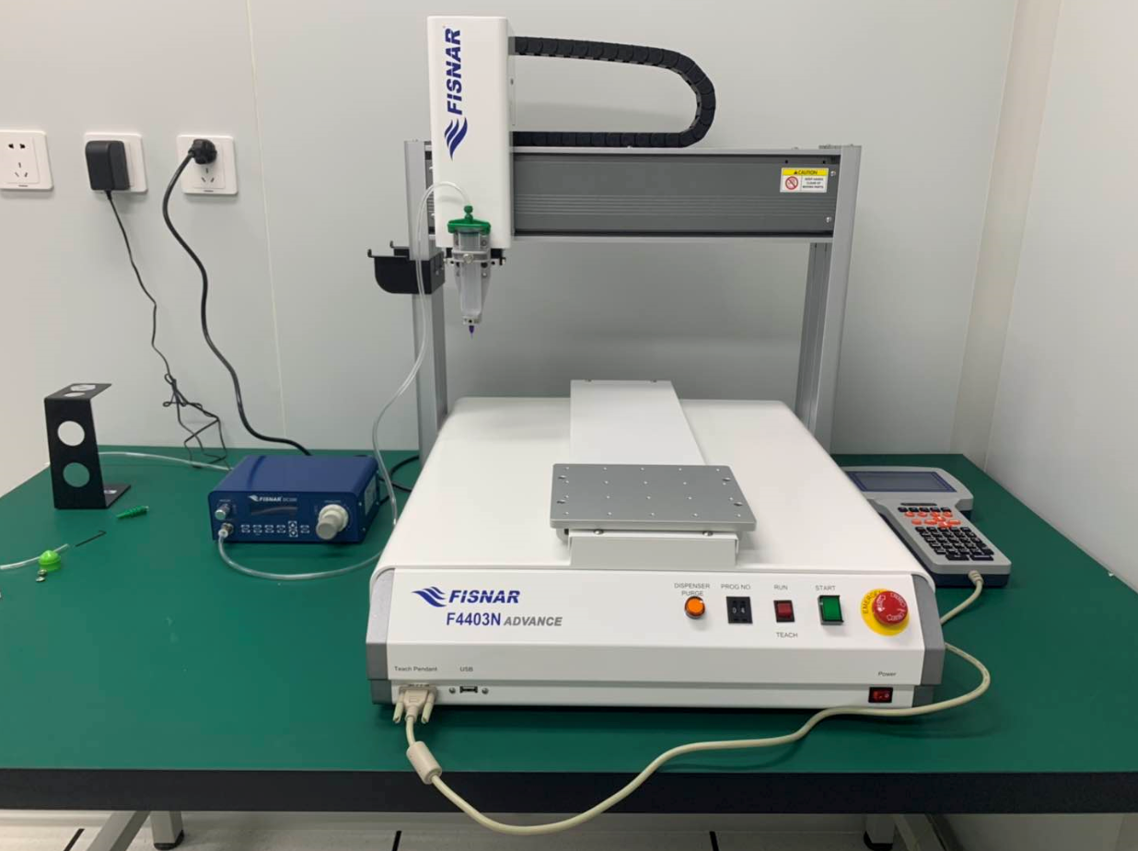
IHEP MAC status: prepare site qualification
Huaqiao Zhang(IHEP)
140 m2 class 1000 clean room
Main equipment arrived and installed at IHEP
  Including impact of COVID-19, trade war
Training from vendors are done
CMS/HGCal management visit IHEP MAC
Centrifuge
1.25m*1.25m acc. Gantry
OGP ZIP 635
Mini gantry
Full auto Bonder BJ855

Slide 13
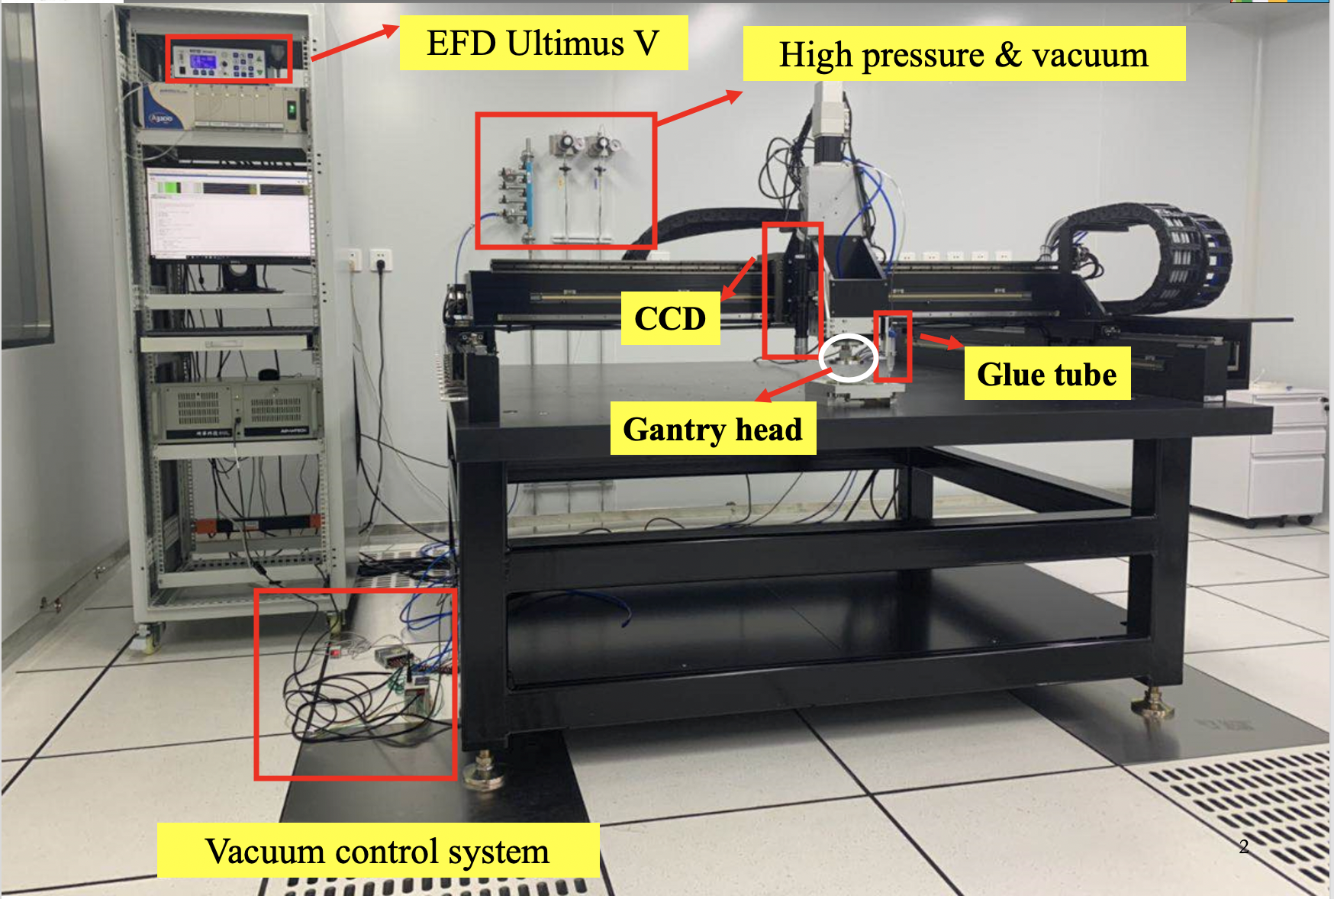
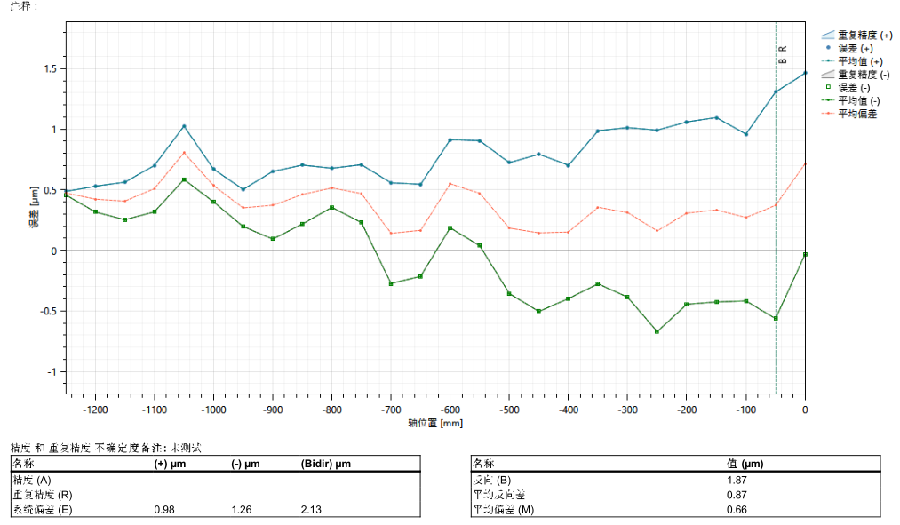
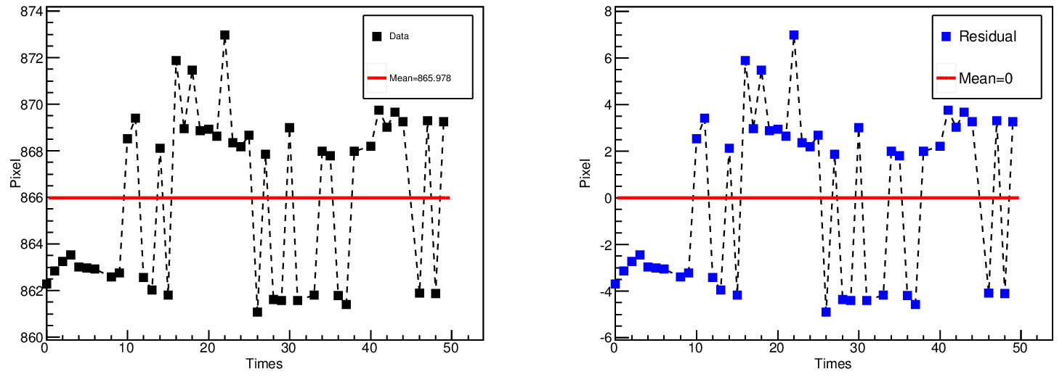
HGCal Module assembly （1）
Huaqiao Zhang(IHEP)
Gantry system integrated vacum, compresed air, vision, dispensor sytems
  Including header, pedestal etc tooling, automating all system
  Gantry positioning calibrated with laser interferometer
    +-5 𝝁m @1.25m*1.25 m*10cm
Repedility accuracy 1𝝁m
Vision accuracy 1𝝁m

Slide 14
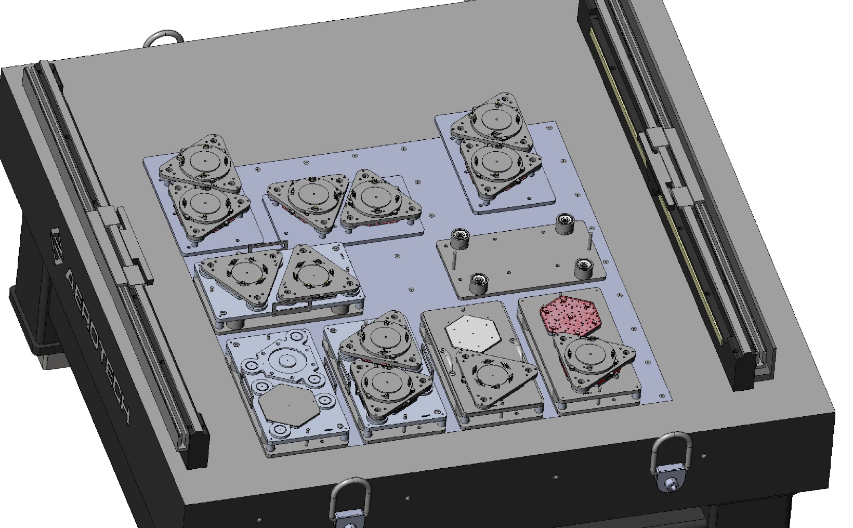
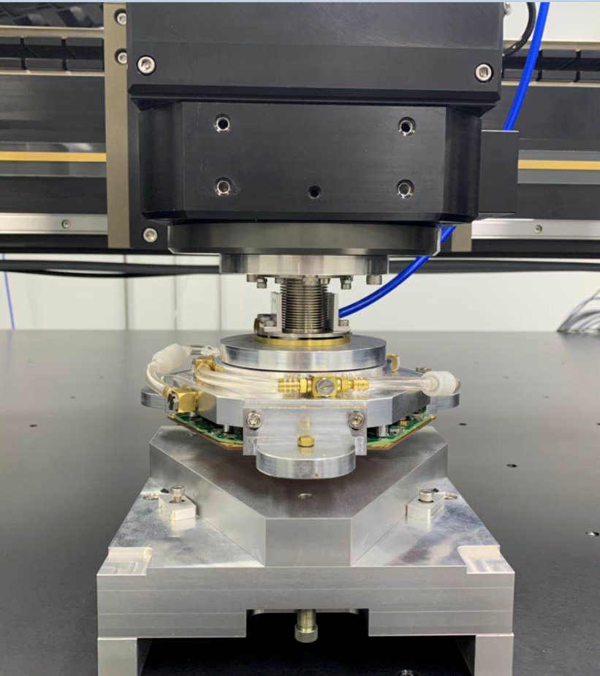
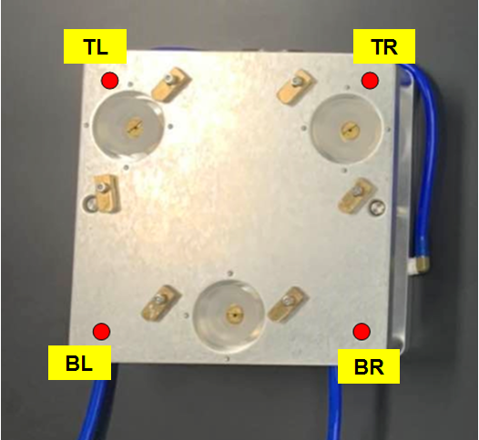
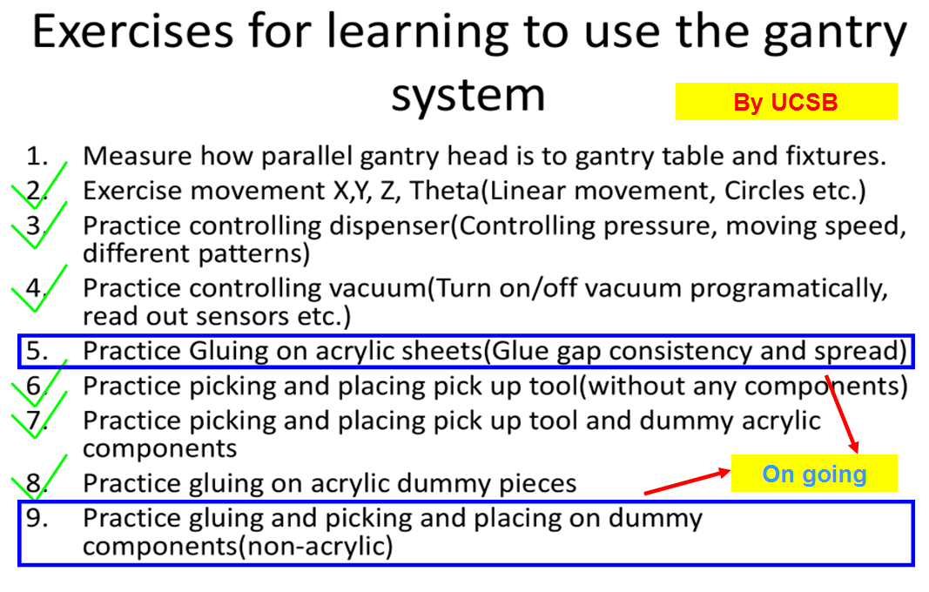
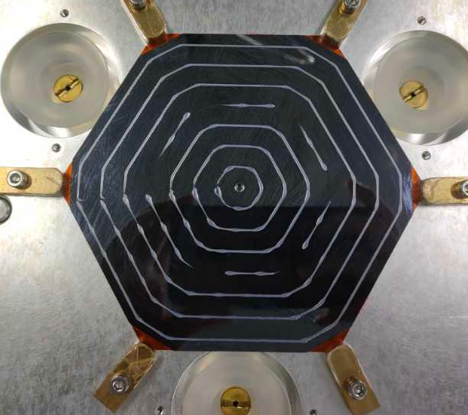
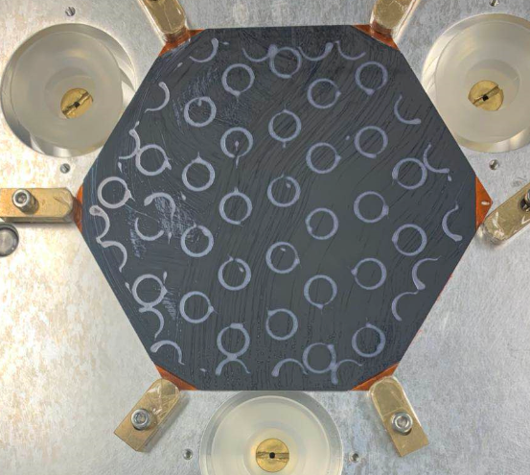
HGCal Module assembly（2）
Huaqiao Zhang(IHEP)
Fabricate tooling，optimize glue steps，finishing site qualification steps
6inch module tools make in IHEP
UCSB fabricating 8 inch tooling for IHEP
Optimize glue partern

Slide 15
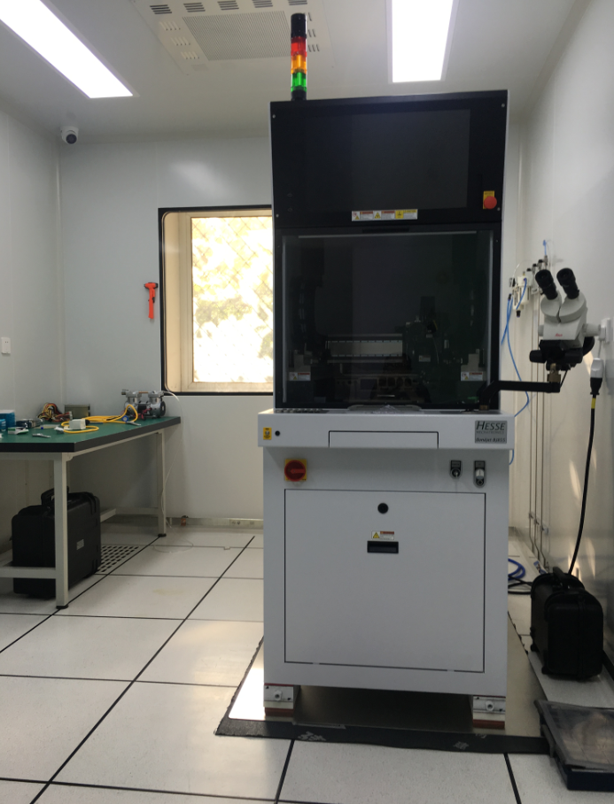
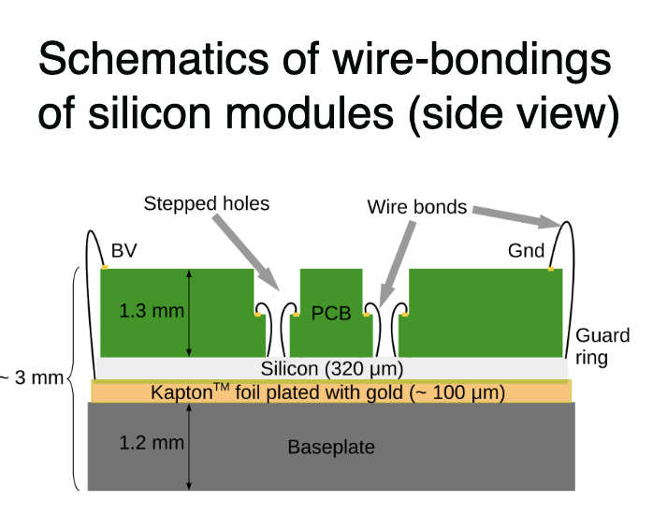
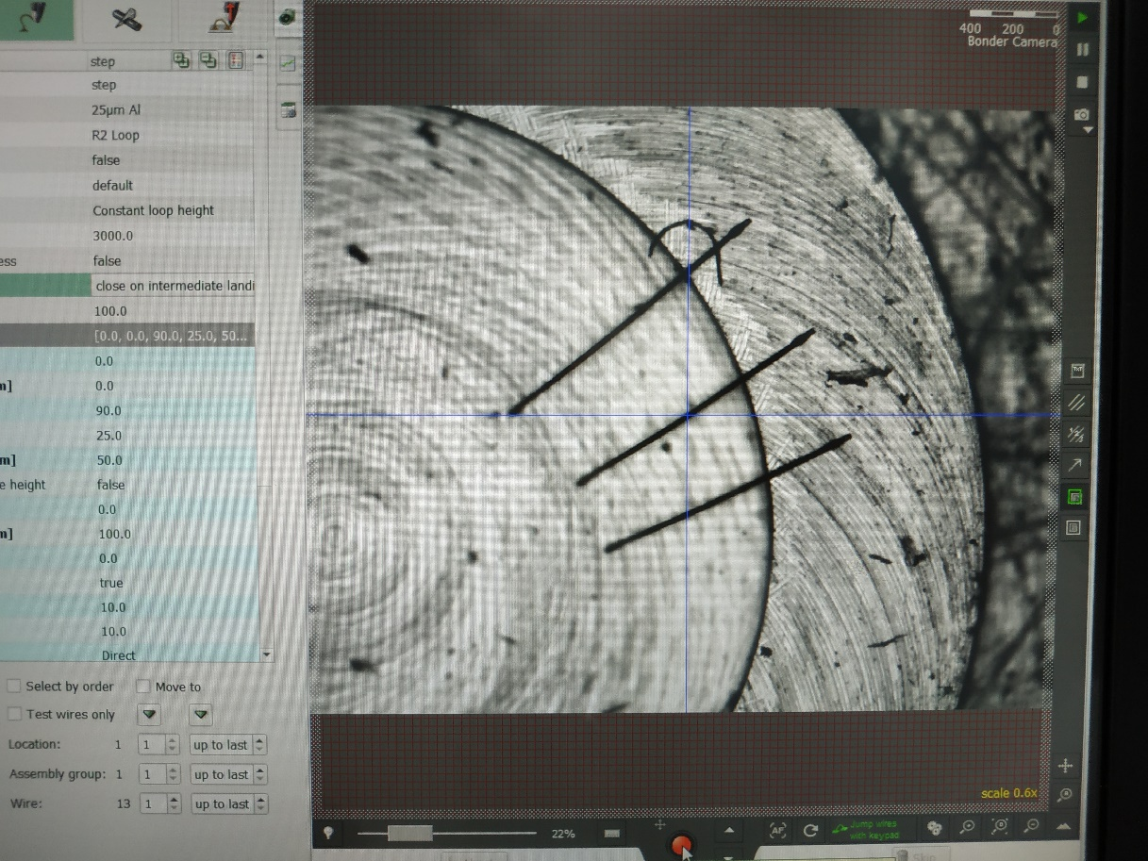
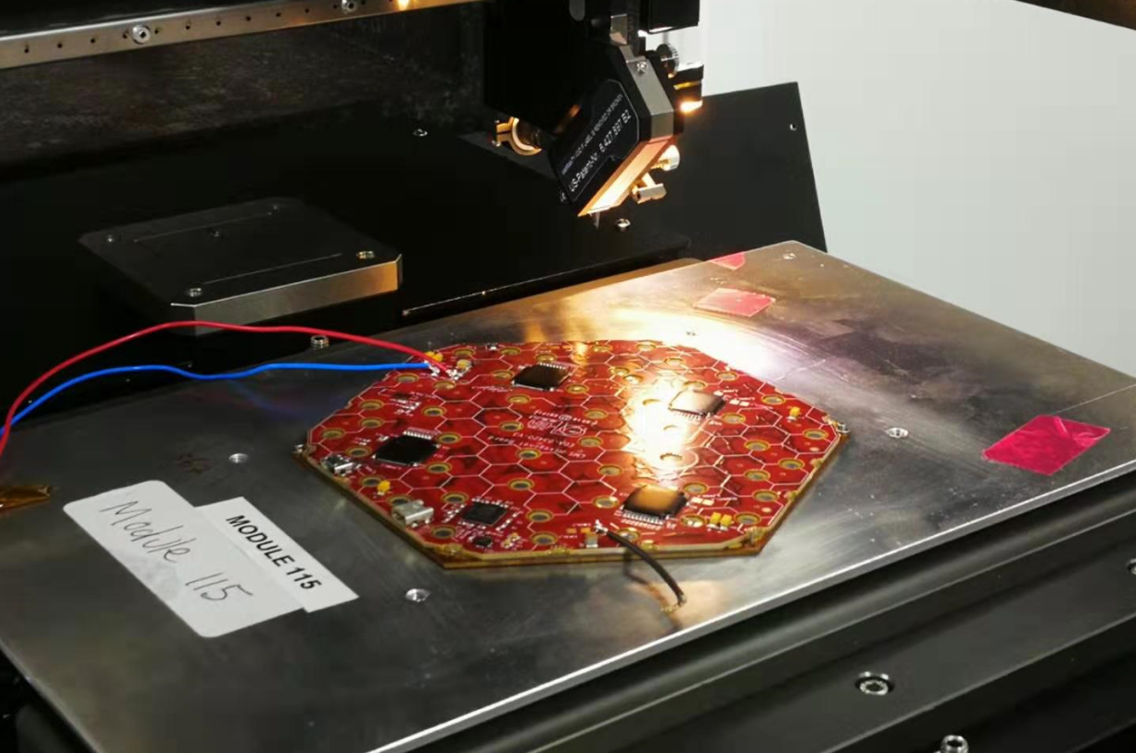
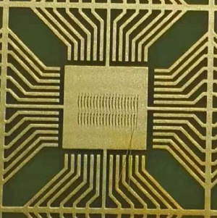
Wire bonding
Huaqiao Zhang(IHEP)
Electrical connections between silicon sensors and PCB
  Fully automated wire bonder BJ855(including QC)
  testing on test kits, dummy module etc
  Qualifying with pull testing (in preparation)
Bonding on test kit

Slide 16
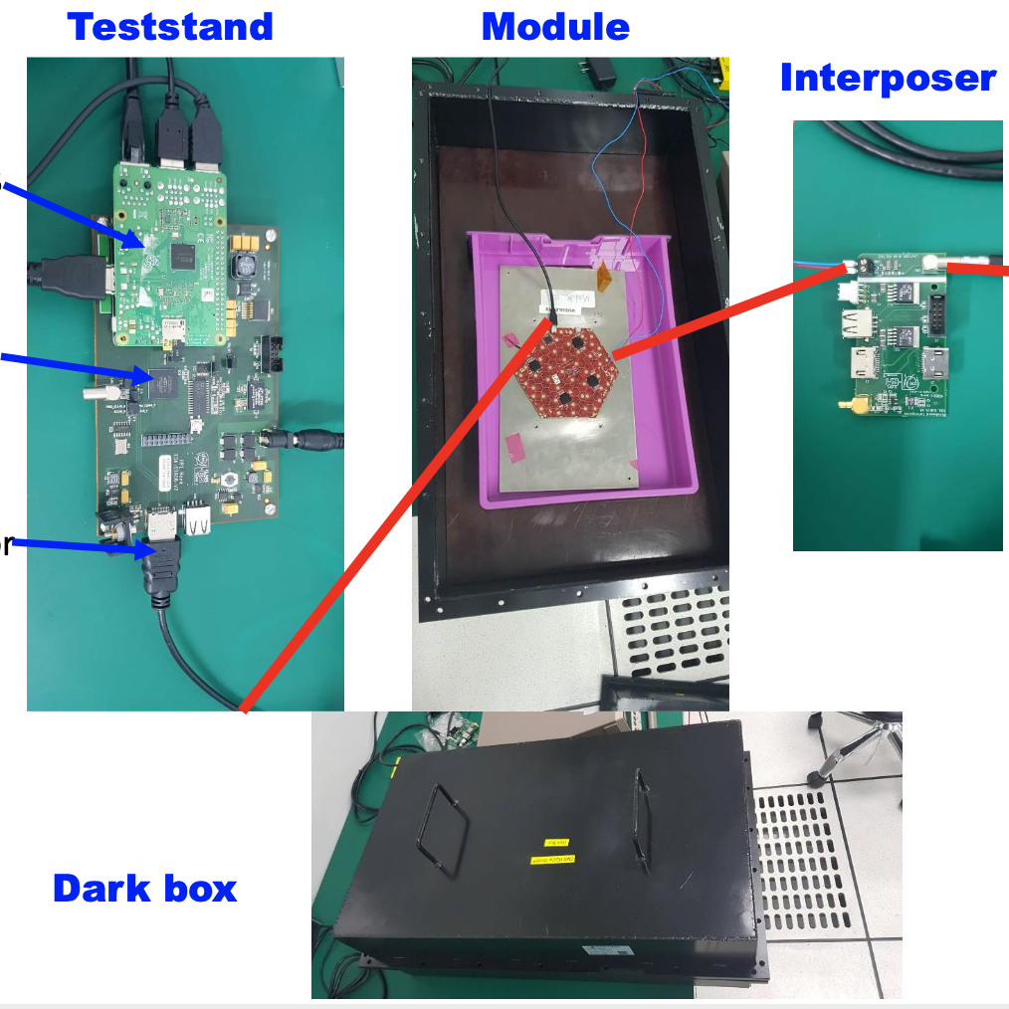
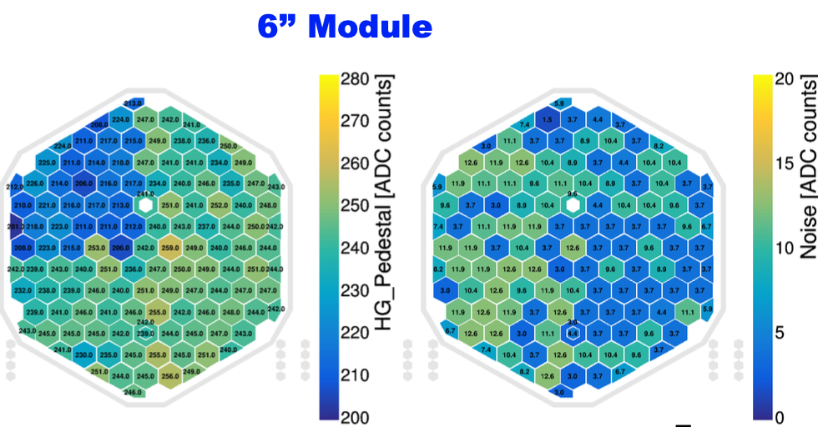

HGCal module tests（1）
Huaqiao Zhang(IHEP)
Single module Test stand：installed and test 6’’ module/8’’ PCB
  Pedestal，noise，charge injection etc.
RPI
FPGA
To module

Slide 17



HGCal module tests （2）
Huaqiao Zhang(IHEP)
IHEP Test System Setup
  Cosmic
  Beam
MIP calibration studies with cosmic muons
Preliminary results

Slide 18

HGCal production data base for MAC
Huaqiao Zhang(IHEP)
HGCAL Database an essential part of HGCAL construction
  Record data of all steps in module production
  GUI being developed: transmit information between local MAC and HGCAL database
  Sensors, PCBs, baseplates, tooling; production steps and testing results; shipping

Slide 19


DC-DC board Designed by ZheJiang U.
Huaqiao Zhang(IHEP)
ZJU Design DCDC board with CERN
ZJU designed DC-DC board
Production of 60 prototype boards

Slide 20

Phase 2 RPC Upgrade Project Overview
New RE3.1/4.1 (iRPC + FEBs)
New LinkBoard System for present RPC
Certification for HL_LHC
Upgrade of Link System to improve timing resolution for existing RPC (|h | < 1.9)
Installation in LS3 (2024-2025)
Extend the RPC coverage up to |η | = 2.4 to increase redundancy in high eta region in stations 3 and 4
Installation in YETS 2021-22 & YETS 2022-23

Slide 21

Tasks for RPC/iRPC TRIG/Backend Electronics
FEE
Off-Detector Ele. for RE3.1/4.1
  Fast/Slow Control to FEE/FEB and Monitering
  TPG by two-end timing + DAQ
For full RPC LB/CB System
  Fast/Slow Control
  System Monitoring
Endcap RPC Concentration(LB/MLB)
  (Task in Trigger Group)
Common hardware for RPC/Muon
  Common CMS accepted ATCA board
  For both Backend and Concentrator
Link
Sys
BEE
TRG

Slide 22



IHEP Trigger/Backend Electronics Proposal
The RPC Back-End electronics proposal with IHEP ATCA prototype was presented to Upgrade, Electronics and DAQ management on 20th February 2019: https://indico.cern.ch/event/800161/.
  The scope and schedule was approved. For the boards design, it was suggested to re-design the system based on common Serenity platform in order optimize the number of boards and the cost.
IHEP Two Daughter Boards
Serenity Two Daughter cards

Slide 23


Hardware Development Strategy and Status
So, Hardware Development been in two steps
  First uTCA/board based System development for iRPC development, testing and installation; Serenity ATCA development and production
  Then ATCA transition and commissioning in LS3
ATCA/Serenity Status 2020
  After communication with CERN management and Greg Ilse as Consortium coordinator at CERN and visit to Imperial College
  IHEP officially accepted as a Serenity Consortium member.
  New Design of ATCA has started.
Micro-TCA board Status 2020
  New design fine and joint tested at CERN
  Production of the MicroTCA bards to be used for chamber commissioning and demonstrator back-end.

Slide 24



Simulation: iRPC Data transmission problem
Simulation shows Too low Efficiency with Rising + Falling edge data of hits - 64bit/channel case
  Tx Latency Window (TxLW): variable time needed to transfer 1 BX’s data according to size of information and TxLW settings.
  TxLW settings(BX): 5, 8, 16, 32, 48, 64
  Average hit rate( Hz/cm^2):600, 800, 1000, 1200, 1500, 1800, 2000
  Including burst; Mean cluster size:2.35 ; Surface of half chamber :6600cm^2 (1 fiber)
data rate of 1 fiber =
Rate(safety factor 3)*surface of half chamber*cluster size*1strip information(128bit)
For 1289 Hz/cm^2,data rate = 1289*6600*2.35*128 Gb/s
thus data rate is 2.56 Gb/s(equal to GBT data bandwidth)
When rate is lower than 1289 Hz/cm^2, A larger window leads
to increased efficiency.
When rate is higher than 1289Hz/cm^2,GBT data bandwidth
becomes the bottleneck rather than tx window sizes.

Slide 25

Suggestion for one Edge (Rising) transmission
Efficiency with different tx latency window sizes - 32bit/channel case
  TxLW settings(BX): 5, 8, 16, 32
  Average hit rate( Hz/cm^2 ,safety factor 3):600, 800, 1000, 1200, 1500, 1800, 2000
  Including burst; Mean cluster size:2.35 ; Surface of half chamber :6600cm^2 (1 fiber)
  Size of the information/channel : 32bit (only rising edge )
For maximum rate 2000 Hz/cm^2,data rate
= 2000_{rate}*6600_{surface}* 2.35_{cluster size} *64 _{1 strip info} Gb/s
thus data rate is 1.99 Gb/s(smaller than GBT data bandwidth)
A larger window leads to increased efficiency.
100 % efficiency is measured with a tx window setting of
32BX in our simulation.
A proper transmission method including TxLW and info
size between FEE and BEE should be well discussed!

Slide 26




iRPC data source
See Hanjun Kou’s Talk
iRPC data source generation
  Parameters setting
    RE3/1 iRPC Chamber and strips
      For one RE3/1 chamber,=153cm,=309cm,covers 20°
      contains 96 strips，read out by 2 links.
      For one strip ,=156cm,=0.4cm
      pitch about 0.55cm at low radius(1.1cm at high radius).
  Data generation
    Random hit point(r, φ) in a chamber
      r: generates the hit point along strip.
      φ: generates the strip number.
    Smear of φ direction :
      generates a consecutive set of strips as a cluster.
    Cluster size :
      1-8,mean is 2.35
    Number of clusters :
      1(75% probability),2(25% probability，keep the cluster size as 1)
HR
iRPC chamber
LR
r
Link1.dat
Link2.dat
hit point
φ smear
a cluster：
2 fired strips

Slide 27


FEE software algorithm
See Hanjun Kou’s Talk
Frontend board emulator
  Hit position
    r is calculated by the time difference of signals from both sides.
  Data format
    Edge: Rising/Falling edge of the signal
    Asic: Totally 3 TDCs on FEB
    Channel: 32 channels for each TDC
    Coarse: Coarse time, combine BCN(Preserved)and t1, t2
    Fine: Fine time, responsible to the precision, 2.5ns/256≈10ps
  Digitization
    For each fired strip, there are always 4 constraint 32-bits data constructed.
      Channel-LR Rising Edge + Channel-LR Falling Edge
      Channel-HR Rising Edge + Channel-HR Falling Edge
strip length L
HR side
LR side
t1
t2
r
$$r= \frac{1}{2}L −\frac{(t2−t1) }{2}∗v$$
r
Algorithm:
  mean cluster size : 2.35
  4*32-bit data needed for 1-strip information
  2 GBT frames to cover 1 strip

Slide 28
IHEP Proposal for iRPC FEB/iRPC transmission(Check-Sort-Push)
See Hanjun Kou’s Talk
BEE is ready and waiting for join test with FEBV2 of two-end reading.
Communication Mechanism study is under going for high event rate
BEB
FEB
data DEMUX
Data path
Slow control
FEE emulator
FEB emulator
120bit@40Mhz 4.8Gb/s
DAQ
data preparation
MUX FIFO
iRPC data source
cluster finding
GBT link
Link1.dat
hit finding
Link2.dat
Θ-φ angle conversion
L1A generate
FEB
FEE emulator
BEB
FEE emulator
120bit@40Mhz 4.8Gb/s
Link2
Slow module
Response command
Slow module
Command
analysis
Vio
GBT link
Link1
Slow module

Slide 29

DEMO System Works fine at IHEP Beijing
Complete iRPC FEE/BEE DEMO System
  2 AMC cards
    1 AMC card as iRPC data source
    1 AMC card as BEE processor
  1 AMC13
    TTC/TTS
    Management
  1 MCH + 1 PC
    Slow control
    Management + data storage
Progress: Fully working in
  1. Hardware, GBT/GBT links
  2. Emulation/Development System
  3. Detector Simulator/data source(see Page 16 and thereafter)
  4. Fast/Slow control, cluster finding, data saving on to disk
iRPC BEE
uTCA Shelf
iRPC FEE
AMC13
MCH
PC
Net cable
SC Fiber
Data Fiber
AMC13
fiber

Slide 30







See Jingzhou Zhao’s Talk
CMS-RPC 触发升级年度进展（2）
BEE Joint Test with 2D iRPC at CERN/904(Test setup Photo)
iRPC 2D chamber
  - X 16 strips,
  - Y 10 strips,
Trigger: Timer/Scintillator
one BEE board(BEB)
two Data Collector boards
  - 16 inputs each
One server for SC and DAQ
Server
SC & DAQ
X
Y
Data
Collector
BEE
board
Very successful joint test Mar. 2020
Analysis results agrees well with other tests
Publication Accepted by collaboration
在CERN与iRPC探测器联调
部分联调测试结果

Slide 31
Summary
GE1/1 GEM Electronics Boards (GEB) mass production in China was completed, GEM detector installation and commission is going on at CERN. GE2/1 GEB design, prototyping and test completed, mass production is expected to start by the end of 2020. ME0 GEB design (1st version) completed, prototypes are being produced.
GEM external frames (FR4) prototypes was produced and passed CERN test in Feb. 2020. Mass production is expected to start by the end of 2020.
Software and hardware platform of various QC procedure during GEM detector assembly were setup. GEM Production site in Peking University is ready. GE2/1 GEM detector mass production is expected to start by the end of this year, 80 GEM detectors will be produced in PKU
Great Progress on HGCal Module Assembling/testing and wire bonding,
Backend(off-Det) electronics DEMO System with big progress
  Simulation
  Demonstrator System tests done at IHEP Beijing
  Joint test with 2D iRPC at CERN with success March 2020
Joint test results showed a working BE electronics
Ready for iRPC validation and commisioning
Thanks!

