Slide 1
EF04: EW Precision Physics and constraining new physics
Zhijun Liang
(IHEP, Chinese Academy of Sciences)
Notes:
Annual strategy planning session for the joint Key Lab for Particle Detectors and Electronics.
You can present an overview of the CEPC Detector design, the R&D program, and go over the key technologies to be pursued during the next five years for CEPC. Aim for about 30‘+10’ approximately.

Slide 2
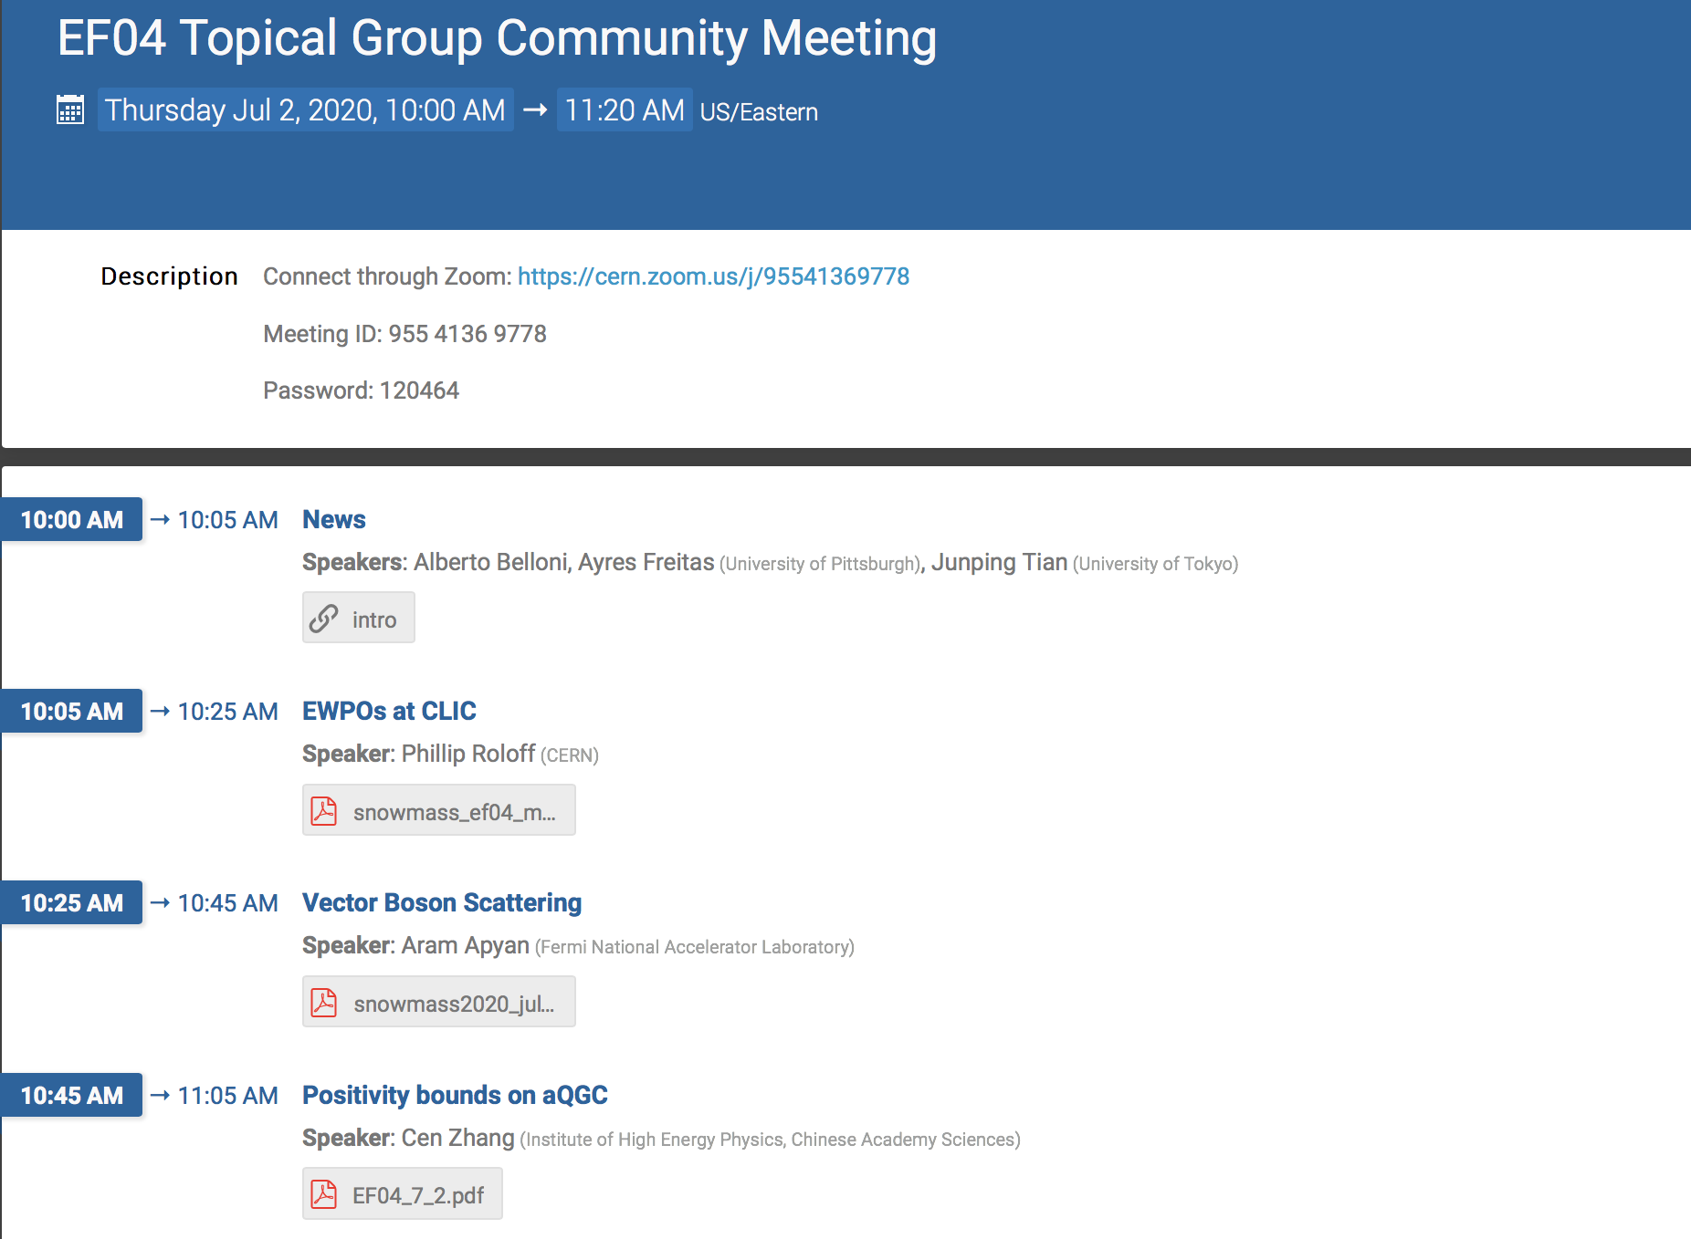
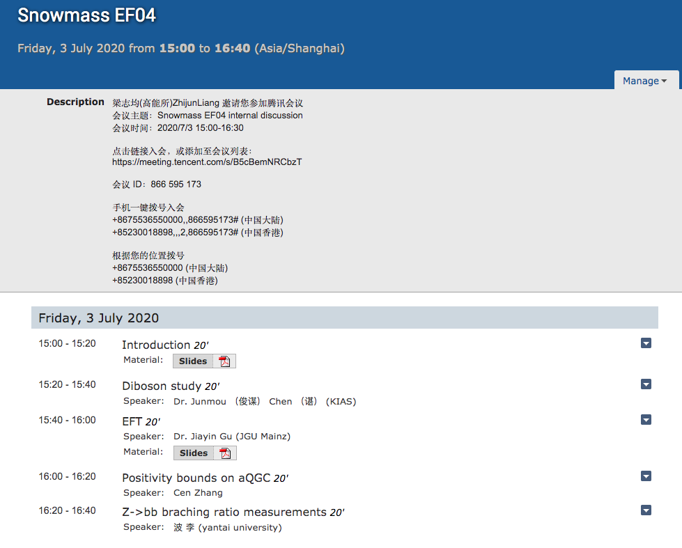
EF04: status
Two internal meetings.
Presented two talks in snowmass EF04
https://indico.fnal.gov/category/1138/
Internal meeting (July 03)
Talk in EF04 snowmass meeting
https://indico.fnal.gov/category/1138/
https://indico.ihep.ac.cn/category/719/

Slide 3
Plan for Snowmass EF04 LOIs contribution
More detailed study of 2~3 benchmark electroweak observables (Siqi …)
Eg: weak mixing angle from Z->bb,Z->ll backward-forward asymmetry
More study with more realistic simulations
More detailed study on experimental and theory systematics
Z->bb branching ratio (Bo Li)
High order EWK calculation (NNLO EWK corrections )
Already setup connection between Zhao Li and EF04 conveners
aTGCs/QGCs in WW events (Jiayin,LingFeng, Dan …)
Unitarity bounds in aQGCs (Cen Zhang)
Please consider to join us and write down your topics in QQ docs
https://docs.qq.com/sheet/DR1NXTXp6V2JkR1NH?tab=m0d77k

Slide 4
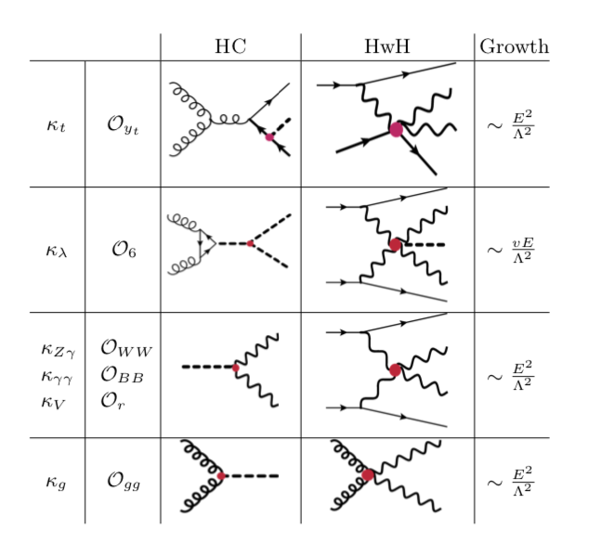
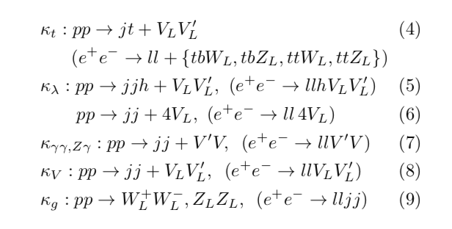
Measuring Higgs couplings with longitudinal external states.
Measure Higgs coupling by probing longitudinal polarization of W/Z boson
Mainly in HL-LHC and may look into CPEC ZH->WW
By Dr. Junmou Chen (KIAS)
1812.09299

Slide 5
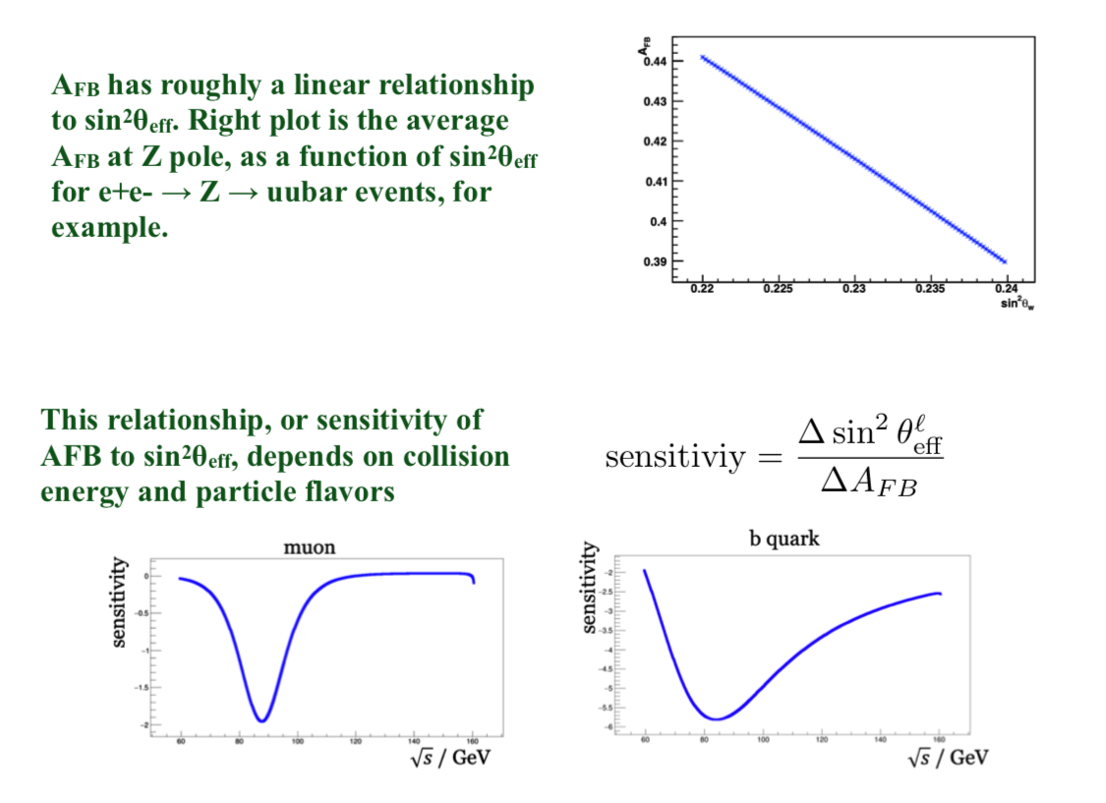
Weak mixing angle measurement at Z pole sin²θeff and AFB
By Dr. Siqi Yang (USTC)
Systematics

Slide 6
R^{b} measurements
R^{b} measurement is sensitive to New physics models (SUSY)
Very interesting about physics implication from Z->bb measurements
Ayres Freitas would like to follow up on that
Systematics: b tagging efficiency hemisphere correlationshigh
Feedback: Need input from QCD experts
Feedback: better to avoid extrapolation from LEP, try standalone estimation from CEPC simulation.
Bo Li (Yantai U.)
Zhijun, Bo Liu(IHEP)
Arxiv:1601.07758v2

Slide 7
By jiaYing Gu,lingfeng Li
Dan Yu, Shuqi Li, Manqi, Zhijun

Slide 8
Unitarity bounds in aQGCs
Cen Zhang (IHEP)

Slide 9
Summary of LOI topic in EF04
Weak mixing angle measurements at Z pole
Eg: weak mixing angle from Z->bb, Z->ll backward-forward asymmetry
More study with more realistic simulations
More detailed study on experimental and theory systematics
High order EWK calculation (NNLO EWK corrections )
aTGCs/QGCs in WW events
Unitarity bounds in aQGCs
Z->bb branching ratio
https://docs.qq.com/sheet/DR1NXTXp6V2JkR1NH?tab=m0d77k

