Slide 1
EF03

Slide 2
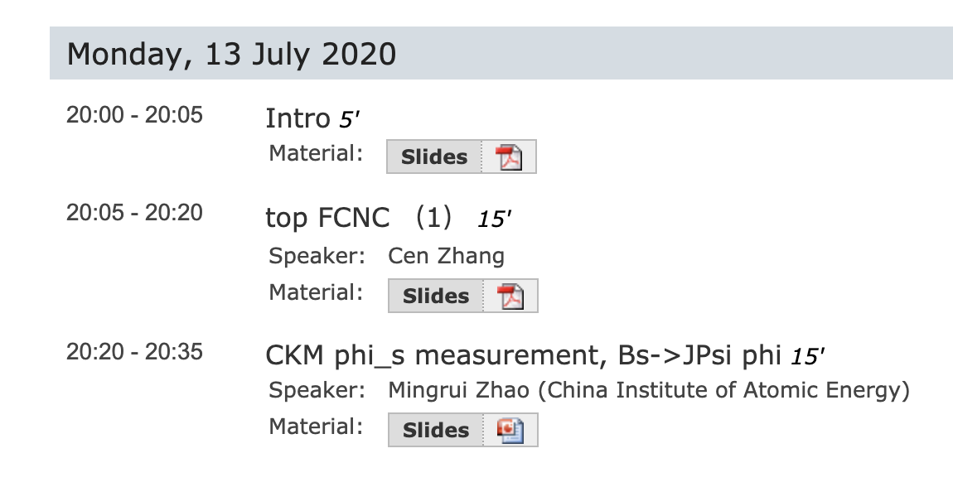
Meetings
Next meeting：31 Aug

Slide 3

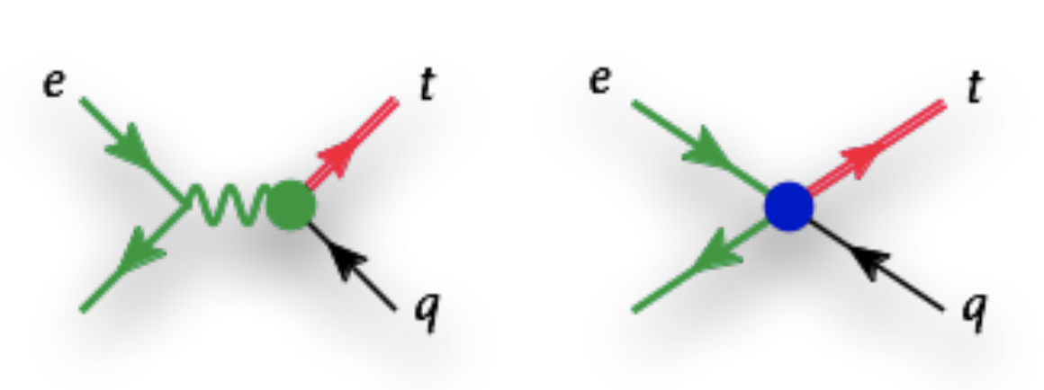
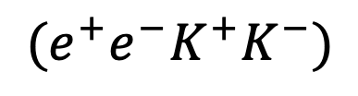
Possible LOIs
1: CPV phase study at CEPC
  Advanced, drafting LoI, will submit soon.
2: Top FCNC at CEPC （lepton colliders）
  Peiwen Wu： LoI draft ready, dedicated to CEPC
  Cen Zhang： need to discuss with EU collaborators (~25th Aug)
    Not decide whether submit LoI
    Content: add FSR etc effects to extend work of 1906.04573
    CEPC + other lepton colliders
$$(e^{+}e^{−}K^{+}K^{−})$$

