Slide 1

Solar axion and anomalous μ_{ν} searches with the full PandaX-II exposure
arXiv:2008.06485 [hep-ex]
周小朋 (Beihang University)
On behalf of PandaX Collaboration
September 26, 2020 CHEP
Notes:
Hello, every one, This is xiaopeng, a PostDoc from Beihang U working on pandax experiment. Here it’my great hornor to give a talk on this topic: Solar axions and anomalous neutrino magnetic moment searches with the full PandaX-II exposure, and the preprint hae been uploaded to this address.
.

Slide 2



















PandaX experiment
PandaX-I
120kg LXe
DM
2009-2014
PandaX-II
580 kg LXe
DM
2015-2019
PandaX-4T
X ton LXe
DM
Near future
PandaX-III
200kg-1T gas Xe-136
0ν2β
future
PandaX
Series of xenon based rare-event detection experiments
Formed in 2009
~50 collaborators
CJPL
2
￼
Notes:
PandaX is a series of xe based rare-evt detection experiments, The first detector is pandax-I, a 120kg DM direct detector, closed in 2014. PandaX-II a half-tone one, just finished all data taking in the mid of this year. And now we are preparing the new two detectors: pandax-xT, designed for DM detection mainly and pandaX-III, with 200kg-1ton Xe-one thirty six enriched gasous detector for no neutrio DBD detection.
The project was formed 10 ys ago. Now, we have about 20 collaboration institutes and about 50 collaborators.

Slide 3
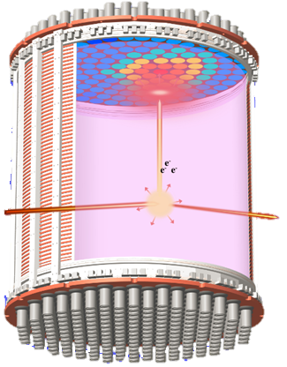
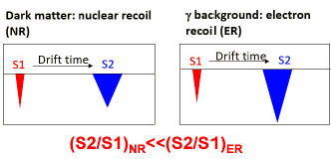
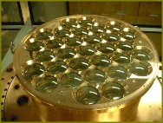




Dual-phase xenon Time Projection Chamber(TPC)
Advantages :
  Xenon has no long-lived radioactive isotopes (except ¹³⁶Xe)
  Large A: large cross section & self-shielding
  Excellent discrimination between nuclear and electron recoils and 3D fiducialization
  Scalability
  9% ¹³⁶Xe for 0ν2β
ZEPLIN，XENON，LUX，LZ，PandaX…
￼
Notes:
IN the last three presentations, the talkers have introduced the Dual-phase xenon Time Projection Chamber(TPC) in detail.
Considering the inevitable advantages, we also adopted this tech in PandaX-I II and the coming 4T detectors.

Slide 4
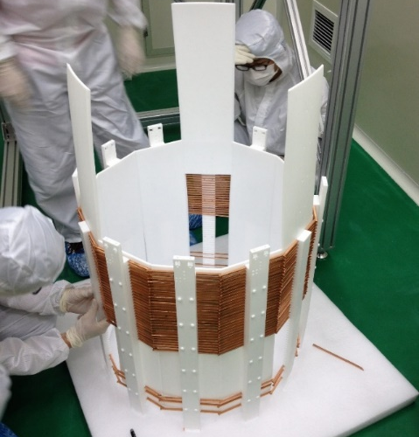
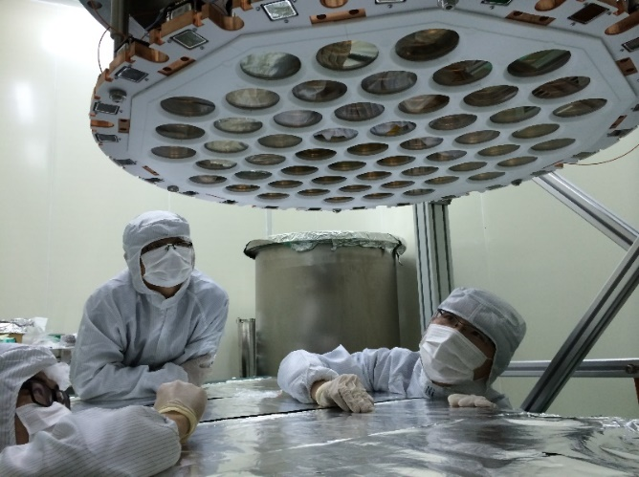
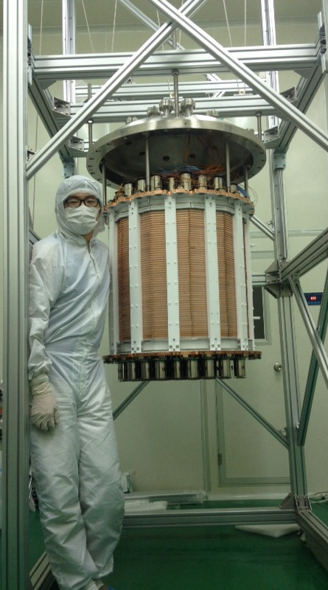
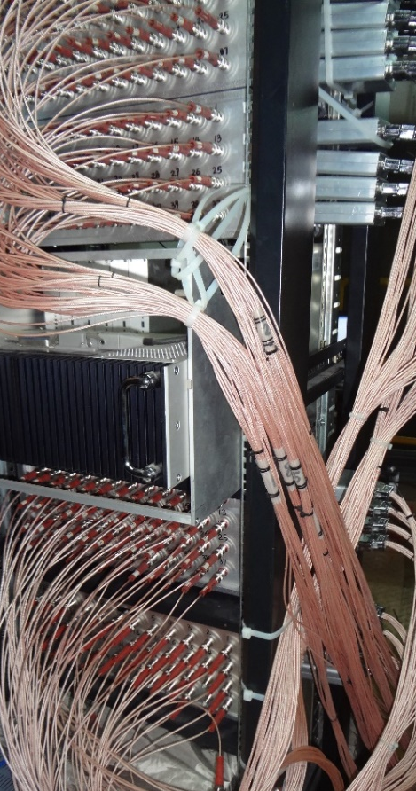
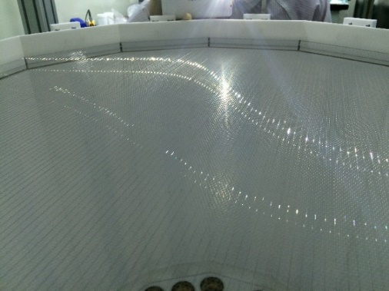
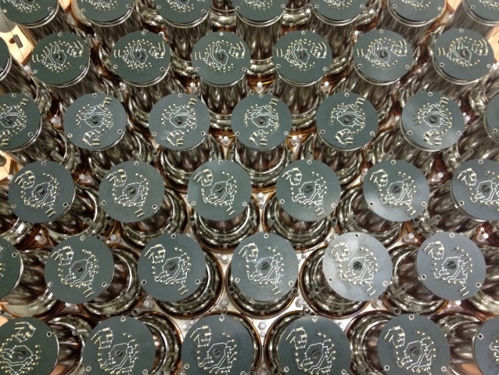
PandaX-II detector
PandaX-II detector:
60 cm * 60 cm cylindrical TPC
580 kg LXe in sensitive region
55 top + 55 bottom 3” target PMTs
24 top + 24 bottom 1” veto PMTs

Slide 5
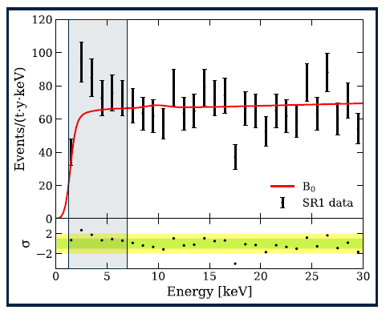
Xenon1T’s new results on Electron Recoil arXiv: 2006.09721
A excess was reported in low energy ER spectrum using 0.65 ton year exposure!
Notes:
As you all know, About two months ago, Xenon1T released their new results on low energy electron recoil. They supported the non-zero solar axion hypothesis with 3.5 sigma significance. But can not exclude the unexpected tritium hypothesis at the same time. As a similar detector adopting same technology but with different backgrounds, PandaX-II can test the excess at the same way. First let start with axion.

Slide 6
Axion
Strong CP
problem
PQ symmetry
A new boson
KSVZ
DFSZ
Strong CP conserve
V.S.
quantum chromodynamics
QCD was predict to break CP-symmetry
nEDM measurement say “no violation”
A plausible solution for strong CP problem (1977,Peccei & Quinn)
Introducing a new U(1) symmetry
Phys. Rev. Lett. 1977-06: 1440–1443.
Axion
(1978, Wilczek & Weinberg)
U(1) broken to generate a new Nambu–Goldstone bosons
named after a laundry detergent (Wilczek,2004 Nobel Lecture )
Phys. Rev. Lett. 1978-01: 223–226.
Phys. Rev. Lett. 1978-01: 279–282.
Invisible axion
DM candidate
PQWW axion excluded in reactor and beam-dump experiments
Physical Review D, 1978, 18(5): 1607.
new models and detection methods proposed
Phys. Rev. Lett. 1979-07: 103– 107.
Nuclear Physics B, 1980, 166(3): 493–506.
Physics Letters B, 1981, 104(3): 199–202.
Sov.J.Nucl.Phys. 1980, 31: 260.
6
￼
Notes:
The axion was raised when theorist trying to answer the strong CP problem with a new introduced U(1) symmetry. It can serve as good dark matter candidate at the same time. The mass of axion is so small, typically 10 to minus 6 to 10 to minus 2 eV per c square .so we usually detect the coupling between axion and photon at microwave caviaty experiments.

Slide 7
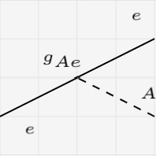
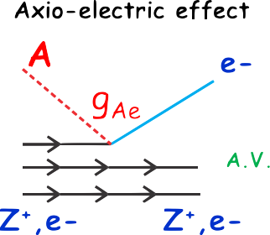
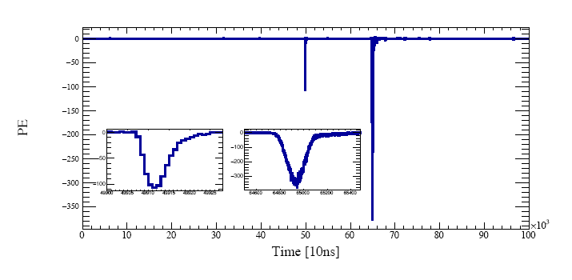
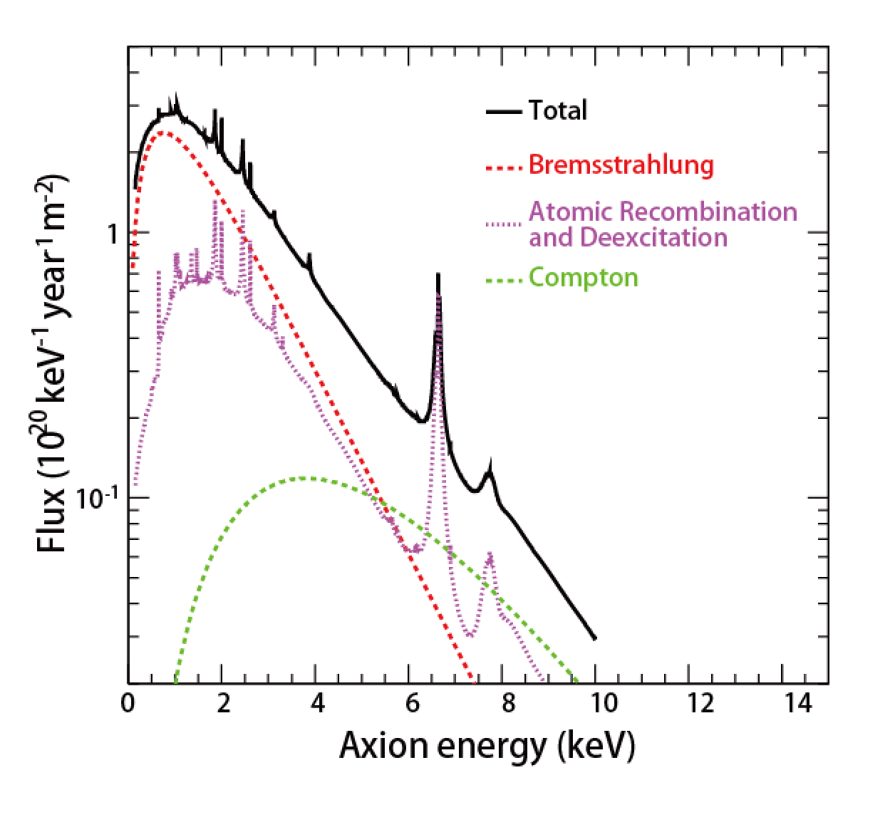

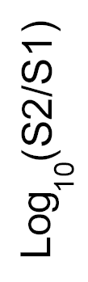
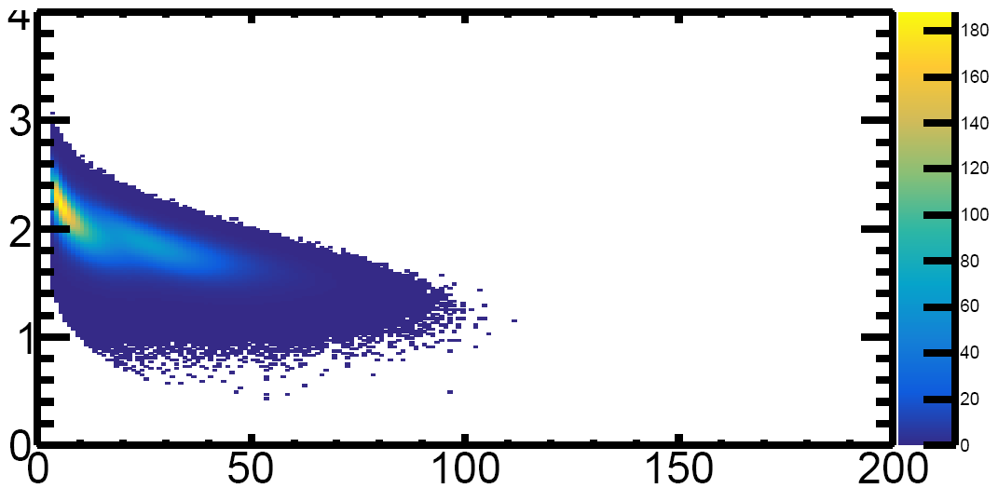
Solar axion
Production
Detection
Signal
ABC axion
Atomic recombination and deexcitation
Bremsstrahlung
Compton
Typical ER signal in PandaX-II
￼
Assuming g_{Ae}= 10⁻¹³
S1[PE]
Notes:
But the sun, as an axion accelerator, will generating the axion with ~keV kinetic energy. It would make it possible for underground dark matter detector to detect the axion via axio-electric effect. There are three channels could generating axion via different coupling, Here we only considering the ABC axion as the input of our analysis because it share the same gae coupling when it was generated and detected. And the results from Xenon1T also indicating the ABC axion is more likely to be the excess. Just like photon electric effect ,When an axion interect with xenon, It would give all it energy to the electron of xenon. Making a electron recoil events. A typical ER Event will generate a paired S1 and S2 signal。 If you record the waveform of both si1 and s2. It would be like this . And further more, if you translate the signal size into a 2D plot in log10(S2:S1):S1 you will a distribution like the right botton figure. This is the simulated axion distribution when the mass of axion equals to 1e-5lkeV/ per c square. So， in general , what we are doing is trying to search a structure like the right bottom figure in PandaX-II’s data.
Now lets talk about the data of PandaX-II.

Slide 8
PandaX-II Data Sets
2015.11 start with commissioning Run8
2019.06 “End-of-Run” completed
  Run 9: 79.6 days (published)
  Run 10: 77.1 days (published)
Full data analysis
（same with WIMP search）
  New position reconstruction
  New detector response model
  Improved background evaluation
  Run 11, span 1: 96.4 days
  Run 11, span 2: 147.9 days
Run8
T1
T2
Notes:
PandaX-II started with a commissioning run called Run8 at the end of twenty fifteen. During run8, dominating Kr events was found in detector. After a distillation campaign , Run9 started. Run9 has collected about eighty days exposure. And before Run10 , a tritium calibration run was carried out like what LUX has done we call it T1. But, we found we can not repeat LUX’s efficient removal just using getter. So another distillation carriedd to suppress the tritium level considerably but still with a residual in Run10 and Run11 . And during End of Run, another tritium injection which we call T2 collected even more tritium data. Generally speking, during the whole operation of PandaX-II, we have collected ~400 days science data and enormous tritium calibration data and also other calibration data. For these data, same reconstruction algorithm used in WIMP search were applied, and . We inherited almost all quality cuts like what zhangdan has introduced in her presntation. But two more modifications were maed for axion searchfor better sensitivity.

Slide 9
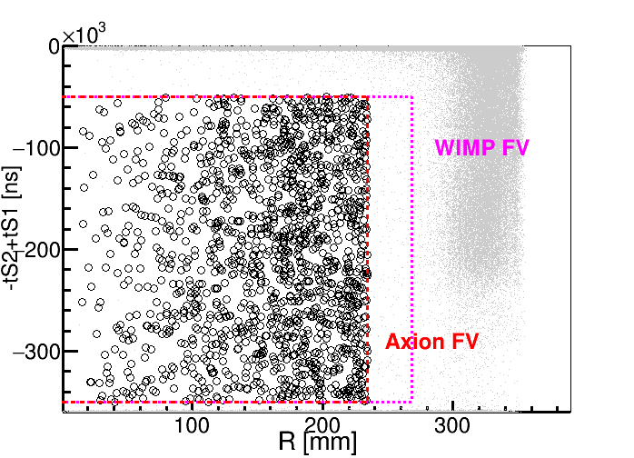
Axion signal in xenon detector:
low energy ER events
  Expand the energy window to 25 keV
  Reduce the FV to 250 kg to avoid the affect of Surface events
Dominant background:
  ¹²⁷Xe: decay away in Run 11
  Tritium: appearing since Run 10
  Flat ER: ²²²Rn, materials
  ⁸⁵Kr
PandaX-II Data selection
100.7 ton-day exposure
2121 events selected
Notes:
First, we expand the data energy window to 25keV to make better background level estimation by involving more information coming from the region larger than axion region.
Second, Due to the events located at the surface of PTFE panels would be reconstructed in side the FV at a small but non-Negligible ratio. We reduce the fiducial volume cut in Radius from two sixty eight to two thirty four minimeter to make sure the contribution from the surface events is less than 1 event
After these selection, two thousand and one handrad twenty one events were picked out within 100.7 tondays exposure for axion search. Among these candicate events, Four major backgrounds are dominant, theyare Xenon-one twenty seven, tritium, flat ER and Krypton eightyfive . The Xe-one twenty seven would decay in several months and is simple to modeling, because the energy deposition of Xe-one twenty seven in Low energy region is a 5keV mono-energetic peak and the event rate is also easy to estimate. So now, lets focus on tritium frist.

Slide 10
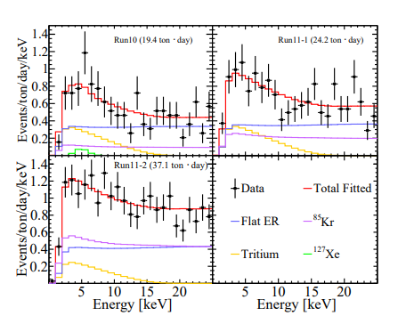
Tritium
Degenerate significantly with axion signal
  Introduced by CH₃T calibration
  Unbinned likelihood fit on Run 10, 11-1, 11-2 independently
  Consistent with a constant rate
  Total fitted 0.037±0.013 μBq/kg
  floating in the fit
Run | Tritium level
10 | 0.040±0.012 μBq/kg
11-1 | 0.043±0.013 μBq/kg
11-2 | 0.032±0.018 μBq/kg
Notes:
As we have discussed before, the tritium showed up in all three data sets after T1 tritium calibration. You can distinguish the tritium shape from the data in the right figure. If someone ask, could this structure comes from the real axion signal? Our answer is no. Because the signal strength is too large to be possible. It Can be rejucted by Run9 data easily and also observations from other experiments. To get the background level of tritium in different runs. we carried out independent fittings for these three sets and found three sets give consistent numbers. So in the following analysis, we put a common but floating constant for tritium level .

Slide 11
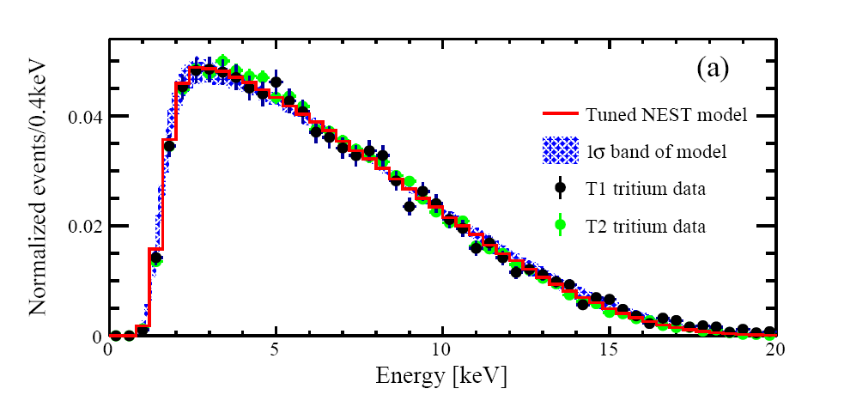
Tritium
Degenerate significantly with axion
  The shape of tritium well understood (small shape systematic error)
  floating in the fit
Reconstruction considering BLS correction
Fitting good ！！
Notes:
You see, in general, axion search is like a shape extraction. Given the Degeneracy between axion and tritium, how good we reconstruct the energy will affect the sensitivity greatly. The shape of tritium in PandaX-II is well understood based on considerable amount tritium calibration data from T1 and T2. Which will eliminate the shape systematic error during the final fitting. What I want to point out is the time interval between these two tritium calibrations is about 3years, During that time the status of PandaX-II has changed a lot including PMT gain, electrical field and so on. The good consistant between two calibration and model can draw a simple concision that the reconstruction algorithm is pretty good for tritium!

Slide 12
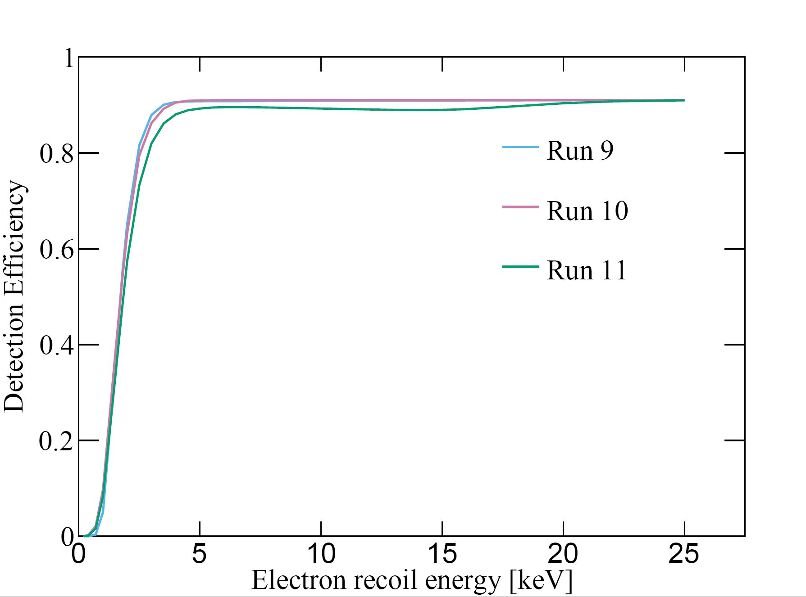
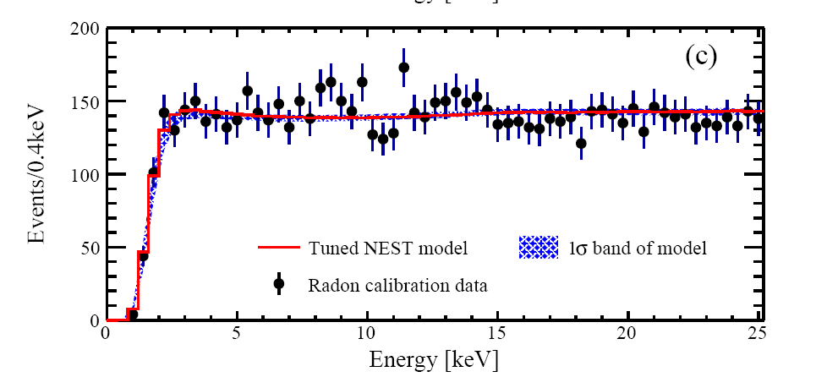
²²²Rn
²²⁰Rn calibration shows “flat”
arXiv:2006.09311
Notes:
As for the flat ER component. It mainly comes from two sourcess：beta decay from lead two forteen， a daughter of Rn222 and gamma rays from all material usedtobuild thedetector . According to the calibration of Radon two twenty, we are confident that the ER modeling is also good for flat ER. And based on Rn220 together with tritium calibrations， The ER detection efficiency can be derived individually for different runs. All three curves plateaued at 91% at high energy region. The deformation of Run11 curve around 10 keV is because of The BDT cut tring to remove the accidental coincidence events. These three curves were also used for all electron recoil components including the axion signal.

Slide 13
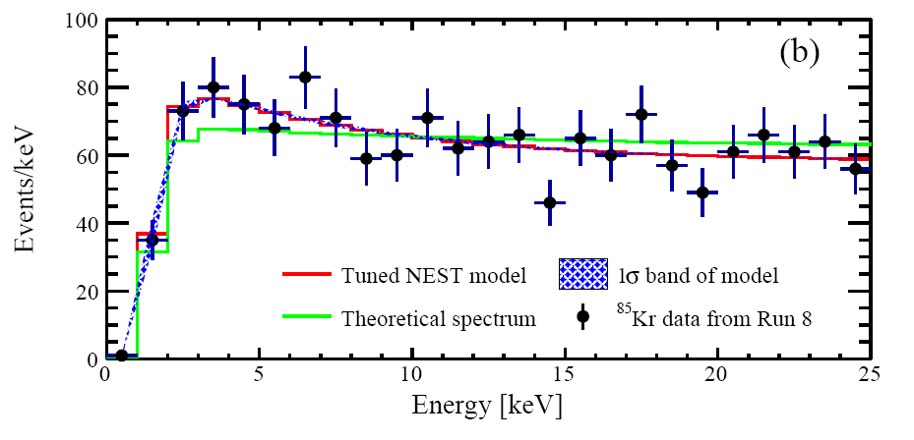
⁸⁵Kr
Run8 LE data was dominated （ 98%, 15mDRU）by ⁸⁵Kr
  Direct measurement of ⁸⁵Kr @ low energy region
  Data driven model (Expo+flat)
  fed into fitting analysis
  Theoretic spec difference as systematic
1mDRU = 1 E-3 /keV/kg/day
arXiv:2007.13686
nuclear structure effects involved
exchange effect calculated using the extended formalism for first-forbidden unique transitions
Notes:
As we have talked before, we have a commissioning run called run8 before science runs. In Run8, about 15 mDRU krypton eight five was found accounting for 98% of all low energy events. These data can serve as a direct measurement of krypton eighty five beta decay spectrum. we fitted the data with an exponential and a flat components getting good fitting resulting like the red line in this figure. And in this figure we also cite a green line from this theoretical calculation paper of typical beta decay in xenon detectors. In this paper， they conclude that the nuclear structure effects will affect the low energy spectrum of beta decays. for Kr eight five, when they involved the atomic exchange effect using extended formalism for first-forbidden unique transitions the spectrum will show an rising tendency at low energy region. I think We need more cooperation with nuclear physicst to make a steady conclusion on this question. The difference between the data fitting curve and theoretic curve was put into the final fitting as systemetic error

Slide 14
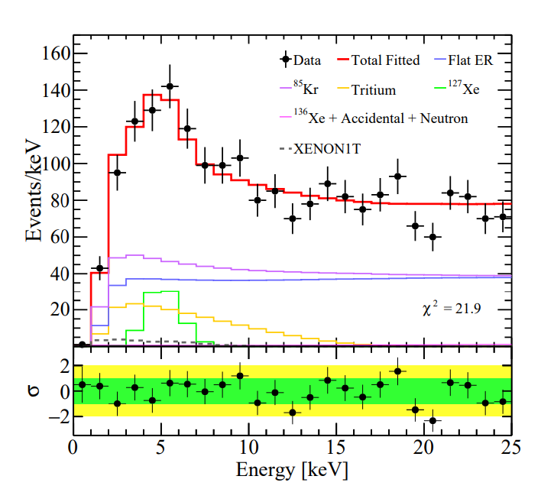
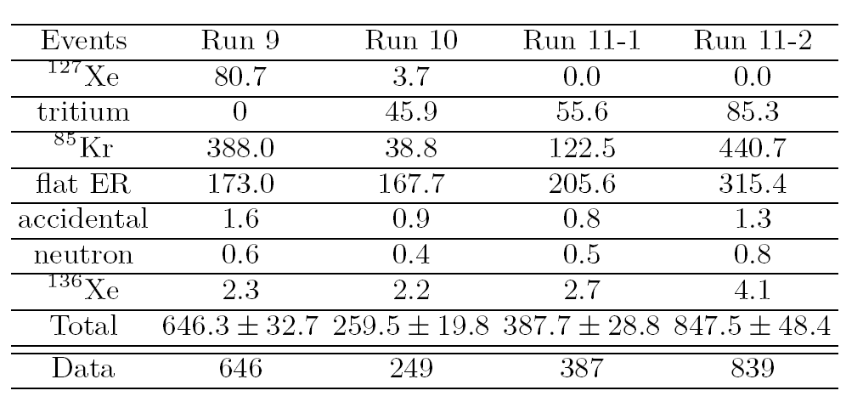
Axion Fitting results
BKG only fitting results
Kr station
Notes:
Except Four ER backgrounds discussed previously, backgrounds from accidental coincidence, neutron and xenon one thirtysix were also included in the final simontimus fitting. We carried out a 2D involving S1 and S2 signals unbinned likelihood fitting for total exposure. And this is what we get. The black dots are data and the red line is the total fitted background. The expected axion signal with XENON1T best fit signal strength is showen as dashed line. You can tell from the best fit table that the data are consistent within 1 sigma fluctuation of background-only hypothesis in general.

Slide 15
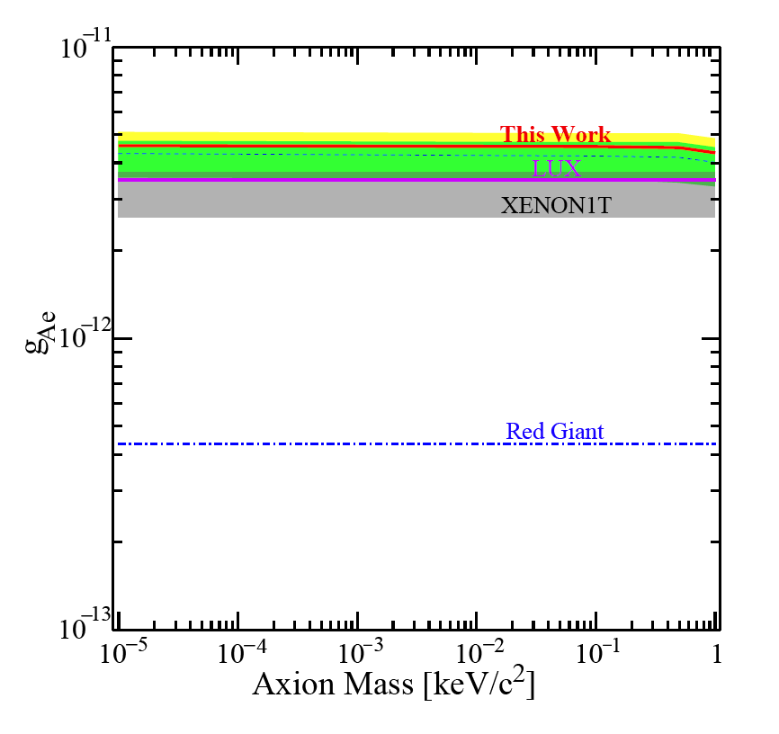
Axion Fitting results
Independent test on XEONN1T’s excess with same detection technology but different background
Axion-electron coupling g_{Ae} < 4.6 × 10⁻¹² for an axion mass less than 0.1 keV/c²
The observed excess from XENON1T is within our experimental constraints.
Kr station
Notes:
Based on the fitting, a profile likelihood ratio CLs method was used to make comparison of data with background only ang background-plus-signal hypotheses. Constraints on the coupling constant $g_{Ae}$ at 90\% confidence level (C.L.) are shown as red line in this figure. This is a independent test on xenon1T’s excess result. From the results, you can see
For the axion mass smaller than 0.1keV per c square, the upper limit on $g_{Ae}$ is at $4.6\times10^{-12}$, We also included the xenon1T’s results as gray shaded band. This band was derivrd from Xenon1T’s paper considering the gagamma constraints from CAST’s result. And the conclusion is The observed excess from XENON1T is within our experimental constraints.

Slide 16
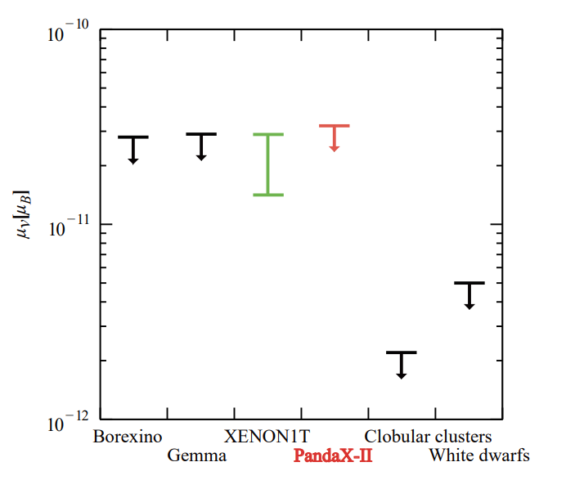
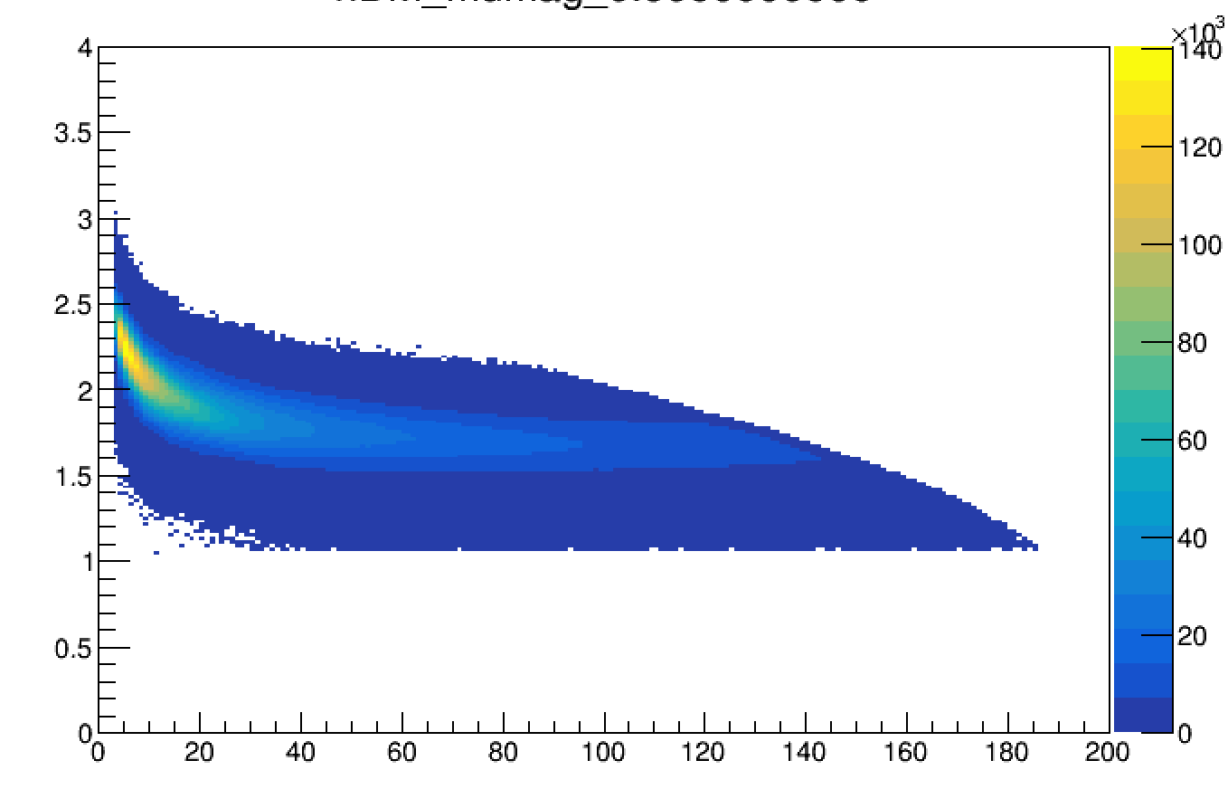
μ_{ν} Fitting results
25 keV cutoff
Kr station
S1[PE]
µ_{ν} < 3.2 × 10⁻¹¹µ_{B}
Notes:
Except axion, Xenon1T’s excess can also be explained as neutrino with enhanced magnetic
momnet. This is the signal distribution function for neutrino with enhanced magnetic moment. We also carried out test on this hypothises. No excess .The 90% C.L. upper limits on the anomaly neutrino magnetic moment. is set to 3.2 × 10−11µB.
So what is this excess.? to answer the question, I think we have to look forward to next generation detectors including upcoming XENONnT, LZ and PandaX-4T

Slide 17
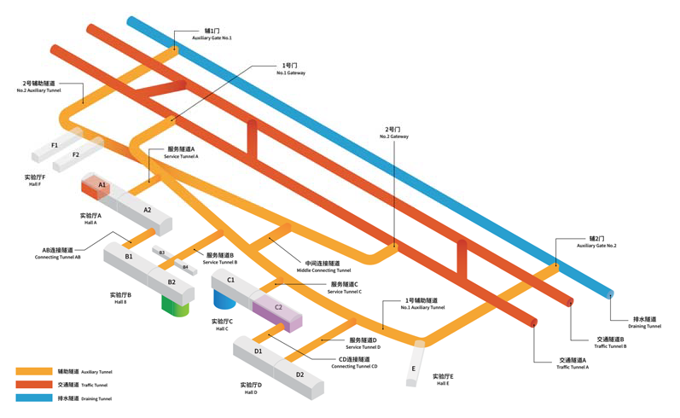



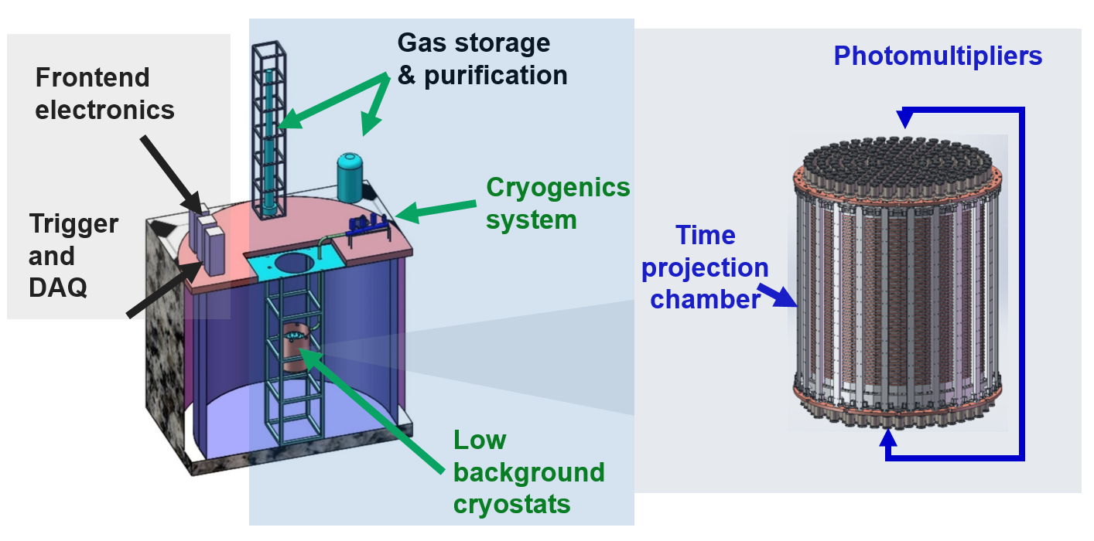
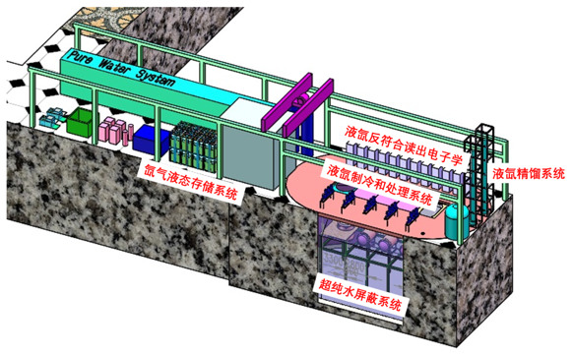
PandaX-4T
B2 Hall
14m(H)x14m(W)x65m(L)
JUNA
  PandaX-4T (4-ton in sensitive region)
PandaX
169+199+144
CDEX
TPC Drift region: Φ ~1.2m, H ~1.2m
Notes:
. Lets take a look at PanadX-4T.
PandaX4T will contain 4T xenon in the sensitive region, almost 7 times to PandaX-II. It will be operated at CJPL-II B2Hall in the future. Here are some diagrams shows every systems of PandaX-4T. We use ~500 PMTs to monitoring any signal happened in the senstivite region and around the detector is 1000 ton pure water screening backgrounds from the rock and air.

Slide 18
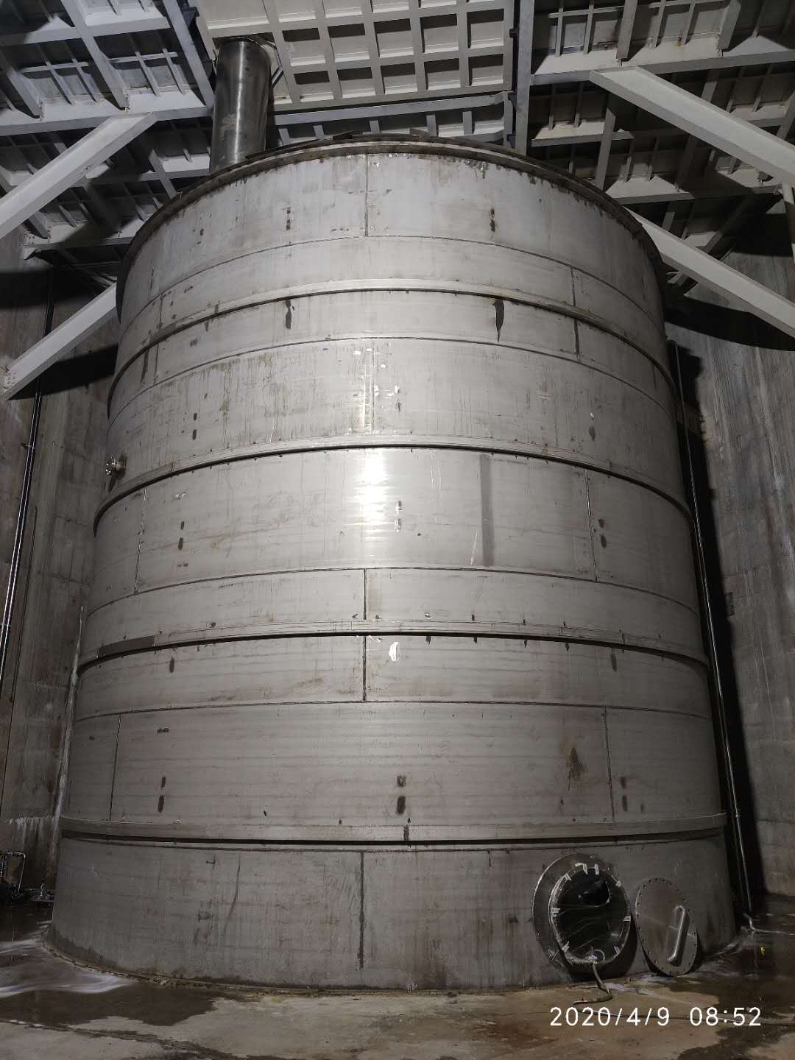
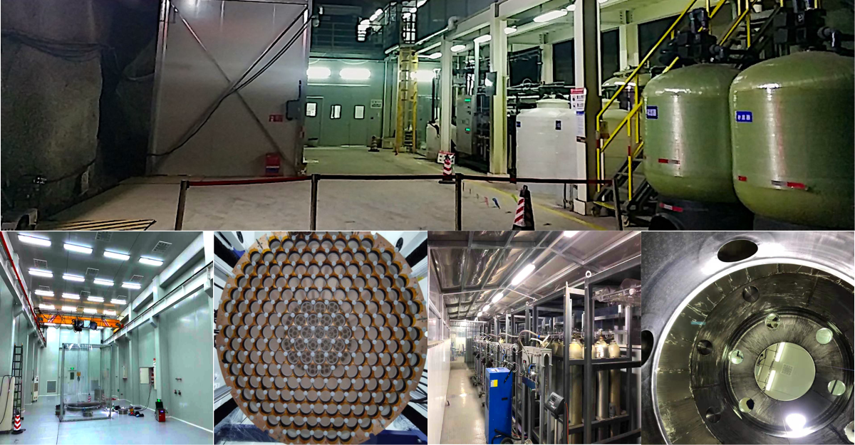
PandaX-4T’s house
Notes:
For now, we have finished all infrastructure systems including clean room water shielding radon removal air supply and gas handling.

Slide 19
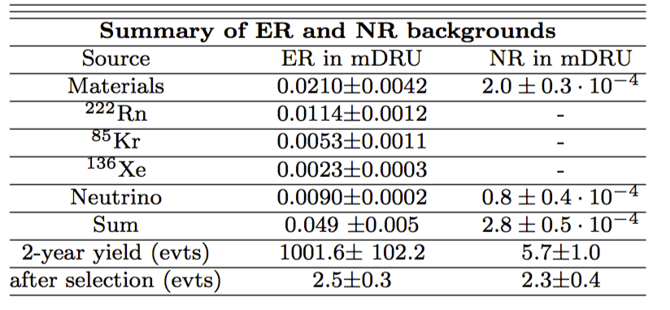
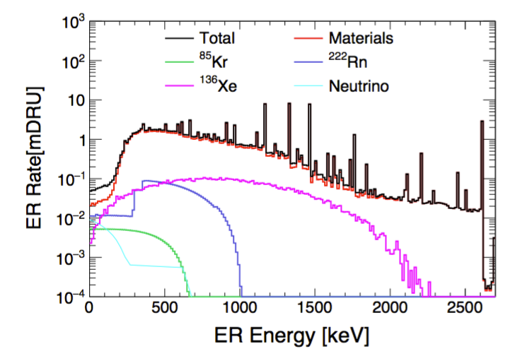
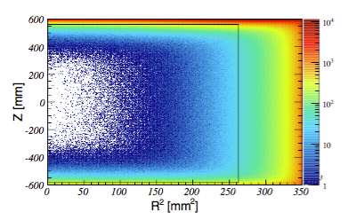
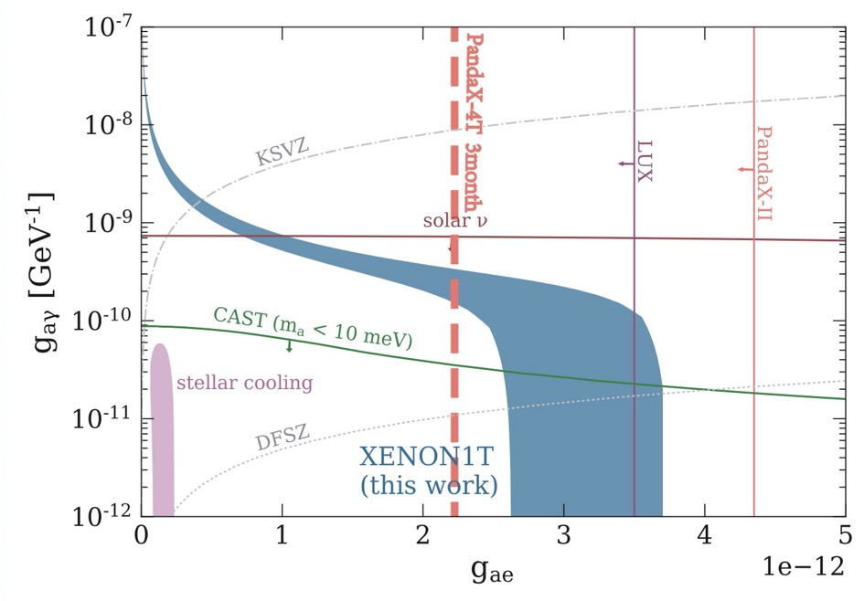
PandaX-4T Simulation Sci. China PMA 62 (2019) no.3, 31011
ER background in PandaX-4T
PandaX-4T 1 ton-year
Onsite detector assembly started: 2019
Commissioning of PandaX-4T: end of 2020
First physics data from PandaX-4T in 2021
Notes:
Based on the simulation, the background level of ER events from PandaX-4T is less than PandaX-II by a factor of 16, including bigger fiducial mass. PanadX4t would give a conclusive result to test the excess signal of XENON1T with just 1 ton-year ‘s data exposure. Here is somen key timeline of PandaX-4T The onsite detector assembly started one year ago. And we hope we will start the commissioning at the end of this year. And The first physics result would be ready in twenty twenty one

Slide 20


PandaX-II shutdown in 2019.06, with 100.7 ton days data for axion analysis
01
Four major backgrounds at low energy region were studied with robust data driven estimate and modeling.
02
Independent test of ABC axion and neutrino with enhanced magnetic moment hypotheses carried out.
XENON1T’s excess is within our experimental constraints.
03
PandaX-4T is on progress, and will test the excess together with upcoming XENON-nT and LZ
04
Summary
04
Thank you!
Notes:
Let’s surmarrize,

Slide 21

The only failure is to stop searching. — James Beacham
THANK YOU

Slide 22
Some published results of PandaX-II
Dark matter models | Exposure (Ton-day) | Publications
WIMP-nucleon Spin-Independent | 33 | PRL 117, 121303 (2016)
WIMP-nucleon Spin-dependent | 33 | PRL 118, 071301 (2017)
Inelastic scattering | 27 | PRD 96, 102007 (2017)
Axion and ALP | 27 | PRL 119, 181806 (2017)
WIMP-nucleon SI | 54 | PRL 119, 181302 (2017)
light mediator，self-interacting DM (*) | 54 | PRL 121, 021304 (2018)
EFT models and SD (*) | 54 | PLB 792, 193–198 (2019)
0ν2β decay search | 8.1 (¹³⁶Xe) | CPC 43, 113001 (2019)
Three experiments with similar dual-phase Xe TPC technology, LUX, XENON1T, and PandaX-II, pushed limits down further and further for WIMP direct detections
(*) collaborating with theorists: Hai-bo Yu (UCI) and Wick C. Haxton (UCB&LBNL)

Slide 23
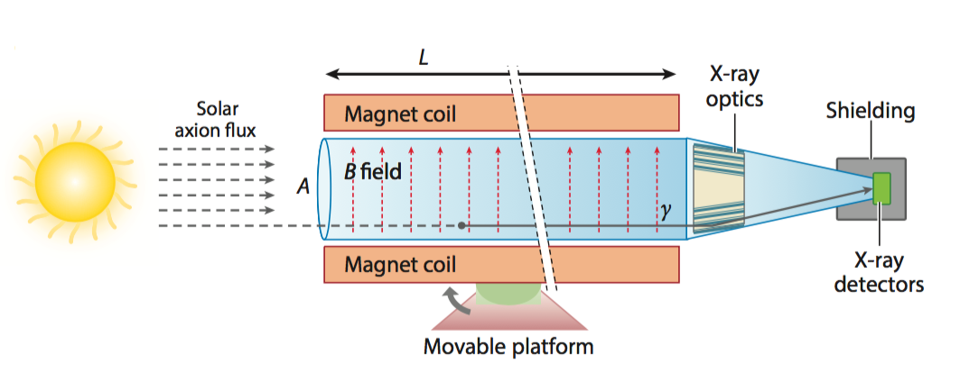
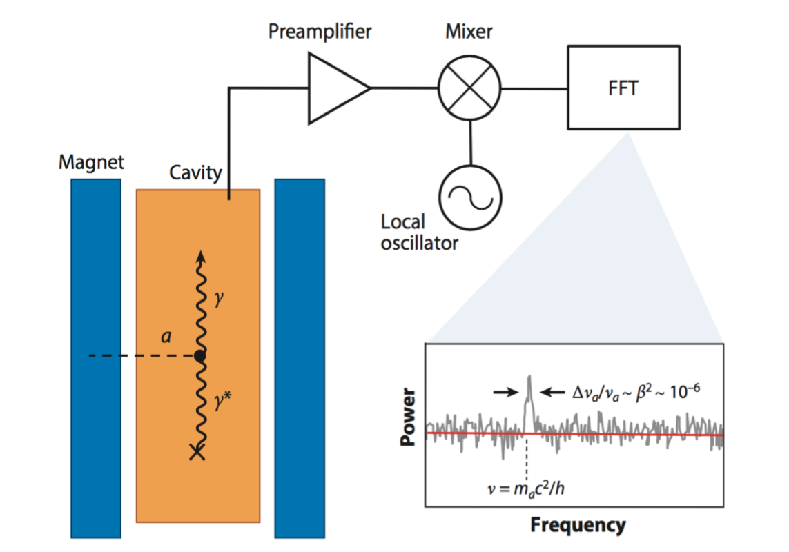
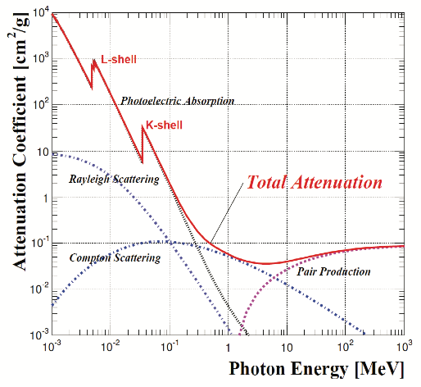
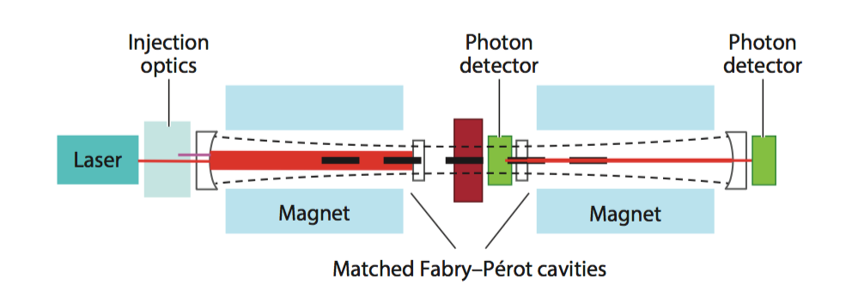
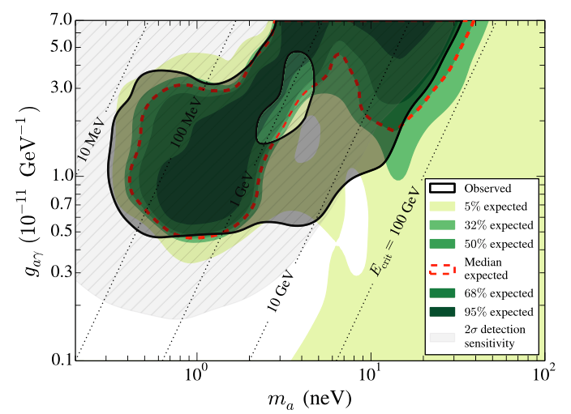
Phys. Rev. Lett. 120, 151301
CAST,IAXO
ADMX, ADMX-G2
PandaX, XENON, LUX, CDEX ……
Detect the axion couplings to photon or electron
Fermi_LAT
Direct
ALPS
Indirect
Generate
Direct the astrophysics anomaly caused by axion couplings
Generate axion with LASER in strong B field
Axion Sources:
  Sun, the biggest photon source around us
  DM halo, assuming DM particle is axion-like particles
Like WIMPs, no strong positive result yet
More and more experiments carried out
Search excess in Electron Recoil Spectrum!
23

Slide 24
Background Sources
Source | Evaluation
¹²⁷Xe | 35.5 day lifetime, decay away in Run 11
³H | Introduced after Run 9, fitted from data, see later
²²²Rn | Depletion effect from measurement
⁸⁵Kr | Not a constant due to air leakage in Run 11
neutrons | Data-driven estimation
surface events | Data-driven extrapolation
accidental events | Newly trained BDT discriminator

Slide 25
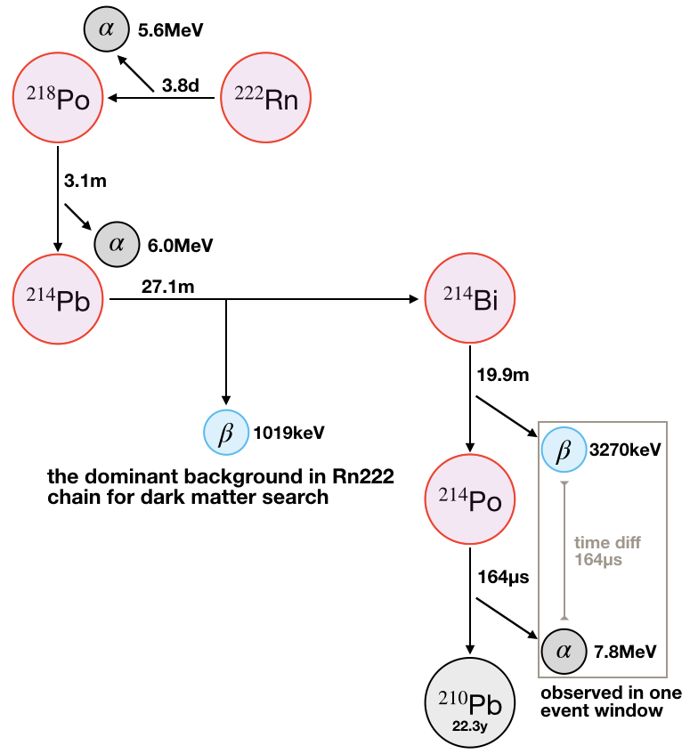
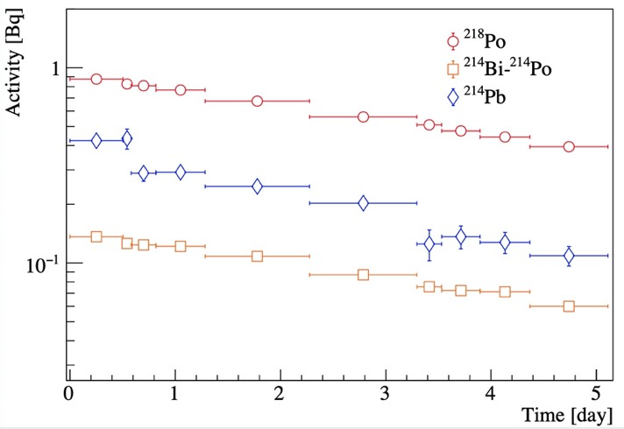
²²²Rn Background
Major ER contribution from ²¹⁴Pb
  Charged Rn progenies attracted to the cathode with negative HV
  Less contribution in fiducial volume: “depletion effect”
New method to evaluate ER event rate from ²¹⁴Pb
  The depletion ratio measured from ²²²Rn calibration (end-of-run)
  Interpolation from ²¹⁸Po and ²¹⁴Bi
PandaX-II ²¹⁴Pb level: 10μBq/kg
arXiv:2006.09311
²²²Rn calibration
Notes:
Among Rn daughters, Pb214 is the major ER contributor. However, the level of Pb214 is not equivalent to Rn or the other daughters. The reason is that the Rn progenies are charged, and they are attracted to the cathode with negative HV. Therefore along the decay chain, the concentration of these daughters in the detector center is less and less, which we call it the ”depletion effect”. In our new method, we estimate Pb214 from earlier daughter Po218 and later daughter 214Bi. The depletion ratio has been measured from Rn222 calibration during end-of-run.

Slide 26
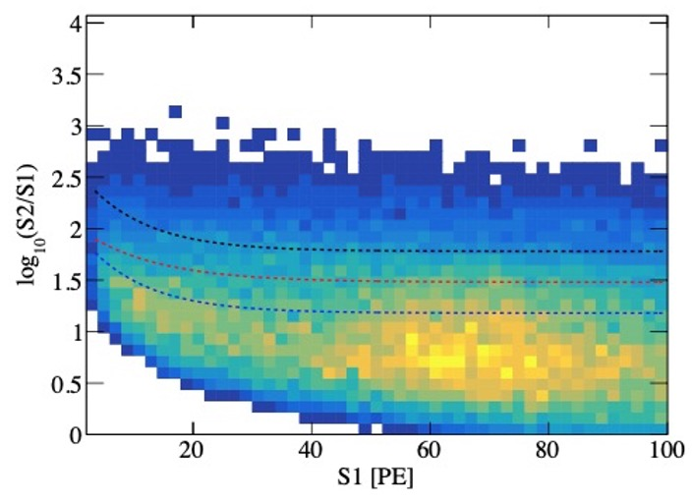
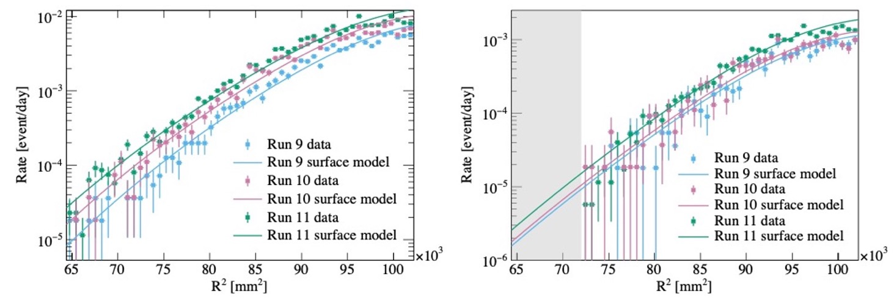
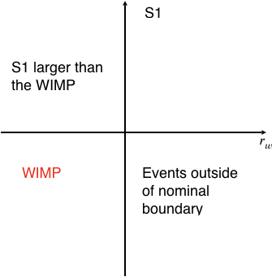
Surface Background
Surface events
  Mostly ER events from Rn plate-out
  Losing S2 on the surface, shifting below ER region
Data-driven extrapolation from outside FV region
ER region
NR region
Surface events
JINST 14 (10): C10039, 2019
FV
Outside
FV
Outside
Control Region
S1 [50, 100]PE
Signal Region
S1 [3, 45]PE

Slide 27
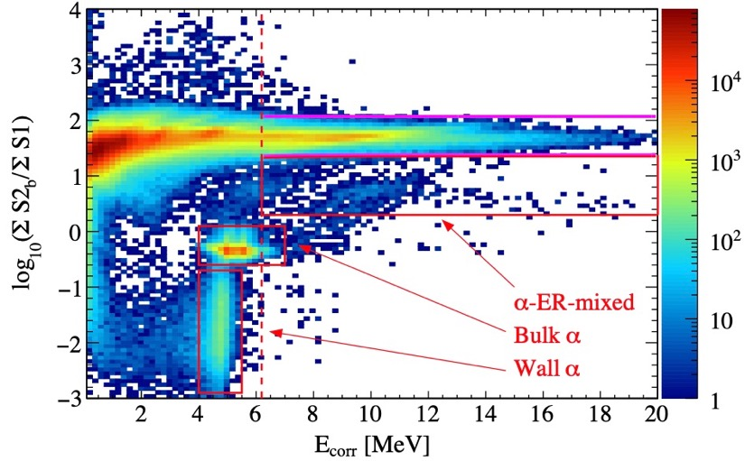
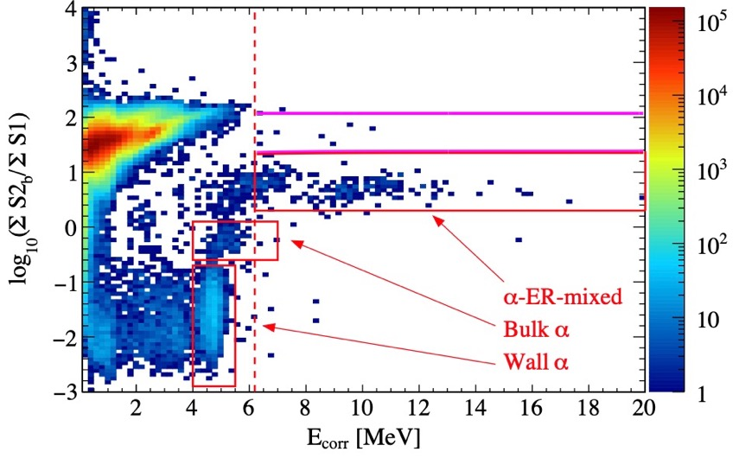
Neutron Background
New evaluation based on high energy gammas (HEGs)
  Neutron events associated with HEGs (neutron capture, nuclear de-exciation)
  Scale factor (neutron events / HEGs) from MC simulation with HEGs included
  Tested in AmBe calibration data
PandaX-II full exposure: 3.0±1.5 events in WIMP signal region
SCIENCE CHINA Physics, Mechanics & Astronomy(2019)
AmBe calibration
Dark matter run10
with a rejection cut
HEGs
HEGs

