Slide 1
The LTS and HTS detector magnet design
Zhao Ling
On behalf of superconducting magnet group

Slide 2
Outline
Solenoid design in the CDR
Progress of thin solenoid magnets
New design of solenoid(LTS)
New design of solenoid(HTS)
Next plan

Slide 3
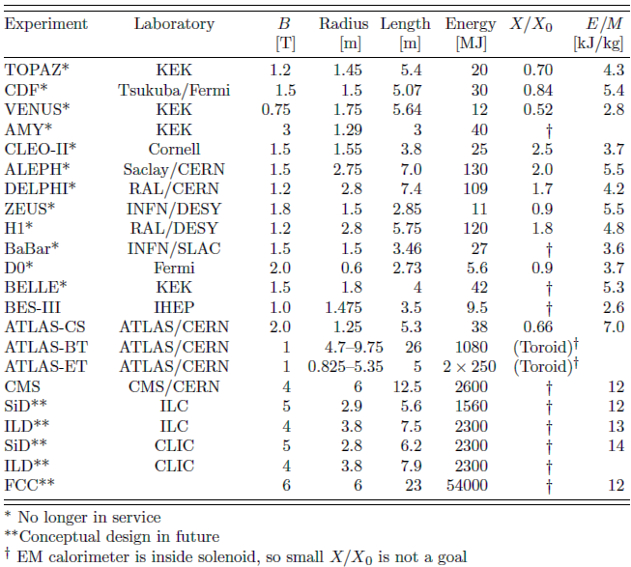
History of High Energy Physics Detector Magnets
Main parameters of detector magnets
1969 CERN –BEBC, Big European Bubble Chamber (solenoid)
1972 CERN –Omegamagnet (large aperture dipole)
1977 CERN/ISR –Solenoid
1978 DESY –CELLO (solenoid)
1983 SLAC/PEP4 –TPC solenoid
1985 KEK/TRISTAN –TOPAZ, VENUS (solenoids)
1988 CERN/LEP –ALEPH, DELPHI (solenoids)
1990 DESY/HERA –ZEUS (solenoid)
1997 SLAC –BABAR (solenoid)
2004 KEK –BESS-Polar (ultra-thin solenoid)
2007 CERN/LHC –CMS (solenoid), ATLAS (Toroids, solenoid)
T. M. Taylor, CERN Summer Student Lecture, 2006
Revised August 2017 by Y. Makida (KEK)
Notes:
Not an exhaustive list!
Historically detector magnets were the first application of superconductivity (Bubble Chambers)
• As early as late 60s and beginning of 70s big magnet in LHe pool, boiling: Argonne and BEBC (CERN); concept of cryostabilisation (Stekly criterion)
1978 CELLO, Pure aluminum as stabiliser was employed for thin solenoids; then also for outer solenoids, toroids and now is becoming the standard stabiliser.
• Remarkably in 30 years the magnetic field increased only a factor 2: from 2-3 T to 6 T peak field of CMS.

Slide 4
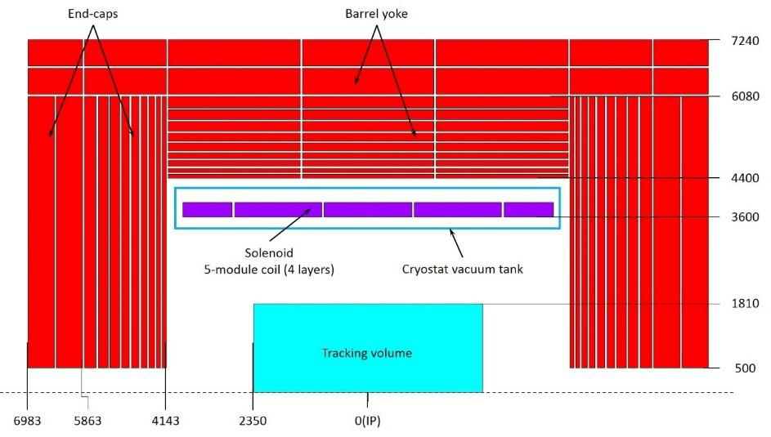
Design of LTS DETECTOR MAGNET in CDR
By Guoqing Zhang
Solenoid central field ：3T
Working current：15779A
Coil inner radius：3600mm
Cable length：30.1km
CMS
Pure Al+Alloy
CEPC
Pure Al+Alloy
Pure aluminum stabilizer
Aluminum alloy reinforcement

Slide 5
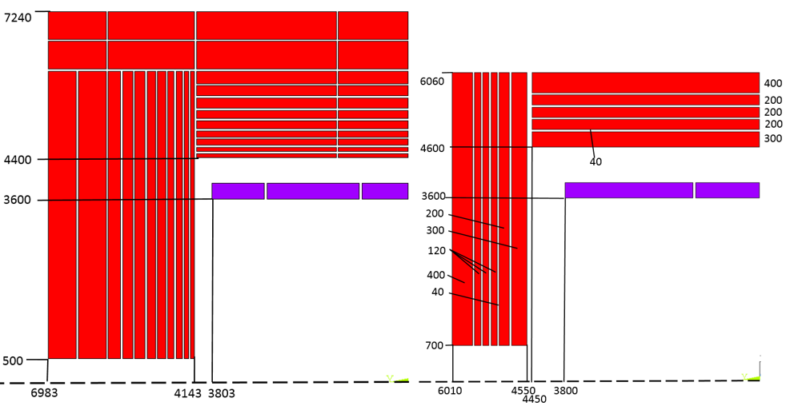
New Yoke Design of LTS DETECTOR MAGNET
By Feipeng Ning
 |  | CEPC CDR version | CEPC New version
Central field (T) |  | 3 | 3
Operating current (A) |  | 15779 | 16796
Inner diameter of coil (mm) |  | 7200 | 7200
Length of coil (mm) |  | 7606 | 7600
Barrel yoke inner diameter (mm) |  | 8800 | 9200
Barrel yoke outer diameter (mm) |  | 14480 | 12120
Total length of yoke (mm) |  | 13966 | 12020
Weight of barrel yoke (t) |  | 5940 | 3137
Weight of each end cap (t) |  | 3316.6 | 1144
Total weight of yoke (t) |  | 12,573 | 5,425
CDR version
New Yoke version

Slide 6
New requirement
The detector magnet will be located between the Hadron calorimeter and Electromagnetic calorimeter ；
Reduce mass : Increase coil current density，and superconductor were reduced from four layers to two or three layers.
Reduce the radial space occupied by superconducting magnet.
Central field: 3T
Magnet inner bore: >4 meter
Coil Length: about 6 meter.

Slide 7
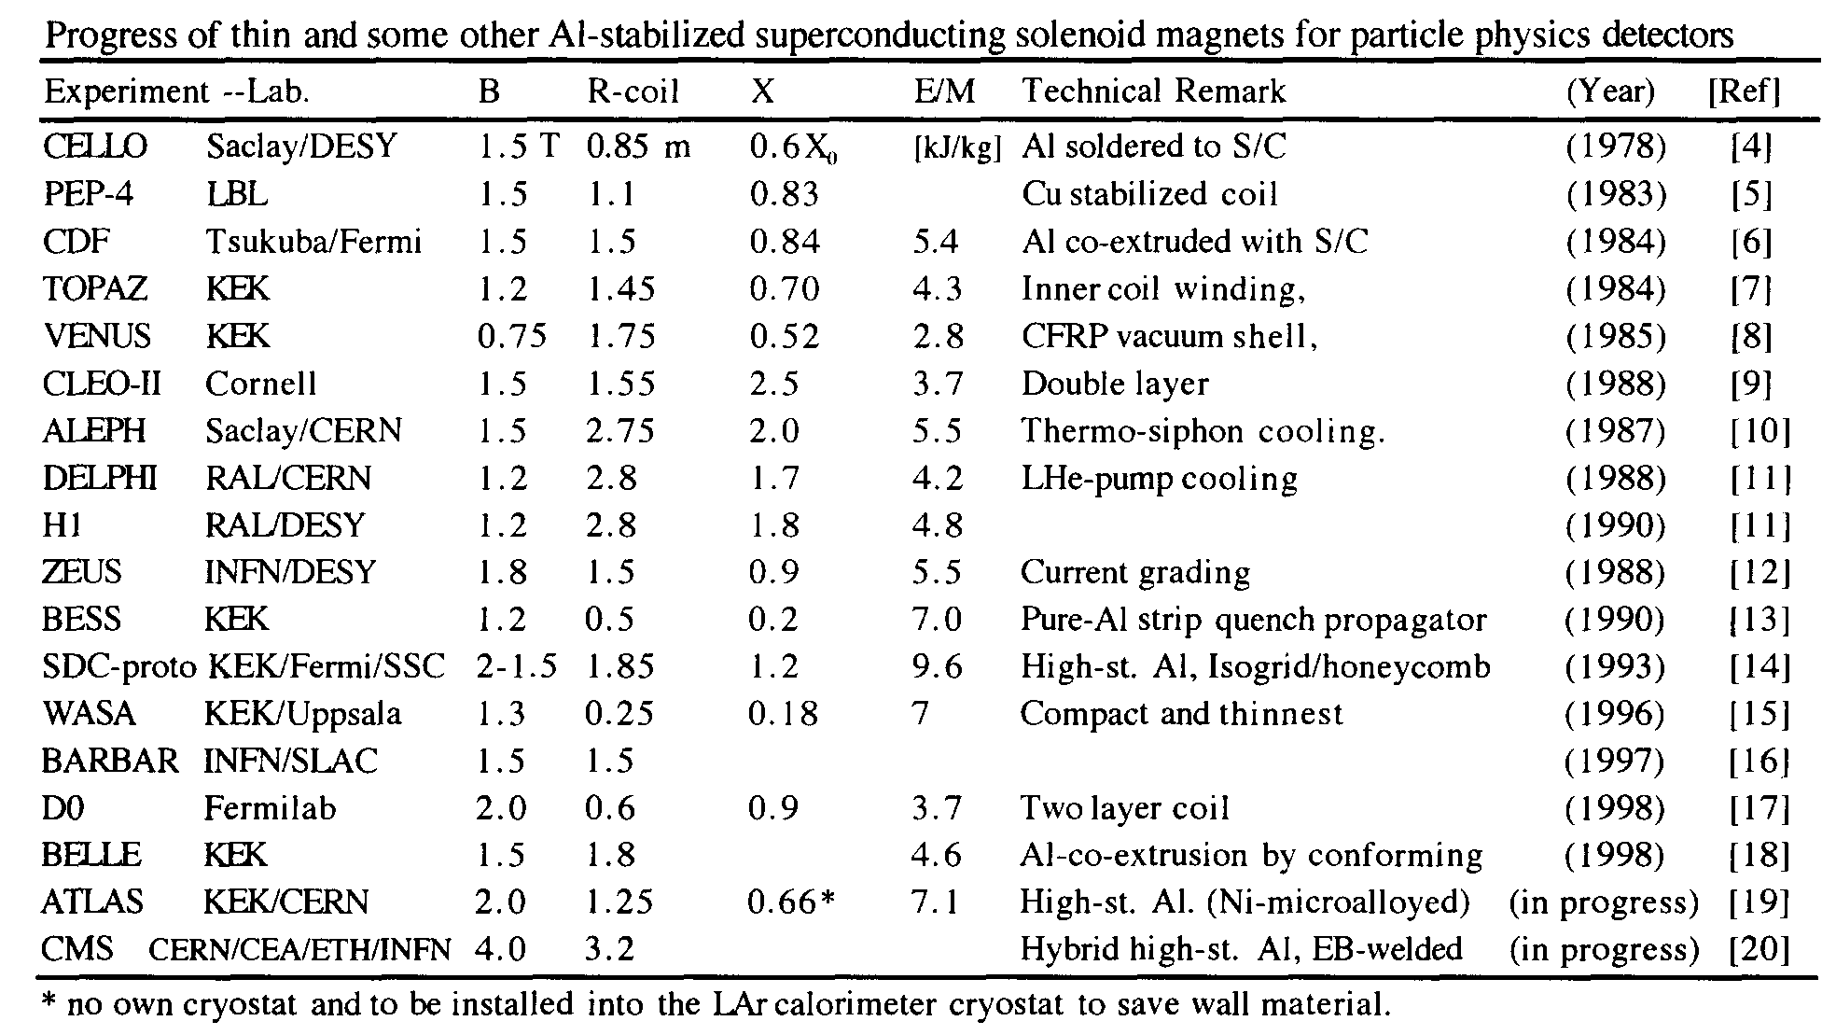
Progress of thin solenoid magnets

Slide 8
Comparison: Thickness of thin solenoid
 | CMS | BESIII | ALEPH | DELPHI | BESS-POLAR | WASA | SDC PROTOTYPE | IDEA* | CDR(CEPC) | NEW DESIGN
Central field (T) | 4 | 1 | 1.5 |  | 0.8 | 1.3 | 1.5 | 2 | 3 | 3
Operating current (A) | 19600 | 3369 | 5000 |  | 380 | 900 | 12000 | 20000 | 16796 | 16956
Inner diameter of coil (mm) | 6360 | 2960 | 5300 |  | 900 | 553.6 |  | 2200 | 7200 | 4600
Length of coil (mm) | 12480 | 3520 | 6350 |  | 1400 | 465 | 1900 | 6000 | 7606 | 5000
Outer shell external diameter(mm) | 7600 | 3292 | 5840 | 3080 | 1060 | 650 | 4012 |  | 8700 | 5600
Inner shell inside diameter(mm) | 5940 | 2750 | 4960 | 2600 | 800 | 490 | 3400 |  | 6800 | 4400
Thickness of cryostat (mm) | 830 | 271 | 440 | 240 | 130 | 80 | 306 | 300 | 950 | 300~400?

Slide 9
New design of solenoid(LTS)
By Guoqing Zhang
Coil with two layers superconductor ：weight of superconductor is 11.4t。
Coil with three layers superconductor：weight of superconductor is 17.2t.

Slide 10
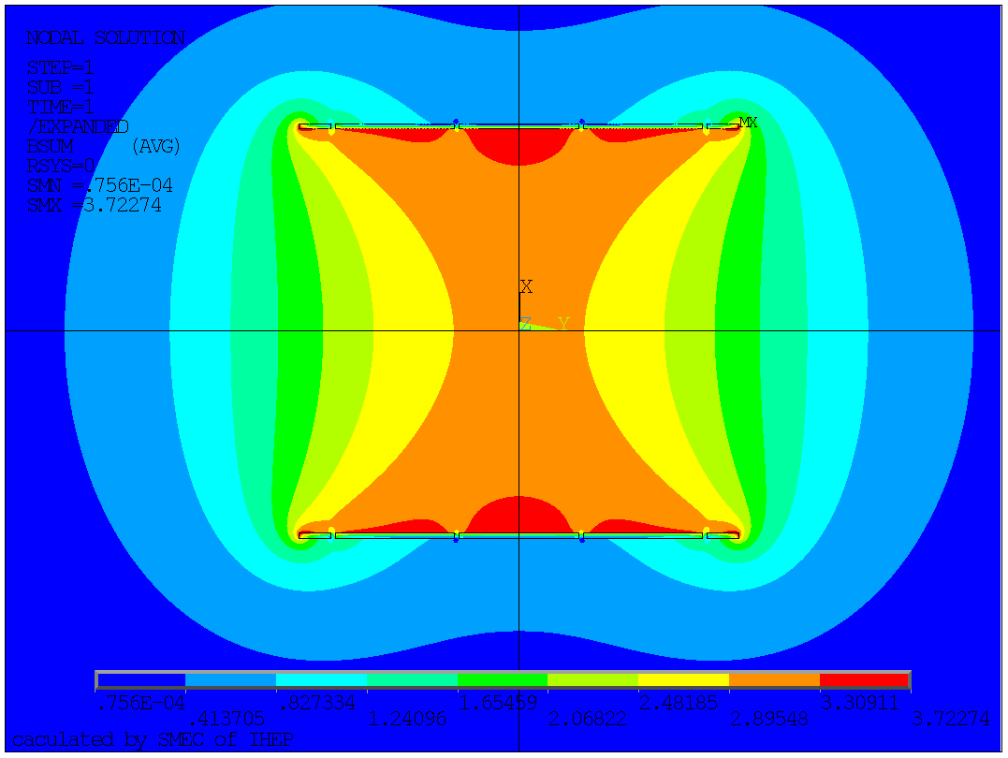
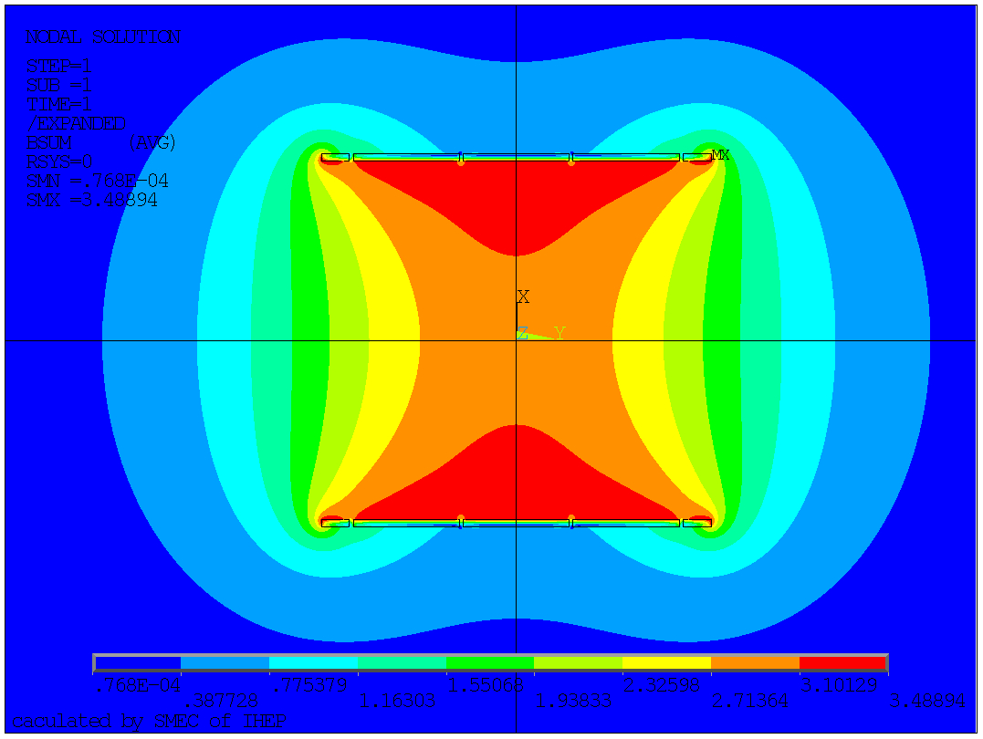
New design of solenoid(LTS)
By Guoqing Zhang
Central field：3.0T；
Max field on coil：3.73T/3.495T；
Stored energy：0.3959GJ/0.40024GJ；
Working current：16956A/11338A；
Two layers coil
three layers coil
Field Distribution

Slide 11
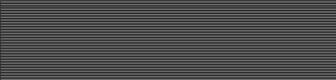
New design of solenoid(HTS)
By Feipeng Ning
Coil parameters:
Coil inner radius | 2.2 m
Coil length | 6 m
Cable layers | 2
Tape layer of each cable | 35
Tape width/thickness | 10 mm/80 μm
Operating current | 29700 A
Operating temperature | 5 K
20
10
5
15

Slide 12
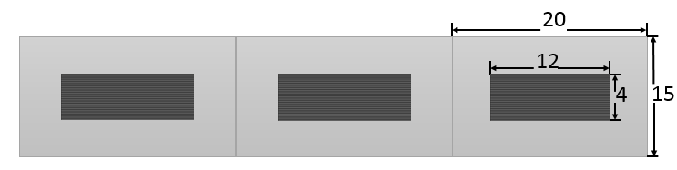
Radiation thickness calculation
By Feipeng Ning
35 layers HTS tapes of each cable.
Material | Thickness | Radiation thickness |  | Nuclear Interaction length
 | X, mm | X₀, mm | X/X₀ | λ0, mm | λ=X/λ0
Cu | 0.7 | 14.36 | 0.0244 | 153.2 | 0.0023
Fe | 1.75 | 17.57 | 0.0996 | 167.7 | 0.0104
Ag | 0.07 | 8.543 | 0.0082 | 154 | 0.0005
YBa2Cu3O7 | 0.07 | 12.49 | 0.0056 | 296.5 | 0.0002
MgO | 0.00000035 | 78.28 | 0.0000 | 274 | 0.0000
Al2O3 | 0.0000028 | 70.38 | 0.0000 | 247.9 | 0.0000
CeO2 | 0.0000105 | 16.54 | 0.0000 | 230 | 0.0000
Al stablizer | 10 | 88.97 | 0.1686 | 397 | 0.0378
MLI, Fiber glass | 0 | 286 | 0.0000 | 415 | 0.0000
Glassepoxy | 2 | 286 | 0.0070 | 428.9 | 0.0047
Total, X_{tot} |  |  | 0.2815 |  | 0.0455
Radiation thickness of HTS cable
(don’t include cryostat):
 | X0 | λ
Single cable | 0.2815 | 0.0455
Double layers cable | 0.563 | 0.091

Slide 13
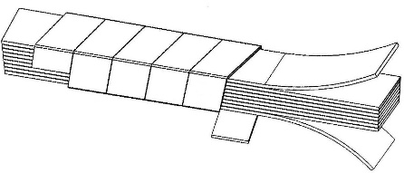

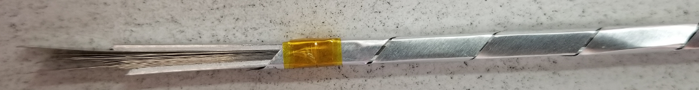
HTS cable development
Prototype cable:
Tape Width: 4 mm, thickness: 80 μm; tape layer: 20
Expected operating current: 6000 A
ReBCO Stack Cable
Compact stack structure:
Al film thickness and width
Winding stress
Other materials

Slide 14
Next Plan
For LTS:
R&D of High strength superconducting cable with self supporting structure;
For HTS:
R&D of HTS cable;
R&D of Large HTS coil;
For both:
Optimization of coil support system;
Optimization of coil cooling structure;
Optimization of vacuum vessel structure;
Thin solenoid

Slide 15
Comparison
LTS:
more experience on cable and coil winding；
small temperature margin(4.5~6K)；
more mass(coil thickness 60mm)；
HTS
more R&D on cable and coil winding；
Higher temperature margin(4.5~20K)；
lower mass(coil thickness 30mm)；

Slide 16
Funds and personnel
Funds: 1.5millon(IHEP)+3millon(0-1)+3millon
Personnel: Zian Zhu/Ling Zhao/Feipeng Ning
Part time: Meifen Wang/Huan Yang/Guoqing Zhang
Students: 1~2
More R&D is needed for detailed design.

Slide 17
Thanks for your attention!

Slide 18
Back Up
BESS-Polar solenoid

Slide 19
Back Up

Slide 20
Back Up

Slide 21
Back Up
A shared cryostat for solenoid and electronic calorimeter.

Slide 22
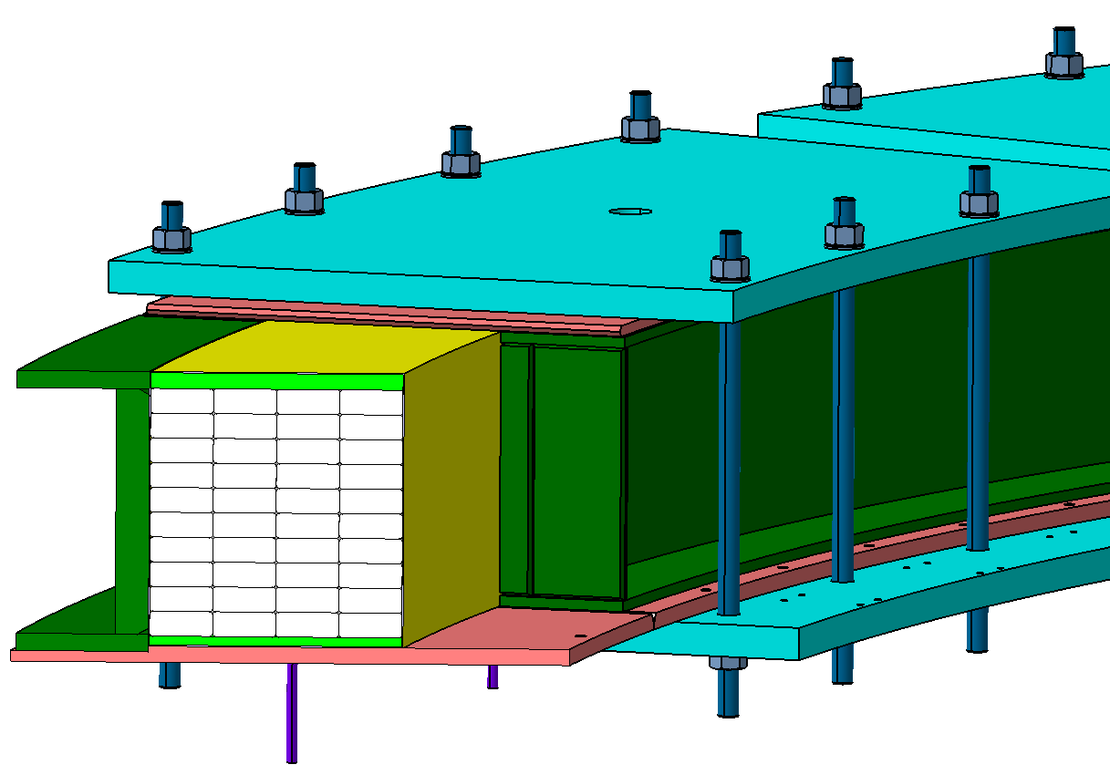
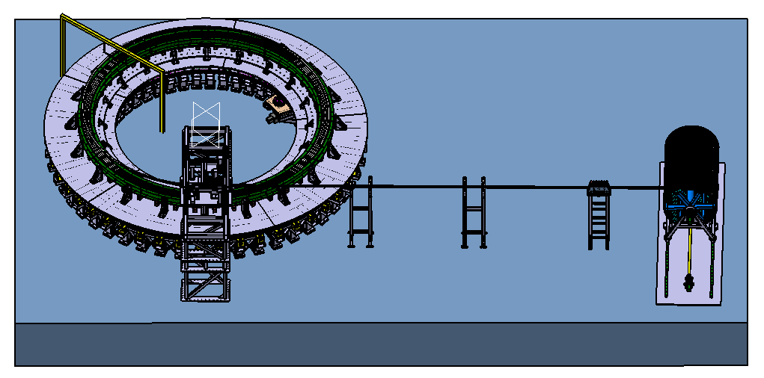
Back Up
超导磁体Dummy线圈及绕制工艺装备设计
绕制生产线布置
生产线占地：22mx16m；
回转平台
已矫直导体：高度2.2米
放缆桶
Dummy线圈设计
成型机
Dummy线圈包括一个铝支撑筒和dummy线圈；
内径7.2米，长度约0.3米；
采用56*22mm的Dummy铝合金缆进行绕制，共4层，每层十匝；
匝间绝缘大于500V；
对地绝缘大于1000V。
成型机桁架
缓冲支撑
矫直机
生产线搭建前在产线所在区域布置靶标测量点，便于产线设备安装调试。
控制系统控制整个系统的运行，各子系统可单独运行，也可联动。
通过单机调试及联动调试使整个生产线得以平稳运行。

Slide 23
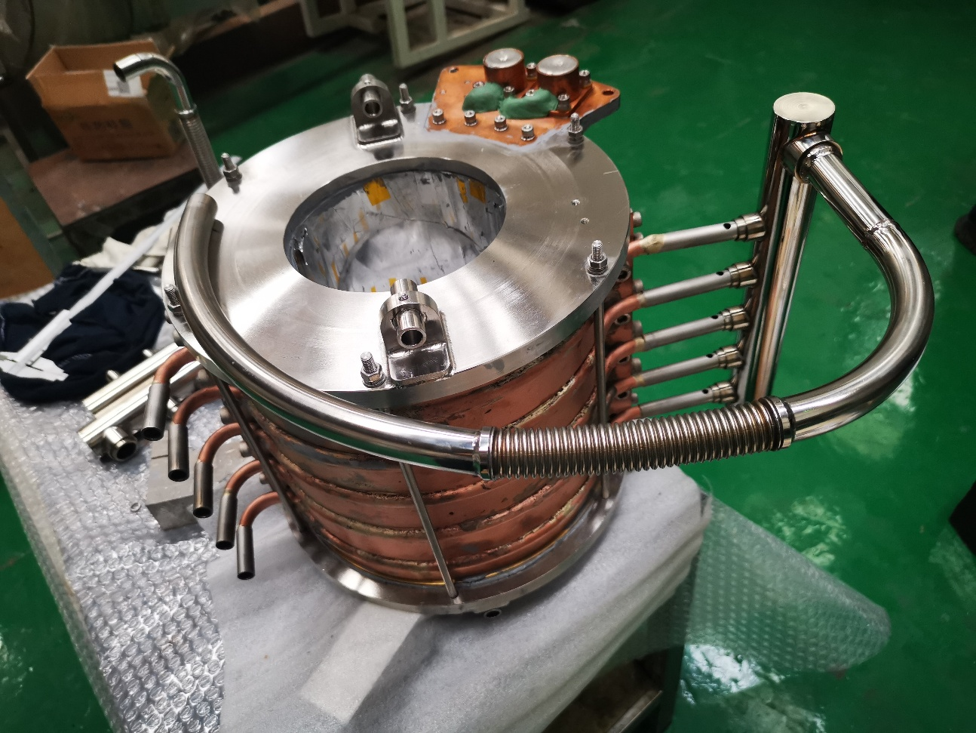
Coil Cooling Design
Back Up
 | Internal section size(mm) | Wall thickness(mm) | Length(mm)
Cooltube | Φ8 | 1 | 400
Feed pipe | Φ12 | 2 | 600
Exhaust pipe | Φ12 | 2 | 140
The phase separator | Φ100 | the upper plate 6，the bottom palte 10，cylinder 6 | 106
Steam tank、Sump | 50×20 | 2 | 203

Slide 24
Back Up

Slide 25
Back Up

