Slide 1
CEPC BOOSTER KEY ISSUE STUDY PROGRESS
Daheng JI
2020.09.23

Slide 2
Outline
Booster Error Study Based on FODO Lattice (CDR)
  Booster optics (CDR)
  Error effect and correction of linear optics
  Sawtooth effect @180GeV
  Effect of earthfield @10GeV
  Impacts/solution of Detector Stray Field
  Dynamic simulation with errors during ramping and table ramping scheme
Booster Error Study Based on Lower Emittance Lattice

Slide 3
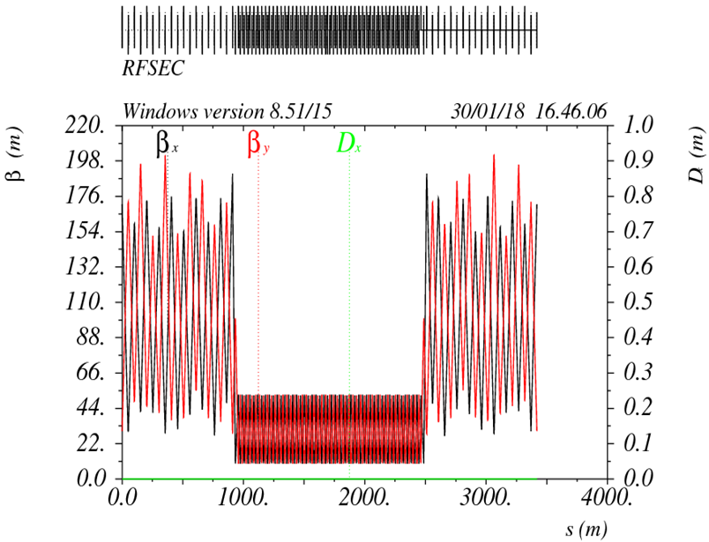
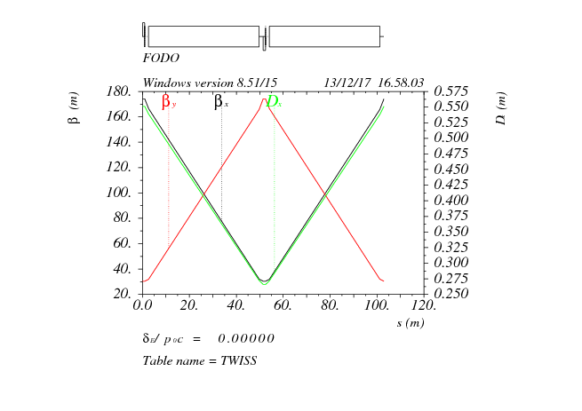
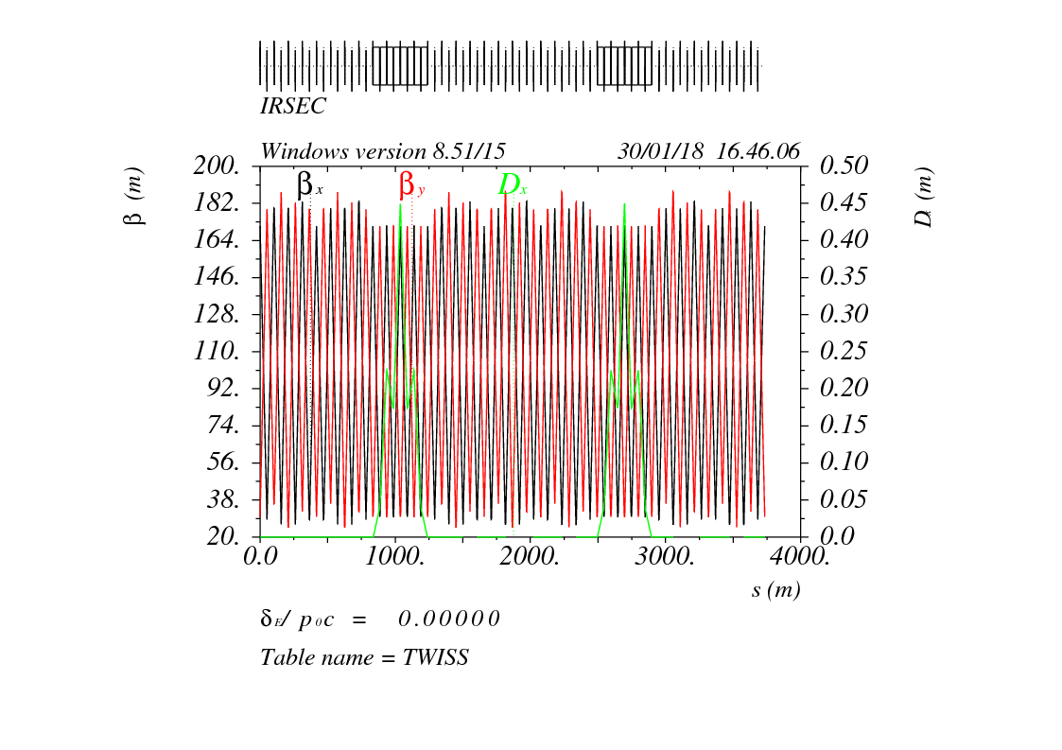
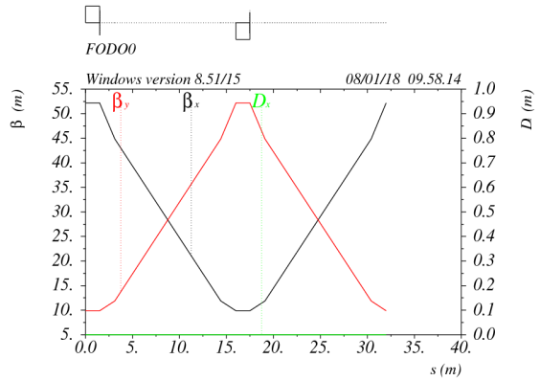
Booster optics (CDR)
90°/ 90° FODO cell
2 cells @ booster = 3 cells @ collider
Noninterleave sextupole scheme
Low average beta to reduce the multi-bunch instability
RF
FODO cell
IR: booster bypasses the collider.
25m separation:
IR
- civil engineering
radiation protection
Synchroneity w collider

Slide 4
Error effect and correction for linear optics (CDR1)
 | Dipole | Quadrupole | Sextupole
Transverse shift X/Y (μm) | 100 | 100 | 100
Longitudinal shift Z (μm) | 100 | 150 | 100
Tilt about X/Y (mrad) | 0.2 | 0.2 | 0.2
Tilt about Z (mrad) | 0.1 | 0.2 | 0.2
Nominal field | 1e-3 | 2e-4 | 3e-4
Almost impossible to obtain the initial closed orbit naturally
  Start from sextupole off
Orbit correction (COD)(100 Seeds)
  Response matrix method(RM)
  SVD method
  3 Iterations
Optics correction(15 Seeds)
  Response matrix method
  LOCO code
  Dispersion corrected
  3 Iterations
*Error term in shadow are now introduced into the error model.
Gaussian distribution and cut-off at 3σ
 | Accuracy (m) | Tilt (mrad) | Gain | Offset w/ BBA(mm)
BPM(10Hz) | 1e-7 | 10 | 5% | 30e-3
 | Amount
HCorrector | 1053
VCorrector | 1054
BPM | 2108

Slide 5
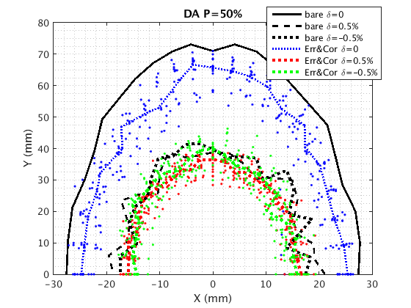
Error effect and correction for linear optics (CDR2)
RMS | Before Correction | COD | COD + Optics
Orbit (mm) | 15.9/9.7 | 0.1867/0.1060 | 0.0575/0.0525
Beta Beating(%) | 58.14 /46.72 | 14.62/12.33 | 0.294/0.353
Delta Tune | 0.048/0.058 | 0.0265/0.0277 | 0.0265/0.0277
Delta Dispersion(m) | 8.504/4.880 | 0.0708/0.0174 | 0.005/0.007
Optics correction needs independent quadrupole magnet PS.
COD+Optics Correction has a good effect on beam parameter and DA recovery.

Slide 6
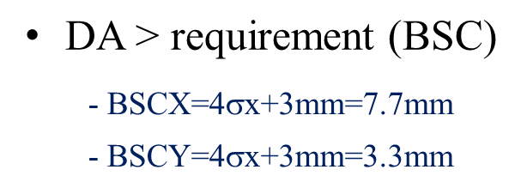
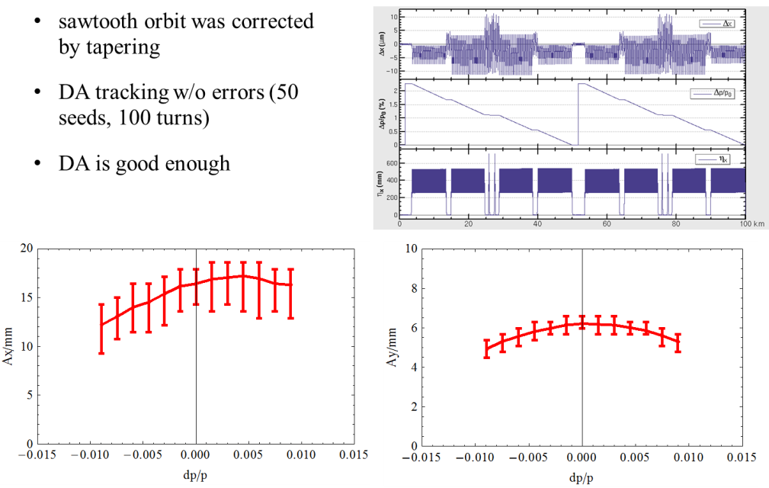
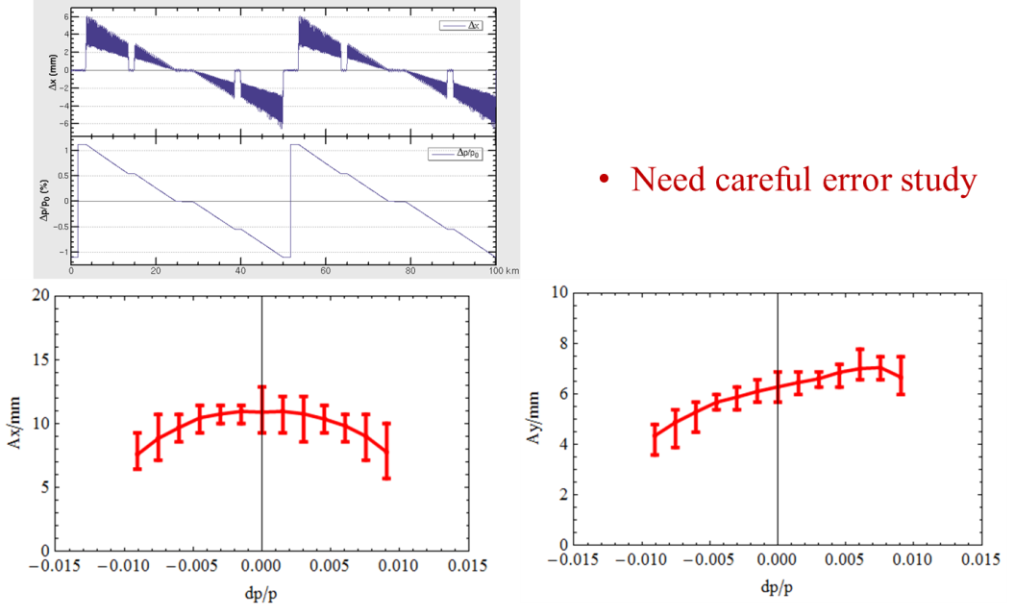
Sawtooth effect @180GeV
2 RF stations
Maximum sawtooth orbit: 6 mm
Energy deviation: 1.1%
Emittance growth: ~3.6%
Study of orbit correction with errors is going on.
Possible solutions:
Tapering for all the quad and sext
Taper dipoles in 8 sections
Orbit correction
W/O taper
W taper

Slide 7
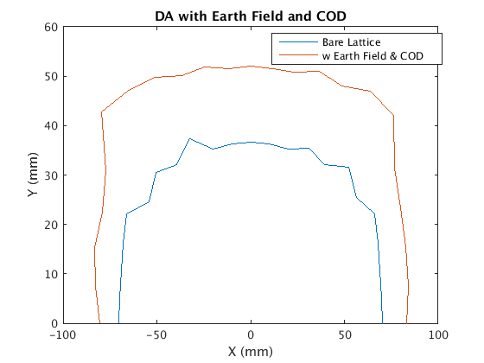
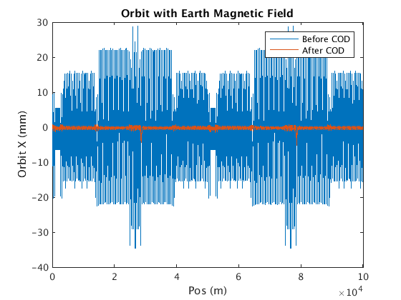
Effect of earthfield @10GeV
~20% vacuum pipe (drift) is exposed in earthfield directly.
treat drifts as week dipole to simulate the effect of earthfield
Assume earthfield: 0.3~0.6 gauss (simple model: perpendicular component only )
Working point can be corrected by weaken the dipoles systematically (-0.07%)
Global COD correction was tested for 0.3 gauss earthfield.
DA is acceptable after COD correction.
0.3 gauss
first turn trajectory

Slide 8
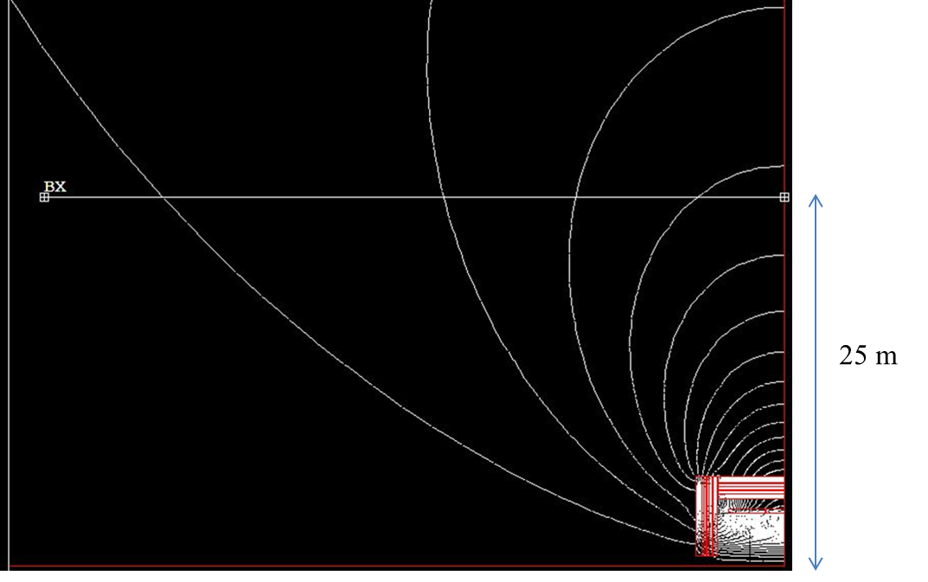
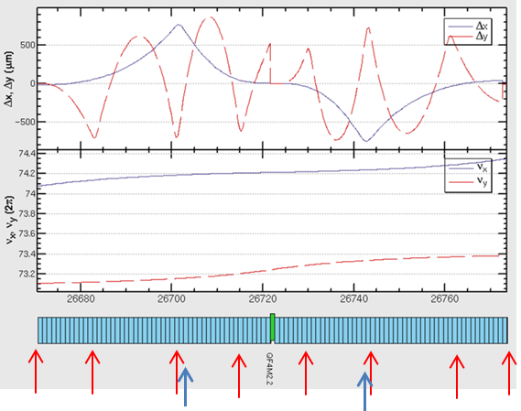
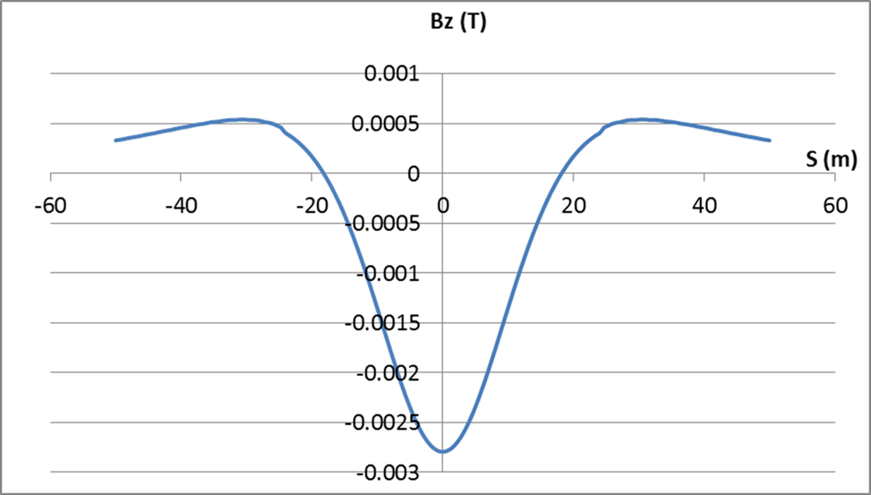
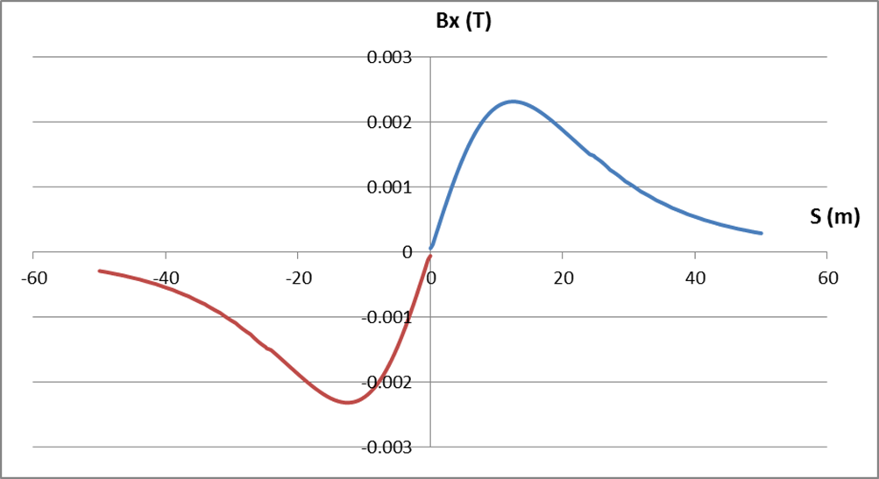
Impacts/solution of Detector Stray Field
Bz=28Gs Bx=23Gs By=2.3 Gs
Longitudinal field is modeled as solenoid.
Transverse field is modeled as dipoles.
100 slices (-50m ~ 50m): simulate the real distribution of detector field.
Beam dynamics effects of detector field is strongest at 10 GeV.
Orbit correction (8 v correctors+ 2 h correctors)
No influence to booster DA @10GeV
Extra SR loss < 1%, critical energy <10% @(180GeV)

Slide 9
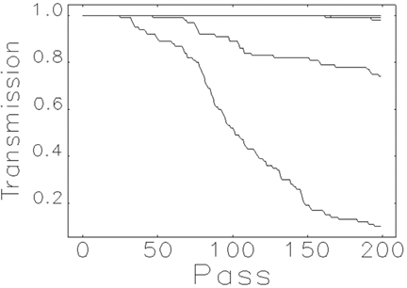
Dynamic simulation with errors during ramping
Dynamic simulation with orbit correction
Consistent simulation for orbit correction and ramping process (elegant)
No close orbit before orbit correction
Two steps of orbit correction
- Sex off → sex open
Transmission efficiency: 100%
Study for track precision/synchronization tolerance
Add random strength errors for dipoles, quadrupoles, sextupoles and correctors after COD correction at 10GeV
Ramping simulation for first 200 turns
100 random seeds and 100 particles
The worst 10% cases are rejected.
Track precision/synchronization requirement: ~ 3×10⁻⁴ (RMS)
amplitude=3.0e-4

Slide 10
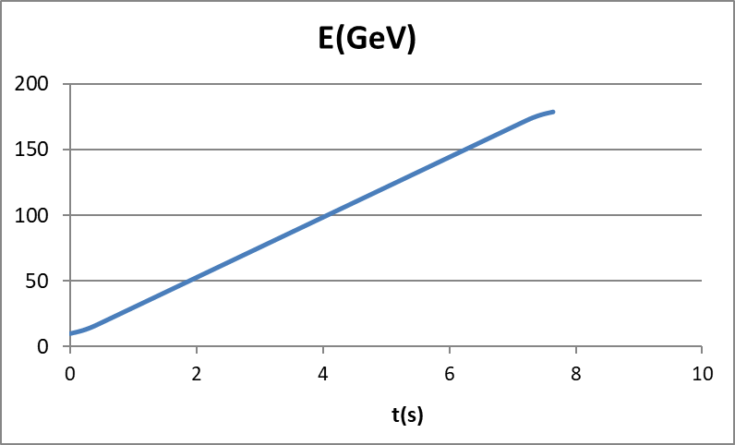
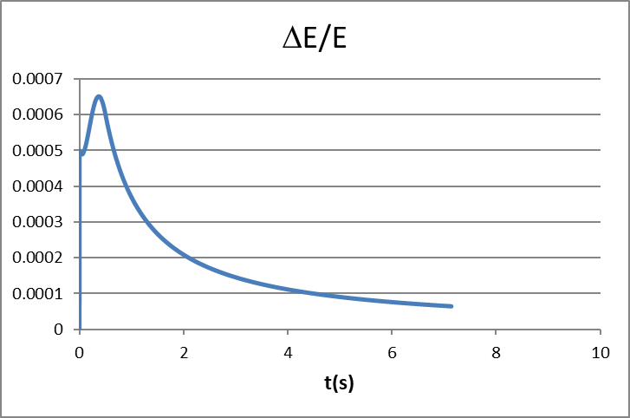
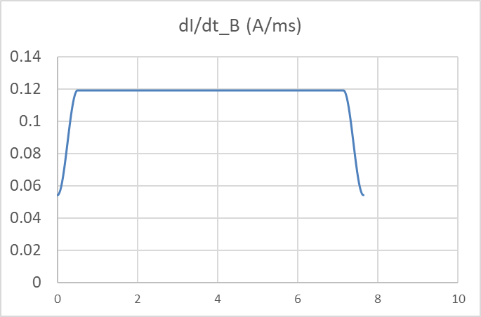
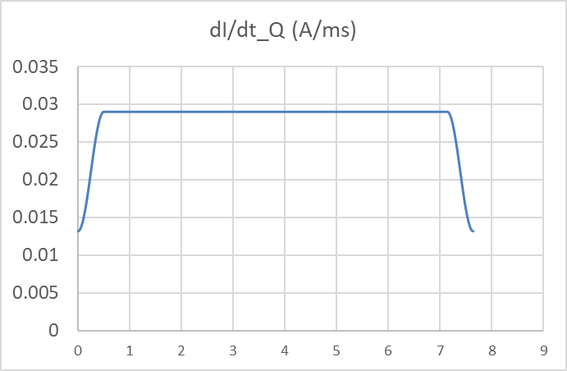
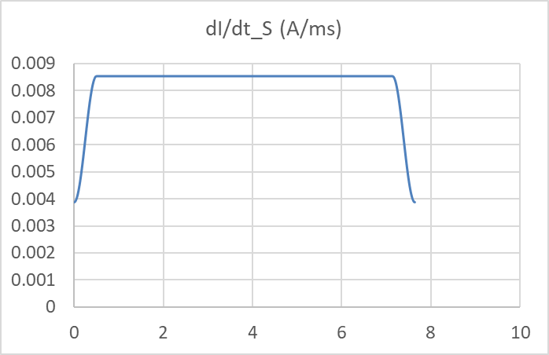
Table ramping scheme
There is some waiting time without ramping for CEPC booster and the duty factor is different for four energy modes.
Tracking precision and synchronization of power supplies need to be controlled.
Primary ramping table design is considered.
Ramping step : 0.5ms
Clock frequency: 2kHz
Points number: ~16000*2
Energy precision: < 0.07%
dipole
quadrupole
sextupole

Slide 11
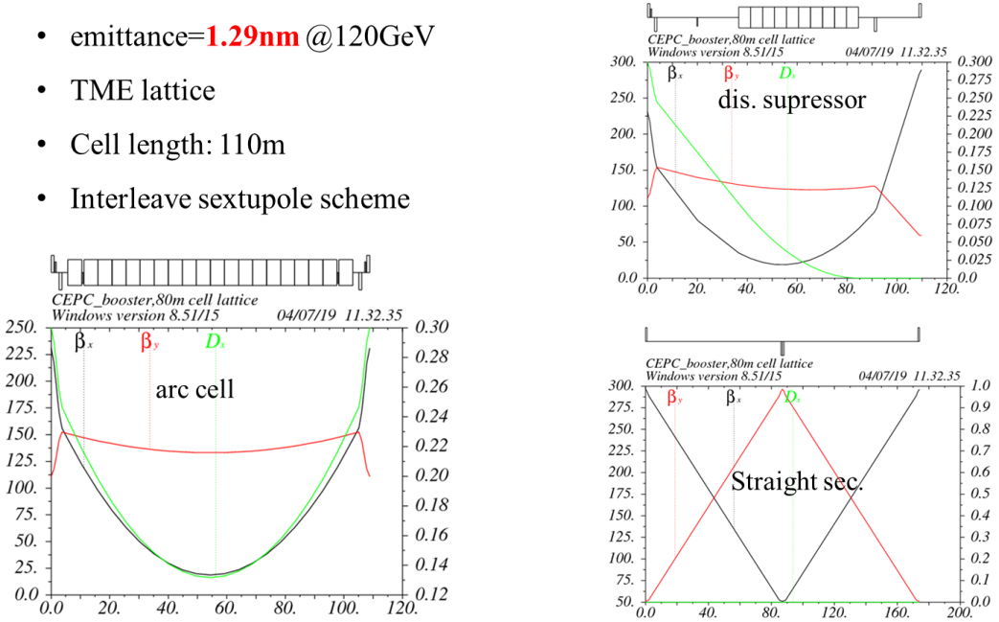
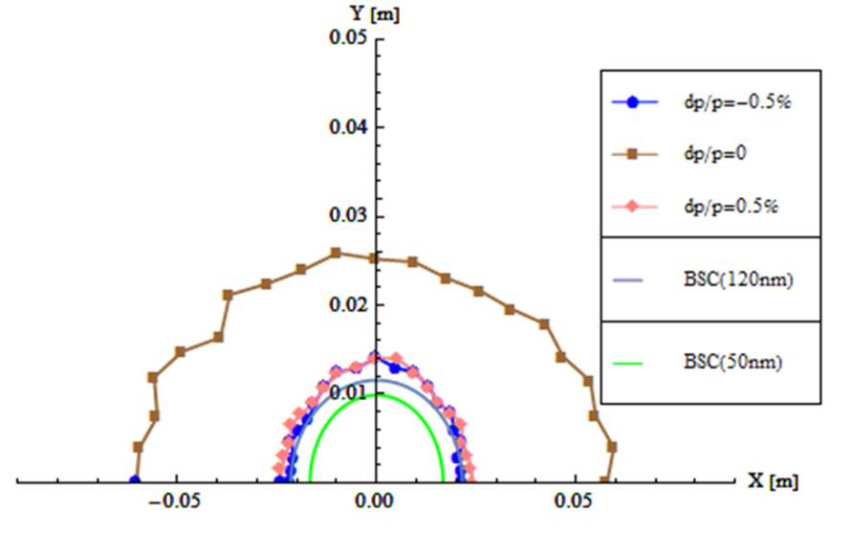
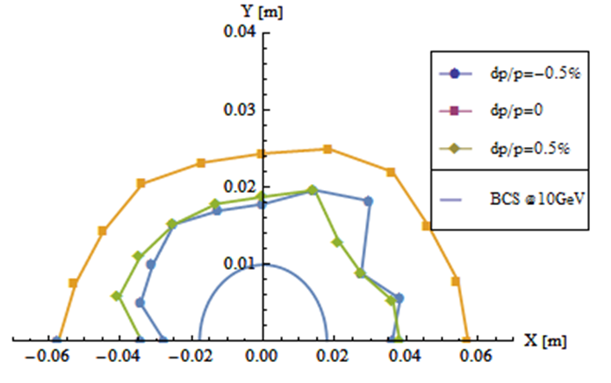
Lower emittance lattice
Emittance: 3.57nm → 1.29nm
Coupling requirement: 0.5% → 1.4%
Injection for higher lum. H mode
Off-axis injection for CDR H
Difficulty transfer from Collider to booster
CDR
new

Slide 12
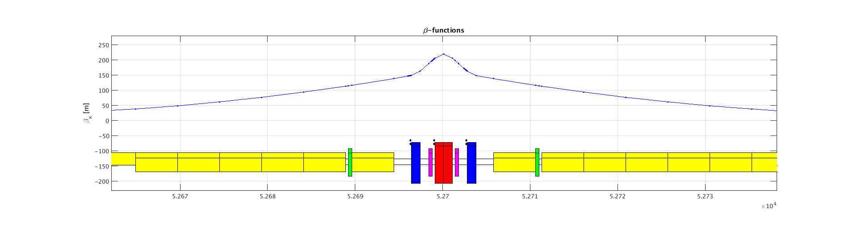
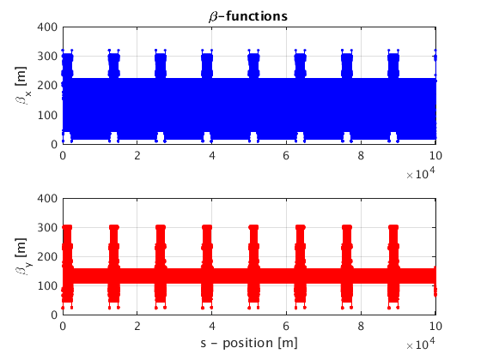
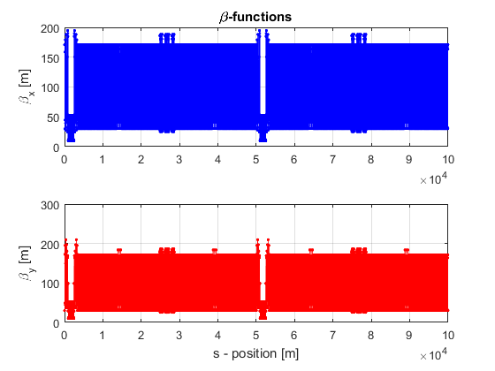

Error effect and correction for linear optics (TME1)
 | FODO | TME(Lower Emittance)
Emittance X (nm) | 3.57E-09 | 1.29E-9
Tunes | [263.2016/261.2193] | [319.2507/129.2806]
Quad amount | 2110 | 2528
Quad Strength (K1L rms） | 0.0383 | 0.0828
Sext amount | 512 | 2912
Sexts Strength (K2L rms) | 0.1795 | 0.1512
H Corrector | 1053 | 896
V Corrector | 1054 | 1632
BPM | 2108 | 2528
$$Error Effect ∝\sqrt{N}∗KL$$

Slide 13
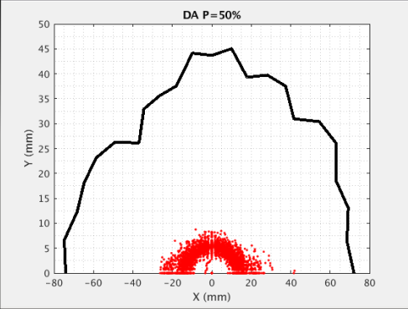
Error effect and correction for linear optics (TME2)
Error set and correction process is same as FODO Lattice
Beam parameter and DA recovery not good
  Strong focusing?
  1/4 resonance?
  Correctors and BPMs arrangement?
  …
on going
RMS | FODO | TME
Orbit (mm) | 0.0575/0.0525 | 0.4065/0.2389
Beta Beating(%) | 0.294/0.353 | 3.940/5.439
Delta Tune | 0.0265/0.0277 | 0.0159/0.0200
Delta Dispersion(m) | 0.005/0.007 | 0.0156/0.0229

Slide 14
Summary
Strong focusing and large size enables CEPC Booster to be highly sensitive to error effect and dependent on correction.
CDR Lattice:
  Orbit and optics correction are necessary and have plenty of quality to recovery beam parameters and DA well
  Simulation results show sawtooth, earth field and detector stray field effect could be controlled by orbit correction
  Independent quadrupole PS and table ramping are necessary
Lower Emittance Lattice:
  Smaller emittance
  Much more sensitive
  Error correction is not satisfactory now
  Lattice design optimization and error analysis loop in ongoing
  Meanwhile, develop FODO based lower emittance lattice

Slide 15
Thanks

Slide 16
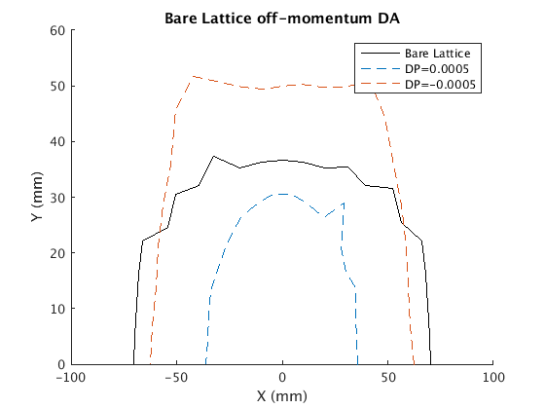
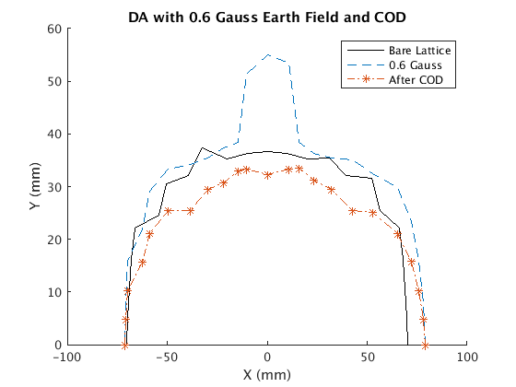
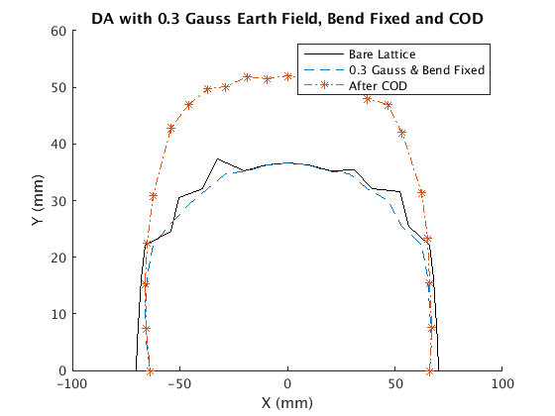
Back up

Slide 17
