Slide 1

CEPC plasma accelerator R&D progress status
Institute of High Energy Physics
Chinese Academy of Sciences
Xiaoning Wang
On Behalf of CEPC Plasma Injector Working Group CEPC Day, Sep.23, 2020

Slide 2
Outline
  CEPC Plasma Injector Status
  Electron Acceleration
  CEPC PWFA Linac
  Positron Acceleration
  Experimental status
  Summary

Slide 3
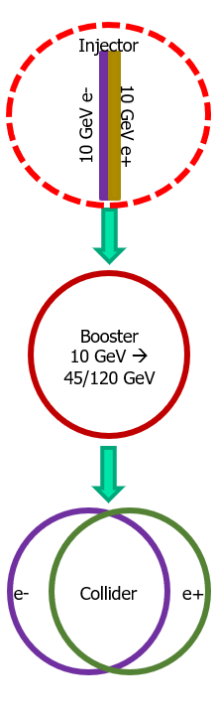
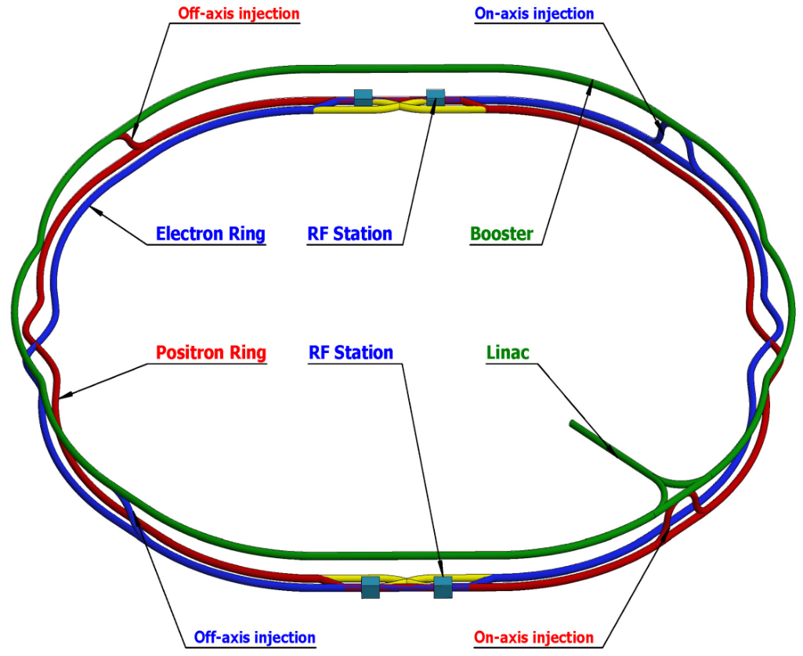
CEPC Plasma Injector(CPI)
LOW FIELD DIPOLE PROBLEM!!
Plasma-based Acceleration
Why PWFA, not LWFA?
1) Hardly no dephasing in PWFA, much longer accelerating length
2) Easier to shape the driver, good for stability and efficiency
3) High enough driver energy, higher energy conversion efficiency
PWFA
Notes:
为了解决……引入PWFA

Slide 4
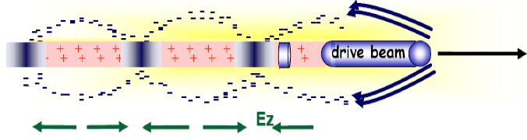
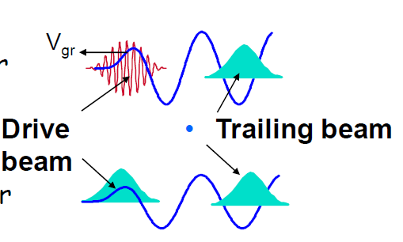
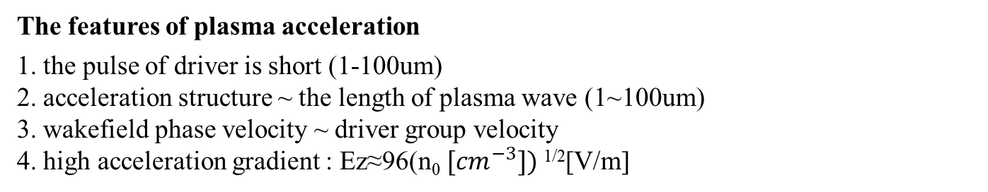
Plasma based accelerators(PBA)
1. Motivation
Conventional accelerator：
powered by microwaves
copper structure with irises
Breakdown->acceleration gradient ≤ 100MV/m
Plasma based accelerators :
quasi-neutral and collective behavior
No breakdown->acceleration gradient ~ 10GV/m two or three orders larger than RF cavities !
2. How to accelerate beams?
Drive Beam:
laser driver
beam driver
Trailing beam
The features of plasma acceleration
1. the pulse of driver is short (1-100um)
2. acceleration structure ~ the length of plasma wave (1~100um)
3. wakefield phase velocity ~ driver group velocity
4. high acceleration gradient : Ez≈96(n₀ $[{cm}^{−3}])$^{1/2}[V/m]
Notes:
因为它的加速梯度……

Slide 5
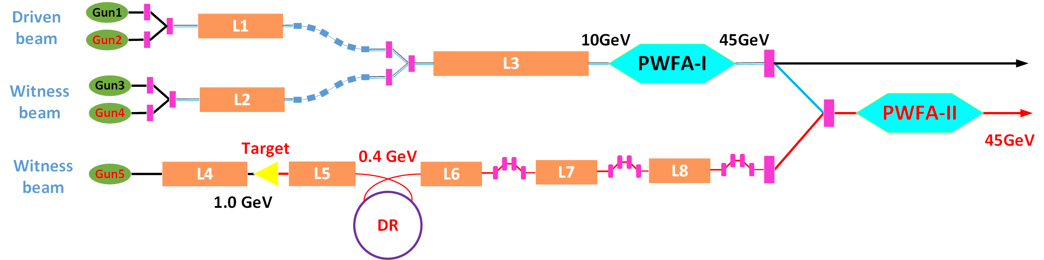
Key Physics and Technology
e1
e2
e3
e3
e4
e4
p1 1.2nC, 2.4 GeV
p1
p1
Dazhang Li, CPS, September 2019
Dazhang Li, CPS, September 2019
Electron Acceleration
  High transformer Ratio, High efficiency, Stability
Positron Acceleration
  Stable acceleration (different schemes), energy spread control, efficiency enhancement……
Conventional Accelerator design and optimization
  Photon-guns, Linac, Positron generation and damping ring ……
Beam manipulations:
  Dechirper, external injection, staging and cascading ……
Notes:
黑色：有了初步的结果
蓝色：正在做的
红色的：接下来要做的

Slide 6
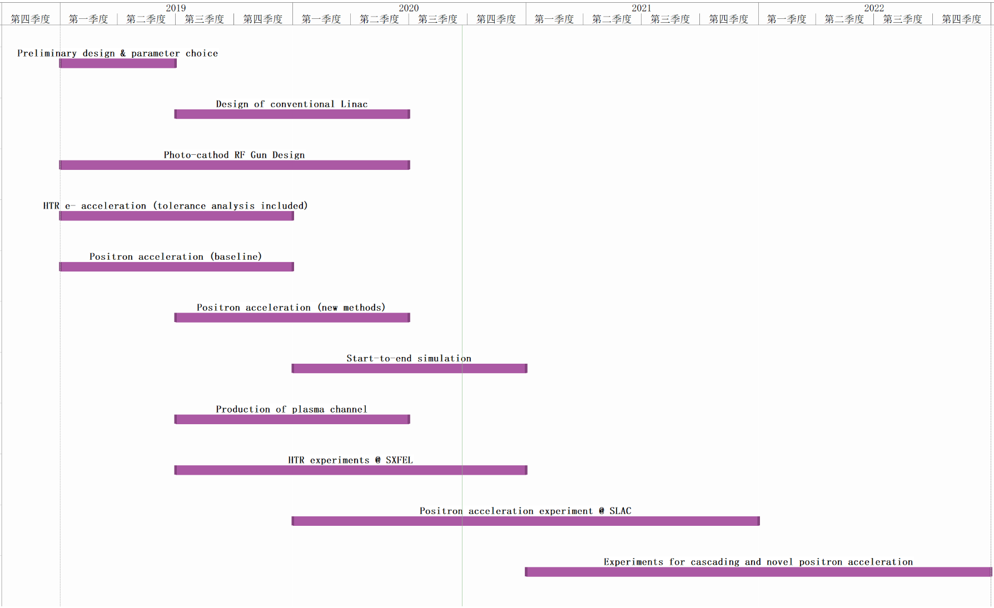
CEPC Plasma Injector Plan

Slide 7
CEPC Plasma Injector(CPI)
e1
e2
e3
e3
e4
e4
p1 1.2nC, 2.4 GeV
p1
p1
Dazhang Li, CPS, September 2019
Dazhang Li, CPS, September 2019
 | e1/e3 Before PWFA-I | e3 After PWFA-I | e2/e4 Before PWFA-I | e4 After PWFA-I | p1 Before PWFA-II | p1 After PWFA-II | Booster Requirement
Energy (GeV) | 10/10 | 45.5 | 10/10 | 45.5 | 2.4 | 45.5 | 45.5
Bunch Charge (nC) | 5.8/0.84 | 1 | 15/4.5 | >3 | 1.2 | 1 | 0.78
Bunch length (ps) | 2/0.257 | <1 | 3/0.7 | <1 | 0.07 | <1 | <10
Energy Spread | ~/0.2% | ~1% | ~/0.2% | 1% | 0.2% | ~1% | 0.2%
E_{normal} (μm⸱rad) | <20*/<100 | ~100 | <50*/<100 | ~100 | <50 | ~100 | <800
Bunch Size (μm) | 3.87/8.65 | <20 | 30/20 | <20 | 20 | <20 | <2000

Slide 8
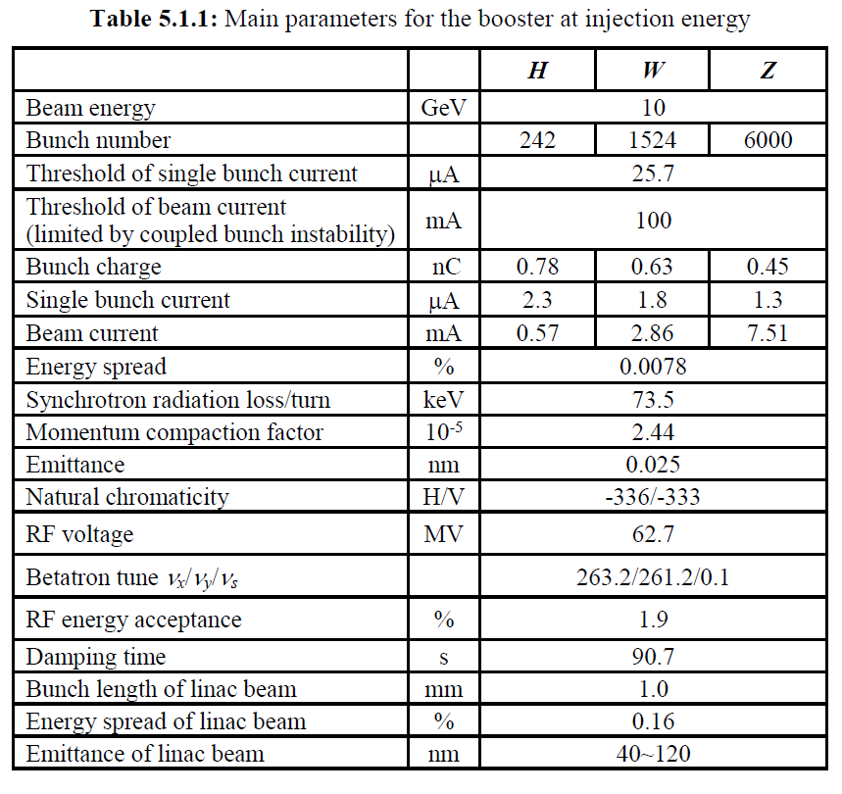
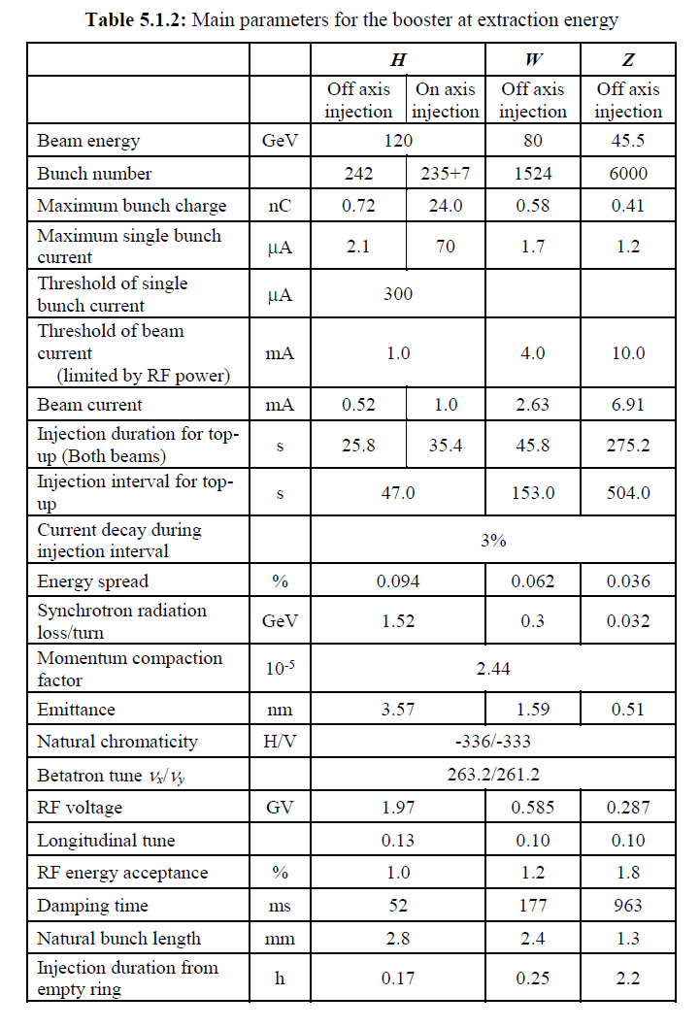
Booster Requirement for CPI
 | Booster Requirement
Energy（GeV） | 45.5
Bunch Charge（nC） | 0.78
Bunch length(um) | <3000
Energy Spread(%) | 0.2
ε_{N}(μm⸱rad) | <800
Bunch Size(um) | <2000
CEPC CDR (2018)
By Wang Xiaoning, Wang Dou (IHEP)
Notes:
依据于18年CDR booster参数提出的
其中energy及其 稳定度、charge、能散对是我们plasma injector有挑战性的几个参数要求

Slide 9
Outline
  CEPC Plasma Injector Status
  Electron Acceleration
  CEPC PWFA Linac
  Positron Acceleration
  Experimental status
  Summary

Slide 10
Electron Acceleration Status
1. CEPC plasma injector electron acceleration design
（1）HTR design confirmation & optimization
（2）Single factor tolerance analysis
（3）Multi-factor tolerance analysis
2.Start to end simulation
（1）Loading linac output data through Quickpic
（2）Iteration

Slide 11

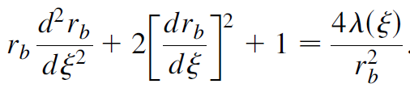

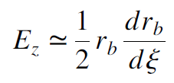


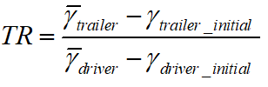


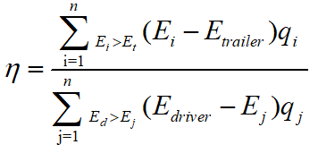

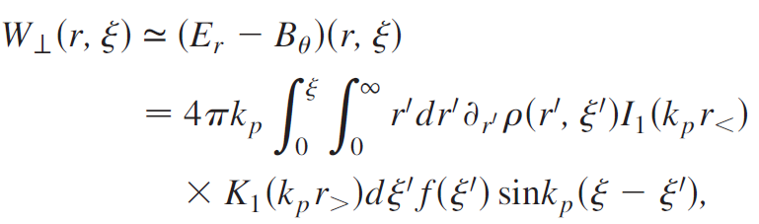

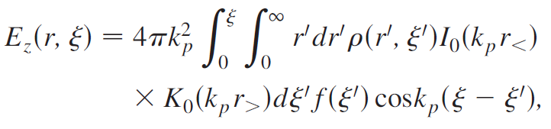
Basic formulae
Beam parameters calculation:
Blow-out regime:
Hosing:
Linear regime:
Dechirper:
……

Slide 12

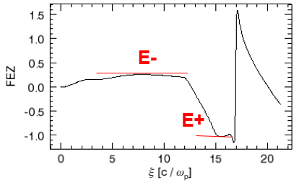
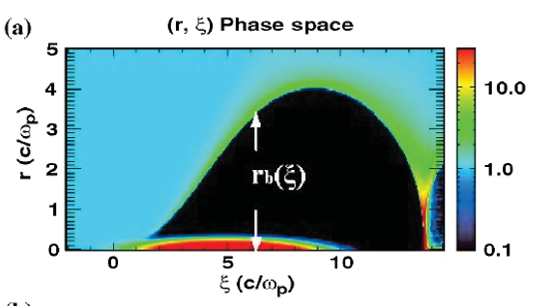





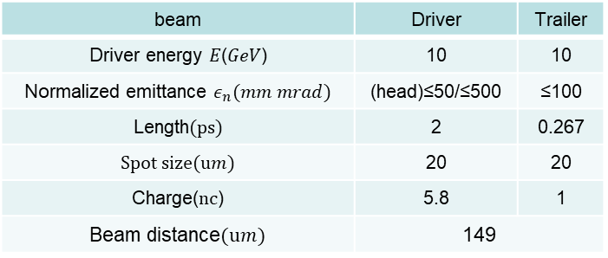


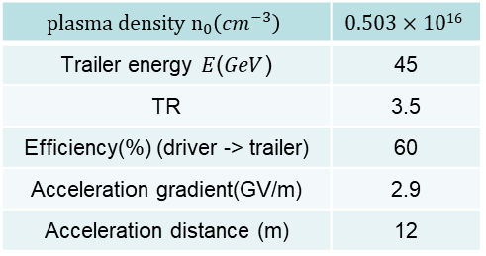

Electron Acceleration HTR Design
beam | Driver | Trailer
Driver energy $E$($GeV$) | 10 | 10
Normalized emittance $ε_{n}(mm mrad)$ | (head)≤50/≤500 | ≤100
Length(ps) | 2 | 0.267
Spot size(u$m$) | 20 | 20
Charge(nc) | 5.8 | 1
Beam distance(u$m$) | 149
$${plasma density n}_{0}\left(cm^{−3}\right)$$ | $$0.503×1016$$
Trailer energy $E$($GeV$) | 45
TR | 3.5
Efficiency(%) (driver -> trailer) | 60
Acceleration gradient(GV/m) | 2.9
Acceleration distance (m) | 12
By Zhou Shiyu (2018)
Nonlinear(Bubble) regime: nb/np>>1 or
HIGH TRANSFORMER RATIO
$TR=E+/E$⁻
The equation of boundary:
E$⊥$=
$$\frac{r}{2}$$
Lu W , Huang C , Zhou M , et al, PRL(2006)
Notes:
Plasma 电子加速最重要的就是高变压比的实现，从而实现由低能量的driver获得高能量的trailer
高变压比的实现主要基于由清华大学鲁巍老师提出的bubble regime, 这个机制也被业内广泛认可

Slide 13
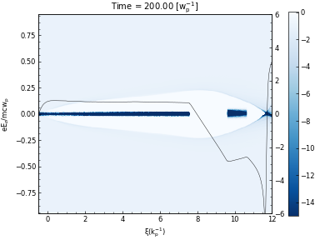
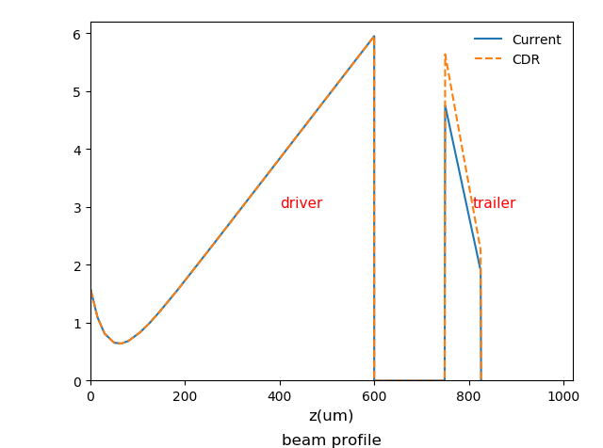
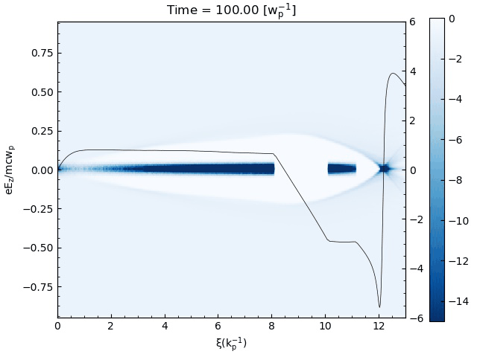




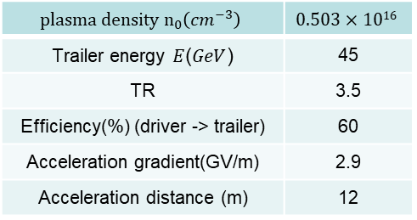
Electron Acceleration HTR Design
beam | Driver | Trailer
Driver energy $E$($GeV$) | 10 | 10
Normalized emittance $ε_{n}(mm mrad)$ | (head)≤50/≤500 | ≤100
Length(ps) | 2 | 0.267
Spot size(u$m$) | 20 | 20
Charge(nc) | 5.8 | 1
Beam distance(u$m$) | 149
$${plasma density n}_{0}\left(cm^{−3}\right)$$ | $$0.503×1016$$
Trailer energy $E$($GeV$) | 45
TR | 3.5
Efficiency(%) (driver -> trailer) | 60
Acceleration gradient(GV/m) | 2.9
Acceleration distance (m) | 12
By Zhou Shiyu (2018)
Center-of-mass energy of Z is 91GeV
Trailer 45GeV->Not ideal
Trailer 45.5GeV->Full energy injection
Improve TR
No match->ε_{N}↑
Optimization:
1、Small energy spread
3、Slow down the dispersion of the head of driver
Trailer charge->0.84nC
Ez⁻↑->trailer energy<45GeV/45.5GeV
$$δ_{E}>1\%$$
Decrease the emittance of the head of driver->20𝑚𝑚 𝑚𝑟𝑎𝑑
Linac can accept
2、Restrain the increase of emittance
Beam matched
Tzoufras M , Lu W , Tsung F S , et al, PRL( 2008)
An, Weiming. Electronic Thesis & Dissertations(2013)
Wang Xiaoning (IHEP), An Weiming(BNU)
Notes:
18年提出的电子加速baseline的方案，我们对该方案进行了conformation并进一步对参数进行了优化，从而提高trailer的品质

Slide 14
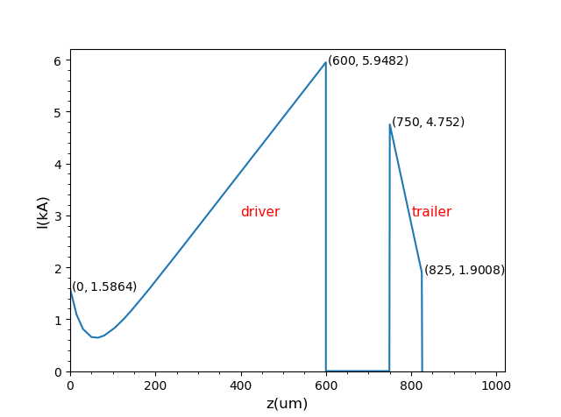

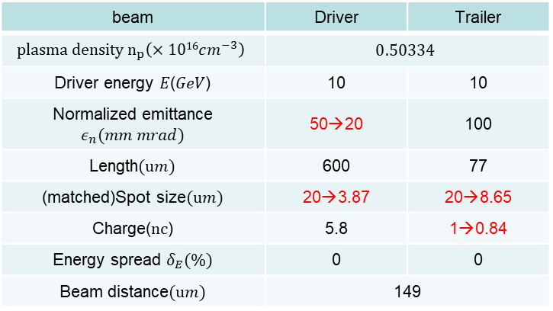
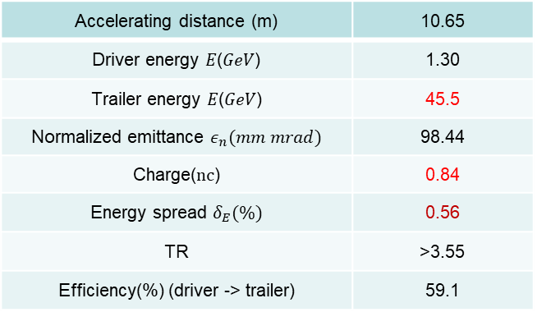
Electron Acceleration HTR Design
beam | Driver | Trailer
$${plasma density n}_{p}\left(×1016cm^{−3}\right)$$ | $$0.50334$$
Driver energy $E$($GeV$) | 10 | 10
Normalized emittance $ε_{n}(mm mrad)$ | 50→20 | 100
Length(u$m$) | 600 | 77
(matched)Spot size(u$m$) | 20→3.87 | 20→8.65
Charge(nc) | 5.8 | 1→0.84
Energy spread $δ_{E}(\%)$ | 0 | 0
Beam distance(u$m$) | 149
Booster Requirement
Energy（GeV） | 45.5
Bunch Charge（nC） | 0.78
Bunch length(um) | <3000
Energy Spread(%) | 0.2
ε_{N}(μm⸱rad) | <800
Bunch Size(um) | <2000
Accelerating distance (m) | 10.65
Driver energy $E$($GeV$) | 1.30
Trailer energy $E$($GeV$) | 45.5
Normalized emittance $ε_{n}(mm mrad)$ | 98.44
Charge(nc) | 0.84
Energy spread $δ_{E}(\%)$ | 0.56
TR | >3.55
Efficiency(%) (driver -> trailer) | 59.1
By Wang Xiaoning, An Weiming(2020)
Wang Xiaoning (IHEP), An Weiming(BNU)
Notes:
优化后的加速参数表，最终trailer的参数都能达到booster的要求，直接将能散降到0.2%是非常困难的，后面会通过dechirper降到0.2%

Slide 15
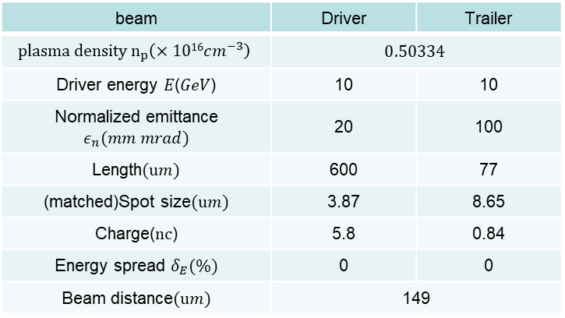
Start to End Simulation
Dazhang Li, CPS, September 2019
beam | Driver | Trailer
$${plasma density n}_{p}\left(×1016cm^{−3}\right)$$ | $$0.50334$$
Driver energy $E$($GeV$) | 10 | 10
Normalized emittance $ε_{n}(mm mrad)$ | 20 | 100
Length(u$m$) | 600 | 77
(matched)Spot size(u$m$) | 3.87 | 8.65
Charge(nc) | 5.8 | 0.84
Energy spread $δ_{E}(\%)$ | 0 | 0
Beam distance(u$m$) | 149
Linac output data-> Quickpic->PWFA simulation
Gihub ：https://github.com/UCLA-Plasma-Simulation-Group/QuickPIC-OpenSource
Gitee(domestic): https://gitee.com/BNU-Plasma-Astrophysics-Group/QuickPIC-OpenSource?_from=gitee_search
anweiming@bnu.edu.cn
Wang Xiaoning (IHEP), An Weiming(BNU)
Notes:
为quickpic开发了与传统加速器模拟软件的接口功能

Slide 16
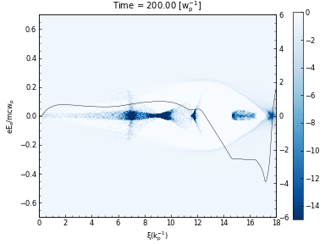
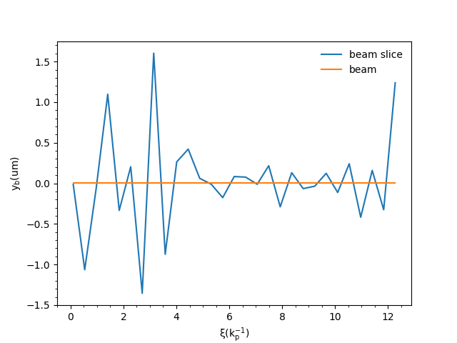
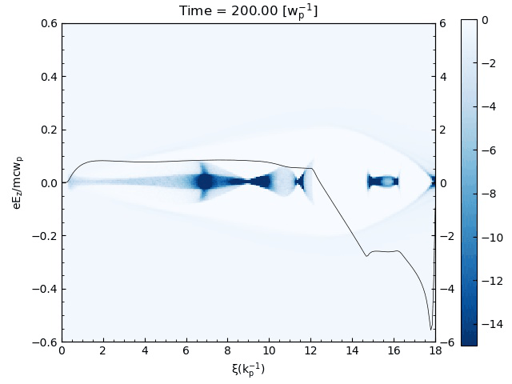
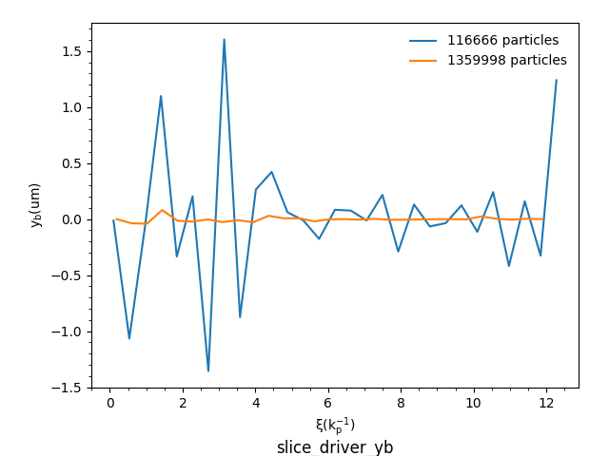
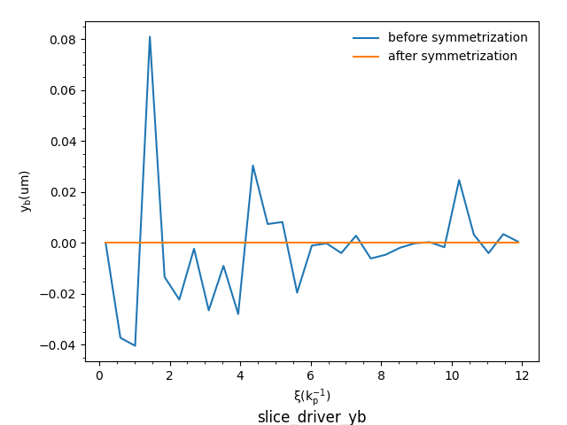
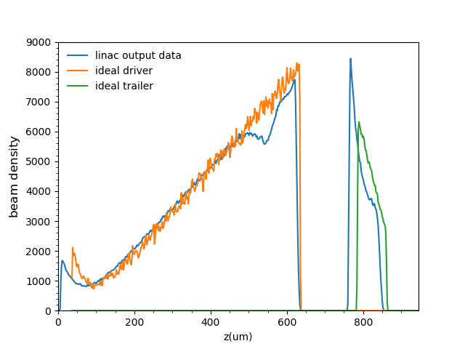
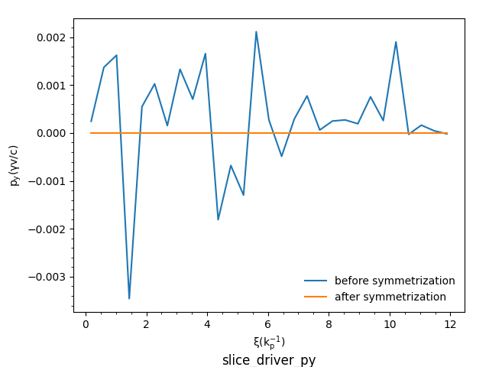
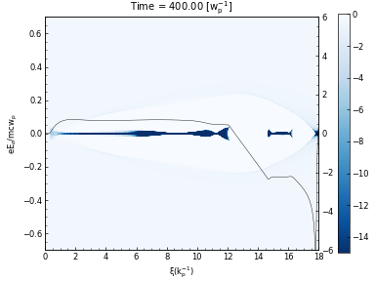
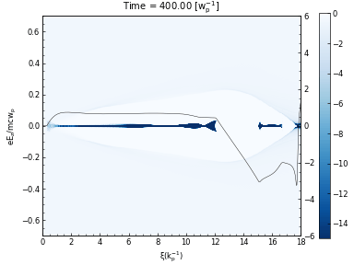
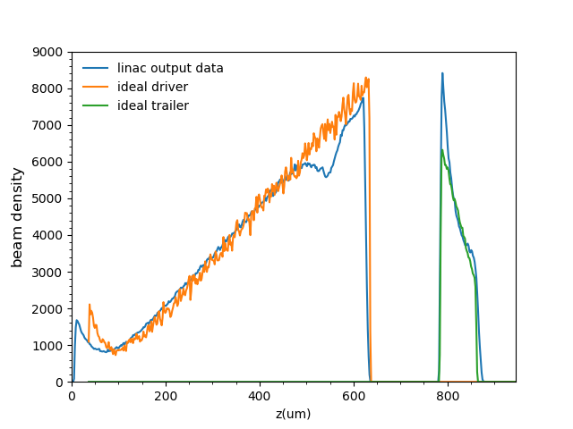
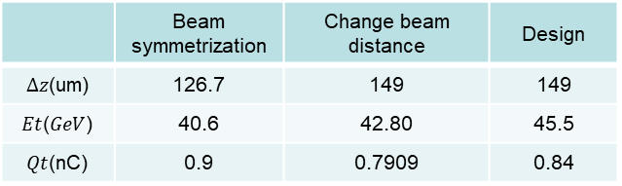
Start to End Simulation
Longitudinal shaping is well maintained → TR 
Big slice jitter in PWFA acceleration → hosing → Transverse-Longitudinal coupling
t~5000 -> hosing
t~8000 -> trailer lost
t~8000 -> hosing
t~13000 -> trailer lost
30 slice(0.3[kp⁻¹])
Driver initial beam centroid
0.11m particles → 1.36m particles
beam initial[$x$, $y\text{,} px$,$py$]~ [0,0,0,0]
 | Beam symmetrization | Change beam distance | Design
$∆z$(um) | 126.7 | 149 | 149
$Et$($GeV$) | 40.6 | 42.80 | 45.5
$Qt$(nC) | 0.9 | 0.7909 | 0.84
1kp⁻¹~52.52um

Slide 17
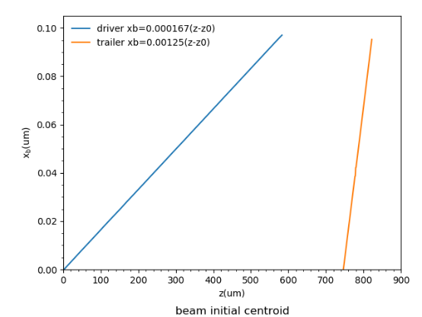
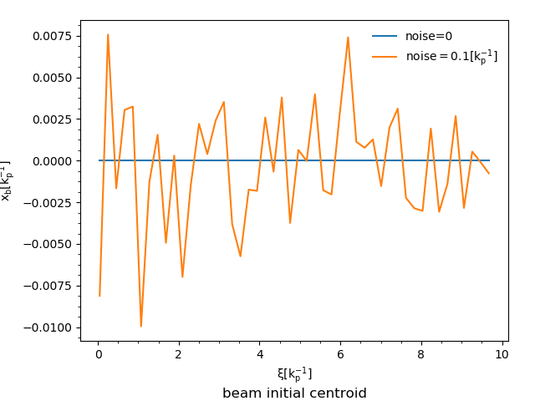
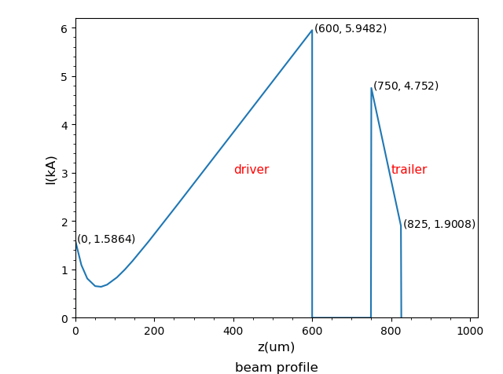
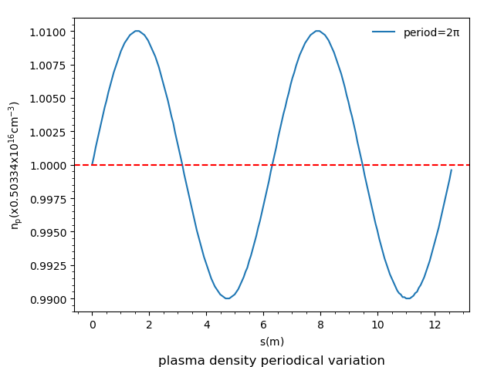
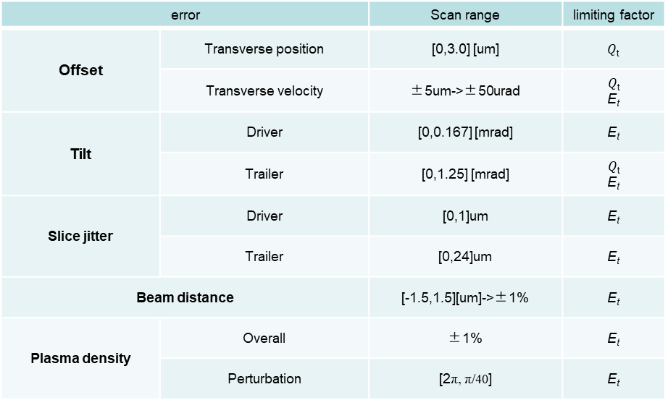
Tolerance analysis
error |  | Scan range | limiting factor
Offset | Transverse position | [0,3.0] [um] | $Q$_{t}
 | Transverse velocity | ±5um->±50urad | $$Q\text{t}$$ E_{t}
Tilt | Driver | [0,0.167] [mrad] | E_{t}
 | Trailer | [0,1.25] [mrad] | $$Q\text{t}$$ E_{t}
Slice jitter | Driver | [0,1]um | E_{t}
 | Trailer | [0,24]um | E_{t}
Beam distance |  | [-1.5,1.5][um]->±1% | E_{t}
Plasma density | Overall | ±1% | E_{t}
 | Perturbation | [2π, π/40] | E_{t}
beam distance
1[k_{p}⁻¹]~74.03um
Wang Xiaoning (IHEP), An Weiming(BNU)

Slide 18
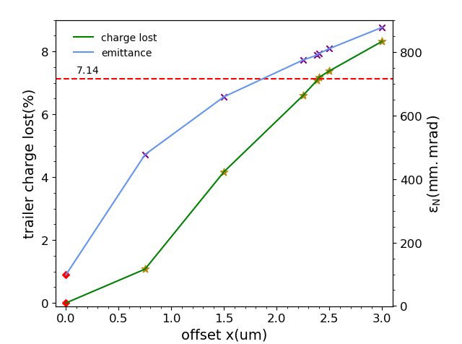
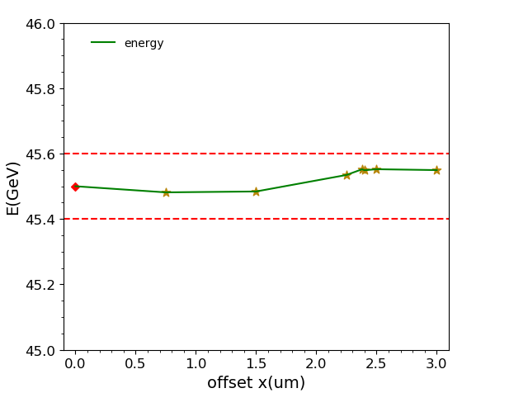
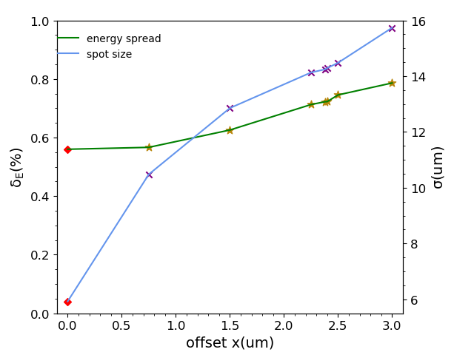
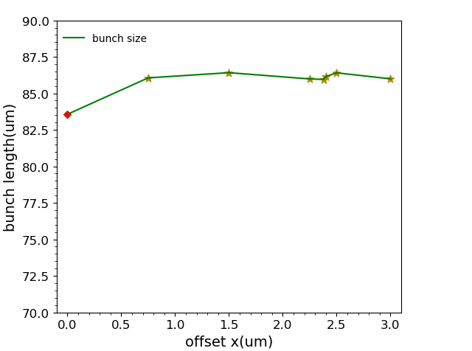
Transverse Position Offset
x offset max~2.38um

Slide 19
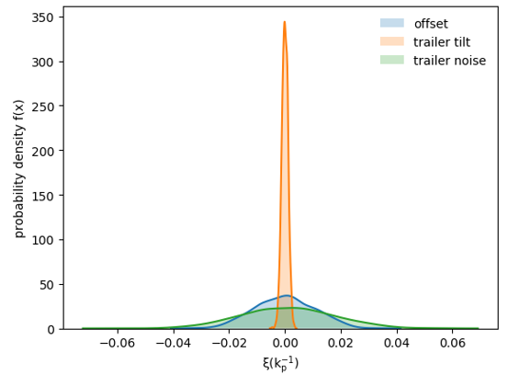
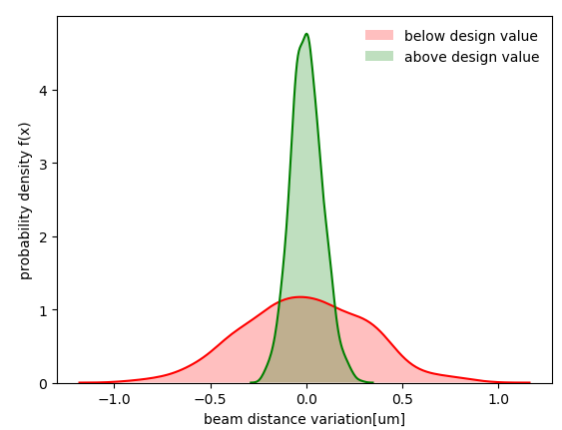
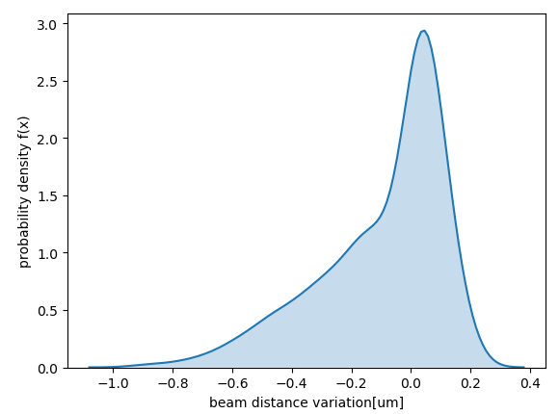

Multi-factor tolerance analysis
error |  | limitation
Offset | Transverse position | ±2.38um
 | Transverse velocity | on going
Tilt | Driver | on going
 | Trailer | ±3.3mrad
Transverse noise | Driver | 0.025nm
 | Trailer | ±3.7um
Beam distance |  | [148.05,149.25]
Plasma density | Overall | ±0.26%
 | Perturbation | on going
~150 simulations, 100h/simulation
Python + quickpic:
100 Random seed -> 100 random errors combination
Every error is Gaussian and independent, having its own distribution
1[k_{p}⁻¹]~74.03um
Wang Xiaoning (IHEP), An Weiming(BNU)

Slide 20
Outline
  CEPC Plasma Injector Status
  Electron Acceleration
  CEPC PWFA Linac
  Positron Acceleration
  Experimental status
  Summary

Slide 21
PWFA-I Requirements
The electron acceleration as the first step
Requirements of electron beam acceleration (V2.0)
Electron acceleration | Unit | Driven bunch | Trailer bunch
Energy | GeV | 10 | 10
Bunch charge | nC | 5.8 | 0.84
Bunch length | ps | 2 | 0.25
Bunch space | ps | 0.5
Energy spread |  | - | ≤0.2%
Norm. rms emittance | mm·mrad | 20 | 100
Beam size | μm | 3.87 | 8.65
$$β_{∗}=156mm \left(V1.0\right)→14.6 mm (V2.0)$$
Meng Cai(IHEP)

Slide 22
Linac design status
Beam longitudinal shaping
  Laser shaping @ electron gun: finished the preliminary design
  Longitudinal modulation @ transport line: under consideration
Two electron bunch merge : under consideration
Bunch compressor
  Chicane: finished the preliminary design
  TBA: under consideration
Main Linac design: the interface with PWFA accelerator, high priority
  Lattice design: finished the preliminary design
Positron source
  Finished the preliminary design
The preliminary design of the linac and the end-to-end simulation (from electron gun to FFS) have been finished , but can not meet the requirements, still need more optimization.
Meng Cai(IHEP)
Notes:
激光整形：失真
合束：初步方案，对各部分稳定性要求很高，束流模拟还未进行
束长压缩：Chicane四个二级铁，TBA引入六极铁校正高阶色散项，抵消CSR效应（同步辐射效应引起的发射度增长）;
Linac的重点：束流加速，与CPEC plasma injector的接口部分，高电荷量+短束长

Slide 23



CEPC PWFA Linac
Meng Cai(IHEP)
Notes:
1、由尾场效应引起的，横纵向的耦合
2、先给一个理想的横向分布，α=0，和纵向没有耦合，再去做模拟
快速聚焦：畸变，色品效应，加六级铁是否可以矫正？
Trailer 由于尾场作用，受到强聚焦，已经有一些变形
纵向横向的耦合，电子枪出来就是这样，因为我们的driver太长了
理想情况下，横向应该是平的
先给一个理想的横向分布，α=0，和纵向没有耦合，再去做模拟

Slide 24
Outline
  CEPC Plasma Injector Status
  Electron Acceleration
  CEPC PWFA Linac
  Positron Acceleration
  Experimental status
  Summary

Slide 25


Positron Acceleration
By Zhou Shiyu(2018)
Zhou Shiyu(THU)
Notes:
Baseline方案，加速参数达标，trailer的加速品质很好，但是对横向稳定性要求比较苛刻，不利于实验和工程的实现

Slide 26












Hollow Plasma Channel
Acceleration gradient：>5GV/m
Efficiency：>30%
Energy spread ：1.5%
Paper: under revision
Zhou Shiyu(THU)
Notes:
Driver和trailer都处于聚焦场里，是一种比较稳定的机制，对横向offset的容忍度更高，目前可得到的加速参数…这也是目前我们的正电子加速方案
Acceleration in Hollow channel plasma, beam loading机制是是比较复杂的，每个slice加速场是不均匀，slice能散很大,目前采用的是高斯束流，如果把头部砍掉，能量啁啾其实是比较理想的。

Slide 27




Uniform Plasma Channel
Simulation parameters:
Efficiency：22%
Induced energy spread： 1.6%
Emittance can be controlled
Zhou Shiyu(THU)
Notes:
在均匀等离子里的加速相对容易一些，与电子的加速类似，对各个因素的容忍度会更高,参数还有比较大的优化空间，实验的实现更容易一些，所以可能先会尝试这种方法。
正电子需要通过和plasma相互作用来得到聚焦力

Slide 28
Outline
  CEPC Plasma Injector Status
  Electron Acceleration
  CEPC PWFA Linac
  Positron Acceleration
  Experimental status
  Summary

Slide 29


SXFEL experiment preparation
Upgrade laser system：
  Amplifier outlet average energy：157mJ
  RMS stability ： 1.186%
  Pulse width：30fs
Plasma experimental station: preliminary set up
  Vacuum system: installation & testing
  Light path
  Beam diagnostic system
Peng Bo(THU)
Notes:
上海的实验的目的：是产生能够电离plasma形成plasma channel的强激光
准备阶段，放大器搭好了，后面进激光压缩池，能把脉宽压缩到30fs.
上海的
将来的目的：用LWFA产生fs超短电子束，作为探针,扫描plasma channel
seed和放大的光谱晶体放大波段不同， 光谱越宽可以压缩到的脉宽越短，seed有一个展宽，经过放大之后，光谱会有一点变窄，有可能会影响到压缩的脉宽

Slide 30








Tsinghua Dechirper Experiment
Measurement of plasma density
12$×$2mm Nozzle interferogram
10cm gas cell ionizing ray
电离线
10cm
simulation results: 2$×10$¹⁸[cm⁻³]
Experimental result: 2$×10$¹⁸[cm⁻³]
Observe a clear hollow channel plasma
intensity
phase
Bessel light
gas density↑ hollow channel plasma length↓
By wave front sensor
Using shearing interference theory
Liu Shuang(THU)
Notes:
Plasma气体密度的测量
在清华产生了均匀等离子体并用喷嘴测得了其密度，用gas cell产生了10cm的等离子体并测得其电离线，用贝塞尔光束聚焦产生并观察到了hollow channel
高密度的喷嘴可测，低密度的无法测得，我们电子加速用的密度比较低，但是gas cell 电离线的产生可以判断plasma是否电离
用的是氮气

Slide 31


Tsinghua Dechirper Experiment
Optimize energy spectrum measurement resolution
chamber
RF deflecting cavity
Screen 2
Gas cell
sector dipole
Screen 1
$E$~42$MeV$
$$∆E=\frac{E×σ_{x}}{ρ\left(1−cosθ\right)+Lsinθ}≈0.01MeV$$
Beam spot at Screen2
Liu Shuang(THU)
Notes:
能谱的测量精度，测试成功后后面会移植到上海进行dechiper实验
能谱测量的优化：
新加了四块四级铁
过了磁铁之后有能量分布的电子束，纵向被拉伸，测能散

Slide 32



SLAC FACET-II PROPOSAL
Cascaded-HTR
Full energy inject
Hollow Plasma Channel
Dechirper
Positron acceleration
email from Mark Hogan
head of the plasma acceleration group in SLAC

Slide 33
Summary and prospects
1. CEPC plasma injector electron acceleration
（1）HTR design & optimization
（2）Start to end simulation
（3）Tolerance analysis
（4）Further optimization to reduce linac design requirements
2.CEPC PWFA Linac
（1）Preliminary design
（2）Further optimization to meet the requirement of plasma linac
3. CEPC plasma injector positron acceleration
（1）two new acceleration methods proposed
（2）Efficiency enhancement
4. Experimental
（1）SXFEL experiment preparation and wait for the beam time
（2）Tsinghua experiment is on going

Slide 34
Reference
[1Tajima T , Dawson J M . Laser Electron Accelerator[J]. Phys.rev.lett, 1979, 43(4):267-270.
[2]Chen P , Dawson J M , Huff R W , et al. Acceleration of Electrons by the Interaction of a Bunched Electron Beam with a Plasma[J]. Physical Review Letters, 1985, 54(14):693.
[3] An W , Decyk V K , Mori W B , et al. An improved iteration loop for the three dimensional quasi-static particle-in-cell algorithm: QuickPIC[J]. Journal of Computational Physics, 2013, 250:165-177.
[4] Lu W , Huang C , Zhou M , et al. Nonlinear Theory for Relativistic Plasma Wakefields in the Blowout Regime[J]. Physical Review Letters, 2006, 96(16):165002.
[5] Huang C , Lu W , Zhou M , et al. Hosing instability in the blow-out regime for plasma-wakefield acceleration.[J]. Physical Review Letters, 2007, 99(25):255001.
[6] Wu Y P , Hua J F , Pai C H , et al. A near-ideal dechirper for plasma-based electron and positron acceleration using a hollow channel plasma[J]. 2018.
[7] Kumar N , Pukhov A , Lotov K . Self-modulation instability of a long proton bunch in plasmas[J]. Physical Review Letters, 2010, 104(25):255003.

Slide 35
THANK YOU
FOR YOUR ATTENTION
Notes:
That’s all. Thank you for your listening.

