Slide 1
  Progress of Electrostatic-Magnetic Deflector for CEPC
  Bin Chen
  CEPC Day (Sep 23) 2020

Slide 2
Outline
  Introduction
  Design of dipole magnet
  Design of electrostatic separator
    Installation error analysis of electrostatic separator
    Methods to reduce the parasitic mode losses
    Thermal analysis of the electrode
    Vacuum design
  Mechanical design
  Precision High Voltage Power Supply
  Project progress

Slide 3
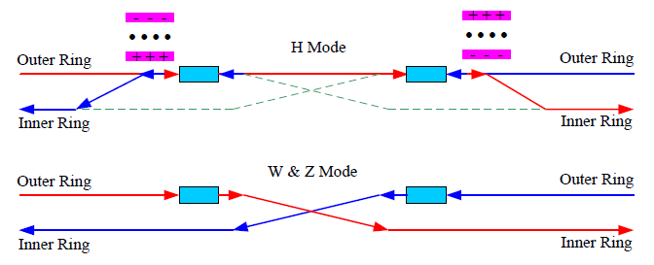
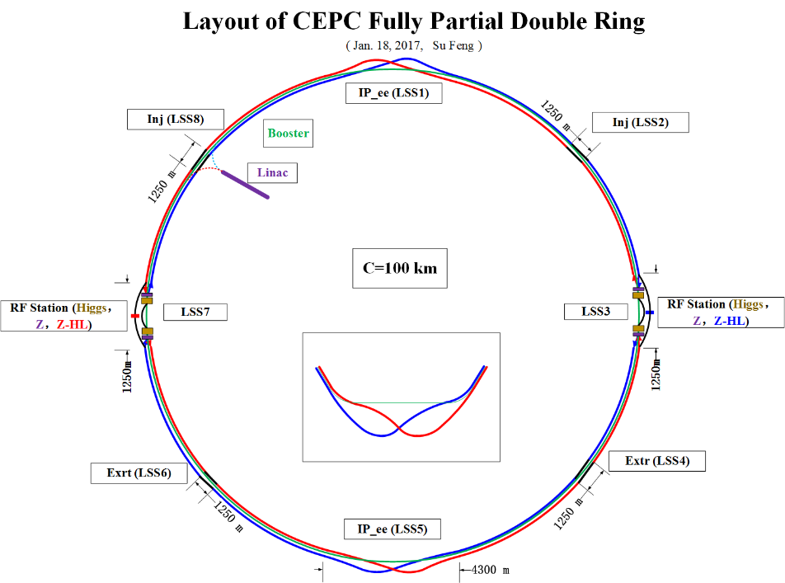
Introduction
  In the RF region, A set of electrostatic separators combined with dipole magnet (Electrostatic-Magnetic Deflector ) are installed downstream of the RF cavities.
  They are used to avoid bending of incoming beam and deflect the outgoing beam in H mode. After the Deflectors , the positive and negative electron beams of the outer ring passing through the RF cavities are deflected to their respective inner rings.
Layout of RF region
  Optics of the RF region for Higgs (left), W and Z (right) modes

Slide 4
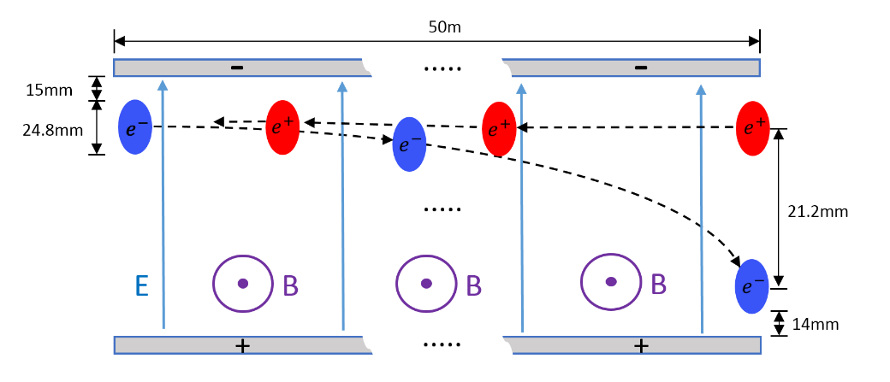
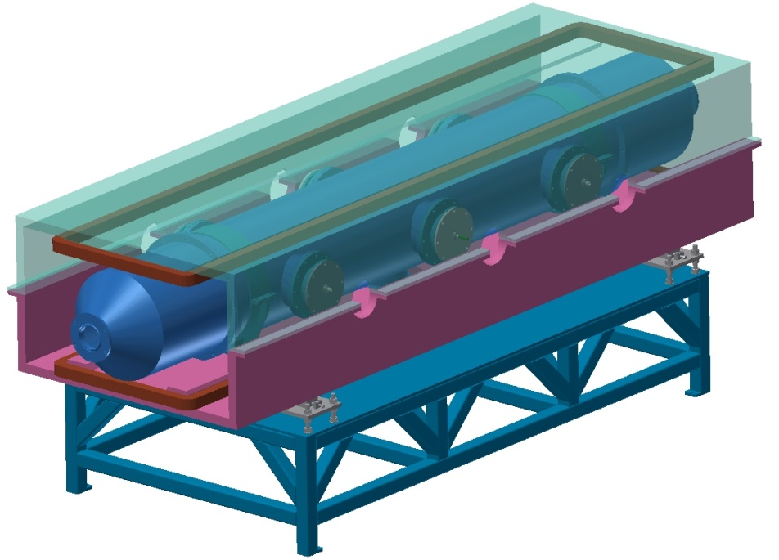
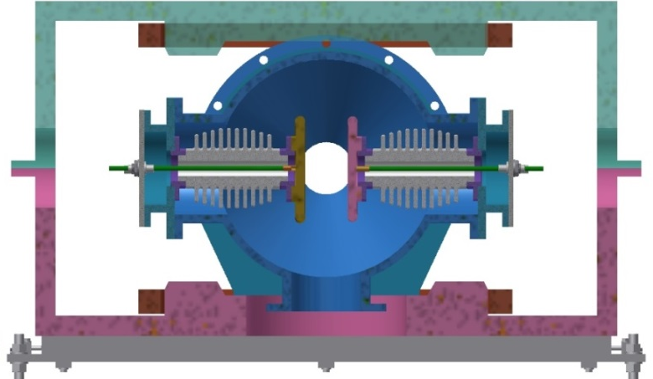
Introduction
  The Electrostatic-Magnetic Deflector is a device consisting of perpendicular electric and magnetic fields.
  One set of Electrostatic-Magnetic Deflectors including 8 units, total 32 units will be need for CEPC.
 | Filed | Effective Length | Good field region | Stability
Electrostatic separator | 2.0MV/m | 4m | 46mm ⅹ11mm | 5ⅹ10⁻⁴
Dipole | 66.7Gauss | 4m | 46mm ⅹ11mm | 5ⅹ10⁻⁴
Schematic of Electrostatic-Magnetic Deflector
metal-ceramic support
high voltage feedthrough
UHV tank
Magnet
Support
  structure drawing of Electrostatic-Magnetic Deflector
coil
electrode

Slide 5
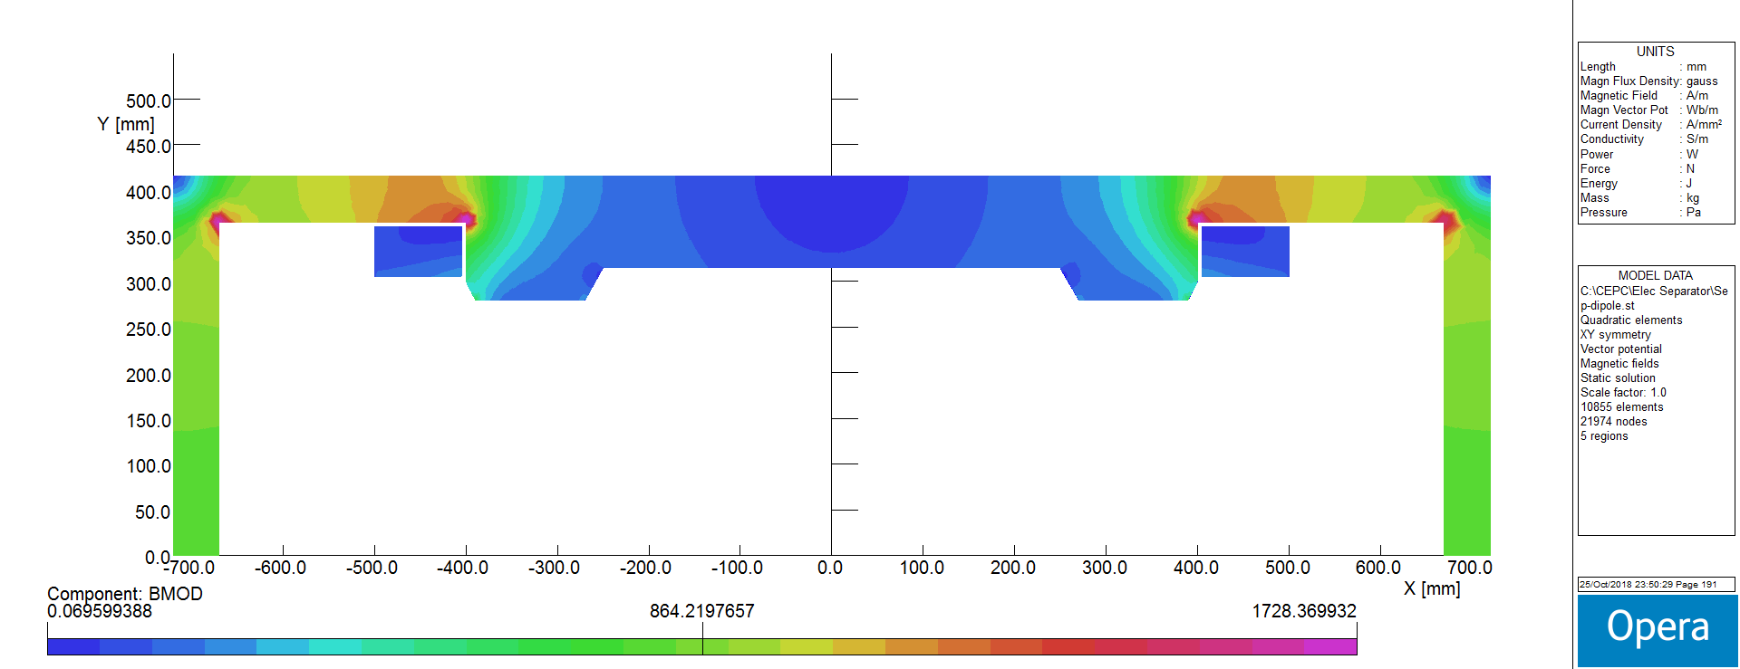
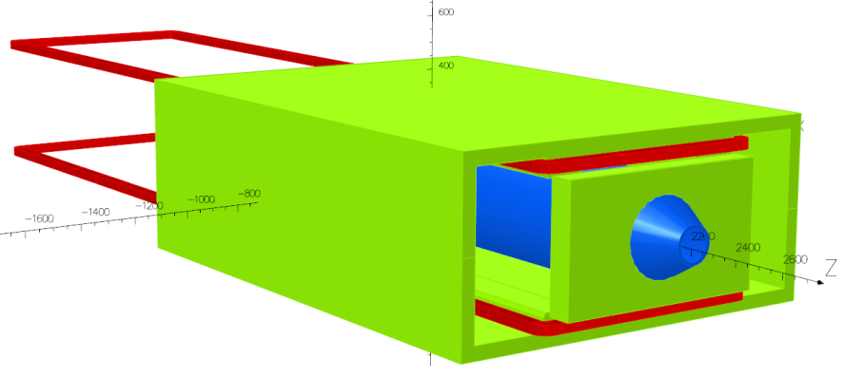
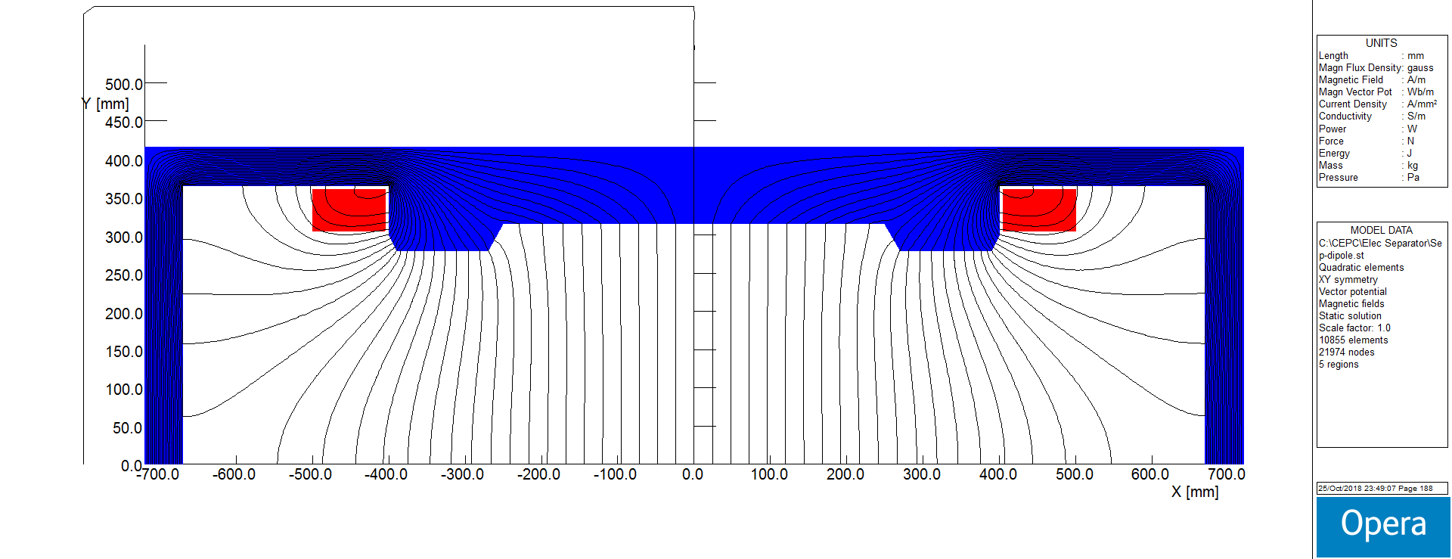
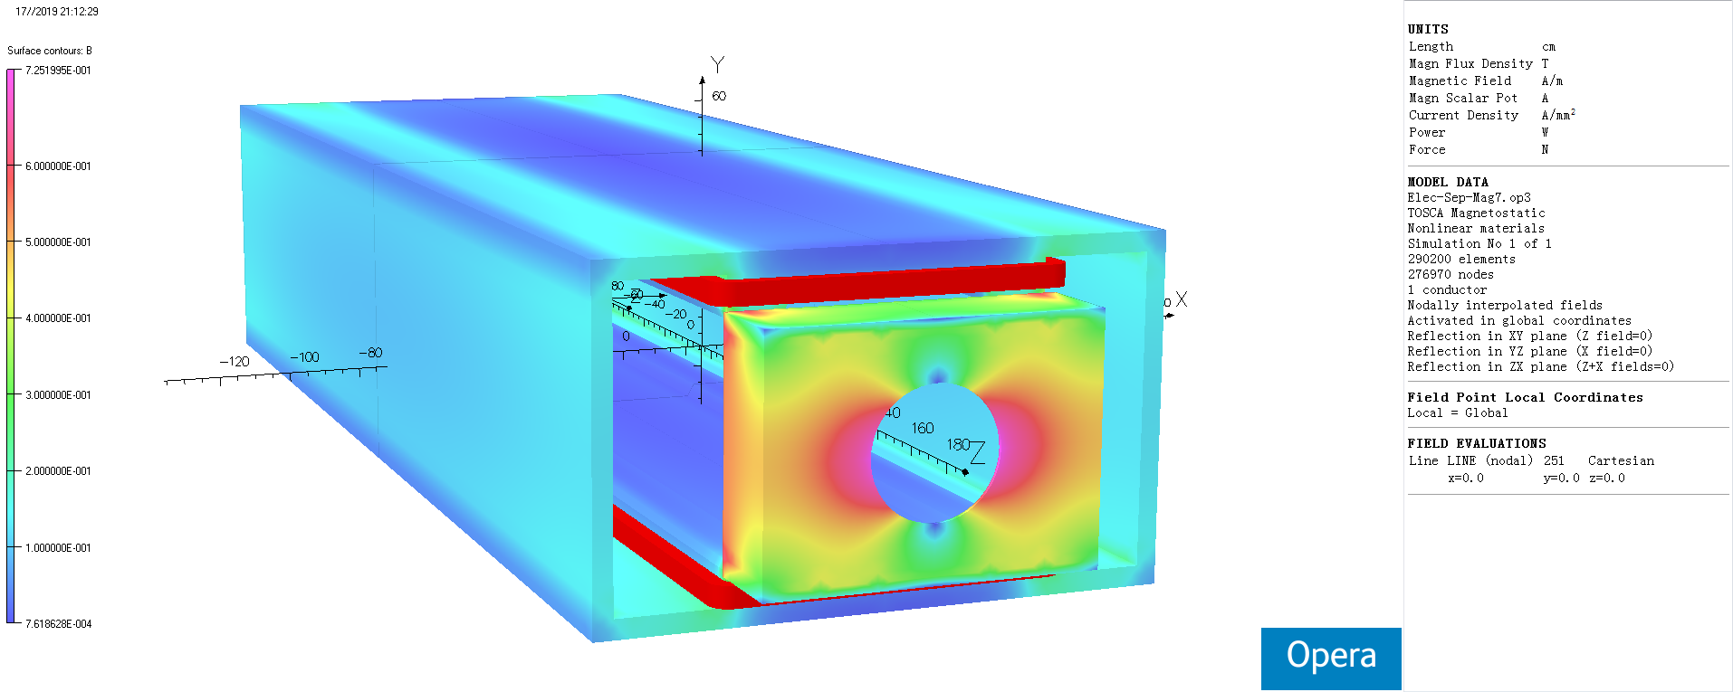
Design of dipole magnet
  The magnet adopts h-type yoke structure, because of the higher field integrals uniformity and installation consideration of the electro-static system.
  The magnetic field design and manufacturing technology are quite mature.
  The magnet development is supported by IHEP internal fund.
  The prototype contract was signed in July 2020.
Field Distribution
Magnetic flux density distribution in the core
3D Model and Magnetic flux density distribution

Slide 6
  Design of Electrostatic Separator
  An electrostatic separator comprise a pair of electrodes, UHV tank, metal-ceramic supports, high voltage feedthrough, High voltage circuit and vacuum system, etc.
  Key technology :
  Field uniformity design
  Reduce the separator's impedance and loss factor
  Mechanical structure design
  Parameters of electrostatic separator
Separator length | 4.5m
Inner diameter of separator tank | 380mm
Electrode length | 4.0m
Electrode width | 180mm
Nominal gap | 75mm
Maximum operating field strength | 2MV/m
Maximum operating voltage | ±75kV
Maximum conditioning voltage | ±135kV
Good field region (0.5‰ limit) | 46mm ⅹ11mm
Nominal vacuum pressure | 2.7e-8 Pa

Slide 7
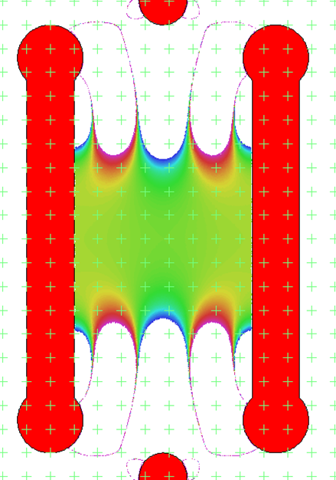
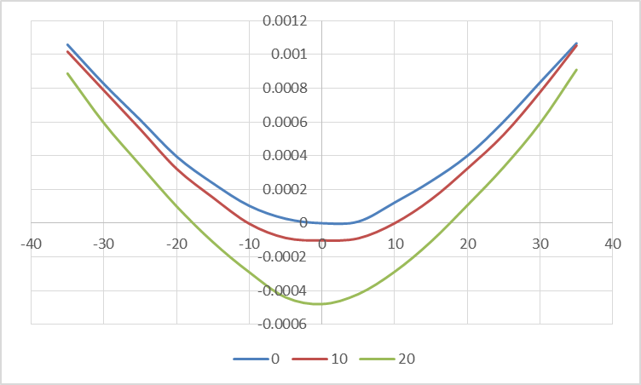


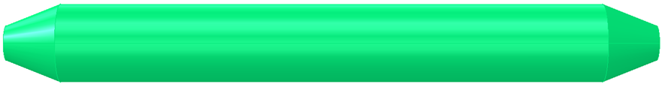
  Design of Electrostatic Separator
Electrode (a pair of metal flat plate)
Dimension : 4m long and 180mm wide
Material : Pure Titanium
  Field strength : 2MV/m
UHV tank
4.5m long and 38cm inner diameter
Material : stainless-steel 316L
Field homogeneity：7.5cm*5cm 0.5‰
Calculated integrated electrical field uniformity ：4.6cm*3cm 0.5‰
18cm
Length：400cm
With：18cm
Thickness：2cm
Radius：1.5cm
Density：4.54g/cm³
Weight：≈65kg
400cm
ID：9.5cm
ED：7.5cm
thickness：1cm
25cm
400cm

Slide 8
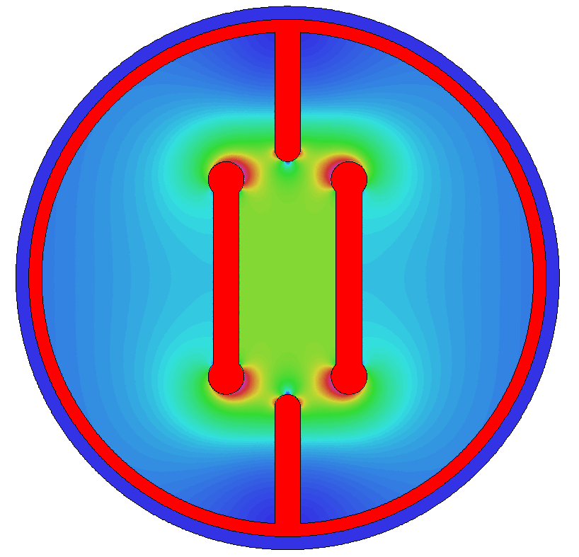
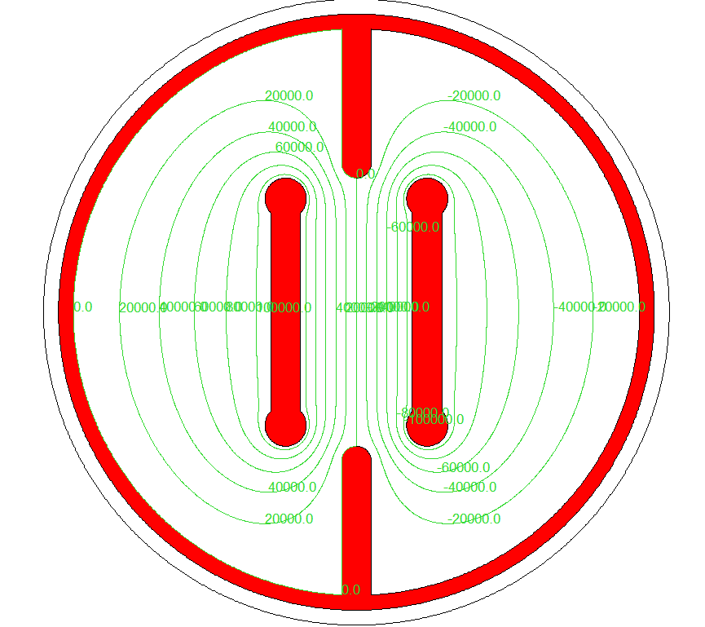
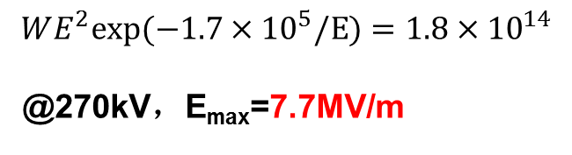
  Design of Electrostatic Separator
Maximum field strength：3.86MV/m @150kV
6.95MV/m @270kV
“Kilpatrick's criterion”
基尔帕特里克准则
$$WE^{2}exp(−1.7×{10}^{5}/E)=1.8×{10}^{14}$$
@270kV，E_{max}=7.7MV/m
Electric potential line

Slide 9
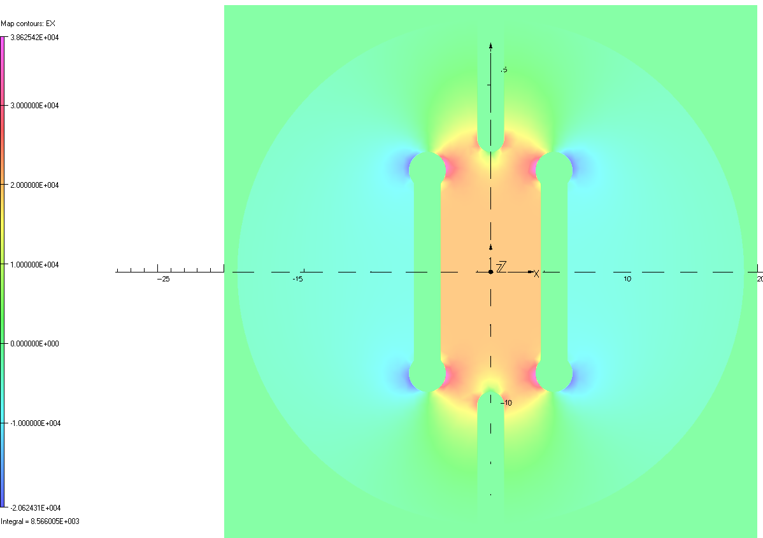
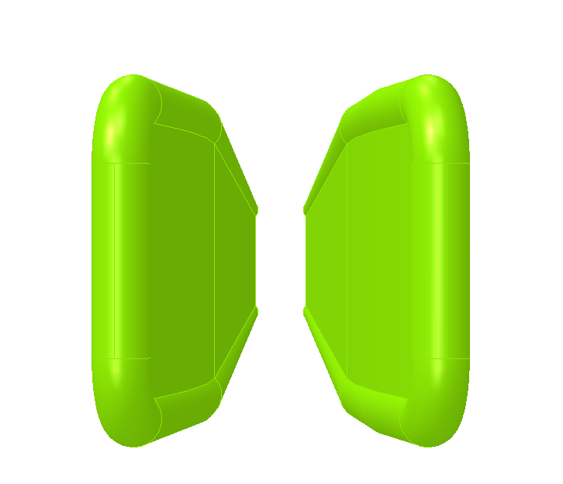
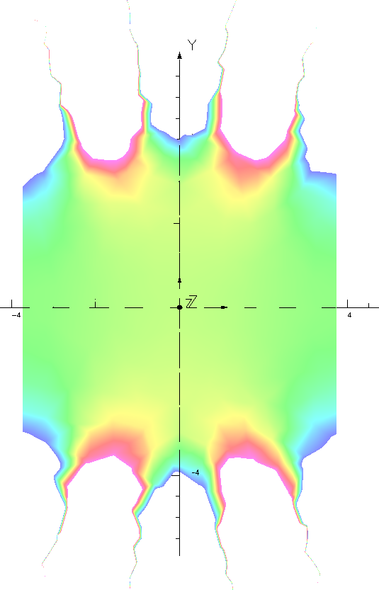
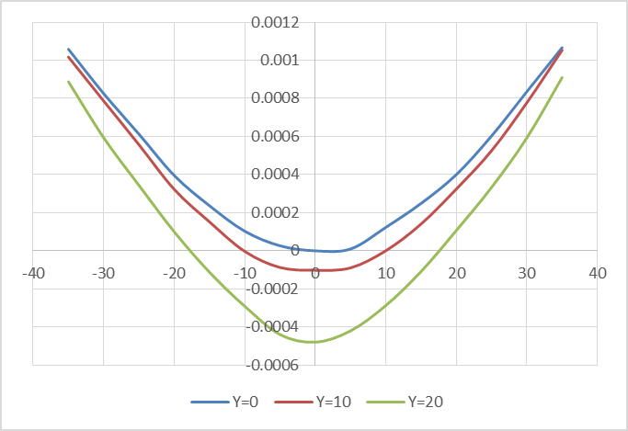
  Installation error analysis of electrostatic separator
no error in the mechanical position ：
电场分布
0.5‰好场区范围约75mm×60mm
纵向积分均匀性：0.5‰范围约为45mm×40mm

Slide 10
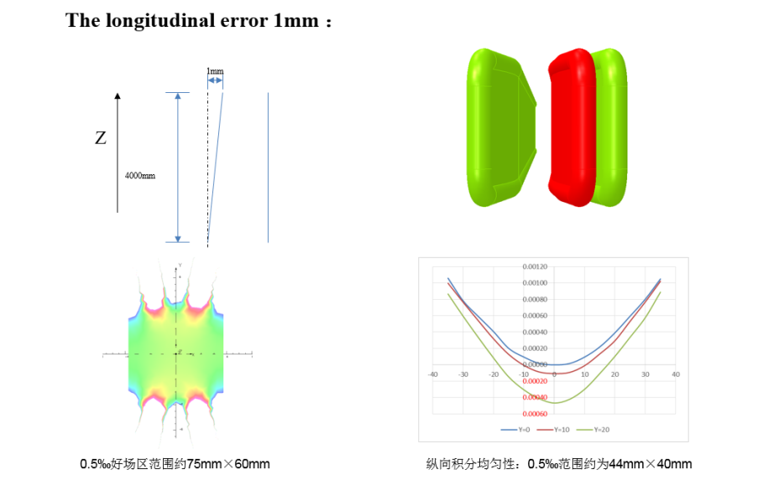
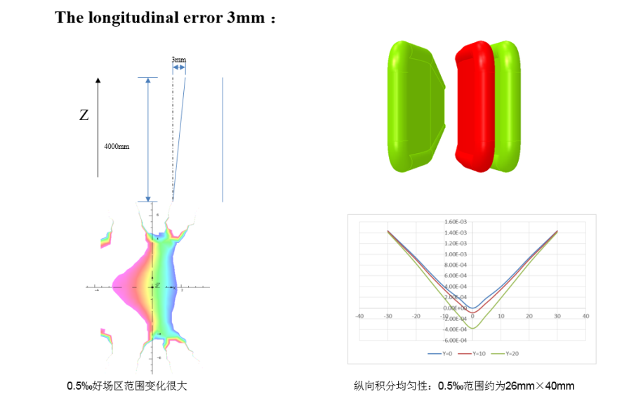
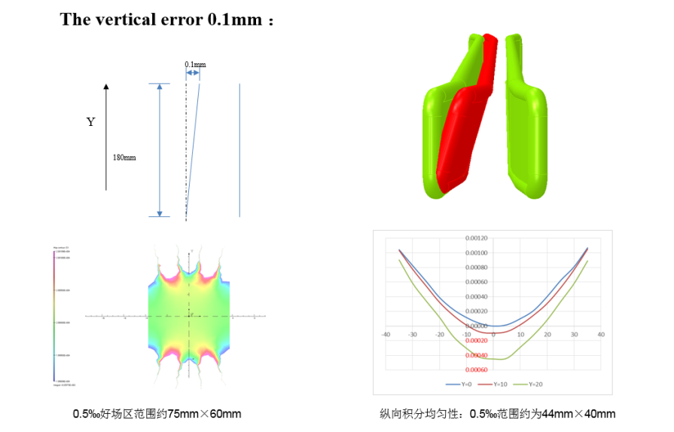
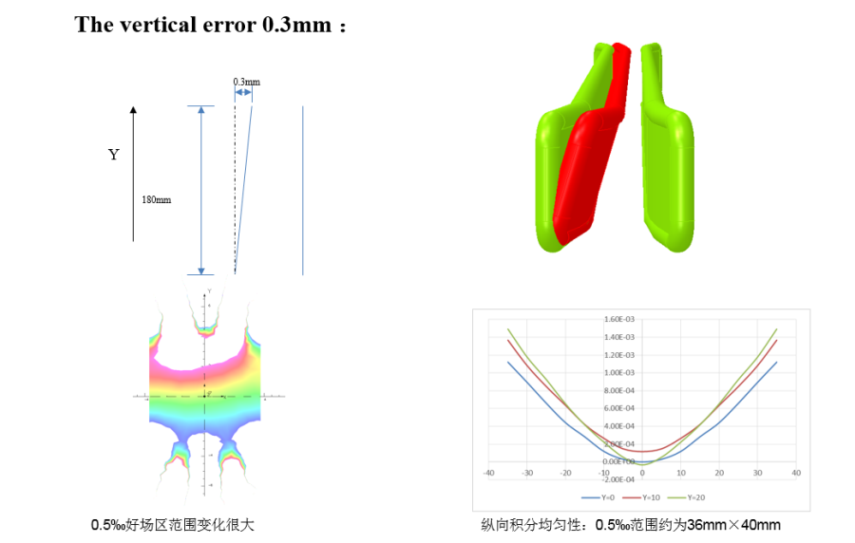
  Installation error analysis of electrostatic separator
According to the simulation result of installation error of electrostatic separator , the longitudinal error should be less than 1mm and the vertical error should be less than 0.1mm.

Slide 11

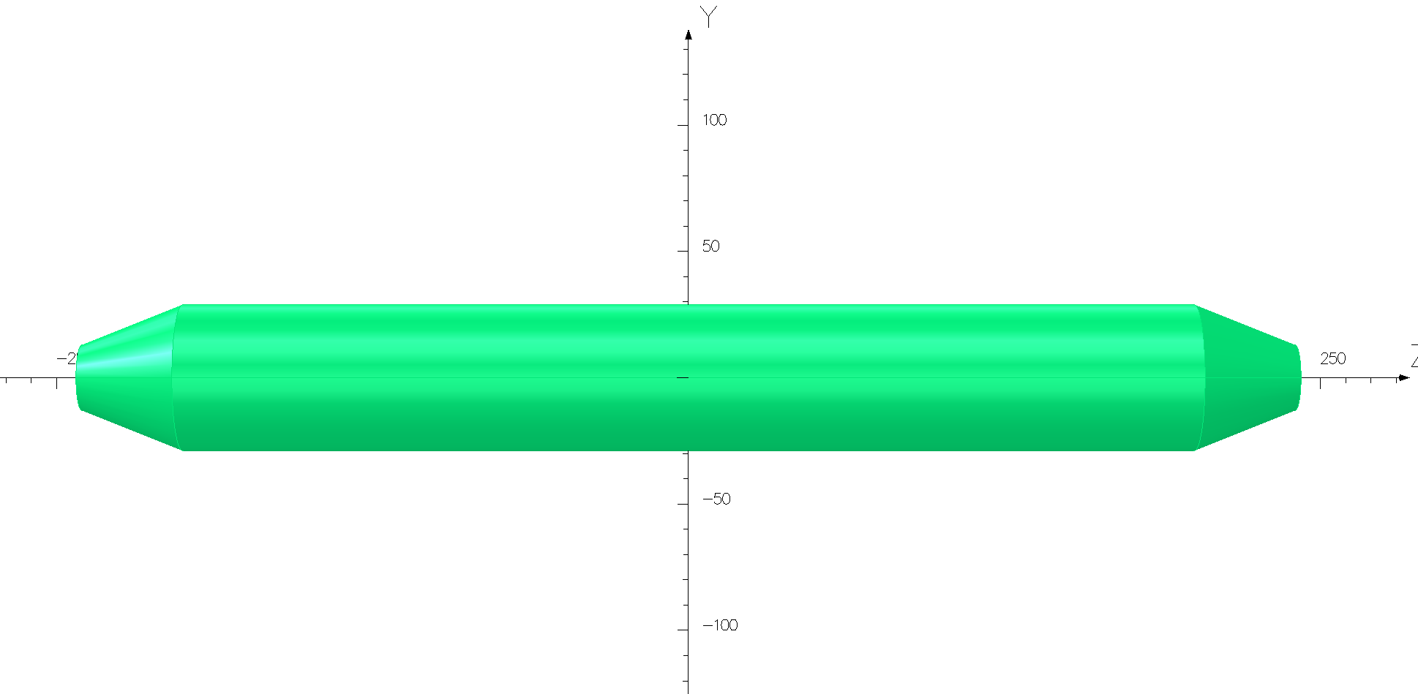
Methods to reduce the Parasitic mode losses
  The electrostatic separators are large contributors to the overall impedance. There are two methods implemented in the design of the separator which reduce the loss factor:
  ground electrodes
  tapered ends
  These two methods are merged in one unusual surface which smoothly guides the field energy from a normal vacuum chamber geometry to the multiple electrode geometry and then back to the normal vacuum chamber.
tapered ends
Ground electrodes

Slide 12
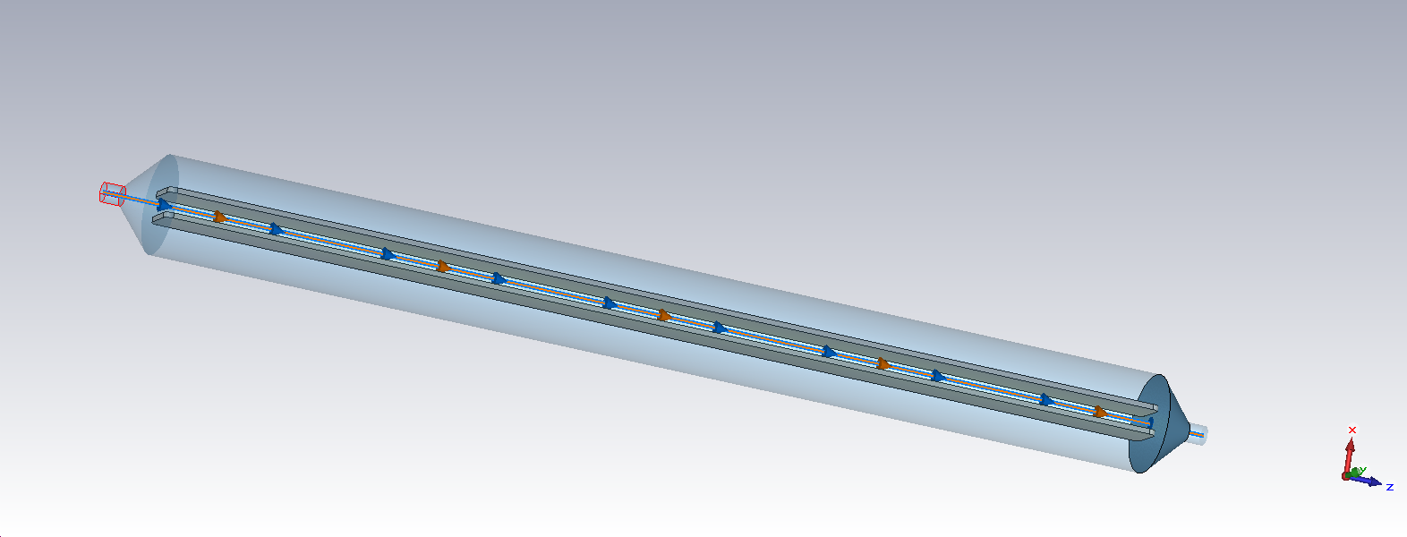
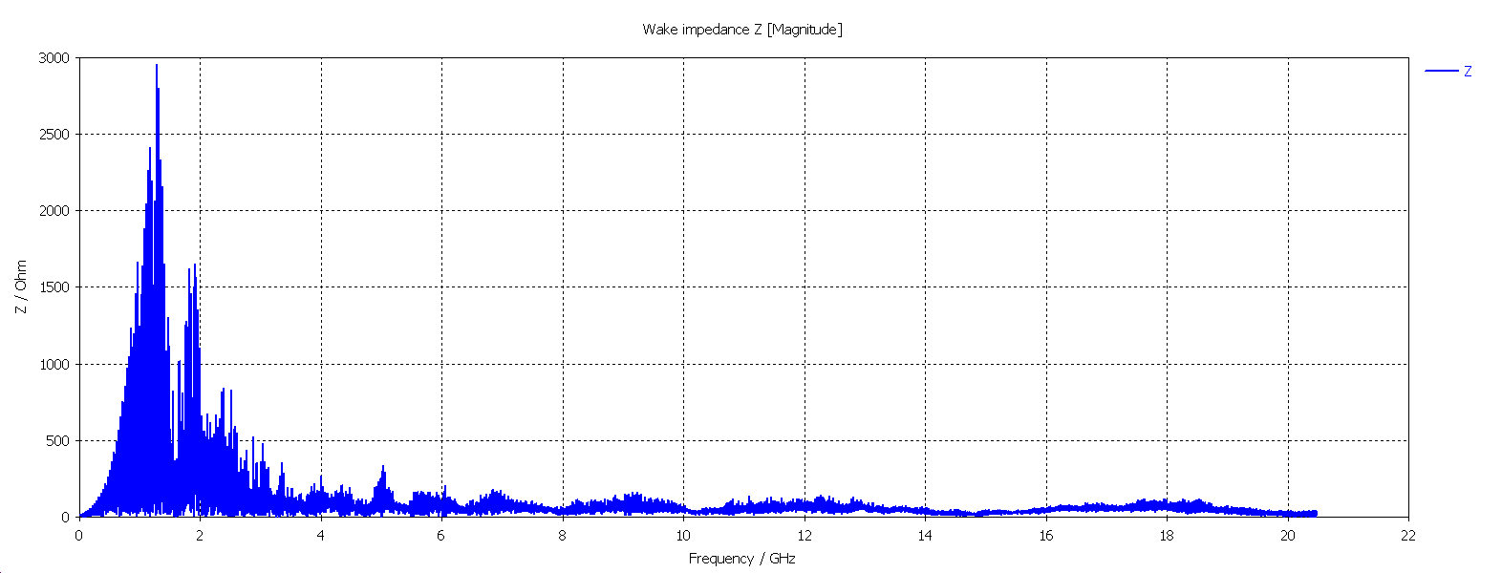
Methods to reduce the Parasitic mode losses
3D tapering, no g.e.
Separator tank length | 4000mm
Inner diameter of separator tank | 380mm
Electrode height | 180mm
Electrode gap | 75mm
Electrode thickness | 20mm
Transition taper length | 52.5mm
Transition pipe diameter | 75mm
Ground plate length | ×
Ground plate height | ×
Ground plate thickness | ×
Wake Integration type : Indirect Interfaces
Simulated wake length : 50000 mm
Wake shift x : 0 mm
Wake shift y : 0 mm
Wake-Loss-Factor : 1.256987e+000 V/pC
-------------------------------------------------------
P_{loss} : 531.5w(Higgs)/2.12kw(W)/7.42kw(Z)

Slide 13
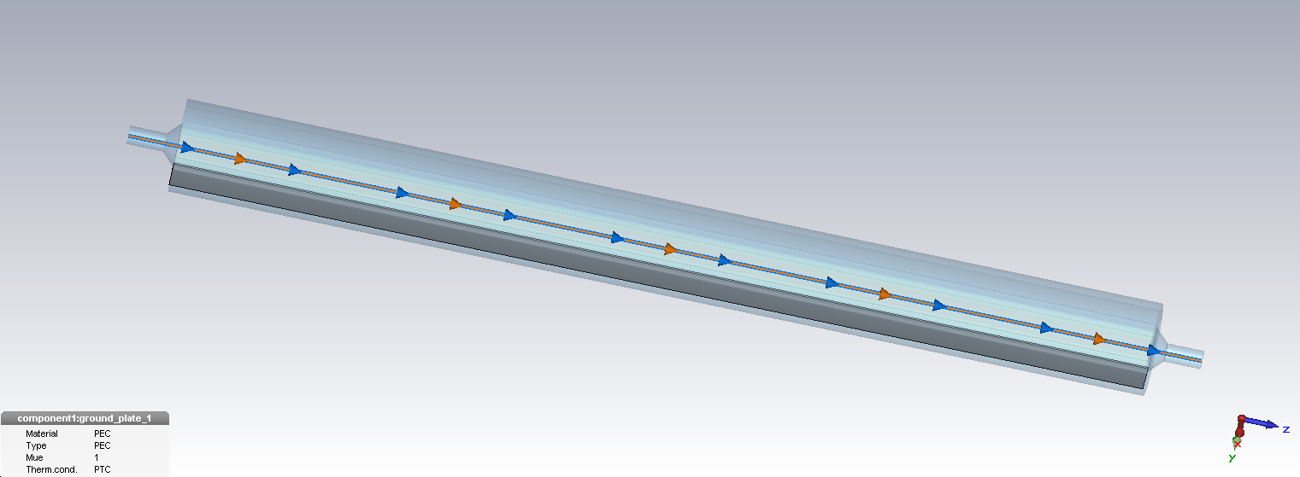
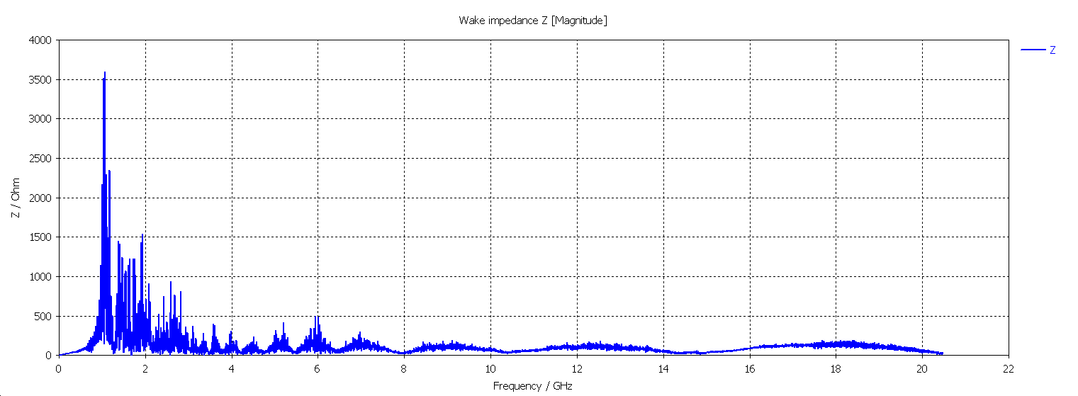
Methods to reduce the Parasitic mode losses
Partially tapering + g.e.
Separator tank length | 4000mm
Inner diameter of separator tank | 380mm
Electrode height | 180mm
Electrode gap | 75mm
Electrode thickness | 20mm
Transition taper length | 52.5mm
Transition pipe diameter | 75mm
Ground plate length | 4000mm
Ground plate height | 100mm
Ground plate thickness | 10mm
Wake Integration type : Indirect Interfaces
Simulated wake length : 50000 mm
Wake shift x : 0 mm
Wake shift y : 0 mm
Wake-Loss-Factor : 1.393547e+000 V/pC
----------------------------------------------------------------
P_{loss} : 589w(Higgs)/2.35kw(W)/8.22kw(Z)

Slide 14
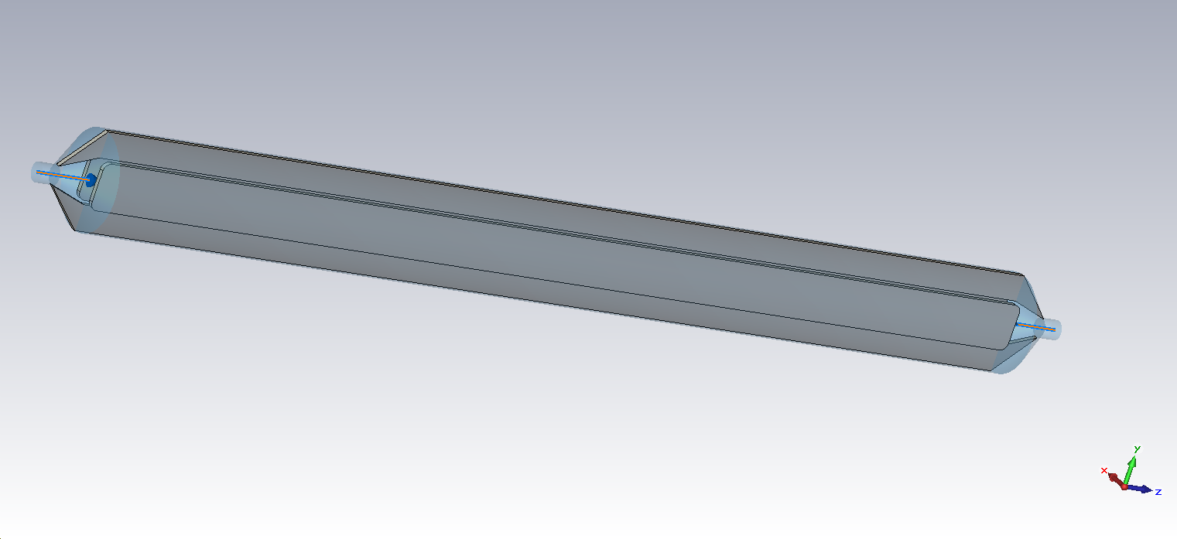
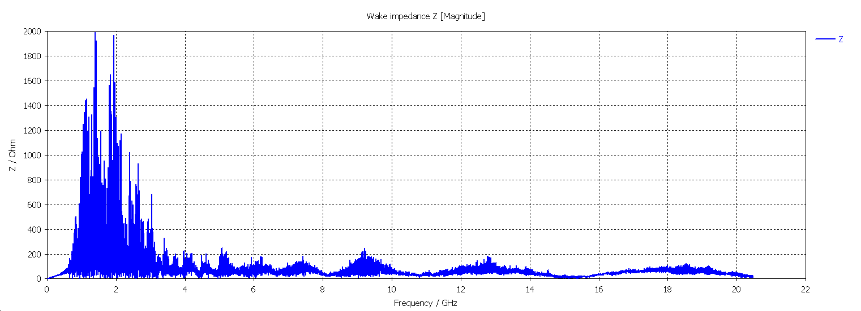
Methods to reduce the Parasitic mode losses
3D tapering + g.e.
Separator tank length | 4000mm
Inner diameter of separator tank | 380mm
Electrode height | 180mm
Electrode gap | 75mm
Electrode thickness | 20mm
Transition taper length | 150mm
Transition pipe diameter | 75mm
Ground plate length | 4300mm
Ground plate height | 100mm
Ground plate thickness | 10mm
Wake Integration type : Indirect Interfaces
Simulated wake length : 50000 mm
Wake shift x : 0 mm
Wake shift y : 0 mm
Wake-Loss-Factor : 1.170499e+000 V/pC
------------------------------------------------------------------------
P_{loss}: 495w(Higgs)/1.98kw(W)/6.91kw(Z)

Slide 15
Methods to reduce the Parasitic mode losses
  According to the simulation, there is a relatively strong narrowband impedance below 3GHz (caused by cavity structure).
  The structure of the cavity needs further optimization (increase the thickness of the ground electrode, and make it as close to the beam as possible)
  The absorber maybe necessary to absorb such high power in separator;
  Equipping the electrodes with a simple closed-loop Cooling system.
No. Description | K [V/pC]
(1) Partially tapering + g.e. | 1.393547
(2) 3D tapering, no g.e. | 1.256987
(3) 3D tapering + g.e. | 1.170499

Slide 16
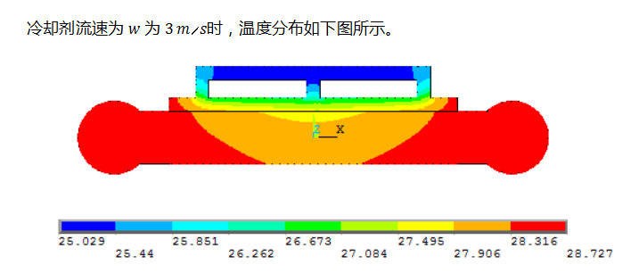
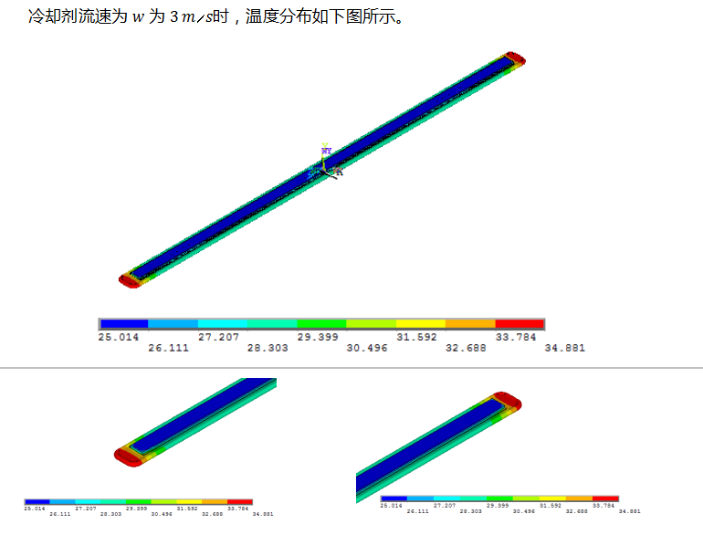
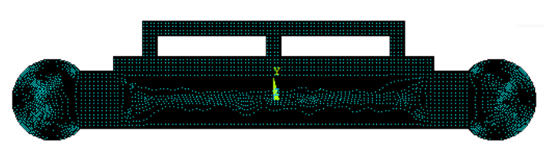
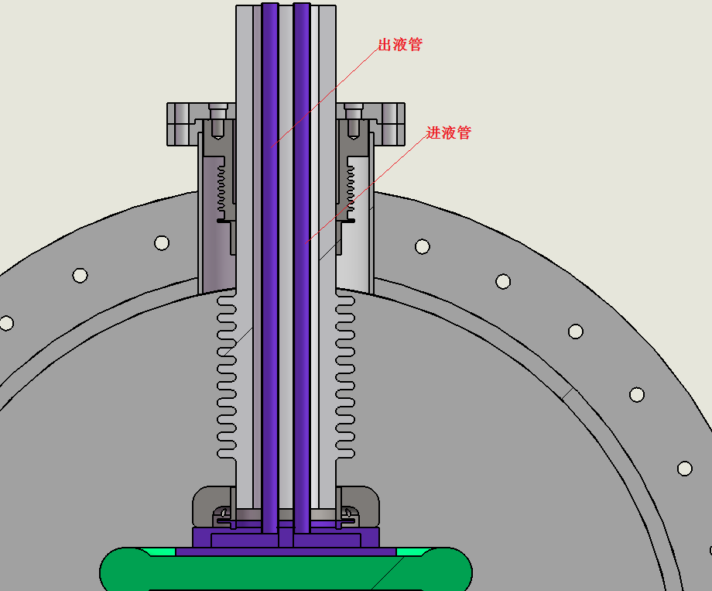
    Thermal analysis of the electrode
Closed-loop cooling system
The cooling plate is mounted on the outside of the electrode plate
The coolant : 3M “Fluorinert” FC-77
Simulation (2D &3D)
The thermal analysis of the electrode plate was carried out . When the flow rate was 1m/s, the temperature rise at the end of the electrode plate was about 15℃.

Slide 17
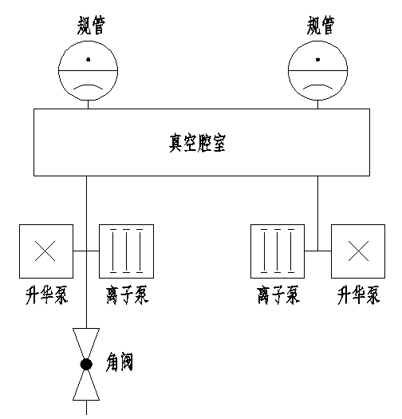
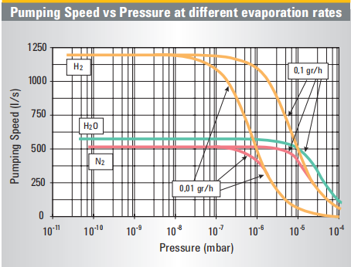
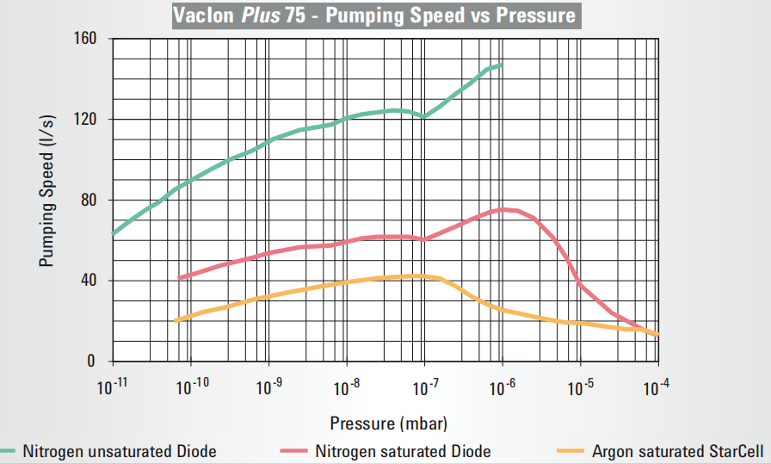
  Vacuum design
真空系统示意图
离子泵的抽速曲线
升华泵的抽速曲线
  To minimize the breakdown rate, the vacuum in all separators will be kept at the low pressure of about 2×10⁻¹⁰Torr. However, the size of the whole prototype is very large, so it is not easy to reach the test goal. So special care will be taken to the welding, sealing of the separator components in vacuum system design.
Including: two sputter ion pump ( pumping speed 1000l/s), and two sublimation pump ( pumping speed 1000l/s).
Considering add the NEG pump, which maintains a high pumping rate at ultra-high vacuum, especially for hydrogen.

Slide 18
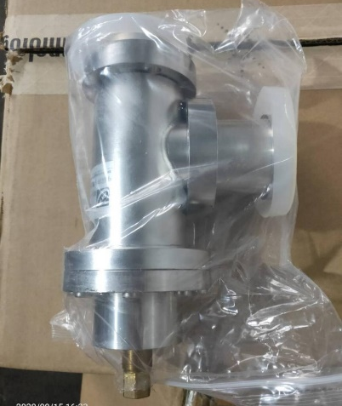
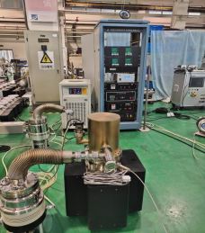
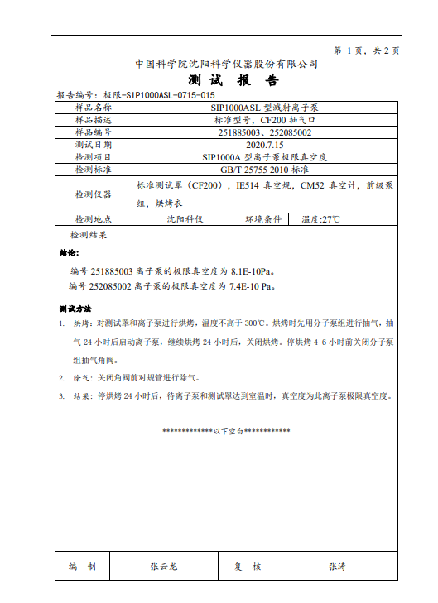
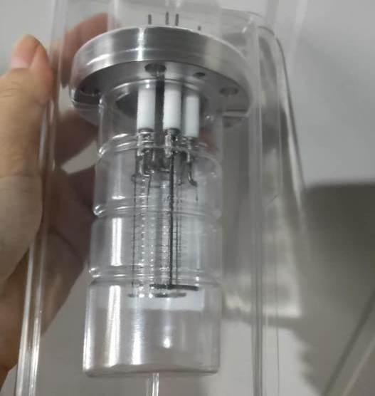
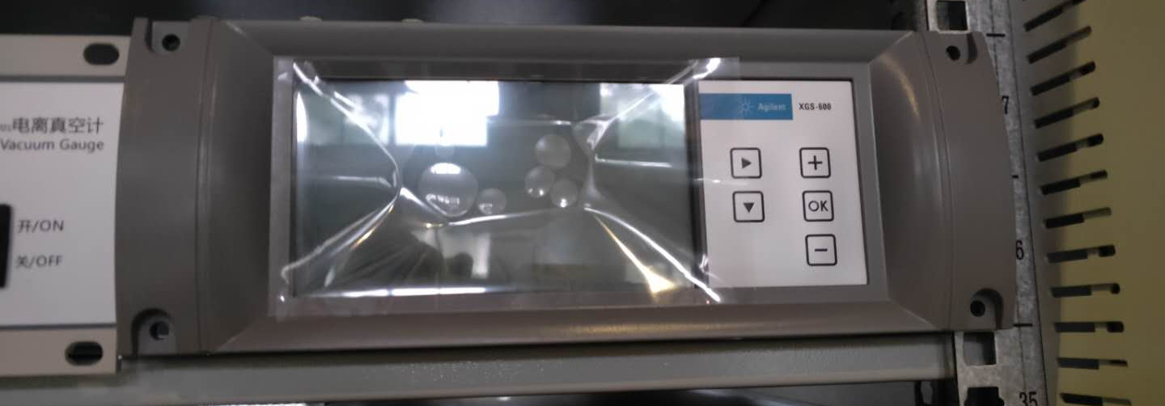
  Vacuum design
Angle valve, gauge and vacuum gauge

Slide 19
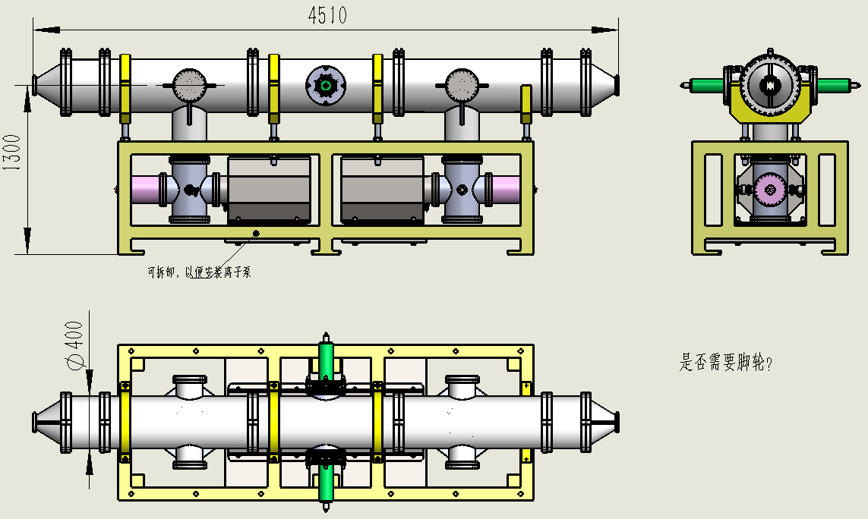
  Mechanical design
whole structural

Slide 20
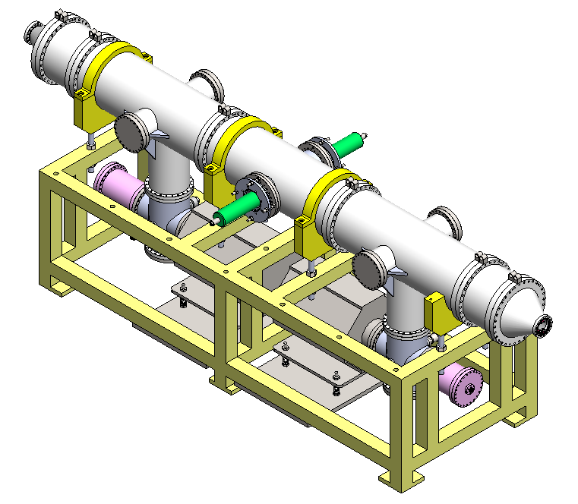
  Mechanical design
whole structural

Slide 21
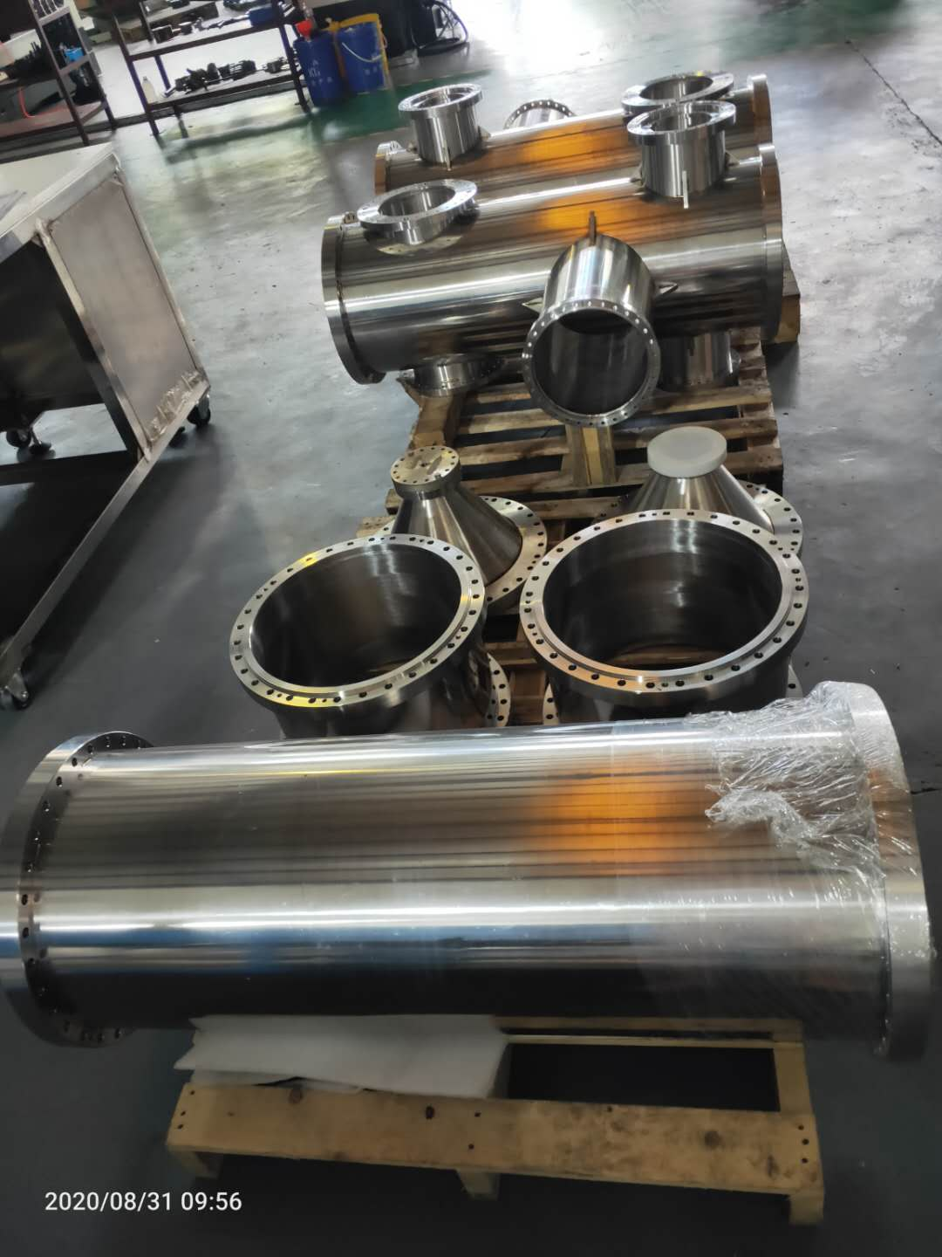
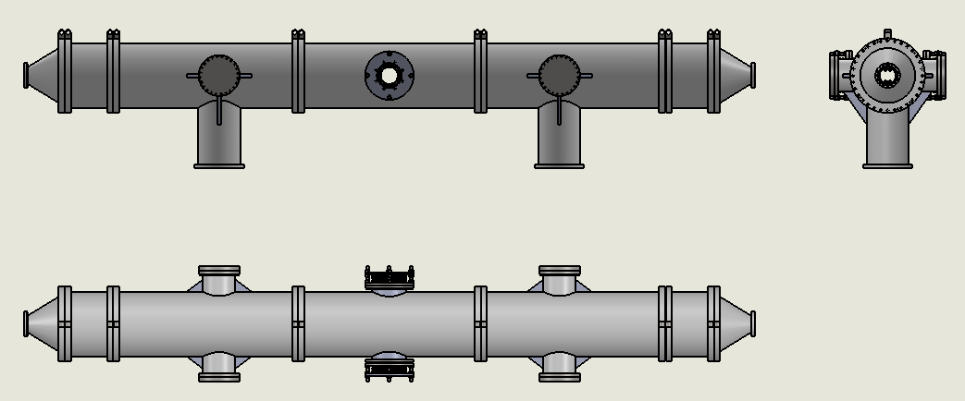
  Mechanical design
UHV tank
Material : stainless-steel 316L.
Split into 7sections, step positioned to ensure installation accuracy.
Electrochemical polishing treatment to make the HV sparking rate as low as possible.
High temperature vacuum degassing treatment to achieve ultra high vacuum.
Adopt metal seal to keep low leak rate of vacuum.
The main parts of the vacuum chamber have been welded. Afterword the vacuum chamber will be polished and leak tested.

Slide 22
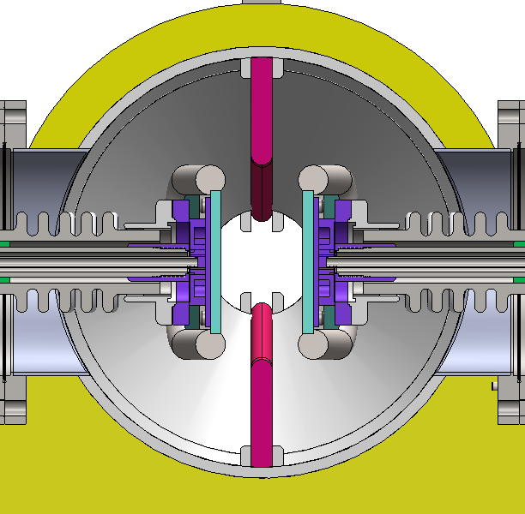
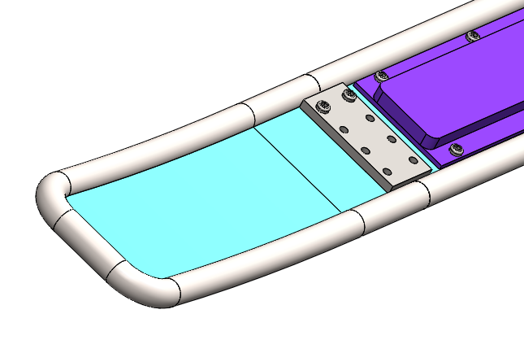
  Mechanical design
Electrode
Due to the large size, titanium welding deformation is large and difficult to correct, so as to minimize the range of welding.
Electrode plate and cooling plate are separated and bolted together.
The cold plate material is stainless-steel 316L.
The electrode plate is divided into three sections: the middle straight plate, the arc plate on both sides, and bolted connection. In this way, the dimensional accuracy of the middle part and the curved part on both sides is easy to be realized.

Slide 23
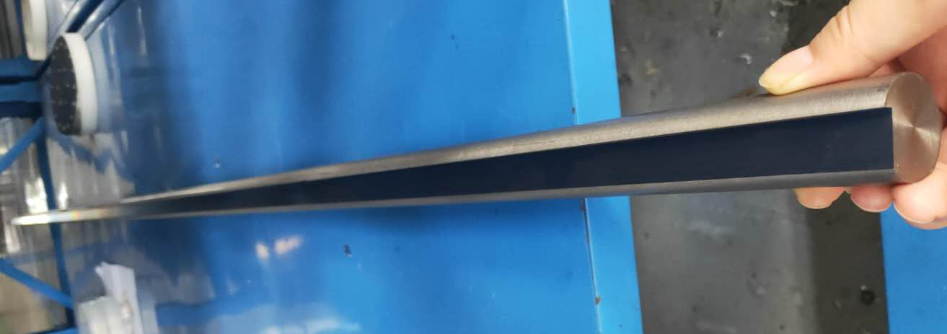
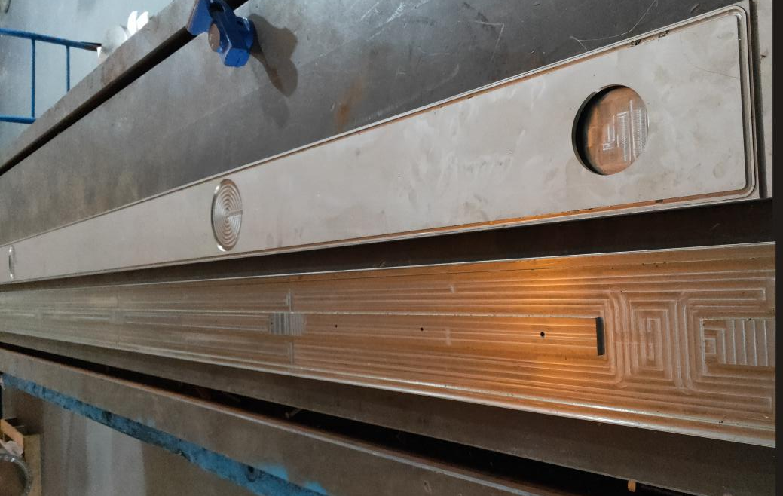

  Mechanical design
Electrode
Titanium rod processing completed
cooling plate processing completed
Titanium mounting flange

Slide 24


  Mechanical design
Ground Electrode
The ground electrode material is aluminum 6061 T6.
The ground electrode is divided into 5 sections: 2 sections of triangle, 2 sections of short rectangle and 1 section of long rectangle. The purpose of segmentation is to facilitate machining and installation
The ground electrode is fixed with a fixed clamp welded on the vacuum chamber.

Slide 25


  Mechanical design
HV metal-ceramic support
The ceramic parts are made of 95% alumina ceramics.
The ceramic ends are metallized , and the metal flanges are welded for fixation, which has the advantage of high mechanical strength.
The electrode have two supports, one is fixed, the other can be fine-tuned, to ensure the installation accuracy requirement and avoid the deformation of electrode.

Slide 26

  Mechanical design
High voltage feedthrough
The inside of the ceramic tube is atmosphere, with feedthrough cable and liquid pipe, and the outside is vacuum.
Bellows are soft connections for easy installation and position adjustment.
Each electrode plate has only one feedthrough device, both feed HV and cooling liquid.

Slide 27


Precision High Voltage Power Supply
Including : two HV supplies of maximum 150kV– one positive and one negative polarity.
Voltage margin for conditioning
An imported high-voltage power supply was ordered in November 2019.
A domestic high voltage power supply was ordered in March 2020.
 | Unom | Inom | Residual ripple | Stability
Heinzinger import | 150kV | 1.5mA | 1ⅹ10⁻⁴ | 1ⅹ10⁻⁴
Wisman domestic | 150kV | 4mA | 1ⅹ10⁻⁴ | 1ⅹ10⁻⁴

Slide 28

Precision High Voltage Power Supply
  To generate the high voltage, the rectified mains voltage is converted to rectangular alternating current of approx. 20 kHz and fed into a high-voltage transformer. Afterwards the voltage is multiplied and rectified in a subsequent multi-stage converter cascade. The generated high voltage is corrected in a high-voltage filter.

Slide 29



Precision High Voltage Power Supply
威思曼分压器RVD

Slide 30




Precision High Voltage Power Supply

Slide 31




Precision High Voltage Power Supply

Slide 32
  Project progress
The proposal review of the deflector was held on September 3, 2019
The electrostatic separator prototype bid was completed on February 25, 2020.
The electrostatic separator prototype contract was signed in March 2020
Review of the manufacturer's design was held on May 11, 2020
The dipole magnet prototype contract was signed in July 2020
Now the deflector is being fabricated, and the separator is scheduled to be completed by October.

Slide 33
Thank You!

