Slide 1
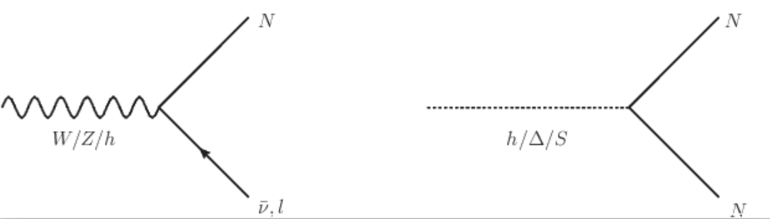
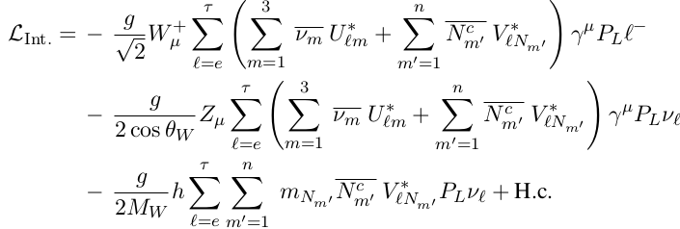

Heavy neutrino production (via Higgs)
ν-N mixing
via Dirac mass term:
∝ |V_{lN}|^2
Higgs-NP scalar mixing
via Majorana mass term:
∝ scalar mixing |sinα|^2
y_{D} is suppressed.
y_{N} is not.

Slide 2
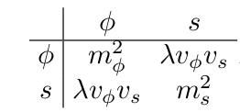



A minimal, effective case
Can h→ NN probe the h-s mixing to tiny levels?
‘small coupling’ assumption:
A small coupling between the `Higgs’-like Φ and a singlet S.
Mostly decoupled Φ, S sectors if the mixing terms are small.
SM Higgs-like
S vev gives the N mass
Small coupling:
& neglecting |H|²S terms

Slide 3
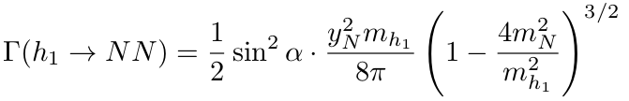

s can be light and both h₁, h₂ contribute to the signal.
h₂’s non-NN decay channels are |sinα|² suppressed.
Both h₁→NN branching and the σ(h₂) scales ~ |sinα|²
h₂→NN branching ~ 100%
yet negligible (off-shell) at lower E_{COM} if h₂ is massive.

Slide 4
May probe models with tiny Dirac masses.
likely more leptons, SM bkg friendly…
Higgs -> N N

Slide 5
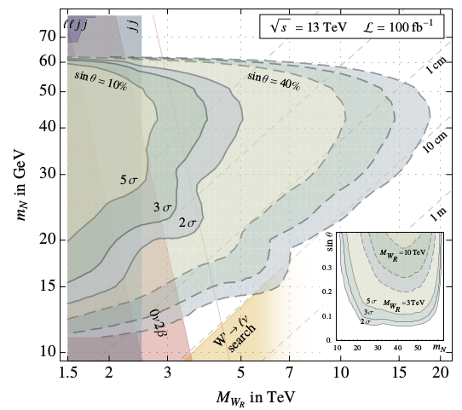
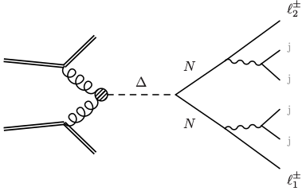
Typical `precision’ RHN searches: LNV
Semileptonic decay: one same-sign lepton pair
NN → l⁺l⁺jjjj smoking gun for Majorana N
Mass peak at ljj (x2)
Maiezza, Nemevšek, Nesti 15’
The LRSM analysis, pp→h(Δ)→ NN→ ll4j
0νββ bound from GERDA II

Slide 6
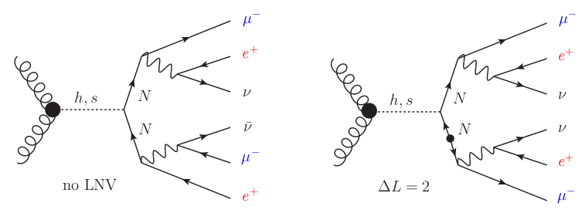
Higher precision channel: Fully leptonic decays
two same-sign, same-flavor lepton pairs
limits from pp collision, see
Available w/wo LNV
* ΔL=0 requires N coupling
to at least two flavors
** or taus.
Y.Gao, M.Jin, K.Wang,
JHEP 2002 (2020) 101
NOTE: W_{R} & Z’ do not
contribute to this channel;
Neutrino L-R mixing is needed!

Slide 7
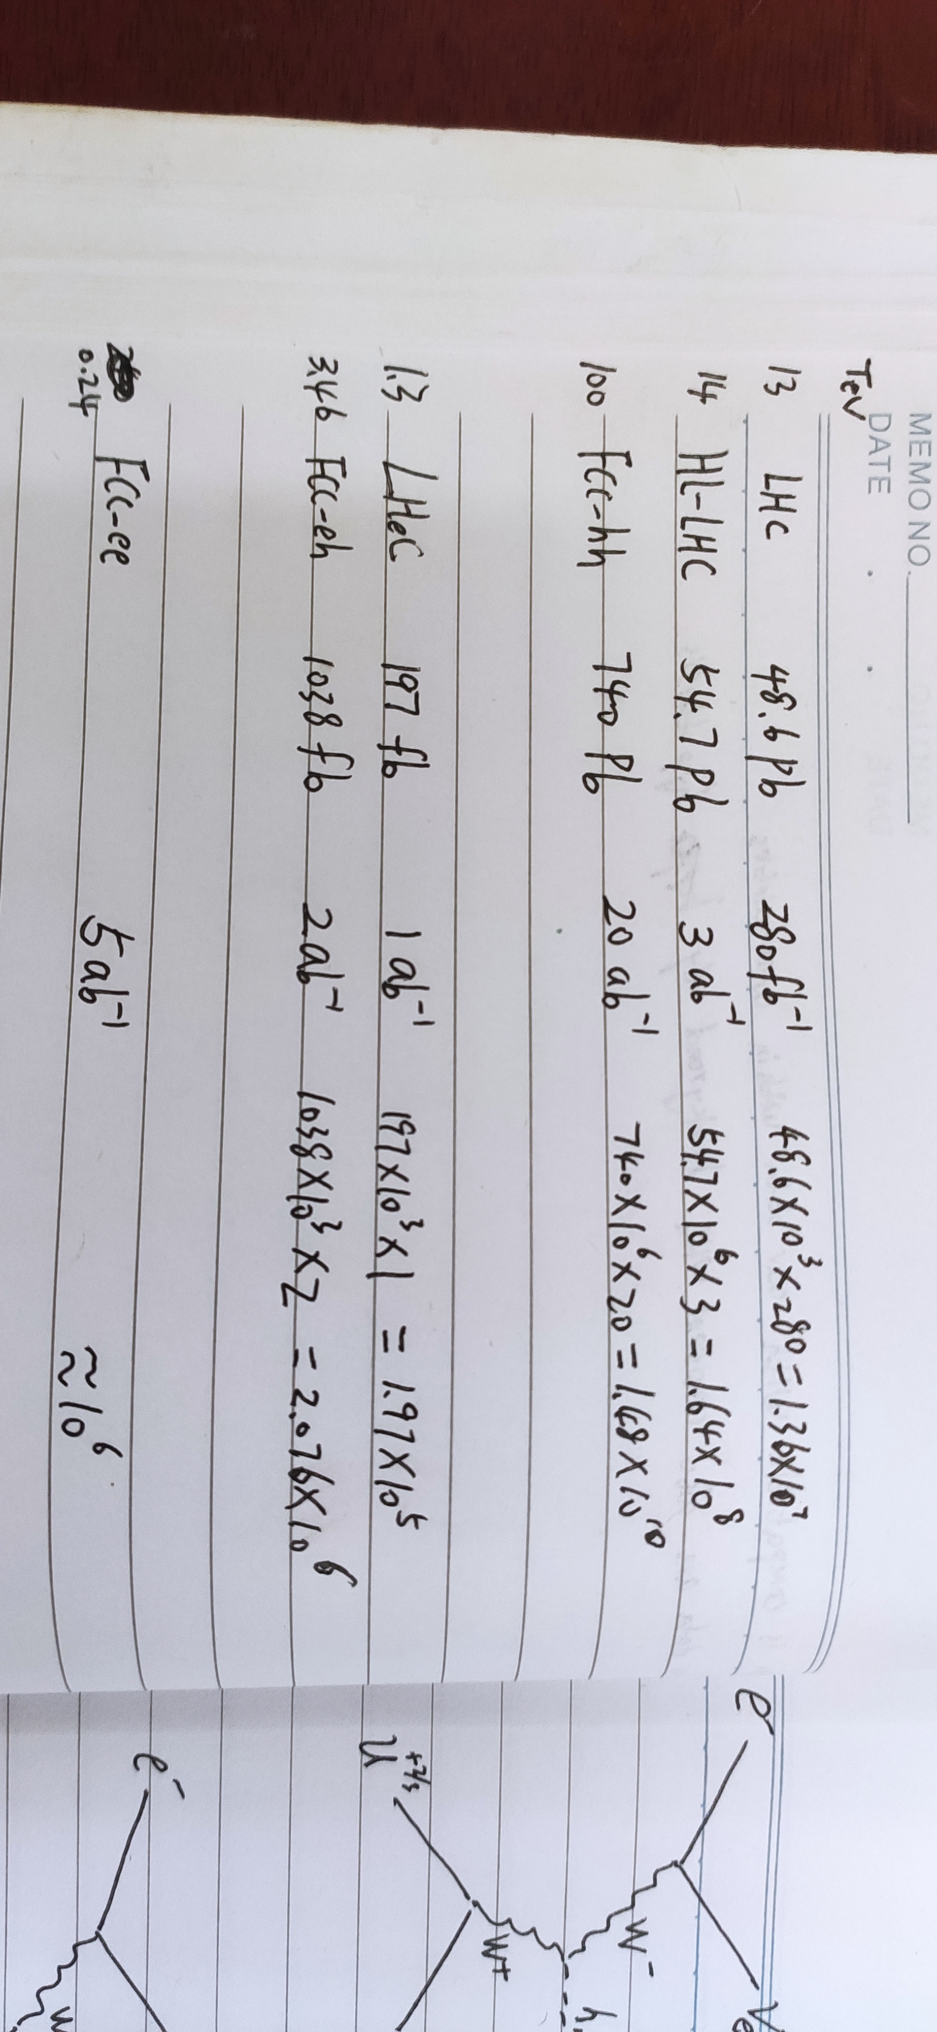
Lepton colliders: e+e- -> h Z
|V_{lN}|^2 -based searches should be performed at Z-pole.
Higgs has an associated Z. (Good for background veto)
Higgs luminosity at future machines…
& CEPC: ~ 10⁶ Higgs

Slide 8
Practically, h rare decay limit is capped by luminosity
BR_{h-> NP} < (σ_{hZ} *L)⁻¹.
Semileptonic channel:
1 same-sign, same flavor pair
no missing ET. LNV = 2
ee > Zh > (jj) (l⁺l⁺ + jets)
SM backgrounds:
ee > 4τ Z
ee > 2l Z
ee > 2l WW
ee > 4l z
ee > 2τ 2l Z
intrinsic:
neutrinos carry away
LN, can fake LNV.
Need wrong sign
leptons and/or
unconstructed leptons
(missing or unisolated)
Max Higgs branching can
be (roughly) estimated at
O(10⁻³) * |sinα|²
If not kinematically limited and y_{N}^{~O(1)}
Monte Carlo & Simulation in progress…

Slide 9
Fully leptonic channel is very clean.
Fully leptonic channel:
2 same-sign, same flavor pair
LNV = unknown
with missing ET, no soft jets.
ee > Zh > (jj) (e⁺e⁺ μ⁻μ⁻ + MET)
SM backgrounds:
ee > 4τ Z
ee > 4τjj (mostly 4taZ)
ee > 6τ (removeable by Mjj)
intrinsic:
neutrinos carry away
LN, can fake LNV.
Bkg friendly:
SM final states need
two wrong sign leptons
to fake this signal
Comparable max branching
BR_{max} < O(10⁻³) * |sinα|²
If not kinematically limited and y_{N}^{~O(1)}
Use strong lepton number & flavor cuts
Monte Carlo & Simulation in progress…

Slide 10
Clean signal may become statistically limited.
Machine’s luminosity cap: BR _{h → NP} < (σ_{hZ} *L)⁻¹.
Or one-event discovery?
& CEPC: ~ 10⁶ Higgs

