Slide 1
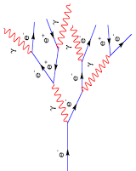
Digitization model
Shengsen, Linghui
i
Q₋^{i}
Q₊^{i}
$$Q_{±}^{i}=E_{0}∙e^{− \frac{\frac{L}{2}±z_{i}}{L_{Att}}}$$
$$t_{min}^{±}=\frac{z_{min}^{±}}{v} ,$$
$$v= \frac{c}{n} , n≈2.15$$
$$Q_{±}=\sum_{i}{Q_{±}^{i}}$$
$$t_{±}=Gaus(t_{min}^{±}, σ_{t})$$

