Slide 1
Discussions on working group and some other issues
Xiaomei Zhang
2020-10-20

Slide 2
Working group for work recommendation from review committee
Work items recommended from review committee
DIRAC redundancy
Rucio
IAM
We were asked to set up working group on that and reported to the committee during collaboration meeting
Expect experts from sites to involve in discussions and problems solving
Each site lead or organize one group, pushing forward the progress?

Slide 3
DIRAC Redundancy (1)
Redundancy servers are expected to be installed in Tier1 sites (JINR, IN2P3, CNAF)
The suggested working group
Persons familiar with DIRAC from each site
Experience with DIRAC additional servers would be great
Persons in:
Xiaomei from IHEP
Igor and Nikolay from JINR
? from CNAF
? from IN2P3
Others?
Status:
JINR already has the first redundancy DIRAC service up

Slide 4
DIRAC Redundancy (2)
Things to be discussed and done
Machines or VMs needed?
What kind of redundancy is enough and possible?
What components to be redundant locally and remotely?
How to set up redundancy servers in data centers?
Testing and usage?
Monitoring?

Slide 5
Rucio
Manpower?
XuanTong from IHEP
Others?
Discuss?
Testbed set up
Study on data organization and policies
Design and develop for JUNO cases
Prepare for raw data transfer tests

Slide 6
IAM
Working group?
IAM expert join?
Planned to discuss

Slide 7
Work groups for others
Large scale tests operation group
Production with production system
Reconstruction with frontier/squid access
Raw data transfer
Analysis with JSUB
Other technology
XCache in JUNO?

Slide 8
JSUB
A tool to do mass user job submission and management
Deployment will be done with CVMFS with the respository /cvmfs/dcomputing
The first version would be out in November
Volunteers needed to test out
A large scale of tests will be done in November to know its performance

Slide 9
/cvmfs/dcomputing
This repository will hold the tools of JUNO computing, including DIRAC client, JSUB, site conf
This cvmfs repository need to be supported as well with /cvmfs/juno.ihep.ac.cn
The configuration and key is the same as /cvmfs/juno.ihep.ac.cn

Slide 10
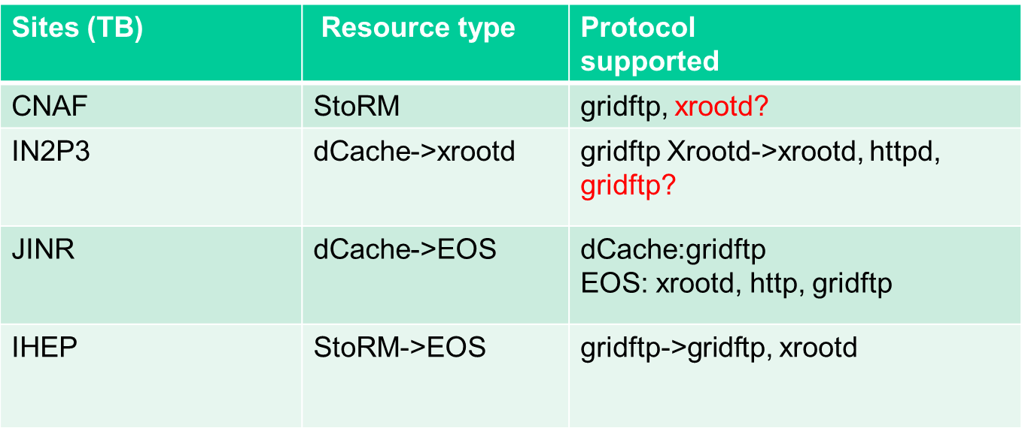
TPC
Three protocols exist: gridftp, xrootd, httpd, but no common TPC protocols
Can we have common protocols for all the sites?
CNAF add xrootd TPC support to StoRM?
IN2P3 new xrootd server add gridftp as well?
IHEP will move to EOS SE before this year with gridftp, xrootd
At the end, xrootd becomes a common TPC protocol for all the sites

