Slide 1
Status of the High luminosity lattices for the CEPC collider
Yiwei Wang
on behalf of the CEPC Accelerator Physics Group
CEPC day
Oct 19, 2020

Slide 2
Outline
Lattice design for high luminosity
Higgs mode
Z mode
tt mode

Slide 3
Overall parameters for Higgs mode
 | Higgs (CDR) | Higgs (high)
Number of IPs | 2 | 2
Beam energy (GeV) | 120 | 120
Circumference (km) | 100 | 100
Synchrotron radiation loss/turn (GeV) | 1.73 | 1.8
Crossing angle at IP (mrad) | 16.5×2 | 16.5
Piwinski angle | 3.48 | 4.87
Number of particles/bunch N_{e} (10¹⁰) | 15.0 | 16.3
Bunch number (bunch spacing) | 242 (0.68μs) | 214
Beam current (mA) | 17.4 | 16.8
Synchrotron radiation power /beam (MW) | 30 | 30
Bending radius (km) | 10.7 | 10.2
Momentum compact (10⁻⁵) | 1.11 | 7.34
β function at IP β_{x}* / β_{y}* (m) | 0.36/0.0015 | 0.33/0.001
Emittance e_{x}/e_{y} (nm) | 1.21/0.0024 | 0.68/0.0014
Beam size at IP s_{x} /s_{y} (μm) | 20.9/0.06 | 15.0/0.037
Beam-beam parameters ξ_{x}/ξ_{y} | 0.018/0.109 | 0.018/0.115
RF voltage V_{RF} (GV) | 2.17 | 2.27
RF frequency f _{RF} (MHz) (harmonic) | 650 (216816) | 650 (217500)
Natural bunch length σ_{z} (mm) | 2.72 | 2.25
Bunch length σ_{z} (mm) | 4.4 | 4.42
HOM power/cavity (2 cell) (kw) | 0.46 | 0.48
Energy spread (%) | 0.134 | 0.19
Energy acceptance requirement (%) | 1.35 | 1.7
Energy acceptance by RF (%) | 2.06 | 2.5
Beamstruhlung lifetime (min) | 80 | 41
Lifetime (hour) | 0.43 | 0.34
F (hour glass) | 0.89 | 0.88
Luminosity/IP L (10³⁴cm⁻²s⁻¹) | 2.93 | 5.0
Luminosity can be increased ~4% if reducing the length of straight sections.
A smaller emittance from booster is necessary.
by D. Wang, 17 July 2020

Slide 4
Design of high luminosity lattice (Higgs)
Fit parameter list with luminosity of $5.0×{10}^{34}/{cm}^{2}/s$
Stronger optimization and stricter hardware requirement should be made to get enough dynamic aperture
Optimization of the quadrupole radiation effect
Interaction region: longer QD0/QF1
ARC region: longer quadrupoles
Reduction of dynamic aperture requirement from injection
Straight section region: larger βx at injection point
Maximization of bend filling factor to minimize the synchrotron radiation loss per turn
ARC region: sextupoles in two rings changed from staggered to parallel; The left drifts are used for longer bend.
RF region: shorter phase tuning sections
Optimization of high order chromaticity for arc region
Reduction of the length from IP to 1st quadrupole without changing the front-end position of the FD cryo-module
V1: L*=1.9m, LQ1=3m, LQ1=2m, KQ1A=103T/m, KQ1B=62T/m, KQ1C=56T/m, d=0.6m
V2: L*=1.9m, LQ1=2.5m, LQ1=1.5m, KQ1A=142T/m, KQ1B=96T/m, KQ1C=56T/m, d=0.3m

Slide 5
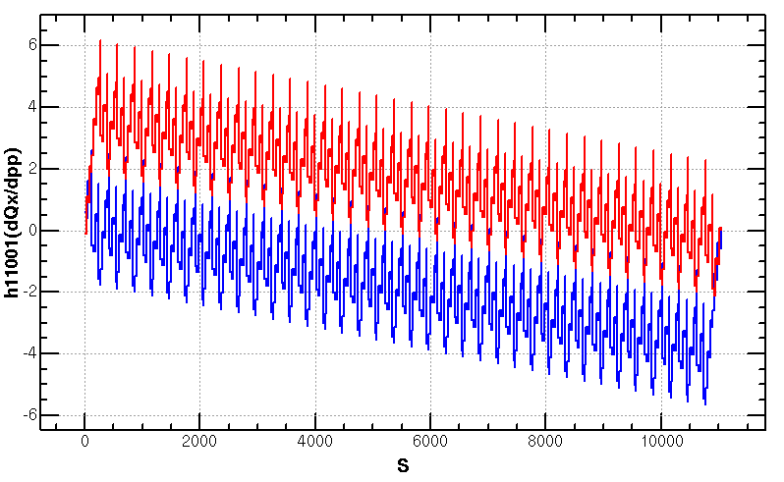
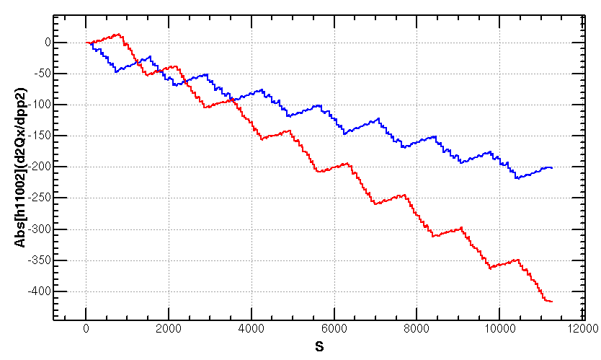
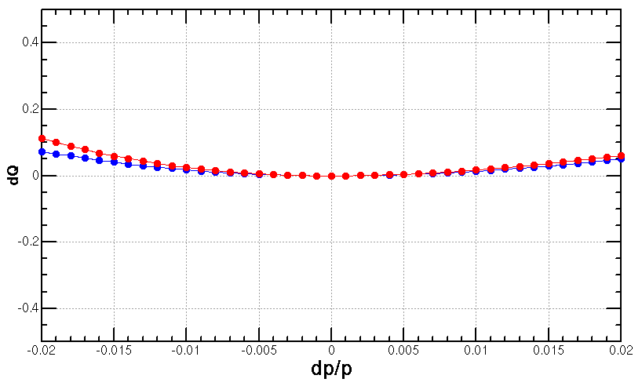
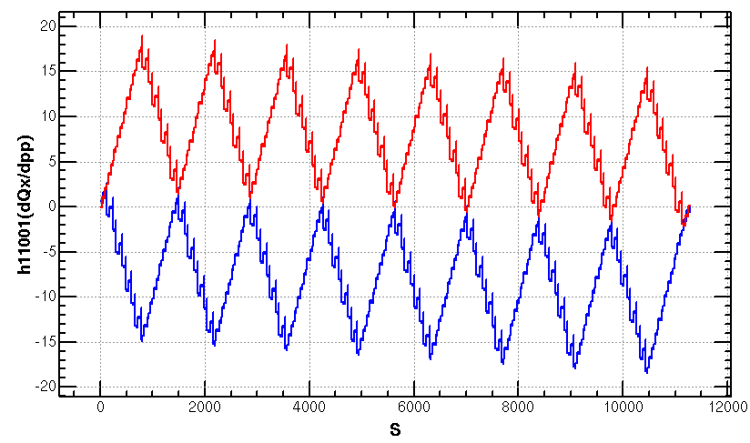
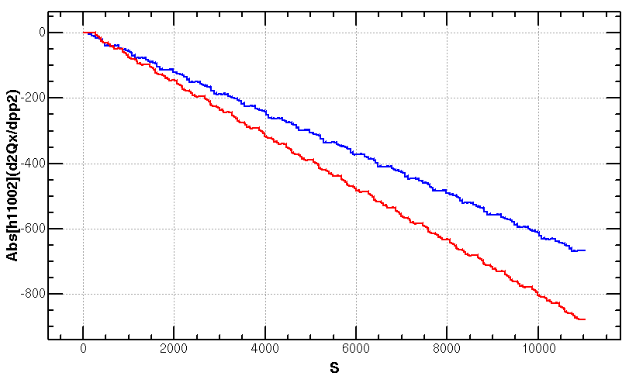
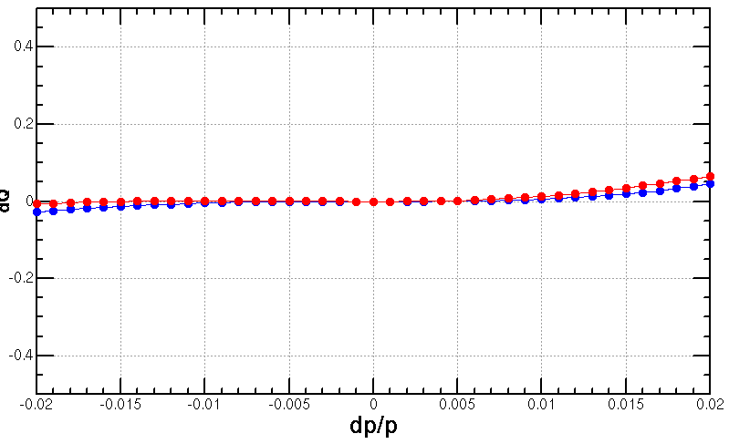
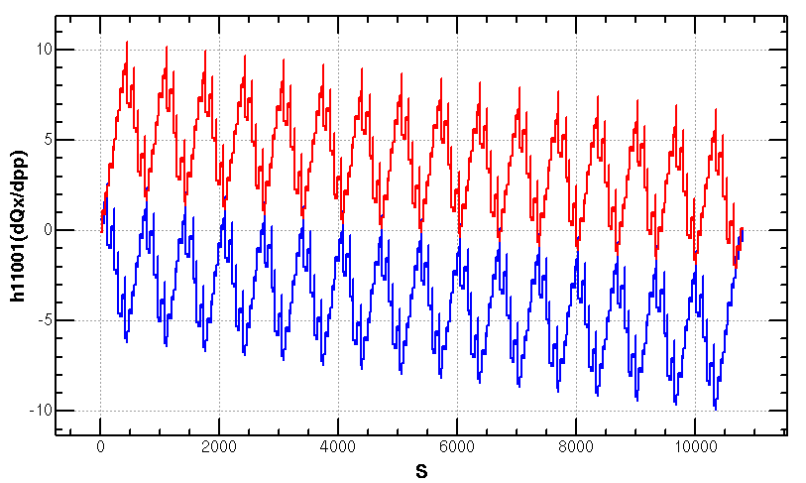
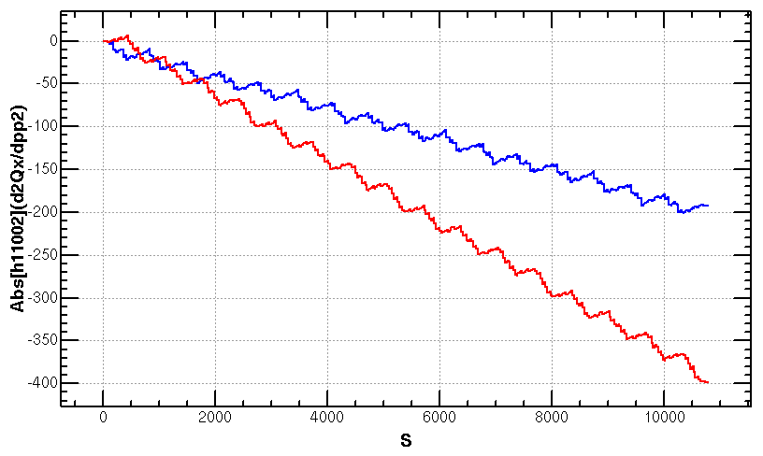
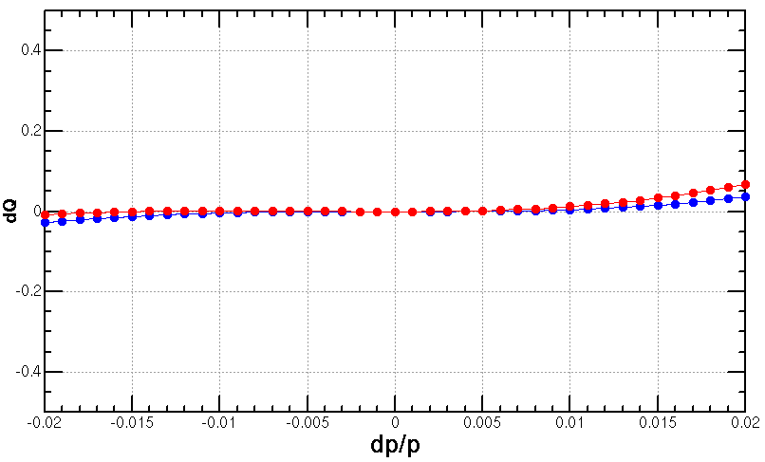
Optimization of high order chromaticity for arc region
FODOS1=Join[
FODOSF1,FODO,FODOSF1SD1,FODO,FODOSD1];
2*FODO1,36*FODOS1,2*FODO1
Scheme with 2 repeated sextupoles
Proposed by K. Oide
Q’’=313, 410
FODOS1=Join[
FODOSF1,FODO,FODOSF1, FODOSF1,FODO,FODOSF1, FODOSF1,FODO,FODOSF1, FODOSF1,FODO,FODOSF1SD1,FODO,FODOSD1, FODOSD1,FODO,FODOSD1, FODOSD1,FODO,FODOSD1, FODOSD1,FODO,FODOSD1];
2*FODO1,8*FODOS1,2*FODO1
Scheme with 8 repeated sextupoles
Proposed by Tianjian Bian
Ref: Tianjian Bian, PhD thesis
Q’’=9, 145
FODOS1=Join[
FODOSF1,FODO,FODOSF1,
FODOSF1,FODO,FODOSF1SD1,FODO,FODOSD1,
FODOSD1,FODO,FODOSD1];
2*FODO1,16*FODOS1,2*FODO1
Scheme with 4 repeated sextupoles
Q’’=8, 139

Slide 6
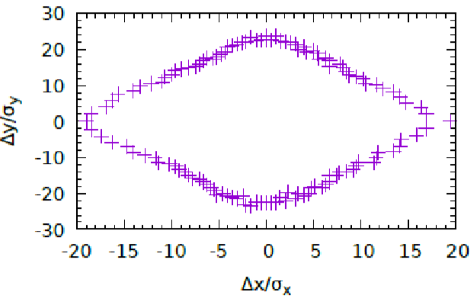
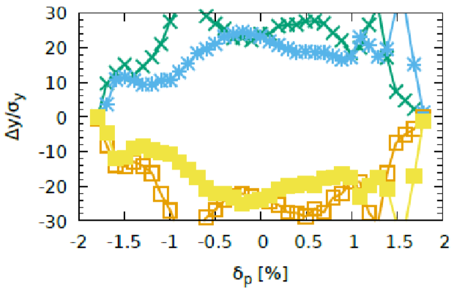
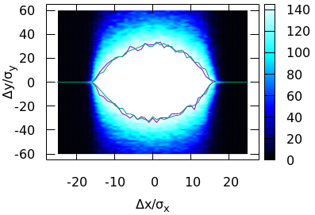
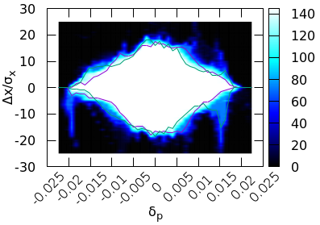
Dynamic aperture optimization
With better correction of energy dependent aberration and shorter L* (without changing the front-end position of the final doublet cryo-module)
DA w/o error achieved 16𝜎𝑥×32σy×1.9%
CDR: L=$3.0×{10}^{34}/{cm}^{2}/s$
Achieved (w/o error): $20σ_{x}×24σ_{y}×1.8\%$
Goal (w/ error): $8σ_{x}×15σ_{y}×1.35\%$
High luminosity: L=$5.0×{10}^{34}/{cm}^{2}/s$
J. Wu,
Y. Zhang,
Y. W. Wang
Achieved (w/o error): $16σ_{x}×32σ_{y}×1.9\%$
Goal (w/ error): $8σ_{x}×15σ_{y}×1.7\%$
Notes:
$11?σ_{x}×15σ_{y}×1.7\%(booster 3.6nm)$

Slide 7
High luminosity lattice with different βy*
The βy* is highly correlated with luminosity
If loose the βy* from 1mm to 1.5mm (CDR), the luminosity will be lower than $3.0×{10}^{34}/{cm}^{2}/s$ (CDR)
The beam-beam parameter can not reach the limit due to mismatch of βy* and emittance.
If squeeze the βy* from 1mm to <1mm, the energy acceptance will be larger than 1.7% which make the DA and thus difficult to reach.

Slide 8
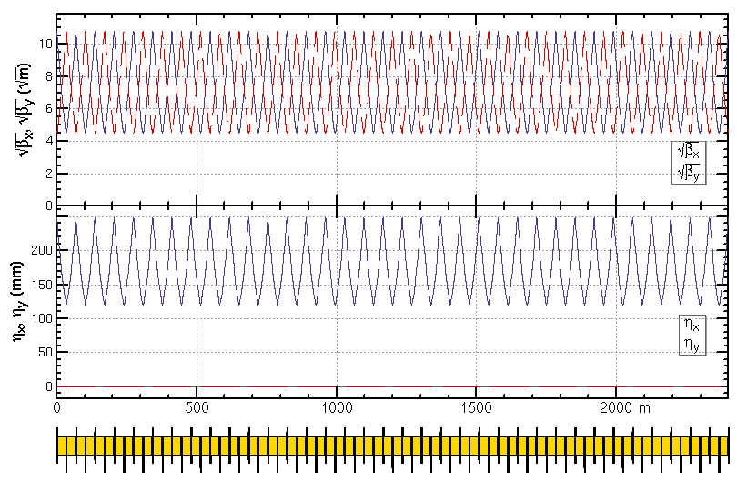
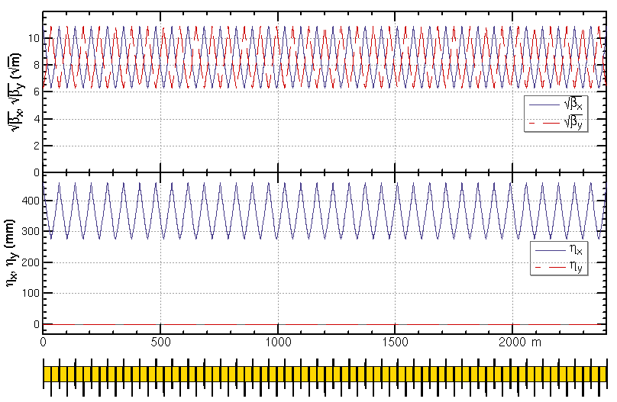
Z mode of the high luminosity lattice
For the interaction region, the optics are almost kept.
For the arc region, the phase advance of each cell will be changed from 90/90 to 60/60 and the additional sextupoles need to be installed for the Z mode (Ref: FCC-ee CDR).
Higgs mode: 5 cells/period, 42 sextupoles in 35 cells
Z mode: 7 cells/period, 12 additional sextupoles (+29%) in 35 cells
SF
SD
SD
SF
SD
35 cells of Higgs mode
35 cells of Z mode

Slide 9
Z mode of the high luminosity lattice（cont.）
For the RF region, the 2-cell cavities for the Z mode will locate at two sides of H/W/ttbar ones. The bunches can be filled in a full ring.
Jiyuan Zhai, CEPC day, 23 Sep 2020

Slide 10
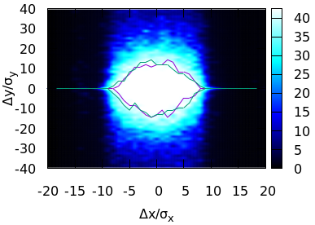
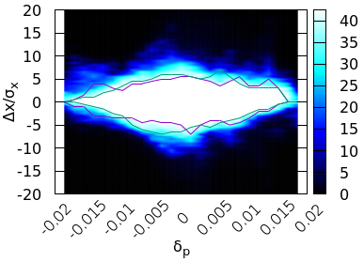
Dynamic aperture for tt mode (preliminary)
To evaluate the dynamic aperture of the lattice at tt bar
Keep by*=1mm, scale the energy to 180 GeV, increase the RF bucket height to 3%
providing a not bad start point
Specific lattice design for tt bar is under going and the dynamic aperture should be better
The particle by* is larger (FCC-ee: by*=1.6mm)
Re-optimization of dynamic aperture for tt mode
J. Wu,
Y. Zhang,
Y. W. Wang

Slide 11
Summary
Lattices for a luminosity goal 5.0*10^34 /cm^2/s has been designed whose by*=1mm, emittance=0.68nm.
Stronger optimization had be made in order to get enough dynamic aperture.
With better correction of energy dependent aberration and shorter L* (without changing the front-end position of the final doublet cryo-module)
The DA (16𝜎𝑥×32σy×1.9%) without error effects is enough.
For the Z mode
For the arc region, the phase advance of each cell will be changed from 90/90 to 60/60 and the additional sextupoles need to be installed for the Z mode (Ref: FCC-ee CDR).
For the RF region, the 2-cell cavities for the Z mode will locate at two sides of H/W/ttbar ones.
For the tt mode
DA was evaluated by simply scaling the energy and the RF bucket height
providing a not bad start point.
Specific lattice design for tt bar is under going and the dynamic aperture should be better

Slide 13
Overall parameters for Z mode
 | Z (CDR) | Z (high)
Number of IPs | 2 | 2
Energy (GeV) | 45.5 | 45.5
Circumference (km) | 100 | 100
SR loss/turn (GeV) | 0.036 | 0.036
Half crossing angle (mrad) | 16.5 | 16.5
Piwinski angle | 23.8 | 17.0
N_{e}/bunch (10¹⁰) | 8.0 | 14.5
Bunch number | 12000 | 15000
Beam current (mA) | 461 | 1045.3
SR power /beam (MW) | 16.5 | 37.3
Bending radius (km) | 10.7 | 10.7
Momentum compaction (10⁻⁵) | 1.11 | 2.23
β_{IP} x/y (m) | 0.2/0.001 | 0.15/0.001
Emittance x/y (nm) | 0.18/0.0016 | 0.52/0.0024
Transverse σ_{IP} (um) | 6.0/0.04 | 8.8/0.049
ξ_{x}/ξ_{y}/IP | 0.004/0.079 | 0.0048/0.098
ξ_{x}/ν_{s} | 0.288 | 0.21
V_{RF} (GV) | 0.1 | 0.13
f _{RF} (MHz) (harmonic) | 650 | 650
Nature bunch length σ_{z} (mm) | 2.42 | 2.93
Bunch length σ_{z} (mm) | 8.5 | 9.1
HOM power/cavity (kw) | 1.94 (2cell) | 3.75 (1cell)
Energy spread (%) | 0.08 | 0.117
Energy acceptance (DA) (%) | 1.5 | 1.4
Energy acceptance by RF (%) | 1.7 | 1.5
Lifetime (hour) | 2.5 | 1.9
L_{max}/IP (10³⁴cm⁻²s⁻¹) | 32.1 | 101.6
* Based on CDR, a tentative parameter list
by D. Wang, 17 July 2020

Slide 14
Optimization of the ARC lattice
2nd order chromaticity is a main aberration for the optimization of momentum acceptance.
2nd order chromaticity generated in the ARC region and corrected with IR knobs (phase advance or K1)
However, the IR knobs will generate chromaticity at IP (beta, alfa and dispersion) especially for the horizontal plane.
FODO cells with 8 repeated sextupoles generated much more less 2nd order chromaticity for horizontal plane.
The dynamic aperture reduction due to errors may be larger as much more repeated sextupoles for each plane.
A compromise lattice with 4 repeated should help.

Slide 15
Dynamic aperture optimization
w/ synchrotron motion, radiation damping and fluctuation
w/o error effects
With algorithm of the Multi-Objective Differential Evolution (MODE)
Variables: 52 [32 arc sextupoles + 8 IR sextupoles + 4 multipoles (k1 components) + 8 phase advance]
Tracking turns : 25 (optimization with 25 turns while DA result in 145 turns)
Objectives: DA area in X/Y (with coupling)
boundary: $\frac{x^{2}}{{18}^{2}}+\frac{z^{2}}{{20}^{2}}=1$
obj1: the Whole Area of DA in x-δ plane
obj2: the Off-momentum DA area in x-δ plane
obj2
obj1

