Slide 1




Institute of High Energy Physics, CAS
Some theoretical issues about the XYZ states
Qiang Zhao
Division of Theoretical Physics
Institute of High Energy Physics, CAS
zhaoq@ihep.ac.cn
Conference on Flavor Physics and CP Violation
Fudan University, June 7-11, 2021

Slide 2
Outline
1. Hadrons beyond the conventional quark model
2. Threshold phenomena and dynamics
3. Phenomenology for Y(4260) and Zc(3900)/X(3872)
4. Reminder of some crucial issues

Slide 3
Our comprehension of the non-perturbative QCD seems to be much less than we thought!
meson
baryon
Conventional quark model prescription
Exotic states are expected by QCD
Hybrid
Glueball
Tetraquark
Pentaquark
Hadronic molecule
How the non-pQCD manifest itself in the quark-gluon interactions?
What is the proper effective degrees of freedom in the description of hadron structures?

Slide 4
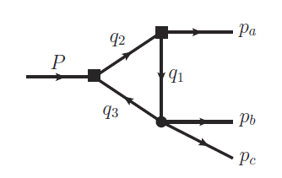
1. Hadrons beyond the conventional quark model
Exotics of Type-I:
J^{PC} are not allowed by Q‾Q configurations, e.g. 0⁻⁻,1⁻⁺ …
Direct observation
Exotics of Type-II:
J^{PC} are the same as Q‾Q configurations
Outnumbering of conventional QM states?
Peculiar properties?
“Exotics” of Type-III:
Leading kinematic singularity can cause measurable effects, e.g. the triangle singularity.
What’s the impact?
How to distinguish a genuine state from kinematic effects?

Slide 5
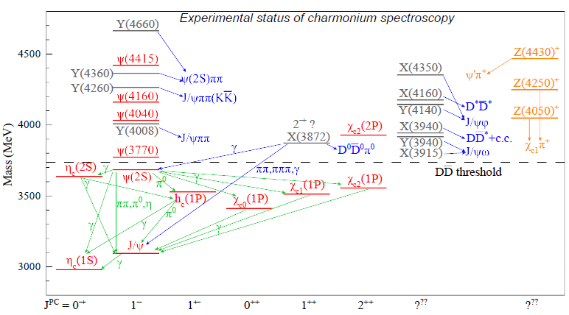
Heavy flavor states: Charmonia and charmonium-like states, i.e. X, Y, Z’s.
Apparent deviations occur above the open charm thresholds.
Charged charmonium states definitely indicate novel phenomena beyond the potential QM.
Zc(4200)
Zc(4020)
Zc(3900)
Most of these new states are close to some S-wave open thresholds.
(I): Zc(3900), Zc(4020), Zc(4430), Zcs(3982) …
(II): Y(4260), Y(4360), X(3872) …
What the potential QM could have missed?
States below the open charm thresholds indicates the success of the potential quark model.

Slide 6
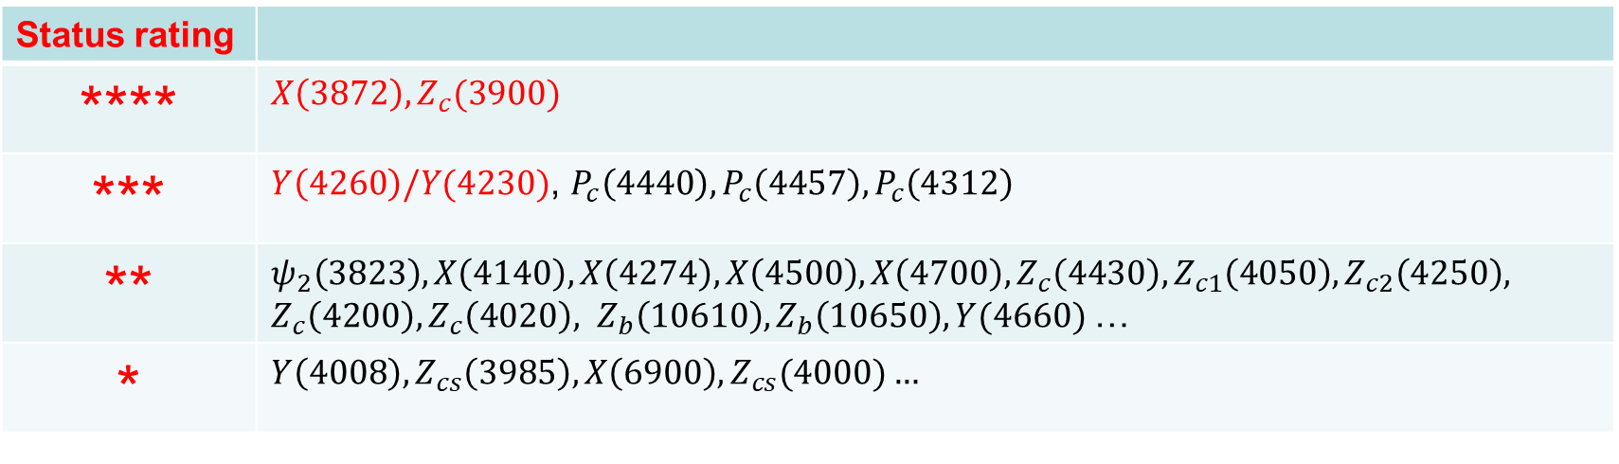
The present status on the study of QCD exotics
1) There have been tens of exotic candidates observed in experiment. But their properties are far from well established.
Status rating
**** | $X\left(3872\right), Z_{c}(3900)$
*** | $Y\left(4260\right)/Y(4230)$, $P_{c}\left(4440\right), P_{c}\left(4457\right), P_{c}\left(4312\right)$
** | $$ψ_{2}\left(3823\right), X\left(4140\right), X\left(4274\right), X\left(4500\right), X\left(4700\right), Z_{c}\left(4430\right), Z_{c1}\left(4050\right), Z_{c2}\left(4250\right),$$ $Z_{c}\left(4200\right), Z_{c}\left(4020\right), Z_{b}\left(10610\right), Z_{b}\left(10650\right), Y(4660)$…
* | $$Y\left(4008\right), Z_{cs}\left(3985\right), X\left(6900\right), Z_{cs}(4000)…$$
How many states we would expect?
Different models have different descriptions of the underlying effective degrees of freedom (EDoF). How to distinguish/combine these different scenarios?

Slide 7
Tetraquark vs. hadronic molecule
Belle Collaboration, Phys. Rev. Lett. 91, 262001 (2003)

Slide 8
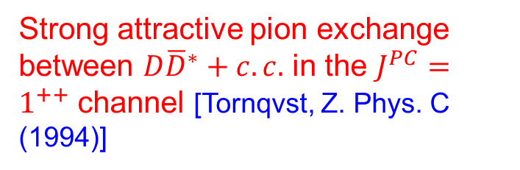
Strong attractive pion exchange between $D{\overline{D}}^{∗}+c.c.$ in the $J^{PC}=1^{++}$ channel [Tornqvst, Z. Phys. C (1994)]
~ 60 MeV mass diff.
Godfrey and Isgur, PRD32, 189 (1985)
N. Brambilla et al., Phys. Rept. 873, 1-154 (2020)

Slide 9
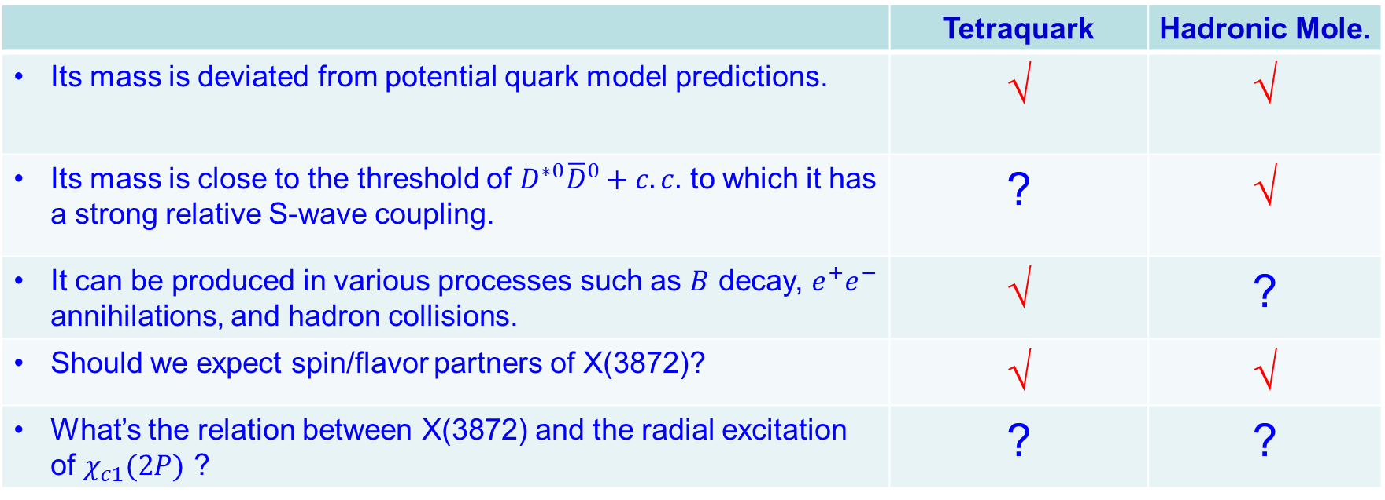
Why X(3872) is so special?
Tetraquark vs. hadronic molecule
A confirmed signal apparently deviated from quark model expectations.
 | Tetraquark | Hadronic Mole.
Its mass is deviated from potential quark model predictions. | √ | √
Its mass is close to the threshold of $D^{∗0}{\overline{D}}^{0}+c.c.$ to which it has a strong relative S-wave coupling. | ? | √
It can be produced in various processes such as $B$ decay, $e^{+}e^{−}$ annihilations, and hadron collisions. | √ | ?
Should we expect spin/flavor partners of X(3872)? | √ | √
What’s the relation between X(3872) and the radial excitation of $χ_{c1}(2P)$ ? | ? | ?
What are the proper effective DoFs in the description of X(3872).

Slide 10
Success of potential quark model:
Hadrons are made of quarks (antiquarks) as QCD color singlet
Typical quark model prescription (e.g. Godfrey-Isgur model):

Slide 11
The same form of quark potential should account for the X(3872) as a tetraquark state!
Very rich spectra are expected in the diquark-antidiquark model!
To be understood:
Can diquarks be treated as a compact object?
Mass may not be sufficient criteria for assigning a candidate into the spectrum, e.g. the mass location of X(3872) in the tetraquark scenario does not tell whether X(3872) is compact or loosely bound?
Observables sensitive to the internal structures?
How about the widths?
M.N. Anwar, J. Ferretti, E. Santopinto, PRD 98, 094015 (2018)

Slide 12
The connection between the quark model and QCD ONLY becomes clear in certain circumstances: in the heavy quark limit the soft QCD for quark-antiquark or quark-quark interactions can become much simpler.
However, the effects of the open channels on the soft QCD potential is also evident!
G. S. Bali, et al., Phys. Rev. D62, 054503 (2000)
J. Bulava, et al., Phys. Lett. B793, 493 (2019),
M. Foster and C. Michael (UKQCD), Phys. Rev. D59, 094509 (1999)

Slide 13
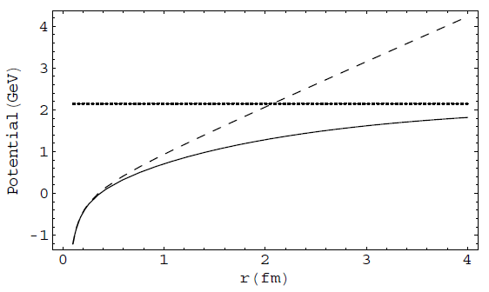
2. Threshold phenomena and dynamics
Color screening effects? String breaking effects?
V(r) = −κ/r + σ r
LQCD
Linear conf.
‾qq creation
Coulomb
The effect of vacuum polarization due to dynamical quark pair creation may be manifested by the strong coupling to open thresholds and compensated by that of the hadron loops, i.e. coupled-channel effects.
E. Eichten et al., PRD17, 3090 (1987)
E. J. Eichten, K. Lane, and C. Quigg, Phys. Rev. D 69, 094019 (2004)
B.-Q. Li and K.-T. Chao, Phys. Rev. D79, 094004 (2009);
T. Barnes and E. Swanson, Phys.Rev. C77, 055206 (2008)

Slide 14




Typical processes where the open threshold coupled channels can play a role
The open channel couplings introduce NOT ONLY additional dynamics (add. effective DOF) into the hadron structures, BUT ALSO novel kinematic effects, i.e. triangle singularity …
Y.J. Zhang, G. Li, Q. Zhao, PRL(2009);
X. Liu, B. Zhang, X.Q. Li, PLB(2009)
Q. Wang et al. PRD(2012), PLB(2012)
“ρπ puzzle”
X.-H. Liu et al, PRD81, 014017(2010);
X. Liu et al, PRD81, 074006(2010)
Q. Wang et al, PRD2012
G. Li and Q. Zhao, PRD(2011)074005
F.K. Guo, C. Hanhart, G. Li, U.-G. Meiβner and Q. Zhao, PRD82, 034025 (2010); PRD83, 034013 (2011)
F.K. Guo and Ulf-G Meiβner, PRL108(2012)112002
The mass shift in charmonia and charmed mesons, E.Eichten et al., PRD17(1987)3090
X.-G. Wu and Q. Zhao, PRD85, 034040 (2012)

Slide 15
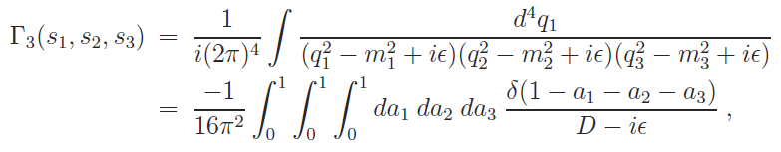



Exotics of Type-III:
Peak structures caused by kinematic effects, in particular, by triangle singularity.
The TS occurs when all the three internal particles can approach their on-shell condition simultaneously:
for all j=1,2,3.
L. D. Landau, Nucl. Phys. 13, 181 (1959);
J.J. Wu, X.-H. Liu, Q. Zhao, B.-S. Zou, Phys. Rev. Lett. 108, 081003 (2012);
Q. Wang, C. Hanhart, Q. Zhao, Phys. Rev. Lett. 111, 132003 (2013); Phys. Lett. B 725, 106 (2013)
X.-H. Liu, M. Oka and Q. Zhao, PLB753, 297(2016);
F.-K. Guo, C. Hanhart, U.-G. Meissner, Q. Wang, Q. Zhao, B.-S. Zou, arXiv:1705.00141[hep-ph], Rev. Mod. Phys. 90, 015004 (2018)

Slide 16
The narrow two-body open thresholds:
Their possible impact on the spectrum should be systematically investigated.
S-wave thresh.
P-wave thresh.
g_{eff}
h₁ (P, V, A, …)
M
h₂ (P, V, A …)

Slide 17
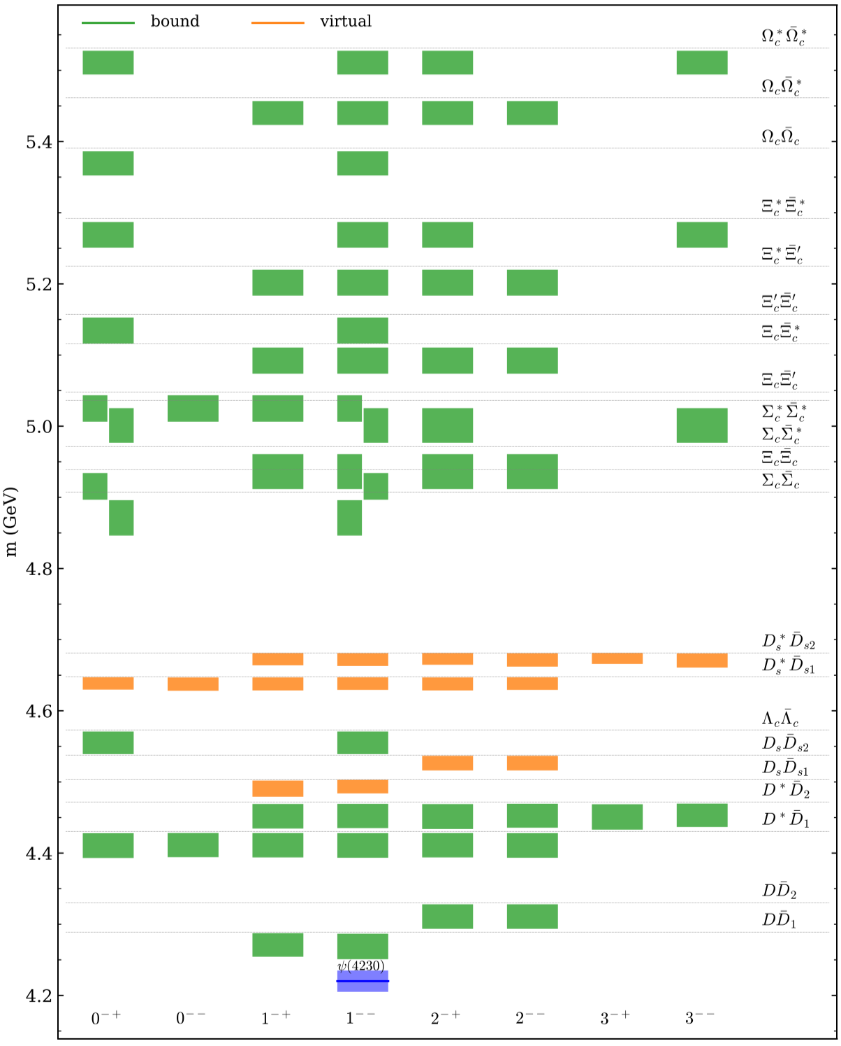
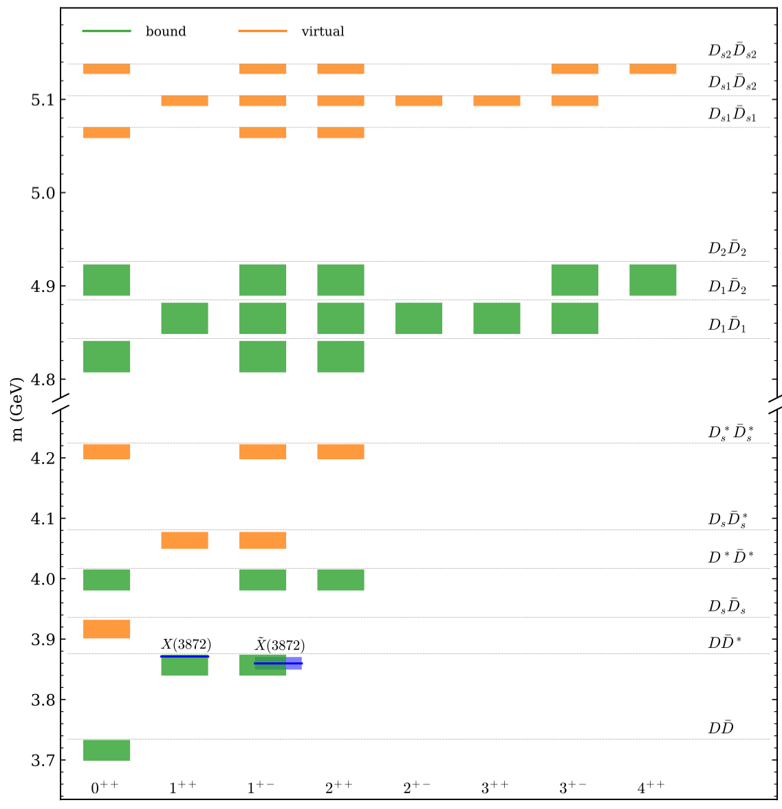
X.-K. Dong, F.-K. Guo, B.-S. Zou, Progr. Phys. 41 (2021) 65 [arXiv:2101.01021]

Slide 18
Dynamics that can contribute in additional to the potential quark model Hamiltonian
g_{eff}
h₁
Weinberg’s compositeness theorem:
Ψ
h₂
: two-hadron kinetic energy.
: two-hadron reduced mass.
: transition amplitude between the elementary component and two-hadron state.
Wave function in momentum space:
Normalization of the physical wavefunction leads to the interpretation of the states mixings:

Slide 19
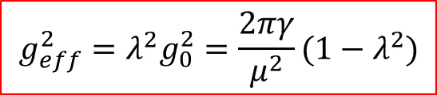

Unitarization and formation of hadronic molecules
Given that the inverse range of force β >> γ (=(2μE_{B})^{1/2}), the integral can be evaluated model independently for the case of the S-wave coupling:
$$g_{eff}^{2}=λ^{2}g_{0}^{2}$$
h₁
Ψ
h₂
$$g_{eff}^{2}=λ^{2}g_{0}^{2}=\frac{2πγ}{μ^{2}}(1−λ^{2})$$
Self-energy:
T matrix for the two continuum hadron scattering:
=
+
+
+ …
+

Slide 20
S wave thresholds and effects on the lineshapes
F.-K. Guo, C. Hanhart, U.-G. Meissner, Q. Wang, Q. Zhao, B.-S. Zou, Rev. Mod. Phys. 90, 015004 (2018)

Slide 21


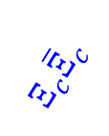


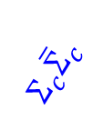
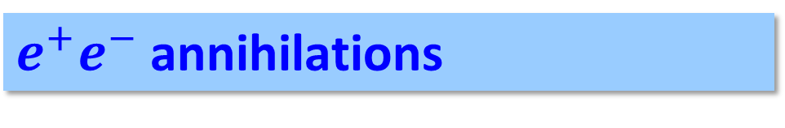
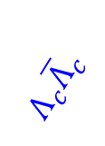



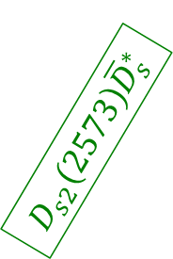
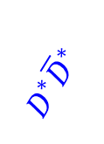


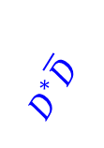

$e^{+}e^{−}$ annihilations
(III) Rich physics, but lack of data
$$D_{s1}\left(2420\right){\overline{D}}_{s}$$
$$D_{s0}\left(2317\right){\overline{D}}_{s}^{∗}$$
(I) Well explored
(II) Recently scanned
$$Σ_{c}{\overline{Σ}}_{c}$$
$$Ω_{c}{\overline{Ω}}_{c}$$
$$Λ_{c}{\overline{Λ}}_{c}$$
$$Ξ_{c}{\overline{Ξ}}_{c}$$
$$D\overline{D}$$
$$D^{∗}\overline{D}$$
$$D_{s}^{}{\overline{D}}_{s}^{}$$
$$D_{s}^{∗}{\overline{D}}_{s}^{}$$
$$D_{s}^{∗}{\overline{D}}_{s}^{∗}$$
$$D^{∗}{\overline{D}}^{∗}$$
$$D_{1}\left(2420\right)\overline{D}$$
$$D_{s2}\left(2573\right){\overline{D}}_{s}^{∗}$$
$$D_{1}\left(2420\right){\overline{D}}^{∗}$$
$$D_{s1}\left(2536\right){\overline{D}}_{s}^{∗}$$
P wave thresholds
$$D_{2}\left(2460\right){\overline{D}}^{∗}$$
S wave thresholds

Slide 22




3. Y(4260) and Z(3900)/X(3872)
e⁺
π
Y(4260)
π
e⁻
Zc(3900)
J/ψ
ψ(4415)
The first S-wave narrow open charm threshold in vector channel
Y(4360)
D*‾D₁
Charmonium spectrum
Y(4260)
D‾D₁
ψ(4160)
$π$
$γ$
ψ(4040)
X(3872)
D‾D*
ψ(3770)
Zc(3900)
D‾D
ψ′(3686)
$π$
$2π, 3π, γ$
J/ψ
J^{PC} = 1⁻⁻

Slide 23
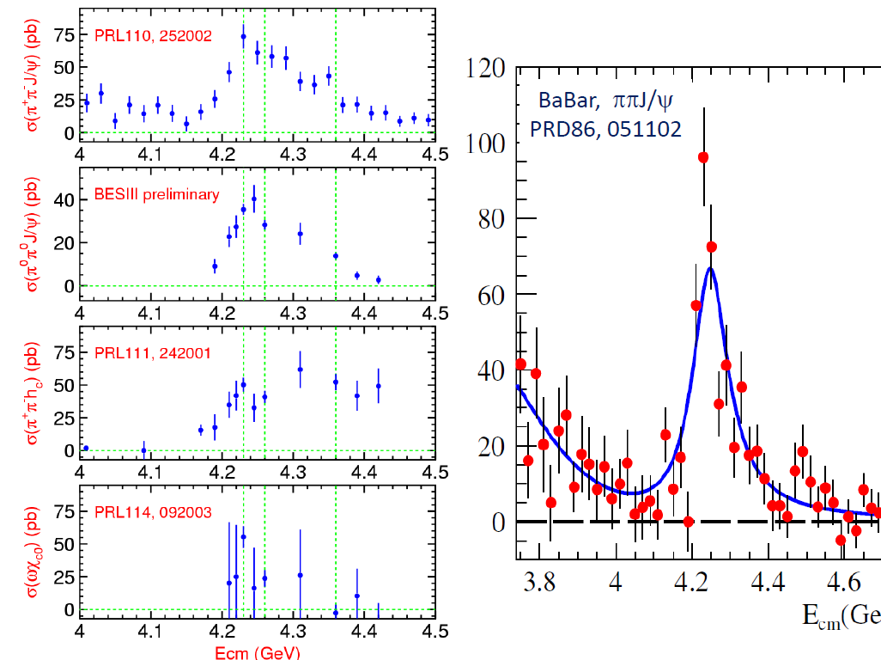
BESIII, arXiv:1611.01317 [hep-ex]
One state or two states?
BESIII, arXiv:1610.07044 [hep-ex]
Gao, et al., 1703.10351[hep-ex]

Slide 24
Resonance parameters extracted around 4.26 GeV in different channels
BESIII

Slide 25
Many papers on the properties of Y(4260), e.g. see recent reviews and reference therein:
H.-X. Chen, W. Chen, X. Liu and S.-L. Zhu, Phys. Rept. 639, 1 (2016)
F.K. Guo, C. Hanhart, U.-G. Meissner, Q. Wang, Q. Zhao, B.-S. Zou, Rev. Mod. Phys. 90, 015004 (2018)
A. Esposito, A. Pilloni and A.D. Polosa, Phys. Rept. 668, 1 (2017)
Why the DD*pi channel has the largest cross sections?
Hadronic molecule picture can explain.
Hybrid picture can possibly explain.
Tetraquark picture seems to be failed.
What are the probes for the internal structures? How to distinguish short-ranged and long-ranged dynamics?
D₁
Ψ
‾D
What is the dynamical connection with the production of Zc(3900) and X(3872)?

Slide 26
Y(4260) could be a hadronic molecule made of DD₁(2420) with coupled channel effects.
Y(4260) may have sizeable couplings to DD₁(2420) if it is a hybrid. Then, how to distinguish them?
D₁
D*
D₁(2420)
Y(4260), 1⁻⁻
Y(4260)
π
D₁
‾D
‾D₀
‾D
‾D(1868)
The production of Zc(3900) is strongly correlated with Y(4260) and enhanced by the triangle singularity kinematics.
D1
π
D*
D
π
J/ψ (hc)
Q. Wang, C. Hanhart, QZ, PRL111, 132003 (2013); PLB(2013)
Q. Wang et al., PRD89, 034001 (2014); M. Cleven et al., PRD90, 074039 (2014);
W. Qin, S.R. Xue, QZ, PRD94, 054035 (2016)

Slide 27






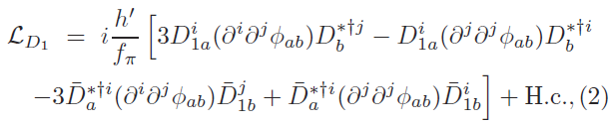
Lagrangians in the NREFT
Y(4260)D₁D coupling:
Zc(3900)DD* coupling:
D₁D*pi coupling:
Q. Wang, C. Hanhart, QZ, PRL111, 132003 (2013); PLB(2013)
Q. Wang et al., PRD89, 034001 (2014); M. Cleven et al., PRD90, 074039 (2014);
W. Qin et al., PRD94, 054035 (2016)

Slide 28

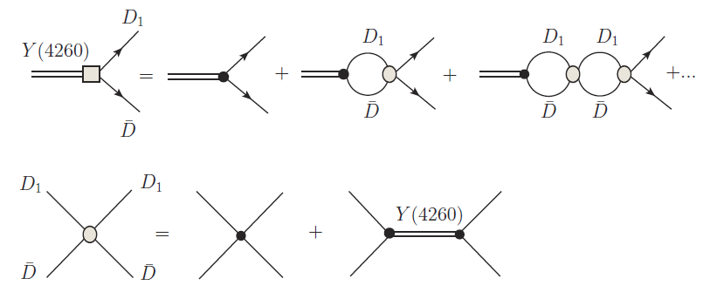
Defining the molecular component of Y(4260)
HQSS breaking is implicated

Slide 29
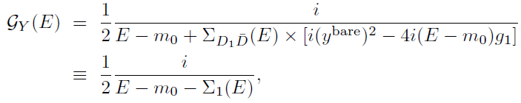




The propagator of Y(4260)

Slide 30




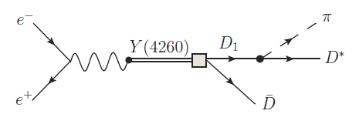

短程波函数
长程波函数
Y(4260) is dominated by molecular component but also contains a component (charmonium? Or something else?) as a compact structure.

Slide 31
Similar treatment for Zc(3900) as a DD* molecular state
D*
D*
D*
D*
Zc(3900)

Slide 32
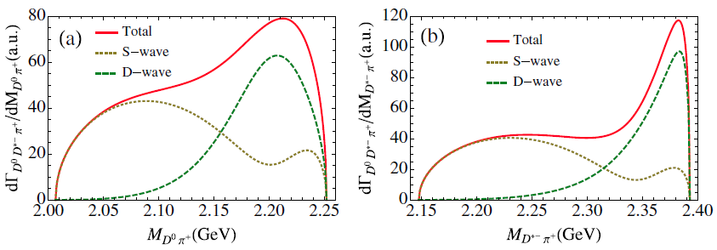
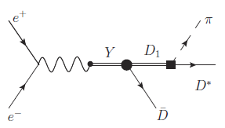
Invariant mass spectra for Dπ, D*π, and ‾DD*
Signature for D₁(2420) via the tree diagram.
The Zc(3900) could have a pole below the DD* threshold.
Dominant S-wave only contributes to different kinematics:

Slide 33
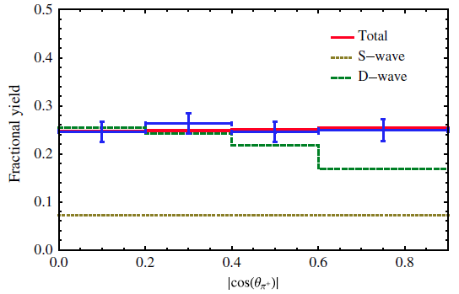
Angular distribution analysis
π⁺
BESIII (2013)
θ_{π}⁺
e⁺
e⁻
D
θ_{πD}
D*
The dominance of D wave at the Zc peak can compromise with the angular distribution.

Slide 34

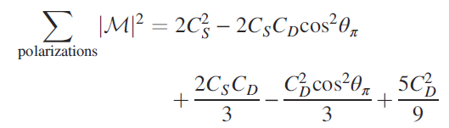

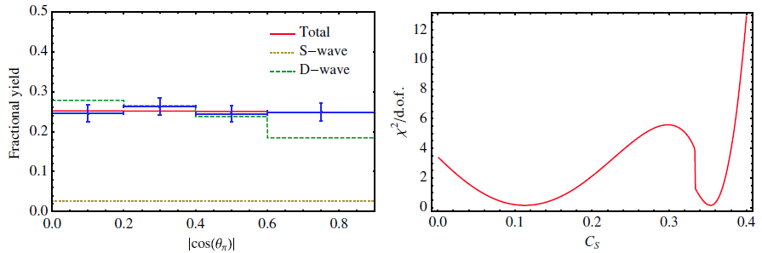

How a D wave can be present?

Slide 35
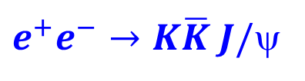
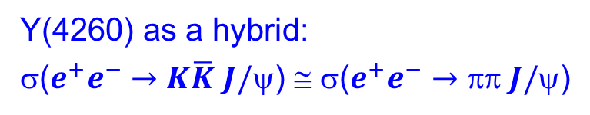
Y(4260) may have sizeable couplings to DD₁(2420) if it is a hybrid.
Then, how to distinguish them?
$e^{+}e^{−}→K\overline{K} J/$ψ
c
D₁
‾q (‾u,‾d,‾s )
q (u, d, s )
‾c
‾D
A hybrid mode will have access to J/ψ K‾K by quark rearrangement?
Y(4260) as a hybrid:
σ($e^{+}e^{−}→K\overline{K} J/$ψ) ≅ σ($e^{+}e^{−}→ J/$ψ)
BESIII, PRD 97, 071101(R) (2018)

Slide 36
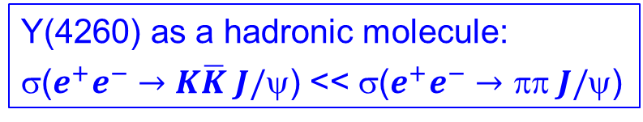

What kind of observables are sensitive to the internal structure of Y(4260)?
D₁D: 2420+1868=4288 MeV
D_{s1}D_{s}: 2460+1968=4428 MeV
2536+1968=4504 MeV
D_{s1}D_{s}*: 2536+2112=4648 MeV
D_{s2}D_{s}*: 2573+2112=4685 MeV
$e^{+}e^{−}→K\overline{K} J/$ψ
Y(4260) as a hadronic molecule:
σ($e^{+}e^{−}→K\overline{K} J/$ψ) << σ($e^{+}e^{−}→ J/$ψ)
Z. Cao and Q.Z., Phys. Rev. D99, 014016 (2019)

Slide 37

Lineshapes of the J/ψK invariant mass spectrum at different energies
-- sensitive to the nearby triangle singularity condition!
BESIII, PRD 97, 071101(R) (2018)
Why Zcs(3985) does not appear in the threshold region?
$\sqrt{S}=4.17$ GeV
T. Xiao et al., Phys.Lett.B 727 (2013) 366-370

Slide 38

BESIII, arXiv:2011.07855v1 [hep-ex]
Experimental evidence for $Z_{cs}(3985)$
D_{s1}(2536)
D_{s2}(2573)
M.C. Du, Q. Wang and Q. Zhao, arXiv:2011.09225v1 [hep-ph]

Slide 39
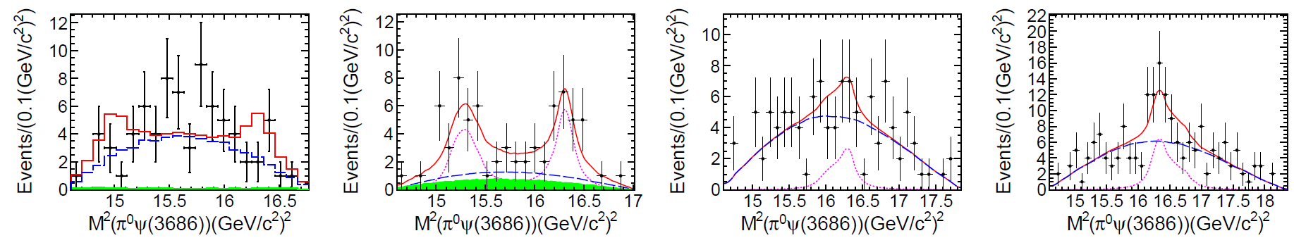
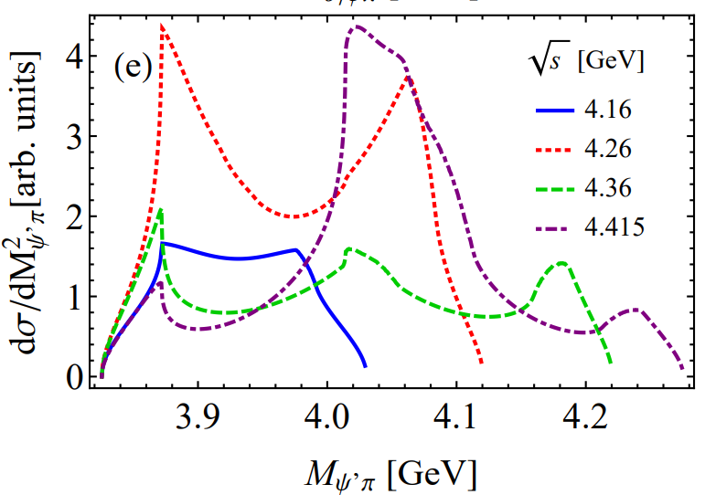

$$e^{+}e^{−}→ψ\left(3686\right)π^{0}{ π}^{0}$$
BESIII, Phys.Rev. D97 (2018) no.5, 052001
X.-H. Liu, PRD90 (2014) 074004

Slide 40
Production correlation?

Slide 41
K* has been removed from the π K spectrum.
No Zc(3900) signals seem to be present.
Negative results from Belle and LHCb in similar processes.
In contrast, X(3872) can be produced in both B decays and heavy ion collisions.
This, however, may be understandable.
s
‾q
X(3872);
Zc(3900)
X(3872)
q
‾q
‾D (‾D*)
s
‾c
‾q
b
‾c
c
b
‾q
D* (D)
c
‾q
I=0, 1
I=0
Short-distance component is responsible for the large production rate of X(3872) in both B decays and heavy ion collisions [G. Y. Chen, W. S. Huo and Q. Zhao, Chin. Phys. C 39, no. 9, 093101 (2015)].

Slide 42
The general features with the tetraquark or hadronic molecule scenarios:
Very rich spectra are expected.
The form of diquark DoF can lead to very different results for the tetraquark production and decay.
A strong coupling for a tetraquark state into a nearby S-wave threshold may need unitarization which will still introduce a molecular component into the wavefunction.
Limited number of states close to threshold.
Possible mixing with the kinematic singularity, but can be clarified by energy dependence of the lineshape measurement.
Unitarization is crucial and EFT can be implemented. However, whether or not a molecular state can be formed would depend on the detailed dynamics.
h₁
Ψ
h₂

Slide 43
4. Reminder of some crucial issues
What are the proper effective degrees of freedom for hadron internal structures?
What are the possible color-singlet hadrons apart from the simplest conventional mesons (q‾q) and baryons (qqq)? (e.g. multiquarks, hadronic molecules, hadroquarkonia …)
What are the proper observables for determining the internal structures for hadrons ?
How to distinguish genuine states from kinematic enhancements due to TS?
What’s happening in between “perturbative” and “non-perturbative”?
… …

Slide 44
Recent reviews on hadron spectroscopy and QCD exotics:
F.K. Guo, C. Hanhart, U. G. Meißner, Q. Wang, Q. Zhao and B.S. Zou, Rev. Mod. Phys. 90, no.1, 015004 (2018);
H.X. Chen, W. Chen, X. Liu and S.L. Zhu, Phys. Rept. 639, 1-121 (2016);
A. Esposito, A. Pilloni and A. D. Polosa, Phys. Rept. 668, 1-97 (2017);
A. Ali, J.S. Lange and S. Stone, Prog. Part. Nucl. Phys. 97, 123-198 (2017);
Y.R. Liu, H. X. Chen, W. Chen, X. Liu and S.L. Zhu, Prog. Part. Nucl. Phys. 107, 237-320 (2019);
N. Brambilla, S. Eidelman, C. Hanhart, A. Nefediev, C.P. Shen, C.E. Thomas, A. Vairo and C.Z. Yuan, Phys. Rept. 873, 1-154 (2020);
R.F. Lebed, R.E. Mitchell and E.S. Swanson, Prog. Part. Nucl. Phys. 93, 143-194 (2017);
Y. Yamaguchi, A. Hosaka, S. Takeuchi and M. Takizawa, J. Phys. G 47, no.5, 053001 (2020).
R.M. Albuquerque, J.M. Dias, K.P. Khemchandani, A. Martinez Torres, F.S. Navarra, M. Nielsen and C. M. Zanetti, J. Phys. G 46, no.9, 093002 (2019)
Thanks for your attention!

