Slide 1
Amplitude analysis of $D_{s}$ hadronic decays at BESIII
Xinchen Dai
Institute of High Energy Physics
on behalf of the BESIII collaboration
Conference on Flavor Physics and CP violation
Fudan University, Shanghai, China

Slide 2
Outline
Introduction
Strategy
Amplitude analysis and BF measurement
Summary

Slide 3
Introduction
3
Amplitude (Dalitz plot) analysis provides a method to study the hadronic decays of Ds.
Hadron spectroscopy & Structure of the resonance
Determine the phase of the intermediate mode
Understand the dynamics of 2-body decays of Ds.
$D_{s}^{+}→SP{, D}_{s}^{+}→VP$, $D_{s}^{+}→AP$… (test $SU{\left(3\right)}_{F}$symmetry)
Reduce the systematic uncertainties related to the substructures in branching fraction measurement.
Analyses of
$D_{s}^{+}→K^{−}K^{+}π^{+}$ [arXiv:2011.08041]
$D_{s}^{+}→π^{+}π^{0}η$ [Phys. Rev. Lett. 123, 112001 (2019)]
$D_{s}^{+}→K_{s}^{0}π^{+}π^{0}$ [arXiv:2103.15098]
$D_{s}^{+}→K_{S}^{0}K^{−}π^{+}π^{+}$ [Phys. Rev. D 103, 092006 (2021)]
$D_{s}^{+}→K^{−}K^{+}π^{+}π^{0}$ [arXiv:2103.02482]

Slide 4
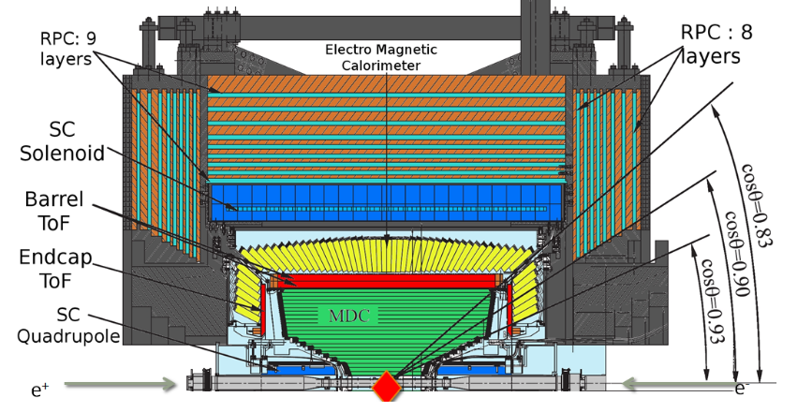
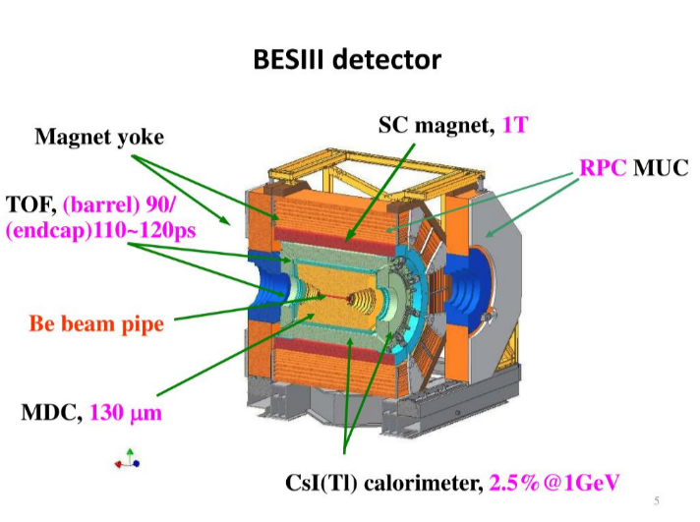
Data sets collected near $D_{s}^{∗+}D_{s}^{−}$ threshold
4
$e^{+}e^{−}→D_{s}^{∗+}D_{s}^{−}$
$E_{cm}=4.178\sim 4.226$ GeV
Integrated luminosity of 6.32 $fb^{−1}$
$\sqrt{s}$ (GeV) | Year | Lum. ($pb^{−1}$)
4.178 | 2016 | 3189.0
4.189 | 2017 | 526.7
4.199 | 2017 | 526.0
4.209 | 2017 | 517.1
4.218 | 2017 | 514.6
4.226 | 2013 | 1047.3

Slide 5
Double tag technique
5
$$K^{+}$$
Tag side
$$K^{−}$$
$$D_{s}^{−}$$
$$π^{−}$$
4.178GeV
$$e^{+}$$
$$e^{−}$$
$$D_{s}^{∗+}$$
$$D_{s}^{+}$$
$$γ/π^{0}$$
Signal mode
Single tag(ST): reconstruct one of the Ds
Double tag(DT): reconstruct both of the DsDs*
ST yield: $N_{ST}^{i}=2×N_{D_{s}D_{s}}×B_{ST}^{i}×ε_{ST}^{α}$
DT yield: $N_{ST}^{i}=2×N_{D_{s}D_{s}}×B_{ST}^{i}×B_{sig}×ε_{DT}^{i}$
Advantage:
Absolute BF
Low background
Cancel the systematic uncertainties in tag side
$$ℬ_{sig}=\frac{Y_{DT}^{α}}{\sum_{α}{Y_{ST}^{α}∙\frac{ε_{DT}^{α}}{ε_{ST}^{α}}}}$$
Independent of the cross section of $e^{+}e^{−}→D_{s}^{∗+}D_{s}^{−}$

Slide 6
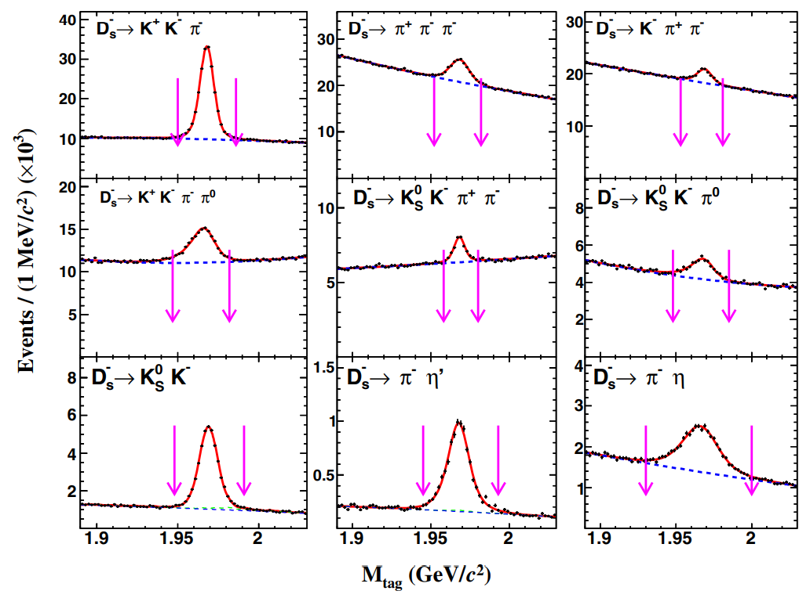
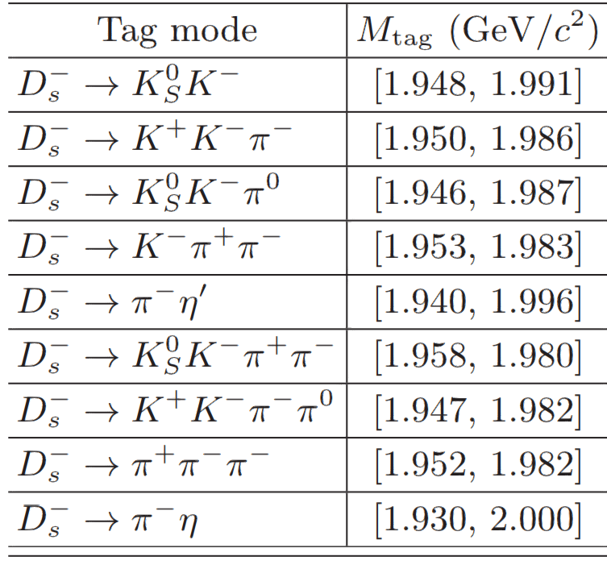
Strategy
6
DT method
Background analysis
MC simulation, sideband, multivariate analysis
Description of signal spectrum (M($D_{s}$)).
MC shape $⊗$ Gaussian, MC shape or polynomial for background.
$$M\left(D_{s}\right) GeV/c^{2}$$

Slide 7
Strategy
7
Bkg function
(RooNDKeysPdf)
Amplitude analysis:
Unbinned maximum likelihood Fit:
PDF = $f_{s}S+(1−f_{s})B=ε(p_{j})R_{4}(p_{j})[f_{s}\frac{{\left|A_{D_{s}}(a_{i},p_{j})\right|}^{2}}{\int{ε(p_{j})}{\left|A_{D_{s}}(a_{i},p_{j})\right|}^{2}R_{4}(p_{j})dp_{j}}+(1−f_{s})\frac{B_{ε}(p_{j})}{\int{B(p_{j})R_{4}(p_{j})dp_{j}}}]$
$A_{D_{s}→sig}=Σ_{n}c_{n}A_{n}, c_{n}=ρ_{n}e^{iφ_{n}}$
Covariant tensor formalism
$A_{n}=P_{n}^{1}P_{n}^{2}S_{n}F_{n}^{1}F_{n}^{2}F_{n}^{D_{s}}$, $P_{n}^{i}$ propagator, $F_{n}^{i}$ barrier, $S_{n}$ angular distribution.
Log-likelihood:
$lnL_{total}=Σ_{k}^{N_{data}}log\left(f_{s}S(p_{k})+\left(1−f_{s}\right)B(p_{k})\right)$.
For $D_{s}^{+}→π^{+}π^{0}η$:
$lnL_{total}=Σ_{k}^{N_{data}}log\left(S(p_{k})\right)−Σ_{k}^{N_{data}}w_{bkg}^{k}log(S(p_{k}))$
BF Measurement
Update the MC samples with the results of amplitude analysis.
Looser selection criteria, more statistics.
Acceptance function
MC integration
$$B_{ε}=B/ε$$

Slide 8
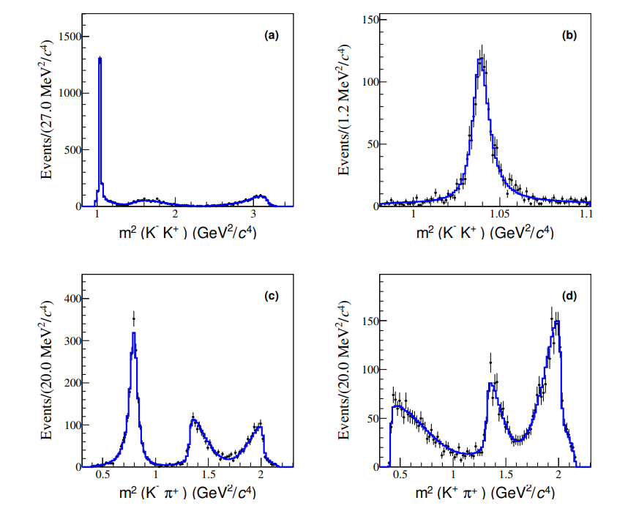
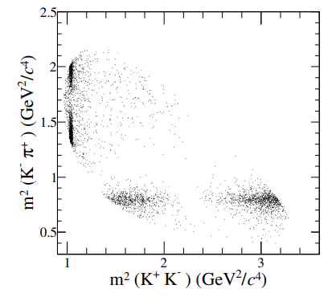
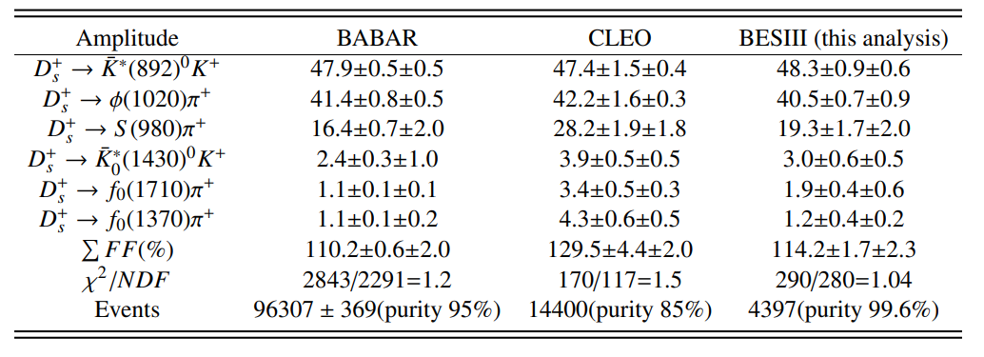
Amplitude analysis of $D_{s}^{+}→K^{−}K^{+}π^{+}$
8
arXiv:2011.08041
$D_{s}^{+}→K^{−}K^{+}π^{+}$ is a golden channel which is often used as the normalization mode.
BF of $D_{s}^{+}→f_{0}(980)π^{+}$
PRD 79, 072008 (CLEO-c)
PRD 83, 052001 (BABAR)
Do not distinguish between $f_{0}(980)$/$a_{0}(980)$
Background free
4399 DT events with a purity
of 99.6%@ $\sqrt{s}=4.178 GeV$
Fit model:
$χ^{2}$/ndf = 290/280

Slide 9
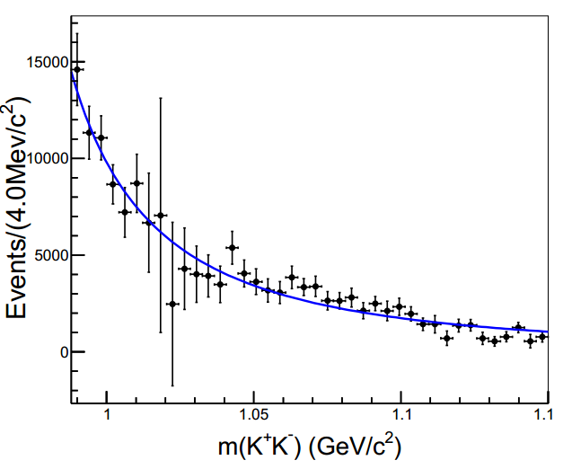
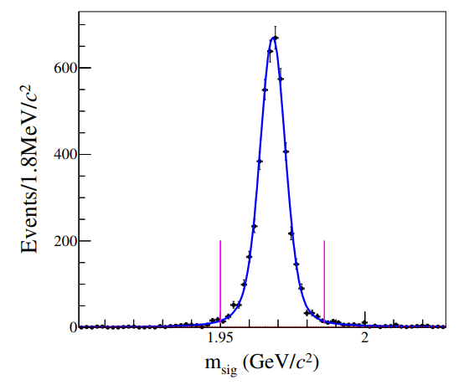
Amplitude analysis of $D_{s}^{+}→K^{−}K^{+}π^{+}$
9
The parameterization of S(980):
$χ^{2}$/NDF = 1.17
$K^{+}$ $K^{−}$ S-wave ( $S(980)$ ) is extracted from model-independent partial wave analysis
5148 ±77
Branching Fraction:
$$B\left(D_{s}^{+}→K^{−}K^{+}π^{+}\right)=\left(5.47±0.08±0.13\right)\%$$
$$B\left(D_{s}^{+}→φπ^{+}\right)=\left(4.60±0.17\right)\%$$
$$B\left(D_{s}^{+}→{\overline{K}}^{∗}{\left(892\right)}^{0}K^{+}\right)=\left(3.94±0.12\right)\%$$
Consistent with theoretical predictions
Phys. Rev. D 93, 114010 (2016)
$$M\left(D_{s}\right) GeV/c^{2}$$
Best precision

Slide 10
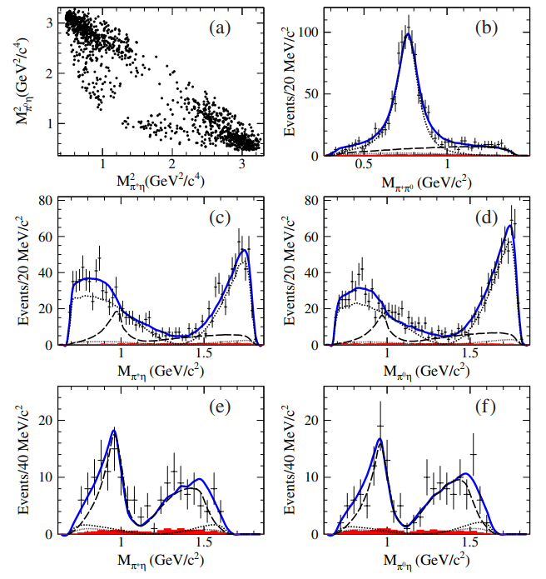
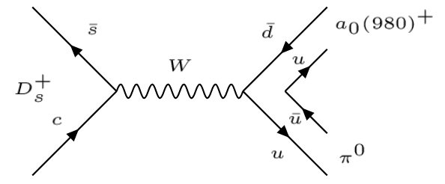
Amplitude analysis of $D_{s}^{+}→π^{+}π^{0}η$
10
PRL 123, 112001 (2019)
1239 DT events with purity
of 97.7% @$\sqrt{s}=4.178 GeV$
$$B\left(D_{s}^{+}→π^{+}π^{0}\right)<3.4×{10}^{−4}$$
$$B\left(D_{s}^{+}→π^{+}ρ^{0}\right)=(1.9±1.2)×{10}^{−4}$$
$$B\left(D_{s}^{+}→π^{+}π^{0}η\right)=\left(9.5±0.28±0.41\right)\%$$
$$M\left(π^{+}π^{0}\right)>1.0GeV/c^{2}$$
$$B\left(D_{s}^{+}→a_{0}{\left(980\right)}^{+\left(0\right)}π^{0(+)}\right)=\left(2.20±0.22±0.34\right)\%$$
The BF of $D_{s}^{+}→a_{0}{\left(980\right)}^{+\left(0\right)}π^{0(+)}$ is larger than BFs of pure annihilation process by 2 order of magnitude.
$χ^{2}$/ndf = 82.8/77
Significance > 5$σ$

Slide 11
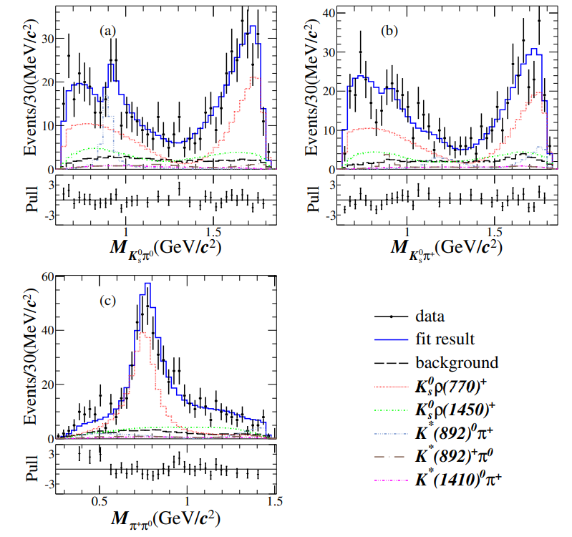
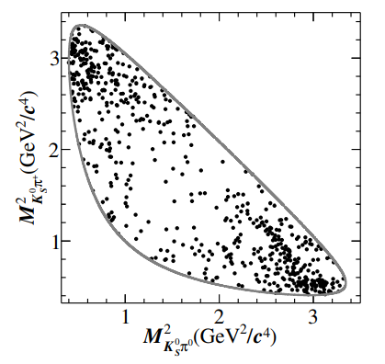
Amplitude analysis of $D_{s}^{+}→K_{s}^{0}π^{+}π^{0}$
11
arXiv:2103.15098
609 DT events with purity
of 83.1% @$\sqrt{s}=4.178 \sim 4.226 GeV$
$D_{s}^{+}→K^{∗+}π^{0}$, $K^{∗0}π^{+}$ are good modes to searching for CPV and studying the $SU{\left(3\right)}_{F}$ symmetry and its breaking effect.
Fit model:

Slide 12
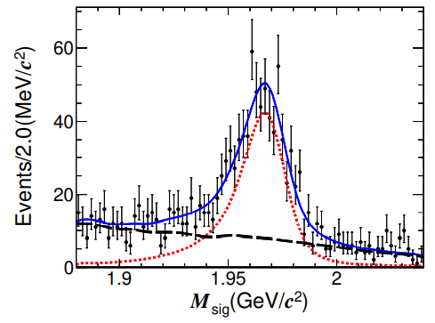
Amplitude analysis of $D_{s}^{+}→K_{s}^{0}π^{+}π^{0}$
12
$$(×{10}^{−3})$$
$$666±37$$
[4] PRD 84 (2011) 074019
[7] EPJC 42, (2005) 391
[8] PRD 100, (2019) 093002
$$M\left(D_{s}\right) GeV/c^{2}$$
Test the CP conservation:
Signal shape: MC simulated shape$⊗$ Gaussian
Background shape: MC simulated shape
$B\left(D_{s}^{+}→K_{s}^{0}π^{+}π^{0}\right)=\left(5.33±0.41±0.15\right)\%$
$B\left(D_{s}^{−}→K_{s}^{0}π^{−}π^{0}\right)=\left(5.63±0.44±0.16\right)\%$
$A_{CP}=\frac{B\left(D_{s}^{+}\right)−B(D_{s}^{−})}{B\left(D_{s}^{+}\right)+B(D_{s}^{−})}=\left(2.7±5.5±0.9\right)\%$
$B\left(D_{s}^{+}→K_{s}^{0}π^{+}π^{0}\right)=\left(5.43±0.30±0.15\right)×{10}^{−3}$
Statistical error dominates.
No CPV is observed.
$B\left(D_{s}^{+}→K^{0}ρ^{+}\right)=\left(5.46±0.84±0.44\right)×{10}^{−3}$
$B\left(D_{s}^{+}→K^{∗0}π^{+}\right)=\left(2.71±0.72±0.30\right)×{10}^{−3}$
$B\left(D_{s}^{+}→K^{∗+}π^{0}\right)=\left(0.75±0.24±0.06\right)×{10}^{−3}$
Most precise measurements

Slide 13
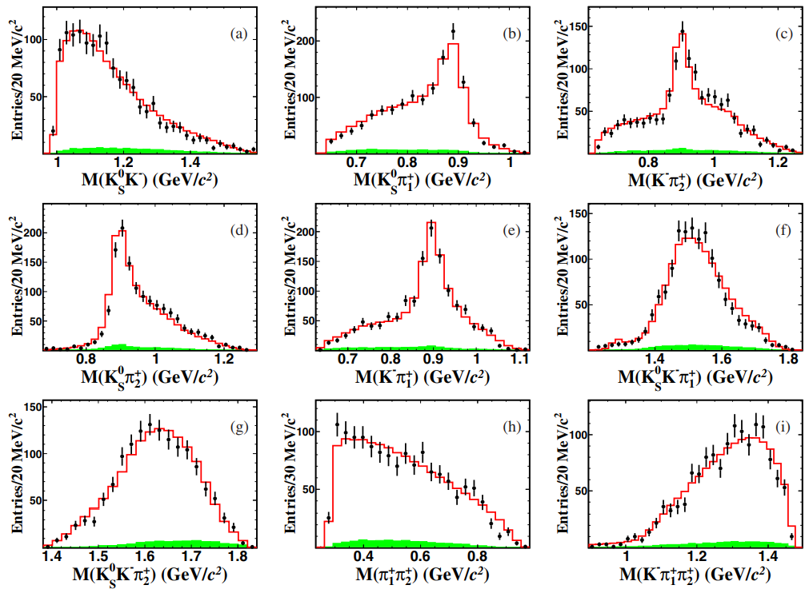
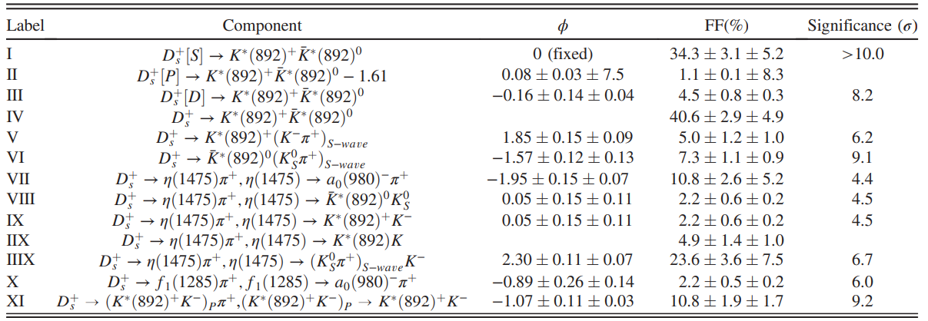
Amplitude analysis of $D_{s}^{+}→K_{s}^{0}K^{−}π^{+}π^{+}$
13
Phys. Rev. D 103, 092006 (2021)
Argus Collaboration (1992):
$$B\left(D_{s}^{+}→K^{∗+}{\overline{K}}^{∗0}\right)=\left(7.2±2.6\right)\%$$
Z.Phys.C 53 (1992) 361
1308 DT events with a purity
of 94.9% @ $\sqrt{s}=4.178\sim 4.226 GeV$
$$B\left(D_{s}^{+}→K_{s}^{0}K^{−}π^{+}π^{+}\right)=\left(1.46±0.05±0.05\right)\%$$
$$B\left(D_{s}^{+}→K^{∗+}{\overline{K}}^{∗0}\right)=\left(5.34±0.39±0.64\right)\%$$
Much more precise
Fit model:
Combinatorial background
Dominant

Slide 14
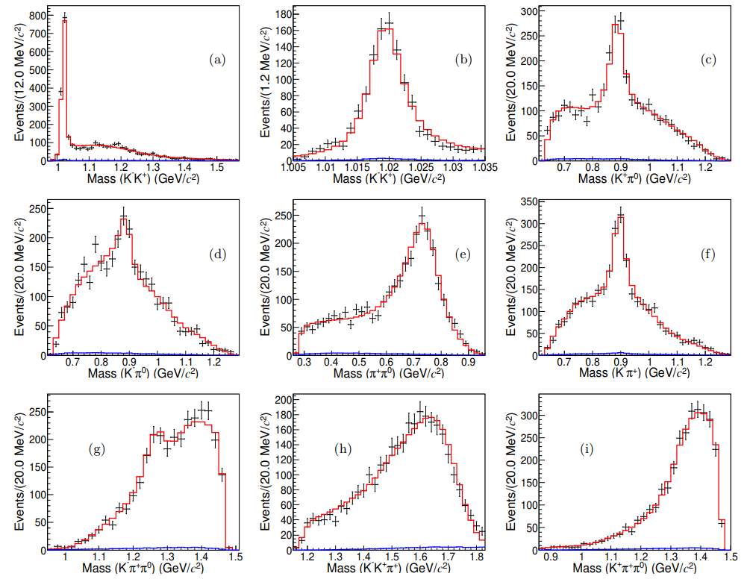
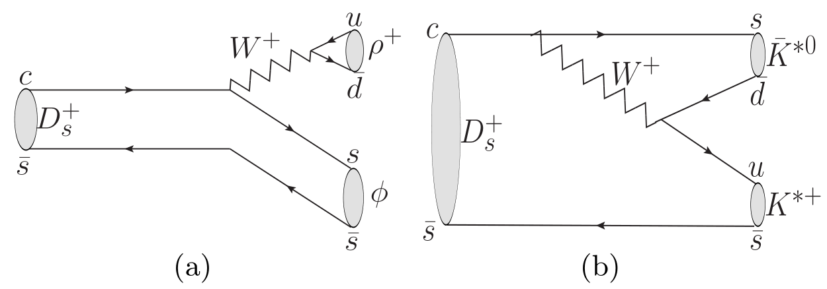
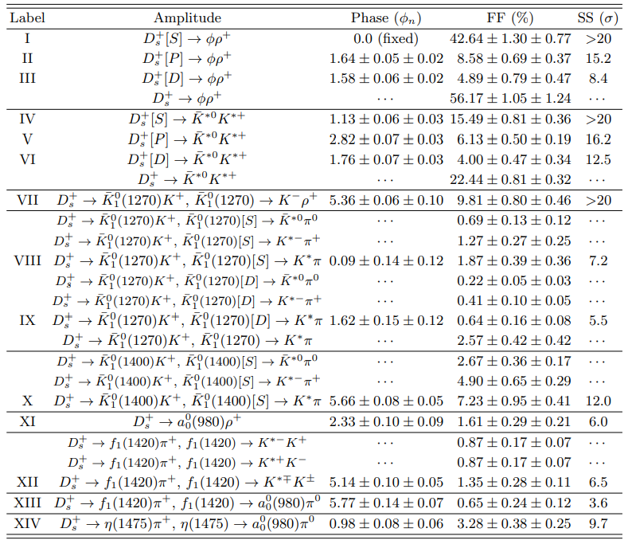
Amplitude analysis of $D_{s}^{+}→K^{−}K^{+}π^{+}π^{0}$
14
arXiv:2103.02482
Dominant by $D_{s}^{+}→VV$ process:
$χ^{2}$/ndf = 288.6/273
background
3088 DT events with purity of 97.5%
The amplitudes of VIII, IX , X and XII are fixed by Clebsch Gordan coefficients and charge conjugation relations

Slide 15
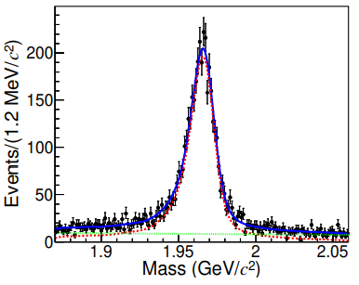
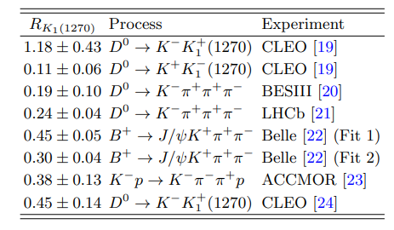
Amplitude analysis of $D_{s}^{+}→K^{−}K^{+}π^{+}π^{0}$
15
$$B\left(D_{s}^{+}→K_{s}^{0}K^{−}π^{+}π^{+}\right)=\left(5.42±0.10±0.17\right)\%$$
$$4365±83$$
$$B\left(D_{s}^{+}→φρ\right)=\left(6.22±0.17±0.24\right)\%$$
Consistent with theoretical prediction PRD 49, 269(1994)
$$B\left(D_{s}^{+}→K^{∗+}{\overline{K}}^{∗0}\right)=\left(5.46±0.23±0.18\right)\%$$
Best precision
$R_{K_{1(1270)}}≡\frac{B\left(K_{1}^{0}→K^{∗}π \right)}{B\left(K_{1}^{0}→Kρ\right)}=\left(0.51±0.12±0.09\right)\%$
$$M\left(D_{s}\right) GeV/c^{2}$$
Disagree with predictions under narrow width approximation and CP conservation. NuclPhysRev.36.02.125
Consistent with the results from [22] (Fit 1) and [24].
[19] PRD85, 122002 (2012)
[20] PRD95, 072010 (2017)
[21] EPJC78, 443 (2018)
[22] PRD83, 032005 (2011)
[23] NPB187, 1 (1981)
[24] JHEP05, 143 (2017)

Slide 16
Summary
16
Amplitude analysis and BF measurement of:
$D_{s}^{+}→K^{−}K^{+}π^{+}$ $Br=\left(5.47±0.08±0.13\right)\%$
$D_{s}^{+}→π^{+}π^{0}η$
$D_{s}^{+}→K_{s}^{0}π^{+}π^{0}$ $Br=\left(5.43±0.30±0.15\right)×{10}^{−3}$ (No evidence of CPV)
$D_{s}^{+}→K_{S}^{0}K^{−}π^{+}π^{+}$ $Br=\left(1.46±0.05±0.05\right)$
$D_{s}^{+}→K^{−}K^{+}π^{+}π^{0}$ $Br=\left(5.42±0.10±0.17\right)\%$
Precise measurement of two-body decays:
$B\left(D_{s}^{+}→φπ^{+}\right)=\left(4.60±0.17\right)\%$
$B\left(D_{s}^{+}→{\overline{K}}^{∗}{\left(892\right)}^{0}K^{+}\right)=\left(3.94±0.12\right)\%$
$B\left(D_{s}^{+}→φρ\right)=\left(6.22±0.17±0.24\right)\%$
$B\left(D_{s}^{+}→a_{0}{\left(980\right)}^{+\left(0\right)}π^{0(+)}\right)=\left(2.20±0.22±0.34\right)\%$ Anomaly
$B\left(D_{s}^{+}→K_{s}^{0}ρ^{+}\right)=\left(5.46±0.84±0.44\right)×{10}^{−3}$
$B\left(D_{s}^{+}→K^{∗0}π^{+}\right)=\left(2.71±0.72±0.30\right)×{10}^{−3}$
$B\left(D_{s}^{+}→K^{∗+}π^{0}\right)=\left(0.75±0.24±0.06\right)×{10}^{−3}$
$B\left(D_{s}^{+}→K^{∗+}{\overline{K}}^{∗0}\right)=\left(5.46±0.23±0.18\right)\%$
Confirm theoretical predictions
$$(×{10}^{−3})$$
[4] PRD 84 (2011) 074019
[7] EPJC 42, (2005) 391
[8] PRD 100, (2019) 093002
Thank you!

