Slide 1
Status of BEPCII-U luminosity and energy upgrades
Yuan Zhang
On behalf of BEPCII-U team
Conference on Flavor Physics and CP Violation, FPCP2021
June 7-11, 2021

Slide 2
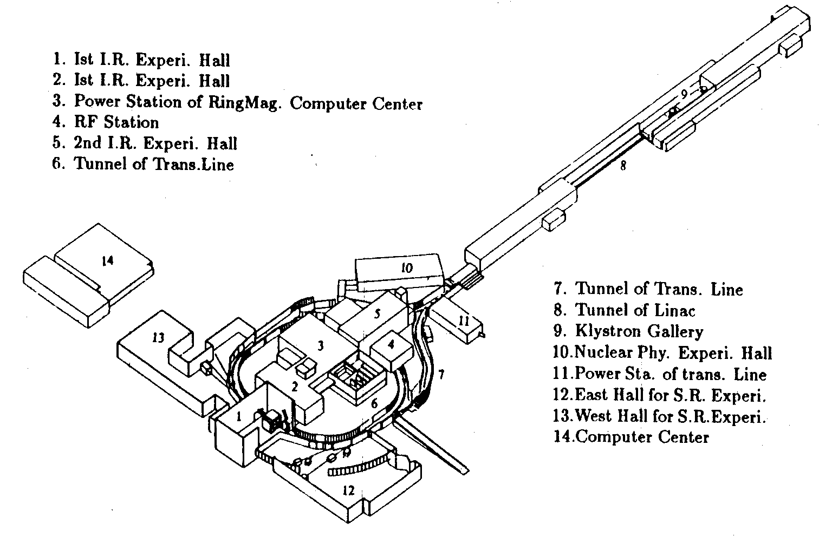
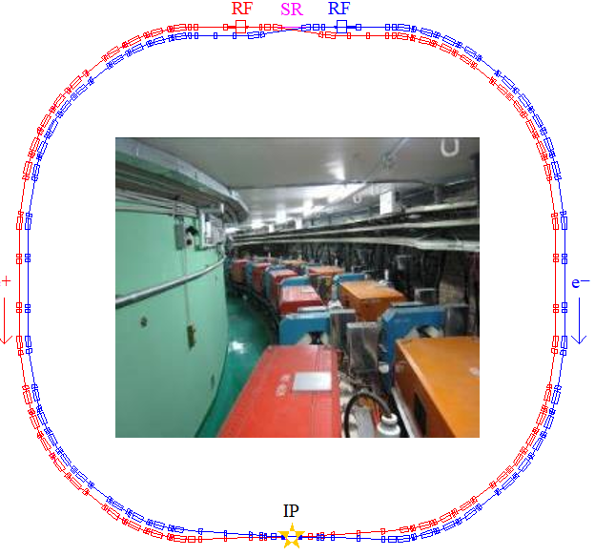
BEPC & BEPCII
30 years ago, BES started data taking (Highest Beam Energy: 2.5 GeV)
  1988-2005
BEPCII (1-2.1 GeV, Optimized at 1.89GeV) (from 2006)

Slide 3
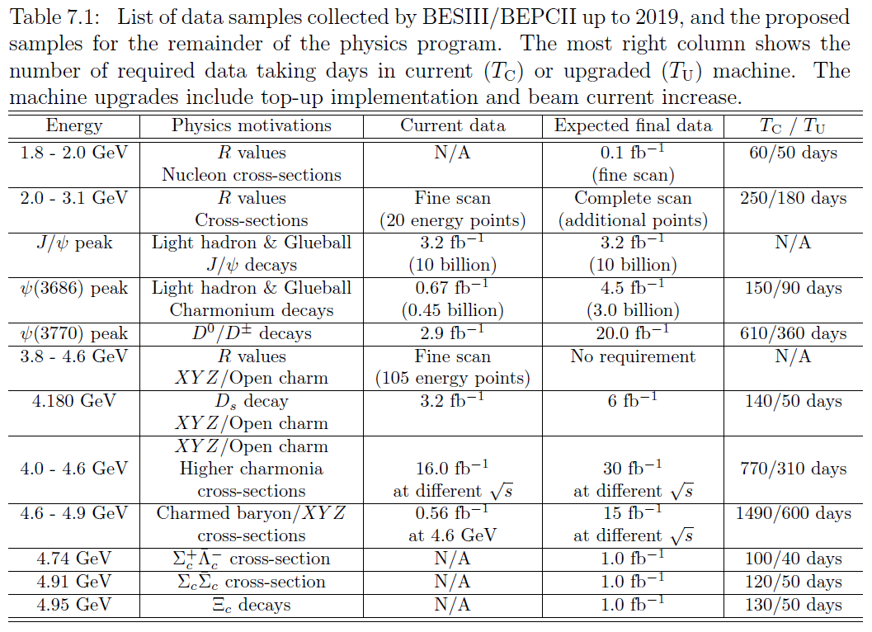
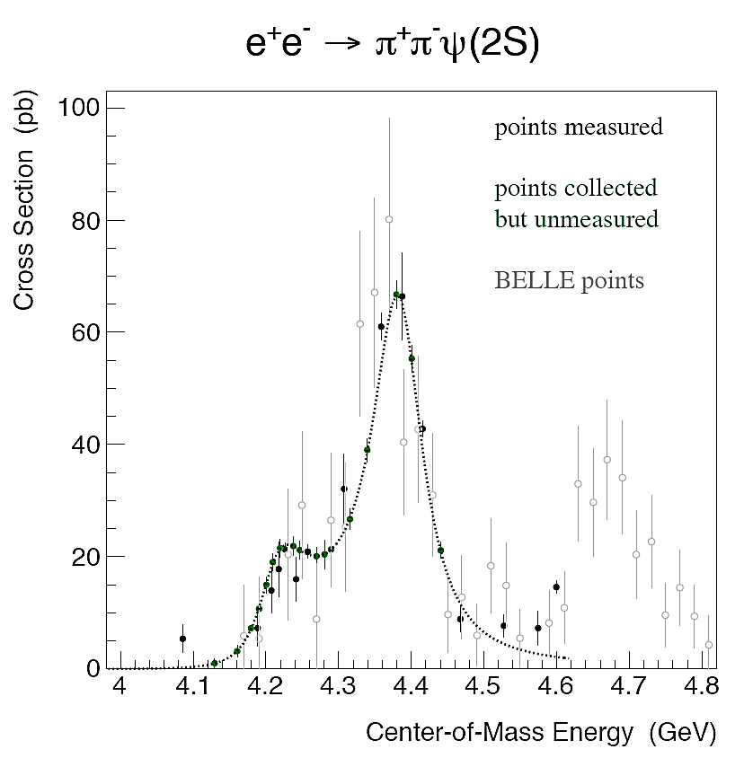
Proposed remainder samples of BESIII
Future Physics Programme of BESIII, Chin. Phys. C 44, 040001 (2020)
3.6 fb⁻¹ in 2020 (186 days)
Notes:
3

Slide 4
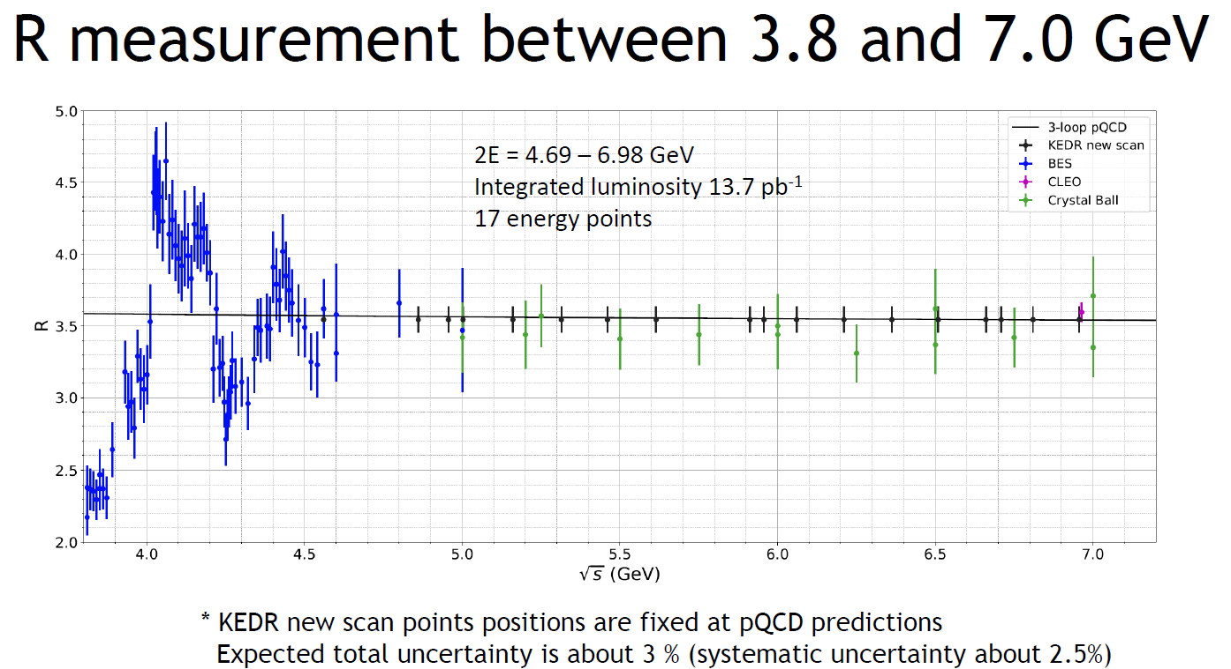
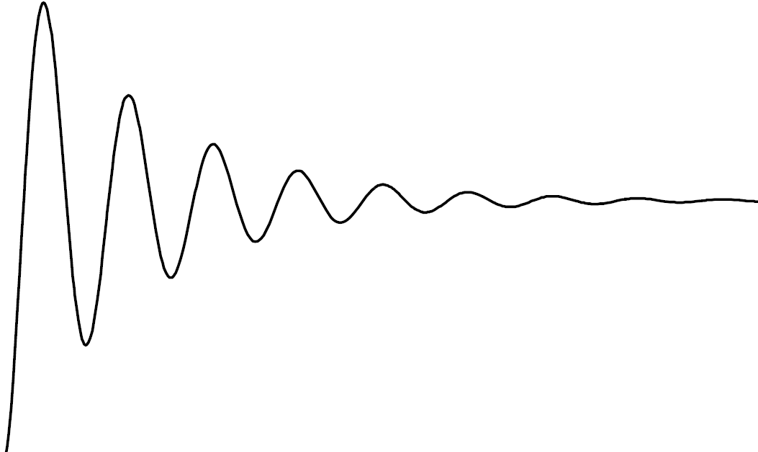
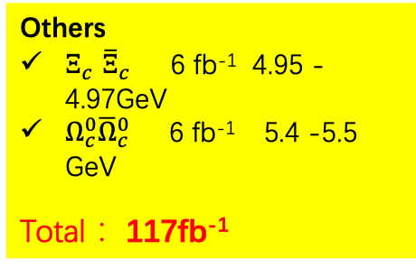
Physics of BESIII between 4.0 – 5.6 GeV
Scan data： 65 fb⁻¹
BEPCII upgrade
4.01 GeV: 20 fb⁻¹ DsDs
4.60 GeV: 20 fb⁻¹
Λ_{c}
Λ_{c}
Others
        $Ξ_{c}^{}{\overline{Ξ}}_{c}^{}$ 6 fb⁻¹ 4.95 -4.97GeV
        $Ω_{c}^{0}{\overline{Ω}}_{c}^{0}$ 6 fb⁻¹ 5.4 -5.5 GeV
        Total： 117fb⁻¹
Few data and potential physics
Unique data samples near thresholds, and using quantum-entanglement:
New charm baryon production and XYZ fine scan
Excited charm hadron states;
Precise test of SM: charm meson and baryon weak decays, CP violation in charm baryon decay, mixing parameters of neutral D and anti-D。

Slide 5
What is BEPCII-U？
Based on BEPCII, not a new machine
Will be optimized at Higher Energy
Luminosity * 3 @ 2.35 GeV
Highest Beam Energy: 2.47 GeV -> 2.8 GeV
Strategy:
Re-use existing system
Only add necessary hardware

Slide 6
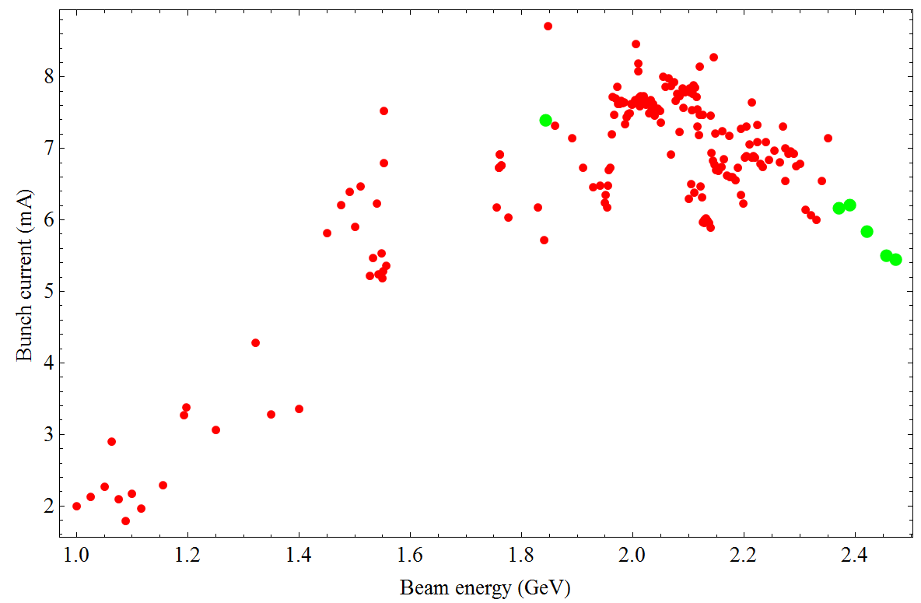
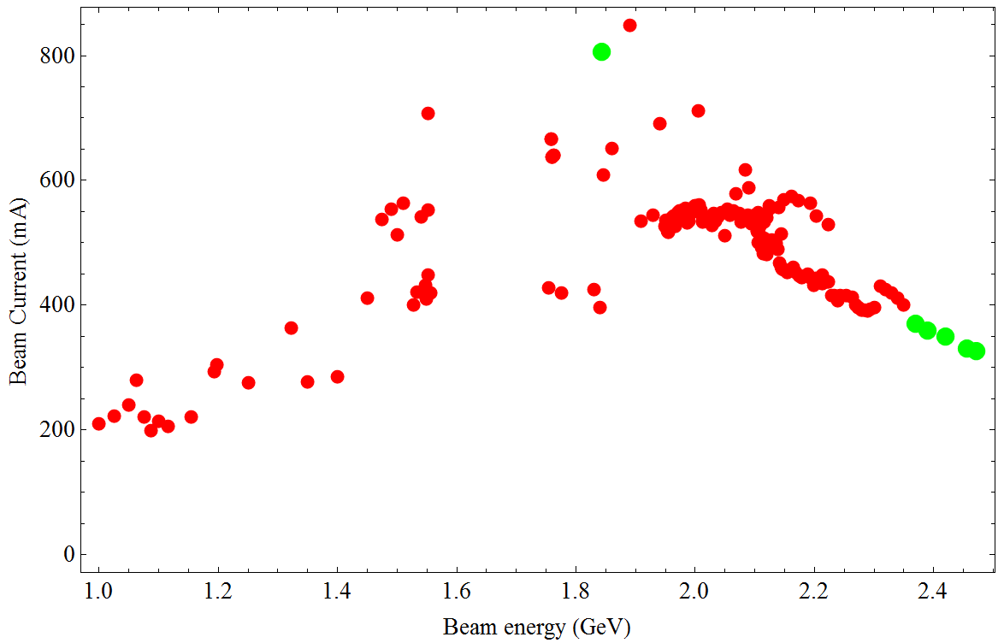
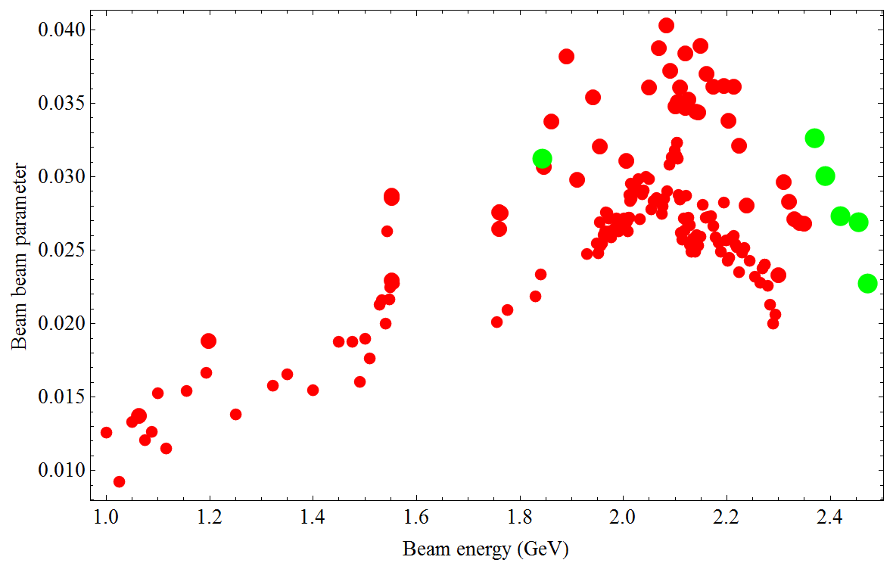
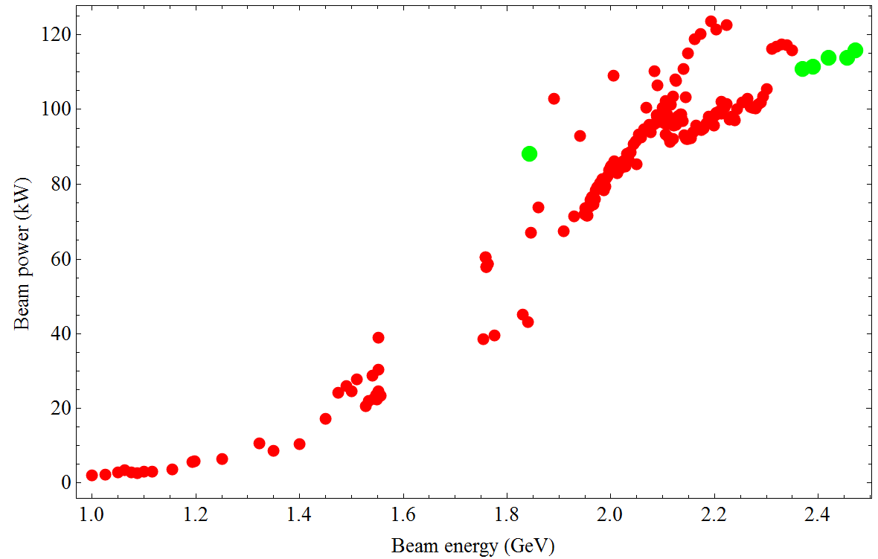
Status of beam performance in 2020/2021
RF Voltage
Bunch Number Limit: 120
(detector and multi-bunch instability)
Bunch current
Beam current
Beam-beam parameter
Beam power
Beam-beam limit: (scheme & damping)
SR power limit: 110 kW (RF systems and Photon absorbers)
Notes:
6

Slide 7
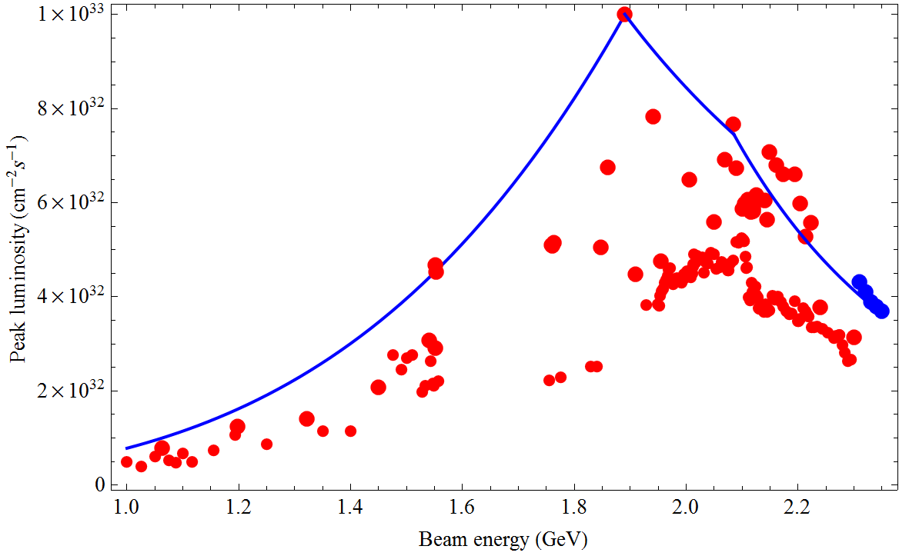
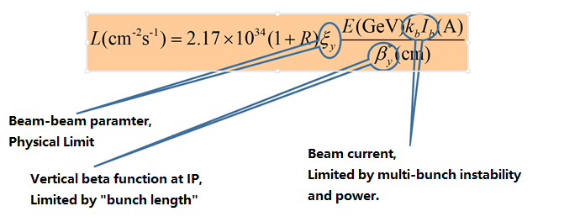
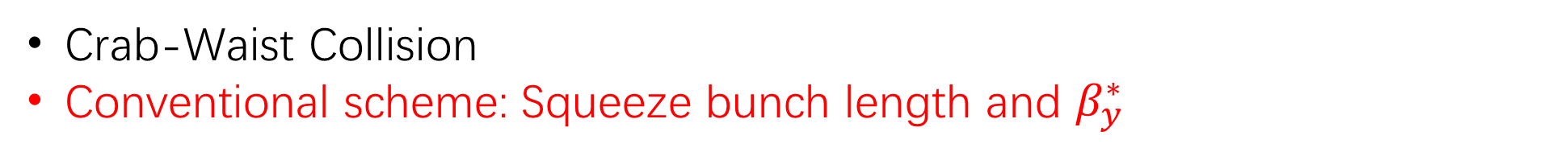
How to increase luminosity at BEPCII
Luminosity drops at high energy
Beam-beam performance drops at higher energy
Crab-Waist Collision
Conventional scheme: Squeeze bunch length and $β_{y}^{∗}$

Slide 8

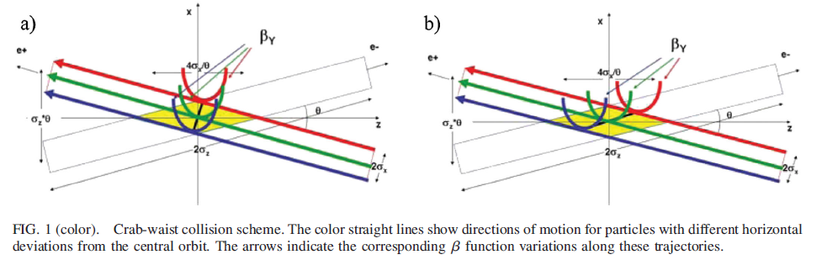
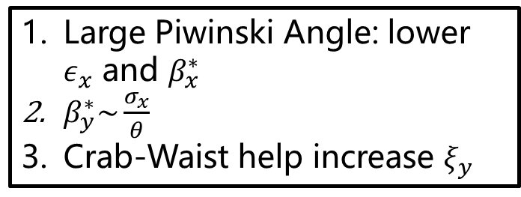
Crab-Waist Scheme ?
Large Piwinski Angle: lower $ε_{x}$ and $β_{x}^{∗}$
$β_{y}^{∗}\sim \frac{σ_{x}}{θ}$
Crab-Waist help increase $ξ_{y}$

Slide 9
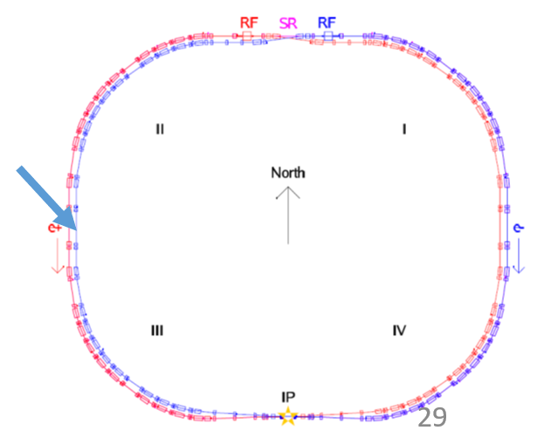
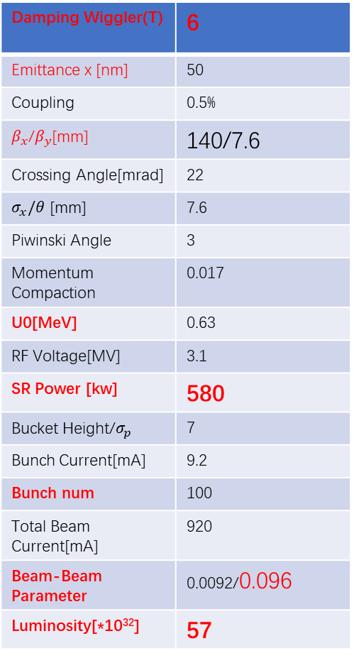
Paths to CW in BEPCII tunnel
Damping Wiggler(T) | 6
Emittance x [nm] | 50
Coupling | 0.5%
$β_{x}$/$β_{y}$[mm] | 140/7.6
Crossing Angle[mrad] | 22
$σ_{x}/θ$ [mm] | 7.6
Piwinski Angle | 3
Momentum Compaction | 0.017
U0[MeV] | 0.63
RF Voltage[MV] | 3.1
SR Power [kw] | 580
Bucket Height/$σ_{p}$ | 7
Bunch Current[mA] | 9.2
Bunch num | 100
Total Beam Current[mA] | 920
Beam-Beam Parameter | 0.0092/0.096
Luminosity[*10³²] | 57
SC Damping wiggler helps reduce emittance
  Very strong SR power (*1.5 whole ring bending magnets) is located at one point
CW optics: total new interaction region, new detector
  Only initial linear optics solution is obtained
Technical challenges:
  6T wiggler
  New final focus magnet (strength *2)
  Limited dynamics aperture requires lower emittance for injection beams
  …

Slide 10
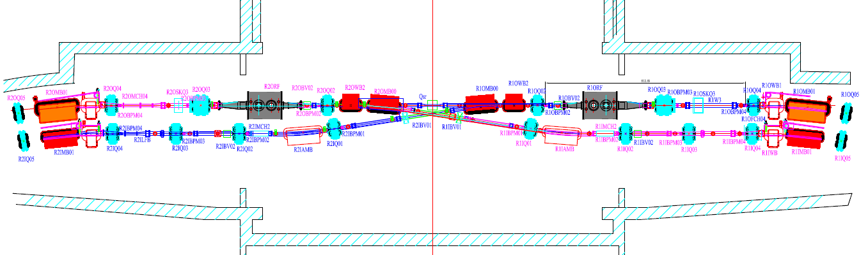
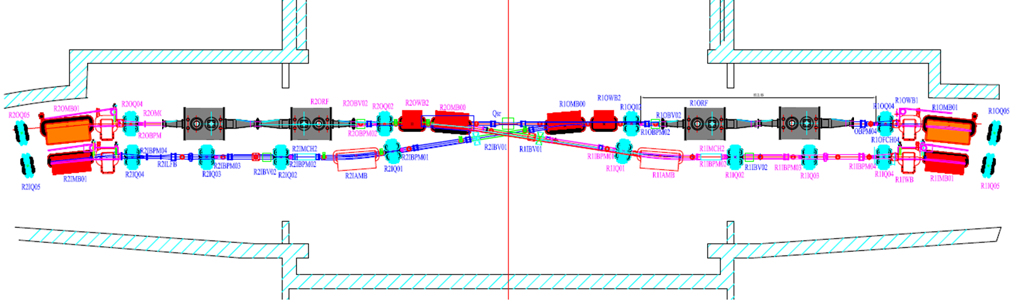
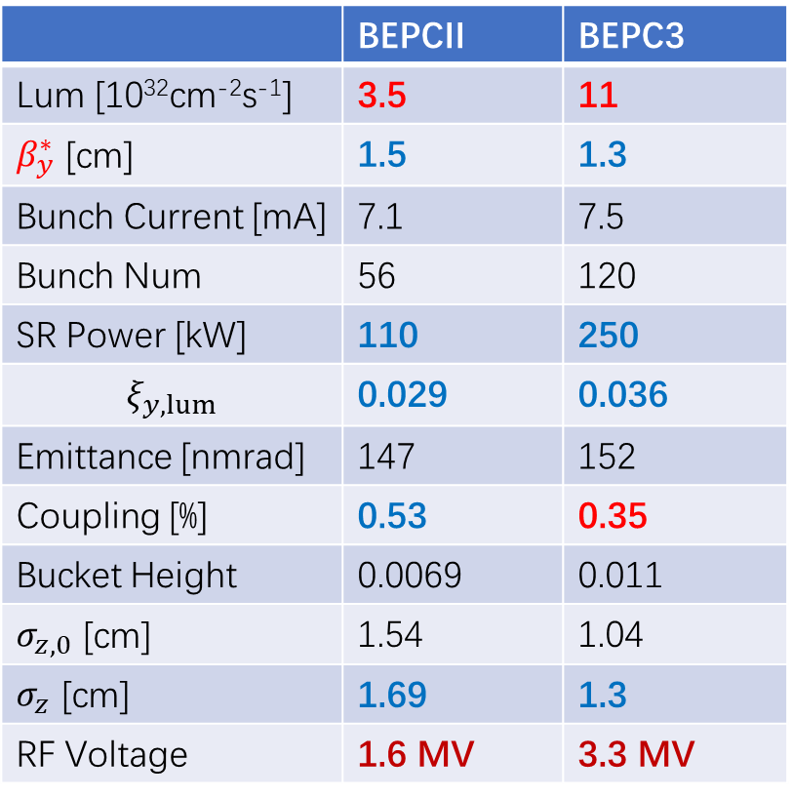
BEPCII-U Machine Parameters & RF modification
Beam Energy：2.35GeV
1 RF cavity/ring => 2 RF cavities/ring
Local lattice has been redesigned
 | BEPCII | BEPC3
Lum [10³²cm⁻²s⁻¹] | 3.5 | 11
$β_{y}^{∗}$ [cm] | 1.5 | 1.3
Bunch Current [mA] | 7.1 | 7.5
Bunch Num | 56 | 120
SR Power [kW] | 110 | 250
$$ξ_{y,lum}$$ | 0.029 | 0.036
Emittance [nmrad] | 147 | 152
Coupling [%] | 0.53 | 0.35
Bucket Height | 0.0069 | 0.011
$σ_{z,0}$ [cm] | 1.54 | 1.04
$σ_{z}$ [cm] | 1.69 | 1.3
RF Voltage | 1.6 MV | 3.3 MV
RF Region@BEPCII
RF Region@BEPCII-U
Luminosity is increased by a factor of 3.
Notes:
10

Slide 11
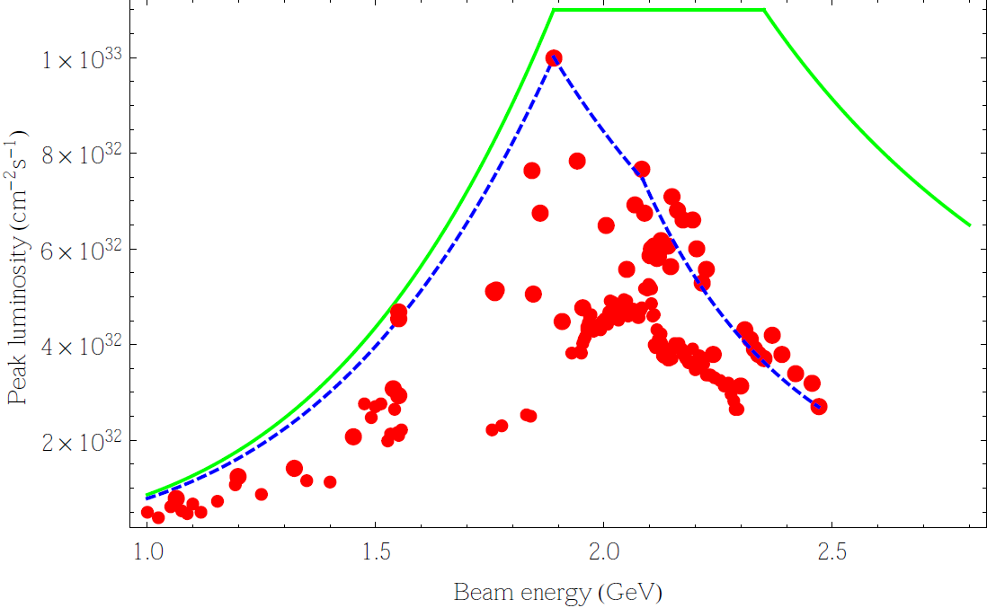
Luminosity Performance at Different Energy
BEPCII-U vs BEPCII
3 倍
Notes:
11

Slide 12
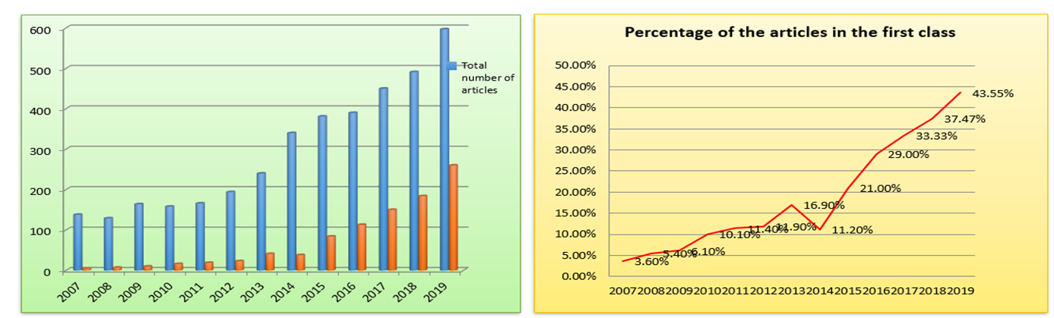
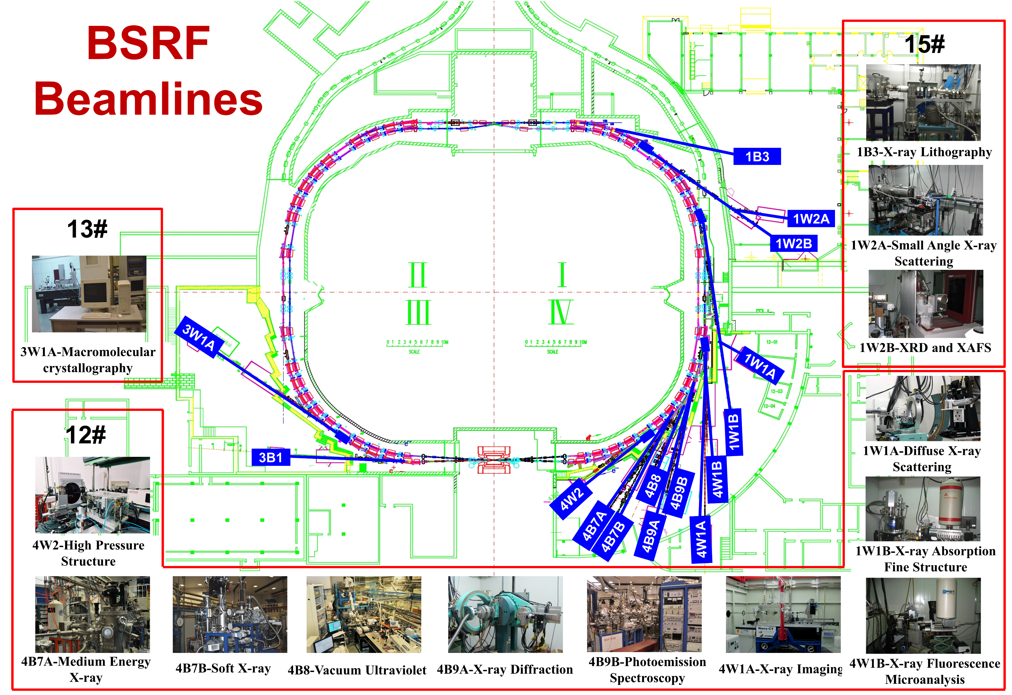
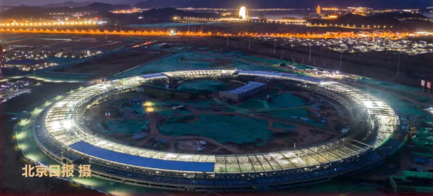
SR Beam Line
Collision mode and parasitic SR
Now: 70 days each year for dedicated SR mode
2020 Jul, IHEP Strategy Meeting
2021 Jan, SR-ACC division
In the 2nd half of 2024, the first few SR beam lines of HEPS begin to work
The BEPCII is being stopped for hardware modification
Dedicated SR mode will be discarded
Only the beam lines in I/IV region will be kept unchanged (except 4W2)
If dedicated SR mode is kept
More photon absorbers: CNY 4M
20 vacuum chamber( antechamber type): CNY 10M
Not only money matters

Slide 13
Some Facts
All groups in Accelerator Division of IHEP are taking part in BEPCII-U
Man power is overlapping for LINAC, RF, Cryogenic, Vacuum etc. between BEPCII-U and HEPS
Time is overlapping between BEPCII-U and HEPS
In the following, not all sub-system will be covered

Slide 14
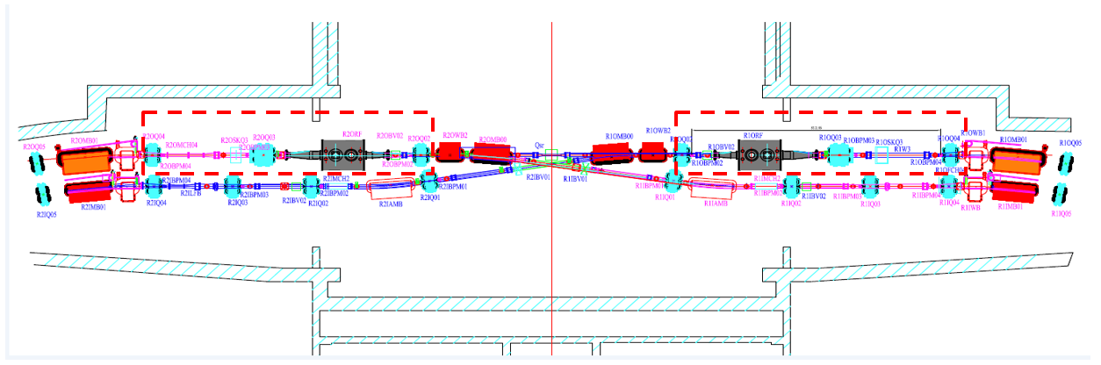
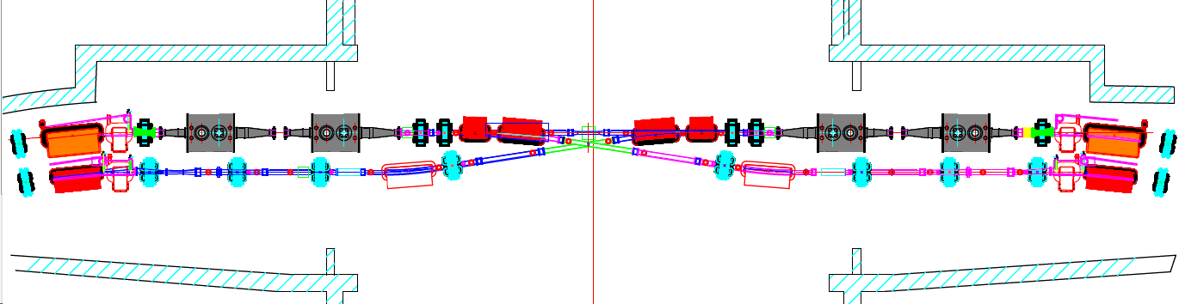
RF region
Beam Optics（lattice）
Mechanical System
RF System
Vacuum
Magnet
Beam Instrumentation
Space is very limited:
Length of one RF cavity is 3.5 m. Two RF cavities totally take 7.2m
Some Quadrupoles will be replaced with smaller size ones. （2.8 GeV）
Skew quadrupole has been removed.
We’ve to find other space for the important
luminosity tuning knob.
Taper vacuum chamber is shortened.
…

Slide 15
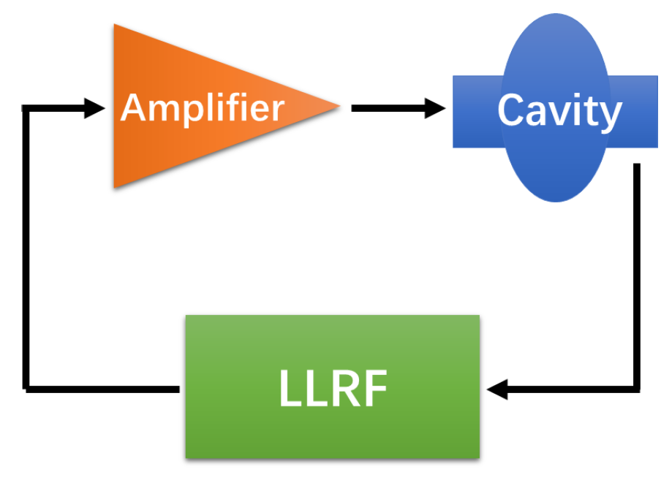
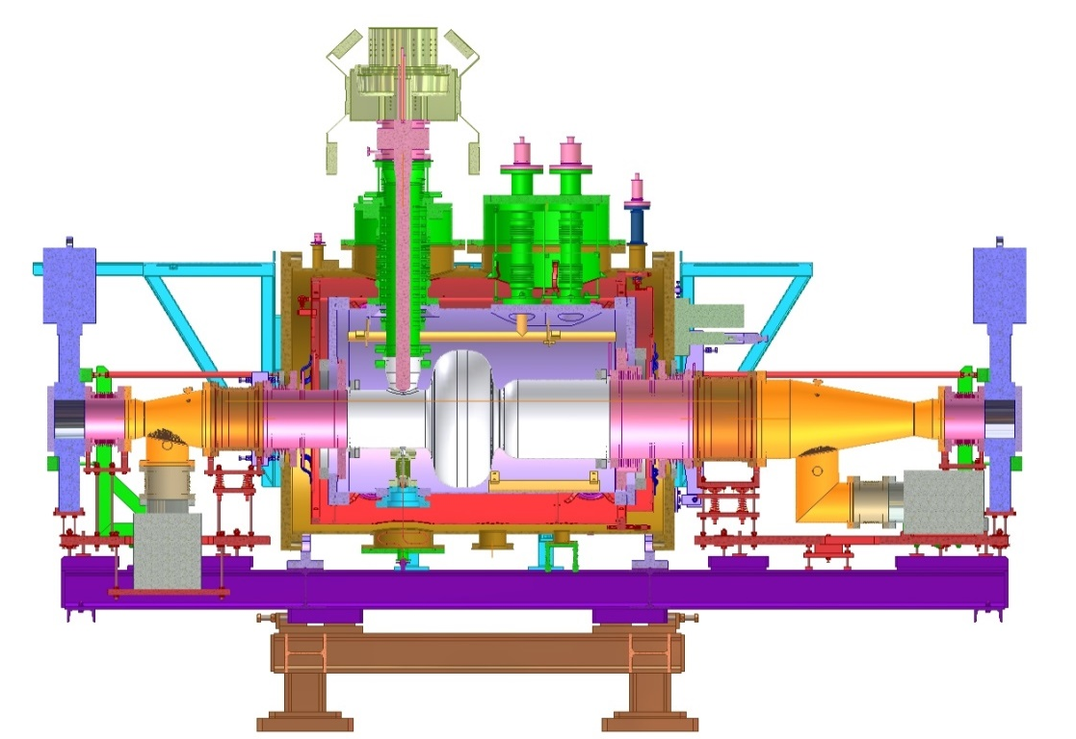
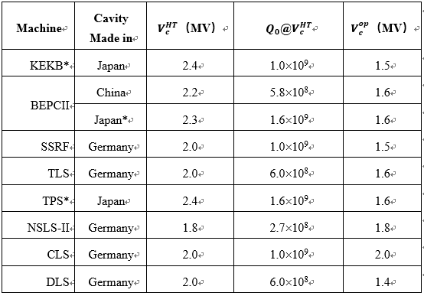
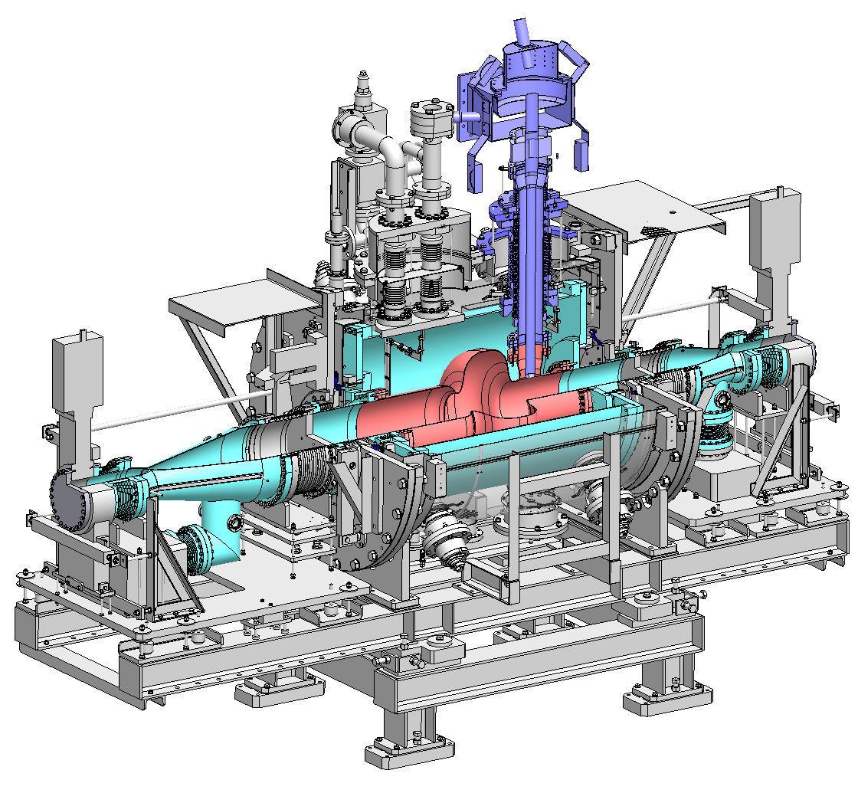
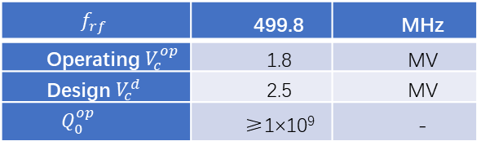
RF Systems
HEPS cavity team is assigned
Two 500MHz/200 kW solid-state amplifier will be design/made.
Four 352 MHz/180 kW power source (SOLEIL) is the maximum power operating in the world.
BEPCII: Online two cavities:
  1 in-house
  1 Mitsubishi
1 backup Cavity (Mitsubishi)
1 new cavity
BEPCII
$$f_{rf}$$ | 499.8 | MHz
Operating$V_{c}^{op}$ | 1.8 | MV
Design $V_{c}^{d}$ | 2.5 | MV
$$Q_{0}^{op}$$ | ≥1×10⁹ | -
HEPS
vs
Notes:
15

Slide 16
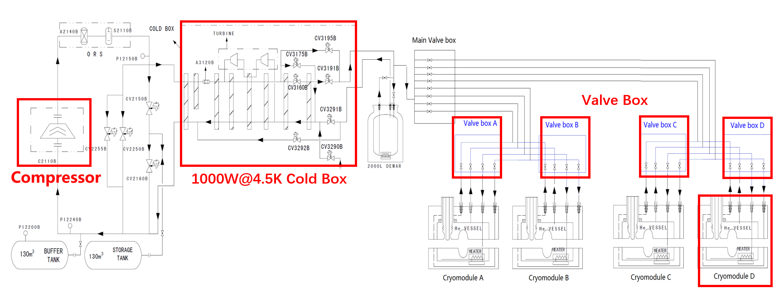
Cryogenic Systems
The cryogenic systems must meet the requirement of upgraded SRF systems
Reuse existing cryostat modules(2 online, 1 backup) ，1 new module
Total new design:
  Cryogenic refrigerator: 500W@4.5K -> 1000W@4.5K
  One valve box for two cavites -> each cavity has one value box
  New transfer line/control system
Keep present, add one copy (Space is limited)
  + one Cryogenic refrigerator: 500W@4.5K
  + valve box
  + transfer line
Modifcation based on present apparatus
  Cryogenic refrigerator: 500W@4.5K -> 1000W@4.5K
    2000 L dewar is kept
  Main valve box is kept (only minor change)
  8 channel transfer lines is kept ( modification is necessary) )
  + 4 local valve boxes
  New 4-channel transfer lines

Slide 17
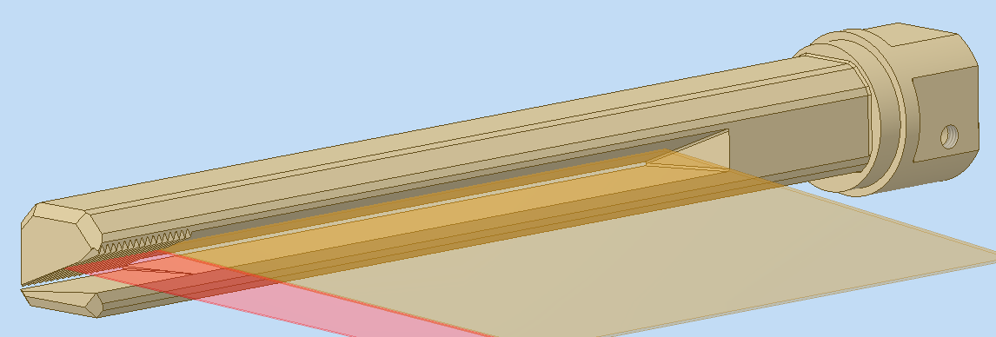
Photon Absorber
Higher SR power challenge the photon absorbers.
After evaluation, totally 4 classes/54 type/139 photon absorber need to be manufactured. ~ 80% need be replaced.
  Nearly all vacuum chamber will be open to air. (vacuum scrubbing)
  Nearly all (inner ring) bending magnets have to be moved during the removal and installation of absorbers. (bellows are fragile)
New material(CuCrZr/ODSC) will be used：Some tests show that material property is not stable
3486W
1738W
Notes:
17

Slide 18
Possible Measures
All necessary photon absorbers would be manufactured but only serve as a backup
Some stress test for power density is designed and (may be) done
A stress test for power will be designed and done before the machine long shutdown for hardware modification
  SR mode
  Two online cavities could server
  ~250kW in the SR ring
Metallographic analysis will be done for some specific highest power density online absorbers in near future, which would help evaluate the lifetime and limit (power density)
Some more detailed optimization design and 3d printing model will be made to simulate the installation in the tunnel this summer
It is expected top-up injection could reduce the cycle time and increase the lifetime.

Slide 19
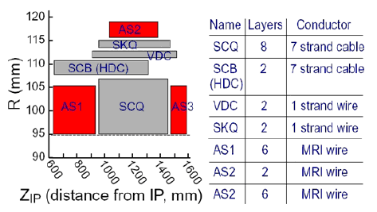
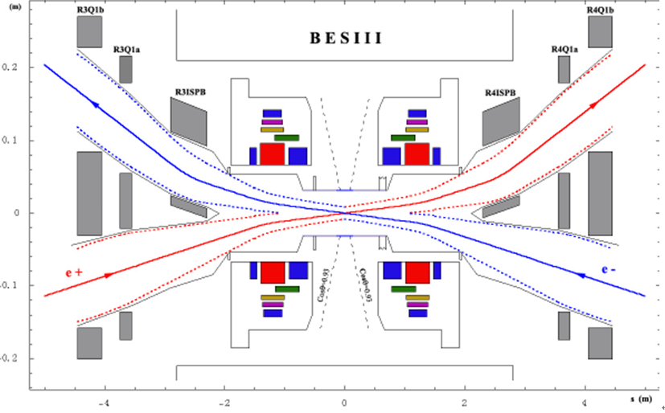
Issues of SCQ (2.8GeV)
SCQ is the super-conducting final focus quadrupole near IP
The structure of SCQ is usually very complicated and compact
The maximum measured exciting current of BEPCII SCQ is 530A
The actual exciting current of BEPCII SCQ is 549A@2.459GeV, which has already exceeded the maximum measured data
Two new SCQ is required for BEPCII to run at 2.8GeV
A new scheme to reduce SCQ strength is also under design in case the new SCQ could not be manufactured on time

Slide 20
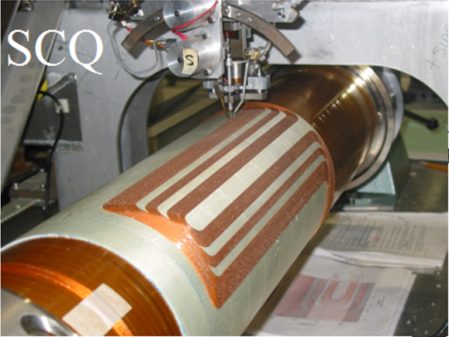
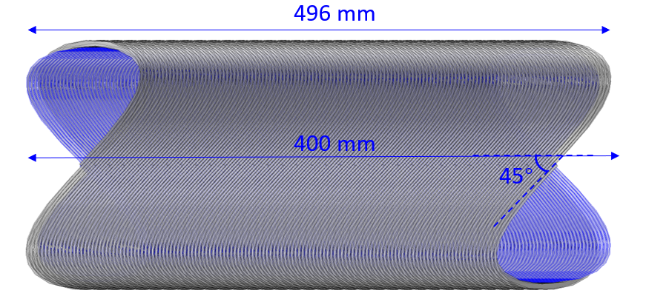
Development of new SCQ (+solenoids)
Two teams are working in parallel.
Serpentine (Cos2θ type)
  First developed at BNL
  Compact, Combined function magnets, Exact field quality
  In-house winding machine has been developed at IHEP
Canted cosine theta (CCT)
  Become popular in recent 10 years
  Based on numerical control machine
  CCT correctors have been made in-house for HL-LHC

Slide 21
Normal Conducting Maget @ 2.8 GeV
 | Function | Issue | Progress | Solution | Impact
BEPC, 70B | Bending Outer ring
BEPCII, 67B | Bending Inner ring | Field Measure: 900A，1200 A is required | Measure of Sample Magnet, FINE! |  | High-order multipole field
105(L)Q | Quadrupole | Max: 162 A, Exceeding limit@ 2.47 GeV | Measure @ 200A, Simulation. Limit: 220A | Lattice design with limited strength | Luminosity loss, DA, lifetime, background.1-to-N: hysteresis curve
Q1A | Dual-aperture Quadrupole | Field Measure:1577A 1680 A is required |  | Simulation data is used | Optics error
ISPB | Septum Magnet | Field Measure1300A， 1525 A is required |  | Simulation data Is used | error

Slide 22
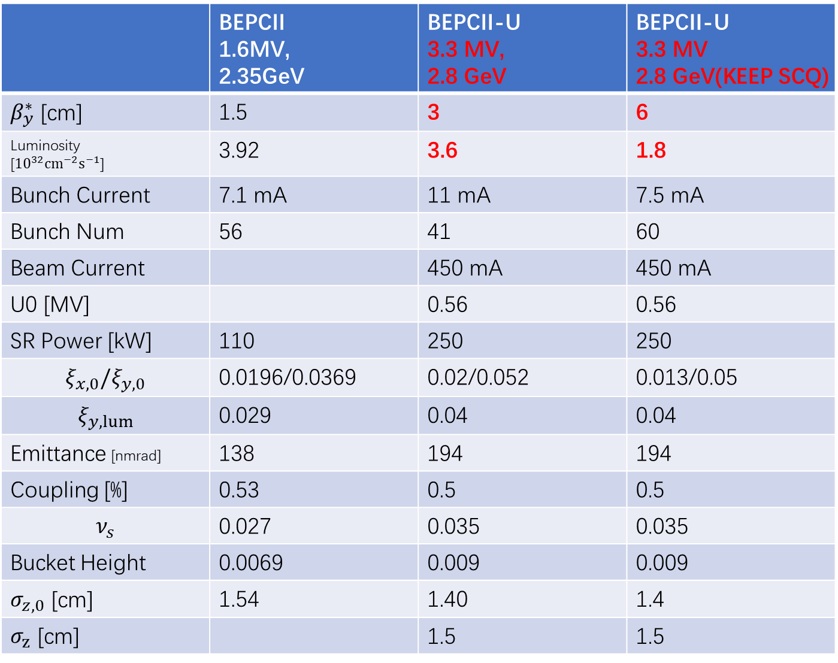
 | BEPCII 1.6MV, 2.35GeV | BEPCII-U 3.3 MV, 2.8 GeV | BEPCII-U 3.3 MV 2.8 GeV(KEEP SCQ)
$β_{y}^{∗}$ [cm] | 1.5 | 3 | 6
Luminosity [${10}^{32}cm^{−2}s^{−1}$] | 3.92 | 3.6 | 1.8
Bunch Current | 7.1 mA | 11 mA | 7.5 mA
Bunch Num | 56 | 41 | 60
Beam Current |  | 450 mA | 450 mA
U0 [MV] |  | 0.56 | 0.56
SR Power [kW] | 110 | 250 | 250
$$ξ_{x,0}/ξ_{y,0}$$ | 0.0196/0.0369 | 0.02/0.052 | 0.013/0.05
$$ξ_{y,lum}$$ | 0.029 | 0.04 | 0.04
Emittance [nmrad] | 138 | 194 | 194
Coupling [%] | 0.53 | 0.5 | 0.5
$$ν_{s}$$ | 0.027 | 0.035 | 0.035
Bucket Height | 0.0069 | 0.009 | 0.009
$σ_{z,0}$ [cm] | 1.54 | 1.40 | 1.4
$σ_{z}$ [cm] |  | 1.5 | 1.5
2.8 GeV

Slide 23
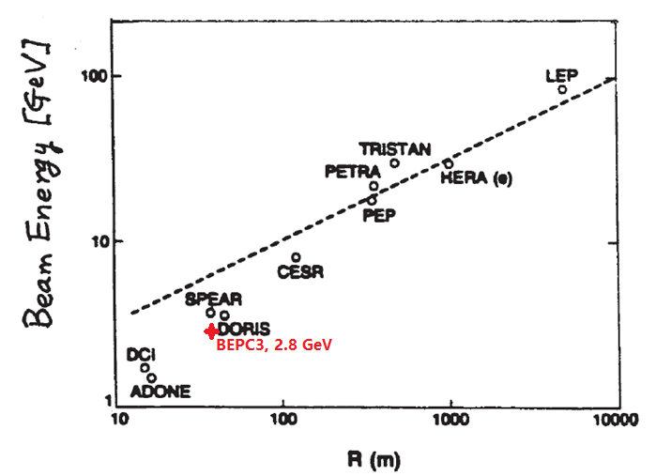
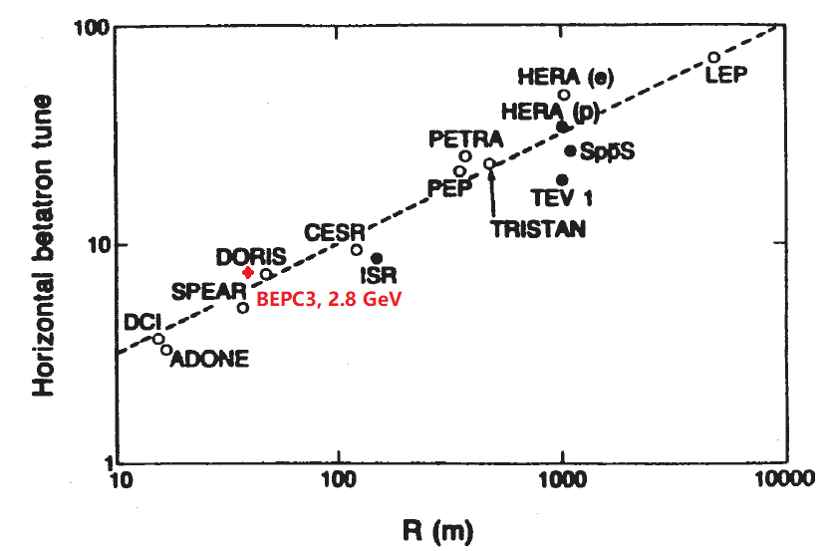
Beam Energy vs Radius

Slide 24
Schedule
July-Dec. 2024, Shutdown for Hardware Installation
January 2025, Restart
2025-2028, Beam Commissioning (2.3-2.5 GeV)
2028-2030, Beam Commissioning (2.5-2.8 GeV)

Slide 25
Summary
High SR Power + High RF Voltage
=> higher luminosity near 2.35 GeV
2.8 GeV is achievable
Upgrade is expected to be finished in the following 4 years

