Slide 1

Jets in ML
Gang LI
IHEP

Slide 2
One of the most striking phenomena that can be observed in high-energy collisions of elementary particles is the production of highly collimated bunches of particles

Slide 3
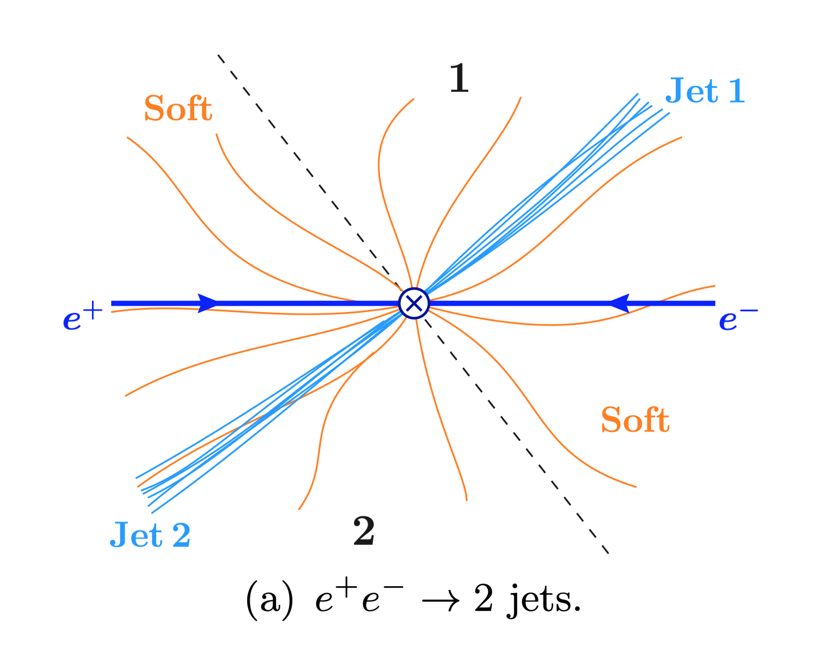
Jets in HEP

Slide 4
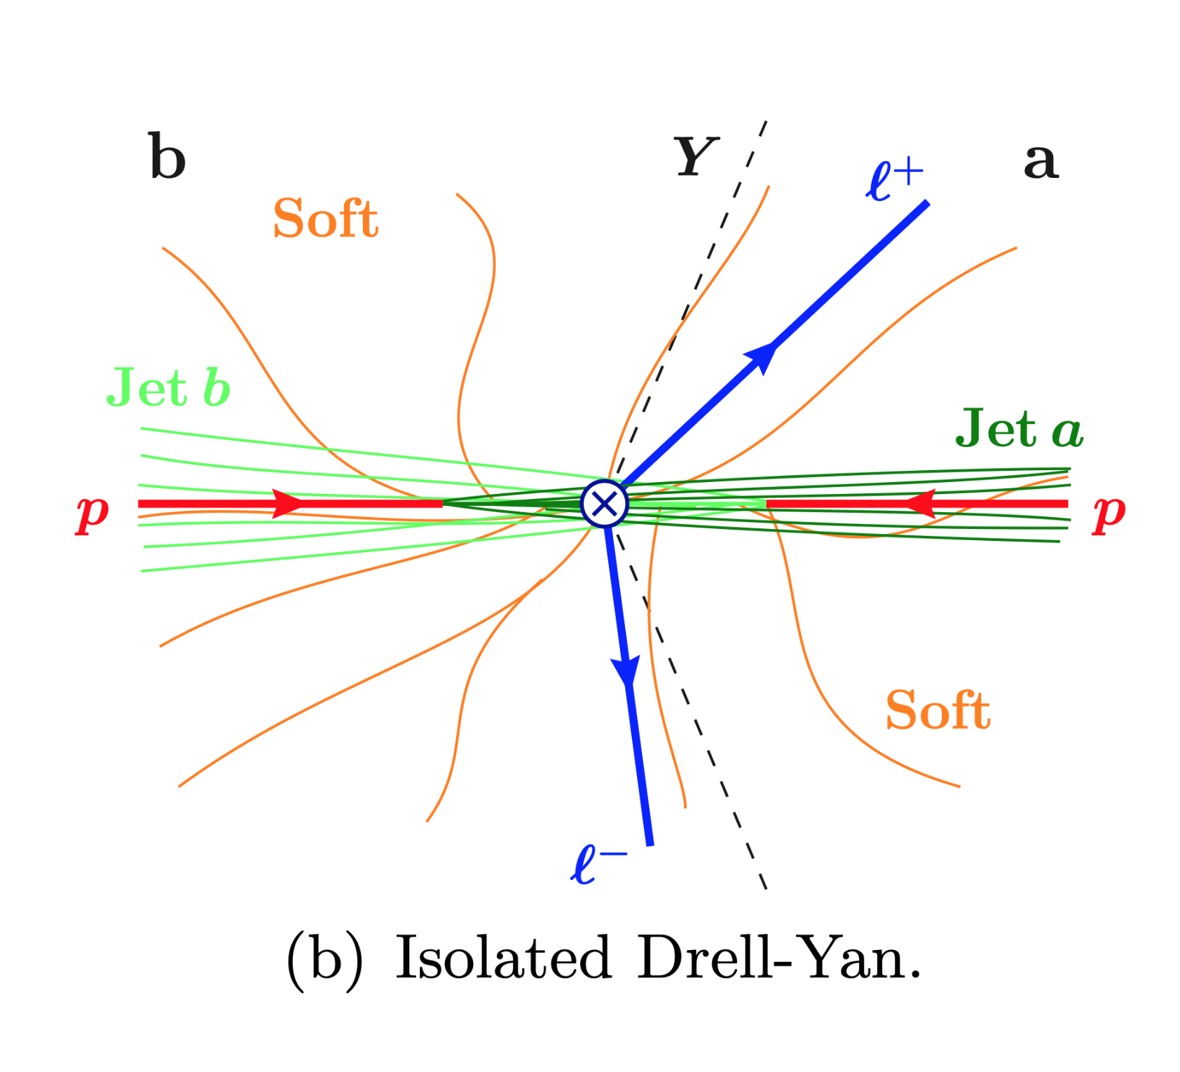
Jets in HEP

Slide 5
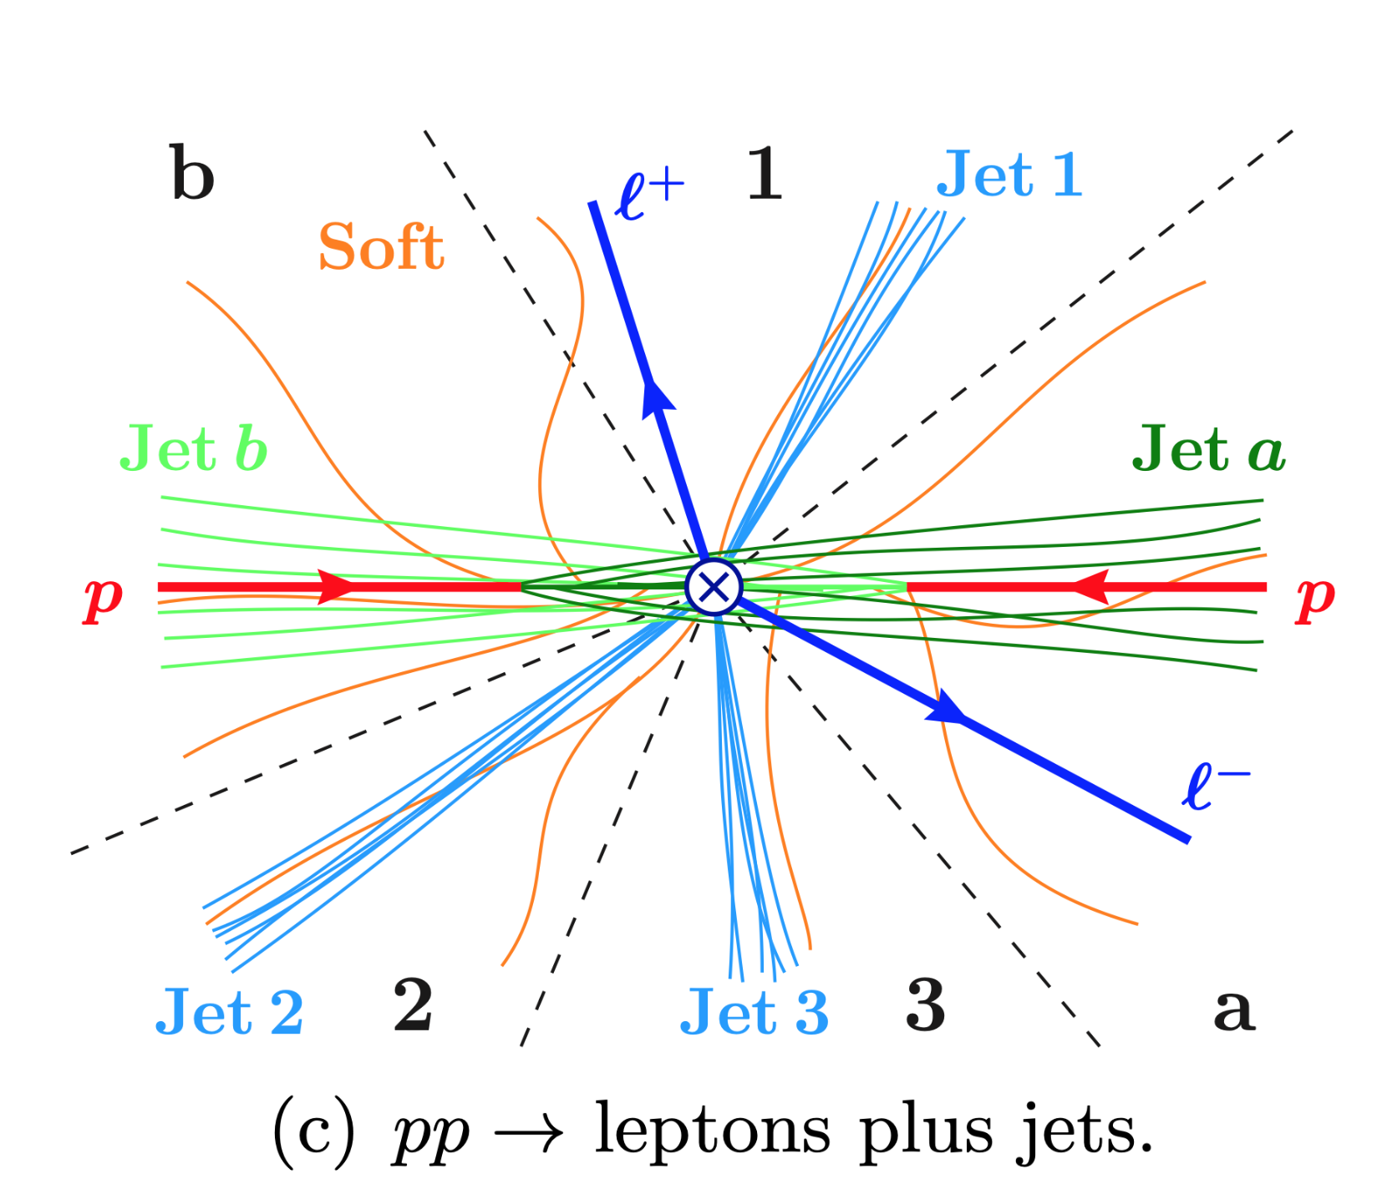
Jets in HEP

Slide 6
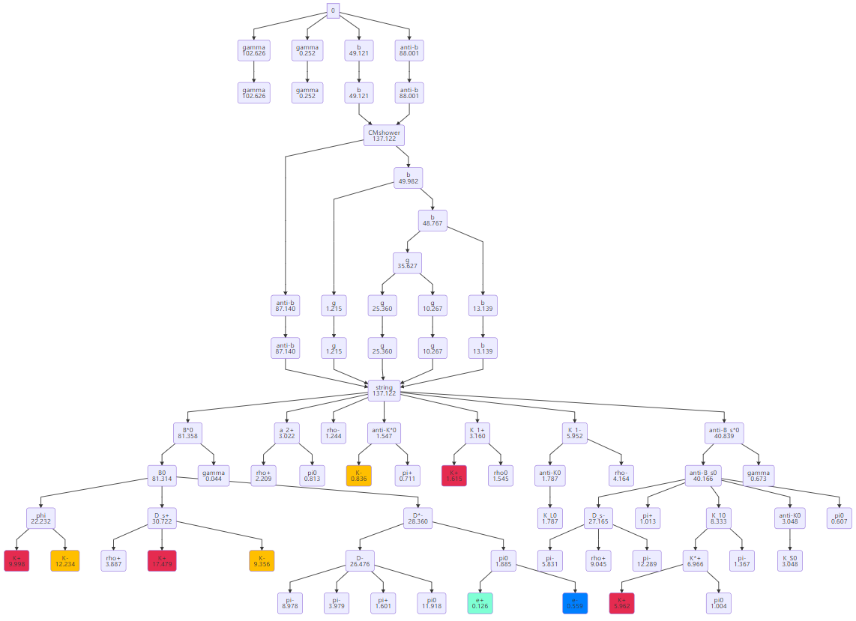
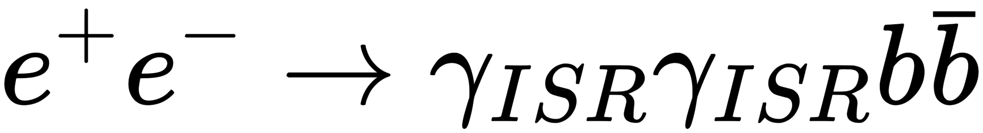
Hard process
Fragmentation
(Final) state particles

Slide 7
What information we want to have?
A event in detector: collection of final state particles
A particle: 4 + 3 + 3 variables
  P4: (E, px, py, pz,) or (E, m, θ, φ) … (E²=p²+m² , if m known)
  Where it starts: impact parameters (x,y,z), not available for neutrals, by assumptions.
  Where it ends: Ks, Λ, B, D, … , only applicable for long lived particles (cτ >= O (10 μm))

Slide 8
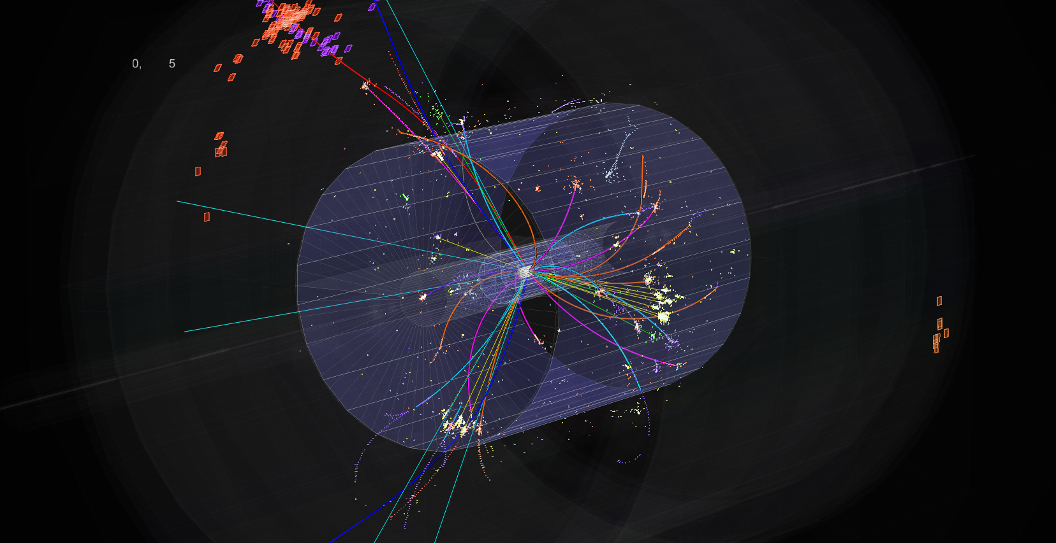
What information we could have?
Lots of hits ( pixels ) : hits → clusters → particles → jets → events

Slide 9
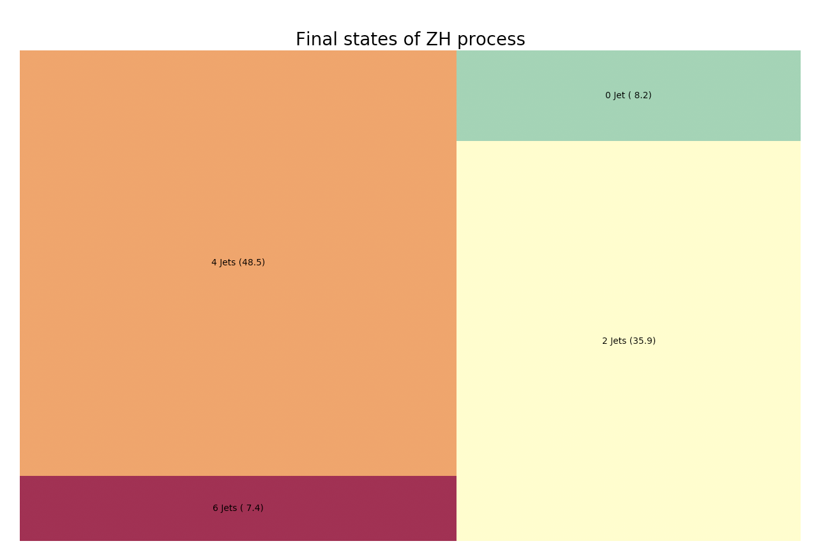
1,000,000 Higgs events
~8% decays of the Higgs has no jet and >90% w/i jets

Slide 10
The elements of Machine Learning
Priori knowledge
Data/information
Models (no free lunch theorem)

Slide 11
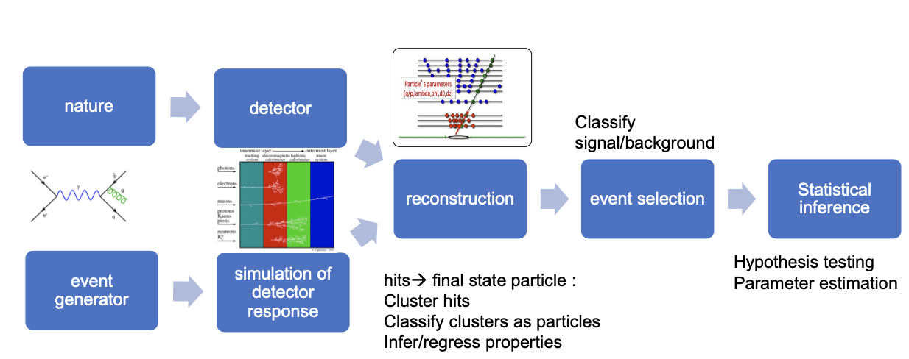
ML at HEP

Slide 12
Flavor Tagging
--- identify the type of a jet
Notes:
Flavor tagging software, LIFIplus, it this is directed taken from ILCsoft with a few changes.

Slide 13
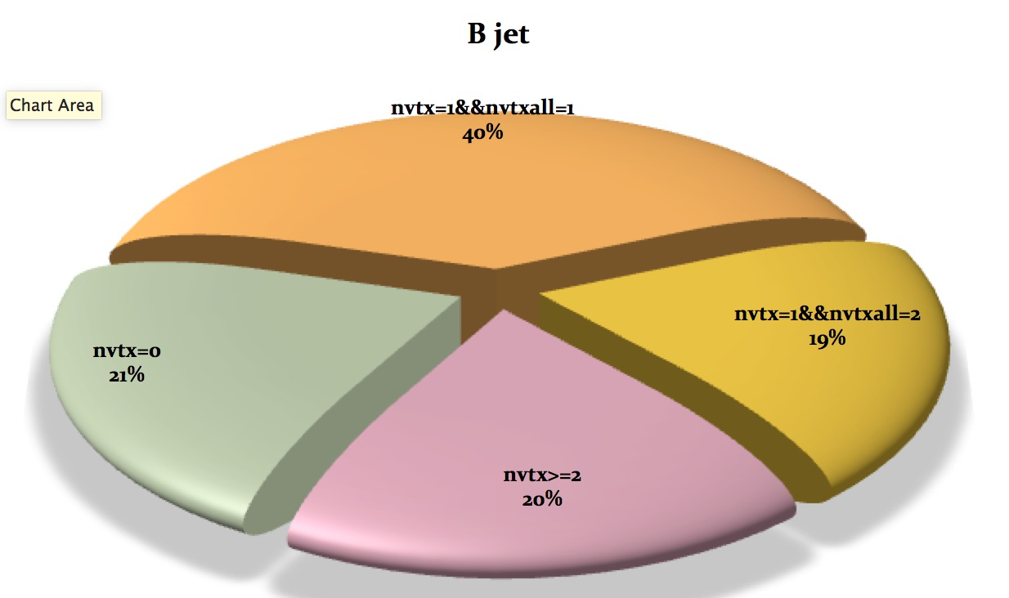
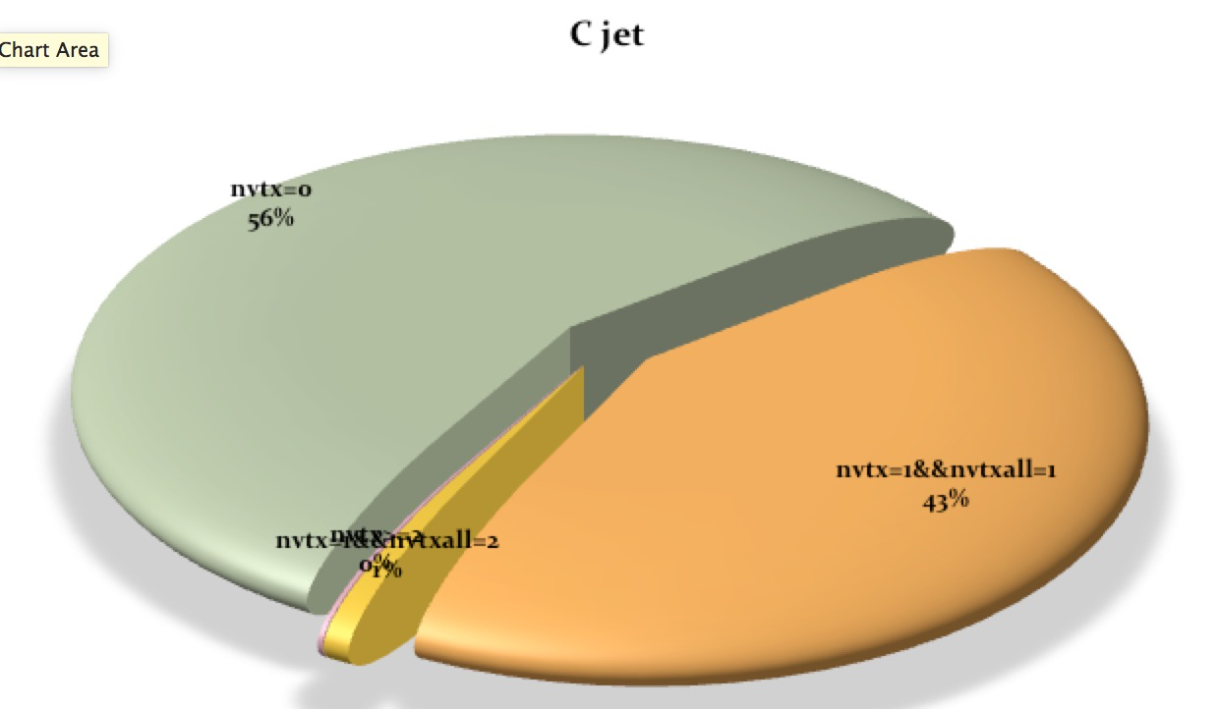
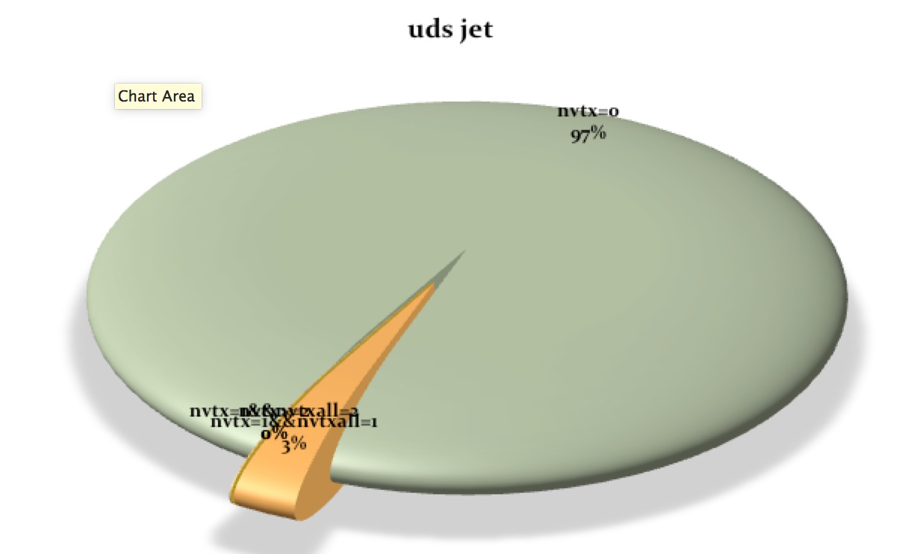
Check the # of vertexes
 | Total | nvtx==0 | nvtx=1&& Nvtxall==1 | nvtx==1&&nvtxall==2 | Nvtx>=2
B | 400 000 | 83 099 | 156 094 | 76 239 | 80 135
C | 400 000 | 223 238 | 169 400 | 3 392 | 662
uds | 400 000 | 382 522 | 10 511 | 171 | 106
Notes:
Here show some statistics of secondary vertex for different jets. Form the table and the pan-care chart, we can see b-jet usually has more vertexes c-jet has less, for comparison we can see that most light jets have no vertex.

Slide 14
Input variables of each category
nvtx=0 | trk1d0sig trk2d0sig trk1z0sig trk2z0sig trk1pt_jete trk2pt_jete jprobr5sigma jprobz5sigma d0bprob d0cprob d0qprob z0bprob z0cprob z0qprob nmuon nelectron trkmass(17)
nvtx=1&&nvtxall=1 | trk1d0sig trk2d0sig trk1z0sig trk2z0sig trk1pt_jete trk2pt_jete jprobr jprobz vtxlen1_jete vtxsig1_jete vtxdirang1_jete vtxmom1_jete vtxmass1 vtxmult1 vtxmasspc vtxprob d0bprob d0cprob d0qprob z0bprob z0cprob z0qprob trkmass nelectron nmuon(25)
nvtx=1&&nvtxall=2 | trk1d0sig trk2d0sig trk1z0sig trk2z0sig trk1pt_jete trk2pt_jete jprobr jprobz vtxlen1_jete vtxsig1_jete vtxdirang1_jete vtxmom1_jete vtxmass1 vtxmult1 vtxmasspc vtxprob 1vtxprob vtxlen12all_jete vtxmassall (19)
Nvtx>=2 | trk1d0sig trk2d0sig trk1z0sig trk2z0sig trk1pt_jete trk2pt_jete jprobr jprobz vtxlen1_jete vtxsig1_jete vtxdirang1_jete vtxmom1_jete vtxmass1 vtxmult1 vtxmasspc vtxprob vtxlen2_jete vtxsig2_jete vtxdirang2_jete vtxmom2_jete vtxmass2 vtxmult2 vtxlen12_jete vtxsig12_jete vtxdirang12_jete vtxmom_jete vtxmass vtxmult 1vtxprob(29)
Notes:
This page shows the features used in the BDT, there are a lot. But most them are relative vertex information even there no secondary vertex found. Also number of leptons, jet shape variables, vertex mass/energy information are also used in flavor tagging.

Slide 15
Performance
Notes:
Now let’s see the flavor tagging performance.

Slide 16
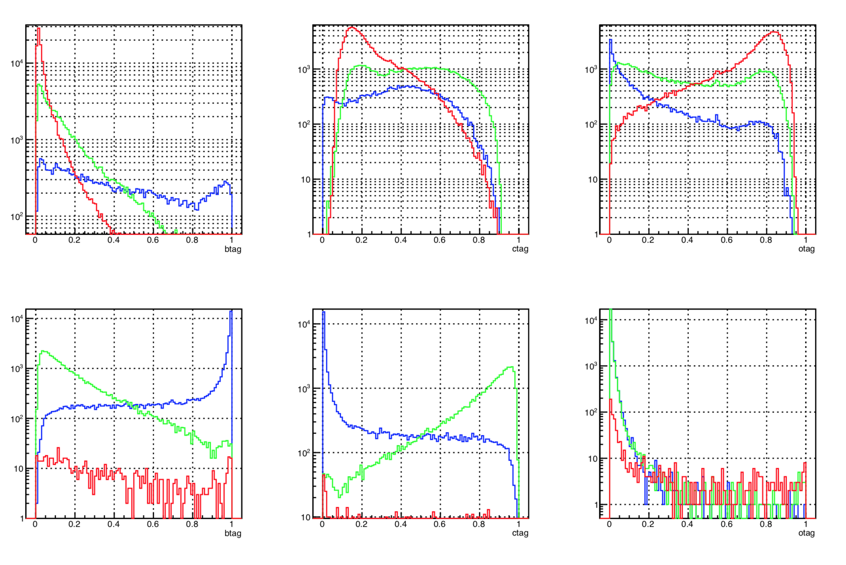
Output b, c, and o likeliness
cat1
cat2
btag+ctag+otag=1: 2 outputs
Notes:
This plots show the b-likeliness, c-likeliness and o-likeliness of two categories. Please note that this log-scale. Three output are nomalized to 1. so there are only two are independent. From the plots, we can see if there no second vertex found, the tagging performance are not very good, fortunately only a small fraction of b-jet has no 2nd vertex.

Slide 17
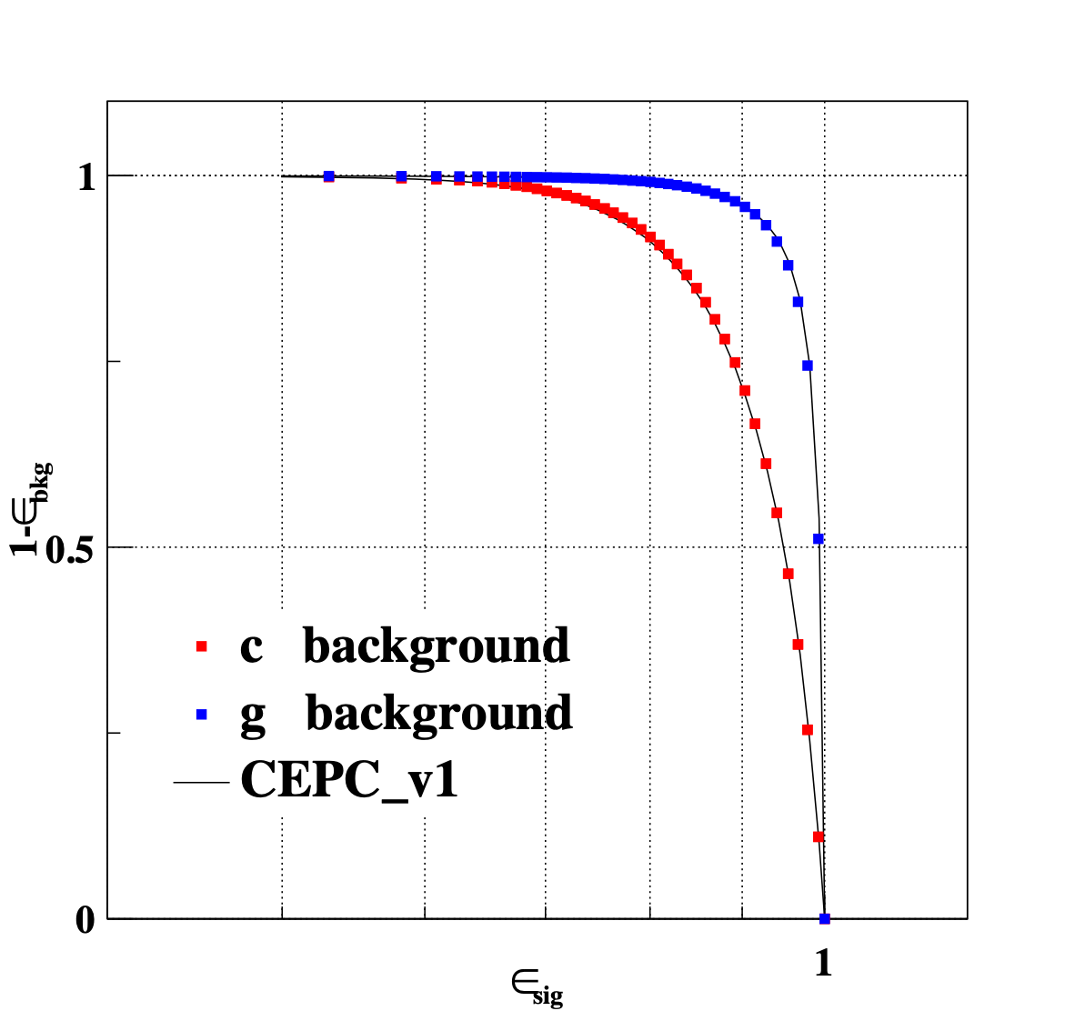
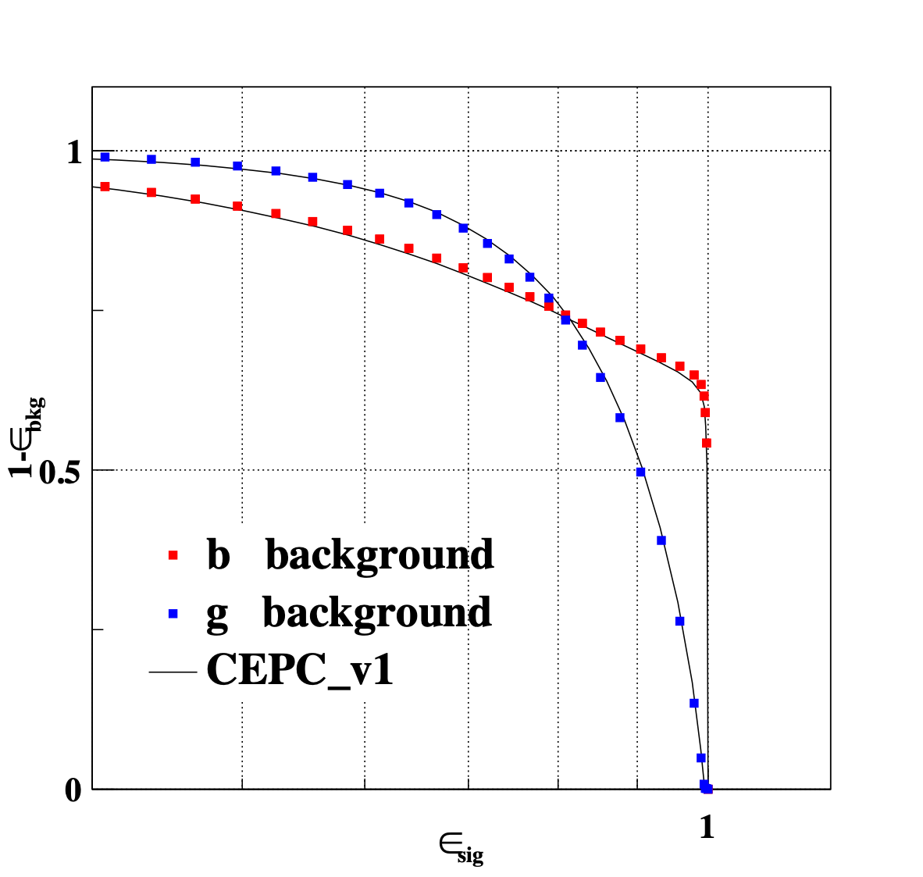
Performance: ROC used to evaluate how good the algorithm
Receiver Operating Characteristic Curve (ROC)
80% b-tagging eff. : Reject 90% c and 99% o jets
80% c-tagging eff. : Reject 75% b and 75% o jets
Notes:
This this the standard receiver operating characteristic curve, ROC curve of b tagging and c tagging. The x axis is tagging efficiency and the y axis is mis-identification rate. It goes to more upper-right, better performance.
For reference. If we take 80% tagging efficiency of b jet, the rejection rate is 90% and 99% for c jet and light jet.
If we take 60% tagging efficiency for c jet, both rejection rates of b- and c jet are 75%. The is the b-tagging performance in baseline case. In the following let’s look at some variations.

Slide 18
More than BDT
Notes:
The LCFIplus software is based on TMVA package in root, and try various algorithms in TMVA, bdt is the most performant and fat one. But it still worth to try some new algorithms in the fast developing machine learning field.

Slide 19
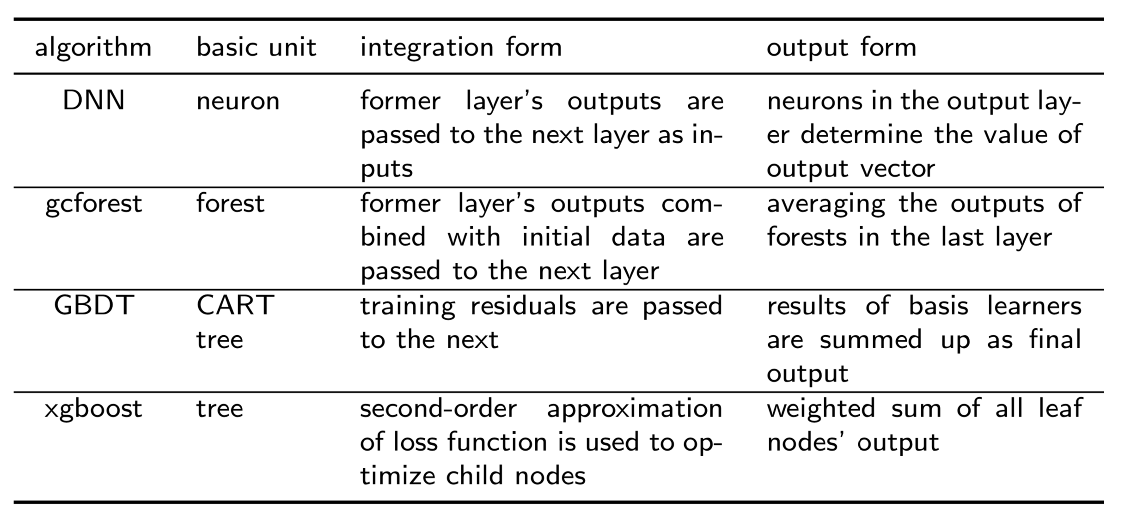
Alternative machine learning algorithms
Input variables kept as the same
Notes:
Here we tried other 4 methods together with BDT for comparison. They are DNN, the so called deep learning, gcforest, GBDT, and xgboost. In the tests, the input feature variables are kept as the same.

Slide 20
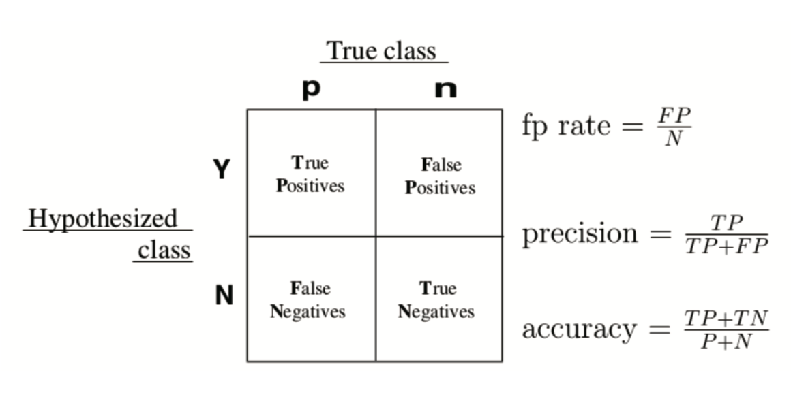
Terminologies
Confusion matrix or table of confusion
ROC: Receiver operating Characteristic Curve, the ability of a binary classifier
AUC: Area under the curve
Precision: # of correctly classified in positive / # of positive
Accuracy: # of correctly classified in both / # of all
AUC and accuracy used next
Notes:
Here are some terminologies used in the test, beside roc curve, we also use AUC: area under the curve. The accuracy, it is defined the number of objects correctly classified divided by the total number.

Slide 21
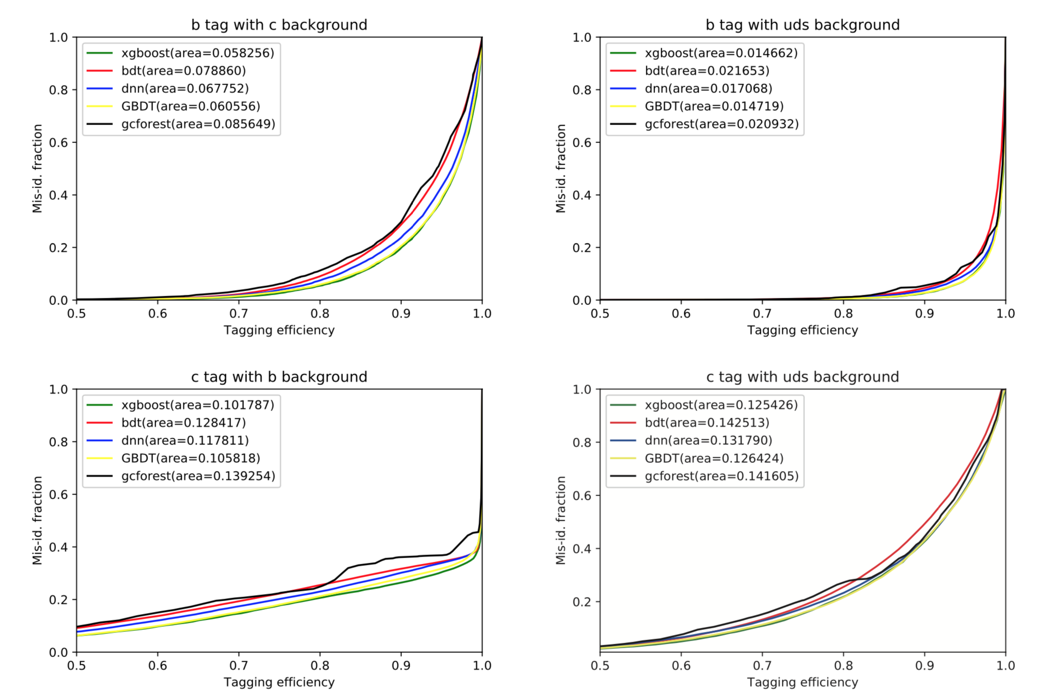
Tag efficiency vs. mis-identification
AUC: the smaller the better
xgboost best
Notes:
Here are the comparison results: the tagging efficiency versus mid-identification rate. Area is the AUC, in this case, the smaller the better. From the plots, we can see xgboost is the best, GBDT is also very good, only a little bit worser than xgboost,

Slide 22
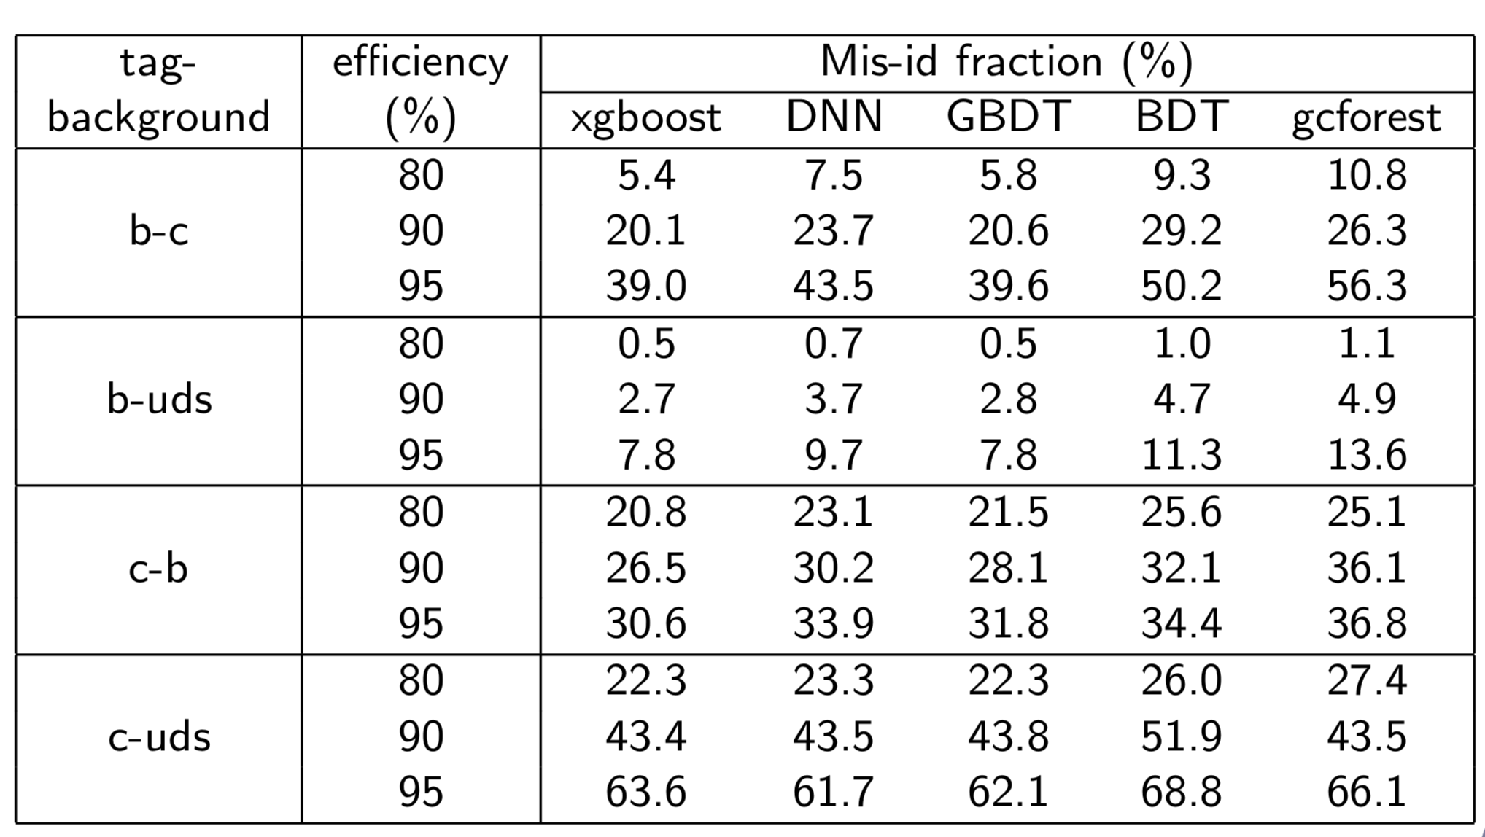
Tagging efficiency vs. mis-identification
Notes:
Here are numerical result. We take 80, 90, 95 tagging efficiency for b and c jet, to look at the mis-identification rates of background.
It is very clear xgboost has the best performance, better than baselien BDT by about 5-8 percent.

Slide 23
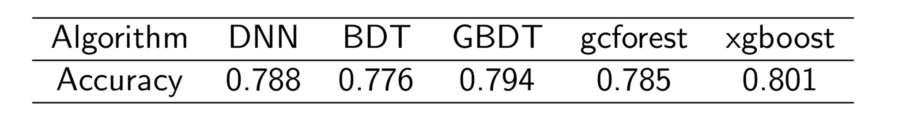
Accuracy
Alternative ML algorithms can improve the b/c-tagging performances
xgboost is the best, not DNN
~60 features: not so many for DNN
More features, such as particle level, even hit level, will be used
Notes:
More numerical results: accuracy is more straight forward. Again xgboost has the largesyt accuracy 80 percent. BDT is only 77.6 percent. We can conclude that the alternative machine leaning method can improve b/c-tagging, xgboost is the best, not DNN the famous deep learning. The reason is that only 60 feature is as many as enough for DNN. We should add more information, such as particle level variables, or even hit level information to look at the performance

Slide 24
New ideas
New representation /feature
New method (model)
From jet to event level

Slide 25
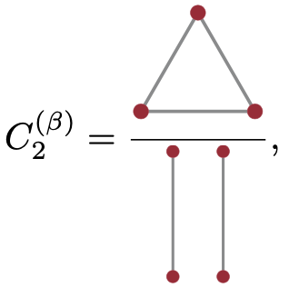
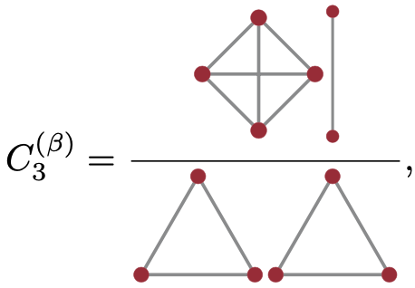
New features according to information theory
Jettiness/jet-substructure
Energy correlators (JHEP06(2013)108 )
Energy flow polynomials
Energy flow networks

Slide 26
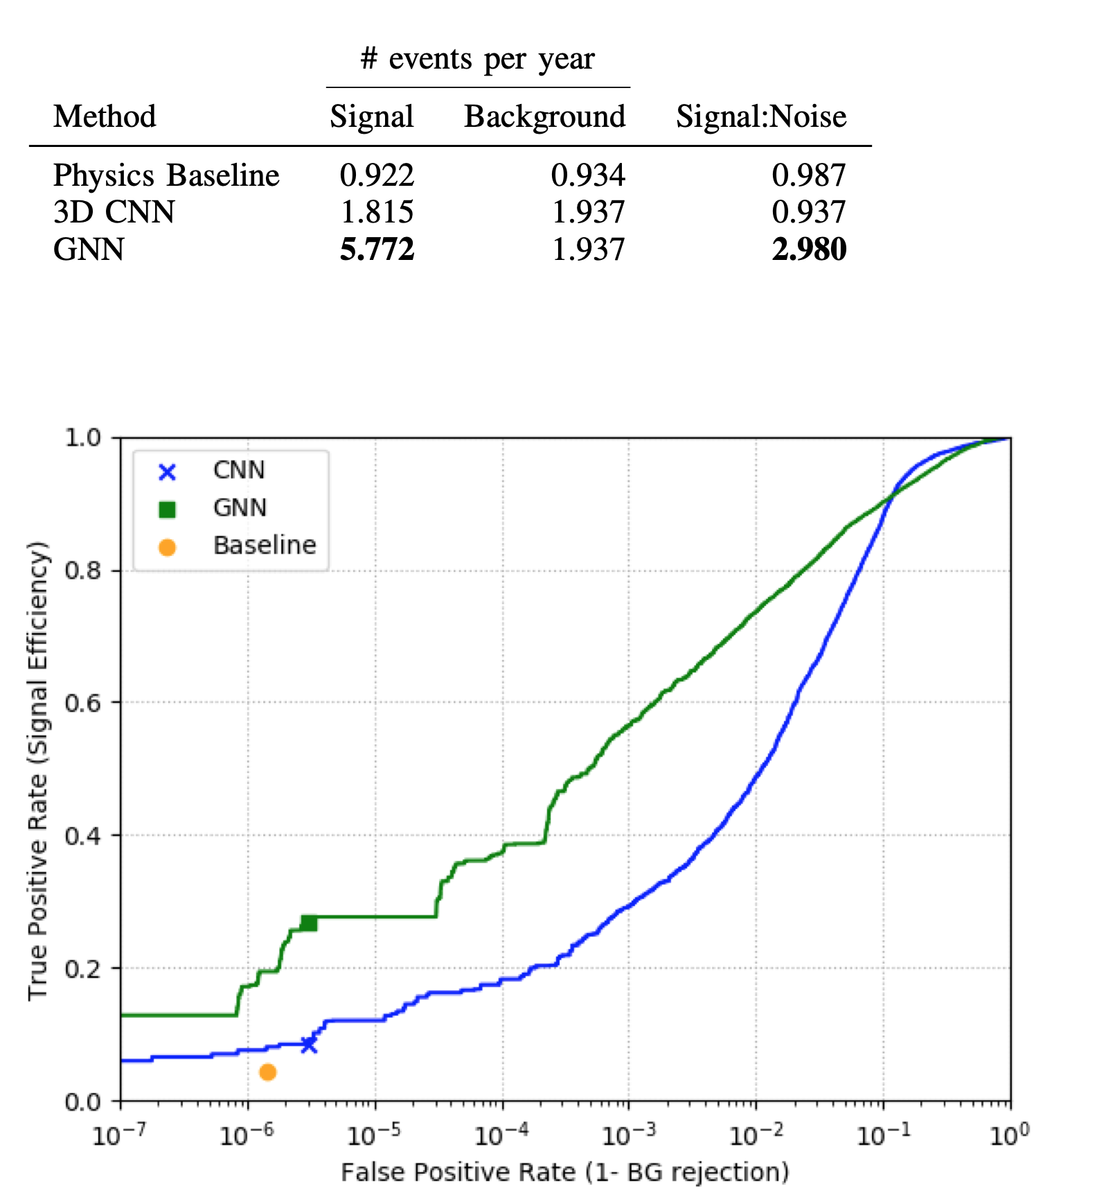
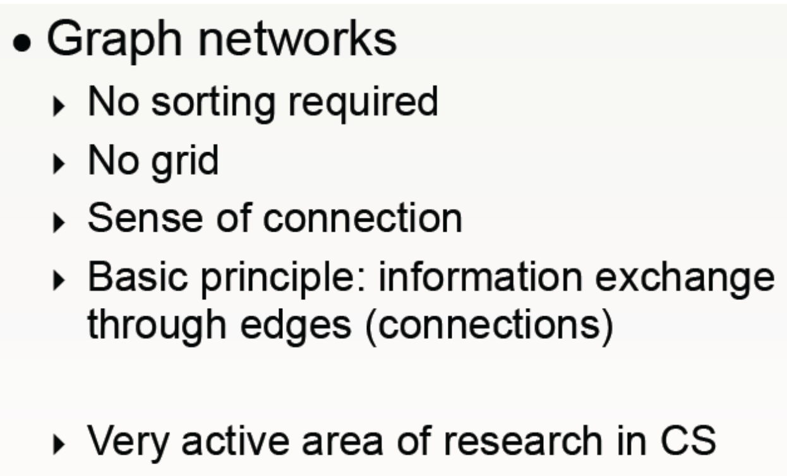
New method (model)
arXiv:1809.06166
Graph convolution neural network: use detector deposits rather than an image in a GCNN
graph theory
  Node: particles/energy deposits
  Edge: the connections among them

Slide 27
Forget about Jets, because they are vey soft to reconstruct
Our goal is classify signal/background

Slide 28
Summary
No free lunch
  Try many algorithms, starting with simple ones
Mapping your problem to ML field
  Check the literature

Slide 29
