Slide 1
Example: Jet Flavor Tagging with TMVA
Gang LI
IHEP
2020.11.12

Slide 2
Flavor Tagging in ROOT/TMVA
Notes:
Flavor tagging software, LIFIplus, it this is directed taken from ILCsoft with a few changes.

Slide 3
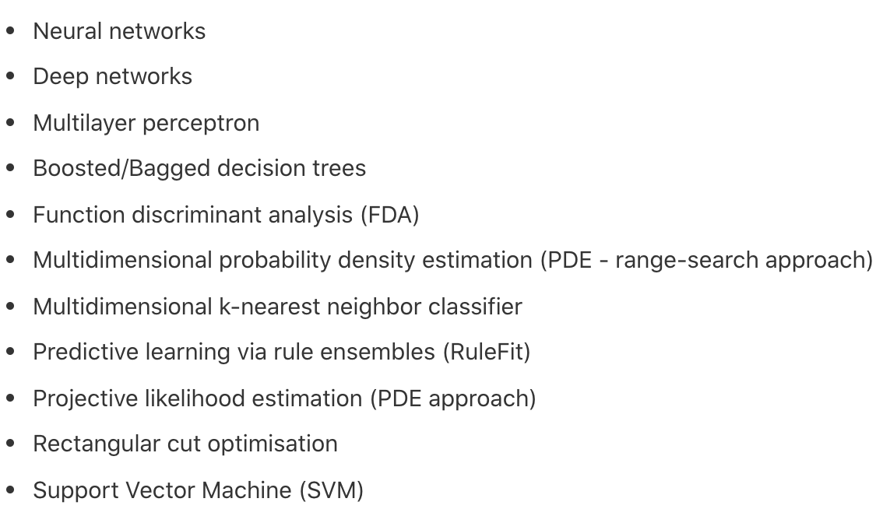
TMVA in root a ML toolkit
developed and used by HEP community
https://root.cern/manual/tmva/
It has plenty of traditional and newly developed algorithms
Well documented,
Tutorials/examples
Interfaces
Very easy to used

Slide 4
ML training

Slide 5
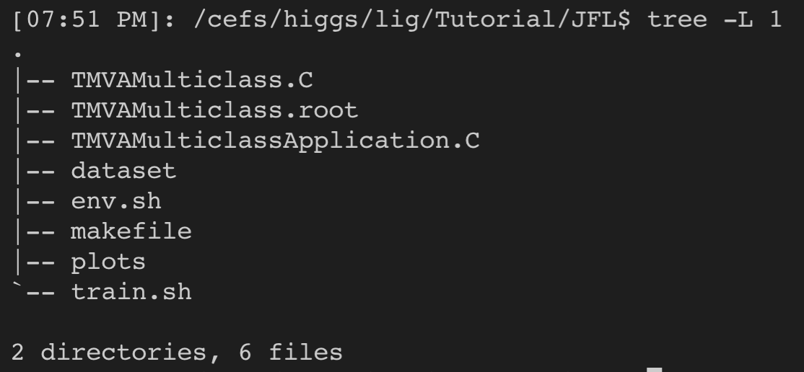
Everything can be found at /cefs/higgs/lig/Tutorial/JFL
Setup scripts: env.sh / jobs script: train.sh
Code/makefile
Data: datset (up to 200k, only 11k for test)
Plot scripts
The output is a root file

Slide 6
Some suggestions
10k events 200k jets
Try different methods on same dataset
Reading the log messages to understand how they work and how to improve their performance
Plot ROCs and compare the performances
Try other ML approaches

