Slide 1
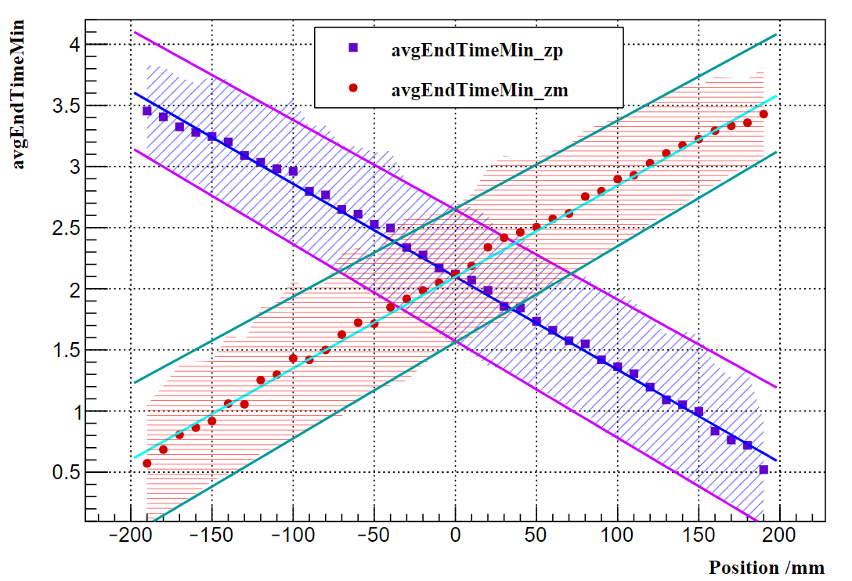
$$y=0.00720213x+2.65594$$
$$y=0.00748178x+2.09736$$
$$y=0.00786573x+1.56233$$
$$y=−0.00734668x+2.64628$$
$$y=−0.00760144x+2.09816$$
$$y=−0.00791792x+1.57249$$

Slide 2
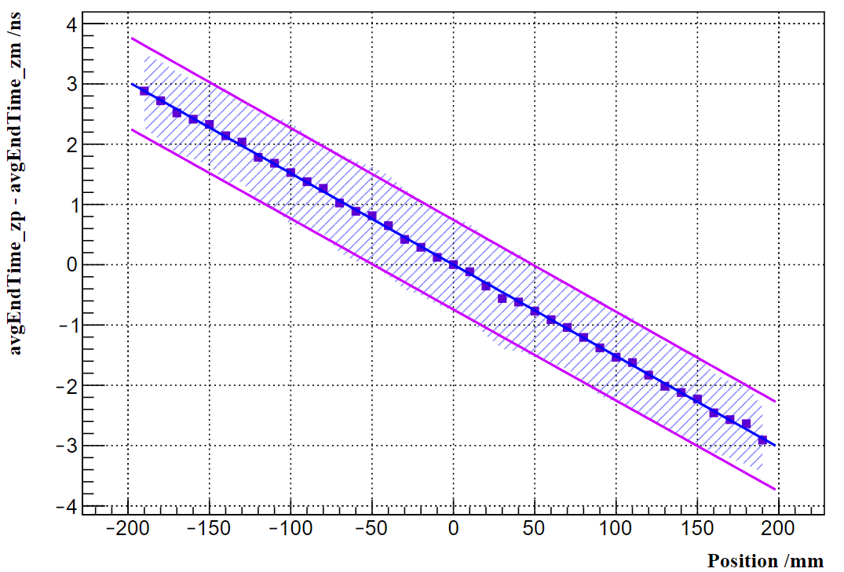
$$y=−0.0152389x+0.743592$$
$$y=−0.0151686x+0.000995823$$
$$y=−0.0150935x−0.743085$$

