Slide 1
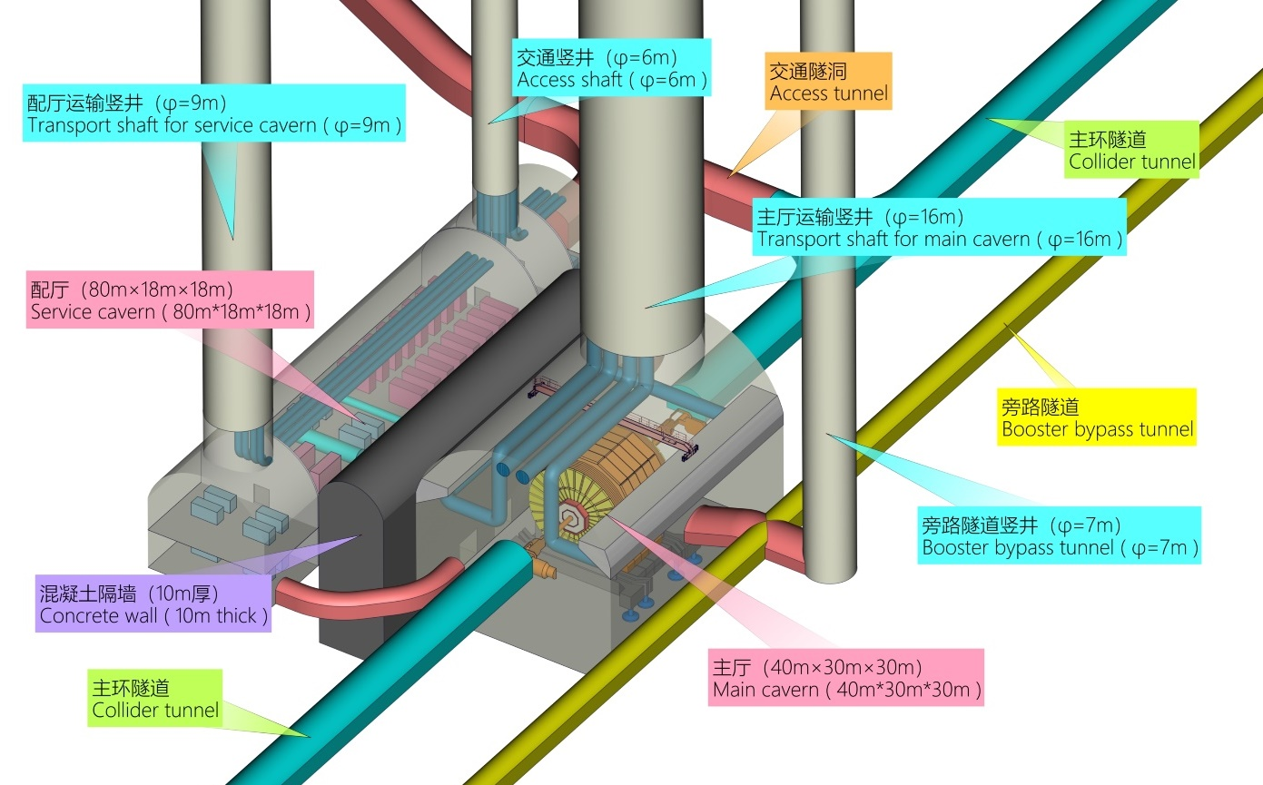
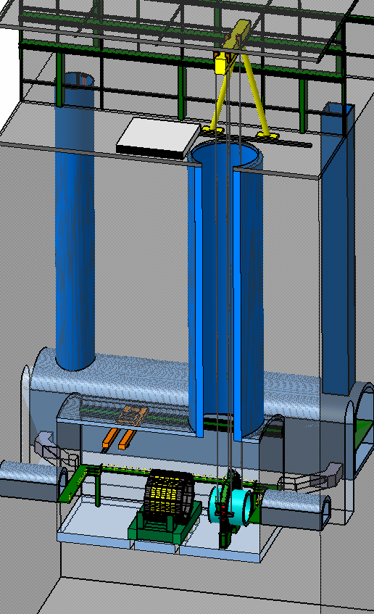
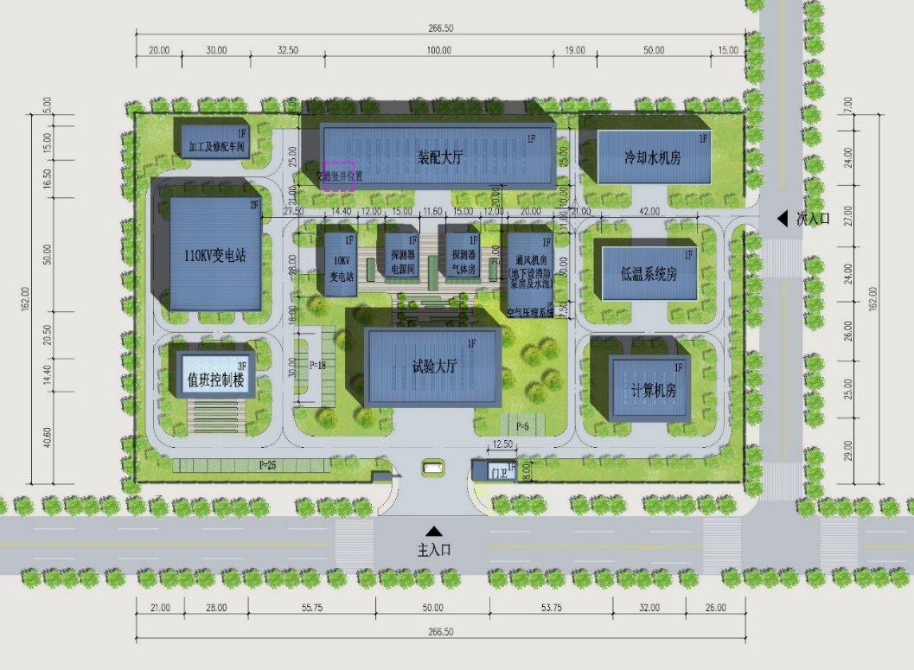
Experimental Hall
Biggest part lowered by 1000 tons gantry crane
Main cavern
Host the detector
40*30*30 m(L*H*W)
One main access shaft, Ø16 m
Auxiliary cavern
Peripheral equipment and devices
80*18*18 m(L*H*W)
One service shaft Ø9 m
One personnel access shaft Ø6 m
Ground buildings at experimental area

