Slide 1
DCI news and discussion
Xiaomei Zhang
2020-11-13

Slide 2
Migration to CentOS7
JUNO software is moving from SL6 to CentOS7.8
All the Grid sites are already on CentOS7.8
But singularity still used to give a unique env
Use standard image: /cvmfs/unpacked.cern.ch/registry.hub.docker.com/library/centos:centos7
For Cloud site, CentOS7 images are being built and tested
When all are ready, we will have a test with the latest JUNO version

Slide 3
JSUB
A tool to do mass user job submission and management for JUNO, especially user analysis
The first version is out and installed in CVMFS repository /cvmfs/dcomputing.ihep.ac.cn
Today the developer Yifan will have a brief introduction on it
The detailed user guide is:
https://jsubpy.github.io/
Volunteers are needed to test out and give feedback

Slide 4
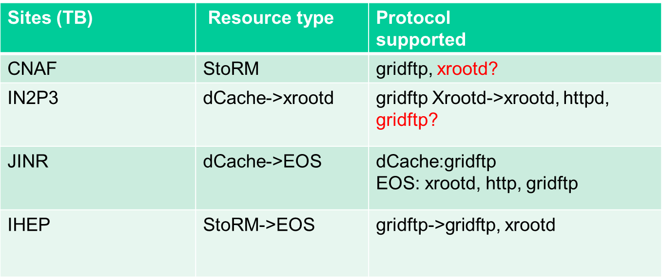
TPC tests
Last time, we agree on to have a common protocol: gridftp, then add xrootd, httpd eventually
XuanTong had a detailed test on these protocols among site SE and gave a talk on it later

Slide 5
Tests planned
After TPC is ready, a certain scale of transfer tests based on DIRAC DMS will be done
Before that, a survey of SE space will be done
JSUB also will have a scale test on functions and performance for user simulation and analysis
The time is expected to be last week of November

