Slide 1

Hadronic structures from threshold cusps and triangle singularities
Feng-Kun Guo
Institute of Theoretical Physics, CAS
PKU, 29 Oct. 2020
Review article:
FKG, X.-H. Liu, S. Sakai, Prog. Part. Nucl. Phys. 112 (2020) 103757 [arXiv:1912.07030]

Slide 2

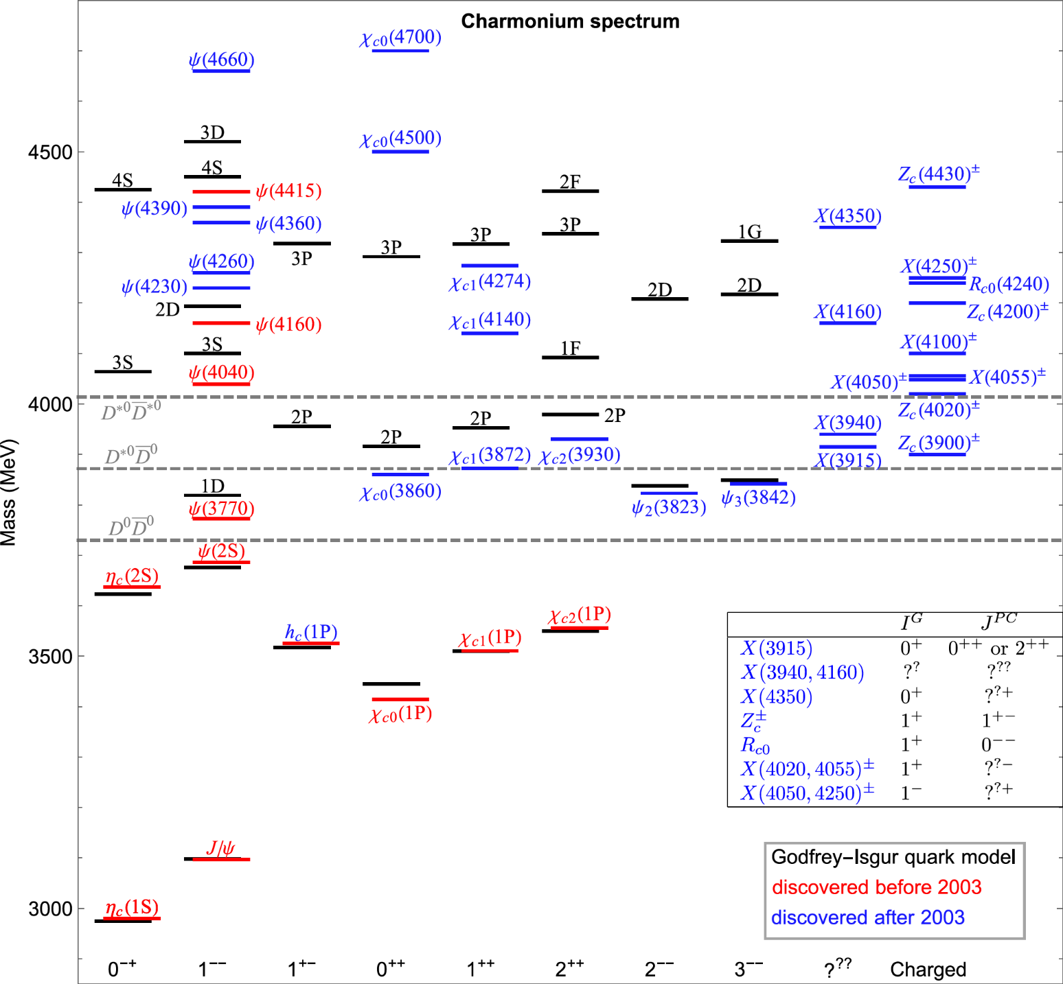
Charmonium-like structures
All puzzling structures are around or above S-wave open-charm thresholds
Too many vector states
Too many 1++ states
Charged structures!

Slide 3
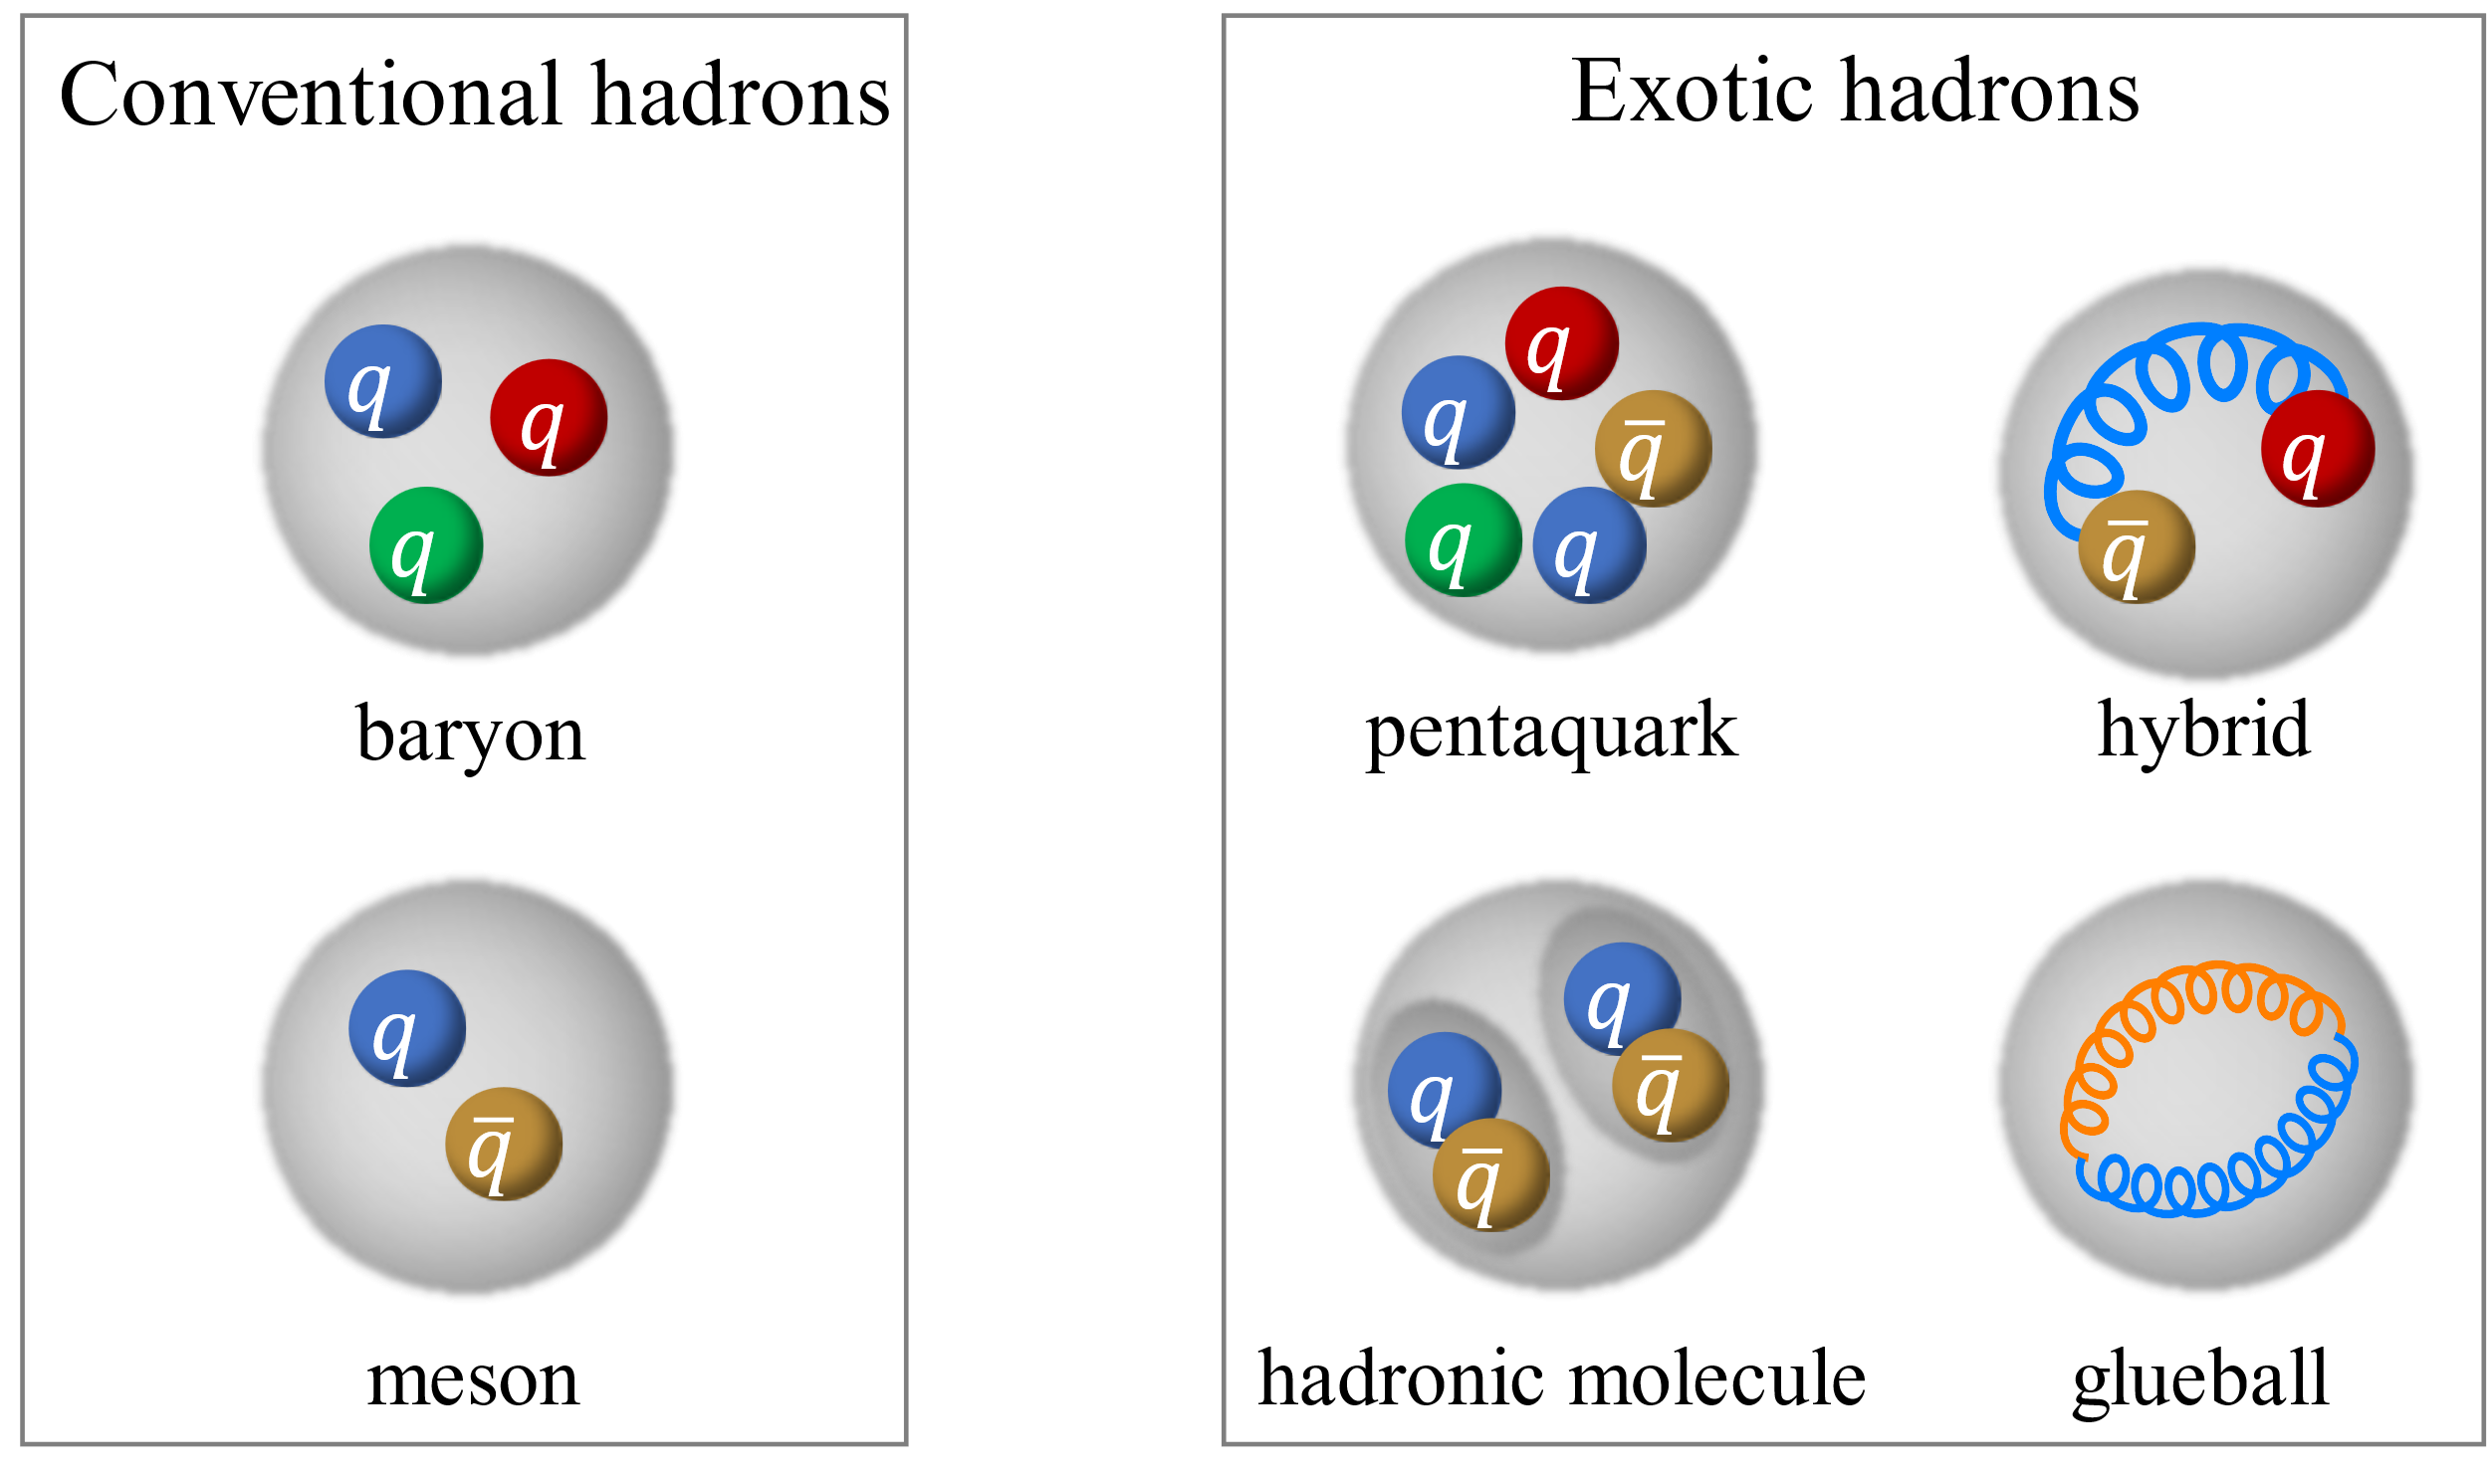
Exotic hadrons

Slide 4
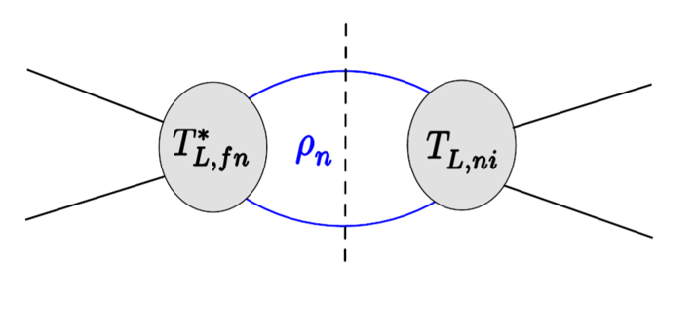
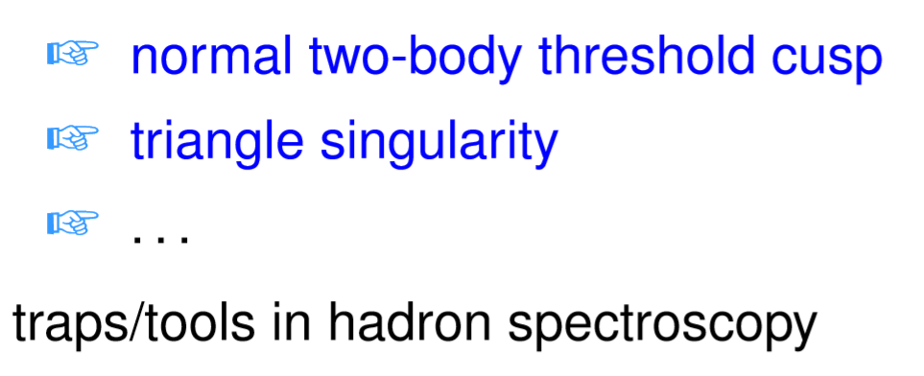
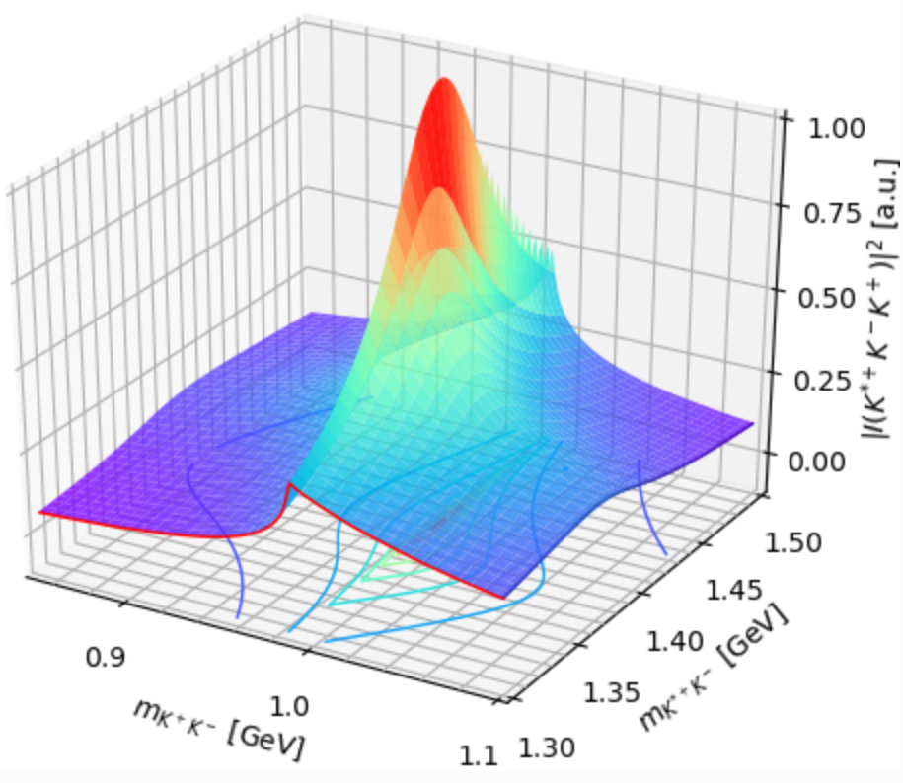
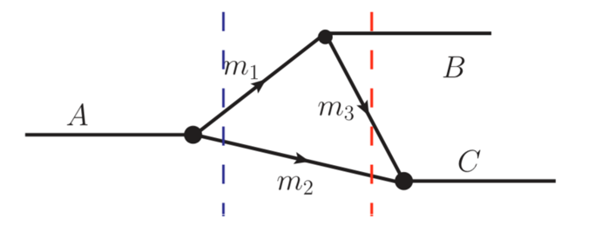
S-matrix singularities
Dynamics: poles, corresponding to hadron resonances, genuine physical states such as the ordinary and exotic mesons, baryons; location fixed by the dynamics
Kinematics: (normally) branch points of the S-matrix, due to on-shell intermediate particles, results of unitarity; location fixed by the involved kinematic variables: masses, energies

Slide 5
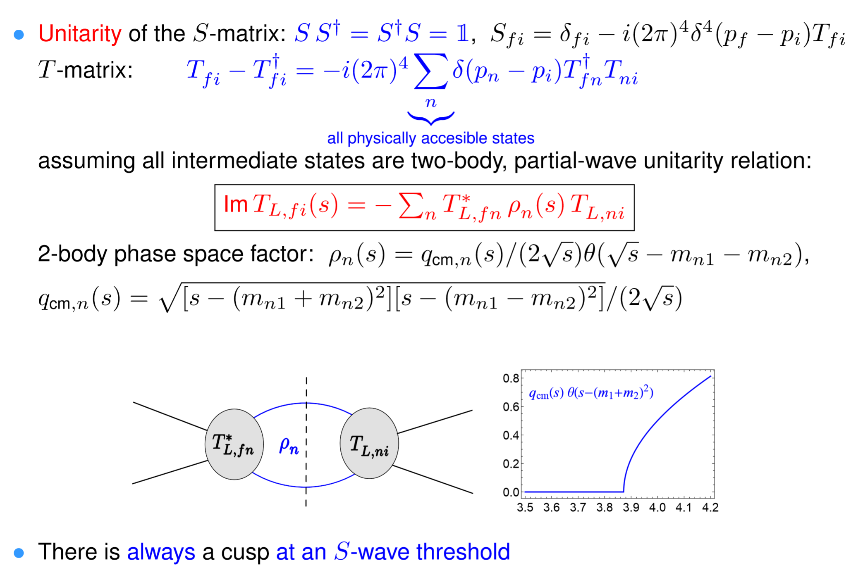
Threshold cusp

Slide 6
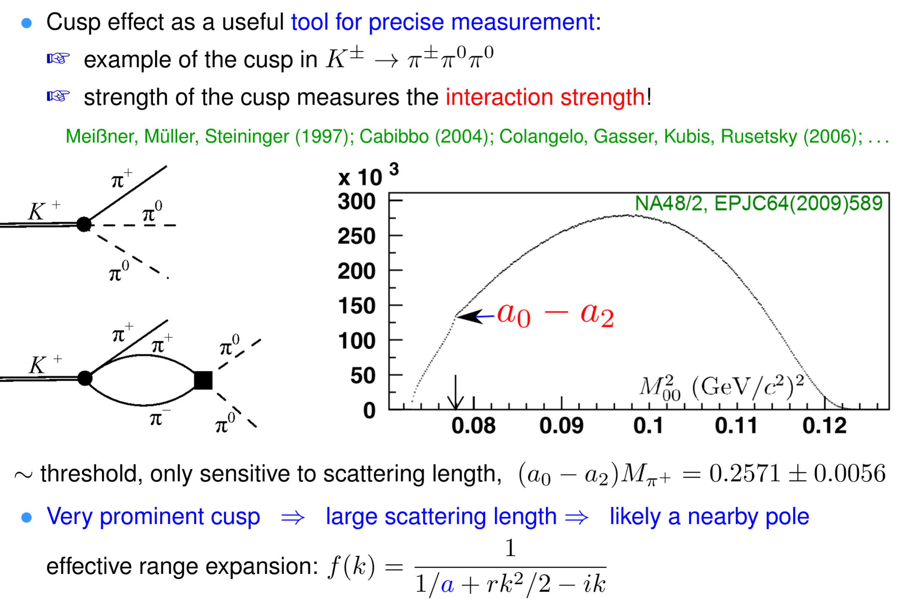
Threshold cusp as a tool

Slide 7

Triangle singularity (TS)
Logarithmic singularity $⇒$ peak
Bayar, Aceti, FKG, Oset, PRD94(2016)074039

Slide 8
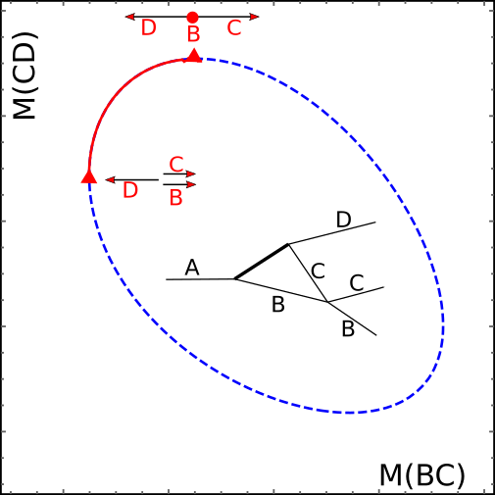
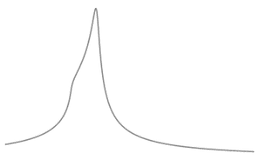
Triangle singularity (TS)
R
R

Slide 9
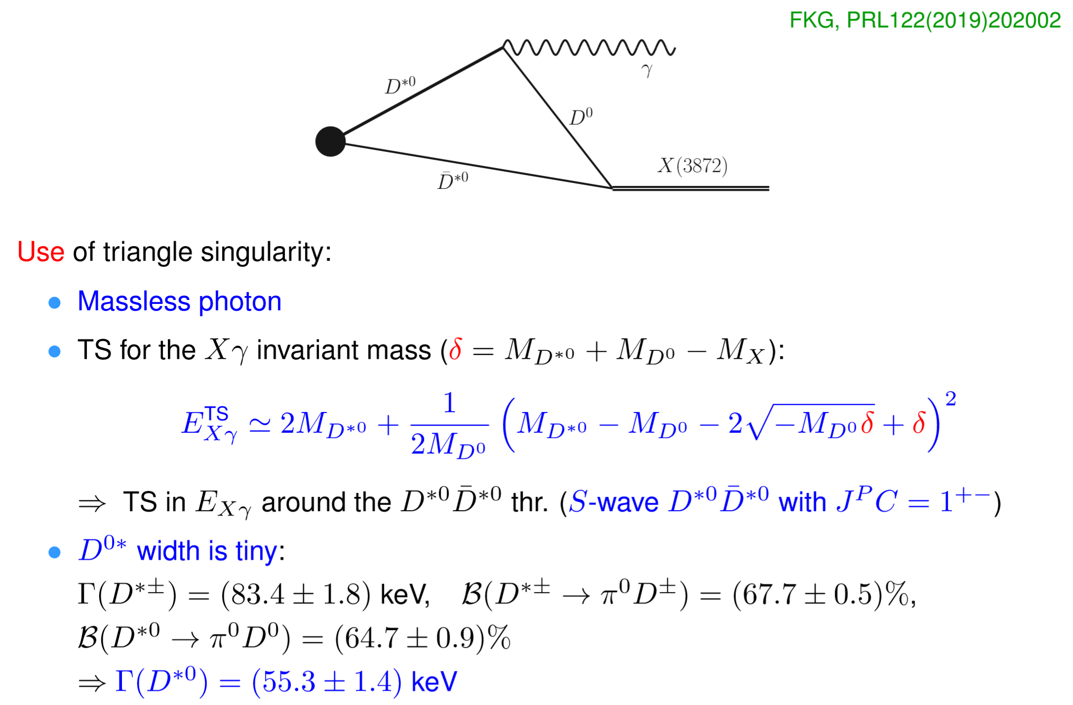
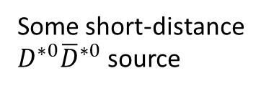
TS as a tool: precise measurement of X(3872)
Some short-distance
$D^{∗0}{\overline{D}}^{∗0}$ source

Slide 10
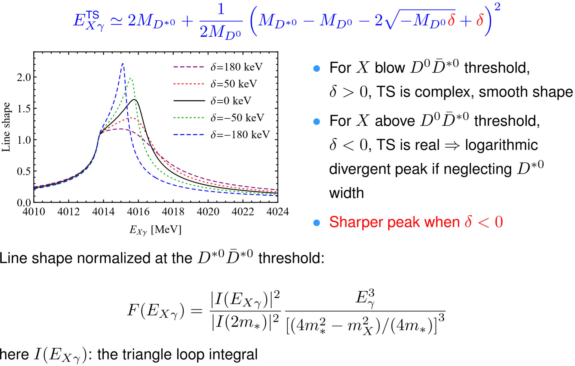
TS as a tool: precise measurement of X(3872)

Slide 11
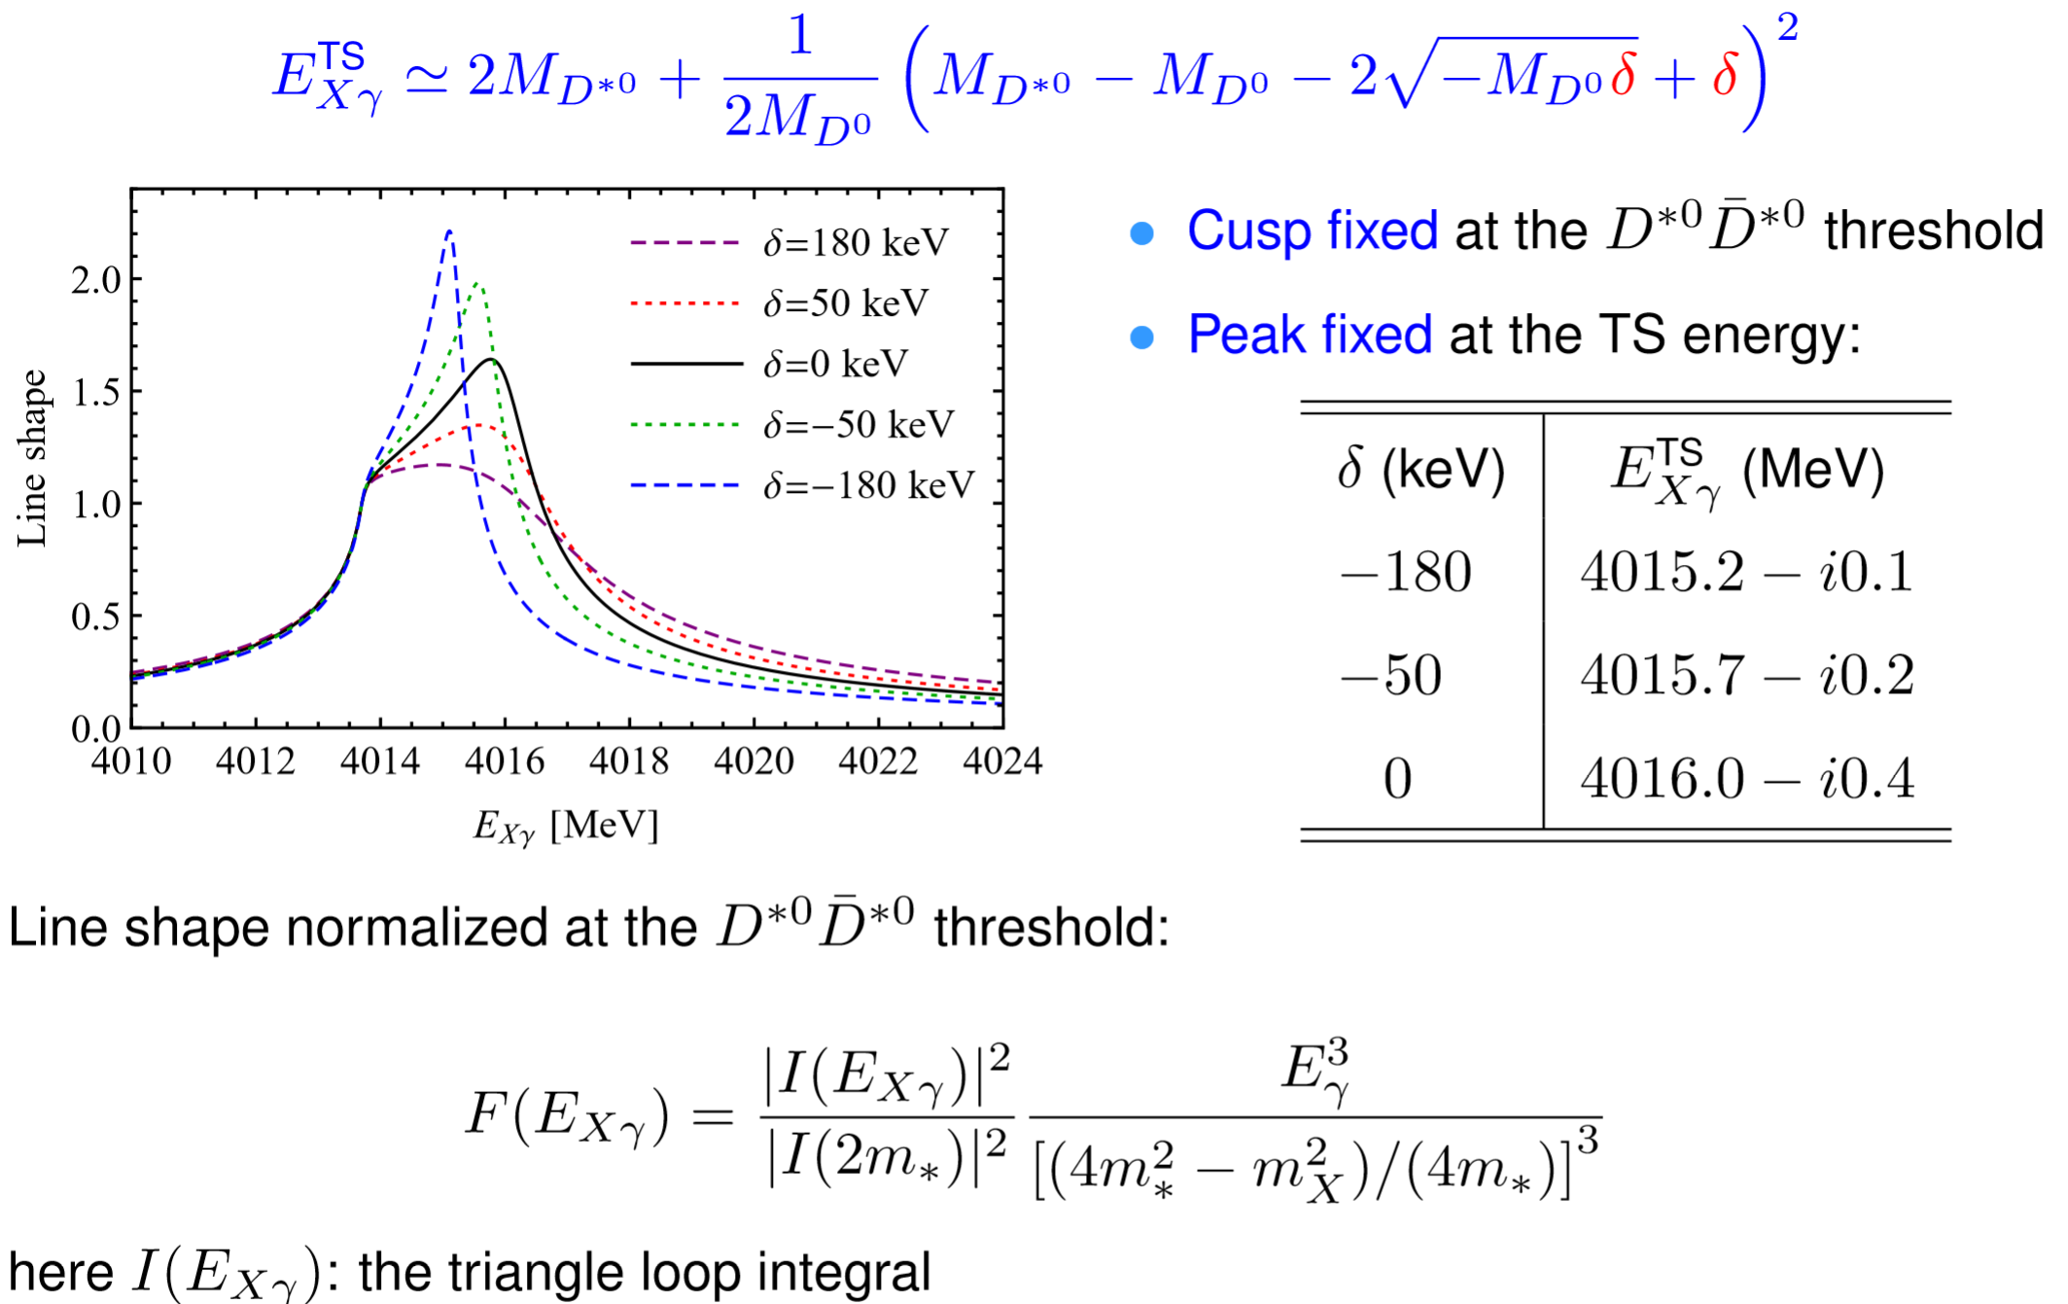
TS as a tool: precise measurement of X(3872)

Slide 12
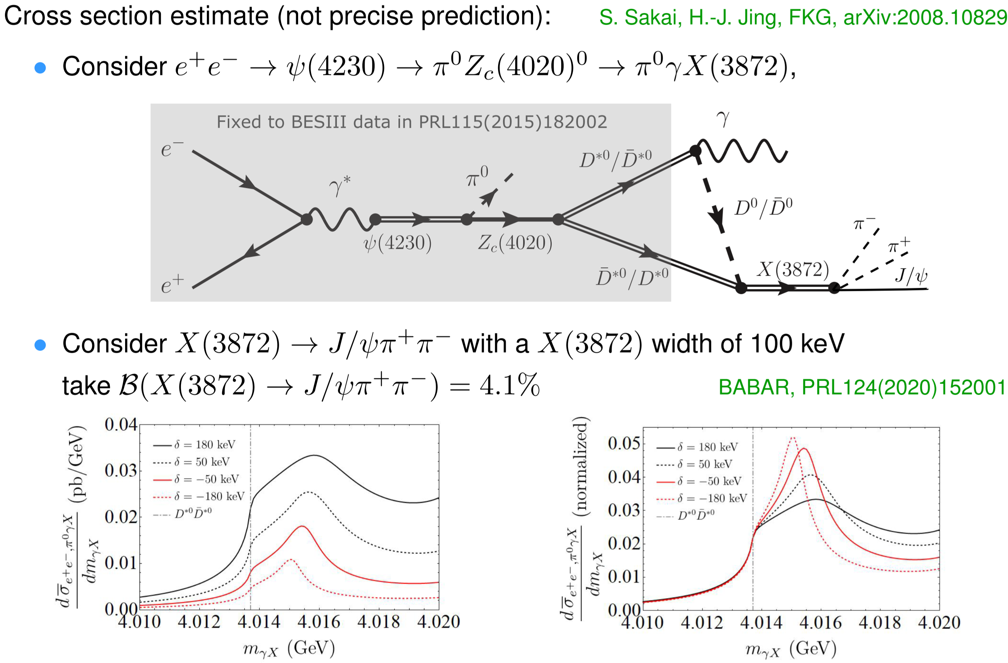
TS as a tool: precise measurement of X(3872)
The cross section can be higher at higher energies, e.g. above 4.4 GeV, but seems still difficult for STCF…

Slide 13
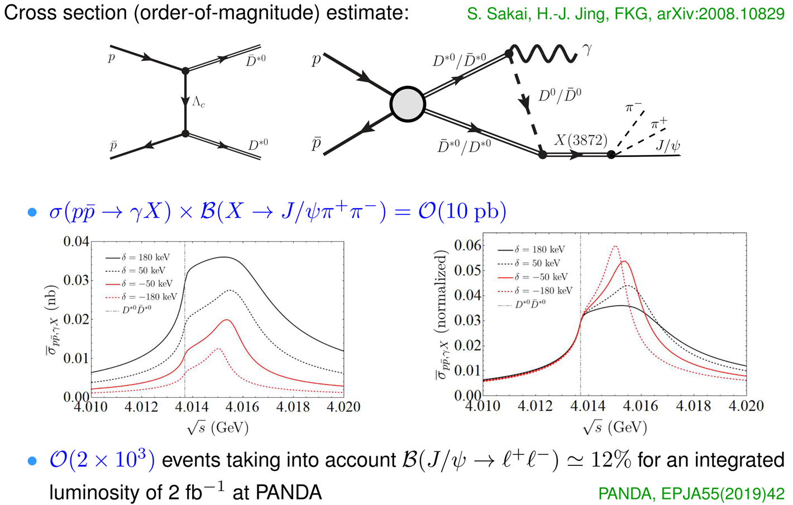
TS as a tool: precise measurement of X(3872)

Slide 14
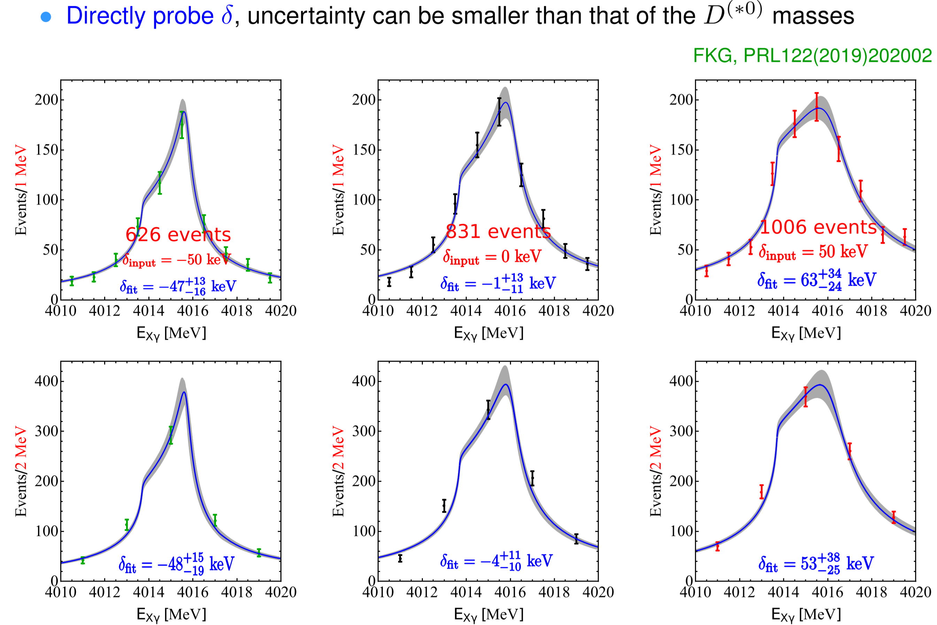
TS as a tool: precise measurement of X(3872)
Monte Carlo simulation of the sensitivity:

Slide 15
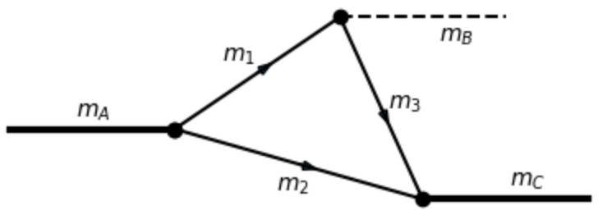
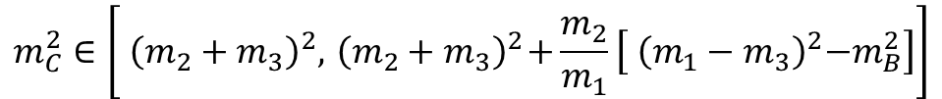
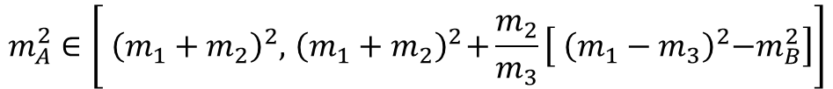
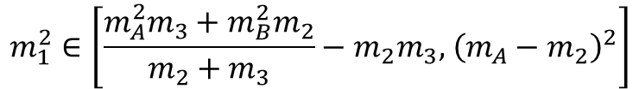
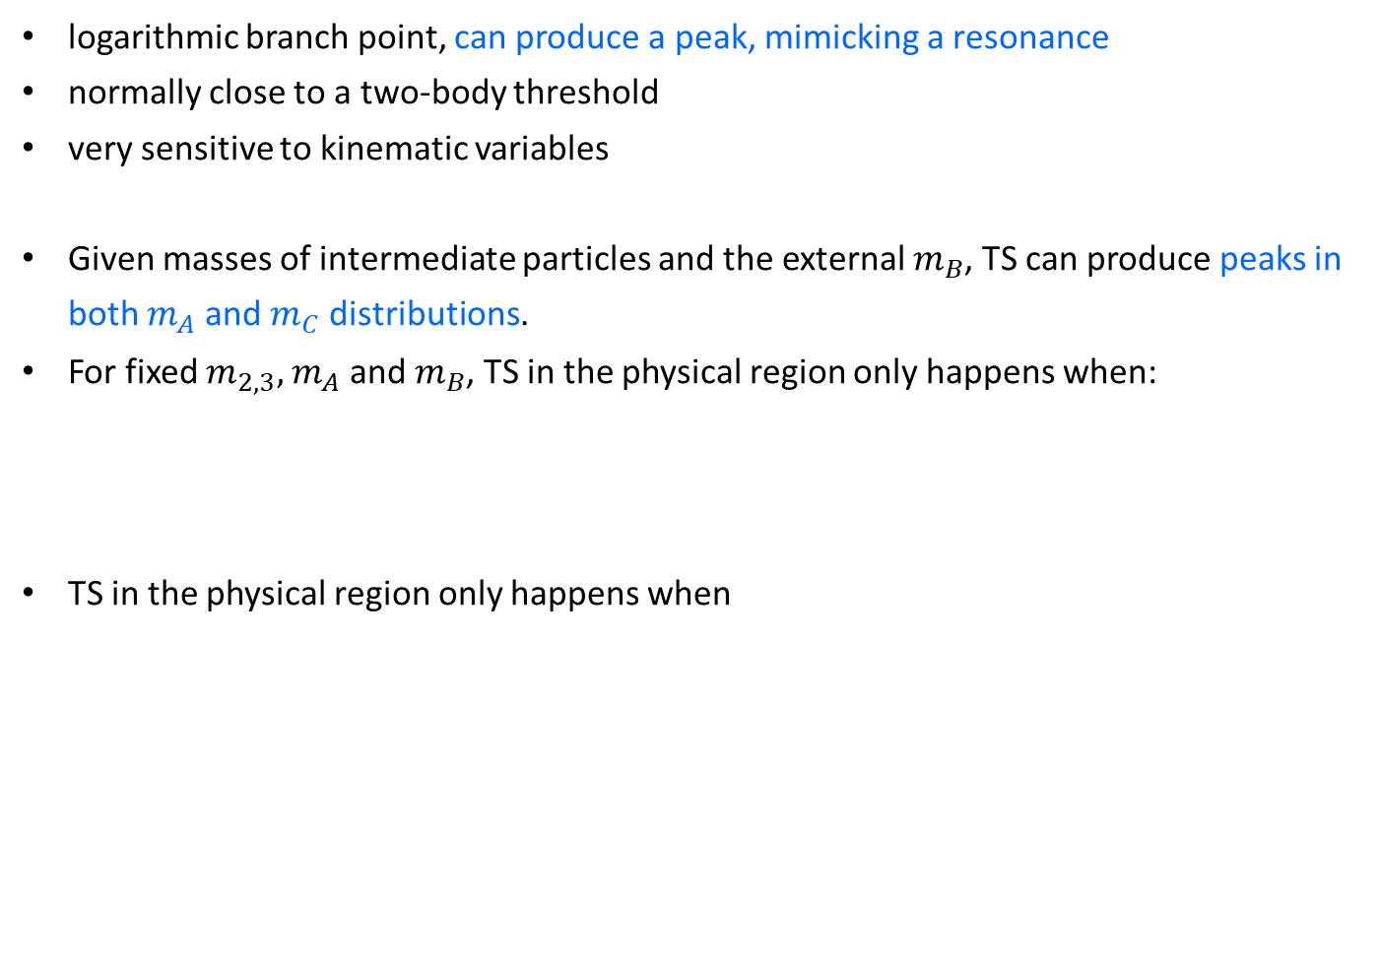
Features of TS
logarithmic branch point, can produce a peak, mimicking a resonance
normally close to a two-body threshold
very sensitive to kinematic variables
Given masses of intermediate particles and the external $m_{B}$, TS can produce peaks in both $m_{A}$ and $m_{C}$ distributions.
For fixed $m_{2,3},$ $m_{A}$ and $m_{B}$, TS in the physical region only happens when:
TS in the physical region only happens when
$$m_{1}^{2}∈\left[\frac{m_{A}^{2}m_{3}+m_{B}^{2}m_{2}}{m_{2}+m_{3}}−m_{2}m_{3},{ \left({m_{A}−m}_{2}\right)}^{2}\right]$$
$$m_{A}^{2}∈\left[{ \left({m_{1}+m}_{2}\right)}^{2},{ \left({m_{1}+m}_{2}\right)}^{2}+\frac{m_{2}}{m_{3}}\left[{ \left({m_{1}−m}_{3}\right)}^{2}−m_{B}^{2}\right]\right]$$
near threshold
$$m_{C}^{2}∈\left[{ \left({m_{2}+m}_{3}\right)}^{2},{ \left({m_{2}+m}_{3}\right)}^{2}+\frac{m_{2}}{m_{1}}\left[{ \left({m_{1}−m}_{3}\right)}^{2}−m_{B}^{2}\right]\right]$$

Slide 16
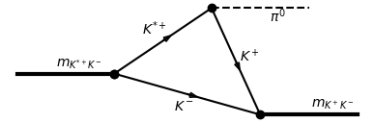
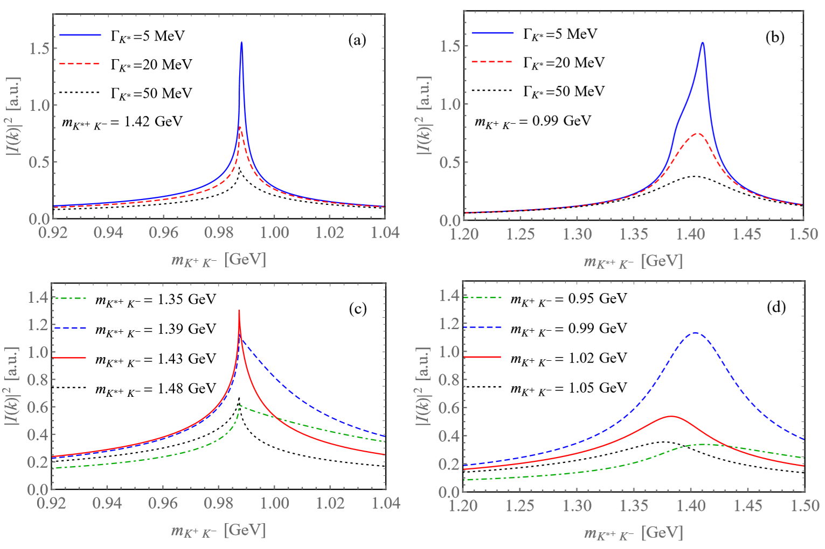

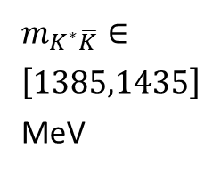
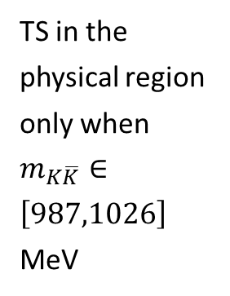
Features of TS
While a resonance would persist independent of energy.
TS in the physical region only when
$m_{K\overline{K}}∈\left[987,1026\right]$ MeV
$m_{K^{∗}\overline{K}}∈\left[1385,1435\right]$ MeV

Slide 17
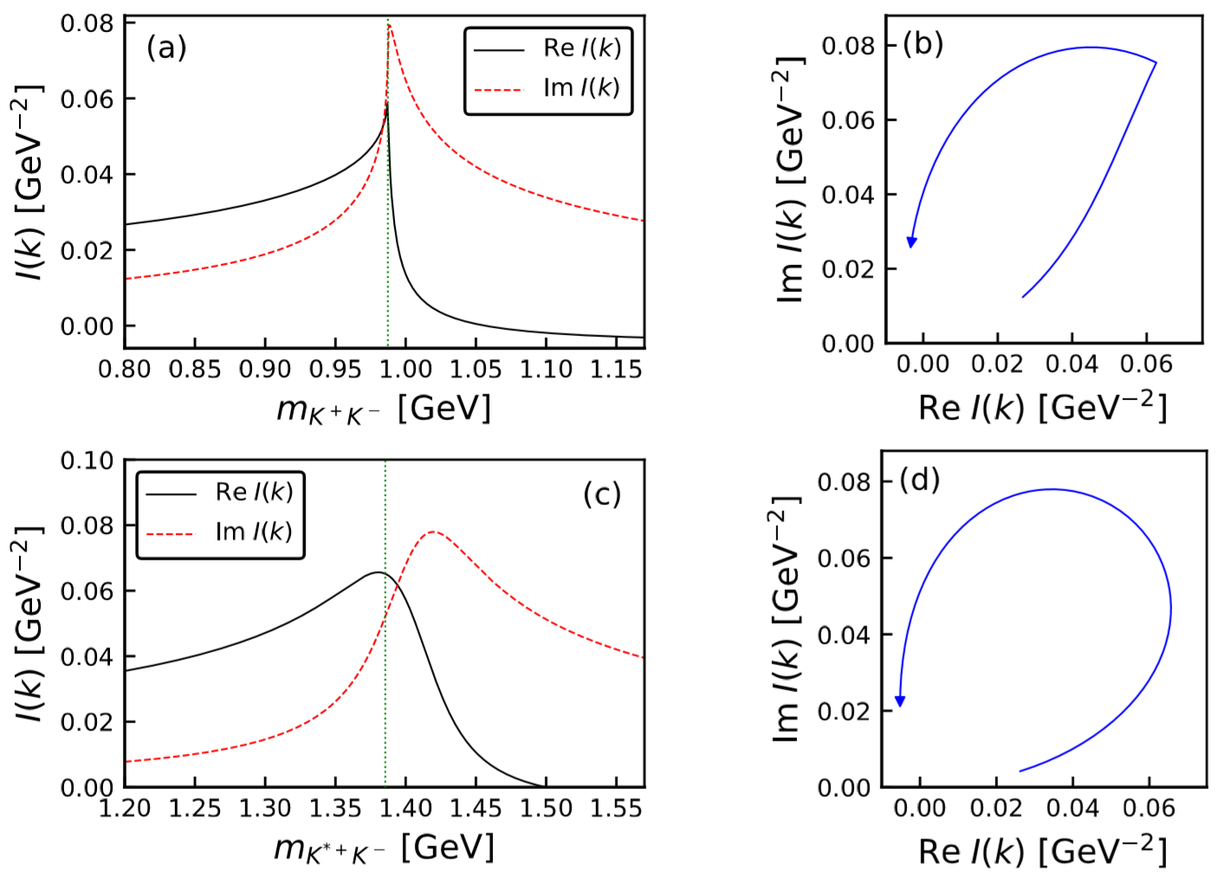






Features of TS
Phase motion of triangle diagram in the presence of a TS
$K\overline{K}$ threshold
$m_{K^{∗}\overline{K}}=1.42$ GeV
$m_{K\overline{K}}=0.99$ GeV
The argand plot is counterclockwise, resembling that of a resonance

Slide 18
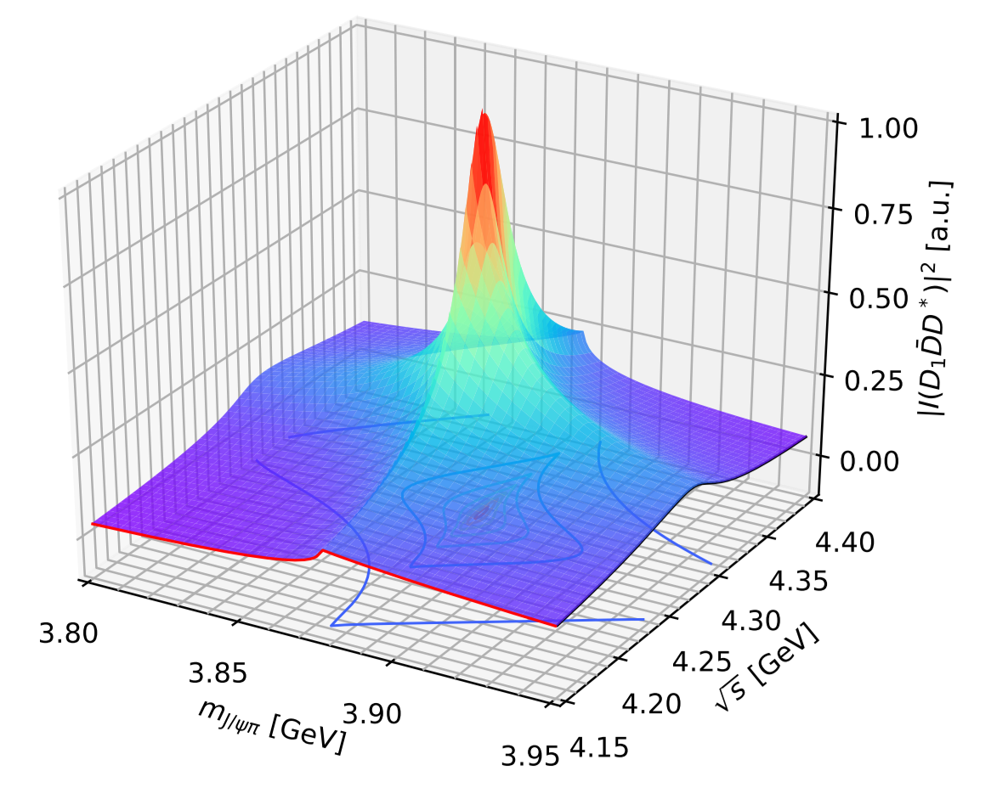
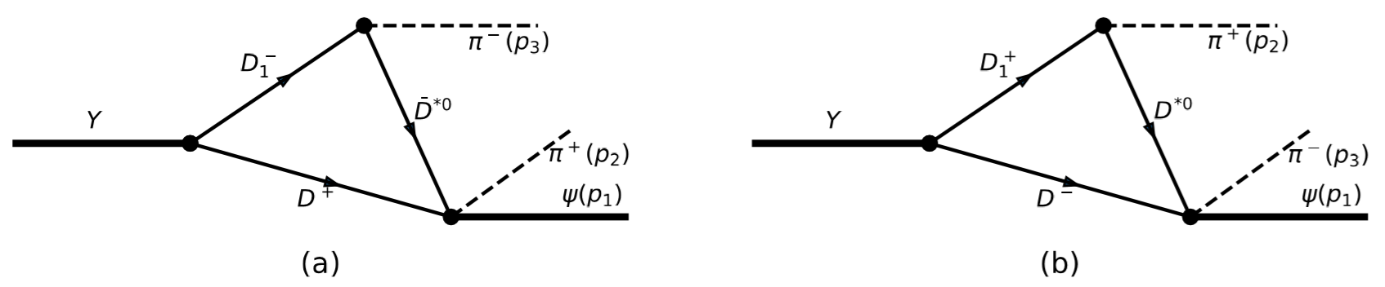
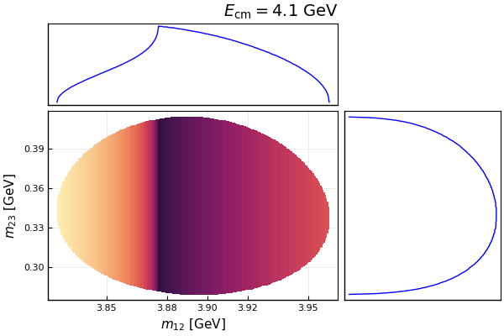
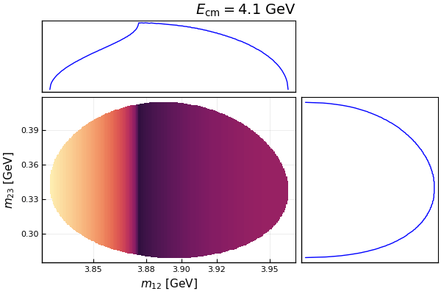
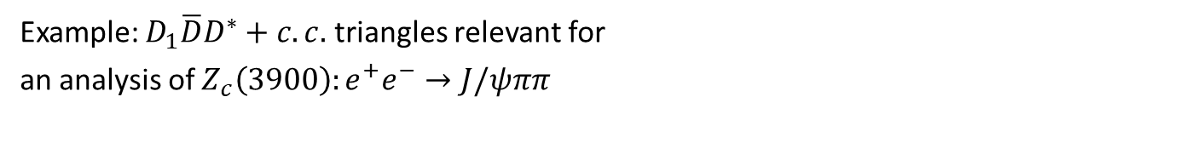



Example: $Z_{c}\left(3900\right)$
Example: $D_{1}\overline{D}D^{∗}+c.c.$ triangles relevant for
an analysis of $Z_{c}\left(3900\right):e^{+}e^{−}→J/ψππ$
Very sensitive to energy!
Scalar 3-point $D_{1}\overline{D}D^{∗}$ loop
Sum of $D_{1}\overline{D}D^{∗},D_{1}{\overline{D}}^{∗}D^{∗},D_{2}{\overline{D}}^{∗}D^{∗}$loops

Slide 19
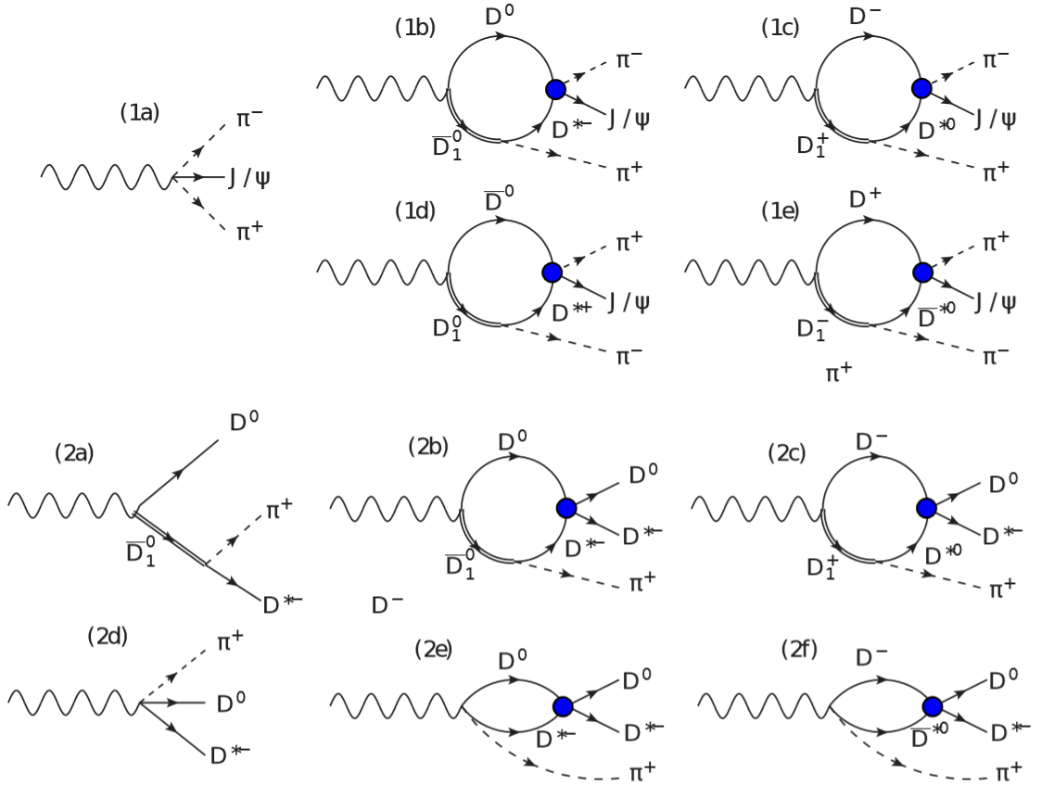
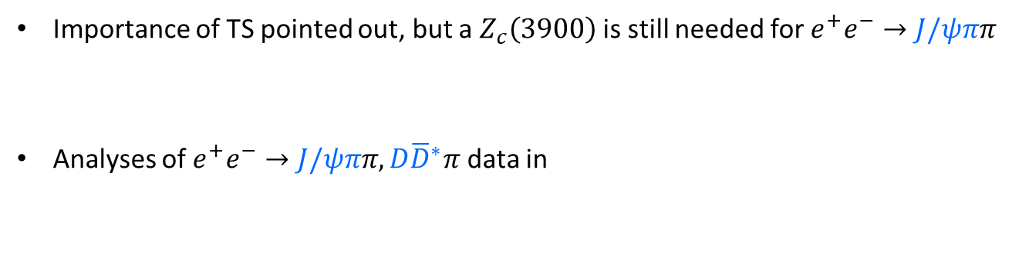
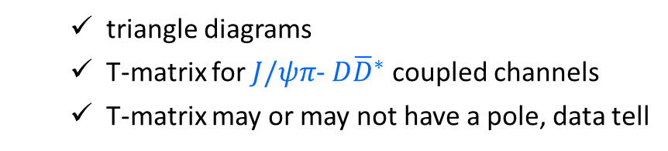

Example: $Z_{c}\left(3900\right)$
Example: $D_{1}\overline{D}D^{∗}+c.c.$ triangles relevant for an analysis of $Z_{c}\left(3900\right):e^{+}e^{−}→J/ψππ$
Importance of TS pointed out, but a $Z_{c}\left(3900\right)$ is still needed for $e^{+}e^{−}→J/ψππ$
Analyses of $e^{+}e^{−}→J/ψππ, D{\overline{D}}^{∗}π$ data in
Q.Wang, Hanhart, Q.Zhao, PRL111(2013)132002; PLB725(2013)106;
Q.-R. Gong, J.-L. Pang, Y.-F. Wang, H.-Q. Zheng, EPJC78(2018)276
Albaladejo, FKG, Hidalgo-Duque, Nieves, PLB755(2016)337
  triangle diagrams
  T-matrix for $J/ψπ$- $D{\overline{D}}^{∗}$ coupled channels
  T-matrix may or may not have a pole, data tell
used D-wave $D_{1}(2420)D^{∗}π$ coupling

Slide 20
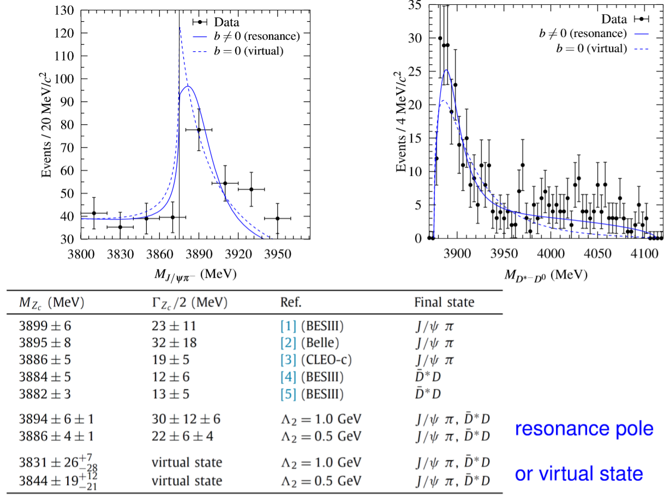


Example: $Z_{c}\left(3900\right)$
  The T-matrix from the best has a pole
Albaladejo, FKG, Hidalgo-Duque, Nieves, PLB755(2016)337
$χ^{2}/dof=$1.09
$χ^{2}/dof=$1.36
  The same parameters produce FV energy levels consistent with lattice results by Prelovsek et al.
Albaladejo, Fernandez-Soler, Nieves, EPJC76(2016)573

Slide 21
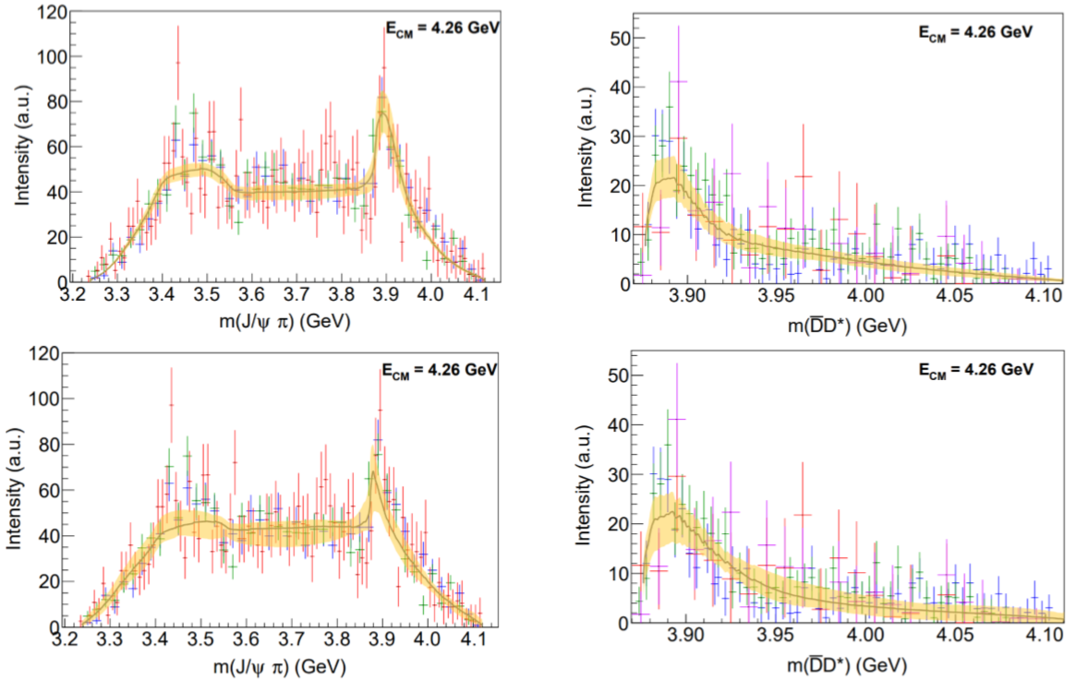
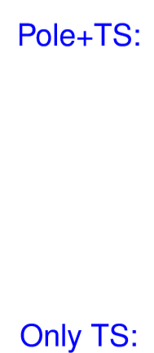

Example: $Z_{c}\left(3900\right)$
However, the JPAC analysis has a different conclusion
Pilloni et al. (JPAC), PLB772(2017)200
used S-wave $D_{1}(2420)D^{∗}π$ coupling

Slide 22
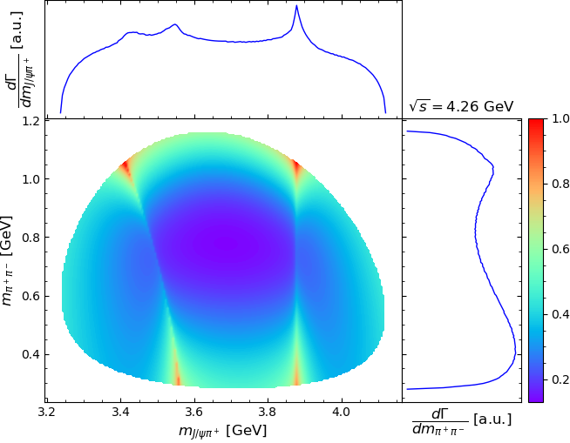
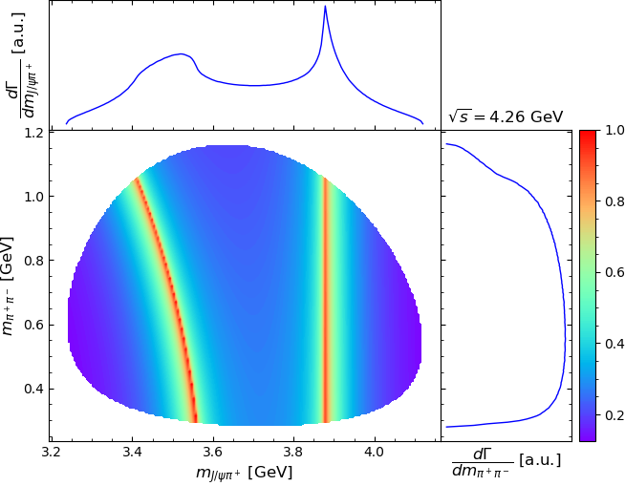
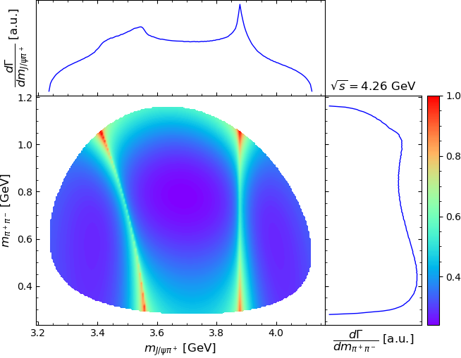
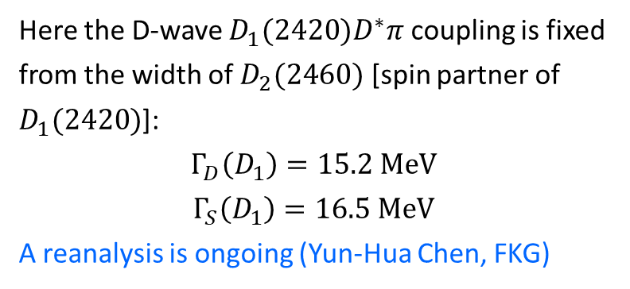
Example: $Z_{c}\left(3900\right)$
Partial waves for the $D_{1}(2420)D^{∗}π$ coupling make a difference
FKG, arXiv:2001.05884
Pure D-wave
Pure S-wave
Here the D-wave $D_{1}(2420)D^{∗}π$ coupling is fixed from the width of $D_{2}(2460)$ [spin partner of $D_{1}(2420)$]:
$$Γ_{D}\left(D_{1}\right)=15.2 MeV$$
$$Γ_{S}\left(D_{1}\right)=16.5 MeV$$
A reanalysis is ongoing (Yun-Hua Chen, FKG)
S+D-wave

Slide 23
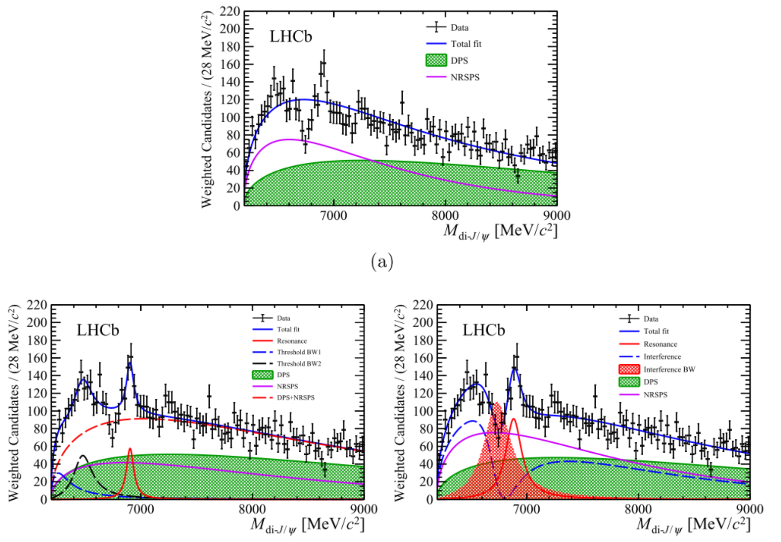
$$X\left(6900\right)$$
LHCb, Sci. Bull., in print [arxiv:2006.16957]

Slide 24
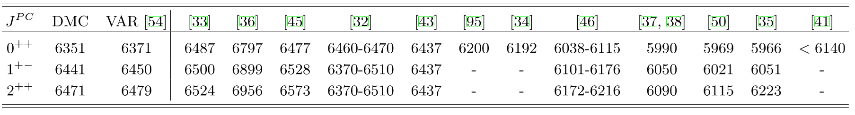
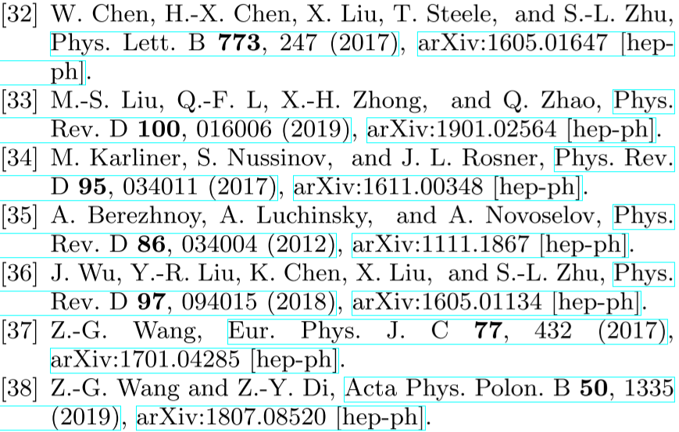
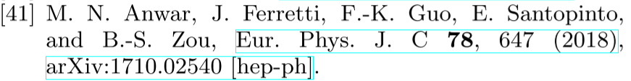

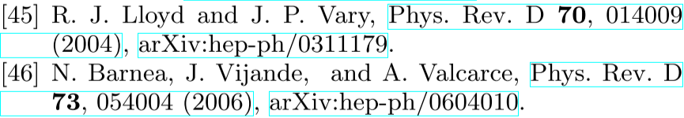

$$X\left(6900\right)$$
Existence of fully-charm tetraquarks predicted long ago
Already many studies on fully-charm tetraquarks and on the double-$J/ψ$ structure, I apologize for not reviewing them here
Masses of fully-charm tetraquarks predicted in various models
e.g., Y. Iwasaki, PTP54(1975)492; K.-T. Chao, ZPC7(1981)317
Taken from Gordillo, De Soto, Segovia, arxiv:2009.11889

Slide 25
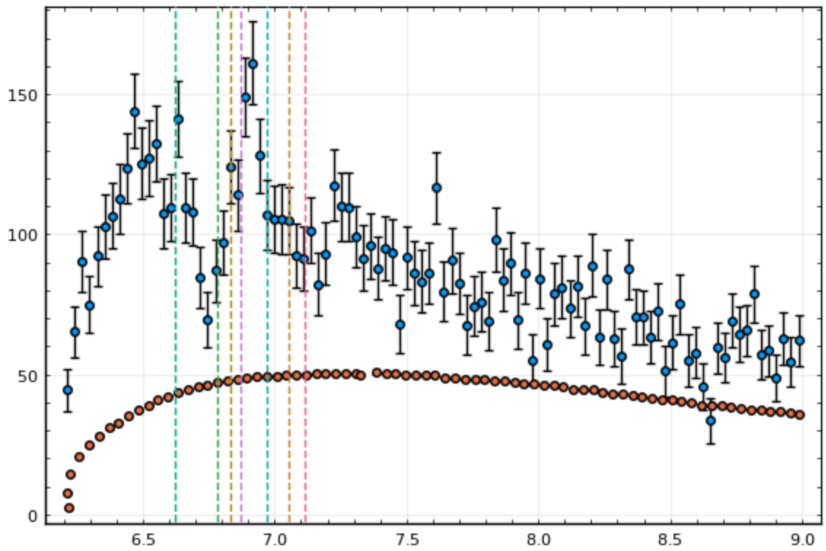
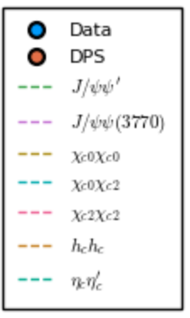


$$X\left(6900\right)$$
X.-K. Dong, Baru, FKG, Hanhart, Nefediev, 2009.07795 [hep-ph]
Many thresholds in the interesting region, but
Consider two cases:

Slide 26

$$X\left(6900\right)$$

Slide 27





$$X\left(6900\right)$$
Consider only S-wave, $J^{PC}=0^{++}$, $2^{++}$
Two-channel case:
Three-channel case:
with six parameters ${ a}_{ij} (1≤i≤j≤3)$
$$V_{ij}=4\sqrt{m_{i1}m_{i2}m_{j1}m_{j2}}{ a}_{ij}$$

Slide 28



$$X\left(6900\right)$$
Fitting procedure:
Generating 20000 different sets of initial values for the parameters
Causality constraint: the only poles allowed on the 1st Riemann sheet of complex energy plane are on the real axis below the lowest threshold
Remove the fits with unphysical narrow spikes
Two-channel fit ($χ^{2}/dof=0.99$):

Slide 29


$$X\left(6900\right)$$
Three-channel fits (Fit 1: $χ^{2}/dof=0.97$; Fit 2: $χ^{2}/dof=1.05$):
Importance of the $J/ψψ(2S)$ and $J/ψψ(3770)$ thresholds, but not just threshold cusps

Slide 30





$$X\left(6900\right)$$
Poles in various Riemann sheets (RSs):
Always a pole near 6.2 GeV, could be on RS1 or RS2
At least one pole at higher energy, but unstable
Strong threshold cusps enhanced by the pole around 6.9 GeV
3-channel fit 1
3-channel fit 2
$$\left|g_{eff}\right| [GeV]$$
$$\left|g_{eff}\right| [GeV]$$

Slide 31



$$X\left(6900\right)$$
Predictions

Slide 32


$$X\left(6900\right)$$
As for the pole around 6.2 GeV:

Slide 33



$$X\left(6900\right)$$
The code (in julia) is available online: https://github.com/fkguo/double_jpsi_fit and can be played online interactively by clicking on that page
  IMinuit.jl

Slide 34

Thank you for your attention!
Conclusion
Complications from thresholds and TSs need to be taken into account in Dalitz-plot analysis of multi-body final states: going beyond the isobar model by including the most relevant thresholds and the singular triangles
TS effects are sensitive to energies:
  TS-induced peak for the initial-state (final-state) energy distribution may be checked by varying the invariant mass of final (initial) states
Kinematical singularities (threshold cusp, TS) and resonances are NOT exclusive
Looking forward to new discoveries!

Slide 35

Derivation of the TS equation

Slide 36

Derivation of the TS equation

Slide 37

Derivation of the TS equation

Slide 38

Derivation of the TS equation

Slide 39

Derivation of the TS equation

Slide 40




$$X\left(6900\right)$$
It’s reasonable that they$≲𝒪(Λ_{QCD}^{−2,−4})$
Parameter values:

Slide 41










Complications in resonance searching due to TS
Difficulties for multi-hadron final states
Many resonances from the cross channel: branching fractions often unknown, interference between overlapping resonances, …
Complicated 3-body FSI:
$$K$$
$$B$$
$$ψ$$
$$K$$
$$B$$
$$B$$
$$K$$
$$ψ$$
$$ψ$$
intermediate states can be different from external ones; threshold cusps; triangle singularities
Kinematical singularities (threshold cusp, TS) and resonances are NOT exclusive

Slide 42





Schmid theorem
Schmid, PR154(1967)1363; Debastiani, Sakai, Oset, EPJC79(2019)69; FKG, Liu, Sakai, arXiv:1912.07030
Channels with both tree-level and triangle diagrams: interference may give rich structure
tiny $Γ_{1}$
finite $Γ_{1}$

