Slide 1
pfd: a Singular Library to Simplify IBP Reduction Coefficients (and any rational functions in theoretical physics)
Zihao Wu (吴子昊)
University of Science and Technology of China
2008.13194 J. Boehm, M. Wittmann, Z. Wu, Y. Xu and Y. Zhang (accepted by JHEP)

Slide 2
Introduction
Feynman integral
Master integrals
IBP Reduction
IBP Reduction coefficients
Huge sized
(can be >1GB)

Slide 3
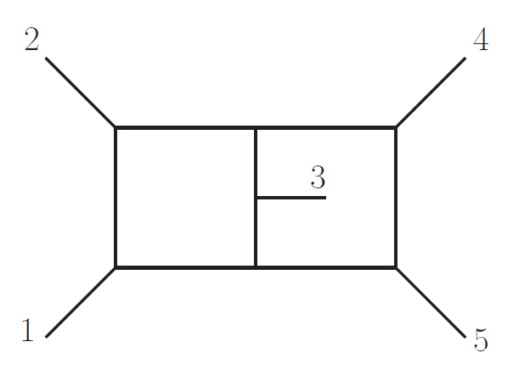
Introduction
Master integrals analytically evaluated, PhysRevLett.123.041603
Chicherin, Gehrmann, Henn, Wasser, Zhang, Zoia
Deg-4 numerator integrals reduced to Master integrals (IBP) JHEP 02 (2020) 079
Bendle, Böhm, Decker, Georgoudis, Pfreundt, Rahn, Zhang
Linear coefficients are analytic and huge
2.4 G ⟹ 700 M
Laporta Basis
UT Basis

Slide 4
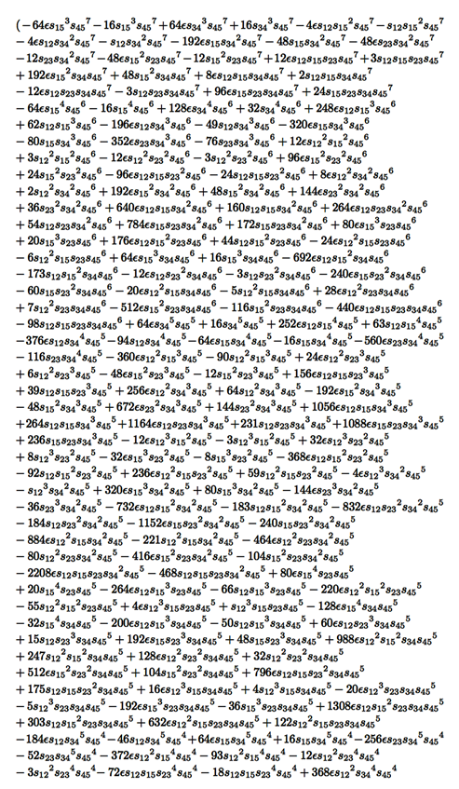
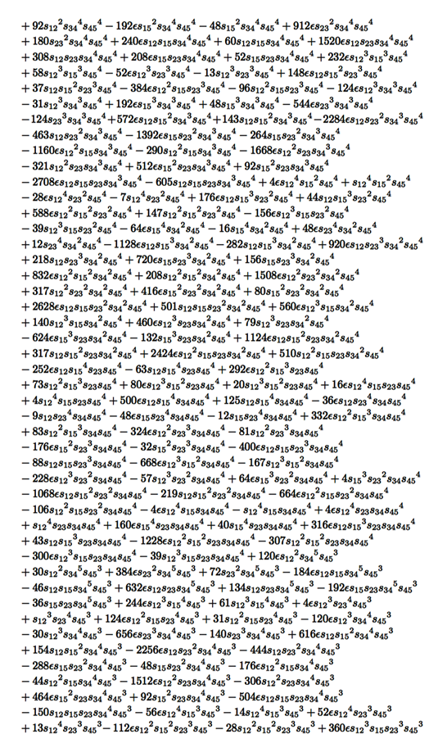
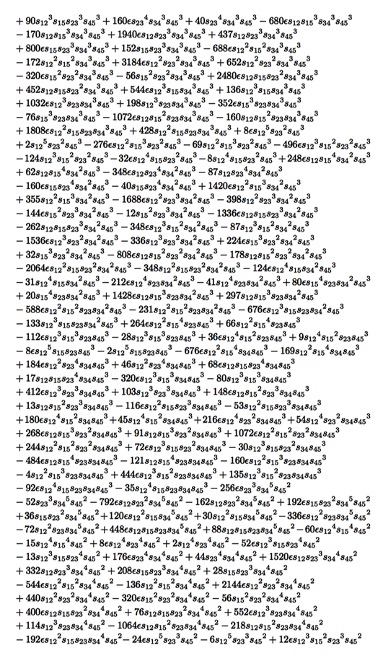
Introduction
One example of the coefficients (5-page long)

Slide 5
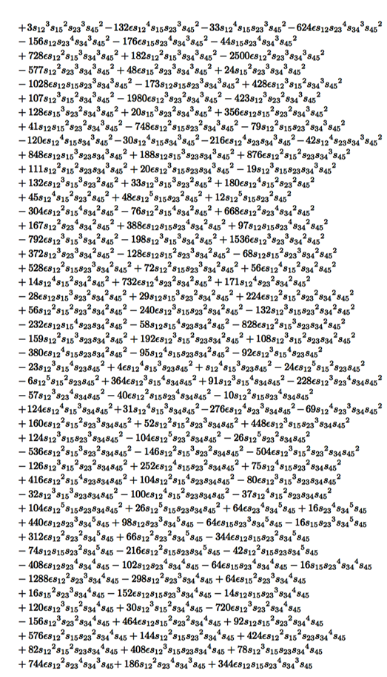
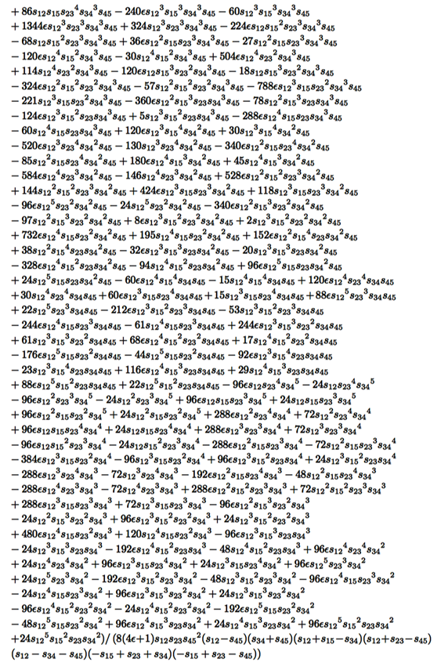
Introduction
One example of the coefficients (5-page long)
Simplify by partial fraction decomposition?
Denominator

Slide 6
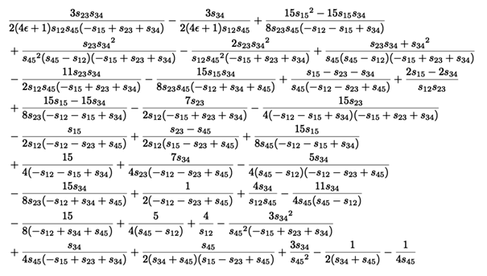
Introduction
After partial fraction decomposition:
=
pfd.lib (based on Improved Leinartas’ Algorithm)

Slide 7
Introduction
2.4 G ⟹ 700 M ⟹ 19.8M
Laporta Basis
UT Basis
After partial fraction decomposition
Size shortened by >100 times!

Slide 8
Outlook
Introduction
IBP Reduction, UT Basis and Symbol Letters
Improved Leinartas’ Algorithm for Multivariate Partial Fraction
Examples
Summary

Slide 9
Outlook
Introduction
IBP Reduction, UT Basis and Symbol Letters
Improved Leinartas’ Algorithm for Multivariate Partial Fraction
Examples
Summary

Slide 10
IBP Reduction and UT integrals
Integral family
Integration by parts (IBP) relations
[Tkachov and Chetyrkin 1981]
Master integrals
Master integral
IBP reduction coefficient
[Smirnov 1004.4199]

Slide 11
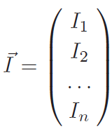
IBP Reduction and UT integrals
Differential equations
Uniform transcendental (UT) basis
[J. Henn 1304.1806]
Symbol letters
Pole factors of IBP coefficients
 | Symbol letters | Function in ε | Function of kinetic variables (not symbol letter) | Function in both ε and kinetic variables
UT basis | appear | appear
Laporta basis | appear | appear | appear | appear

Slide 12
Outlook
Introduction
IBP Reduction, UT basis and Symbol Letters
Improved Leinartas’ Algorithm for Multivariate Partial Fraction
Examples
Summary

Slide 13
Improved Leinartas’ Algorithm for Multivariate Partial Fraction
Partial fraction decomposition: a one-variable example
1.Decrease the power of numerator
2.Decrease the number of denominator factors

Slide 14
Improved Leinartas’ Algorithm for Multivariate Partial Fraction
A multivariate example:
Input:

Slide 15
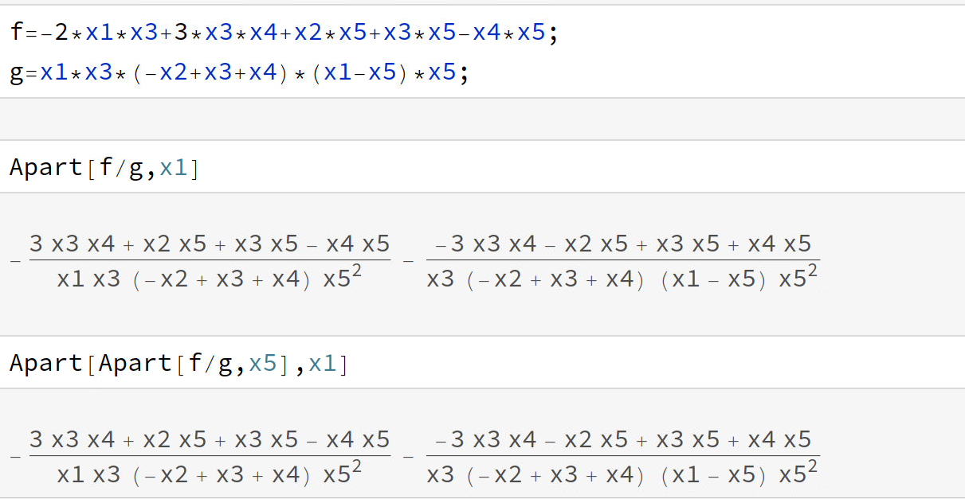
Improved Leinartas’ Algorithm for Multivariate Partial Fraction
A multivariate example:
Use pfd:

Slide 16
Improved Leinartas’ Algorithm for Multivariate Partial Fraction
Polynomial ring
Ideal
generators
example
Polynomial division

Slide 17
Improved Leinartas’ Algorithm for Multivariate Partial Fraction
An example of single variable polynomial division
Multivariable: monomial ordering

Slide 18
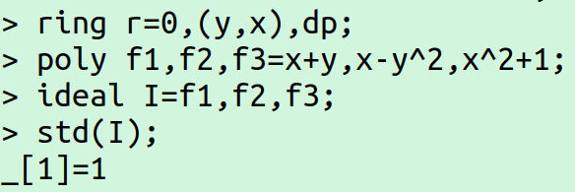
Improved Leinartas’ Algorithm for Multivariate Partial Fraction
Groebner basis
Example:

Slide 19
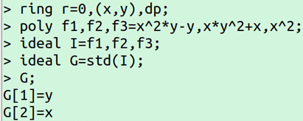
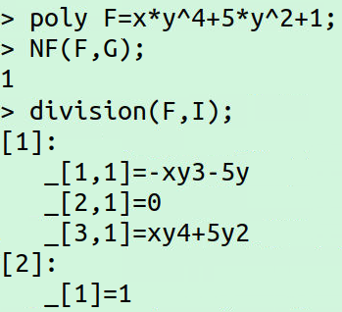
Improved Leinartas’ Algorithm for Multivariate Partial Fraction
Polynomial division via Groebner basis

Slide 20
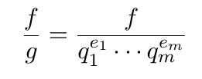
Improved Leinartas’ Algorithm for Multivariate Partial Fraction
Improved Leinartas’ algorithm
1. Factorizing the denominator
2. Decomposition via Hilbert’s Nullstellensatz
Hilbert’s Nullstellensatz
Example:

Slide 21
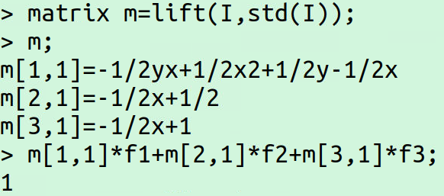
Improved Leinartas’ Algorithm for Multivariate Partial Fraction
How to find hi
Use lift command in Singular

Slide 22
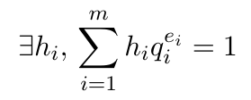
Improved Leinartas’ Algorithm for Multivariate Partial Fraction
Decomposition via Hilbert’s Nullstellensatz
This decreases the number
of denominator factors
Repeat until no term can be decomposed via this step, collect terms with same denominator

Slide 23
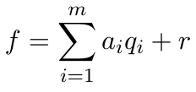
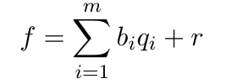
Improved Leinartas’ Algorithm for Multivariate Partial Fraction
3. Short numerator decomposition (new)
3.1. Polynomial division with remainder
3.2. Syzygy reduction on ai (new)

Slide 24
Improved Leinartas’ Algorithm for Multivariate Partial Fraction
How to do syzygy reduction

Slide 25
Improved Leinartas’ Algorithm for Multivariate Partial Fraction
This decreases the power of denominator and numerator
This step is short numerator decomposition, aimed at decrease power of denominator
If r=0, do the decomposition, else leave the input unchanged
Repeat until no term can be decomposed via this step , collect terms with same denominator

Slide 26
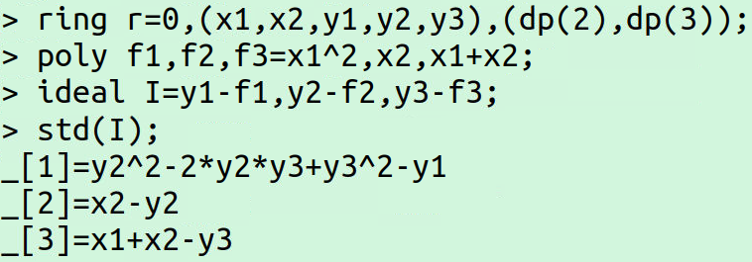
Improved Leinartas’ Algorithm for Multivariate Partial Fraction
4. Algebraic dependence decomposition
Example:
Annihilating polynomial
How to find annihilating polynomial:

Slide 27
Improved Leinartas’ Algorithm for Multivariate Partial Fraction
Decomposition via algebraic dependence
This decreases the number of denominator factors
Repeat until no term can be decomposed via this step , collect terms with same denominator

Slide 28
Improved Leinartas’ Algorithm for Multivariate Partial Fraction
5. Numerator decomposition (new)
Polynomial division with remainder & syzygy reduction
This decreases the power of denominator and numerator
Repeat until no term can be decomposed via this step , collect terms with same denominator

Slide 29
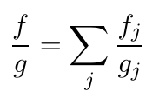
Improved Leinartas’ Algorithm for Multivariate Partial Fraction
Output:

Slide 30
Improved Leinartas’ Algorithm for Multivariate Partial Fraction

Slide 31
Improved Leinartas’ Algorithm for Multivariate Partial Fraction
A simple example for Improved Leinartas’ Algorithm
Input:
1. Factorizing denominator
2. Nullstellensatz decomposition

Slide 32
Improved Leinartas’ Algorithm for Multivariate Partial Fraction
3. Short numerator decomposition
remainder

Slide 33
Improved Leinartas’ Algorithm for Multivariate Partial Fraction
4. Algebraic dependence decomposition

Slide 34
Improved Leinartas’ Algorithm for Multivariate Partial Fraction
5. Numerator decomposition
Output:
(indexed form)

Slide 35
Improved Leinartas’ Algorithm for Multivariate Partial Fraction
=

Slide 36
Outlook
Introduction
IBP Reduction , UT Basis and Symbol Letters
Improved Leinartas’ Algorithm for Multivariate Partial Fraction
Examples
Summary

Slide 37
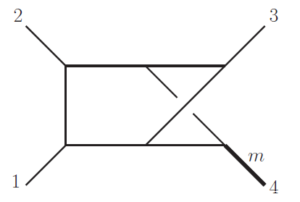
Examples
Nonplanar two-loop four-point with an external massive leg
[Gehrmann and remiddi]
Target:
Compression rate
Target
Laporta basis
9.51MB
2.75MB
(indexed)
IBP
Partial fraction
29%
Target
UT basis
9.04MB
1.53MB
(indexed)
IBP
Partial fraction
17%

Slide 38
Examples
Poles of IBP coefficients (Laporta basis)
Poles of IBP coefficients (UT basis)

Slide 39
Examples
Nonplanar two-loop five-point
Target:
Compression rate
Target
Laporta basis
2.42GB
851MB
(indexed)
IBP
Partial fraction
35%
Target
UT basis
712MB
19.8MB
(indexed)
IBP
Partial fraction
2.8%

Slide 40
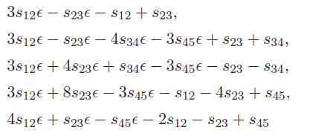
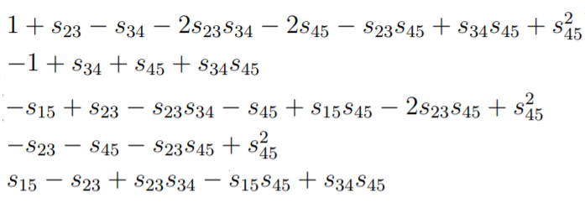
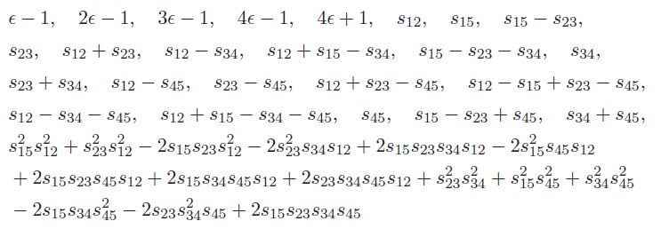
Examples
Poles of IBP coefficients (Laporta basis, mixed)
Better choice of Laporta basis?
[J.Usovitsch 2002.08173]
Not symbol letter
Poles of IBP coefficients (UT basis)

Slide 41
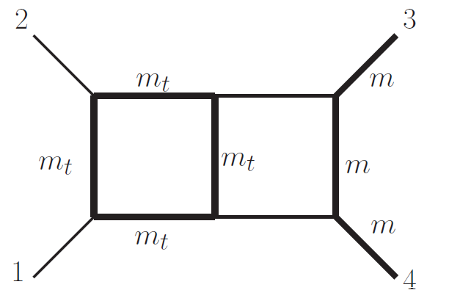
Examples
Two-loop four-point with a top quark loop and a pair of external massive legs
(Elliptic, no UT)
Target:
Compression rate:
Target
Laporta basis
175MB
23.3MB
(indexed)
IBP
Partial fraction
13%

Slide 42
Outlook
Introduction
IBP Reduction , UT basis and Symbol Letters
Improved Leinartas’ Algorithm for Multivariate Partial Fraction
Examples
Summary

Slide 43
Summary
IBP reduction coefficients are usually huge
Use pfd on IBP reduction coefficients, dramatically decreasing the size of coefficients
The poles of IBP reduction coefficients to UT basis has only physical either symbol letters or functions of ε.
The compression is more effective for IBP reduction coefficients to UT basis than Laporta basis

Slide 44
Summary
Further use of improved Leinartas’ algorithm
Simplify IBP coefficients for more diagrams.
Simplify rational functions encountered in other problems.
Operation (adding/multiplying) in partial fraction form, speed up calculations.
Singular package
https://raw.githubusercontent.com/Singular/Singular/spielwiese/Singular/LIB/pfd.lib

Slide 45
Thank you for your attention!

