Slide 1

Threshold structures and triangle singularities
Feng-Kun Guo
Institute of Theoretical Physics, CAS
第二届LHCb前沿物理研讨会, 2020.12.12-13
General model-independent analysis on threshold structures:
X.-K. Dong, FKG, B.-S. Zou, arXiv:2011.14517
Review article focusing more on TSs:
FKG, X.-H. Liu, S. Sakai, Prog. Part. Nucl. Phys. 112 (2020) 103757 [arXiv:1912.07030]

Slide 2

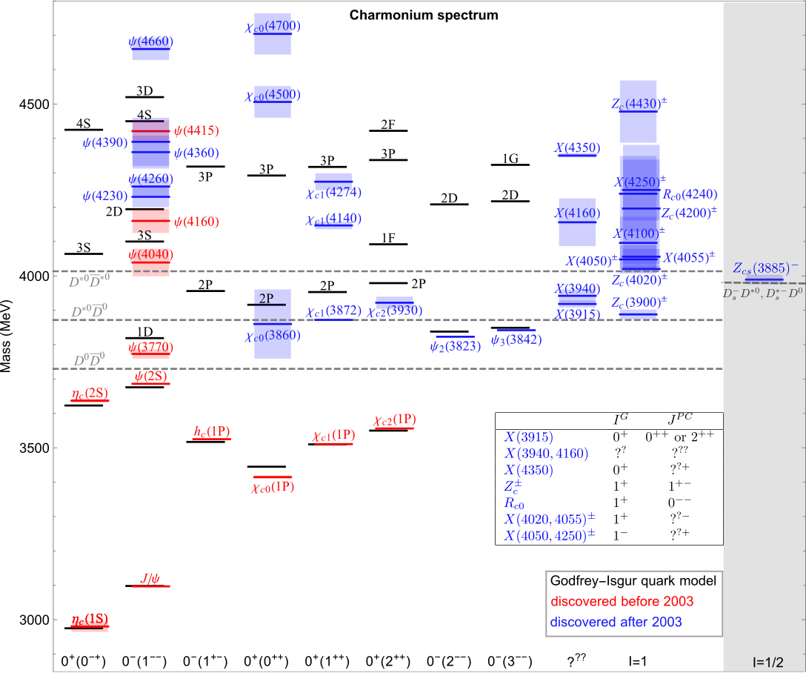
Charmonium-like structures

Slide 3
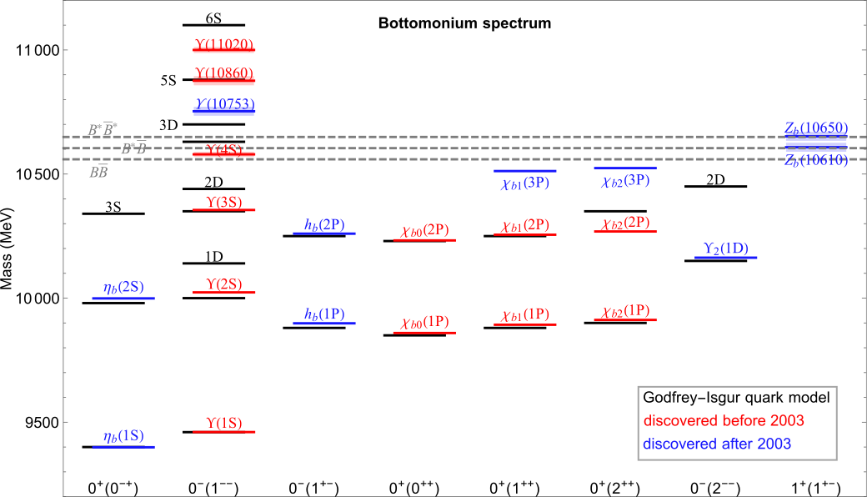
Bottomonium(-like) structures

Slide 4
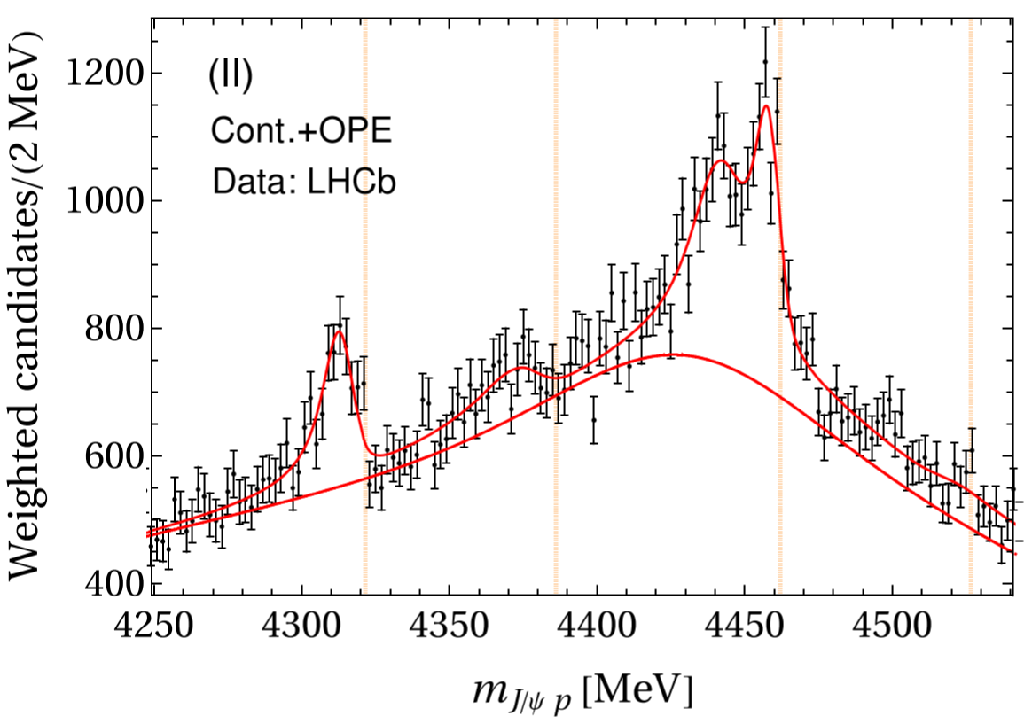
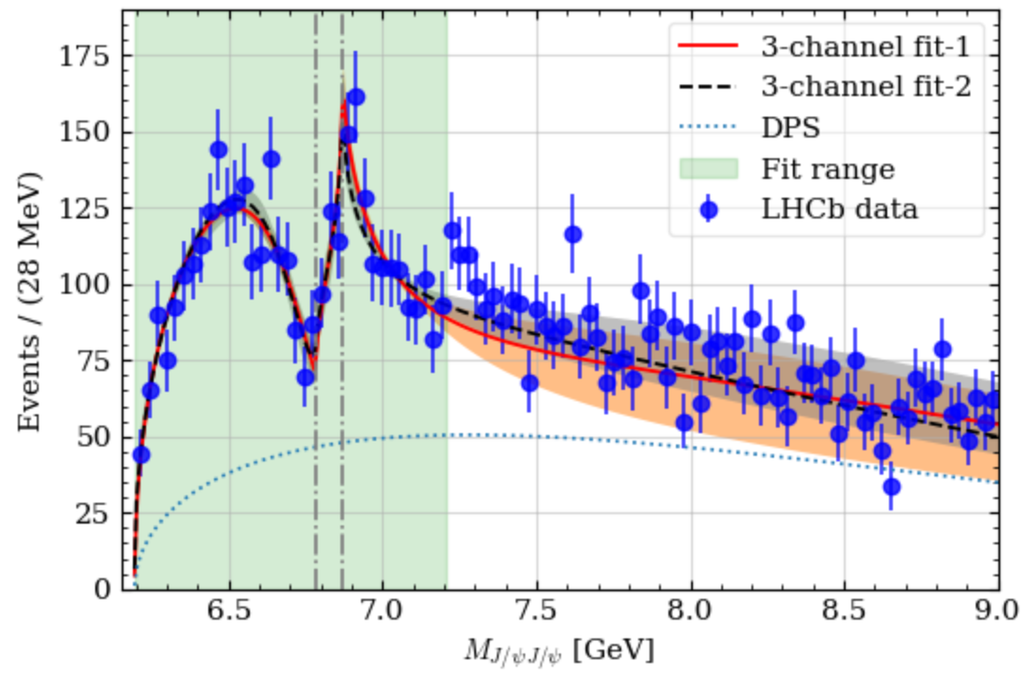





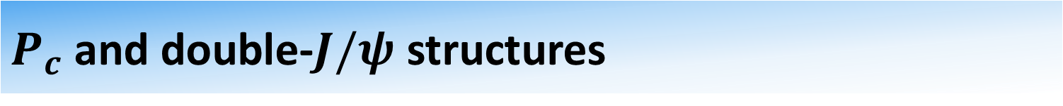

$P_{c}$ and double-$J/ψ$ structures
$$Σ_{c}^{∗}{\overline{D}}^{∗}$$
$$Σ_{c}\overline{D}$$
$$Σ_{c}^{∗}\overline{D}$$
$$Σ_{c}{\overline{D}}^{∗}$$
$$J/ψψ′$$
$$J/ψψ′′$$
data from LHCb, PRL122,222001(2019)
fit from M.-L. Du et al., PRL124,072001(2020),
See the talk by Menglin
data from LHCb, Sci.Bull.65,1983(2020)
fit from X.-K. Dong et al., arXiv:2009.07795
Many new structures are near thresholds of a pair of hadron hadrons.
Why? What is the pattern?

Slide 5
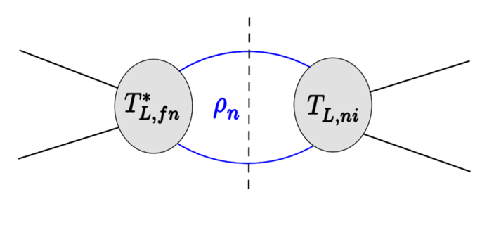
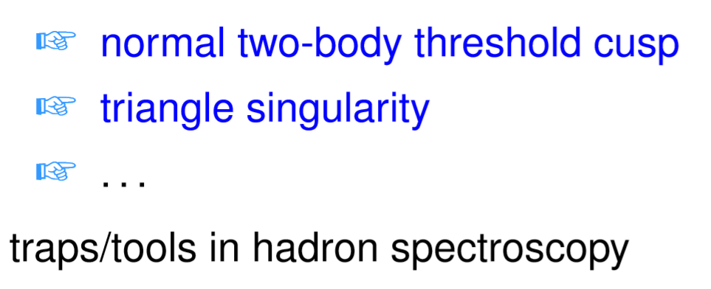
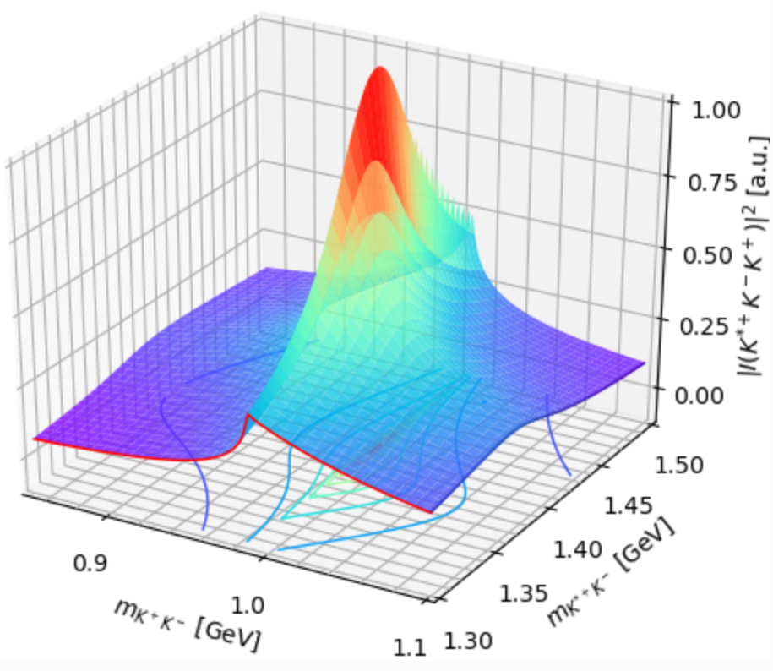
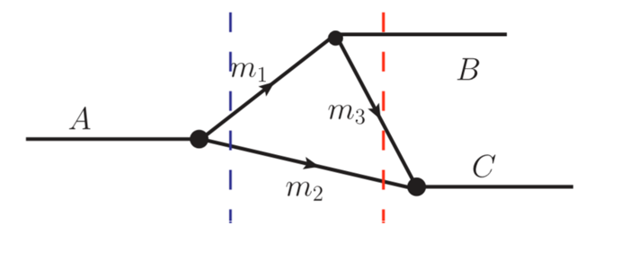
S-matrix singularities
Dynamics: poles, corresponding to hadron resonances, genuine physical states such as the ordinary and exotic mesons, baryons; location fixed by the dynamics
Kinematics: (normally) branch points of the S-matrix, due to on-shell intermediate particles, results of unitarity; location fixed by the involved kinematic variables: masses, energies

Slide 6
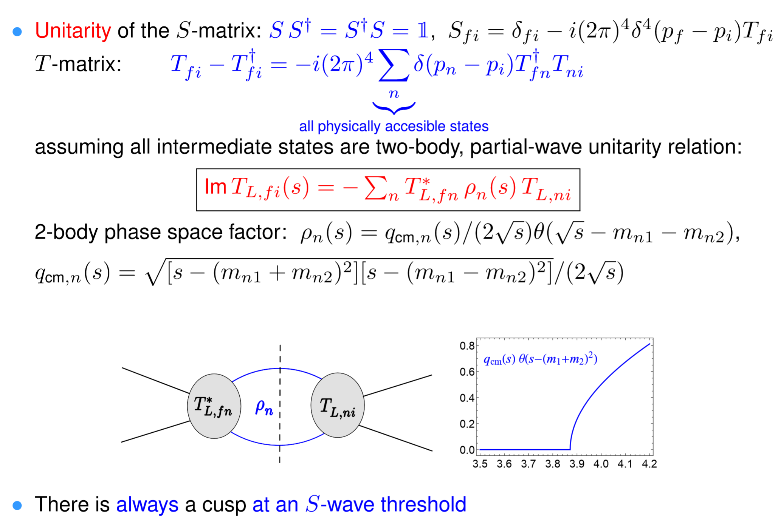
Threshold cusp

Slide 7
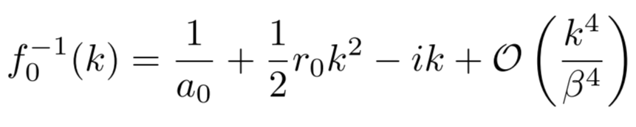
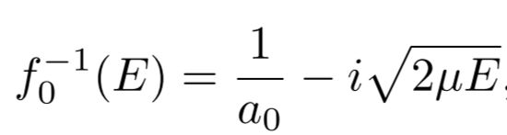
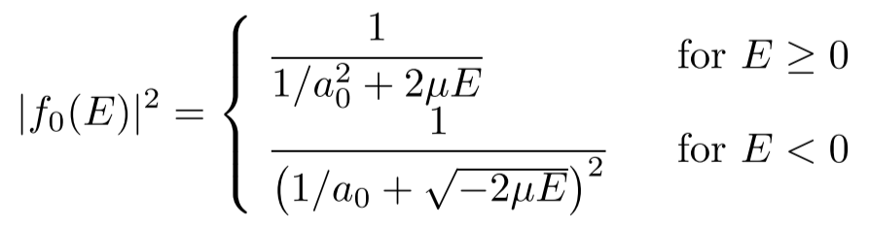
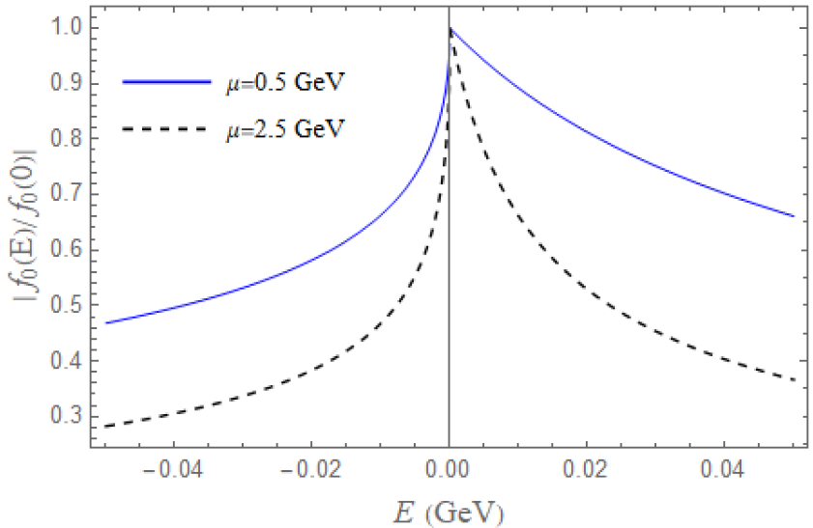

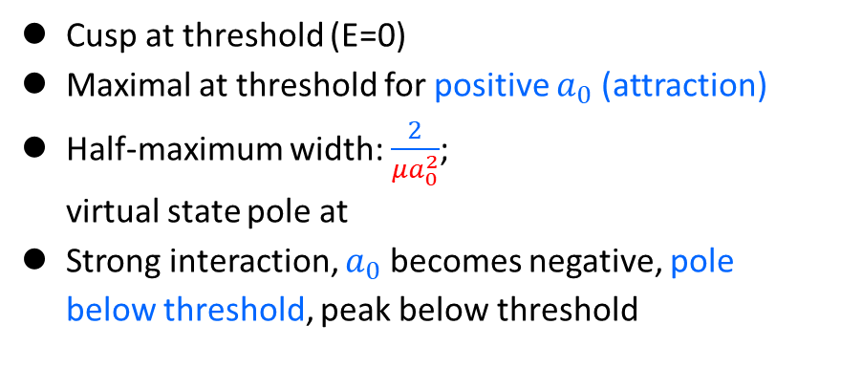

Effective range expansion
$a_{0}$: S-wave scattering length; negative for repulsion or attraction w/ a bound state
positive for attraction w/o bound state
Very close to threshold, then scattering length approximation:
Cusp at threshold (E=0)
Maximal at threshold for positive $a_{0}$ (attraction)
Half-maximum width: $\frac{2}{μa_{0}^{2}}$; virtual state pole at
Strong interaction, $a_{0}$ becomes negative, pole below threshold, peak below threshold
$a_{0}=1 fm$

Slide 8
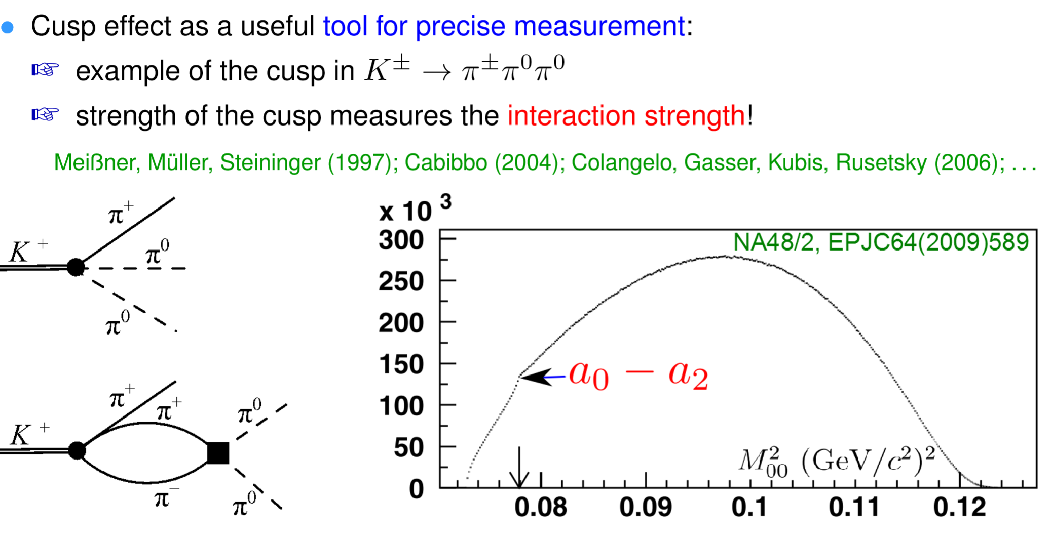
Threshold cusp as a tool
Mass fixed, sensitive to scattering length

Slide 9
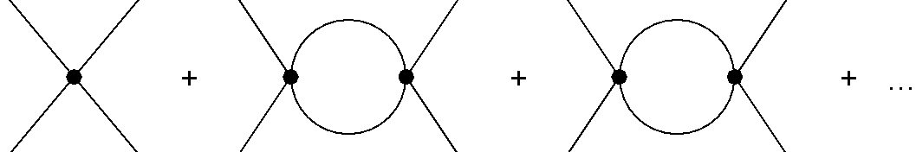
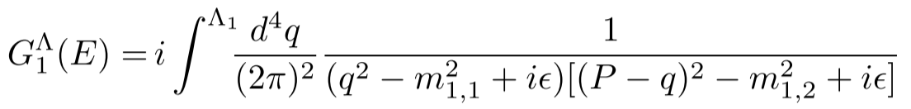
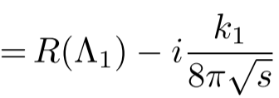
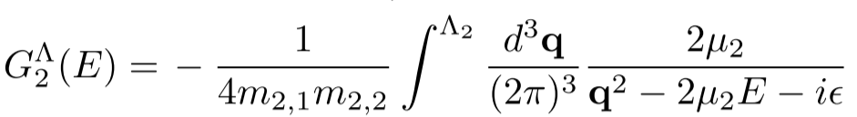
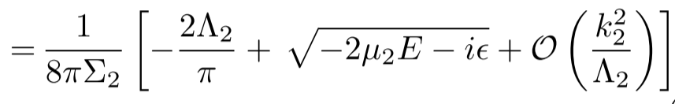









Coupled channels
Full threshold structure needs to be measured in a lower channel coupled channels
Consider a two-channel system, construct a nonrelativistic effective field theory (NREFT)
  Energy region around the higher threshold, $Σ_{2}$
  Expansion in powers of $E=\sqrt{s}−Σ_{2}$
  Momentum in the lower channel can also be expanded
  $Λ$ dependence absorbed by $V^{−1}$
X.-K. Dong, FKG, B.-S. Zou, arXiv:2011.14517
$$V_{11}^{Λ}$$
$$V_{11}^{Λ}$$
$$G_{1}^{Λ}$$
$$V_{11}^{Λ}$$
$$V_{12}^{Λ}$$
$$G_{2}^{Λ}$$
$$V_{21}^{Λ}$$
$$T(E)=V+VG(E)V+VG(E)VG(E)V+…=\frac{1}{V^{−1}−G(E)}$$
Nonanalyticity only from here

Slide 10
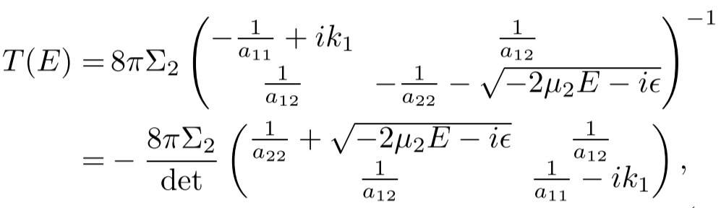

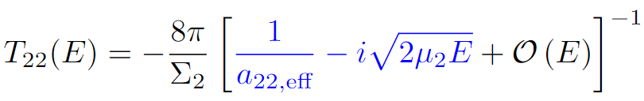
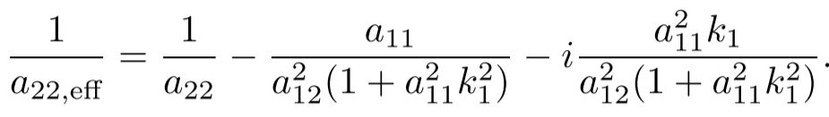
NREFT at LO
Very close to the higher threshold, LO:
Effective scattering length with open-channel effects becomes complex, $Im\frac{1}{a_{22,eff}}≤0$

Slide 11
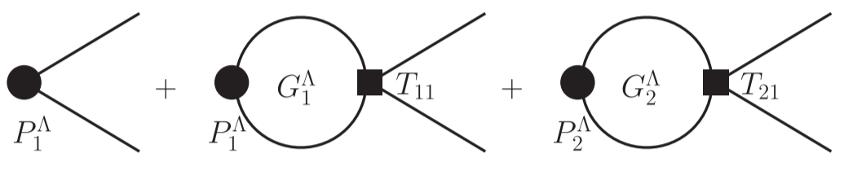
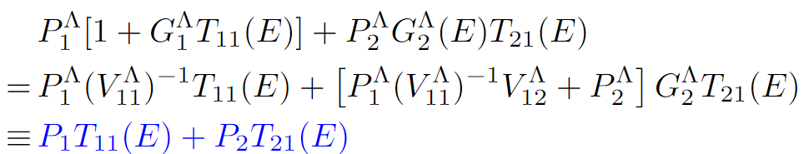
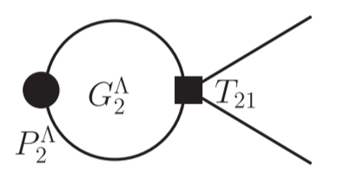
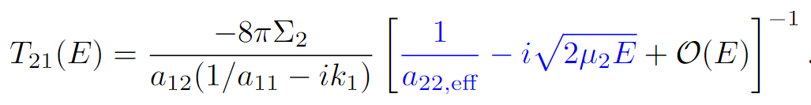
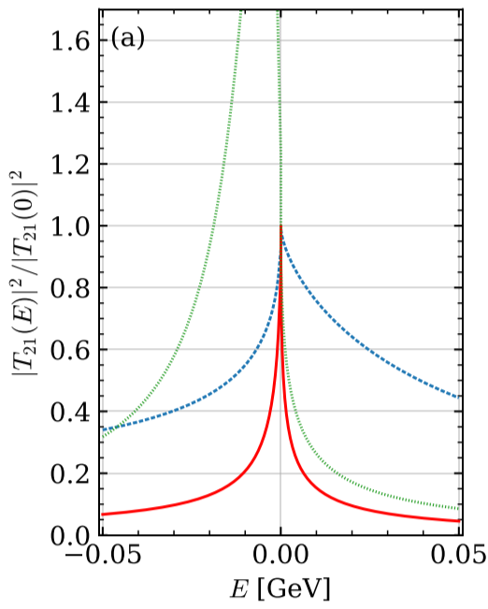
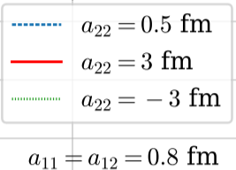
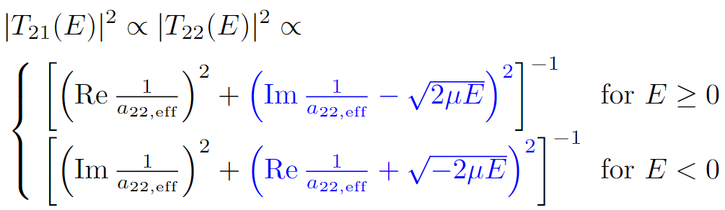
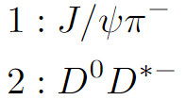
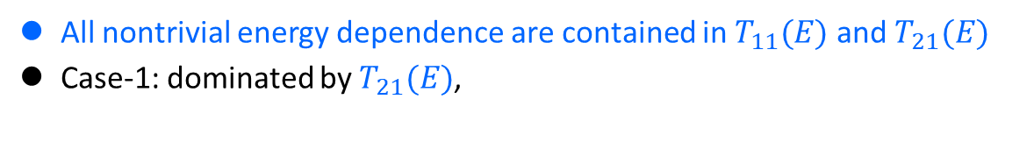
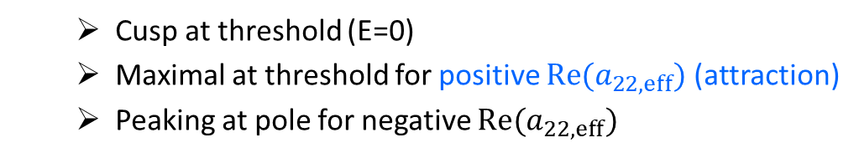
NREFT at LO
Consider a production process, must go through final-state interaction (unitarity)
All nontrivial energy dependence are contained in $T_{11}(E)$ and $T_{21}(E)$
Case-1: dominated by $T_{21}(E)$,
  Cusp at threshold (E=0)
  Maximal at threshold for positive ${Re(a}_{22,eff})$ (attraction)
  Peaking at pole for negative ${Re(a}_{22,eff})$

Slide 12
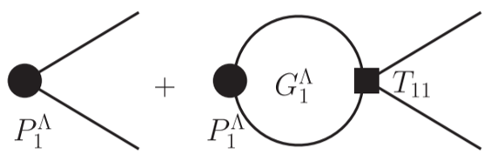
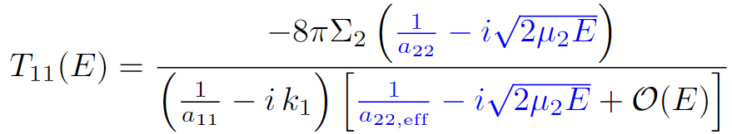
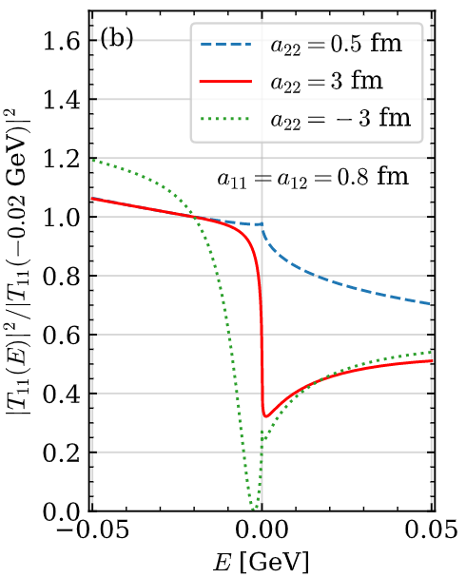
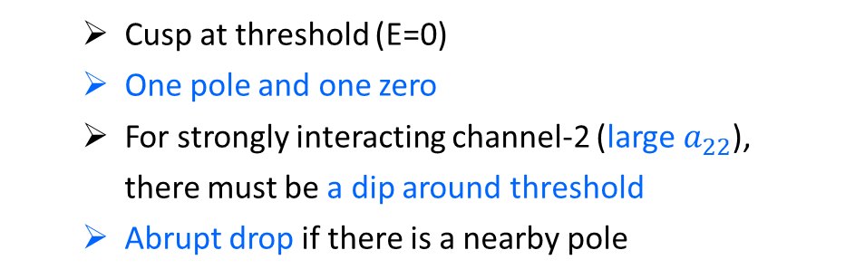
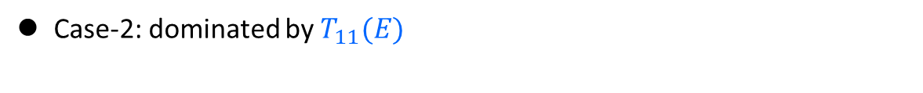
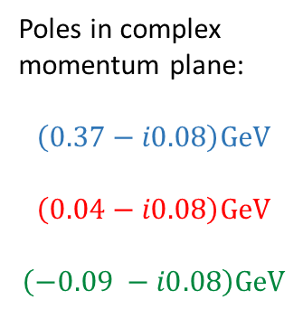
NREFT at LO
Case-2: dominated by $T_{11}(E)$
Poles in complex momentum plane:
$$\left(0.37−i0.08\right)GeV$$
$$\left(0.04−i0.08\right)GeV$$
$$\left(−0.09 −i0.08\right)GeV$$
  Cusp at threshold (E=0)
  One pole and one zero
  For strongly interacting channel-2 (large $a_{22}$), there must be a dip around threshold
  Abrupt drop if there is a nearby pole
More complicated line shape if both channels are important for the production

Slide 13
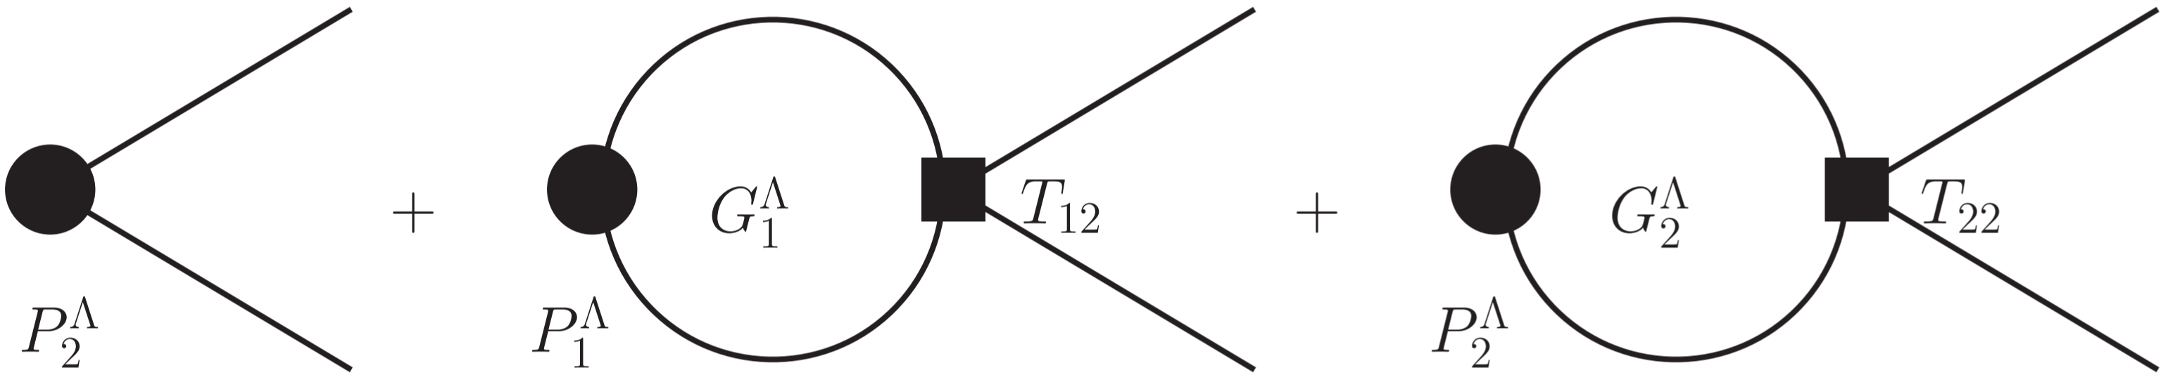
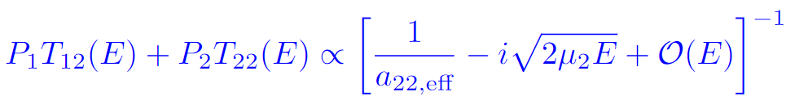
NREFT at LO
Case-3: final states in channel-2
  Suppression due to phase space
  Peak just above threshold would require the pole to be nearby

Slide 14
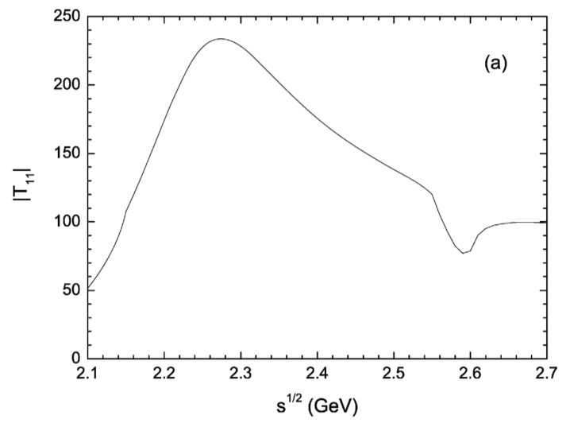
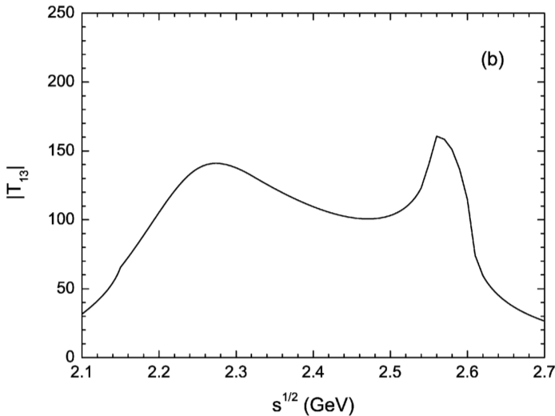


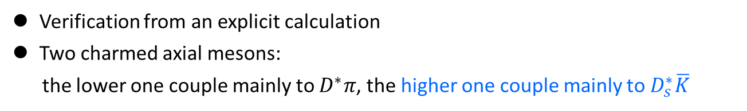
Phenomenology
Verification from an explicit calculation
Two charmed axial mesons:
the lower one couple mainly to $D^{∗}π$, the higher one couple mainly to $D_{s}^{∗}\overline{K}$
FKG, P.-N. Shen, H.-C. Chiang, PLB647(2007)133
Dip in $D^{∗}π→D^{∗}π$
Peak in $D_{s}^{∗}\overline{K}→D^{∗}π$

Slide 15
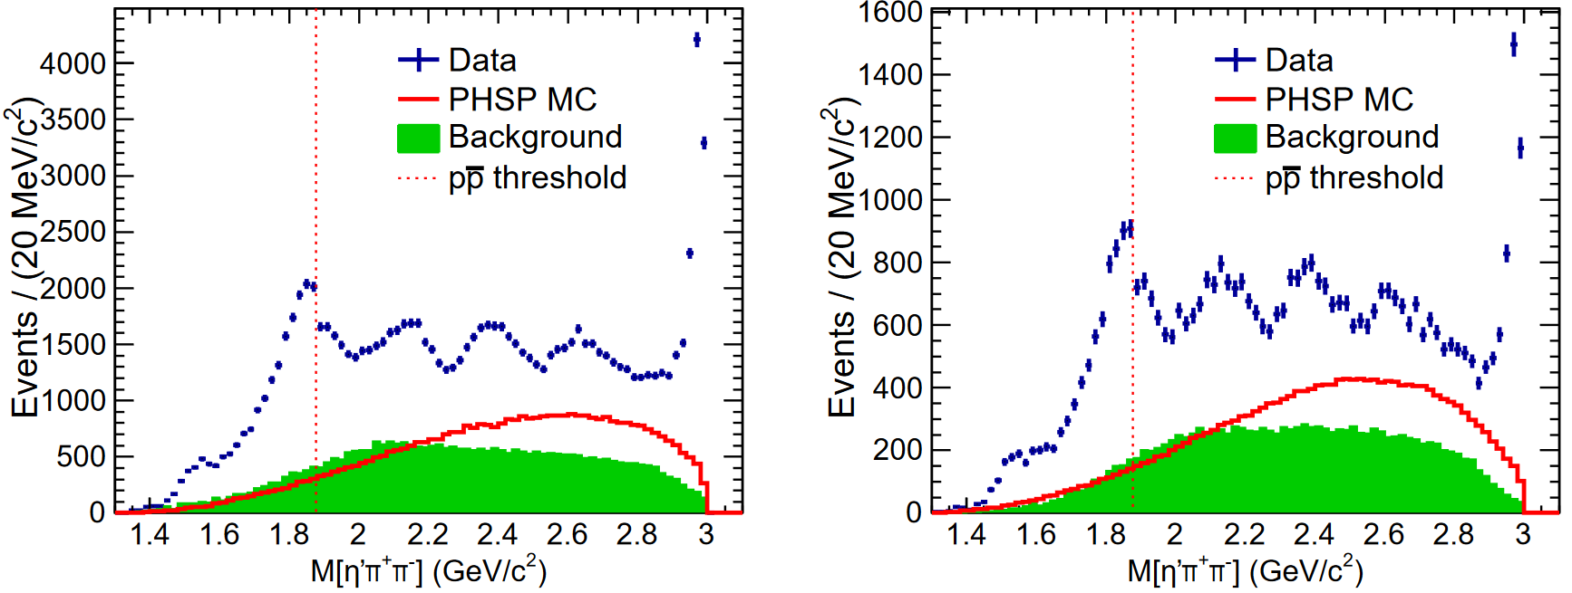
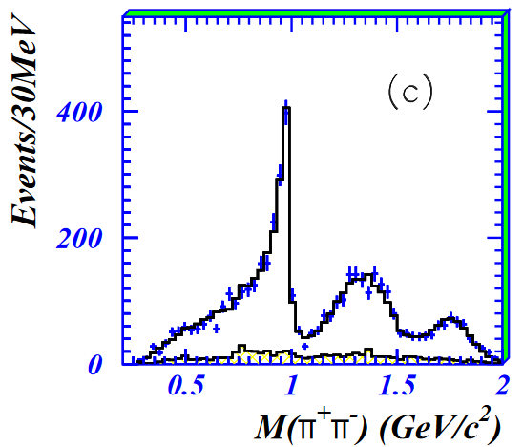
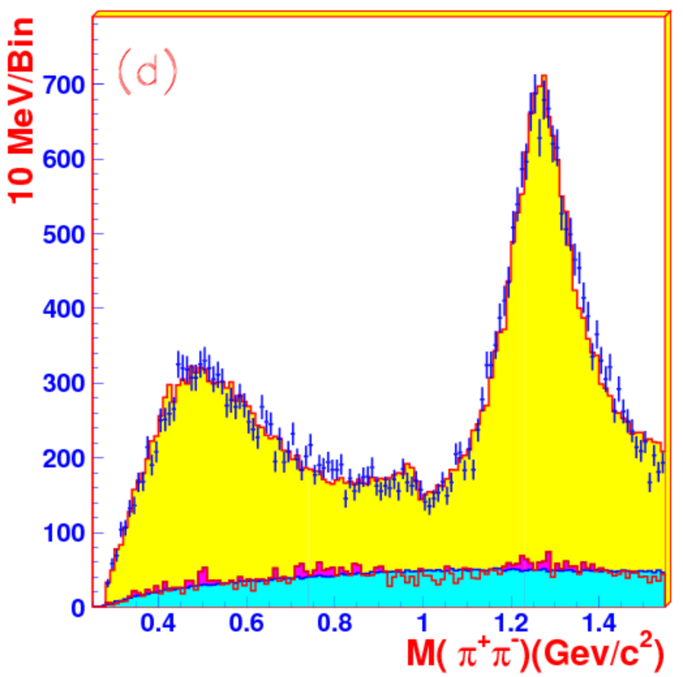




Phenomenology
$p\overline{p}$ threshold in $J/ψ→γη′π^{+}π^{−}$
BESIII,
PRL117(2016)042002
$f_{0}\left(980\right)$ in $J/ψ→φπ^{+}π^{−}$ and $J/ψ→ωπ^{+}π^{−}$
Channels: $ππ$ and $K\overline{K}$
BES,
PLB607(2005)243
BES,
PLB598(2004)149
Driving channel:$K\overline{K}$
Driving channel:$ππ$

Slide 16
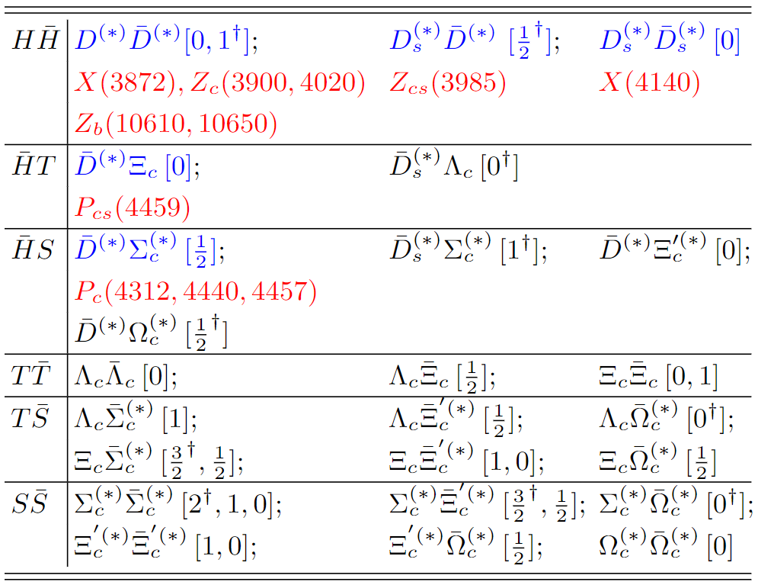


Phenomenology
Production of states with hidden-charm and hidden-bottom: open-flavor much easier than $Q\overline{Q}+$ light hadrons, peaks around threshold of a pair of open-flavor hadrons for attractive interaction
Threshold structures should be more pronounced in bottom than in charm
  Either threshold cusp or below-threshold peak
  Perturbative estimate of scattering length: $a∝m_{Q}$ [potential independent of $m_{Q}$]; nonperturbative for strong attraction, near-threshold pole
  peak width $∝{1/m}_{Q}$ for fixed $a$
$$ρ,ω,φ, ψ^{†}$$

Slide 17


Phenomenology
Production of $P_{c}$ states near the $Σ_{c}{\overline{D}}^{(∗)}$ thresholds
(1) considered as dominant in PRD100(2019)114033
(2) considered in Roca, Nieves, Oset, PRD92(2015)094003
Color suppressed
Figure from Burns, Swanson, PRD100(2019)114033
Our analysis suggests that the $Σ_{c}{\overline{D}}^{(∗)}$ should be the driving channels
Fact: color suppression does not work well,
${D^{(∗)}\overline{D}}^{(∗)}$ should be the driving channels for ${X\left(3872\right),Z}_{c}\left(3900\right),Z_{c}(4020)$

Slide 18










Phenomenology
$P_{c}$ states in $γp→J/ψp$ would behave as dips if driven by VMD or $Λ_{c}{\overline{D}}^{(∗)}$ , harder to find!
If the ${Σ_{c}^{(∗)}\overline{D}}^{(∗)}$ can be important, then there could be peaks
$${\overline{D}}^{\left(∗\right)}(Σ_{c}^{(∗)})$$
$$D^{\left(∗\right)}(Σ_{c}^{(∗)})$$
$${Σ_{c}^{(∗)}(\overline{D}}^{\left(∗\right)})$$

Slide 19
Triangle singularity (TS)
Logarithmic singularity
Bayar, Aceti, FKG, Oset, PRD94(2016)074039
Coleman, Norton (1965); Bronzan (1964)

Slide 20


Triangle singularity (TS)
R
R

Slide 21





Features of TS
logarithmic branch point, can produce a peak, mimicking a resonance
normally close to a two-body threshold
very sensitive to kinematic variables
Given masses of intermediate particles and the external $m_{B}$, TS can produce peaks in both $m_{A}$ and $m_{C}$ distributions.
For fixed $m_{2,3},$ $m_{A}$ and $m_{B}$, TS in the physical region only happens when:
TS in the physical region only happens when
$$m_{1}^{2}∈\left[\frac{m_{A}^{2}m_{3}+m_{B}^{2}m_{2}}{m_{2}+m_{3}}−m_{2}m_{3},{ \left({m_{A}−m}_{2}\right)}^{2}\right]$$
$$m_{A}^{2}∈\left[{ \left({m_{1}+m}_{2}\right)}^{2},{ \left({m_{1}+m}_{2}\right)}^{2}+\frac{m_{2}}{m_{3}}\left[{ \left({m_{1}−m}_{3}\right)}^{2}−m_{B}^{2}\right]\right]$$
near threshold
$$m_{C}^{2}∈\left[{ \left({m_{2}+m}_{3}\right)}^{2},{ \left({m_{2}+m}_{3}\right)}^{2}+\frac{m_{2}}{m_{1}}\left[{ \left({m_{1}−m}_{3}\right)}^{2}−m_{B}^{2}\right]\right]$$

Slide 22





Features of TS
While a resonance would persist independent of energy.
TS in the physical region only when
$m_{K\overline{K}}∈\left[987,1026\right]$ MeV
$m_{K^{∗}\overline{K}}∈\left[1385,1435\right]$ MeV

Slide 23







Features of TS
Phase motion of triangle diagram in the presence of a TS
$K\overline{K}$ threshold
$m_{K^{∗}\overline{K}}=1.42$ GeV
$m_{K\overline{K}}=0.99$ GeV
The argand plot is counterclockwise, resembling that of a resonance

Slide 24








Example: $Z_{c}\left(3900\right)$
Example: $D_{1}\overline{D}D^{∗}+c.c.$ triangles relevant for
an analysis of $Z_{c}\left(3900\right):e^{+}e^{−}→J/ψππ$
Very sensitive to energy!
Scalar 3-point $D_{1}\overline{D}D^{∗}$ loop
Sum of $D_{1}\overline{D}D^{∗},D_{1}{\overline{D}}^{∗}D^{∗},D_{2}{\overline{D}}^{∗}D^{∗}$loops

Slide 25

Thank you for your attention!
Conclusion
Threshold structures (threshold cusp or near-threshold peak) are generally expected for a pair of heavy hadrons with attractive interaction; strong attraction, then hadronic molecules below threshold, otherwise threshold cusps
Structures should be more prominent in bottom than in charm
For multi-body final states: going beyond the isobar model by including the most relevant thresholds and the singular triangles
TS effects are sensitive to energies:
  TS-induced peak for the initial-state (final-state) energy distribution may be checked by varying the invariant mass of final (initial) states
Kinematical singularities (threshold cusp, TS) and resonances are NOT exclusive
Looking forward to new discoveries!

Slide 26




Example: $Z_{c}\left(3900\right)$
Example: $D_{1}\overline{D}D^{∗}+c.c.$ triangles relevant for an analysis of $Z_{c}\left(3900\right):e^{+}e^{−}→J/ψππ$
Importance of TS pointed out, but a $Z_{c}\left(3900\right)$ is still needed for $e^{+}e^{−}→J/ψππ$
Analyses of $e^{+}e^{−}→J/ψππ, D{\overline{D}}^{∗}π$ data in
Q.Wang, Hanhart, Q.Zhao, PRL111(2013)132002; PLB725(2013)106;
Q.-R. Gong, J.-L. Pang, Y.-F. Wang, H.-Q. Zheng, EPJC78(2018)276
Albaladejo, FKG, Hidalgo-Duque, Nieves, PLB755(2016)337
  triangle diagrams
  T-matrix for $J/ψπ$- $D{\overline{D}}^{∗}$ coupled channels
  T-matrix may or may not have a pole, data tell
used D-wave $D_{1}(2420)D^{∗}π$ coupling

Slide 27



Example: $Z_{c}\left(3900\right)$
  The T-matrix from the best has a pole
Albaladejo, FKG, Hidalgo-Duque, Nieves, PLB755(2016)337
$χ^{2}/dof=$1.09
$χ^{2}/dof=$1.36
  The same parameters produce FV energy levels consistent with lattice results by Prelovsek et al.
Albaladejo, Fernandez-Soler, Nieves, EPJC76(2016)573

Slide 28



Example: $Z_{c}\left(3900\right)$
However, the JPAC analysis has a different conclusion
Pilloni et al. (JPAC), PLB772(2017)200
used S-wave $D_{1}(2420)D^{∗}π$ coupling

Slide 29




Example: $Z_{c}\left(3900\right)$
Partial waves for the $D_{1}(2420)D^{∗}π$ coupling make a difference
FKG, arXiv:2001.05884
Pure D-wave
Pure S-wave
Here the D-wave $D_{1}(2420)D^{∗}π$ coupling is fixed from the width of $D_{2}(2460)$ [spin partner of $D_{1}(2420)$]:
$$Γ_{D}\left(D_{1}\right)=15.2 MeV$$
$$Γ_{S}\left(D_{1}\right)=16.5 MeV$$
A reanalysis is ongoing (Yun-Hua Chen, FKG)
S+D-wave

Slide 30

Derivation of the TS equation

Slide 31

Derivation of the TS equation

Slide 32

Derivation of the TS equation

Slide 33

Derivation of the TS equation

Slide 34

Derivation of the TS equation

Slide 35










Complications in resonance searching due to TS
Difficulties for multi-hadron final states
Many resonances from the cross channel: branching fractions often unknown, interference between overlapping resonances, …
Complicated 3-body FSI:
$$K$$
$$B$$
$$ψ$$
$$K$$
$$B$$
$$B$$
$$K$$
$$ψ$$
$$ψ$$
intermediate states can be different from external ones; threshold cusps; triangle singularities
Kinematical singularities (threshold cusp, TS) and resonances are NOT exclusive

Slide 36





Schmid theorem
Schmid, PR154(1967)1363; Debastiani, Sakai, Oset, EPJC79(2019)69; FKG, Liu, Sakai, arXiv:1912.07030
Channels with both tree-level and triangle diagrams: interference may give rich structure
tiny $Γ_{1}$
finite $Γ_{1}$

