Slide 1
Tetraquarks at LHCb
第二届LHCb前沿物理研讨会
张艳席
北京大学
武汉大学，2020年12月13号
LHCb中国组

Slide 2
List of public analyses
Analysis of $B^{+}→D^{+}D^{−}K^{+},$ $X_{0,1}\left(2900\right)→D^{−}K^{+}$, arXiv:2009.00025, 2009.00026
Study of $B_{s}^{0}→J/ψπ^{+}π^{−}K^{+}K^{−}$ decays, $X(4740)→J/ψφ$, arXiv:2011.01867
Multiplicity-dependent $χ_{c1}(3872)/ψ(2S)$ production, $χ_{c1}(3872)/ψ(2S)$, arXiv:2009.06619
Observation of structure in $J/ψ$-pair mass spectrum, $X\left(6900\right)→J/ψJ/ψ$, arXiv:2006.16957
$ψ_{2}(3823)$ and $χ_{c1}(3872)$ in $B^{+}→\left(J/ψπ^{+}π^{−}\right)K^{+}$, $ψ_{2}\left(3823\right)+χ_{c1}(3872)$, arXiv:2005.13422
Study of $χ_{c1}(3872)$ lineshape, $χ_{c1}(3872)$, arXiv:2005.13419
Observation of ${Λ_{b}^{0}→χ}_{c}\left(3872\right)pK^{−}$ decay, $χ_{c1}(3872)$, arXiv:1907.00954
Spectroscopy in prompt $D\overline{D}$ final state, $X\left(3843\right), χ_{c2}\left(3930\right)…$, arXiv:1903.12240
Model-independent study of exotics in $B^{0}→J/ψK^{+}π^{−}$, $Z_{c}\left(4200\right), Z_{c}(4600)$, arXiv:1901.05745
Evidence of exotic in $B^{0}→η_{c}\left(1S\right)K^{+}π^{−}$, $Z_{c}{\left(4100\right)}^{+}$, arXiv:1809.07416
Beautiful tetraquarks in $Υμ^{+}μ^{−}$ final state, $X_{bb\overline{b}\overline{b}}$, arXiv:1806.09707
AmAn of $B^{+}→J/ψφK^{+}$, $X\left(4140\right),X\left(4274\right),X\left(4500\right),X\left(4700\right)$, arXiv:1606.07898, 1606.07895
Confirmation of $Z_{c}{\left(4430\right)}^{+}$, $Z_{c}{\left(4430\right)}^{+},$ arXiv:1510.01951, 1404.1903
Measurement quantum numbers of $X(3872)$, $J^{PC}=1^{++}$, arXiv:1504.06339, 1302.6269
Evidence of $X\left(3872\right)→ψ(2S)γ$, arXiv:1404.0275
Prompt production of $X(3872)$, arXiv:1112.5310
Refs. L1-L16
Observation
Evidence
Null
Notes:
Open heavy flavor: Xib*0/-, 1805.09418, 2010.14485

Slide 3
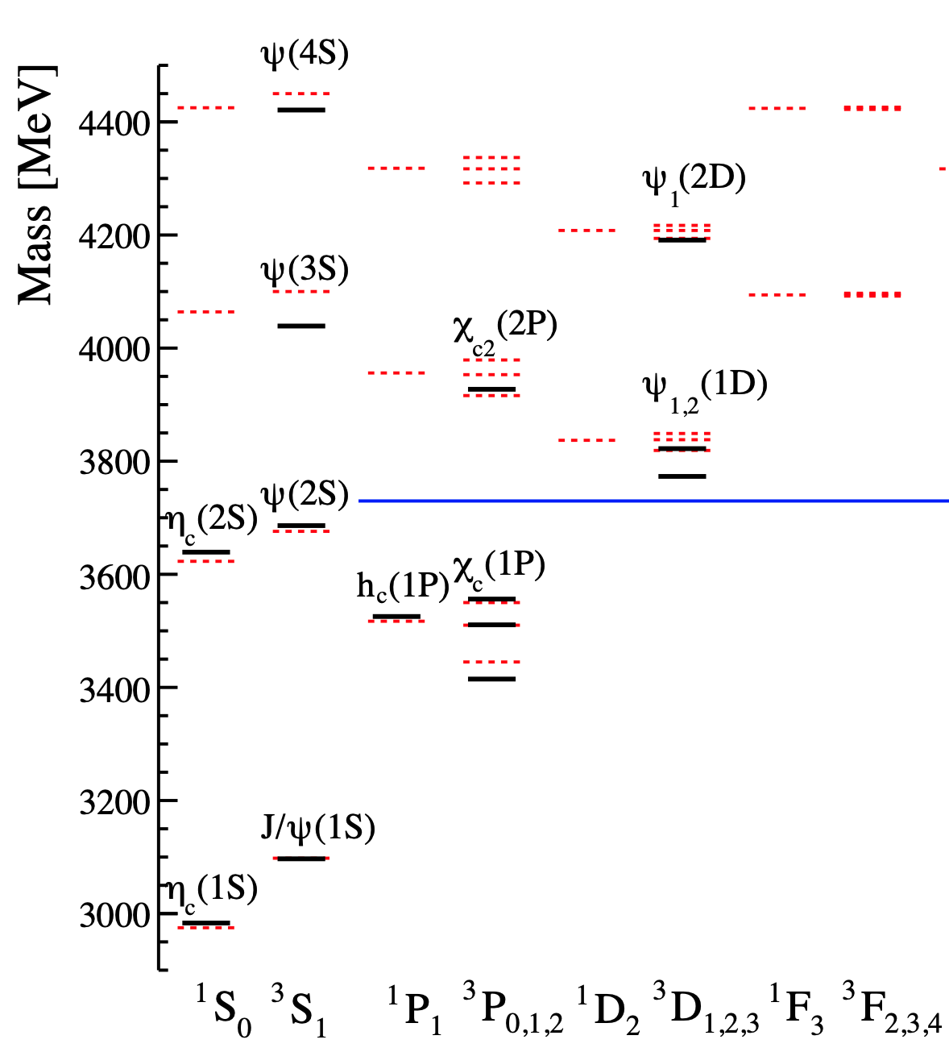
Exotic or not: $X\left(3872\right)$ ?
Refs. L8/14
$$X(3872)$$
_
_
_
u
c
u
VS
c
u
c
$$X(3872)$$
$$D{\overline{D}}^{∗}$$
$J^{PC}=1^{++}$ determined with $B^{+}→{\left(J/ψρ\right)}_{X}K^{+}$
$χ_{c1}(2P)$?
Nearby states of $χ_{c0,2}\left(2P\right)$ candidates:
$X\left(3860\right),$ observed in $e^{+}e^{−}→J/ψ(D\overline{D})$
$X_{0/2}\left(3915\right),$ observed in $D\overline{D},J/ψω$
$X\left(3940\right),$ observed in $e^{+}e^{−}→J/ψ(D{\overline{D}}^{∗})$
$$D\overline{D}$$
PRD100(2019)094003, Rev.Mod.Phys.90 (2018)015003, Rev.Mod.Phys.90 (2018)015004, Phys.Rept.639 (2016) 1

Slide 4
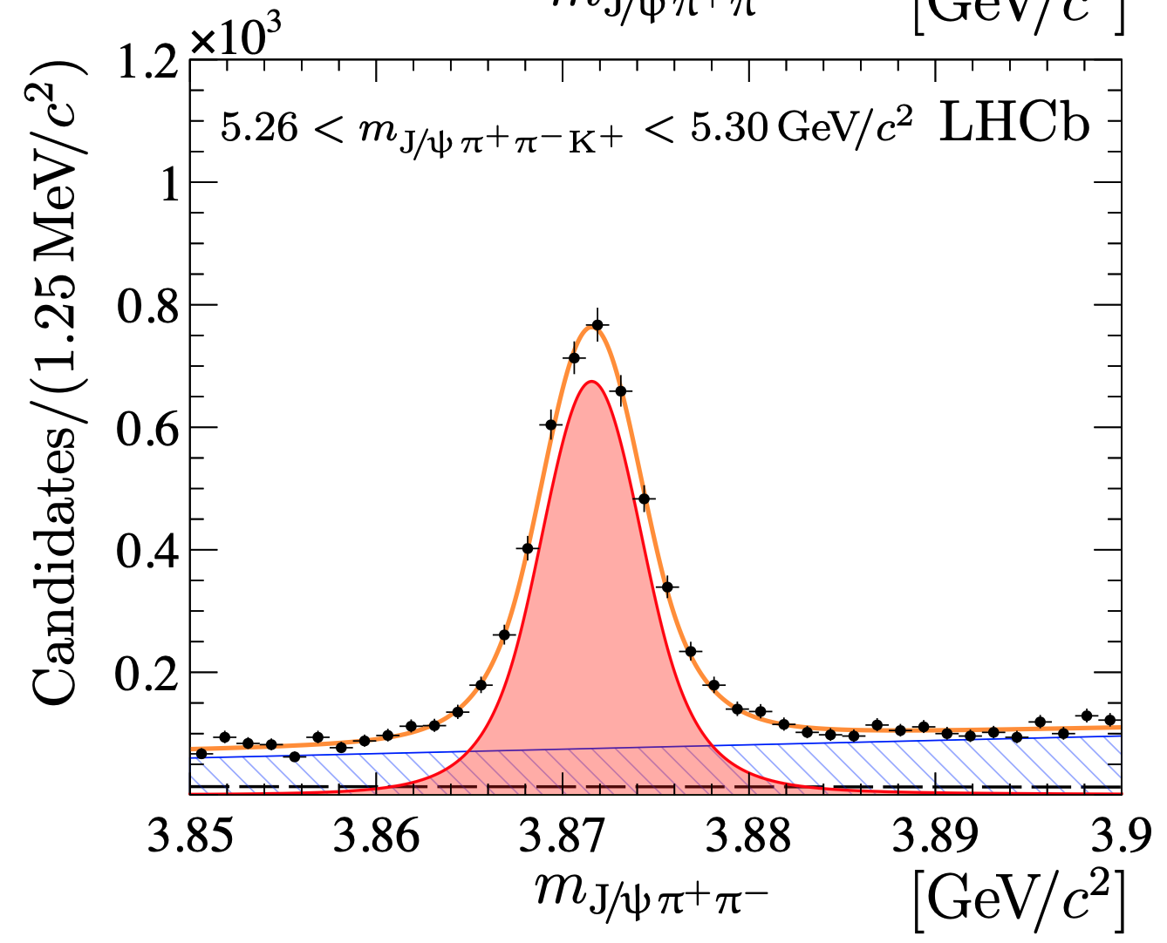
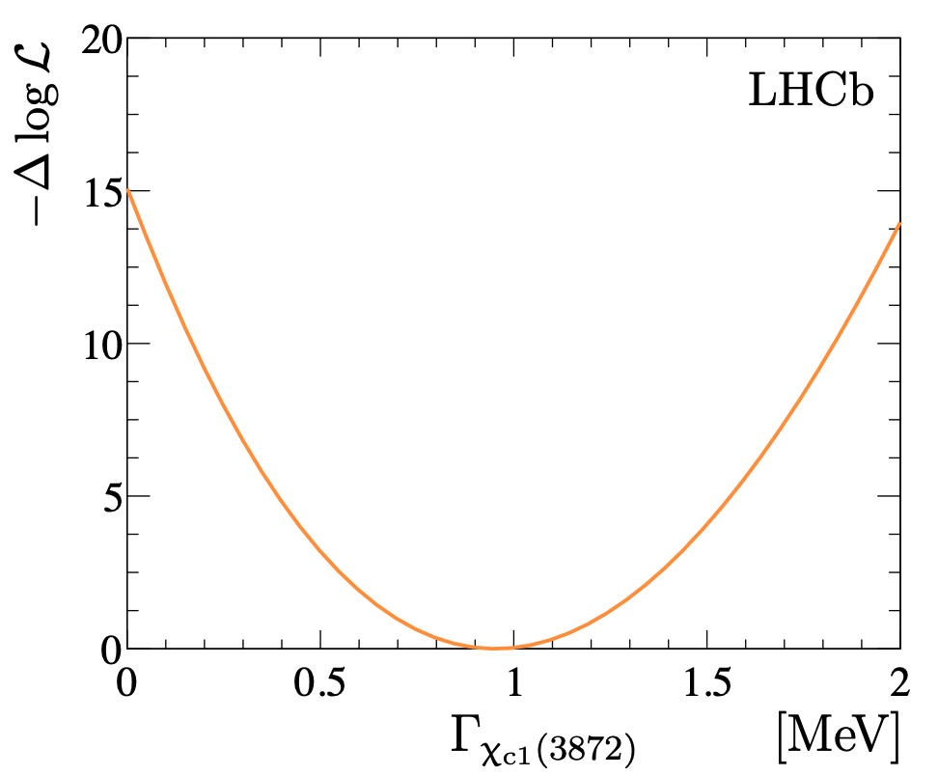
Mass and Width of $X(3872)$
Refs. L5/6
$m_{X(3872)}=3871.64±0.06±0.01$ MeV
$m_{D^{0}{\overline{D}}^{∗}}−m_{X\left(3872\right)}=0.07±0.12({δm}_{K})$ MeV
$Γ_{X\left(3872\right)}={0.96}_{−0.18}^{+0.19}±0.21$ MeV
Not zero by 5.5$σ$
Fit assuming S-wave Breit-Wigner
Experimental resolution $≈2.4$ MeV
Consistent with study using inclusive $b→X(3872)$ decays
$$B^{+}→{\left(J/ψπ^{+}π^{−}\right)}_{X}K^{+}$$
Likelihood scan of width
Notes:
Open heavy flavor: Xib*0/-, 1805.09418, 2010.14485

Slide 5
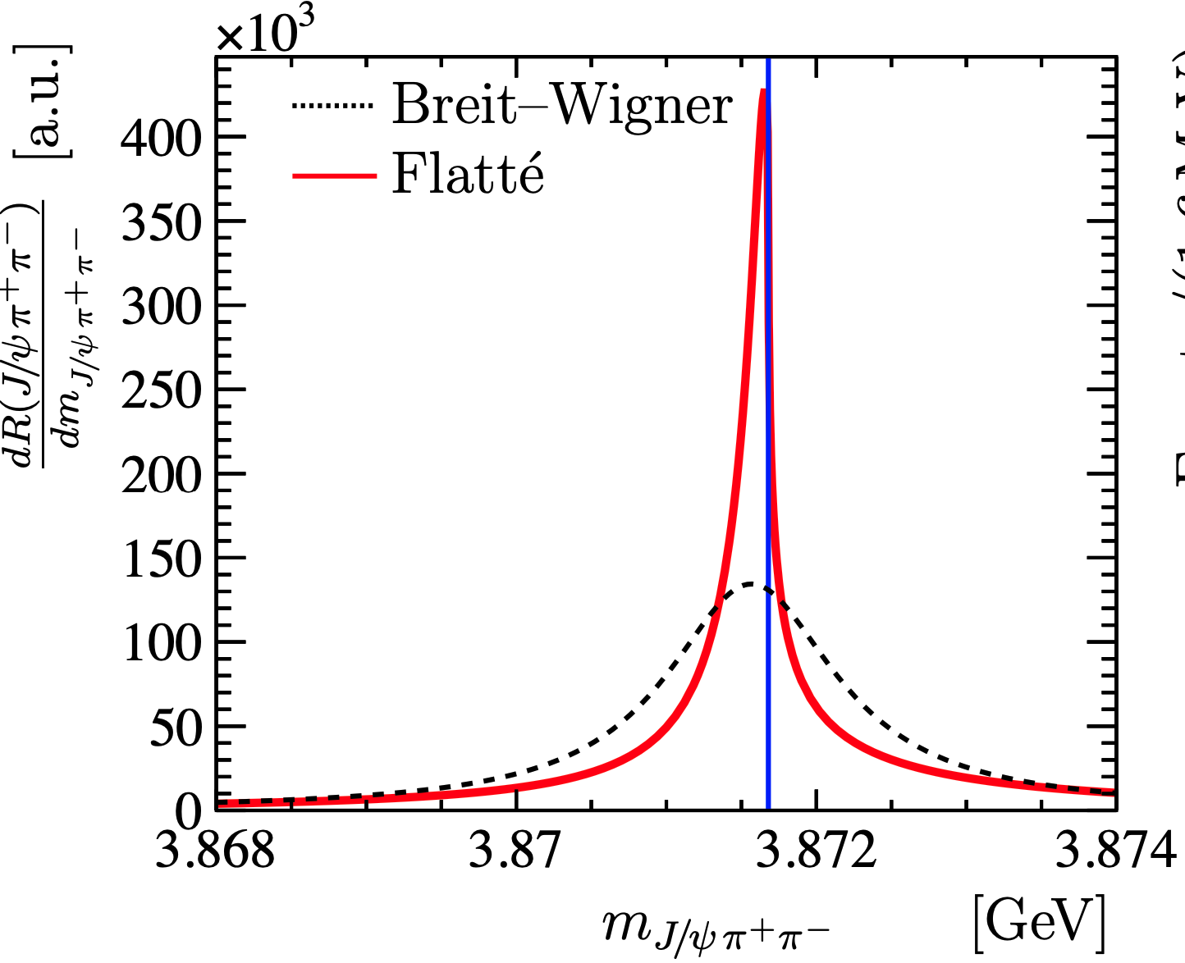
$X\left(3872\right)$ Flatte parameterization
Ref. L6
Lineshape distorted due to coupling to threshold: $X(3872)→DD^{∗}$
$$k=\sqrt{2μE}$$
Flatte lineshape:
PRD76(2007)034007
$$D^{0}D^{∗0}$$
$$J/ψρ$$
Others
$$D^{+}D^{∗−}$$
$$J/ψω$$
Free parameters:
Constrained using measured BFs
$$E_{f},g,g_{ρ},g_{ω},Γ_{0}$$
$$D\overline{D}$$
$m_{D^{0}{\overline{D}}^{∗}}−m_{X\left(3872\right)}=0.01±0.14$ MeV
Pole structure of ${\left|D\left(E\right)\right|}^{2}$ studied (syst. limited):
resonances wrt $J/ψπ^{+}π^{−}$ channel
quasi-bound for $DD^{∗}$, quasi-virtual not excluded, pole positions prefer a large molecule component
Notes:
Open heavy flavor: Xib*0/-, 1805.09418, 2010.14485

Slide 6
$X\left(3872\right)$ decay&production
Ref. L2/7/15/16
$\frac{B[X\left(3872\right)→ψ\left(2S\right)γ]}{B[X\left(3872\right)→J/ψ\left(1S\right)γ]}=2.46±0.64±0.29$
Not very consistent with BESIII
For comparison:
$$B\left[χ_{b1}\left(2P\right)→Υ\left(2S\right)γ\right]/B\left[χ_{b1}\left(2P\right)→Υ\left(1S\right)γ\right]=2.0±0.3$$
Prompt production: $\frac{σ[pp→X\left(3872\right)X]}{σ[pp→ψ\left(2S\right)X]}=\frac{(2.6±0.9)×{10}^{−2}}{B(X\left(3872\right)→J/ψπ^{+}π^{−}))}$
$$≈0.6±0.3$$
$Λ_{b}^{0}$ decay : $\frac{B[Λ_{b}^{0}→X\left(3872\right)pK^{−}]}{B[Λ_{b}^{0}→ψ\left(2S\right)pK^{−}]}=\left(5.4±1.1\right)×{10}^{−2}/(\frac{B[X(3872)→J/ψπ^{+}π^{−}}{B\left[ψ\left(2S\right)→J/ψπ^{+}π^{−}\right]})$
$$≈0.4±0.2$$
$B_{s}^{0}$ decay : $\frac{B[B_{s}^{0}→X\left(3872\right)φ]}{B[B_{s}^{0}→ψ(2S)φ]}=\left(2.42±0.24\right)×{10}^{−2}/(\frac{B[X(3872)→J/ψπ^{+}π^{−}}{B\left[ψ\left(2S\right)→J/ψπ^{+}π^{−}\right]})$
$$≈0.2±0.1$$
For comparison:
PRD100(2019)094003
$σ{[χ}_{c1}(1P)]/σ\left(J/ψ\right)\sim 0.4$ (prompt)
$\frac{B(B^{+}→χ_{c1}(1P)K^{+})}{B(B^{+}→J/ψK^{+})}≈0.49$
$\frac{B(B^{+}→χ_{c1}{(1P)K}^{0}π^{+})}{B(B^{+}→J/ψK^{0}π^{+})}≈0.51$
$\frac{B(B^{+}→χ_{c1}(1P)K^{∗+})}{B(B^{+}→J/ψK^{∗+})}≈0.20$
…
$$\frac{Γ_{χ_{c1}(2P)}}{Γ_{χ_{c1}(1P)}}∼\frac{B\left(χ_{c1}\left(1P\right)→J/ψγ\right)}{B\left(χ_{c1}\left(2P\right)→ψ\left(2S\right)γ\right)}∼15$$
Notes:
Sigma_psi2s(pt>5)~210 nb

Slide 7
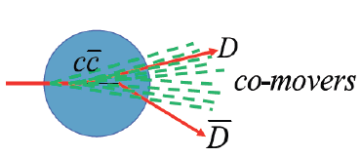
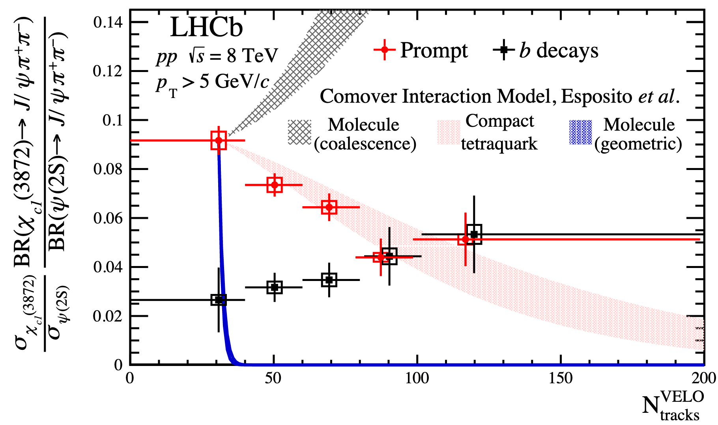
$X\left(3872\right)$ in “nuclear” environment
Ref. L3
Broken due to FSI with co-moving particles (comover model)
Rate depends on two parameters: binding energy, size
Explained $ψ(2S)/J/ψ$, $Υ(nS)/Υ(1S)$ production ratios in $p$Pb data
arXiv:2006.15044
compact
molecule
$$E_{𝒬}^{thr}=m_{DD^{(∗)}}−m$$
Compact
Breakup rate too small compared to expectation in molecule picture
Consistent with a compact state
$N_{tracks}\left(data\right)=N_{tracks}(model)$?
Notes:
Sigma_psi2s(pt>5)~210 nb

Slide 8
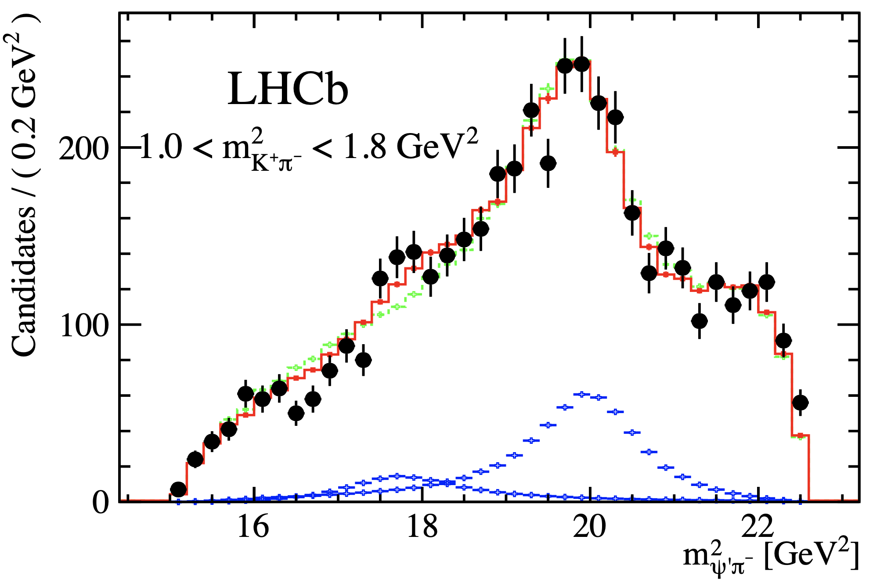
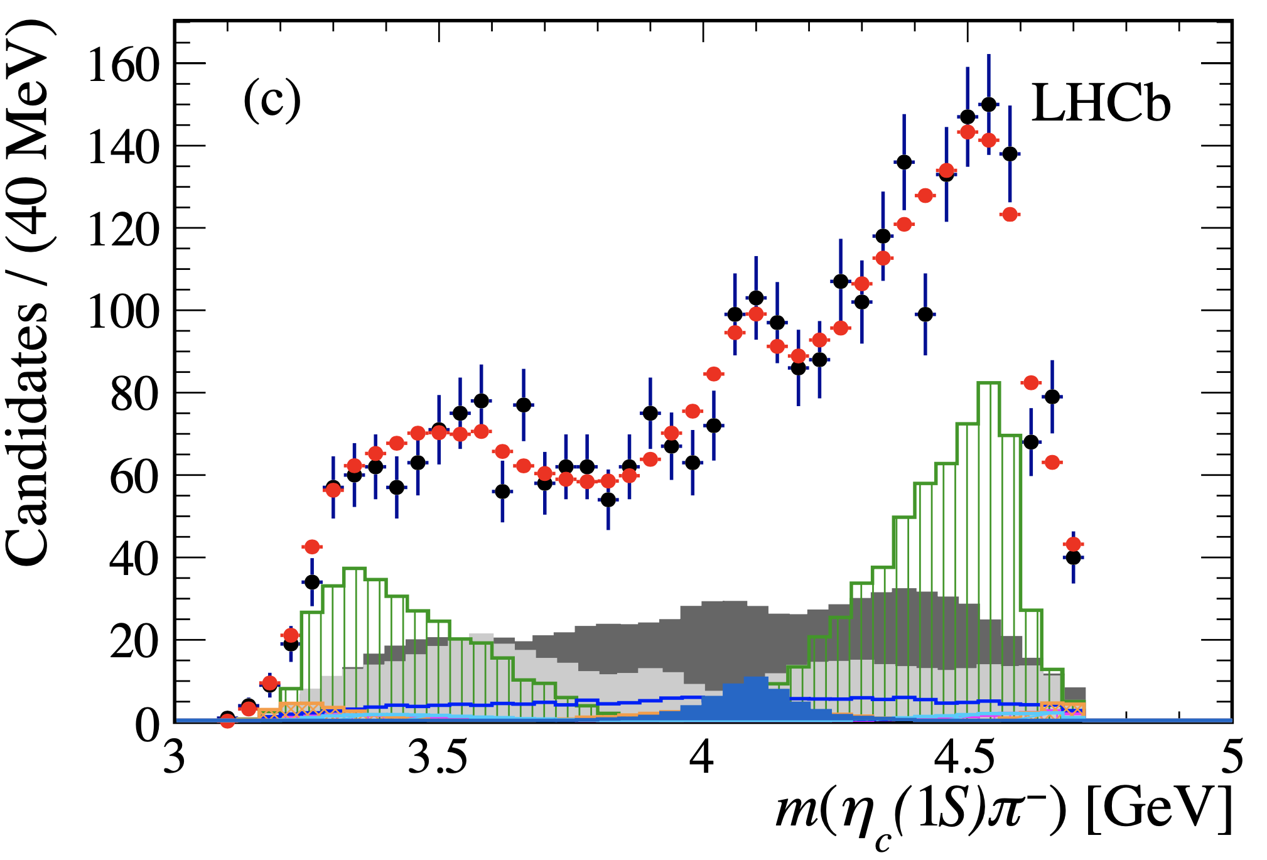
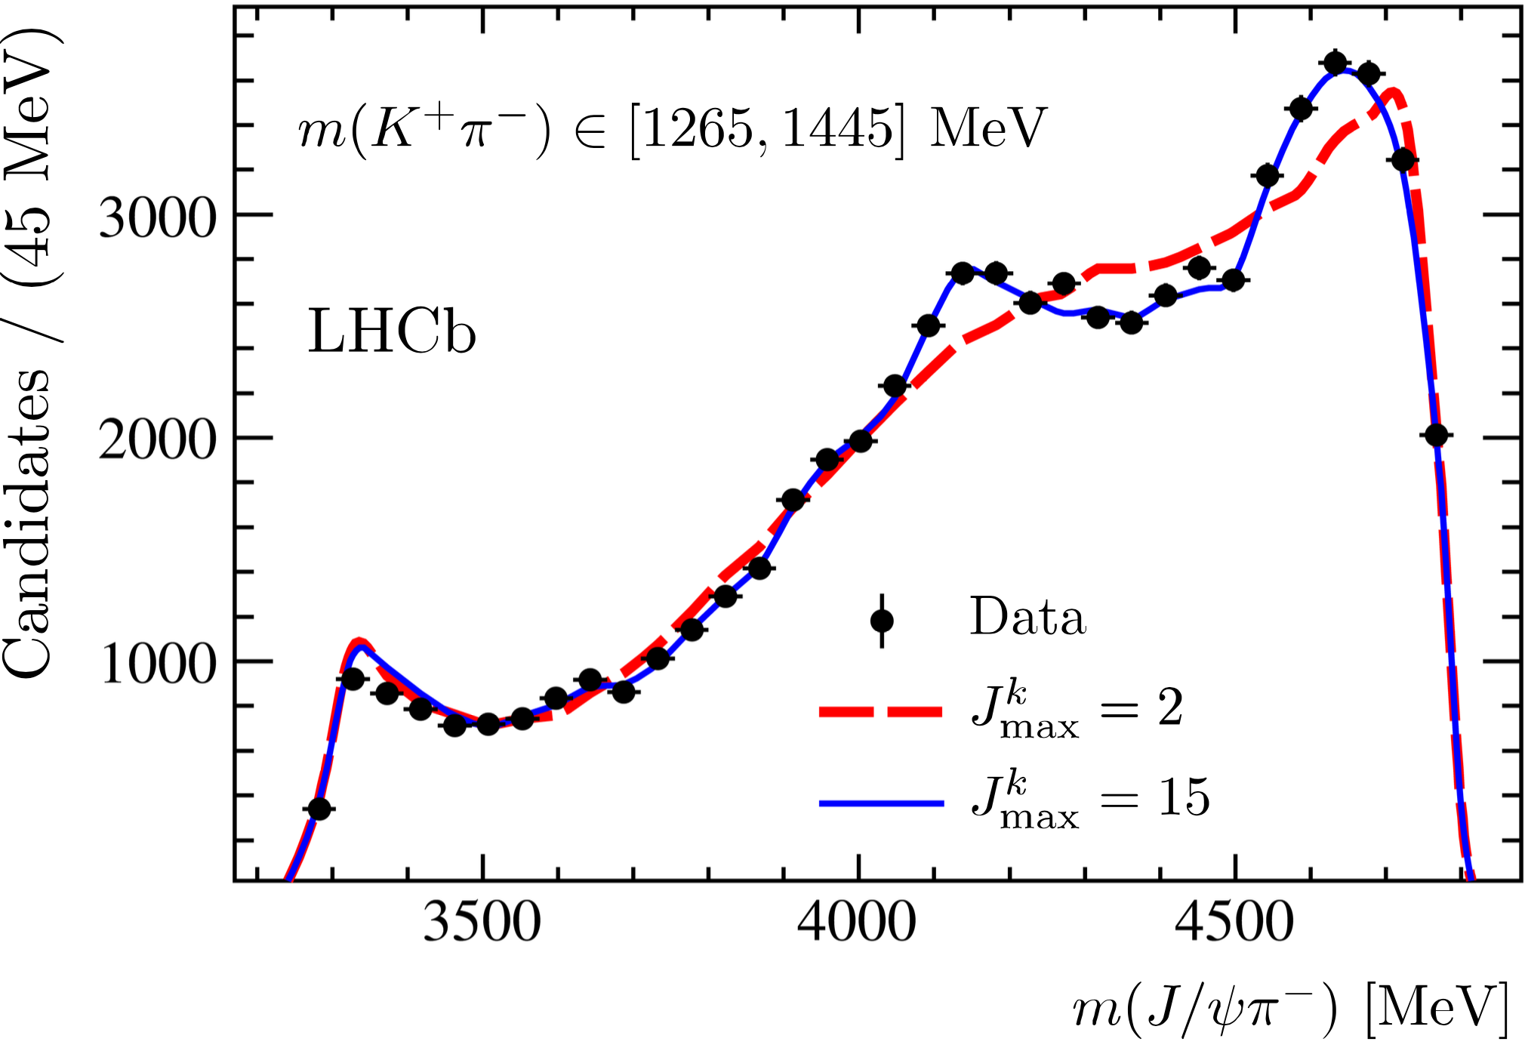
$b$-decay vs prompt
$X(3872)$ the only one (?) observed in $e^{+}e^{−}$, $b$-decay and prompt $pp$ collisions
Production mechanism?
Internal structure?
Difficulties to identify wide states in prompt hadron collisions?
$Z_{c}^{+}$ in beauty decays:
Ref. L9
Ref. L10
Model independent method
$$Z_{c}{\left(4430\right)}^{−}, 1^{+}$$
$$Z_{c}{\left(4200\right)}^{−}, 0^{−}$$
Ref. L13
$$Z_{c}{\left(4200\right)}^{−}, Z_{c}{\left(4600\right)}^{−}$$
$$Z_{c}{\left(4200\right)}^{−}, 0^{+} or 1^{−}$$
$$B^{0}→ψ\left(2S\right)K^{+}π^{−}$$
$$B^{0}→η_{c}K^{+}π^{−}$$
$$B^{0}→J/ψK^{+}π^{−}$$
Notes:
Open heavy flavor: Xib*0/-, 1805.09418, 2010.14485

Slide 9
$b$-decay vs prompt
$X(3872)$ the only one (?) observed in $e^{+}e^{−}$, $b$-decay and prompt $pp$ collisions
Production mechanism?
Internal structure?
Difficulties to identify wide states in prompt hadron collisions?
$Z_{c}^{+}$ in beauty decays:
Ref. L9
Ref. L10
Model independent method
$$Z_{c}{\left(4430\right)}^{−}, 1^{+}$$
$$Z_{c}{\left(4200\right)}^{−}, 0^{−}$$
Ref. L13
$$Z_{c}{\left(4200\right)}^{−}, Z_{c}{\left(4600\right)}^{−}$$
$$Z_{c}{\left(4200\right)}^{−}, 0^{+} or 1^{−}$$
Where are the strange partners $Z_{cs}^{+}$?
$$B^{0}→ψ\left(2S\right)K^{+}π^{−}$$
$$B^{0}→η_{c}K^{+}π^{−}$$
$$B^{0}→J/ψK^{+}π^{−}$$
Notes:
Open heavy flavor: Xib*0/-, 1805.09418, 2010.14485

Slide 10
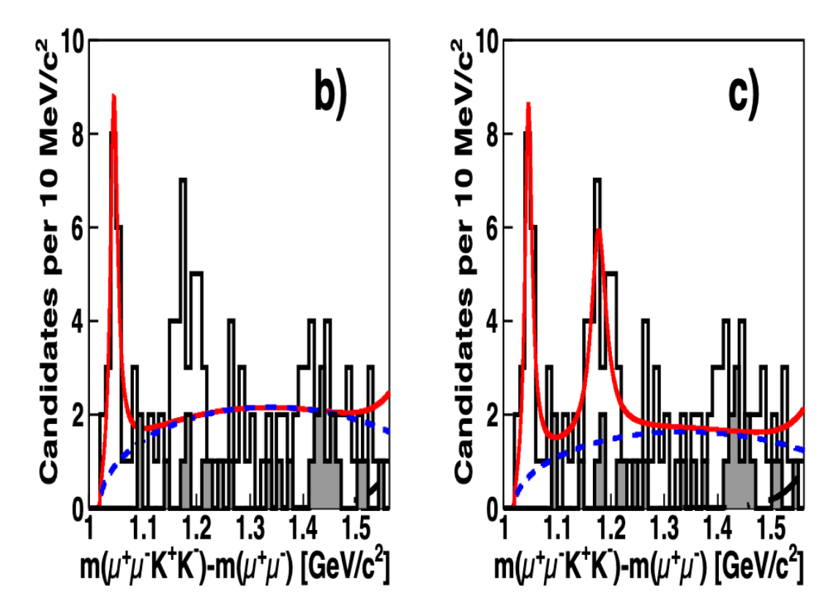
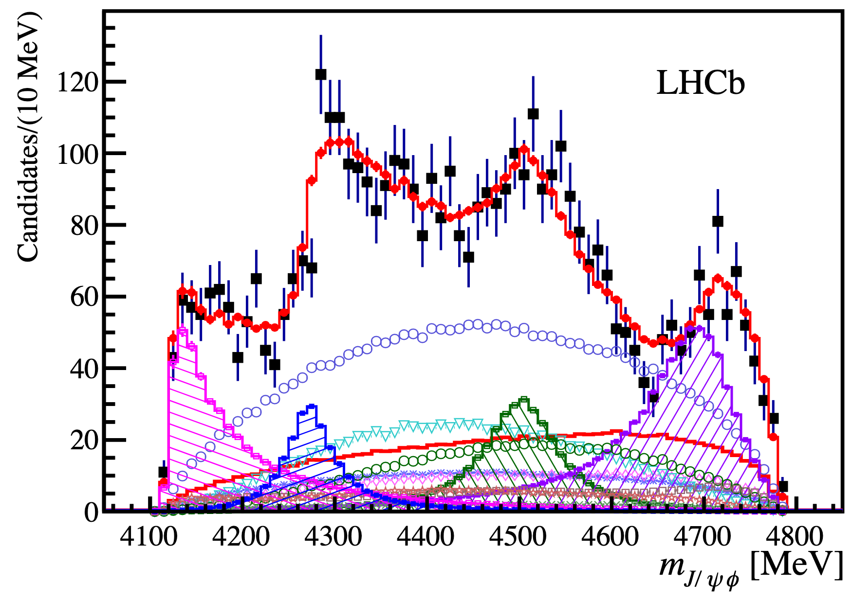
Tetraquark in $J/ψφ$ system
$X→J/ψφ$ first seen by CDF, confirmed by CMS
Observation of $X(4140)$
Evidence of $X(4274)$
1D analysis
PRL102(2009)242002
Mod.Phys.Lett.A32(2017)26
PLB734(2014)261
$c\overline{c}s\overline{s}$ quark contents
LHCb amplitude analysis, observed four states
All much wider
Only Run I data
States | $$J^{PC}$$ | Mass/MeV | Width/MeV
$$X(4140)$$ | $$1^{++}$$ | $4146.5±{4.5}_{−2.8}^{+4.6}$ | $83 ±{21}_{−14}^{+21}$
$$X(4274)$$ | $$1^{++}$$ | $4273.3±{8.3}_{− 3.6}^{+17.2}$ | $56.2±{10.9}_{−11.1}^{+ 8.4}$
$$X(4500)$$ | $$0^{++}$$ | $4506 ±{11}_{−15}^{+12}$ | $92±{21}_{−20}^{+21}$
$$X(4700)$$ | $$0^{++}$$ | $4704 ±{10}_{−24}^{+14}$ | $120±{31}_{−33}^{+42}$
Ref. L9

Slide 11
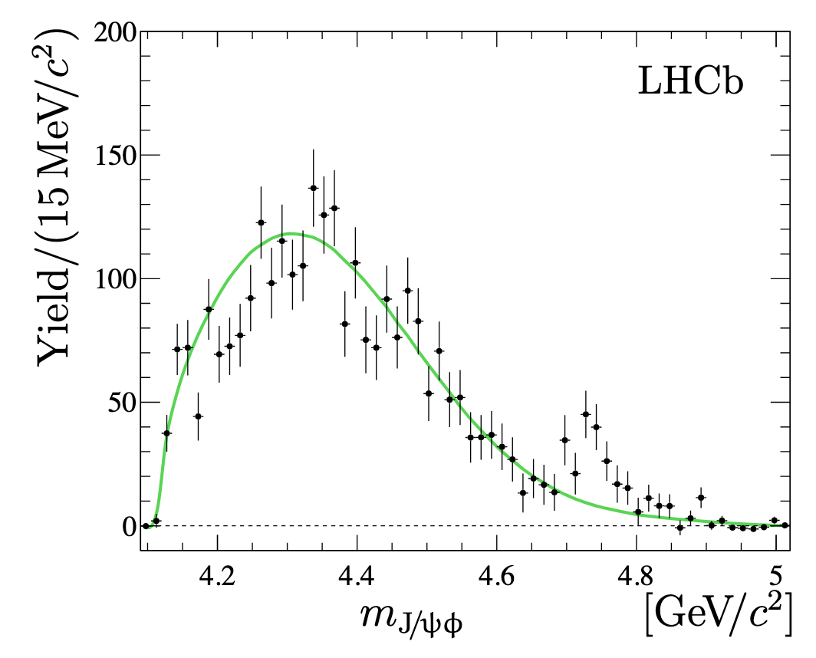
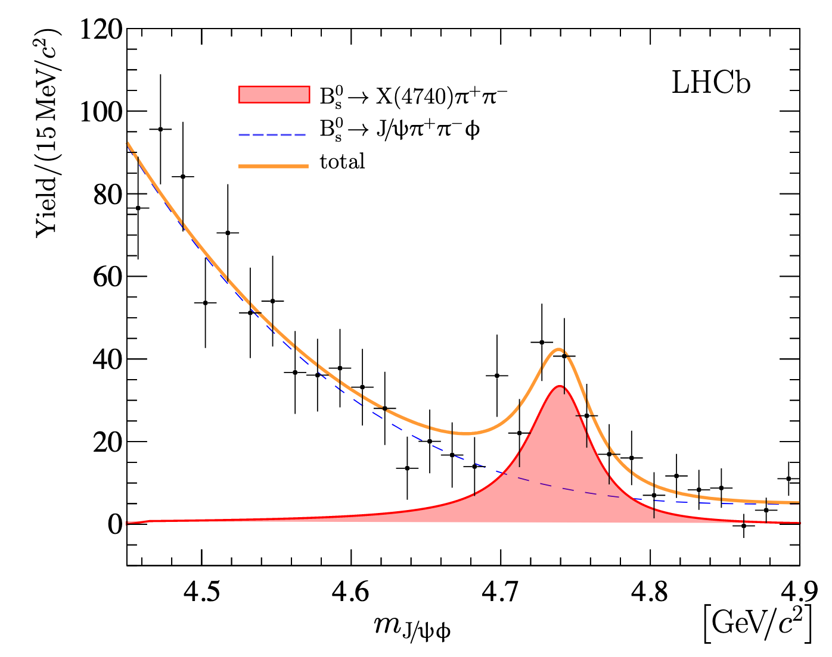
“New” $X(4740)$ structure
Ref. L2
A $J/ψφ$ structure in $B_{s}^{0}→J/ψφπ^{+}π^{−}$decay
Simulation
Zoom in and fit
$$X(4700)$$
$$X(4500)$$
$$X(4140)$$
$$X(4274)$$
$$X(4700)$$
1D fit using S-wave Breit-Wigner
Systematic uncertainties:
Shape of underlying non-$X$
Alternative P-wave or D-wave BW
Inteference …
$m_{X\left(4740\right)}=4741±6±6$ MeV
$Γ_{X\left(4740\right)} =53±15±11$ MeV

Slide 12
Maybe not new
Ref. L2
Could be the $X\left(4700\right)$ in $B^{+}→J/ψφK^{+}$ decay
Amplitude fit needed to resolve
Contribution relatively larger than other X states

Slide 13
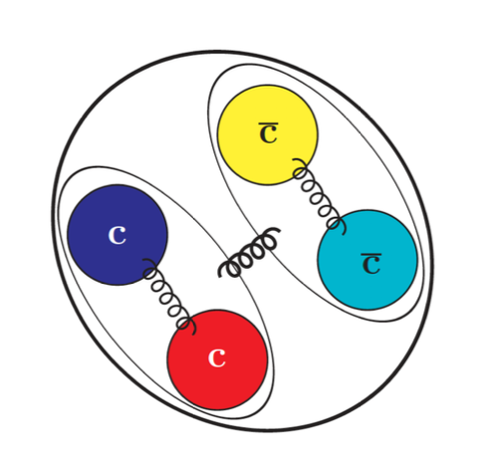
Molecular vs tetraquark
Difficult to interpretation as molecular states
States | $$J^{PC}$$ | Mass/MeV | Nearest thresholds/MeV
$$X(4140)$$ | $$1^{++}$$ | $4146.5±{4.5}_{−2.8}^{+4.6}$ | $D_{s}^{+}{\overline{D}}_{s}^{∗−}:$ 4080
$$X(4274)$$ | $$1^{++}$$ | $4273.3±{8.3}_{− 3.6}^{+17.2}$ | $D_{s}^{+}D_{s0}^{∗}{\left(2317\right)}^{−}$: 4286
$$X(4500)$$ | $$0^{++}$$ | $4506 ±{11}_{−15}^{+12}$ | $D_{s}^{+}D_{s1}^{∗}{\left(2536\right)}^{−}$: 4503
$$X(4700)$$ | $$0^{++}$$ | $4704 ±{10}_{−24}^{+14}$ | $D_{s}^{∗+}{\overline{D}}_{s2}^{∗}{\left(2573\right)}^{−}$: 4681
60 MeV away
$P=−$ for S-wave
$X(4140)$: $c\overline{c}$ state $χ_{c1}(3P)$?
$X(4274)$: $c\overline{c}$ state $χ_{c1}(3P)$?
$X\left(4274\right), X\left(4500\right), X(4700)$ tightly bound $cs\overline{c}\overline{s}$ states. But $X\left(4140\right)$ difficult
PRD101(2020)054039
PRD99(2019)094032
EPJC79(2020)72
PRD94(2016)074007
EPJC77(2017)160
EPJC80(2020)626
EPJC80(2020)464
EPJC77(2017)174
PRD94(2016)074007
PLB766(2017)174
$$c$$
$$\overline{c}$$
$$s$$
$$\overline{s}$$
Decay in $J/ψω$, $DD^{∗}$?

Slide 14
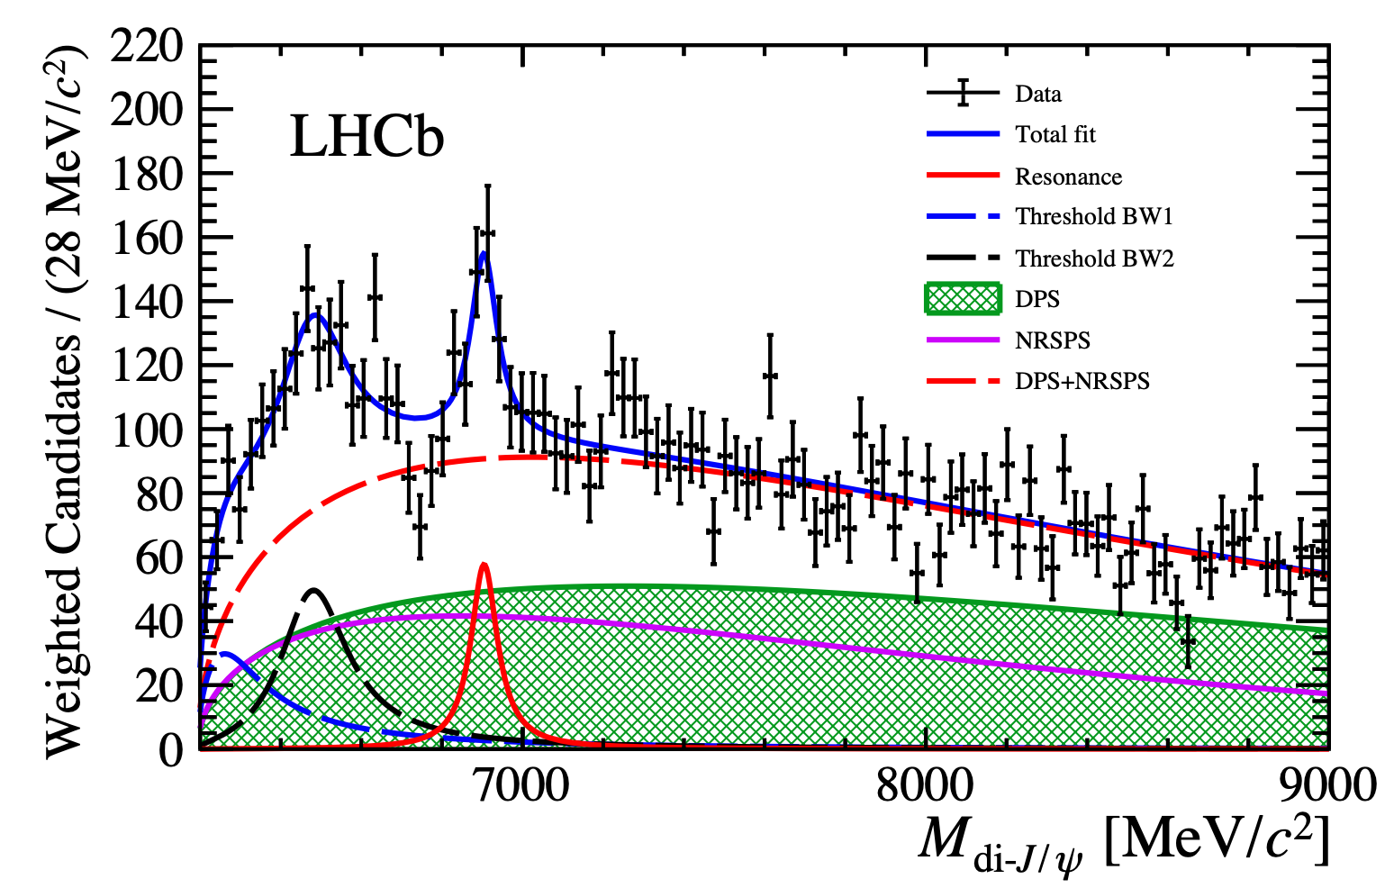
Full-charm tetraquark candidate
Ref. L4
Di-$J/ψ$ mass spectrum
$J/ψ→μ^{+}μ^{−}$
All data, 34K signal pairs
Spectrum modelling:
Smooth function for non-resonant production
Dip
Breit-Wigner (BW) for peaking structures
Broad structure (2 BWs): $>5σ$
Structure at 6.9 GeV/c² (1 BW): $>5σ$
7.2 GeV/c² structure: $<1σ$
$m\left[X\left(6900\right)\right]=6905±11±7$ MeV
$Γ\left[X\left(6900\right)\right]=80±19±33$ MeV
$\frac{σ[pp→\left(X→J/ψJ/ψ\right)]}{σ(pp→J/ψJ/ψ)}=\left(1.1±0.5\right)\%$
Other scenario possible: $J/ψχ_{c}$ feeddown…
$σ\left(pp→J/ψJ/ψ\right)=15.2±1.3$ nb
Difficulty to model the dip at 6.8 GeV !
JHEP 06 (2017) 047

Slide 15
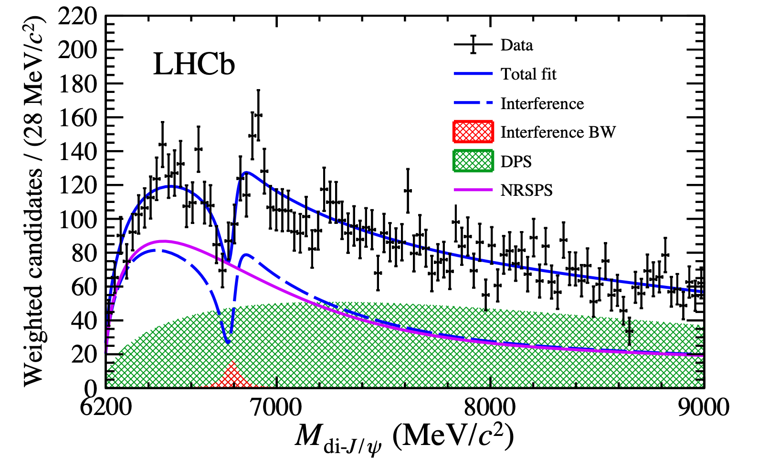
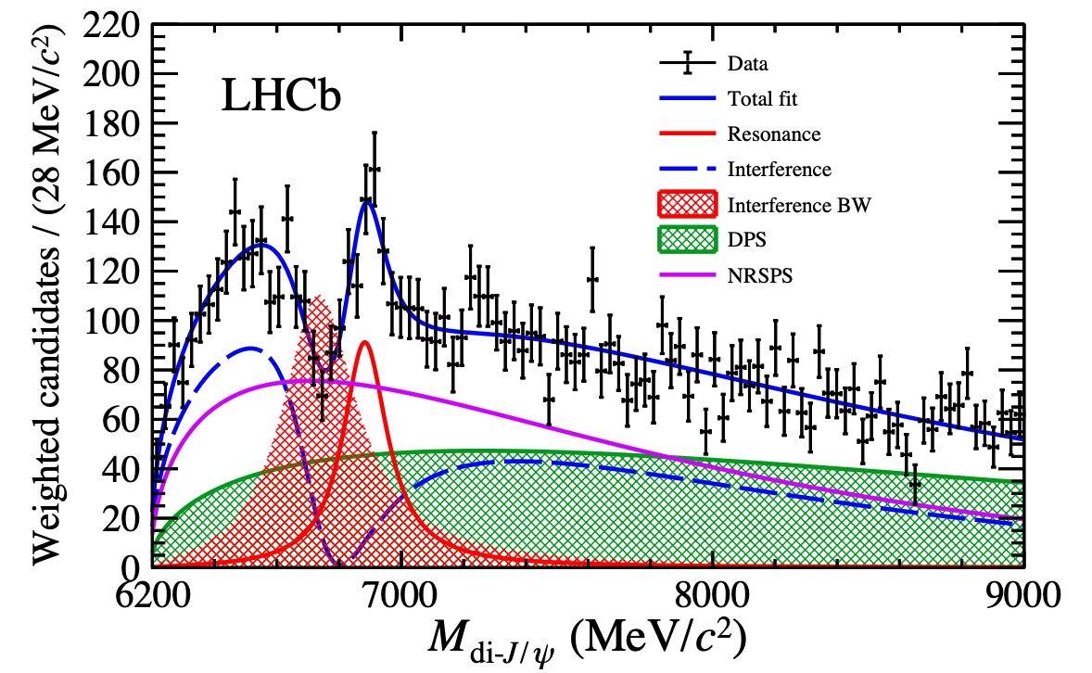
Full-charm tetraquark candidate
Ref. L4
Interference to describe dip at $6.8$ GeV
Two separate choices of possible compositions
I
(Non-resonant + one BW), $P_{χ^{2}}=2.8\%$
II
(Non-resonant + BW1) + BW2, $P_{χ^{2}}=15.5\%$
$m=6741 MeV/c^{2}$
$Γ=288 MeV/c^{2}$
$m\left[X\left(6900\right)\right]=6886±11±11$ MeV
$Γ\left[X\left(6900\right)\right]=168±33±69$ MeV

Slide 16
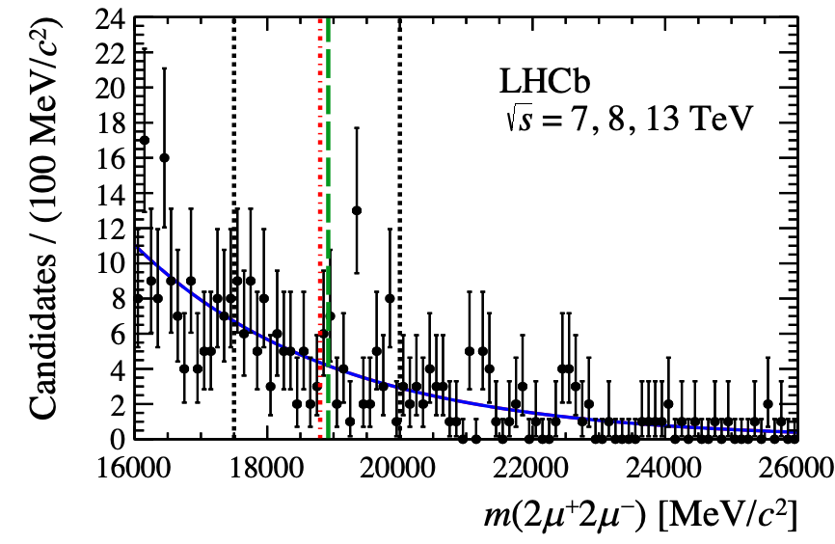
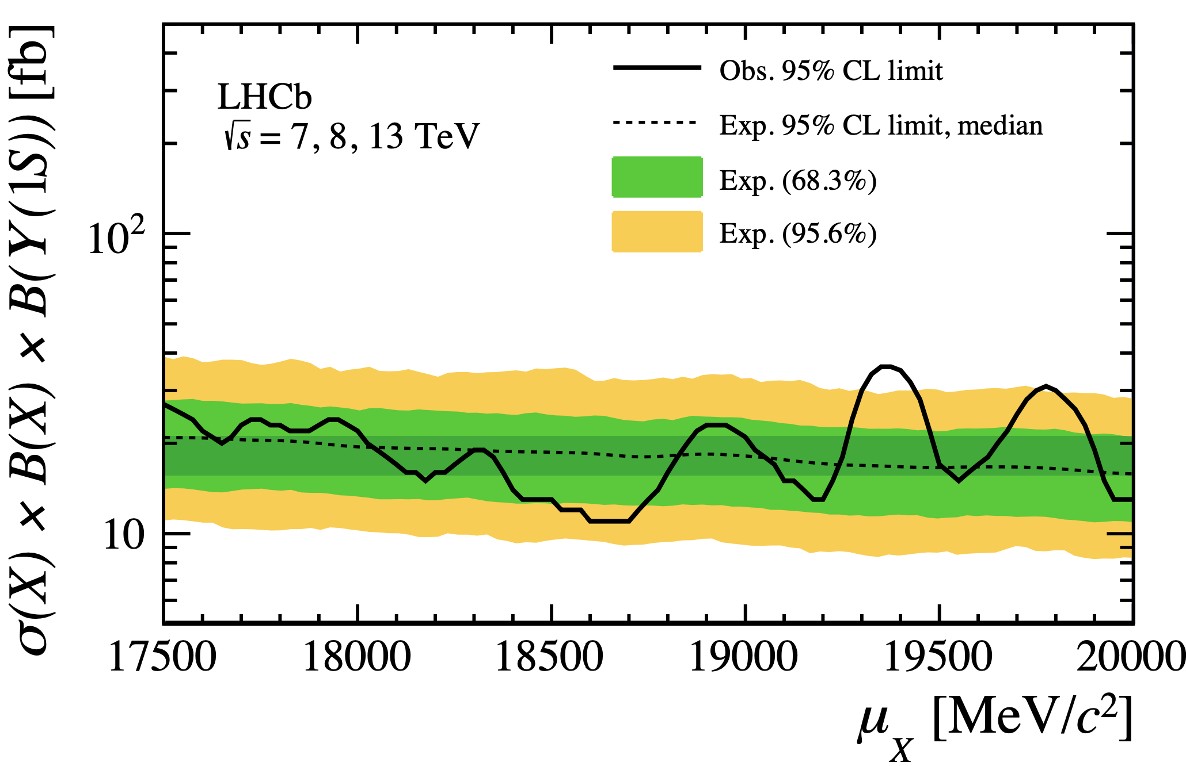
Other quarkonium pairs
Ref. L11
$T_{bb\overline{b}\overline{b}}$ searched in $Υμ^{+}μ^{−}$, including di-$Υ$ candidates, 6.3 fb⁻¹ data
No obvious di-$Υ$ signals at LHCb
$σ<\sim 20$fb at 95%
Upper limit on production
$ψ\left(2S\right)J/ψ, J/ψΥ$ being studied, signals ~1% of di-$J/ψ$
Smaller production and $μ^{+}μ^{−}$ decay rate
A few signal counts?

Slide 17
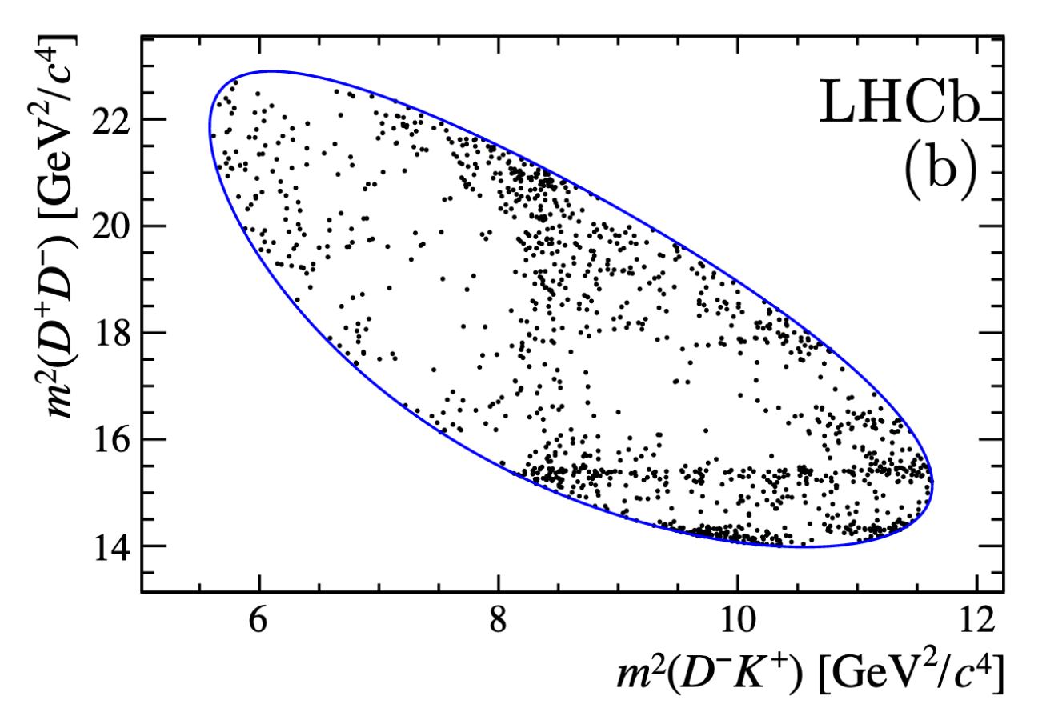
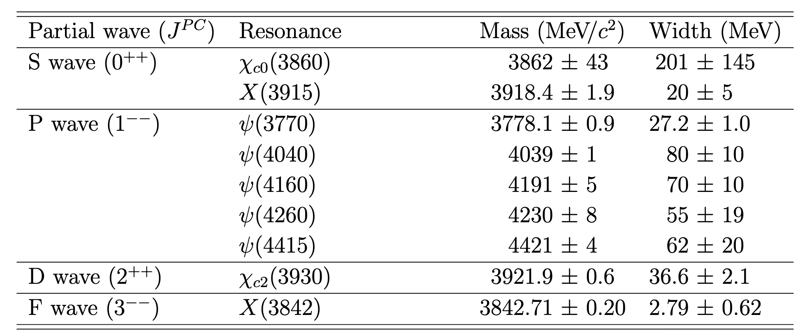
Structures in $B^{+}→D^{+}D^{−}K^{+}$
Ref. L1
$D^{−}K^{+}(\overline{c}\overline{s}ud)$structure observed in $B^{+}→D^{+}D^{−}K^{+}$ decays
Only charmonia expected for conventional hadrons: $0^{++}$, $1^{−−},2^{++}$
Structure not due to charmonia reflections
$$χ_{c0}(3930)$$
$$ψ(3770)$$
$$ψ(4160)$$
$$ψ(4040)$$
$$ψ(4415)$$
$$χ_{c2}(3930)$$
Notes:
Production of heavy flavor is governed by our theory of qcd, involves perturbative and non perturbative processes.
Calculations of heavy flavor production factorizes into parton distribution function in the projectile, parton level cross-section that can be calculated with perturbative expansions where the heavy quark mass set a scale that the prediction can be made at low-pt. The last is creation of color neutral hadrons from heavy quark, called the fragmentation.
The predication power of this framework relies on the universality of PDF and fragmentations. These are tested by studying hadronization in various environment, initial parton correlations in the projectile etc. The final state interaction of heavy flavor object is explored to study hadron strucutre of quark gluon medium in the heavy ion community.

Slide 18
Open charm tetraquark candidates
Ref. L1
_
_
Good fit with two ${X→D}^{−}K^{+}$ structures: $0^{+}, 1^{−}$
c
s
Note: no $D^{+}K^{+}[cu\overline{s}\overline{d}]$ structure needed
d
u
$$X_{1}(2900)$$
$$X_{0}(2900)$$
States | Mass/MeV | Width/MeV | Fraction/%
$$X_{0}(2900)$$ | $2866±7±2$ | $57±12±4$ | $5.6±1.4±0.5$
$$X_{1}(2900)$$ | $2904±5±1$ | $110±11±4$ | $30.6±2.4±2.1$
Quite large contribution!
In total 22 $B→{\overline{D}}^{(∗)}D^{(∗)}K^{0/+}$ modes and $B_{s}→{\overline{D}}^{(∗)}D^{(∗)}KK$, $B→D_{s}^{+}\overline{D}π^{+/−}$…
Some related by isospin. Allow to study similar states, with 100-10K signals
PLB 704 (2011) 559
Notes:
Production of heavy flavor is governed by our theory of qcd, involves perturbative and non perturbative processes.
Calculations of heavy flavor production factorizes into parton distribution function in the projectile, parton level cross-section that can be calculated with perturbative expansions where the heavy quark mass set a scale that the prediction can be made at low-pt. The last is creation of color neutral hadrons from heavy quark, called the fragmentation.
The predication power of this framework relies on the universality of PDF and fragmentations. These are tested by studying hadronization in various environment, initial parton correlations in the projectile etc. The final state interaction of heavy flavor object is explored to study hadron strucutre of quark gluon medium in the heavy ion community.

Slide 19
Summary
Extensive studies of $X(3872)$, settled?
Charged $Z_{c}(c\overline{c}u\overline{d})$ in b decays, how many; strange partners; production
Many $X(c\overline{c}s\overline{s})→J/ψφ$ states, possible excited $c\overline{c}$ states?
Fully heavy states $X_{QQ\overline{Q}\overline{Q}}$, full spectrum?
Open charm tetraquark $csu\overline{d}$: many more to be studied
Tetraquarks
Molecule
Cusps
….

Slide 20
Summary
Extensive studies of $X(3872)$, settled?
Charged $Z_{c}(c\overline{c}u\overline{d})$ in b decays, how many; strange partners; production
Many $X(c\overline{c}s\overline{s})→J/ψφ$ states, possible excited $c\overline{c}$ states?
Fully heavy states $X_{QQ\overline{Q}\overline{Q}}$, full spectrum?
Open charm tetraquark $csu\overline{d}$: many more to be studied
Tetraquarks
Molecule
Cusps
….
日益深入的理论研究与有限的实验能力的矛盾
Thank you for your attention

Slide 21
Backups

Slide 22
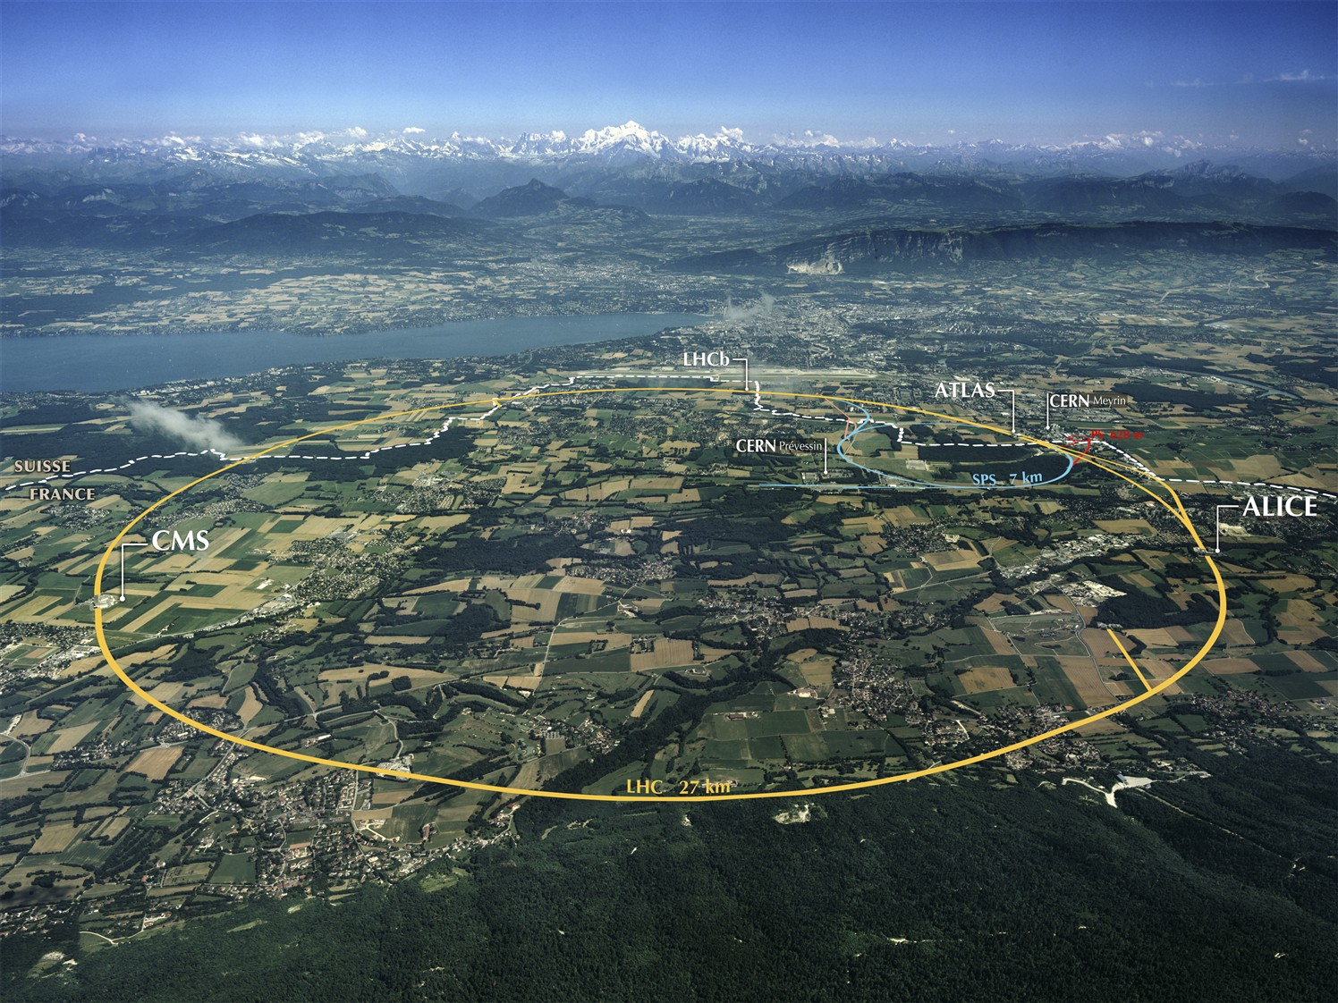
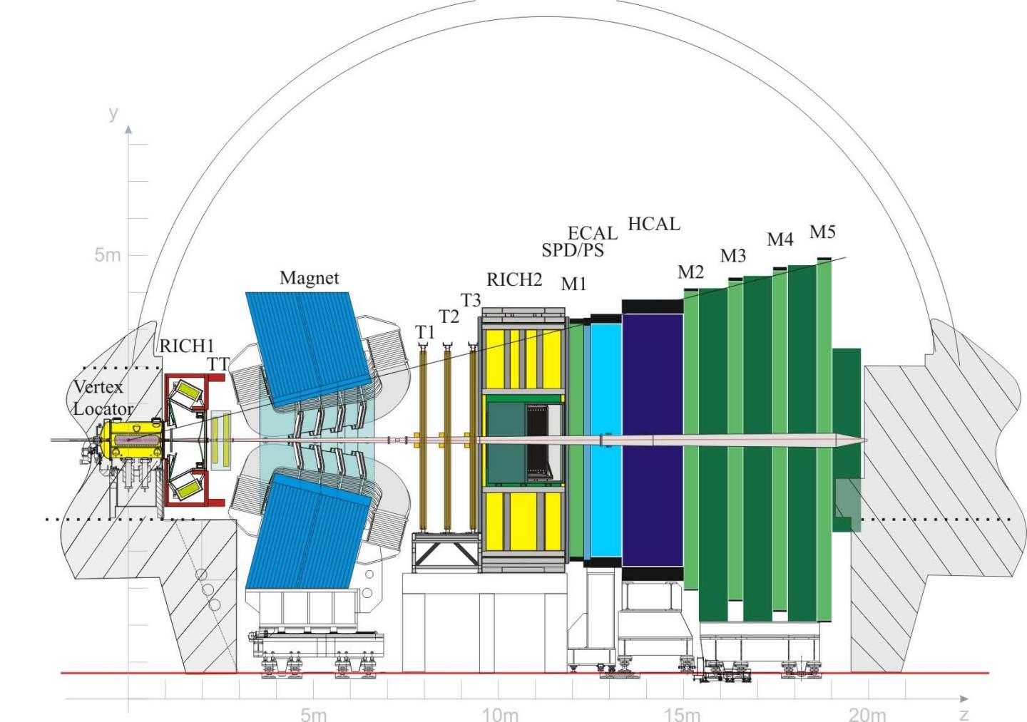
LHCb experiment
One of the four large experiments at CERN
Aiming for precision measurements in $b,c$ flavor sectors
Forward acceptance: $2<η<5$
JINST 3 (2008) S08005
IJMPA 30 (2015) 1530022
Large Hadron Collider Experiments

Slide 23
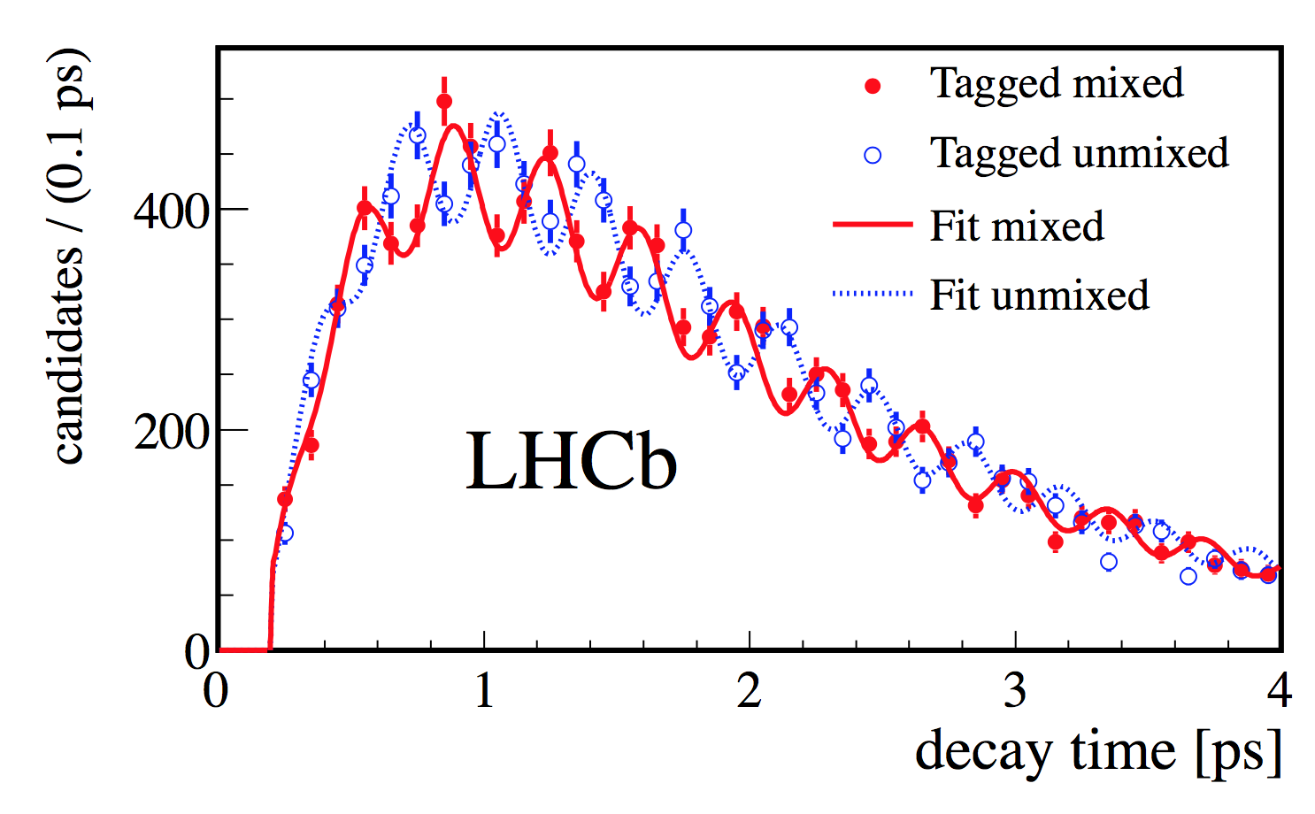
LHCb detector
JINST 3 (2008) S08005
IJMPA 30 (2015) 1530022
Vertex Locator (vertex reconstruction)
Impact parameter resolution: $20μm$
Decay time resolution: $45 fs (τ_{B}\sim 1.5 ps)$
RICH detectors
($K/π/p$ separation <100 GeV)
$ε\left(K→K\right)\sim 95\%$
Mis-ID $ε\left(π→K\right)\sim 5\%$
250 mrad
New J. Phys. 15 (2013) 053021
$$pp$$
$B_{s}^{0}−{\overline{B}}_{s}^{0}$ oscillation
Tracking system
(particle reconstruction)
$ε\left(Tracking\right)\sim 96\%$
${δp}/p\sim$0.5%-1% (5-200 GeV)
$σ\left(m_{B→hh}\right)≈22 MeV$
Muon system
($μ$ identification)
$ε\left(μ→μ\right)\sim 97\%$
Mis-ID $ε\left(μ→μ\right)\sim 1−3\%$

Slide 24
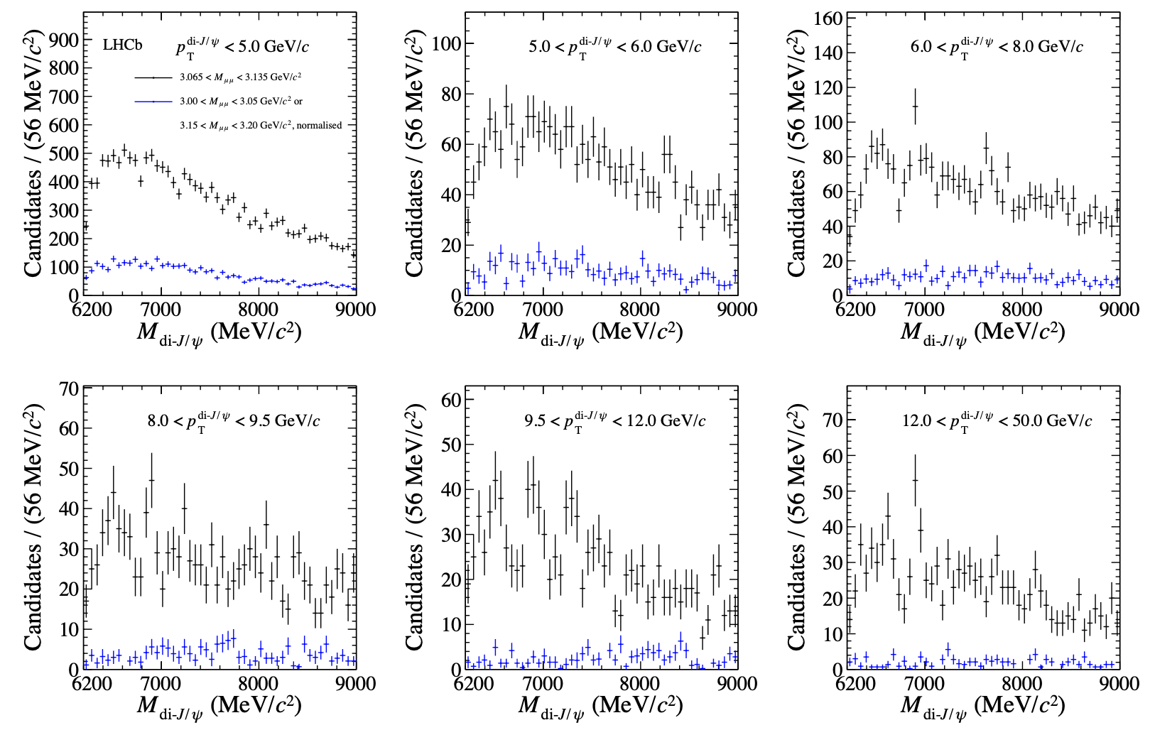
Di-$J/ψ$ invariant mass
Same structures presented in high $p_{T}$ bins
arXiv:2006.16957

Slide 25
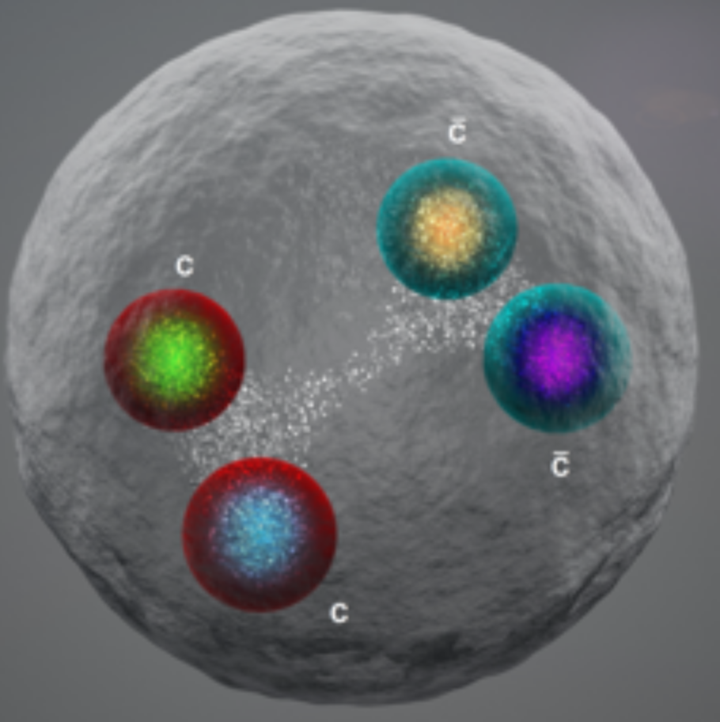
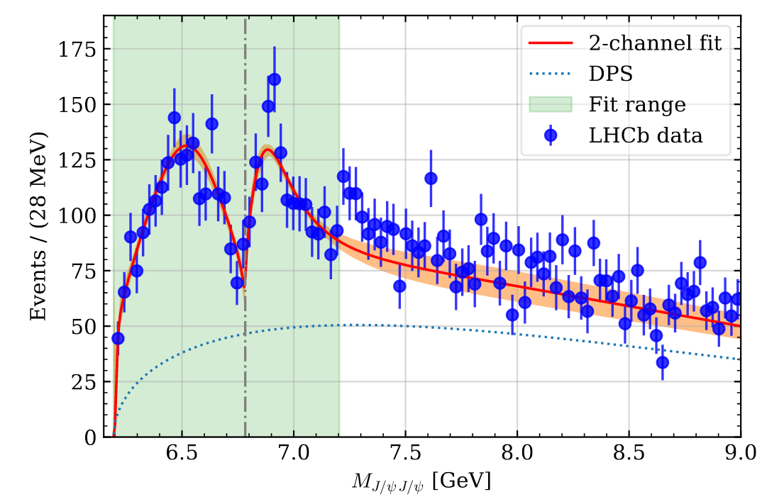
How to interpret data
There are nontrivial structures
But difficult to understand all structures
Peak at 6.9 GeV relatively isolated, well modeled by a BW X(6900)
Structure at threshold: one BW, multiple BWs or feed-downs
Interference is possible and fits better, but not significant enough yet
Statistics could help, LHCb needs Run3. But CMS and ATLAS have many more data
Theory inputs?
Production
Structure
Spectrum
Spin-parity
Other decay may also help
$J/ψ$ $ψ^{′}, J/ψΥ\text{,} \text{ss}\overline{s}\overline{s}$ …
arXiv:2009.08450 …
arXiv:2009.07795 …
arXiv:2006.14445 …
arXiv:2007.05501 …
Structure: naturally tetraquark but also explained with coupled channels ($ψψ,ψ^{′}ψ$…)

Slide 26
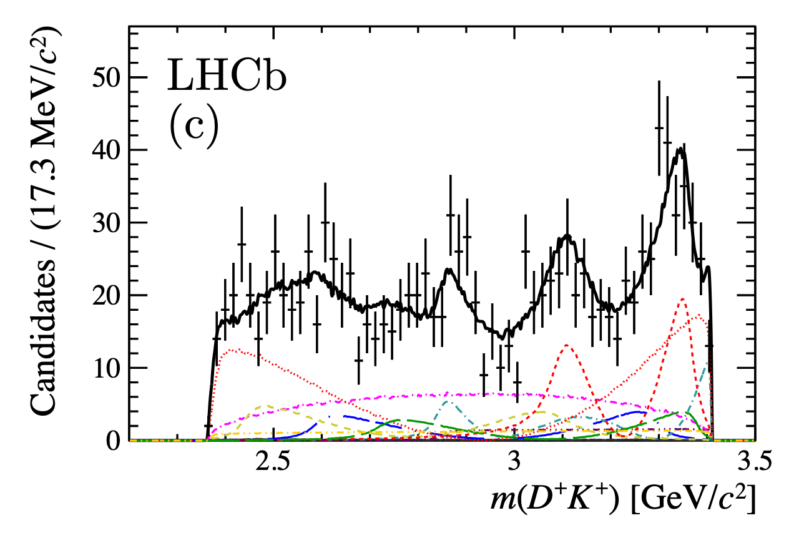
$B^{+}→D^{+}D^{−}K^{+}$ distribution

