Slide 1
CEPC SR System and BES testbeam facility
CEPC SR study group
2020.11.25
CEPC day

Slide 2
Outline
CEPC CDR: parameters and baseline layout
SR design in the CEPC CDR/The new design: parameters, baseline and the applications
The focusing of the CEPC SR and the detection array of the gamma-ray beam
Testbeam facility
summary

Slide 3
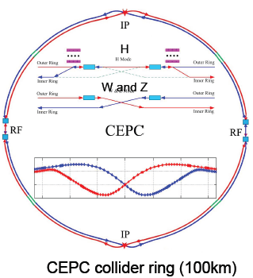
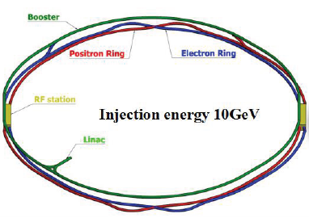
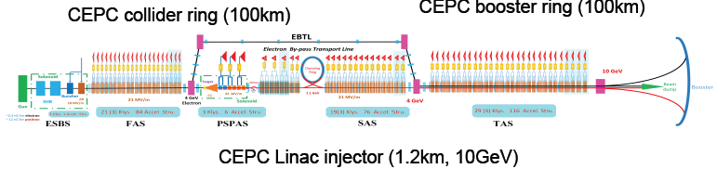
CEPC CDR baselines layout
Notes:
Considering : radiation power, the baseline layout, the cost and the polarization for Z or W mode. If we add wiggler, it maybe useful for polarization, but increase the radiation power also the cost.

Slide 4
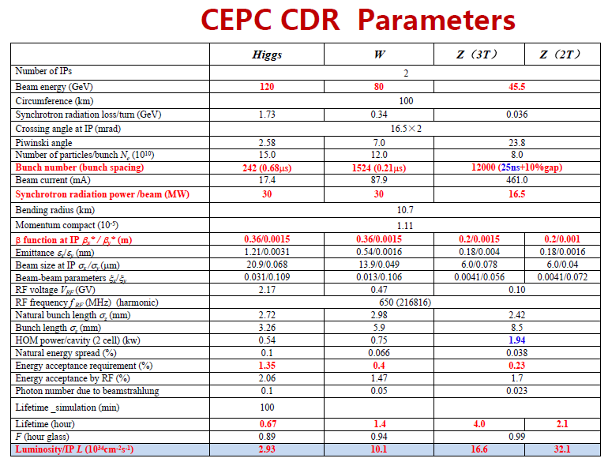
Notes:
The bunch number: 0.68us the dynamic imagination, the time resolution
The bunch length:90ps: 2.72mm

Slide 5
Outline
CEPC CDR: parameters and baseline layout
SR design in the CEPC CDR/The new design: parameters, baseline and the applications
The focusing of the CEPC SR and the detection array of the gamma-ray beam
Testbeam facility
summary

Slide 6
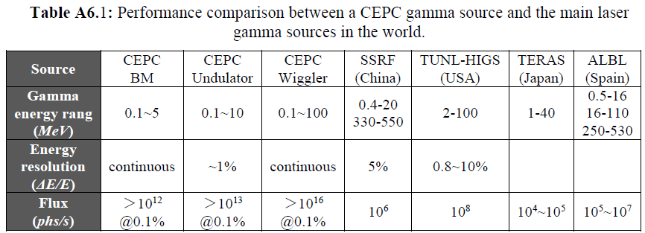
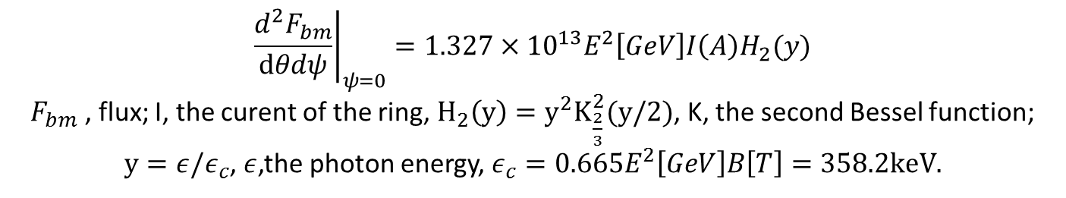
Central intensity of Synchrotron radiation,[photon/s/mrad2/0.1%b.w.]
$${\left.\frac{d^{2}F_{bm}}{dθdψ}\right|}_{ψ=0}=1.327×{10}^{13}E^{2}\left[GeV\right]I\left(A\right)H_{2}(y)$$
$F_{bm}$ , flux; I, the curent of the ring, $H_{2}\left(y\right)=y^{2}K_{\frac{2}{3}}^{2}(y/2)$, K, the second Bessel function;
$y=ε/ε_{c}$, $ε$,the photon energy, $ε_{c}=0.665E^{2}\left[GeV\right]B\left[T\right]=358.2keV.$
Notes:
IN these calculations, the Increment of the radiation power is not considered. It is a big problem. Another problem: do we need undulator and wiggler together? Maybe, just wiggler Is Ok. The gamma energy from the wiggler can cover that from undulator. Also the spectrum from undulator is not monoenergetic too. The another problem is: there are no so many users of the high energy gamma-ray.

Slide 7
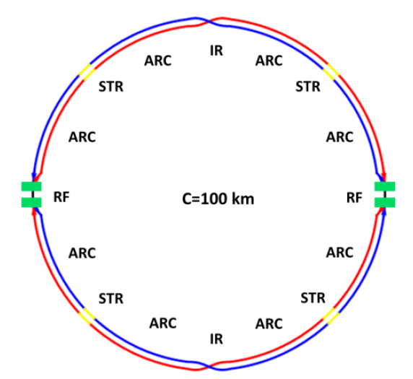
Total design of the SR stations
Four beamlines：
S1+S2
bending magnetic field line：0.1-5MeV, >10^12@0.1%,
High energy X-ray diffraction/scattering/transmission beam line
Hard X-ray micro/nano probe beamline
High voltage extreme condition beam line
wiggler beamline：0.1-100MeV,>10^14@0.1%
Photon-nuclear physics science
Others high energy gamma-ray station, GRB simulations
S1+S2:wiggler+MWCS energy calibration+ Bend

Slide 8
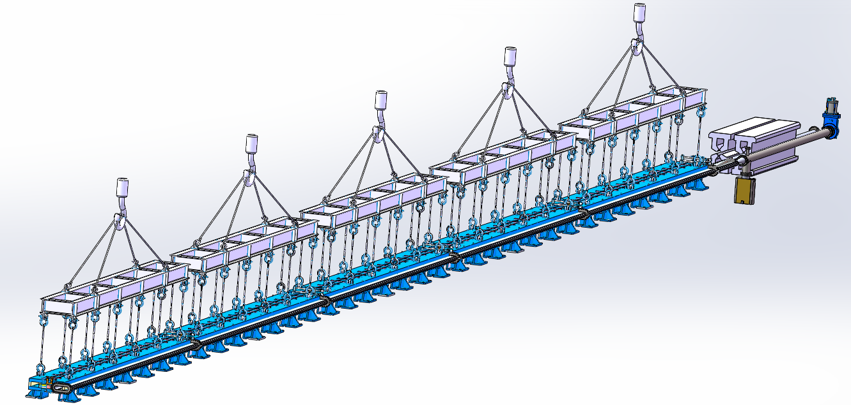
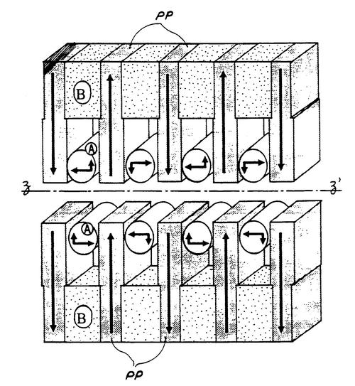
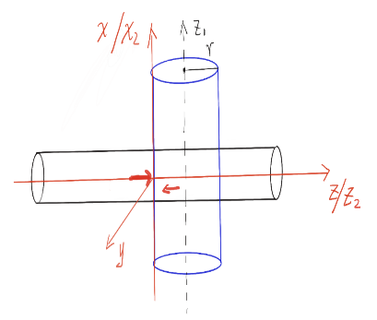
The vacuum chamber design
The first diode vacuum box in the first 28-meter diode vacuum box
The first meter diode vacuum box remains unchanged
The second meter diode vacuum box needs to be extended by 150mm
微波管
束流管
王鹏程，黄永盛，王毅伟，杨梅
电子束团与微波光子180度相互作用

Slide 9
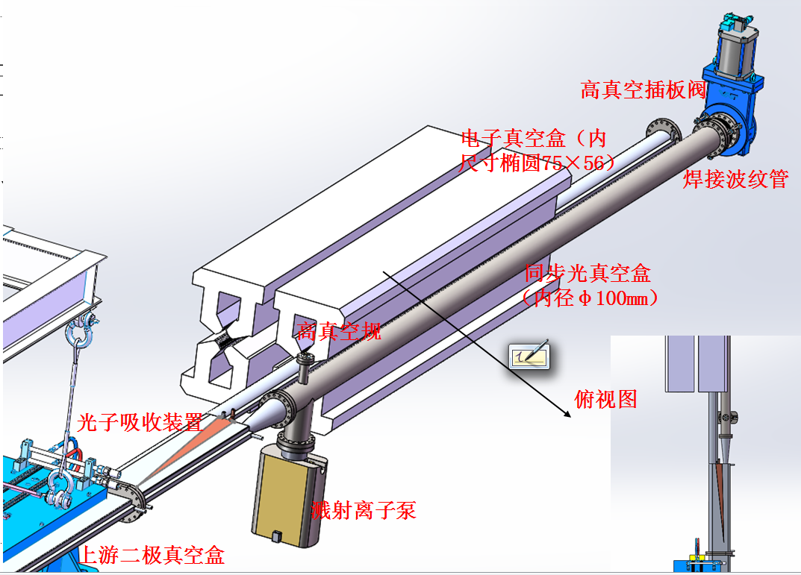
真空管分叉、二级铁末端与四级铁

Slide 10
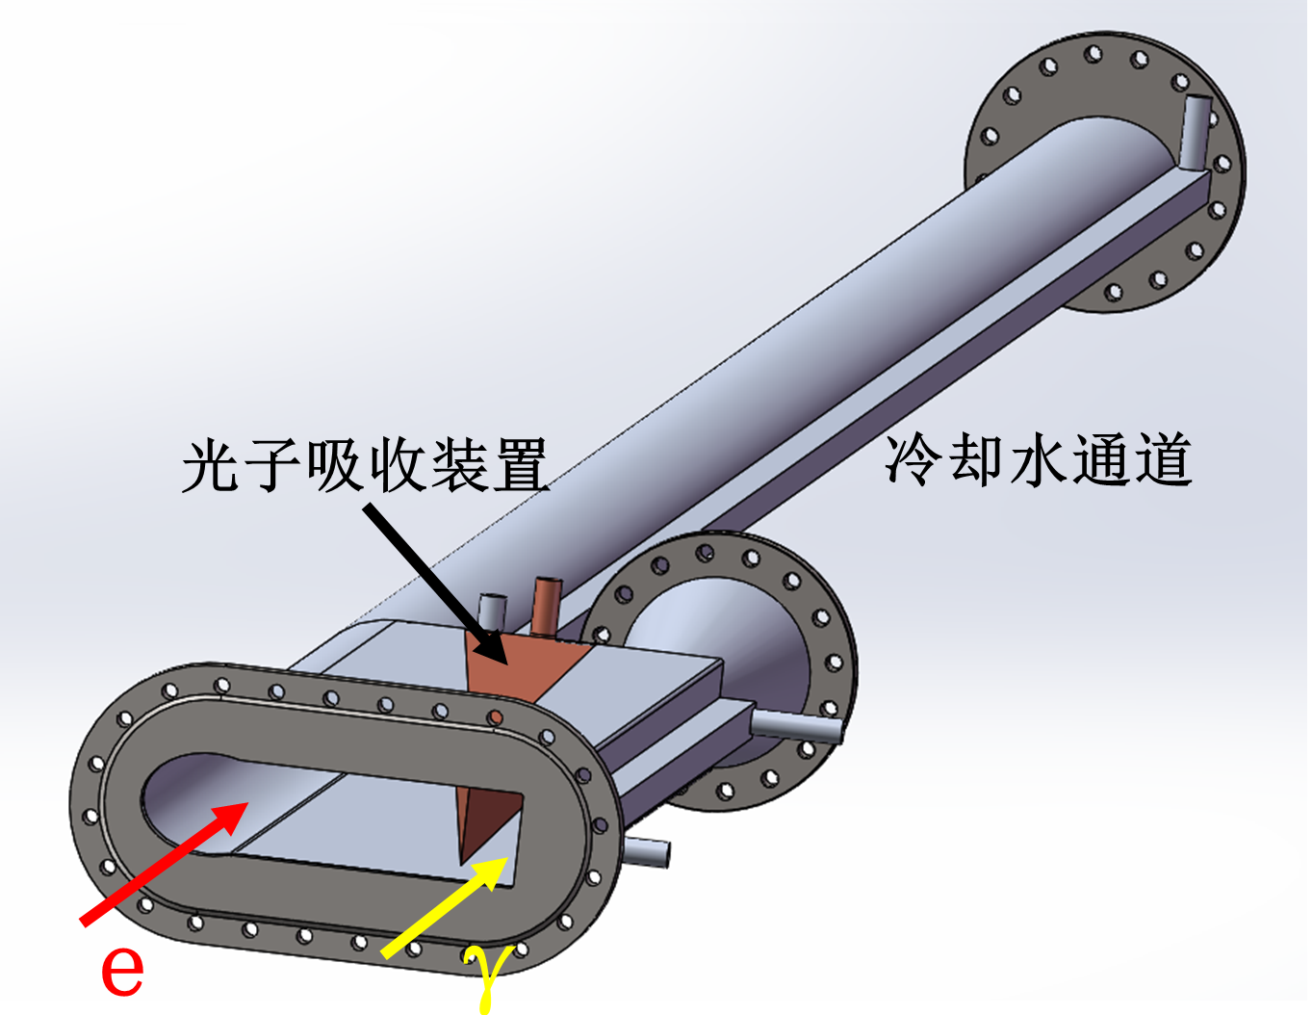
The vacuum chamber design

Slide 11
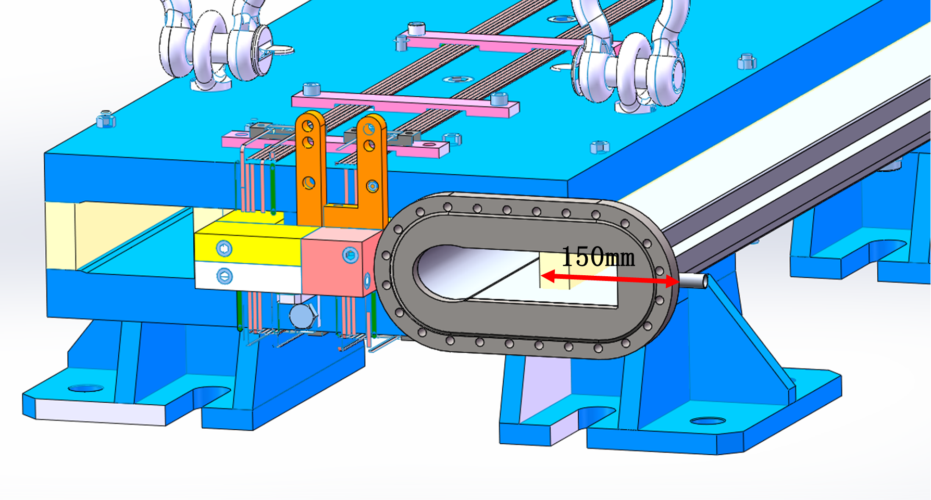
Vacuum piping in dipole iron and requirements for side ends of the iron

Slide 12
Tunnels, halls and shafts
Tunnel cross section :3m * 3m
15m
The door on the shield wall:2m*3m
HALL:
15m * 20m * 5m(高)
with overhead crane
300cm
vacuum
pipe
20m
80cm
20cm
8m
100cm
200cm
Shield wall:1m
Door
上一页各束线的终点坐标，从这个点开始，沿着束线方向，向岩石内挖3X3米的隧道，
挖到10米处是防护门，然后是大厅。见右图。
束线S1和S2的大厅处，需分别有吊装竖井和载小货物电梯
电梯：2m*2m*3m，称重>2顿。
Channel
10m

Slide 13
The discussions
1. The length of the beam line exceeds 700 meters, and the vacuum system is recommended to be composed of getter films (NEG films) + ion pump.
2. All the beam lines can be divided into 8 sections, each section is separated by all-metal ultra-high vacuum valves (9 valves), and each section has a separate rough suction port and gas filling port, and each section 5-10 ion pumps are uniformly distributed in the section (used to pump out gases that are not easy to pump out of getter films such as CH4), and the inner walls of all vacuum boxes are plated with NEG films.
3. The material of the vacuum box can be 304 stainless steel (the inner size is φ100, the wall thickness is 3mm).
4. Vacuum measurement adopts 2 measurement points in each section, and cold cathode vacuum gauge is used for measurement.
5. In the photon collimation area, it is necessary to arrange temperature measurement points in the nearby vacuum box to monitor the temperature change of the outer wall of the vacuum box.

Slide 14
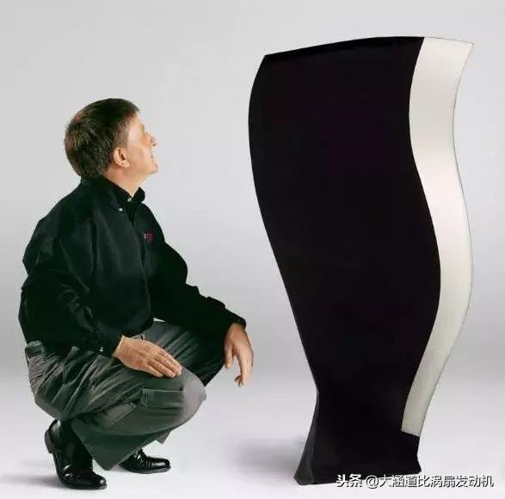
S1 SR from bending magnetic field：0.1-5MeV, >10^12@0.1%
High energy X-ray diffraction/scattering/transmission beam line
In-situ observation and structural analysis of aircraft engine blade growth process
Structural changes of special steel
Observation of special welds
Hard X-ray micro/nano probe beamline
High voltage extreme condition beam line
Structural changes of special materials under dynamic and high pressure conditions of 1000GPa
Study on the equation of state of special materials under static high pressure and high temperature/low temperature

Slide 15
CEPC high-flux γ beamlines
Complementary with the third generations of synchrotron sources, spallation neutron sources, industrial CT, and LCS gamma sources:
7.5cm steel penetration, several micron resolution, high flux fast imagination
Static imaging - engine blade inspection: 6cm thick steel, 1-5 micron resolution
Dynamic imaging---metal phase change process-droplet solidification/seawater corrosion mechanism: us, 6cm thick steel, 1-5 micron resolution
Image reso.
Spallation neutron source
mm
Third generations
Synchrotron radiation source
High energy CT
10um
CEPC-SR γ
（static & dynamic）
LCS γ
um
Micro-nano CT
mm/keV-10keV
cm/100keV
10cm/MeV
penetration/energy

Slide 16
S2: SR from wiggle magnetic field：0.1-100MeV, >10^14@0.1%
Photon-nuclear physics science
Gamma assisted transmutation
Giant resonance,
Nuclear resonance fluorescence
a “mini” giant dipole resonance it is often called pygmy dipole resonance (PDR).
¹²C(α,γ)¹⁶O reaction: the "Holy Grail" of nuclear astrophysics.
Others high energy gamma-ray station, GRB simulations
radio-pharmaceuticals production

Slide 17
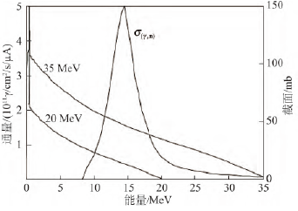
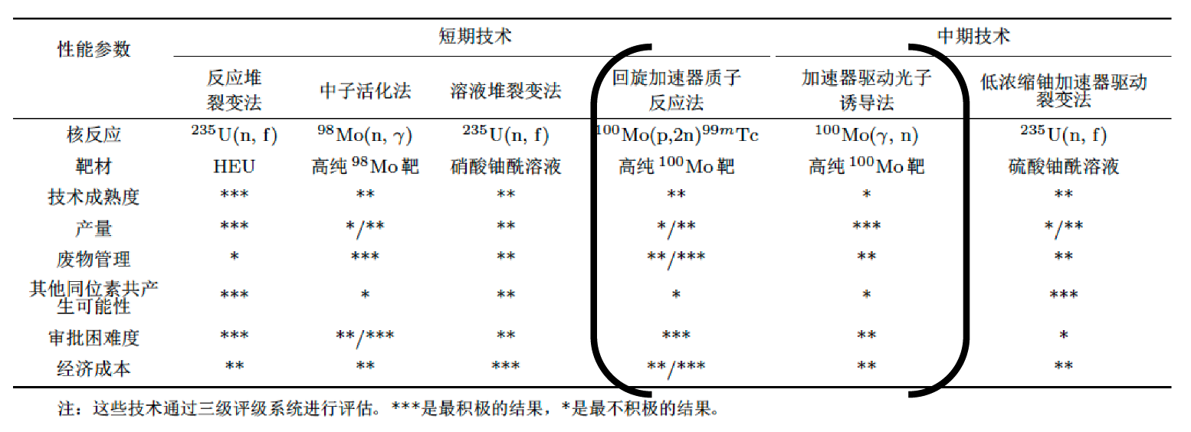

It is very suitable to use wiggler gamma beam energy and flux
𝛾射线诱发100Mo(𝛾,n)反应，反应阈值约为9 MeV；在14.5 MeV 下出现截面最大，约为150 mb。
S=$\frac{N_{A}\left(0.693\right)}{MT}=1.96×10^{13}Bq/mg$
1Mo99=1.66*10^-25kg=1.66*10^-19mg
1mg=6*10^18Mo99
1h 10^14 flux ->1.44mg Mo99
762Ci Molybdenum

Slide 18
Outline
CEPC CDR: parameters and baseline layout
SR design in the CEPC CDR/The new design: parameters, baseline and the applications
The focusing of the CEPC SR and the detection array of the gamma-ray beam
Testbeam facility
summary

Slide 19
The challenges and the next to do
1) The focalization of gamma-ray: larger than MeV
2) The detection of the energy distribution and the spatial distribution of the SR from bending magnetic and wiggler
3) The Mechanical design drawings and equipment, and cost estimates

Slide 20
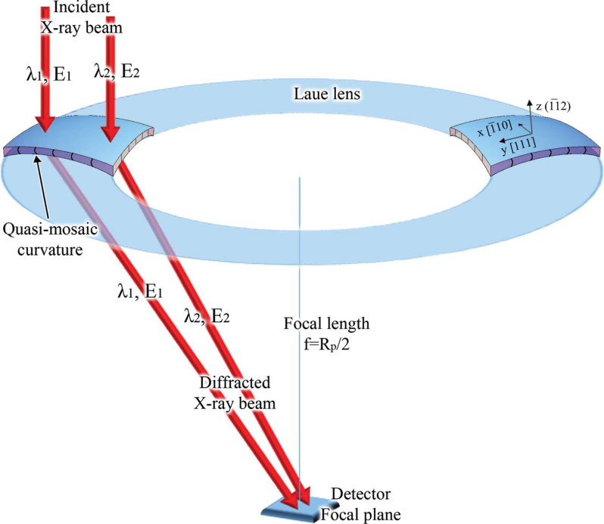
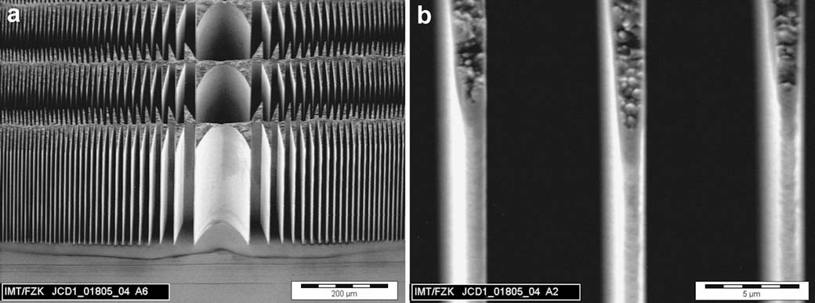
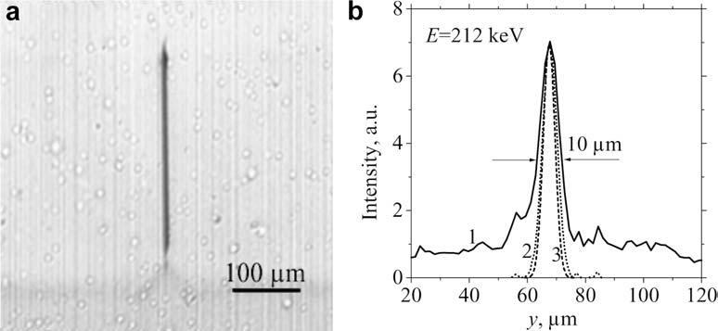
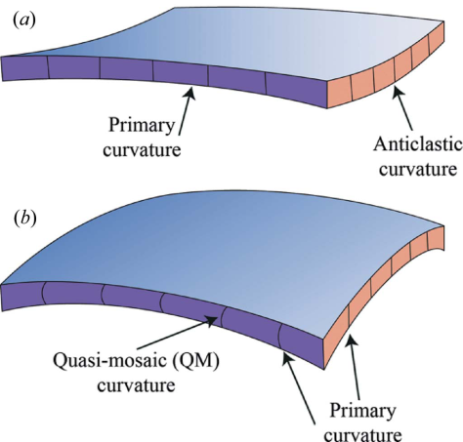
The focalization of hard x-ray
And soft gamma-ray 100keV-1MeV, 1MeV still problem?
LIGA fabrication of X-ray Nickel lenses
100keV-1MeV : Microsystem Technologies 11 (2005) 292–297
Schematic representation of a Laue lens based on QM crystals. J. Appl. Cryst. (2015). 48, 977–989

Slide 21
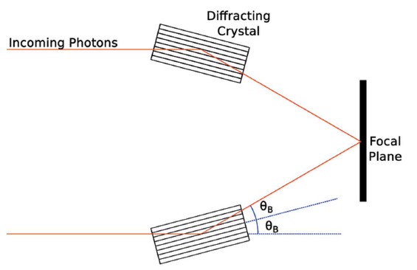

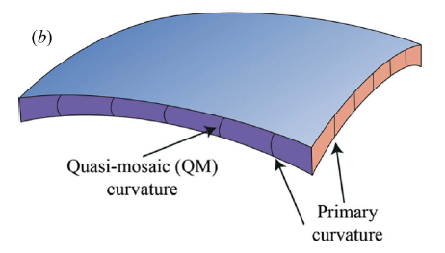
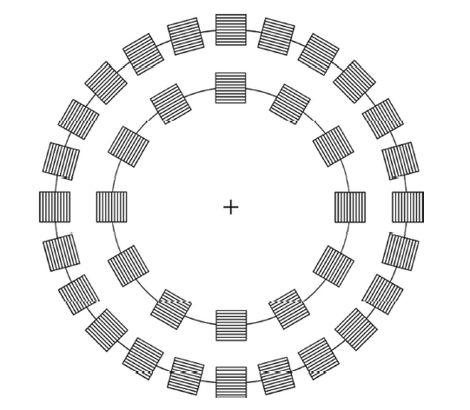
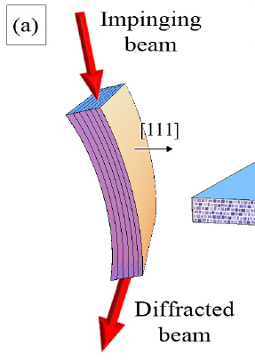
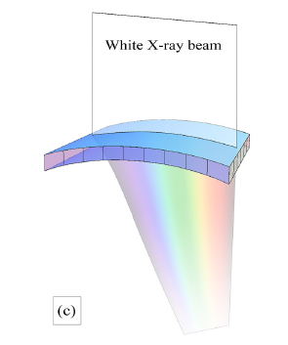
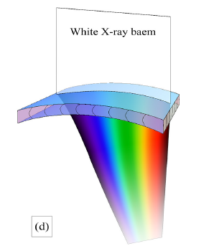
For high-energy photons, the Bragg angle is very small, and even in small beams the crystal must be large to diffract. Therefore, Laue geometry represents a more convenient choice.
Perfect crystal, mosaic crystal,
the maximum reflectivity is 1/2
Curved diffraction plane crystal (CDP), quasi-mosaic (QM) crystal, peak reflectance is not limited by 1/2

Slide 22
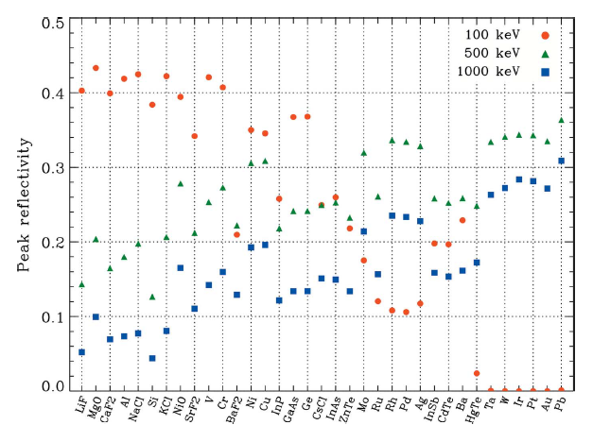
Choice of crystal
For various crystals, the peak reflectance at 100 keV, 500 keV, and 1 MeV energies, Z (atomic number) increases from left to right.
As can be seen from the figure on the right, at high energy, the higher reflectance is a crystal with higher Z; on the other hand, at low energy, the higher reflectance is a crystal with lower Z.

Slide 23
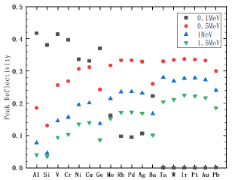
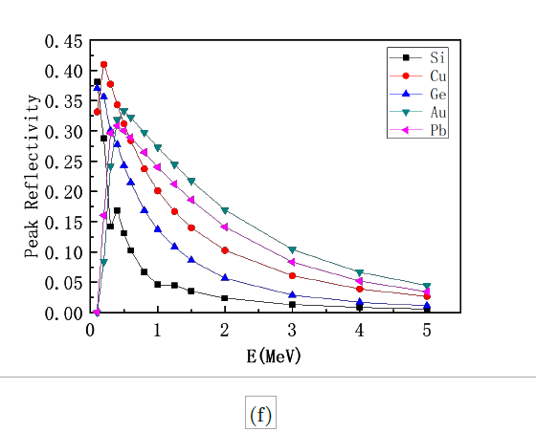
Material selection of MeV focusing lens: Pb, Au
图 : 假设是镶嵌晶体，镶嵌度 Ω 为 30arcsec，微晶厚度 t0 为 5µm，晶体厚度 T0 可由 (3.11)式算出，但被限制在 1 ∼ 25mm 范围内。Si、Ge、Cu、Au 和 Pb 峰值反射率随能量的变化。
图 : 18 种晶体的能量分别在 0.1MeV、0.5 MeV、1 MeV 和 1.5 MeV 时的峰值反射率，按原子序数从左到右逐渐增加排列。假设是镶嵌晶体，镶嵌度 Ω 为 30arcsec，微晶厚度 t0 为 5µm，晶体厚度 T0 可由 (3.11) 式算出，但被限制在 1 ∼ 25mm 范围内。

Slide 24
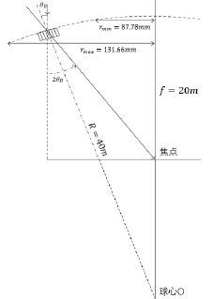
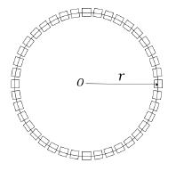

Preliminary scheme of MeV focusing lens
选择劳厄透镜的焦距为 20m，因为 20m 是天体物理学应用中通常会考虑到的焦距。
所以可以算出，当能量为 0.8MeV 时，半径最大为 131.66mm，当能量为 1.2MeV 时，半径最小为 87.78mm。晶体环排列越紧密，相邻环的能量重叠越多，劳厄透镜衍射的能量越平滑，则这个劳厄透镜由 5 个晶体环组成，且每个环上都排列尽可能多的
晶体，这可以使得劳厄透镜的有效面积最大。
估价-100万左右
Figure 2: 0.8-1.2MeV Laue lens geometry
Figure 1: (a) Au Crystal arrangement ，(b)Au Crystal size ，(10×10×3)mm2

Slide 25
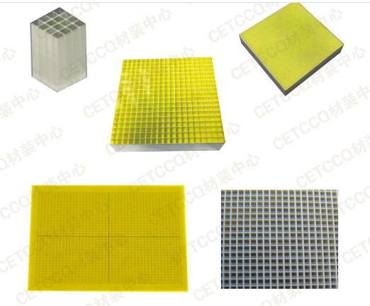
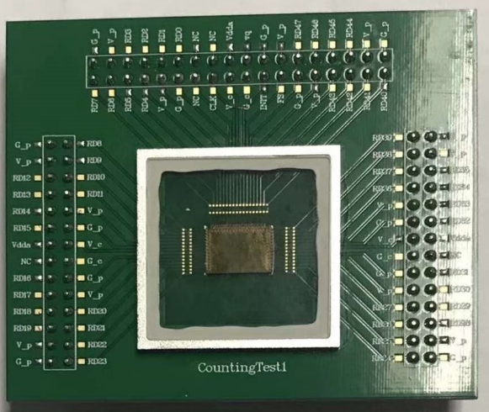
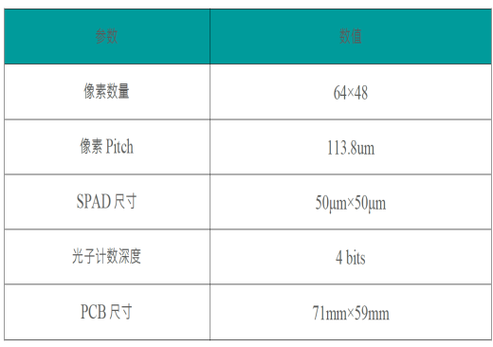
MeV array/imaging gamma detector
Det：Array Cerium-doped gadolinium gallium aluminum multi-component garnet GAGG：150mm*150mm，0.2mm one unit
Elctronics：SiPM array 50um pixel 实现阵列像素4块75mm*75mm的拼接 or 3mm array of SiPM
30-50 Micron plate GAGG Screen
10 Micron particle size GAGG Powder screen

Slide 26
Outline
CEPC CDR: parameters and baseline layout
SR design in the CEPC CDR/The new design: parameters, baseline and the applications
The focusing of the CEPC SR and the detection array of the gamma-ray beam
Testbeam facility
summary

Slide 27
Beijing Test beam- before 2017

Slide 28
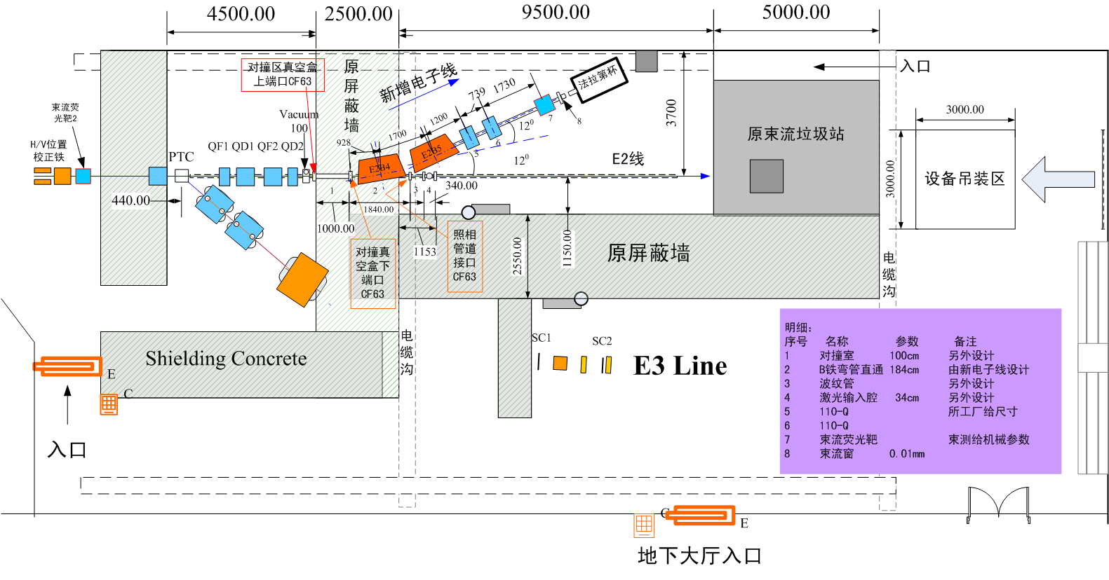
Beijing TestBeam after 2017

Slide 29
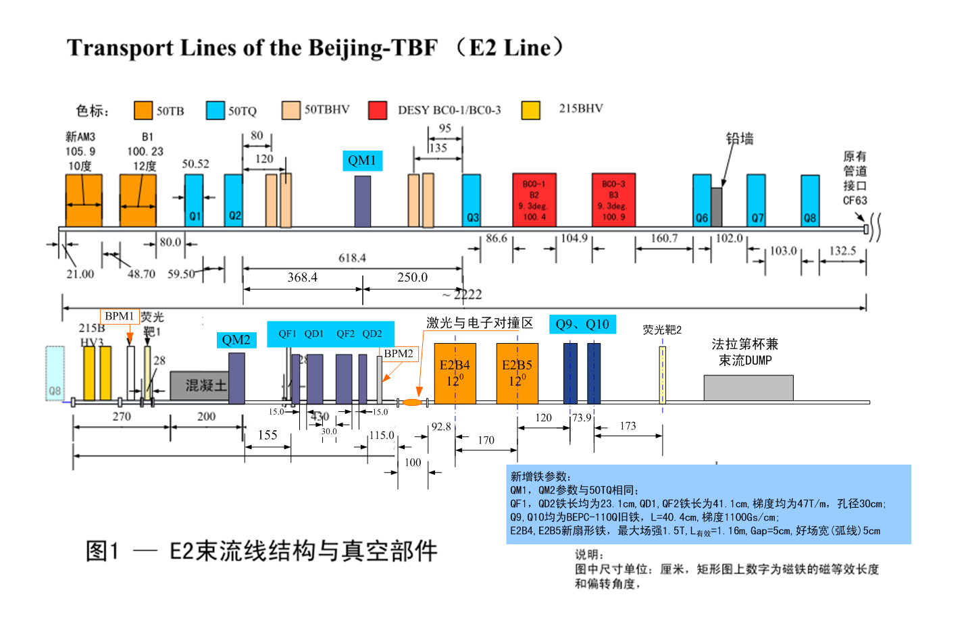
Beijing Test Beam
AM3：10度，B1：12度，B2、B3：9.3度，B4、B5：12度

Slide 30
E2 line :
10-50Hz 2.5GeV 1.89GeV nC 10ps
Electron transmission imaging
Laser-electron inverse Compton scattering
New acceleration principle
Particle acceleration in the Plasma weakfield driven by electron beams
Positron generation and acceleration from a thin target Bombarded by an electron beam (Shen Baifei, Comunication Physics )
Neutron source
Multi-particles radiation field
BPM calibration
CMS calibration: linear region
…

Slide 31
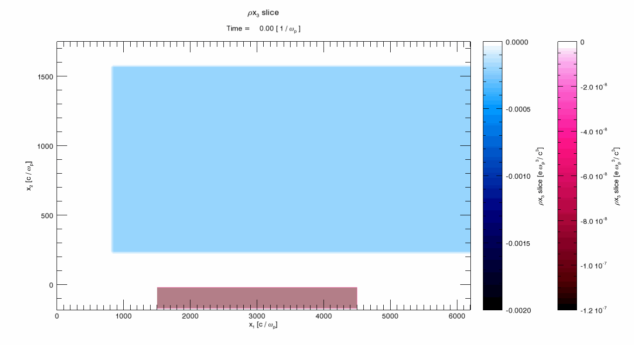
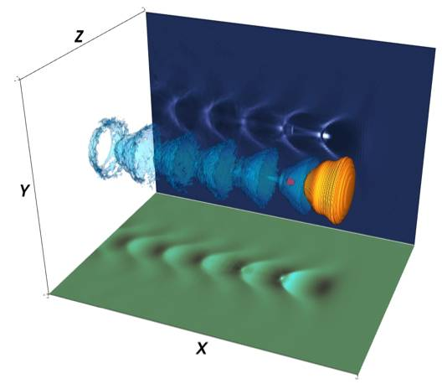
Experimental Study on the plasma wakefield Driven by a High Energy Electron Beam
Beijing test beam:
12.5-50Hz 2G 1nC 10ps; sigma of the beam: mm-cm
Combining the requirements of CEPC and the detection technology of particle physics experiments, we carried out a high charge electron beam-driven wakefield experiments to explore the possibility of experiment landing and provide key experimental data

Slide 32
E3 line:
（1）single particle energy resolution ≤ 1%@300MeV；
（2）spatial positioning accuracy（sigma）≤ 0.15mm；
（3）paritcles（proton、pion介子）number rate，500-700@600MeV/minute （当加速器供束频率25Hz时）。

Slide 33
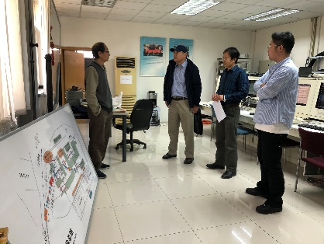
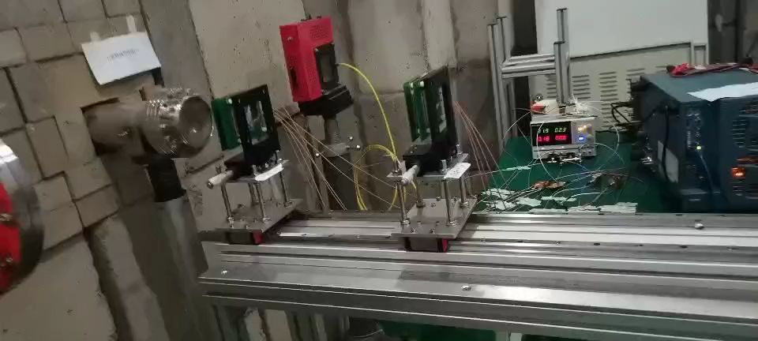
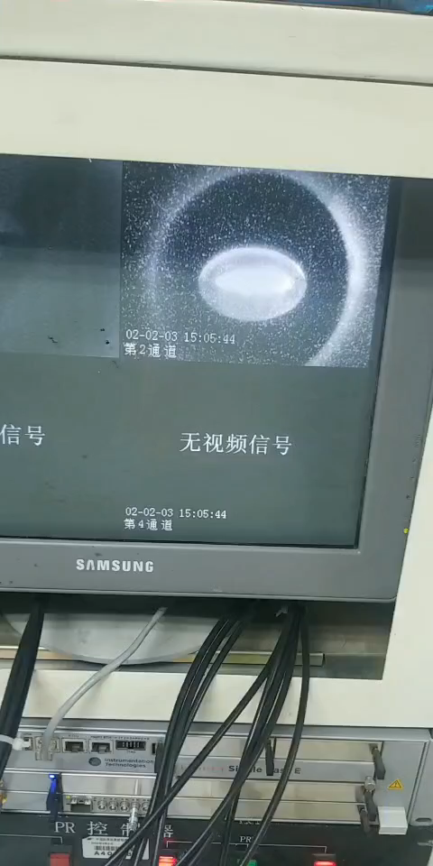
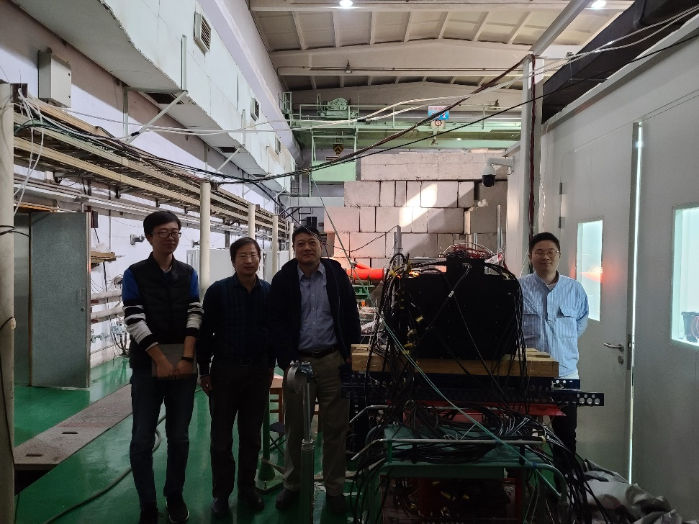
Beam operation
The E3 line hardware recovery is completed, the new detector is installed with the slide rail system
Newly installed control room floor
Control room and lobby line arrangement
Epoxy floor laying on the lobby floor
B23 and other 5 power supplies are renewed
Install new inlet and outlet fans in the ventilation room
All power control system updated
Tuning started on October 10th, and on October 28th, the tuning time was 408 hours
Handed over to users on October 28, for detectors to pick up data-until November 14th, 408 hours

Slide 34
Participating users
CEPC E-CAL(Sci-W ECAL) performance test research (IHEP + University of Science and Technology of China); particle track
Liu Qian National Science and Technology University gas detector test; spatial accuracy:
TOF detector performance test (in-house) LGAD; time accuracy, particle identification
Electronic imaging research (one in nine hospitals);
Silicon detector test (in-house);
CEPC beam energy calibration diamond detector test (in-house)
HERD detector test (Guangxi University);
CMS detector performance test (inside)

Slide 35
Possible choice of high energy single electron particle
Like DESY-----
BEPC SR station
HEPS—SR station

Slide 36
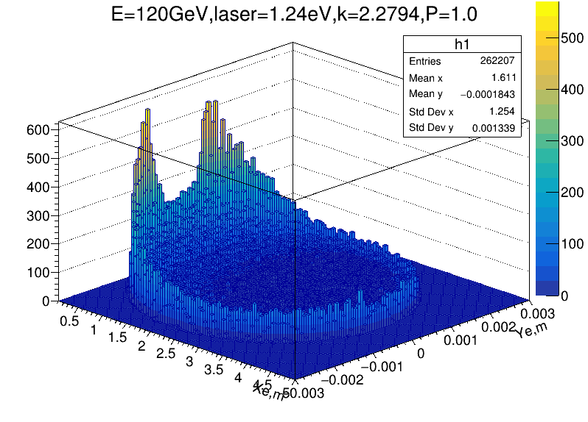
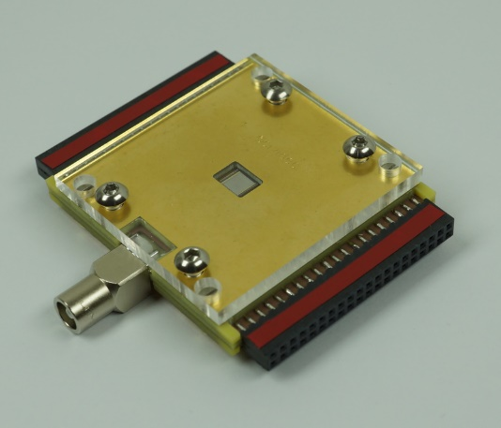
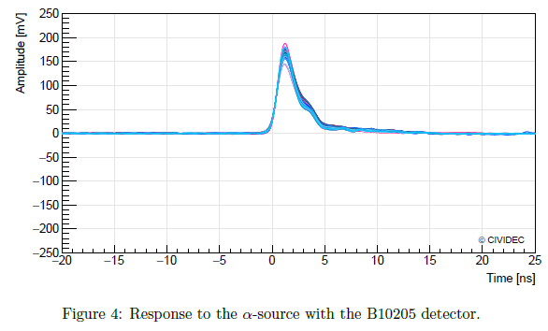
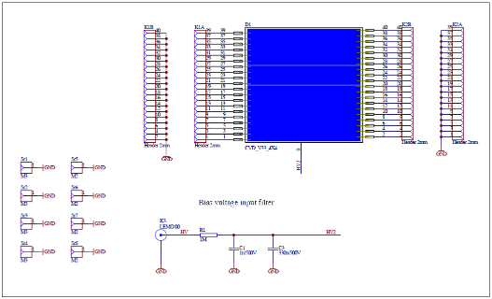






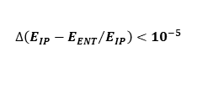

CEPC energy calibration system
ENT
M1
IP
$$∆\left({E_{IP}−E_{ENT}}/{E_{IP}}\right)<{10}^{−5}$$
END
1） Schemes:
LCS+PD of DE(Laser compton scattering and position detection of the deflected electrons) 1MeV
Micro-wave compton scatter+γDetection 6MeV
2）diamond strip detector and test;
3） Simulation study whether the fiber array-Cerenkov radiation solution can be used to replace diamond detectors, with low cost and large detection area, and can be used for two-dimensional position imaging ；
4）Complete the beam extraction beam line design, determine the beam extraction magnet scheme, including dipole and four-pole magnets, to ensure that the beam parameters can be used for Compton scattering and later measurement.
${\text{E}}_{0}\sim$120GeV
drift
10m, o(BPM)=1mm
extraction line
dipole
0.5T, 3m
$σ_{x}<1$ mm
γ
$σ_{y}<1$ mm
${∆x}_{jitter}<1$mm
$$e^{−}$$
ENDA
$σ_{x}<0.5$ mm
$$e^{−}$$
ENDB
for $σ_{E}<0.1$%
$σ_{y}<0.02$ mm
ENDC
for largest $∆E$

Slide 37
Summary
wiggler+Bending magnetic SR beamline was designed;
The possible applications of the beamlines are discussed, especially for the gamma-ray imagination ;
The key challenges need to be study are proposed: the focus of MeV gamma-ray beam and the detection design.
Testbeam was used to calibrate several detection system
Some new ideas are proposed：new acceleration principle, positron acceleration, like-DESY testbeam to supply high frequency single electron.

Slide 38
Thanks go to CEPC-SppC team!

Slide 39
